Slide 1
Massachusetts Executive Office of Housing and Livable Communities Community Development Block Grant Program
Maura T. Healey, Governor
Kimberley Driscoll, Lt. Governor
Edward M. Augustus, Jr., Secretary

Slide 2
CDBG Application Training for: FFY 2024 Date: 12-8-23
Community Development Fund
Mini-Entitlements

Slide 3
Agenda
Overview
Application
Project/program application packets
Evaluation
On-Line Application Form
National Objective
Q and A

Slide 4
Eligible Applicants
Municipalities under 50,000 and
Municipalities that do not receive CDBG funds directly from HUD
Apply only through chief elected official
Must be authorized to obligate the City or Town

Slide 5
Mass CDBG Program Components – Community Development Fund
Community Development Fund
Approximately $23 million available
Non-Entitlement Municipalities Eligible

Slide 6
Grant Award Amounts
Community Development Fund
Category Maximum Grant Award
Single Community $950,000
Two Communities (regional) $1,000,000
Three or more Communities $1,375,000
(regional)
Minimum
All (except planning) $100,000
Planning or design only $10,000

Slide 7
Mass CDBG Program Components – Mini-Entitlements
Mini-Entitlement Program
Selected Communities – see One Year Plan
Up to $9,250,000 million available
Multiple activities – but no more than three in addition to PSS
Required to target
Community Development Strategy

Slide 8
Grant Award Amounts Mini-Entitlement
Maximum Award is $925,000
10 Communities designated for FFY 2024
May not participate in joint application

Slide 9
Due dates CDF and Mini-Entitlement Applications
Applications for CDF and Mini-Entitlements due Monday, March 25, 2024 at 3:00:00 PM via Intelligrants
1 copy of application cover page, joint authorization page(s) with signatures of appropriate CEO due with the application attached in Miscellaneous attachments – No other documents – Do Not Send by Mail

Slide 10
On-line Application
Web-based application forms can be found at http://madhcd.intelligrants.com (will be available soon after the application training)
A link to the application can be found on the CDBG web page
EOHLC will send notice of availability through MMA/email lists & COMMBUYS

Slide 11
New Users
On the log-in page, follow instructions for “New Users”
Contact Mark Southard @ mark.southard@mass.gov for assistance in accessing the system
Questions concerning the application should be directed to program staff – contact CDU Manager, Kathryn McNelis at kathryn.mcnelis@mass.gov if you are not already working with staff

Slide 12
Application Information
1. Is it eligible? Is it ineligible?
2. Will it meet a national objective?
3. Was the need identified through a public process?
4. Is it feasible? Can it be carried out in a timely manner?
5. Will it have an impact?
6. Will it comply with all other federal and state requirements?

Slide 13
The Application
Collection of Forms, Objects and Links:
Forms Page
- Cover Page
- Plans and Certifications
- Thresholds
- Components – Project Packets
- Administrative Budget

Slide 14
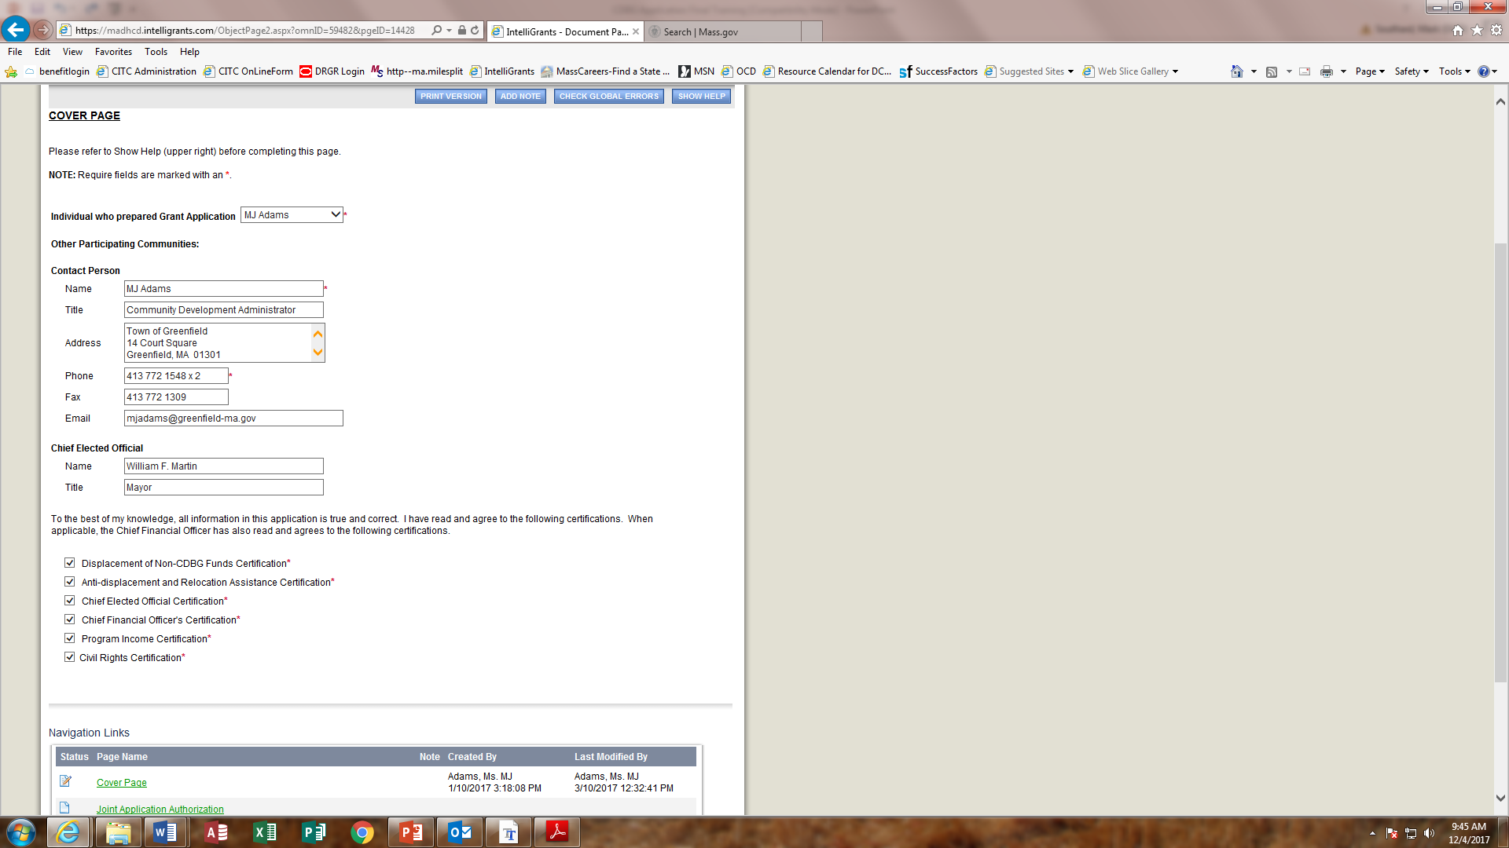

Slide 15
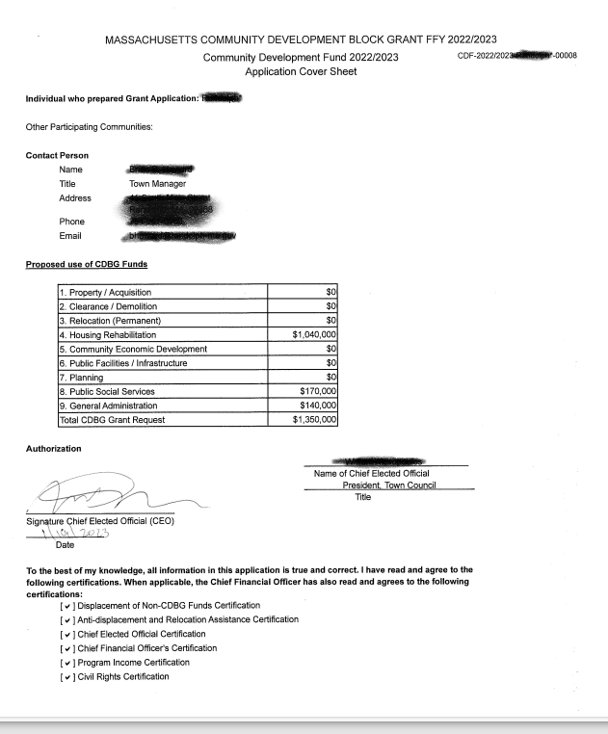

Slide 16
Application Plans and Certifications
The application requires response to a number of plans and certifications
Failure to address these could derail your application or result in a special condition attached to the grant which could delay implementation

Slide 17
Application Plans
1. Anti-Displacement and Relocation Plan
2. Citizen Participation Plan
3. Grant Management Plan
4. Program Income Plan
5. Anti-Speculation and Recapture Plan
6. Program Contingency Plan

Slide 18
Application Certifications
CEO Certification
CFO Certification
Civil Rights Certification
Displacement of Non-CDBG Funds
Anti-Displacement & Relocation Assistance
Public Hearing
Outcome Performance Summary

Slide 19
Application Threshold Timely Expenditure
For previous Grantees:
100% of funds from 2020 or earlier
70% of funds from 2021
Procedural clearances complete from 2022/2023
Funds may be returned to meet these requirements
*CDBG includes CDF, Mini-Entitlement, and Reserves, but for the purposes of this calculation excludes CDBG-CV and Section 108 guarantees. Planning-only grants of $50,000 or less are also excluded from this calculation.
*Greater scrutiny will be applied for 2024 waivers

Slide 20
Application Requirement – ADA Self Eval. Survey & Transition Plan
ADA Self Evaluation Survey and Transition Plan
- All communities as part of the 2024 application must submit, unless….
- Attach to Miscellaneous Attachments on Forms page
OR
- Attach statement that community does not have one, on letterhead.
Questions?
Director
Massachusetts Office on Disability
(617) 979-7317

Slide 21
Threshold Questions
Is the project eligible?
Does the project meet a national objective?
Consistent with Sustainable Development principles?
Are there project specific thresholds: Senior Centers, Barrier Removal, Bid-Ready Plans and Specifications, Housing Rehabilitation
If you cannot demonstrate that you can meet the thresholds, the application or project cannot move forward!

Slide 22
Threshold Questions - What’s Eligible?
Title I of Housing & Community Development Act of 1974, as amended – See Appendix A
Housing assistance
Public facilities
Architectural/Engineering Design*
Infrastructure
Planning
Public social services
Economic Development – must contact EOHLC
*Risk of repayment if project construction not complete within five (5) years

Slide 23
Threshold Questions - What’s Not Eligible
24 CFR 570.207
Expressly Prohibited:
Buildings used for the conduct of government
General government expenses
Political activities
Generally Ineligible:
Purchase of equipment; Furnishings and personal property; Operating and maintenance expenses; New housing construction; Income Payments

Slide 24
Project Threshold National Objectives
1. Benefit to low- and moderate- income persons
or
2. Prevention or elimination of slums and blight
or
3. Urgent need
Identify and describe (document) that you can and how you will meet the national objective

Slide 25
Project Threshold: Senior Centers
Site control under the Board of Selectmen or Mayor
Bid-ready plans and specifications
One set of plans as attachment in application
Letter from Arch/Eng attesting that complete set of specs is prepared and bid-ready
All other financial resources, if necessary, in place at time of application
Elderly persons are presumed by HUD to meet the national objective

Slide 26
Project Thresholds: Architectural Barrier Removal
Must submit a copy of ADA Self-Evaluation Survey and Transition Plan
Programmatic removal of barriers must be explored first
ONLY relevant barrier removal work may be funded

Slide 27
Project Thresholds: Bid-ready Plans and Specifications
Bid-Ready plans and specifications required for public facilities and barrier removal projects with construction costs > $175k
Design development drawings required for those projects and playground/park projects with construction costs of > $25K but < $175k

Slide 28
Project Thresholds: Public Social Services
Social service only applications are not allowed for Mass CDBG
Social service projects may not exceed 20% of the total grant amount
EOHLC encourages PSS that support economic security and self-sufficiency...
No more than 5 public services packets in an application

Slide 29
Housing Rehabilitation Program Status Update
One page update on past program performance
Uploaded to Misc. Attachments
Include budget info, reasons for delays, revised timeline
Justify new request

Slide 30
Special Public Facilities Rule for State CDBG Program Recipients
HUD requires recipients of State CDBG Program grants to retain the use for which CDBG funds were expended on behalf of a public facility project for a minimum of five years after the closeout of the grant.
See Application Guidance for more detail

Slide 31
Component Selection – Project Packets
Top of the Forms page
5 component selections – (project packets - Rehabilitation, Construction, PSS, Planning, Design)
1 project per packet
Packet contains:
Project description - See Application Guidance
Threshold questions
Competitive (scored) questions
Budget and related information

Slide 32
Evaluation
Project Description – Tell us about the project
Budget Information – How will the project be funded; how determined; sources
Project Need – Competitively scored
Project Feasibility – Competitively scored

Slide 33
Evaluation: Project Packets 65 points
For Rehabilitation, Construction and Design, each project packet will be evaluated and scored on the following:
Project Need (40)
Project Feasibility (25)
- CDF projects must meet 39 out of 65 points to be considered fundable
- Planning activity packets will be scored using Project Need only and must receive at least half the points but will not be included in the application score
- Public service packets will be evaluated on information contained in the project description and will be treated as pass/fail – See application guidance

Slide 34
Project Need – 40 points
Define and quantify the need (s) to be addressed. Describe current condition and the impacted population. Indicate how community input contributed to determining the need (15 pts)
Provide/document relevant and current evidence of the extent of the need/problem – narrative should relate to documentation (10 pts)
Describe how the project will address the need and the impact it will have on the need (5 pts)
LMI Score – to be added by EOHLC – Up to 10 pts

Slide 35
Project Feasibility 25 points Are you ready?
Status of design and project readiness to proceed (10 pts)
Describe project budgets and project oversight – cost reasonableness and internal controls (up to 8 pts: 4 pts budget, 4 pts staffing)
Describe/document ER/permits (3 pts)
Describe/identify milestones and timeframe (4 pts)

Slide 36
Mini-Entitlement Scoring
Scored to ensure feasibility
Must complete Competitive Narrative (both Need + Feasibility)
Activity packets must receive a minimum 50% score of each item in the feasibility question

Slide 37
Public Service packets
Public Service packets are evaluated for viability and effective operation.
Do not answer the competitive need and feasibility questions as your response.

Slide 38
Build America Buy America (BABA) for FFY2024 CDBG Applicants
Applicants for infrastructure projects must demonstrate consideration of BABA requirements
Factor into Cost Estimate, if applicable
Project Budget from all sources more than $250,000
Infrastructure definition: “any activity related to the construction, alteration, maintenance, or repair of infrastructure in the United States”

Slide 39
Build America Buy America (BABA) for FFY2024 CDBG Applicants – cont’
Includes rehabilitation of buildings and real property, construction of public facilities and improvements, utilities, water systems, electrical transmission facilities, broadband and transportation infrastructures
Required to apply the Buy America Preference (BAP) for certain products. These include:
iron and steel
and
specific construction materials (non-ferrous metals, lumber, plastic- and polymer- based composite building materials, pipe, and tube)
All manufacturing processes for iron and steel, as well as construction material must occur in the U.S.

Slide 40
Build America Buy America (BABA) for FFY2024 CDBG Applicants – cont’
Note: this will not likely apply to single family housing rehabilitation programs
BABA Determination Form will be available on EOHLC’s CDBG web page soon
Form can be prepared by consultant, but requires municipal sign-off

Slide 41
EOHLC Review Process
Two readers per application
Does application meet threshold requirements
Independent scoring of competitive questions
Meet and discuss, come to consensus –disagreements reviewed with team leader
Team Leader reviews for consistency
Packet scores are averaged
Applications ranked by score and funds allocated until gone

Slide 42
Helpful Hints(and reminders)
Read the One Year Plan
One packet per project
Page Limit - 4 pages for scored responses/ 2 pages for planning and 3 pages PSS project descriptions – See instructions in the Guidance
Income surveys should not be more than 3 years old
Slum & Blight inventory guidance – don’t create your own criteria
Public Hearing – read instructions!
No changes/additions will be accepted after the application deadline
Barrier Removal - scope limited to barrier removal
Bid-ready plans and specifications for all public facilities and architectural barrier removal projects with construction costs over $175,000

Slide 43
Additional Considerations
Administration – GA 15%; Total 30%
Regional applicants must comply with all requirements as do individual applicants
No single community may receive more than $1.35M in CDF grant funds from FFY 2024 awards
No single CDF community may receive more than $1.35 million over a consecutive 2-year period – Waived again for 2024
READ THE APPLICATION GUIDANCE!! And the Technical Assistance Memos!!!

Slide 44
Additional Updates Since Proposed Changes Session
Application deadline moved from March 4, 2024 to March 25, 2024 at 3pm
New deadline for timely expenditure waivers February 26, 2024
Increase of $100,000 in max award to Mini-Entitlements
Increase of $50,000 in max award to Regional Applicants (three or more communities)
Clarification on Lead Remediation up to $25,000 as grant - based on the work write-up and cost estimate for remediation. Not for cost of testing.
Increase of Program Delivery + General Admin. cap from 27% to 30%; GA still capped at 15%
*In process of reviewing data related to Single Case Waivers

Slide 45
Attachments
Attach documents where they belong
Attach documents only where they belong
Attached document names - NO SYMBOLS – Make sure names are consistent
Appendix list if many attachments
Hyper Links – Not recommended
Review attachment requirements in Application Guidance

Slide 46
Application (RFP) Training
CDF and ME
application types

Slide 47
Login Page
Login with your Username and Password.

Slide 48
Home Page
Select the View Opportunities button below to see what is available to your organization.
Select the Open Inbox button below to open your system message inbox
Select the Open Tasks button below to view your active tasks.

Slide 49
Opportunities
To apply for an item listed below, select the Apply Now button below each description.
This page will give you a list of all potential applications available for your agency.
Clicking the Apply Now button will begin the application.

Slide 50
Agreement Page
Are you sure you want to create this item?
Clicking the “I Agree” or “I Do Not Agree” buttons will continue the process of starting/ending the application.

Slide 51
Request for Proposal Menu
1. Select the View Forms button below to view, edit, and complete forms.
2. Select the View Status Options button below to perform actions such as submitting applications or request modifications.
3. Select the View Management Tools button below to perform actions such as adding people to this document or viewing the document history.
4. Select the View Related Items button below to view see related items such as claims, messages, etc.

Slide 52
RFP Form Menu
This list page gives you an overview of available forms for each RFP.
After saving a form without any errors this page will have a paper and pencil icon.
If the form is saved with an error there will be a stop sign icon on this page.
Example:

Slide 53
Component Selection

Slide 54
Packet Pages
After clicking on an individual packet page (i.e.…Construction Packet, Public Service Packet, Rehabilitation Packet, etc…) The Related Pages will become available at the bottom, In the Related Pages section of the page.

Slide 55
Change the Status
To change the status of the document, click on the View Status Options button.

Slide 56
Status Options
On the Request for Proposal Menu – Status Options page, you have a list of all statuses possible to change at the moment.
To change the status, click the “Apply Status” button below the desired outcome.

Slide 57
Global Errors
After Clicking “Application Submitted”, you will be taken to a Global Errors Page asking you to “Please review this page for accuracy”.
(This message may show up multiple times asking you to review different pages.)

Slide 58
Agreement Page
After all Global Errors have been cleared you will be taken to an Agreement page. If necessary, fill out the text box. When you are satisfied click on the “I Agree” button.

Slide 59
Post Submission
The document’s status will be changed to “Application Submitted”.

Slide 60
Post Submission
Please note: That after submitting the document you no longer have the ability to edit or delete pages within.
(The save button will be visible, but grayed out.)

Slide 61
National Objectives
1. Benefit to low- and moderate- income persons
or
2. Prevention or elimination of slums and blight
or
3. Urgent need
Describe (document) that you can and how you will meet the national objective

Slide 62
Project Threshold National Objective (LMI)
Statutory requirement that at least 70% of all CDBG Expenditures must benefit LMI persons
If the threshold is not met, HUD can require repayment
EOHLC required to report to HUD annually

Slide 63
Project Threshold National Objective (LMI)
HUD LMI limits
https://www.huduser.gov/portal/datasets/il.html
Provides income limits
HUD LMI Block Group
LMISD - All Block Groups, Based on 2011-2015 ACS - HUD Exchange
24 CFR Part 5.609: Definition of Income
eCFR :: 24 CFR 5.609 -- Annual income.

Slide 64
Project Threshold National Objective (LMI)
Low-and-moderate income benefit
Five ways: depends upon the project
1. Area-wide low/moderate income
2. Housing activity
3. Limited clientele
4. Job creation or retention
5. Planning

Slide 65
Project Threshold National Objective (LMI)
Area-wide low/moderate income (LMI)
Service area must be 51% LMI households
Survey no older than 3 years
Copy of blank survey document
Summary survey results
Street by street data
Parcel Map of Service Area including vacant land
If vacant land, describe future use for 5-7 years
Explain methodology for geographic boundaries
Census Data – ACS

Slide 66
Low Mod Area Benefit Service Area
Grantee must determine the service area of the activity and maintain written documentation on file
Maps
If Water project, map with flow direction
Data
Written determination/description
Service area is determined based on the nature of the activity and who the users will be

Slide 67
Low Mod Area Benefit Service Area
In order for a service area to qualify for National Objective purposes it must be primarily residential
And, it must be demonstrated that at least 51% of the residents of the service area are of low-and-moderate income
Two methods: Survey and Census

Slide 68
Low Mod Area Benefit Service Area
Survey must be sound methodologically
See Appendix C HUD’s survey guidance

Slide 69
Low Mod Area Benefit Service Area
Census Data: Block Groups
Must use HUD’s LMI data – see prior slide with link to HUD LMI Block Group Data
You must consult with EOHLC prior to submitting application
We will want: Description of activity; map illustrating the area; block group data.

Slide 70
Project Threshold National Objective (LMI)
2. Housing activity
Providing or improving permanent residential structures which will be occupied by LMI households when completed
Demonstrate that 51% of the units in a structure are LMI households
One unit structure must be occupied by LMI household
One unit of a 2-unit structure must be occupied by LMI household
All other housing structures must have at lease 51% of the units occupied by LMI households
Income must be documented and kept on file for all LMI units

Slide 71
Low Mod Housing Benefit (LMH) Documentation
Must have a standard income verification procedure that uses acceptable forms of source documents/third party verification
Determine income: Part 5 Annual Income
EOHLC recommends third party verification of gross income; 6 to 8 week period; extended to 12 months
Source is typically pay stubs; limited situations certified IRS AGI
Consider seasonal employment and no income claims
Compare to current income limits

Slide 72
Project Threshold National Objective (LMI)
3. Limited clientele (LMC)
Activities that benefit specific groups of persons rather than everyone in an area
Four options:
Groups generally presumed to be principally LMI*: elderly(62+), battered spouses, severely disabled adults, persons with AIDS, abused children, homeless persons, illiterate adults, migrant farm workers (presumed beneficiaries)
Groups of persons already documented as low- and moderate-income
Groups whose composition is such that it can be concluded that a majority of their clientele will be LMI persons
Groups that can be documented to be predominantly LMI (at least 51%)
*Unless there is evidence to the contrary

Slide 73
Low Mod Income Limited Clientele (LMC)
Documentation:
Self-Certification may be used for most activities. Clientele certify to family size and income.
Be sure form is current and updated with income limits
If self-certification is not used, file must contain information or description to justify that program is used by presumed beneficiary or predominately LM persons

Slide 74
Project Threshold National Objective (LMI)
4. Job creation or retention
Not applicable to activities currently supported by Massachusetts CDBG Program

Slide 75
Project Threshold National Objective (LMI)
5. Planning
In order to satisfy the National Objective, demonstrate that the planning project, if implemented, will meet a LMI National Objective
Examples:
- Affordable housing study
- Study of unmet needs for LMI persons in an area that is 51% or more
- Study in a S&B area regarding contributing conditions
- Spot blight study designed to eliminate hazards

Slide 76
Project Threshold National Objective (S&B)
Slums & Blight - Area-wide or Spot
Area-wide basis - application
Submitted no later than 30 days prior to application due date
Once approved by EOHLC, an inventory/ target area is valid for 10 years
Spot blight - only health & safety issues can be addressed

Slide 77
To demonstrate area-wide slums and blight a community needs:
A declaration and description of area or site by local official; Consistent with Chapters 121 A and B
At least 25% of properties experience one or more of the following conditions: See application guidance
Physical deterioration of buildings or improvements
Abandonment of properties
Chronic high occupancy turnover or vacancy rates in industrial/commercial
Significant declines in property values or abnormally low values relative to others
Known or suspected environmental contamination
Map delineating target area/Written description
Current parcel inventory of buildings/properties and infrastructure
Appendix J - summary table
Appendix K - EOHLC’s property and infrastructure rating sheets – Do not modify
Any proposed project must address conditions that contribute to the deterioration of the area

Slide 78
Slums & Blight – Spot basis
Address specific conditions of blight, physical decay or environmental contamination that threaten public health and welfare
Acquisition*, clearance, historic preservation, remediation, building rehabilitation
Provide description of site – Why is the building or property deteriorated?
Must indicate/document serious health and safety concerns – Why is it a serious concern? Provide evidence to support
Limitations on what can be done under this NO, health and safety hazards.
*Must be a precursor to another eligible activity that addresses S&B

Slide 79
Project Threshold Nat’l Objective - Critical Need
AKA - Urgent Need
Catastrophe, natural disaster – Conditions that pose a serious and immediate threat to the health/welfare of the community
Situation not known prior to 18 months preceding EOHLC approval
Community cannot finance on its own and No other financial resources exist
EOHLC approval necessary before application is submitted
Provide:
Description of the nature and seriousness of condition – include timing of development of condition and photographs
Certification by local government of serious and immediate threat and evidence showing unavailability of other financial resources

Slide 80
Questions???

Slide 81
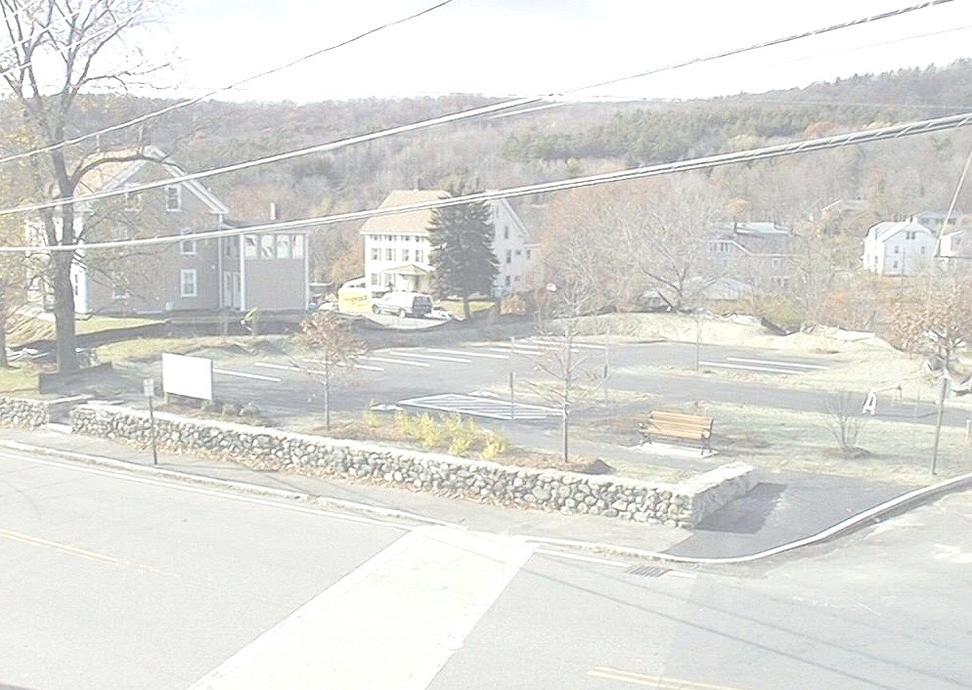
EOHLC
100 Cambridge Street, Suite 300
Boston, MA 02114
Phone: 617.573.1400
www.mass.gov/eohlc/

