Slide 1
Massachusetts Healthcare Personnel Influenza Vaccination in Health Care Facilities
2015-2016 Influenza Season
Alfred DeMaria, Jr., M.D.
Bureau of Infectious Disease and Laboratory Sciences
Katherine T. Fillo, Ph.D, RN-BC
Bureau of Health Care Safety and Quality
Public Health Council
February 8, 2017

Slide 2
Presentation Overview
Background
Regulation
Performance Goal
Methodology
Measures
Results
Conclusions
Enhanced Public Health Actions

Slide 3
Background
Health care personnel (HCP) are at high risk for influenza exposure and illness, and may be a source of influenza virus transmission in health care settings.
Annual immunization is the best method of preventing influenza and potentially serious complications.*
The Massachusetts Department of Public Health (DPH) considers the prevention of influenza by promoting vaccination an organizational priority that should be part of the overall institutional commitment to improvement for licensed healthcare facilities.
*https://www.cdc.gov/flu/professionals/infectioncontrol/healthcaresettings.htm

Slide 4
Background
As a condition of licensure, DPH regulations require health care facilities, including hospitals, ambulatory surgical centers, dialysis centers, clinics, nursing homes, rest homes, and adult day health programs to:
Offer free-of-charge, annual influenza vaccine to all personnel (full and part-time employees, contracted employees, volunteers, house staff and students);
Document receipt of influenza vaccine administered within and outside the facility or document the declination of immunization for HCP; and
Report information to DPH documenting compliance with the vaccination requirement, in accordance with reporting and data collection guidelines of the Commissioner (105 CMR.)
105 CMR 130.325, 105 CMR 140.150, 105 CMR 150.002(D)(8), 105 CMR 158.030(L)(8)

Slide 5
Performance Goal
To protect the lives and welfare of patients, employees, and communities,
as well as to improve quality and reduce healthcare costs, DPH has
established an overall minimum influenza vaccination rate of 90% or greater for eligible HCP at all licensed healthcare facilities.
This performance goal is intended to advance patient and HCP health and
safety by ensuring optimal HCP influenza vaccination coverage, and is in alignment with the National Healthy People 2020 target of 90% influenza vaccination coverage of HCP.
https://www.healthypeople.gov/node/4668/data_details

Slide 6
Methodology
Health Care Facilities report HCP influenza vaccination rates to DPH in two ways:
Consistent with the Centers for Medicare & Medicaid Services (CMS) Quality Reporting Programs, DPH requires acute care hospitals, ambulatory surgical centers, dialysis centers and non-acute hospitals to report health care personnel influenza data through the National Healthcare Safety Network (NHSN) of the Centers for Disease Control and Prevention (CDC).
Clinics, nursing homes, rest homes, and adult day health programs are required to report health care personnel influenza data directly to the DPH Healthcare Associated Infection (HAI) Prevention Program.

Slide 7
NHSN Methodology Acute Care Hospitals, Ambulatory Surgical Centers, Dialysis Centers and Non-acute Hospitals
NHSN requires facilities to provide the number of HCP physically
at the facility for one or more days between October 1 and
March 31 of the influenza season for each of the following three categories:
Employees on facility payroll;
Licensed independent practitioners; and
Students/trainees and volunteers

Slide 8
NHSN Reporting Requirements Acute Care Hospitals, Ambulatory Surgical Centers, Dialysis Centers and Non-acute Hospitals
For each category of HCP, for the period October 1, 2015
to March 31, 2016, facilities must collect and report the number of:
HCP vaccinated at the facility;
HCP vaccinated elsewhere (PCP office, pharmacy, etc.);
HCP that declined vaccine;
HCP with a medical contraindication to the vaccine; and
HCP with unknown vaccine status

Slide 9
NHSN Measures Acute Care Hospitals, Ambulatory Surgical Centers, Dialysis Centers and Non-acute Hospitals
Calculated aggregate percentage for all HCP across Massachusetts acute care hospitals, ambulatory surgical centers, dialysis facilities and non-acute hospitals.
Percentage HCP vaccinated in 2015-2016
HCP Vaccinated at Facility + HCP Vaccinated Elsewhere
Vaccine Coverage =
Total # HCP at Facility
Percentage HCP in facility that declined vaccine in 2015-2016
# HCP Declined Vaccine
Vaccine Declination=
Total # HCP at Facility

Slide 10
NHSN Measures Acute Care Hospitals, Ambulatory Surgical Centers, Dialysis Centers and Non-acute Hospitals
Percentage HCP in facility with a medical contraindication to vaccine in 2015-2016
# HCP with Medical Contraindication
Medical Contraindication =
Total # HCP at Facility
Percentage HCP in facility with unknown influenza vaccine status in 2015-2016
# HCP with Unknown Vaccine Status
Unknown Vaccine Status =
Total # HCP at Facility

Slide 11
Clinic, Nursing Home, Rest Home, and Adult Day Health Program Measures
Facilities are required to report directly to DPH by May 15, 2016:
Total number of employees as of December 31, 2015;
Total number of employees receiving seasonal influenza vaccination provided by the health care facility between August 1, 2015 and March 31, 2016;
Total number of employees receiving seasonal influenza vaccination administered outside the health care facility between August 1, 2015 and March 31, 2016; and
Total number of employees who declined vaccination between August 1, 2015 and March 31, 2016.

Slide 12
Clinic, Nursing Home, Rest Home, and Adult Day Health Center Methodology
The facility vaccination rate was calculated by dividing the number of facility HCPs vaccinated by the total number of facility HCPs.
The overall mean percentage of HCPs vaccinated by facility type was calculated as the mean of all facility vaccination rates.
HCP Vaccinated at Facility + HCP Vaccinated Elsewhere
Vaccine Coverage =
Total # HCP at Facility

Slide 13
Median and Range of HCP Influenza Vaccine Coverage at Massachusetts Acute Care Hospitals 2015-16
Key Findings
The statewide median for vaccine coverage was 92%
39 (53%) facilities achieved vaccine coverage of 90% or greater
Most HCP were vaccinated at their workplace
Median declination was only 4%
N=74 acute care hospitals
*Median and range are measures of HCP vaccine coverage by reporting MA acute care hospitals, not state aggregate rates for HCP

Slide 14
Acute Care Hospital Healthcare Personnel Vaccine Coverage in Aggregate
 | Mean State Aggregate HCP Vaccine Coverage | Range
Total HCP Vaccinated | 231,727 (91%) | (71 - 99%)
Vaccinated at Facility | 173,121 (68%) | (41 - 89%)
Vaccinated Elsewhere | 58,606 (23%) | (3 - 45%)
HCP Declined Vaccination | 14,122 (5%) | (0 - 17%)
HCP with Unknown Vaccination Status | 7,946 (3%) | (0 - 26%)
HCP with a Medical Contraindication | 1,653 (1%) | (0 - 2%)
*Please note the median is the midpoint of the distribution of each measure at MA acute care hospitals. The medians will not necessarily sum to 100%.
Median and range are measures of HCP vaccine coverage by reporting MA acute care hospitals, not state average for vaccinated HCP

Slide 15
Overall HCP Influenza Vaccine Coverage in Massachusetts ACHs by HCP Type
Key Findings
Overall, salaried employees were most likely to decline vaccine when compared to other HCP types. This may be partially explained by salaried employees having the most complete reporting.
Licensed Independent Practitioners were most likely to have unknown vaccine status.

Slide 16
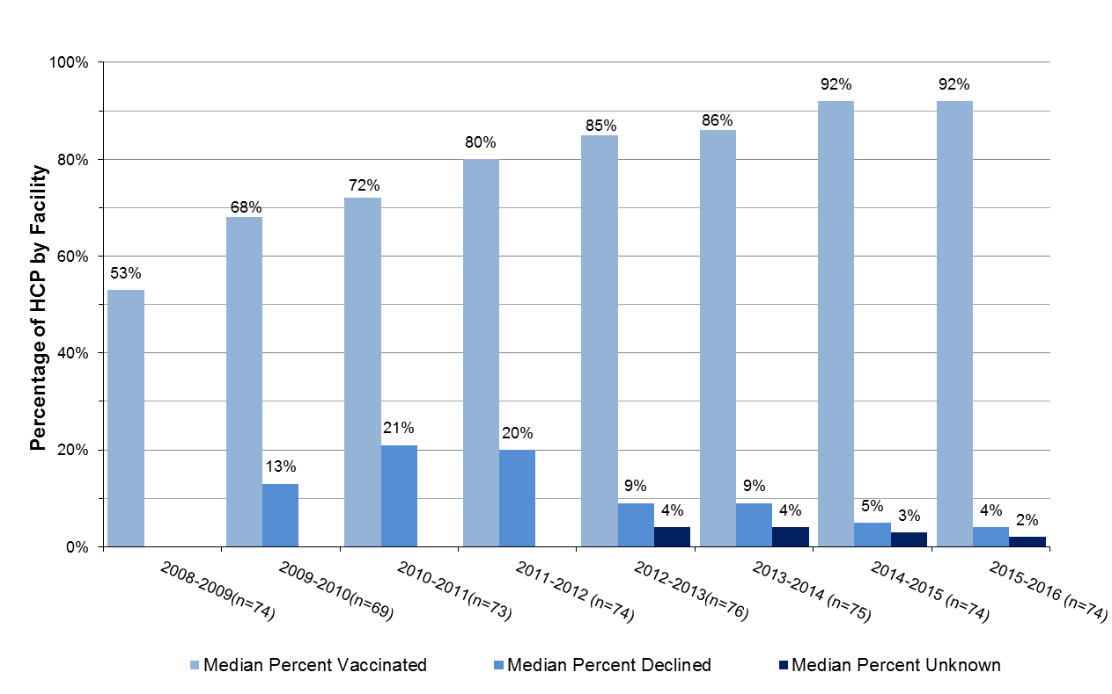
Trends Over Time
Acute Care Hospitals
Median HCP vaccine coverage remained steady in 2015-16 and met the Healthy People 2020 benchmark of 90%. The median declination rate decreased to 4% in 2015-16. This reporting year shows a continued decrease in median declination and unknown categories since data collection began in the 2008-09 season.

Slide 17
2015-2016 Results:
Ambulatory Surgical Centers
Mean percentage of HCP at Ambulatory Surgical Centers Vaccinated against Influenza During 2015-2016 season
 | Mean % Vaccinated | Range
Total Vaccinated | 82% | (22-100%)
Vaccine Declination Rate | 14% | (0-77%)
HCP with Unknown Vaccination Status | 2% | (0-35%)
HCP with a Medical Contraindication | 1% | (0-9%)
Location Vaccinated
At Place of Employment | 45% | (0-93%)
Outside Place of Employment | 37% | (0-90%)
N=53 reporting ASCs

Slide 18
2015-2016 Results:
Ambulatory Surgical Centers
Overall Ambulatory Surgical Center Vaccination of HCP by Personnel Category

Slide 19
2015-2016 Results: Dialysis Centers
Mean Percent of Dialysis Center HCP Vaccinated against Influenza During the 2015-2016 Season
 | Mean % Vaccinated | Range
Total Vaccinated | 86% | (20-100%)
Vaccination Declination Rate | 10% | (0-50%)
HCP with Unknown Vaccination Status | 4% | (0-30%)
HCP with a Medical Contraindication | 1% | (0-5%)
Location Vaccinated
At Place of Employment | 59% | (0-90%)
Outside Place of Employment | 28% | (0-100%)
N=57 Reporting Facilities

Slide 20
2015-2016 Results: Dialysis Centers
Overall Dialysis Center Vaccination of HCP by Personnel Category

Slide 21
2015-2016 Results:
Non-Acute Care Hospitals
Mean Percent of Non-Acute Care Hospital HCP Vaccinated against Influenza During the 2015-2016 Season
 | Mean % Vaccinated | Range
Total Vaccinated | 78% | (49-98%)
Vaccination Declination Rate | 13% | (0-38%)
HCP with Unknown Vaccination Status | 9% | (0-33%)
HCP with a Medical Contraindication | 1% | (0-6%)
Location Vaccinated
At Place of Employment | 53% | (20-77%)
Outside Place of Employment | 25% | (0-50%)
N=36 Reporting Facilities

Slide 22
2015-2016 Results:
Non-Acute Care Hospitals
Overall Non-Acute Care Hospital Vaccination of HCP by Personnel Category
N=36 Reporting Facilities

Slide 23
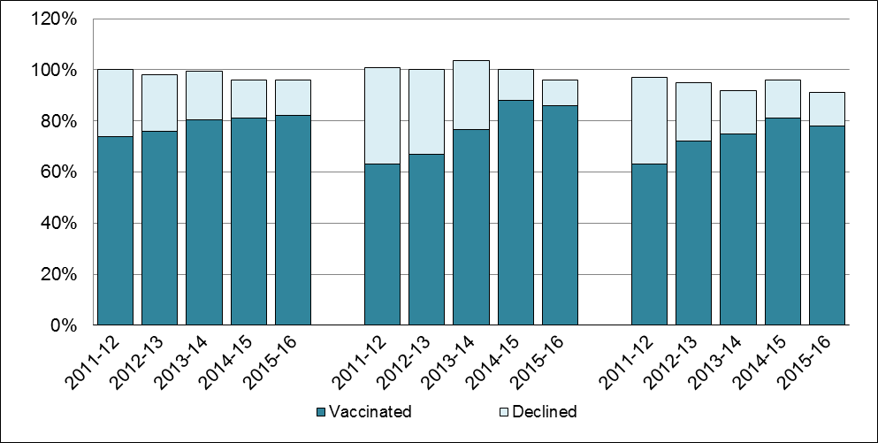
Trends Over Time:
ASCs, Dialysis Centers and Non-Acute Hospitals
Mean Percent of HCP Vaccination and Declination Rates for Ambulatory Surgical Centers, Dialysis Centers and Non-Acute Hospitals: 2011-2016 Influenza Season
ASC
Dialysis
Non Acute Hospital

Slide 24
2015-2016 Results: Clinics
Mean Percent of Clinic HCP Vaccinated against Influenza During the 2015-2016 Season
 | Mean % Vaccinated | Range
Total Vaccinated | 66% | (0-118%)
Total Exceptions* | 31% | (0-100%)
Location Vaccinated
At Place of Employment | 31% | (0-100%)
Outside Place of Employment | 35% | (0-118%)
N=142 Reporting Facilities
*Total exceptions may include declination, medical contraindications or religious exemption.

Slide 25
2015-2016 Results:
Nursing Homes
Mean Percent of Nursing Home HCP Vaccinated Against Influenza During the 2015-2016 Season
 | Mean % Vaccinated | Range
Total Vaccinated | 73% | (0-108%)
Total Exceptions* | 23% | (0-90%)
Location Vaccinated
At Place of Employment | 55% | (0-108%)
Outside Place of Employment | 19% | (0-73%)
*Total exceptions may include declination, medical contraindication or religious exemption.
N=351 Reporting Facilities

Slide 26
2015-2016 Results:
Rest Homes
Mean Percent of Rest Home HCP Vaccinated Against Influenza During the 2015-2016 Season
 | Mean % Vaccinated | Range
Total Vaccinated | 76% | (0-100%)
Total Exceptions* | 26% | (0-58%)
Location Vaccinated
At Place of Employment | 36% | (0-100%)
Outside Place of Employment | 40% | (0-97%)
N=32 Reporting Facilities
*Total exceptions may include declination, medical contraindication or religious exemption.

Slide 27
2015-2016 Results:
Adult Day Health Programs
Mean Percent of Adult Day Health HCP Vaccinated against Influenza During the 2015-2016 Season
 | Mean % Vaccinated | Range
Total Vaccinated | 63% | (0-113%)
Total Exceptions* | 39% | (0-100%)
Location Vaccinated
At Place of Employment | 33% | (0-113%)
Outside Place of Employment | 30% | (0-100%)
N=114 Reporting Programs
*Total exceptions may include declination, medical contraindication or religious exemption.

Slide 28
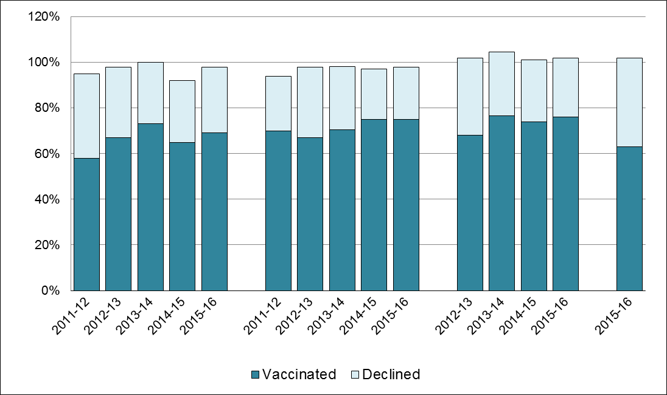
Trends Over Time: Clinics, Nursing Homes, Rest Homes and Adult Day Health Programs
Mean Percent of HCP Influenza Vaccinations and Declinations as Reported by Massachusetts Clinics, Nursing Homes, Rest Homes and Adult Day Health Programs: 2011-2016 Seasons
Clinic
Nursing Home
Rest Home
Adult Day Health
*
Exceptions
* 2015-2016 Season was the first year Adult Day Health Programs were required to report.

Slide 29
Conclusions
All facility types have reported higher vaccination rates in 2015-2016 when compared to 2011-2012 season.
Overall ACH vaccine coverage exceeds the DPH and Healthy People 2020 benchmark for the second consecutive year.
No other facility type reached the established overall performance goal.
The range of vaccine coverage varies widely.
Transitioning the required reporting to the CDC’s National Healthcare Safety Network will result in improved capacity to track, monitor and report HCP influenza data in Massachusetts health care facilities.

Slide 30
Enhanced Public Health Actions
DPH will continue to monitor trends and report annual compliance with the HCP influenza vaccination requirements.
DPH will promote continuous quality improvement, and recommend licensed facilities share vaccination rates with all staff, including administrators, boards of directors, practice managers, ombudsperson and patient/family councils.
DPH hosted an acute care hospital HCP Influenza Summit in January 2016.
DPH will use lessons learned to foster improvement in facilities new to reporting.
DPH presented the 2015-16 nursing home findings at a Massachusetts Senior Care Association meeting of over 300 participants in December 2016 and emphasized the importance of vaccination as well as tools to increase adherence.
DPH encourages facilities to review reported data and current HCP influenza policies, and as necessary implement processes to maximize vaccination coverage.
DPH will promote the DPH and Healthy People 2020 target to vaccinate 90% or greater of eligible HCP in all licensed health care settings.
DPH will collaborate with public health partners to intensify efforts to improve immunization rates among HCP, especially among low outliers.

