Slide 2
Statewide Advisory Council
Dr. Opeoluwa Sotonwa
MCDHH Commissioner
June 15, 2023

Slide 3
Deaf & Hard of Hearing Constituents’ Day May 18, 2023
Our sincere gratitude to all attendees, communication access providers, SAC members, MCDHH Staff and the planning team for their efforts in making this happen.

Slide 4
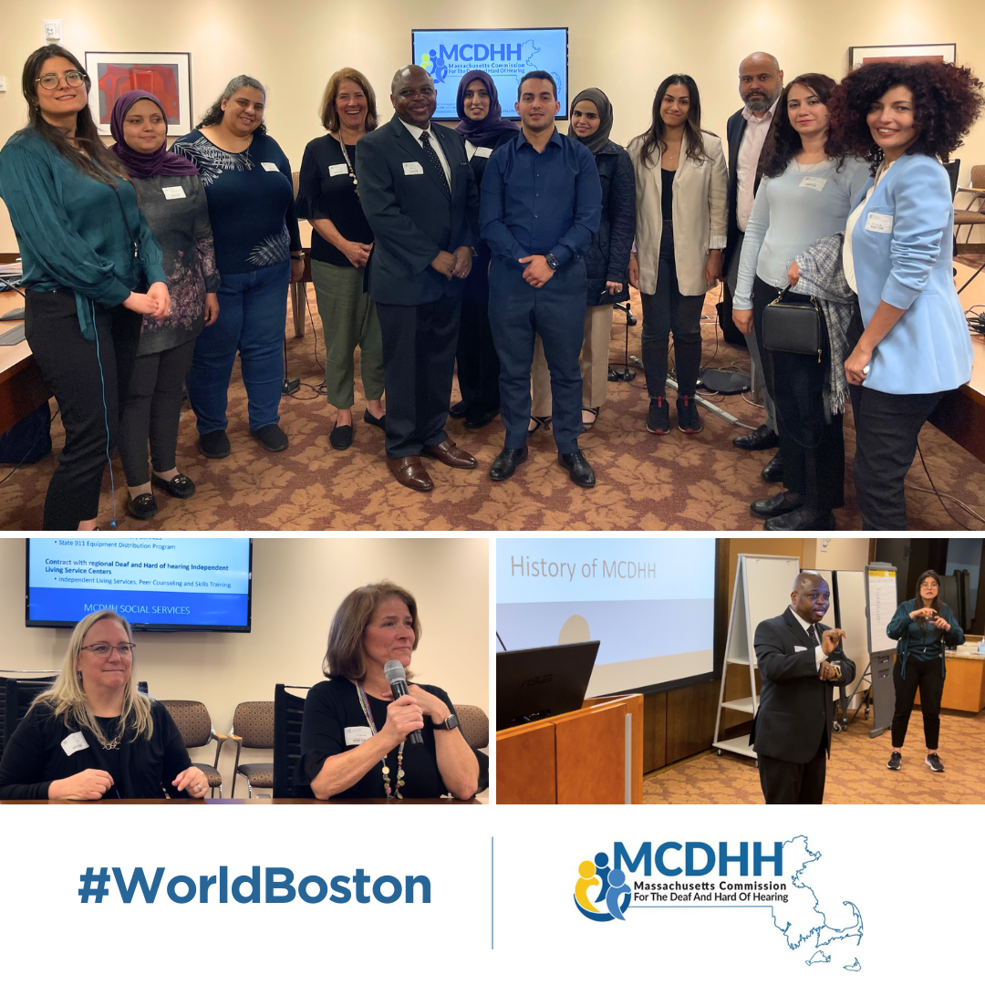
“Equal Access for All” June 8, 2023
The MCDHH team welcomed the International Visitor Leadership Program at the Federal Reserve Bank of Boston to discuss “Equal Access for All” at World Boston.
Our presenters, including Commissioner Opeoluwa Sotonwa and Director of Social Services Margaret Lee explored MCDHH’s latest initiatives, programs, and history with the group.

Slide 5
Recognizing LGBTQIA+ Pride Month

Slide 6
Budget Update

Slide 7
CAS: Divisional Update
Referral:
KMBS – during testing of the New Referral System several issues came to light that need to be resolved. KMBS and MCDHH are still working diligently together to resolve these issues but now the Go Live date is likely pushed out to the fall. More info on this coming once everything is finalized.

Slide 8
CAS: Divisional Update
Workforce Development:
The CART SMEC is currently meeting and will be submitting its Action Plan by the end of July.
We just hired a Sign Language Interpreter Mentorship Coordinator through June 2024 on contract, Charlotte “Dee” Spinkston, who will be working closely with Workforce Development, Interpreters, Referral and Screening to develop and implement programming to support new interpreters coming into the field.
We are continuing our talks with Bristol Community College about a possible collaboration to start up a CART training program. If things progress further we would like to bring in Subject Matter Experts – any MCDHH staff – who are interested in helping further that collaboration.
We will begin doing outreach to the community to promote careers in CART and interpreting services starting right at the beginning of FY24
We created a proposal with Commissioner Sotonwa and Caitlin Parton our General Counsel to hitch our wagon to the MassReconnect Program, to see how we can leverage that program to boost interpreter and CART training numbers and diversity

Slide 9
CAS: Divisional Update
Interpreters:
Interpreters continue to provide outstanding service to our staff and the community
The 2 Legal Deaf Interpreter part time positions and the 2 Legal ASL/spoken English part time positions are in process
Denise Martinez did an outstanding job collaborating with the Department of Children and Families to put together a community legal training that happened April 29 and 30. We trained and qualified more than 20 community interpreters both Deaf and ASL/spoken English to be able to work in DCF Legal Settings.

Slide 10
CAS: Divisional Update
Screening:
Crystal Eusebio and Denise Martinez have worked closely to train all the existing Screening Evaluators – giving them all a refresher course, and to train many new Screening Evaluators, increasing the numbers and diversity of our Screening Evaluation Team.
The Screening Redesign RFI is still in process. We have received a few responses and will be putting together the RFR shortly.
Crystal has continued to streamline and update all of the application and resource materials, updating everything so that it is user friendly, visual and easy to use.

Slide 11
CAS: Divisional Update
After-Hours Emergency Services:
Andy Veith has been doing outreach and support, pulling more interpreters into the program and supporting them once they’ve signed on
The number of emergency requests and fill rate continues to rise

Slide 12
CATTS: Update
Law Enforcement/First Responder Training & Collaboration in May
Municipal Police Training Committee (MPTC) Academy in Plymouth
State 911 Dispatcher Training Academy
State Police 88th Recruit Training Troup (170+ participants)
Ongoing collaboration to develop training for all State Police Veteran Troopers
Ongoing communication with State 911 on Public Safety Access Point accessibility
Our MPTC Training continues. When we schedule we typically do so for the spring or fall and schedule for each of the 5 main academies – Holyoke, Lynnfield, Plymouth, Randolph and Boylston. The first 3 have been completed this spring and the other two are scheduled.

Slide 13
SSD: Departmental Update
Social Services Updates:
Terri Pancare, Children’s Specialist for the Central region, is retiring at the end of August. Terri
We are in the pre-offer stage for the Boston Adult Case Manager.
Sharon MacLean and Emily Graves-Harrison attended a health fair at The Overlook in Charlton and provided information to senior citizens and professionals who work with them.
Emily Graves-Harrison, Children’s Specialist for Western MA, was recognized by the Willie Ross School for the Deaf at their Community Recognition event for her “outstanding support” for their students.
Carol Menton and Melissa Dowler presented at a “Lunch and Learn” with the DCF Northern Regional Office.

Slide 14
SSD: Departmental Update
SUD Updates:
Karran Larson presented at Aging with Dignity on treatment approaches for older DHH individuals with SUD.
Karran and Omar Olazabal are training three new Deaf Recovery Coaches.
SUD team translated a recovery coach curriculum to ASL.

Slide 15
Human Resources: Update
Incoming New Staff
New Staff:
Lori Siedman, Southeast Referral Specialist – May 1st
Heather Daley, Executive Assistant to the Commissioner – May 8th
Salatiel Pineda, Central Referral Specialist – May 22nd
Stephanie Hakulin, Staff Interpreter – June 20th
Existing Posting:
Adult Case Manager – Boston - Interviews completed; Currently finalizing candidate decision.
New Job postings:
CDI – Legal
Central Billing Coordinator
Announcement
Christina LaRock, Designated Interpreter to Commissioner Sotonwa, is leaving MCDHH on July 7th.
Terri Pancare, Children’s Specialist, is retiring from MCDHH.

Slide 16
Commissioner Summer Plans & Field Trips

