Slide 1
WorkKeys Curriculum: Placement Quizzes
June 23, 2020
allison.mcintyre@mass.gov
WorkKeys Curriculum Knowledge Hub
WorkKeys Curriculum Administrator Manual
Sample WorkKeys Questions

Slide 2
Agenda
What are Placement Quizzes?
How do users access Placement Quizzes?
What can users expect from Placement Quizzes?
How do administrators track progress and review users’ scores on the Placement Quizzes?
How can Placement Quiz scores be used to support the job search and training access?
How are user accounts created?
How are Placement Quizzes assigned?

Slide 3
What are Placement Quizzes?
Sixteen, multiple choice questions
Three topics: Applied Math, Graphic Literacy, & Workplace Documents
The score scale is Level 3 up to a Level 7
Job Profiler Database
Assess career readiness abilities
Starting point for engagement with WorkKeys Curriculum

Slide 4
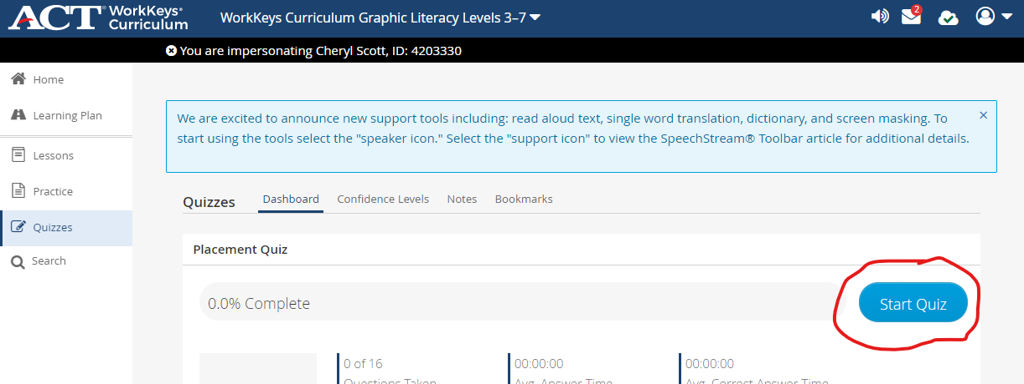
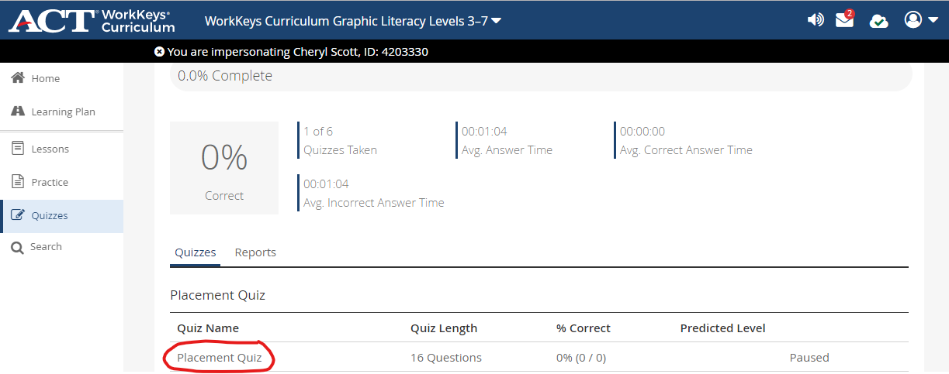
How do users access the PQs?
Log in at https://workkeyscurriculum.act.org/login
Check dark blue bar at the top of the screen
Click “Quizzes” in the left side navigation panel

Slide 5
How do users access the PQs?

Slide 6
What can users expect from Placement Quizzes?
Determine appropriate level for entrance into training program
Email w/username & password + explanation of WKC
Use your career counseling skills
Job Profiler Database

Slide 7
How do administrators track progress and review users’ scores on the Placement Quizzes?
Running a report
Email from benchprep
Examine scores & timing
How can Placement Quiz scores be used to support the job search and training access?
Screening tool
Communicate with your business services team
How do I create student accounts and assign lessons?

