Slide 1















Central MA WIOA Partners planning Meeting
June 29, 2016

Slide 2
Local MOU
The Combined State Plan guides the establishment of local area partnerships and local MOU agreements as required by WIOA.
These requirements will specify how services can be connected, integrated, or enhanced by sharing staffing, resources, or jointly designed in ways that improve outcomes for “shared customers” – youth, job seekers, and businesses.

Slide 3
Local MOU - Process
The Local Board will convene required WIOA One-Stop Partners and other stakeholders (as defined locally) to discuss, negotiate and execute a local “umbrella” Memorandum of Understanding.
The development of the local MOU is a two-step process:
An Interim MOU based on a state developed template to be in place by June 30, 2016.
The Umbrella MOU must not be for less than three years and must be in place by July 1, 2017.
A joint policy from the WIOA partners will be issued explaining the process for the Interim and Umbrella MOUs.

Slide 4
Local MOU- Key Partners
Required One-Stop Core Partners:
WIOA Title I (Adult, Dislocated Worker, Youth)
Title II (Adult Education and Family Literacy)
Title III (Wagner Peyser/Employment Service)
Title IV (Vocational Rehabilitation)
Temporary Assistance to Needy Families (TANF)
Supplemental Nutrition Assistance Program (SNAP)
Unemployment Insurance (UI)
Trade Adjustment Assistance (TAA)
Jobs for Veterans State Grant (JVSG) and
Senior Community Service Employment Program (SCSEP).

Slide 5
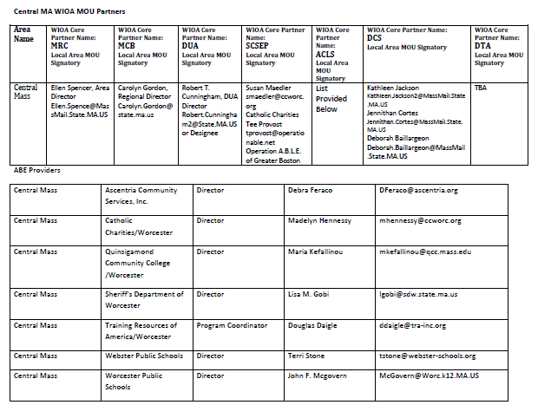
Local Partners

Slide 6
The Purpose of the Local MOU
Establish the roles of local partners in the development of an integrated education and workforce system that supports career pathways in each region to prepare residents with foundation, technical, and professional skills, and provide information and connections to postsecondary education and training.

Slide 7
Our Goal
The local MOU will define shared service strategies for job seekers and businesses and identify related shared customer flow strategies that will include but be limited to:
operation and services workflows,
related referral processes,
coordinated staff development and training,
marketing and community integration,
co-locations of staff (physical and virtual), and
the nature and provisions of related infrastructure and shared costs.
Notes:
Jola will pick up from here. How are we supporting low skilled learners; students with disability? – student centered approach. We are expecting local groups to come back with maps for the hard to serve populations.
Franklin/Hampshire: The Literacy Project convenes WIOA Partners (WIB director is included): ABE programs (TLP, Greenfield CC, Holyoke CC, a WIOA youth program director, the REB board director, Career Center Director, a WIOA Adult Worker Program Director). They work on postsecondary and career opportunities for ABE students.
Greater Lowell: The LWIB is partnering with Lowell Adult Education on an IET program that currently does not have an industry focus (outside of the pilot). Also – ESOL program for DTA customers at One-Stop.
Hampden: Working on aligning ABE with hospitality, health careers, culinary, and manufacturing industries. Regional meetings around Career Ready 101. Holyoke CC, Center for New Americans (CNA), and Smith Vocational and Agricultural High School piloted an ESOL culinary arts program for CNA Adult Career Pathways students- Smith provided the space, course was taught by HCC instructors.
Merrimack: Northern Essex Community College (NECC) convened a discussion on the process for distributing WorkKeys vouchers. The LWIB, local career center, and 6 DESE programs are developing an employer survey.
Metro Southwest: The region has a WIOA “partners” group working on a “shared customer” definition; also an OSCC Partners group that has been providing input regarding the One-Stop Operator RFP.
Integrated Education and Training models:
AACA - Madison Park Vocational Technical High School is providing space for trade classes (carpentry, plumbing, painting, electricity, appliance repair, general maintenance, occupational safety) for AACA’s building maintenance program. Match: United Way, State Street Foundation, ITA vouchers (appr. $8,000).
Cambridge Adult Learning Center– HHA (home health aid) and CNA. The City of Cambridge is providing a job developer. The Rindge School of Technical Arts (Chapter 74 provider of Cambridge Rindge and Latin School), will provide space; consulting, and curriculum resources. City of Cambridge & Cambridge Public School provide match funds. Clinical rotations will take place at employer sites.
Holyoke Community College- HHA (home health aid) and CAN. William J. Dean Technical High School will provide their health sciences lab, also assist with recruitment, targeting parents of their students. Clinical rotations will take place at employer sites.

Slide 8
Final Local MOU
The MOU will:
Provide a description of services to be provided through the one-stop delivery system, including the manner in which the services will be coordinated and delivered through the system
Ensure that one-stop partners adhere to State guidance on one stop delivery system infrastructure costs
Address how one-stop partners will achieve consensus and informally mediate any possible conflicts or disagreement among partners
Address how technical assistance to new one-stop partners and local grant recipients will be provided to ensure partners are informed and knowledgeable of the elements contained in the MOU
Reflect a funding mechanism that meets the requirements of each program’s relevant statutes and regulations
The MOU may include interim plan if needed, on how costs of the services will be funded

Slide 9
Defining Shared Customers
In order to be a shared customer, he/she must meet the eligibility criteria of partner agencies and who is enrolled in more than one core partner program at any time during a fiscal year.
The eligibility criteria for shared customers may vary from region to region depending on participant characteristics (e.g., academic level, level of English proficiency) and regional employment needs (e.g., healthcare, hospitality, advanced manufacturing, financial/business services).
Not ALL customers will be shared customers.

Slide 10
New Career Center Shared Customer Model
New statewide customer flow to manage individuals from various referral sources who are triaged based on new, intensive skill assessment tools to Job Ready and Skill Building Teams within the Career Center.

Slide 11
Discussion
The umbrella MOU – serving customers of similar
characteristics
How core partner collaborations can support career pathways in the region?
How we can work together to support and contribute to career pathways?
What are some opportunities for innovation in program design and accelerated learning along the pathway?
What state guidance is needed?

Slide 12
Next Steps
Signing the Interim MOU and “Agreeing to Negotiate” through FY17!
Set planning meeting calendar
Identify additional data/information to be gathered (and who will gather it)

