Slide 1
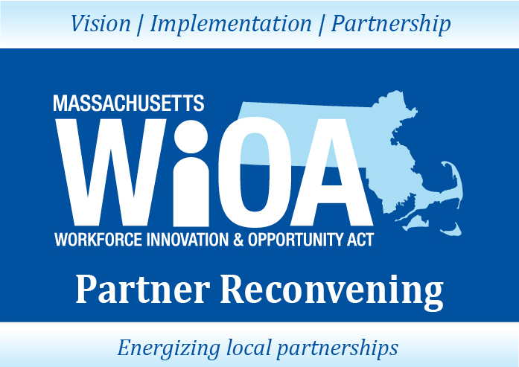
January 8, 2018

Slide 2

CONTINUING TO MOVE FORWARD THROUGH
PARTNERSHIPS
Jennifer James, Undersecretary Workforce Development
Alice Sweeney, Director DCS
January 8, 2018

Slide 3

WIOA IMPLEMENTATION
WIOA
July 2014 Enacted
Combined State Plan Draft
November 2015
Implementation Phase:
Technical Assistance & WIOA State Policy Guidance for local areas
April, 2016 –
On-going
Lead Operator
In Place
Local Signed
Umbrella
MOU
July 1, 2017
MWIB
Establishes
WIOA Steering Committee
October, 2014
Steering Committee &
Workgroups
October, 2014 – November, 2015
Final Rules
Enacted
August, 2016
Provisions
Take Effect
July 2015
*ETPL
*Eligibility
Submission of Combined State Plan
March, 3, 2016
Adjusted
April 1, 2016
DOL Final Approval
October, 2016
Policy & Planning in Regional Local Areas
April, 2017 -
March, 2018

Slide 4





Back in 2016…. Overwhelm mode….where to start?

Slide 5
ITS ALL ABOUT THE TEAM
COLLABORATION:
An unnatural act between unconsenting adults.
Jocelyn Elders
A team is not a group of people who work together. A team is a group of people who trust each other.
- Simon Sinek

Slide 6



HOW DID WE GET HERE FROM THERE
We asked everyone to focus on change-making conditions and not the minutia of WIOA.
PARTNERSHIP LESSONS
From last 3 years (and the experts):
CHOICE
TEAM
TOOLS
Notes:
MANDATE VERSUS CHOICE
DEFINITION OF TRUST (Charles Feltman)
Choosing to make something important to you vulnerable to the actions of someone else.
IT IS THE SMALL MOMENTS (Brene Brown and many other researchers).
Consistent behavior (marble jar friends)
Own mistakes AND call out concerns
GENEROSITY
Old habits, “building the ship in the middle of the ocean” and 1,000 other reasons to not make assumptions.
The work is hard. High Need, High Stakes Resources

Slide 7
ONE VISION FOR MA WORKFORCE PARTNERS:
All Massachusetts residents will benefit from a seamless system of education and workforce services that supports career pathways for individuals and leads to a more informed, educated, and skilled workforce, which meets the Commonwealth’s businesses’ demands and sustains a thriving economy.

Slide 8
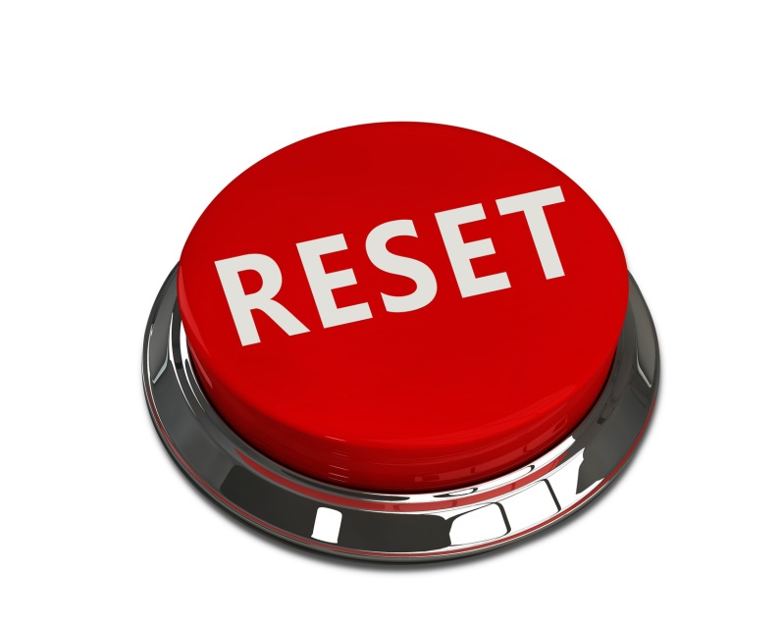
STATE VISION: BREAK IT DOWN
WE ASKED YOU TO START WITH A PROCESS…
Build a team in the region to create:
A Business-driven framework focused on business need
Integrated, customer-centered service design
Career pathways for priority populations
IMPACT

Slide 9
WHAT HAS HAPPENED?
Hundreds of partners across systems and across the state engaging in ideas – dropping sterotypes and turf at the door, hitting the reset button -- to shift the collective system and partner together
Launched new regional planning process (7 regions) to focus on talent shortages in regions and data analysis of critical career pathways in region
Completed procurement of One Stop Career Center operators, now 29 Centers statewide
16 Signed Umbrella MOUs focused on WIOA priority populations (shared resources and infrastructure)
Re-designed adult education (Title II) procurement process focused on career pathway vision and partnership across systems
NEW, nationally recognized partnership between Department of Transitional Assistance and One Stop Career Centers serving 1,440 customers since May, 2017 462 in FY17 and 978 to date in FY18
NEW pilots and integrated services with UI, Career Centers, SCEP, adult education, TANF/SNAP, and Vocational Rehabilitation for adults and youth.
NEW data metrics and data sharing agreements to evaluate employment and wage impacts across WIOA partners
NEW automated integrated registration process partners working together to develop automate process that will provide customers and staff with a dashboard of services for both job seeker and business customers

Slide 10

WHAT’S NEXT
IMPLEMENT THE COMBINED PLAN
Submit Regional Plan
Use Labor Market Information to Inform Plan and MOU Process
Customer-Centered Design: Strengthen Local Umbrella MOUs
Strengthen Business-Driven Strategies to meet Business Customer Needs
Strengthen Customer Flow and Career Pathway processes for Adult and Youth Across Partner Customer Populations
Branding the Workforce System
All Strategies Identified in Above Process Determines the Local Product Behind the Brand.

Slide 11
REGIONAL PLANNING
Established Regional Breakdown
Regions: Berkshire, Pioneer Valley, Central, Northeast, Greater Boston, South East and Cape Cod & Islands
Governor, Lt. Governor and Secretariat Lead Kick Off - April 5, 2017
Partners Involved in Regional Planning
Labor and Workforce Development, Economic Development & Education
Presentations of Plans to Workforce Skills Cabinet (WSC )– December 11, 2017
Blue Prints due to WSC – January 31, 2018
WSC & Public Comment Period – No later than March 2, 2018
Final Regional Blueprint due – March 31, 2018

Slide 12
CUSTOMER-CENTERED DESIGN/MOUs
Feedback/strengthen depth and detail of umbrella MOUs
Workforce Connect Tool: Data on shared customers, outcomes, operations to drive customer-centered improvements
Statewide cross-system training/ case studies:
Business Engagement
Universal Design
Service Integration
Motivational Interviewing

Slide 13
































BRANDING THE WORKFORCE SYSTEM – THE NEED
Businesses and jobseekers lack awareness of the depth, breadth, and interconnectedness of public workforce resources available in the Commonwealth.
Inconsistent branding permeates state, regional, and local workforce systems.
Internally, workforce system employees lack common organizational culture and do not feel like part of a unified system.
Executive Office of Labor and Workforce Development

Slide 14
BRANDING THE MA WORKFORCE SYSTEM
The New Brand will:
Communicate the depth, breadth, and connectivity of our workforce system to multiple audiences.
Capture a joint mission and vision of the Massachusetts public workforce system.
Provide a visual and cultural unification of the Massachusetts workforce system.
Improve visibility and understanding to jobseekers and employers.
Lead to an increase in interactions with jobseekers and employers.
Lead to improved morale, accountability, and performance among employees.

Slide 15



RECOMMENDED UNIFIED BRAND
One dominant brand name
Regional Workforce Development Boards
have geo-locators and consistent
naming structure
Local Career Centers have geo-locators and
consistent naming structure
Partners are co-branded; events and programs are endorsed

Slide 16
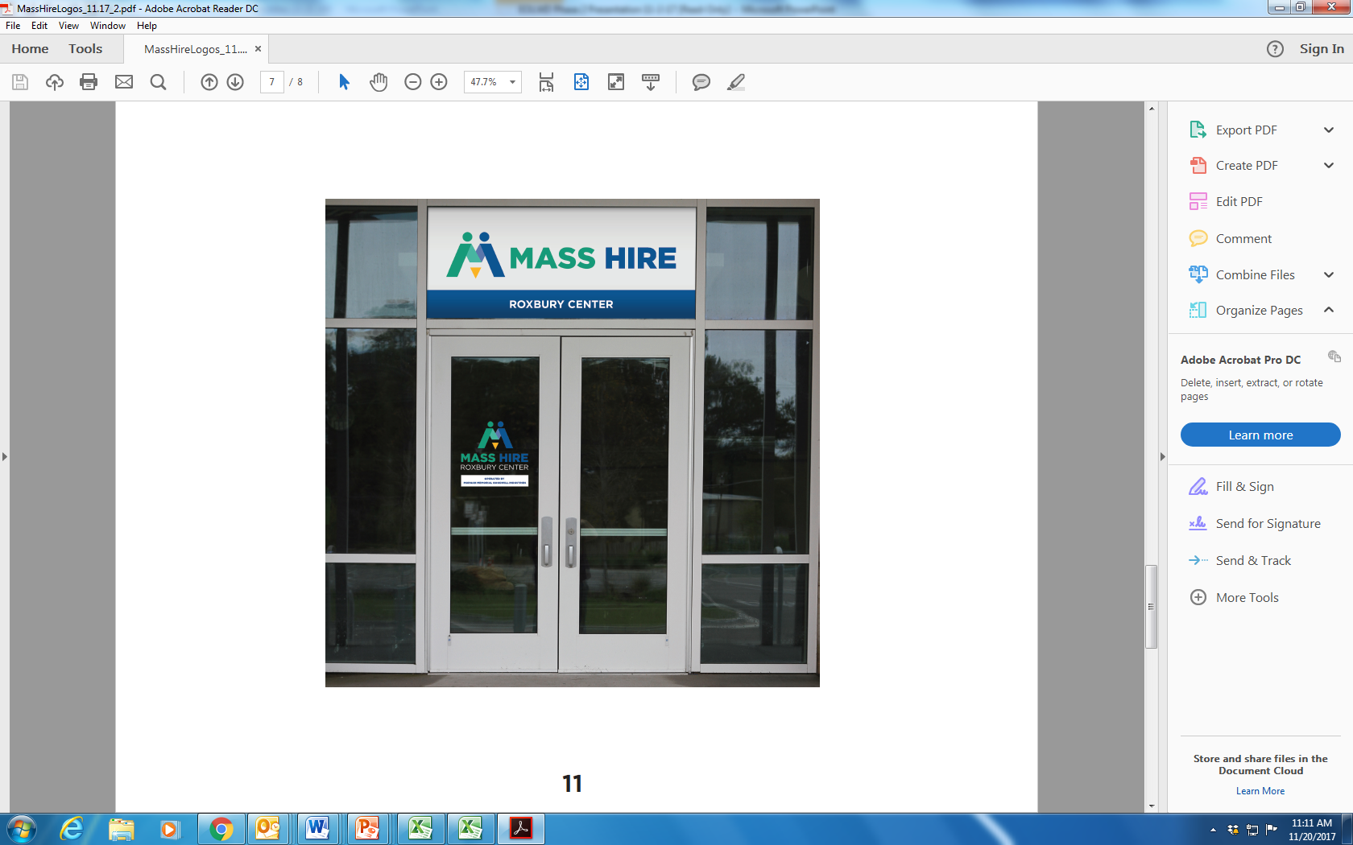
SIGNAGE EXAMPLE

Slide 17
What’s Coming Up
PARTNER PANEL
New Local Partnerships and Building Trust Based Upon Strong Working Relationships
Customer Centered Design/Flow (Universal Access), Work Together Toward the Ideal,
Then do what we can to make it happen
New Models to Serve Our Shared Customers
Creative Use of Funding, Business Service Strategies, Focus on Underrepresented
Partner Empowerment
MOU Implementation/Operationalization, Sharing Customers and Services
Career Center Capacity and Perspective
GUEST SPEAKERS
Accessibility: Foundation for Digital Experience and Future of Work – Francis West, FrancisWestCo
Emerging trends, accessible technology overview and insight into creating a
programmatic approach to embed accessibility in an enterprise setting
Motivational Interviewing – Angela Cooper, Boston Medical Center
How this customer centered approach to interviewing is beneficial to both customers
and staff

Slide 18
Local MOUs and Ongoing Partnerships
Presentation by Panel of Local Area Partners
January 8, 2018

Slide 19
Accessibility: Foundation for Digital Experience and Future of Work
Frances West, FrancesWestCo
Becky Gibson, FrancesWestCo
January 8, 2018

Slide 20
Motivational interviewing
Angela Cooper, LCAT
MASBIRT TTA, Consultant Trainer
January 8, 2018

Slide 21

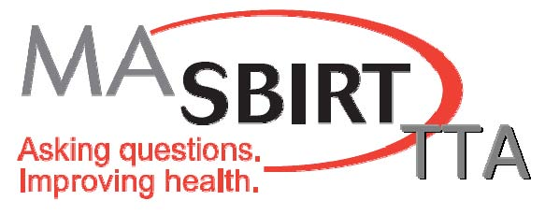
Motivational Interviewing (MI): A Very Brief Overview
Angela Cooper, LCAT
MASBIRT TTA, Consultant Trainer

Slide 22




MASBIRT Training & Technical Assistance (TTA)
(www.masbirt.org)
Supported by MA DPH: Bureau of Substance Addiction Services (BSAS) to build statewide SBIRT awareness and capacity to
Implement and integrate SBIRT into diverse settings and organizations,
Promote clinician SBIRT skills and competency.
Notes:
MASBIRT TTA works with a variety of healthcare orgs, to train and prepare sites for SBIRT implementation. including OB GYN depts., primary care sites, ED’s, CHC’s, school nurses, housing sites for elderly, etc.
The MASS Clearing house has many great pt. education materials that you can order for free. Includes the SBIRT toolkit, as well as toolkits for screening adolescents and women of child bearing age.

Slide 23
A Little Background on MI….
Comes from the substance use field.
Not stages of change (Prochaska, DiClemente); no pre-contemplation concept .
People at all levels have been trained to practice MI.
MI has been effective across cultures and conducted in multiple languages.
Requires on-going training, practice, feedback and supervision to fully integrate the skills into one’s work.

Slide 24
Applicability of MI
Some examples of where MI is used:
Addictions/Gambling/Tobacco
Mandated clients and offenders
Mental Health Disorders
Dental Hygiene
Chronic Illness/Medication Adherence
Health Behaviors (diet and exercise)
With Families in Early Intervention
Education & Employment programs
Homelessness and housing support
MI is proven effective in combination with other practices (some examples):
DBT (Dialectical Behavior Therapy)
CBT (Cognitive Behavioral Therapy) (several variations and applications)
Mental Health/Psychotherapy
Various Addiction Treatment Modalities
Notes:
Discuss History of Motivational Interviewing
MI was developed first in 1983 by Dr. William Miller. He then collaborated with Stephen Rollnick in 1991 to further develop the principles, spirit and skills of MI. In the most recent addition 2013, They developed the Processes of MI
MI originated with Substance/Alcohol users.
MI has expanded to work with very diverse populations and institutions (site the list on the slide)
MI is used in collaboration with DBT, CBT, Restorative Practices and Creative arts therapists

Slide 25
MI Philosophy
… When a client seems unmotivated to change or to
take the sound advice of practitioners, it is often assumed
that there is something the matter with the client and that
there is not much one can do about it. These assumptions
are usually false. No person is completely unmotivated.
Rollnick, Miller, Butler 2008

Slide 26
A Definition of MI
Motivational Interviewing:
A collaborative, goal-oriented style of communication with particular attention to the language of change. It is designed to strengthen personal motivation for and commitment to a specific goal by eliciting and exploring the person’s own reasons for change within an atmosphere of acceptance and compassion.
- Stephen Rollnick and William R. Miller, Sheffield, UK Oct 2011
Notes:
(Facilitator may want to ask how many people have heard of MI or have had training in MI)
One definition of Motivational Interviewing is A collaborative, goal-oriented style of communication with particular attention to the language of change. It is designed to strengthen personal motivation for and commitment to a specific goal by eliciting and exploring the person’s own reasons for change within an atmosphere of acceptance and compassion.
Two things to highlight here is that it is a communication style, and that it is goal focused.
Purpose of MI: For the specific purpose of helping people to move toward behavior change by working through ambivalence.
You can address that MI is not a panacea or the only way of working with people!

Slide 27
Two Aspects of MI
The MI Spirit
Way of being with clients; encompasses respect for each client.
Four inter-related elements: Acceptance, Partnership, Compassion, Evocation.
Each element has behavioral components.
The MI Skills:
Used to increase motivation to change a specific behavior.
Basic Skills:
Open ended questions
Affirmations
Reflections
Summaries
Higher level skill:
Evoking Change Talk & Softening Sustain Talk

Slide 28
Three Key Concepts of MI: People and the Nature of Change
Ambivalence is a normal part of the change process. Change happens by resolving ambivalence.
People want to be their best self.
People already have what they need to be that best self.

Slide 29

Acceptance
Absolute Worth
Each person will grow if given optimal conditions.
Accurate Empathy
See the world through their eyes.
Autonomy
Honoring and respecting each person’s choice.
Affirmation
Seek and acknowledge the person’s strengths and efforts.
Notes:
Acceptance includes
Valuing a person’s absolute worth-and believing they have the potential to grow and change
Accurate Empathy- Is being able to view the world through the clients perspective. This is the most vital component of MI adapted from Carl Jung.
Emphasize this is not to understand how “you” yould feel in the client’s situation, but how the “client” feels in his situation.
“Empathy is an antidote to shame”- Stephen Andrew
Supporting Autonomy- Honoring a person’s self-direction or process. This means even if we don’t agree with the process or direction, we accept it in believing that they have autonomy over their choices.
Affirming ones strengths and efforts toward change

Slide 30
A Taste of MI Skills: Affirmations
Respect and honor the customer as a person of worth, with the capability for growth and change as well as volitional choice about whether to do so.
It is our responsibility to always be on the lookout for the client’s strengths, good steps, and intentions.
Pointing out a person’s strengths and resources can build confidence.
Be Intentional and Specific.
Avoid Positive Judgements!
Notes:
Affirmations are acknowledgments of ones:
Resilience
Successes
Skills and or strengths
Goals and values
Affirmations are intended to highlight and accentuate the positive
They Respect and honor the client as a person of worth with the capability for growth and change as well as volitional choice about whether to make a change.
It is our responsibility as the worker to always be on the lookout for the clients strengths, good steps and intentions.
They should be intentional and SPECIFIC!
Some example statements of Affirmations include:
“It takes courage to face such difficult problems”
“You really care a lot about your family”

Slide 31

Partnership
VS.
“Resistance is an Interpersonal Process”
Notes:
The second part of the Spirit of MI is Partnership or Collaboration.
MI is a partnership; Not something done by an expert to a passive recipient. Not “to” or “on” someone.
MI is an active collaboration between experts. It is “with” someone.
You know you are in partnership or collaboration with someone when it feels like you are dancing together rather then wrestling.
Research shows that activation of the participant’s own expertise is a key condition for change to occur.
MI lives in this middle ground between directing and following, incorporating aspects of each.

Slide 32

Ask Permission: 1. Evoke: “Would it be OK if I share some information with you?” 2. Offer: Share 1 or 2 facts or suggestions. These are true facts and not value statements or commands, and as applicable to the person as possible. 3. Evoke: “What do you think about that?” “How does that fit into your life?”
A Taste of MI Skills:
The MI Sandwich

Slide 33

Compassion
Listen
See
Nonjudgment
Understand
To work with a spirit of compassion is to have your heart in the right place
so that the trust you engender will be deserved.
Notes:
The third component of the Spirit is Compassion. This is embodied by listening, seeing, understanding and not judging a person’s perception.
To be truly compassionate is to work from a place of non-judgment. This can be difficult as we all come to life with our own experiences and perceptions based on our past.
Option to have people reflect on their own judgments: How many of you get on the subway and are easily annoyed at how much room someone is taking up? How loud someone’s music is? Or you notice someone’s shoes or outfit and think, Oh my goodness, where are they going in that?
You can share that you are guilty of this….this is judgment. Possibly challenge them to begin being mindful of your thoughts while on NYC transportation.
(You may share this quote) “Compassion is love in the face of suffering” Mattieu Ricard
“To have compassion for another you must first have compassion for yourself”–Sharon Saltzberg
It is important here to ensure participants that no one is perfect here. That this is a practice that we all work on every day. We will make mistakes, even with our clients. MI challenges us to recognize these mistakes and take steps to repair them.

Slide 34
A Taste of MI Skills: Reflection
One of the most important Skills in MI.
It is a response to a client statement that is a clear assertive statement reflecting what the speaker said or meant.
It is NOT a question!!
It is a process of:
Hearing what the speaker said
Making a guess at what they mean
Stating it back to them in different words
“This has been a really challenging time for you and
you’re ready to do whatever it takes to make your life better.”
Notes:
Use Accurate Empathic Reflections often! It is one of the most important skills of MI.
It is a response to a client statement that is a clear assertive statement reflecting what the speaker said or meant.
It is not a question, meaning the intonation should go down at the end of the statement rather then up!
It is the process of Hearing what the speaker said.
Making a guess at what s/he meant…
Stating it back to them..YOU….

Slide 35

Evocation
“You have what you need, and together we will find it”
People have good reasons for doing what they have been doing.
People already have motivation and resources
within themselves that can be called on.
When people can voice their own reasons for change aloud, they are more likely to make the change.
Notes:
The final part of the Spirit is Evocation.
In the spirit of Evocation we believe that people have what they need inside themselves and together we will find it.
The assumption is that people truly have good reasons for the behaviors they are acting on. We need to explore their reasons before we can evoke change.
And, people have motivation and resources within themselves that can be drawn upon.
The best notions come from the client. The more likely a client is willing to fight for change, the more likely the change will occur.
Option Reference: Bems theory of self perspective-people are more likely to make decisions towards change when it comes from within.
http://www.dbem.ws/SP%20Theory.pdf

Slide 36

A Taste Of MI Skills: Open Ended Questions
Open-Ended Questions Keep A Conversation Going
The Patient THINKS about the answering, instead of answering reflexively.
“In what ways might attending this program improve your life?”
“What is most important to you?”
“When you look forward five years, how would you like to see your life different?”

Slide 37
Why Integrate MI into our Practice?
2009 Motivational Interviewing is made an Evidence Based Practice.
Multiple studies show that MI has an “Additive” effect when used in conjunction with other modalities.
Increases in retention, adherence to program and overall outcomes as well as post program duration of outcomes.
MI training improved worker satisfaction and led to self-reported improvements in burnout scores. It also improved team cohesion, perceived skills, and client satisfaction.
Fidelity matters.
Adding MI to other practices increases both the need for and the difficulty in maintaining fidelity to both practices.
A strong implementation and training protocol can increase the likelihood of maintaining fidelity and reaching desired additive outcomes.

Slide 38
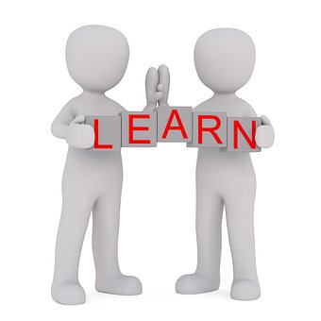
Developing an MI Practice is a Commitment!
Leadership understanding and support!
Implementation Planning.
Fidelity Measures.
Ongoing Training & Support:
2 Day Basic Training
1 Day Advanced Training
Ongoing Coaching & Supervision

Slide 39
Thank you &
Questions?

