Slide 1
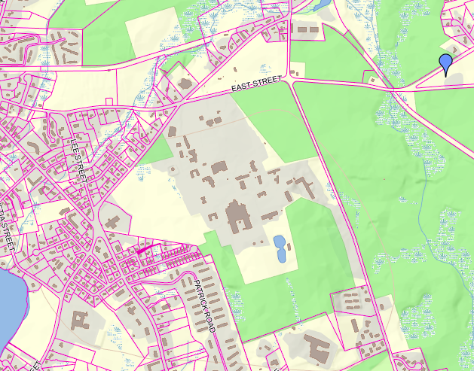

List of Drawings
1 Title Sheet
Site Plans
C4 Floor Layout
Demolition Plan (typical)
New Construction Plan (Typical)
Typical Wall Construction Details
Typical Wall Accessories Plan
Typical Electrical Plan
Miscellaneous Details
C5 Floor Layout
TEWKSBURY HOSPITAL
SAUNDERS BUILDING
Drawing #:
Title Sheet
DMH Project No: 2019-106
1

Slide 2
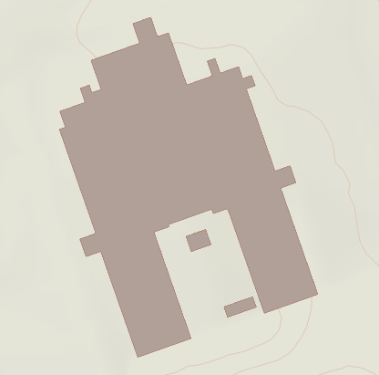
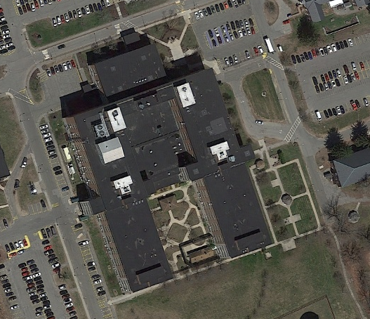
C Wing
Location of “C” wing
Aerial photograph of the Saunders Building
Site Plan
Drawing #:
DMH Project No: 2019-106
2

Slide 3
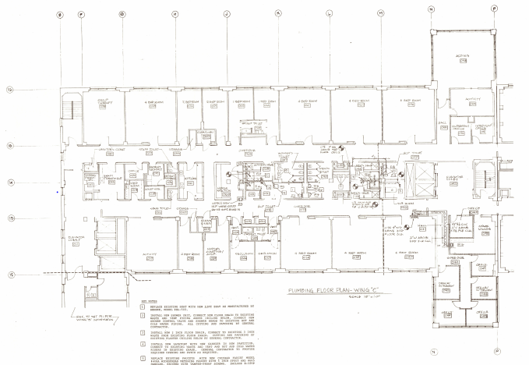
Room #061
Room #060
Room #056
Room #035
Room #034
Room #040
Note: Rooms 061, 060, 056, 035, 034, and 040 are the rooms where the work will occur.
Drawing #:
C4 Floor Layout
DMH Project No: 2019-106
3

Slide 4
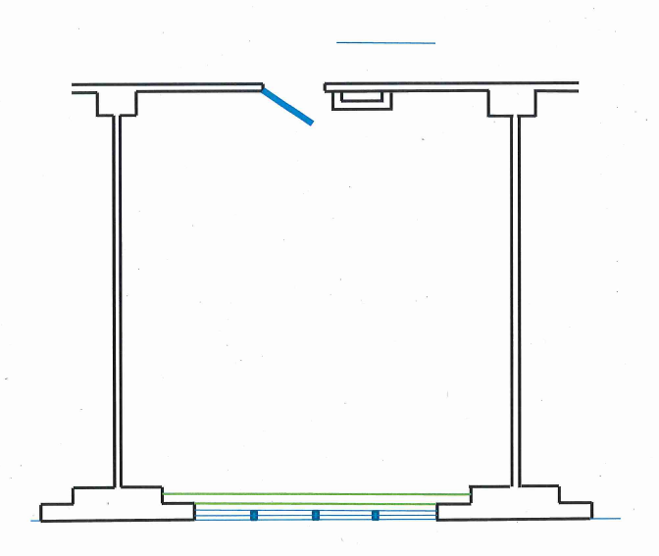
Remove existing tile & CMU needed for installation of new door frame
Remove existing light switch
DEMOLITION NOTES
Cut existing tile and CMU at new door frame locations to inside dimension of frame.
Cut interior and corridor tile back to edge of frame.
Cut existing interior title at proposed connection to new wall assembly.
Remove and properly store existing fixtures and smoke detectors.
Disconnect heating unit and remove required components to allow new wall assembly to be flush with existing window mullion.
Remove existing lighting wall switch at pipe chase.
Remove existing tile needed for installation of new wall
Remove existing light fixtures and smoke detector
Remove existing heating system needed for installation of new wall
Legend
smoke detector
1’ x 4’ lighting fixture
heating unit
mullion in window glass
Typical Demolition Plan
Drawing #:
DMH Project No: 2019-106
4

Slide 5
Cover existing light switch opening with epoxy-painted 12 GA. Steel covers.
New Door Frame
New Light Switches (one double switch per bedroom)
New Wicket Doors
New Lighting Fixtures
New Smoke Detectors
New Thermostat
(one per bedroom)
New Gypsum Wall Assembly
New Night Lights (two per bedroom)
Typical New Construction Plan
Drawing #:
DMH Project No: 2019-106
5

Slide 6
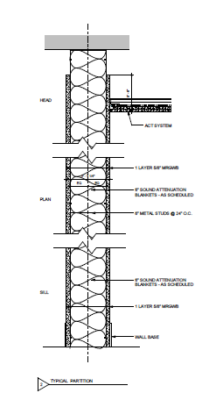
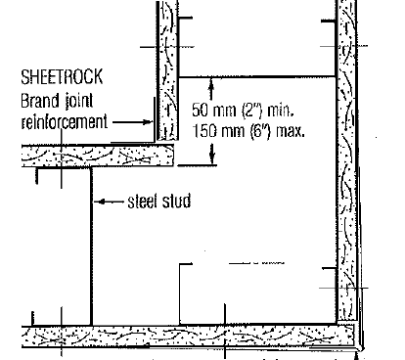
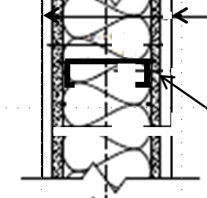
CEILING SLAB
2” to 6”
Fire Stop Track w/ fasteners 24 in. o.c. max
Steel Stud
4” CMU
Tile
Direct Furring Strip
Wall Assembly At Corner
5/8” Gypsum Panel
25-ga. 3-5/8” metal studs 16”o.c.
Isolation strip
Window Mullion
Wall Assembly At Corridor Wall
Wall Assembly At Window Mullion
Thermafiber Sound Attenuation Blankets (SAFB)
5/8” Plywood
Bottom rail w/ fasteners 24 in. o.c. max
FLOOR SLAB
Drawing #:
Typical Wall Construction Details
DMH Project No: 2019-106
6

Slide 7
WALL ACCESSORIES NOTES
Three 1’ x 1’ plastic access panels are to be installed in six of the bedrooms providing access to the electrical and smoke detector junction boxes.
One new light switch shall be installed in each bedroom and shall be approximately 3’ from interior side of corridor wall.
Two night lights shall be installed in each bedroom with a switch connection at the lighting switch location. Night lights shall be installed at approximately 8’ and 16’ from interior side of corridor wall.
One new thermostat shall be installed in each bedroom. Thermostat shall be installed at approximately 12’ from interior side of corridor wall.
8’ - 9”
5’ -0”
2’ -0”
Legend
night light (recessed)
Lighting switch (recessed)
Thermostat (recessed)
access panel (surface mount)
Typical Wall Accessories
Plan
Drawing #:
DMH Project No: 2019-106
7

Slide 8
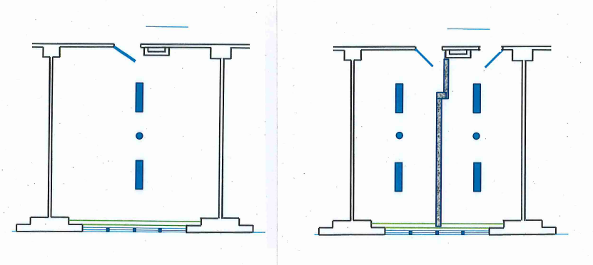
New surface mounted wiremold
Existing Electrical Layout
Proposed Electrical Layout
Legend
night light (recessed)
Smoke Detector (Surface Mounted)
Thermostat (recessed)
1’ x 4’ surface mounted light fixture
Existing Junction Box
Typical Electrical Plan
Drawing #:
DMH Project No: 2019-106
8

Slide 9
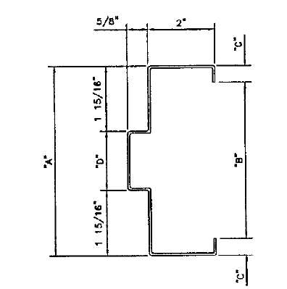
Metal Door Frame Detail
Drawing #:
Miscellaneous Details
DMH Project No: 2019-106
9

Slide 10
Room #061
Room #060
Room #056
Room #035
Room #034
Room #040
Note: Rooms 061, 060, 056, 035, 034, and 040 are the rooms where the work will occur.
Drawing #:
C5 Floor Layout
DMH Project No: 2019-106
10

