Slide 1
2023 Massachusetts Integrated HIV, STI, and Viral Hepatitis Surveillance Report
Massachusetts Department of Public Health
Bureau of Infectious Disease and Laboratory Sciences
December 2024
Notes:
Suggested citation:
Massachusetts Department of Public Health, Bureau of Infectious Disease and Laboratory Sciences. 2022 Massachusetts Integrated HIV, STD and Viral Hepatitis Surveillance Report, https://www.mass.gov/doc/2020-integrated-hivaids-std-and-viral-hepatitis-report/download Published December 2023. Accessed [date].
Bureau of Infectious Disease and Laboratory Sciences
Massachusetts Department of Public Health
Jamaica Plain Campus/State Public Health Laboratory
305 South Street
Jamaica Plain, MA 02130
Questions about this report
Tel: (617) 983-6560
To speak to the on-call epidemiologist
Tel: (617) 983-6800
To reach the Reporting and Partner Services Line^{i}
Tel: (617) 983-6999
Questions about infectious disease reporting
Tel: (617) 983-6801
Requests for additional data
https://www.mass.gov/lists/infectious-disease-data-reports-and-requests
Slide set for 2022 Integrated Report
https://www.mass.gov/lists/std-data-and-reports
For additional contact information see HIV, STD, and Viral Hepatitis Program Staff Contact Information
Acknowledgments
We are grateful to healthcare providers and laboratories across the Commonwealth who report HIV, STI, and viral hepatitis diagnoses and corresponding clinical information to the Massachusetts Department of Health (MDPH), Bureau of Infectious Disease and Laboratory Sciences (BIDLS). These reports are essential to perform timely epidemiologic investigations and to inform an effective public health response. We also wish to acknowledge the contributions of the many program staff within BIDLS who collect, manage, maintain, and analyze this information and who reviewed draft sections relevant to their areas of expertise.

Slide 2
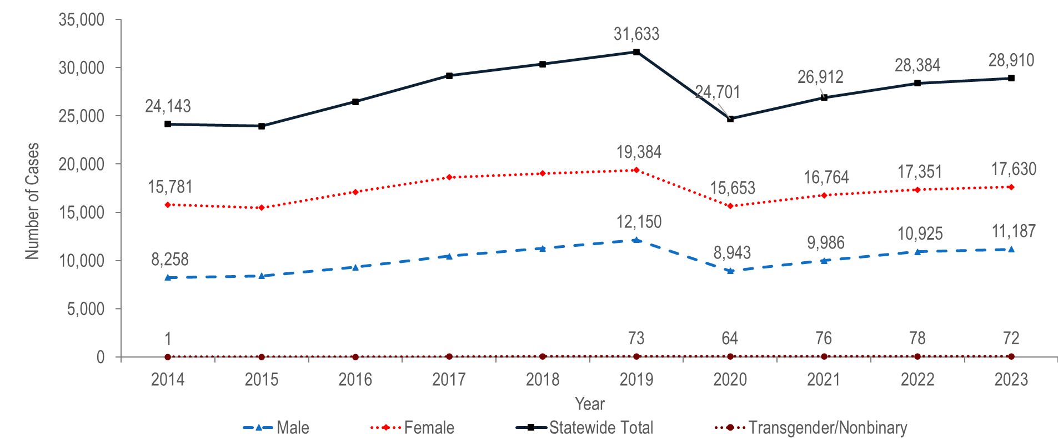
Number of confirmed chlamydia cases reported by gender, Massachusetts 2014–2023¹
¹ Please consider the impact of the COVID-19 pandemic on infectious disease screening, treatment, and surveillance in the interpretation of data from 2020 to 2023.
Note: Cases with no gender reported (2014–2023: N=423) are included in the statewide total but are not depicted in Figure separately due to small numbers.
Data Source: Bureau of Infectious Disease and Laboratory Sciences, data are current as of 7/22/2024 and subject to change.
Notes:
The figure is a trendline graph displaying the annual number of chlamydia cases for four groups (male gender, female gender, transgender/non-binary, and Statewide total) for each year of the ten-year period.
The total number of reported laboratory confirmed chlamydia cases increased by 31% from 24,143 in 2014 to 31,633 in 2019, decreased to 24,701 in 2020, and then increased to 28,910 in 2023.¹ A decrease in reported chlamydia cases in 2020, followed by an increase in 2021 was also observed nationally.²
Each year from 2014 to 2023, approximately twice as many chlamydia cases were reported among females as among males. In 2023, the ratio of female-to-male chlamydia cases was 1.6 (1.6 = 17,630/11,187).
In 2023, 72 chlamydia cases were reported among individuals of transgender experience and/or individuals who are nonbinary.³
¹ Please consider the impact of the COVID-19 pandemic on infectious disease screening, treatment, and surveillance in the interpretation of data from 2020 to 2023.
² CDC, Trends in Reported Cases and Rates of Reported Cases for Nationally Notifiable STDs, United States, 2017-2021*, available at https://www.cdc.gov/std/statistics/2021/default.htm
Pagaoa, Melissa MPH; Grey, Jeremy PhD; Torrone, Elizabeth PhD; Kreisel, Kristen PhD; Stenger, Mark MA; Weinstock, Hillard MD Trends in Nationally Notifiable Sexually Transmitted Disease Case Reports During the US COVID-19 Pandemic, January to December 2020, Sexually Transmitted Diseases: October 2021 - Volume 48 - Issue 10 - p 798-804
³ Please note reported numbers among individuals of transgender experience and individuals who are nonbinary are likely to be underestimates. For more information, see Interpreting HIV, STI, and Viral Hepatitis Data.

Slide 3
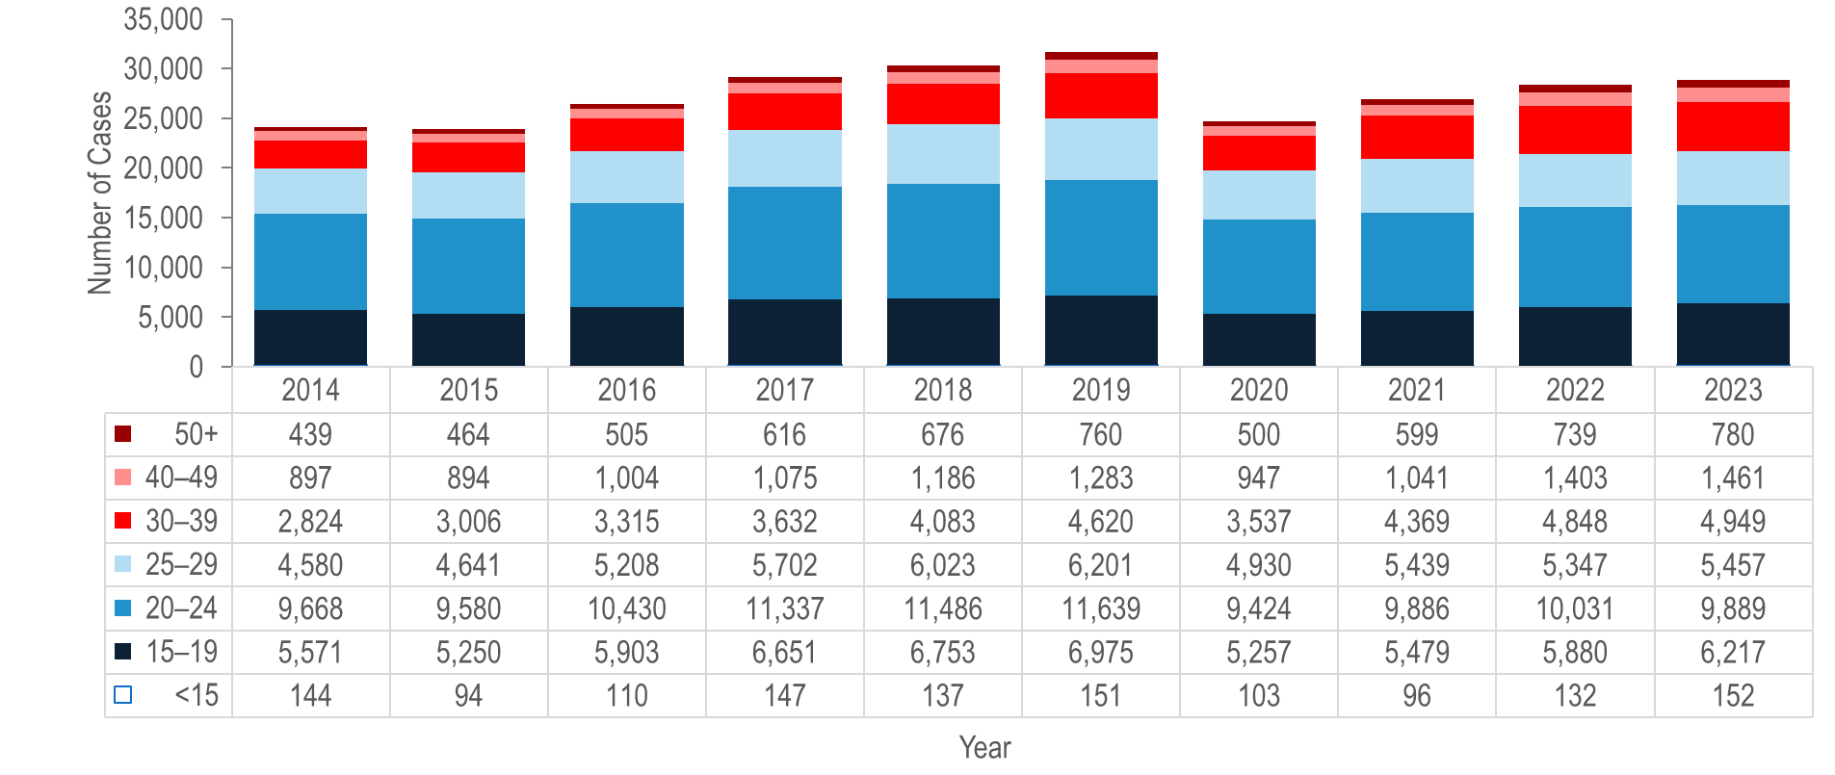
Number of confirmed chlamydia cases reported by age group (years), Massachusetts 2014–2023 ¹
¹ Please consider the impact of the COVID-19 pandemic on infectious disease screening, treatment, and surveillance in the interpretation of data from 2020 to 2023.
Note: Cases with no age reported (2014–2023: N=90) are not included in this figure
Data Source: Bureau of Infectious Disease and Laboratory Sciences, data are current as of 7/22/2024 and subject to change
Notes:
The figure is a stacked bar chart displaying the annual number of chlamydia cases for seven age groups (<15, 15-19, 20-24, 25-29, 30-39, 40-49, and 50+) for each year of the ten-year period.
Each year from 2014 to 2023, the greatest number of chlamydia cases was reported among 20–24 year-olds, followed by 15–19 year-olds. In each of these years over half (56% to 63%) of chlamydia cases were reported among individuals in these age groups.
From 2014 to 2023, the largest increase in the number of reported chlamydia cases was among individuals aged 30–39 years (by 75% from 2,824 to 4,949).

Slide 4
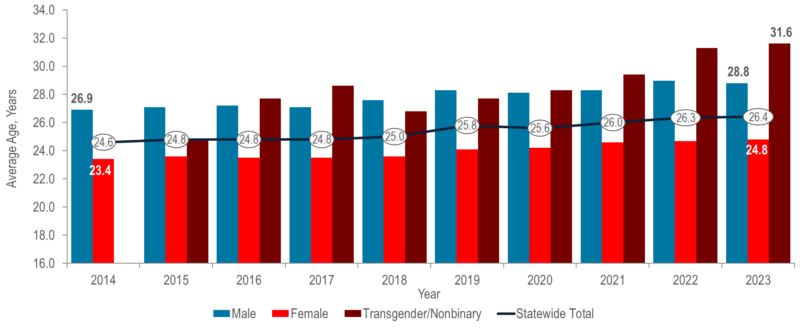
Average age of confirmed chlamydia cases reported by female and male gender, Massachusetts 2014–2023¹
¹ Please consider the impact of the COVID-19 pandemic on infectious disease screening, treatment, and surveillance in the interpretation of data from 2020 to 2023.
Note: Cases with no age reported (2014–2023: N=90) are not included in this analysis and transgender/nonbinary cases are not presented for 2014 because collection of this gender began in 2015.
Data Source: Bureau of Infectious Disease and Laboratory Sciences, data are current as of 7/22/2024 and subject to change
Notes:
The figure is a bar chart displaying the trend in the average age of reported chlamydia cases for the ten-year period for male gender, female gender, transgender/non-binary and the statewide total.
The overall average age of laboratory-confirmed chlamydia cases in Massachusetts increased from 24.6 years in 2014 to 26.4 years in 2023.³ This marks the fifth year that the average age has exceeded the CDC recommended screening age range of under 25 years for sexually active women.
The increase in average age appeared to be driven mostly by male chlamydia cases. From 2014 to 2023, the proportion of chlamydia cases among males increased from 34% to 39% (See Figure 1). Additionally, the increase in average age of chlamydia cases reported among males was greater than the increase among females. From 2014 to 2023, the average age of chlamydia cases reported among males increased by 1.9 years compared to an increase of 1.4 years among females.
¹ Source: Final Recommendation Statement: Chlamydia and Gonorrhea: Screening. U.S. Preventive Services Task Force. September 2021. https://www.uspreventiveservicestaskforce.org/uspstf/recommendation/chlamydia-and-gonorrhea-screening#fullrecommendationstart .
² For more information, see MDPH Chlamydia Screening Advisory (2022) https://www.mass.gov/doc/chlamydia-screening-advisory-2022/download

Slide 5
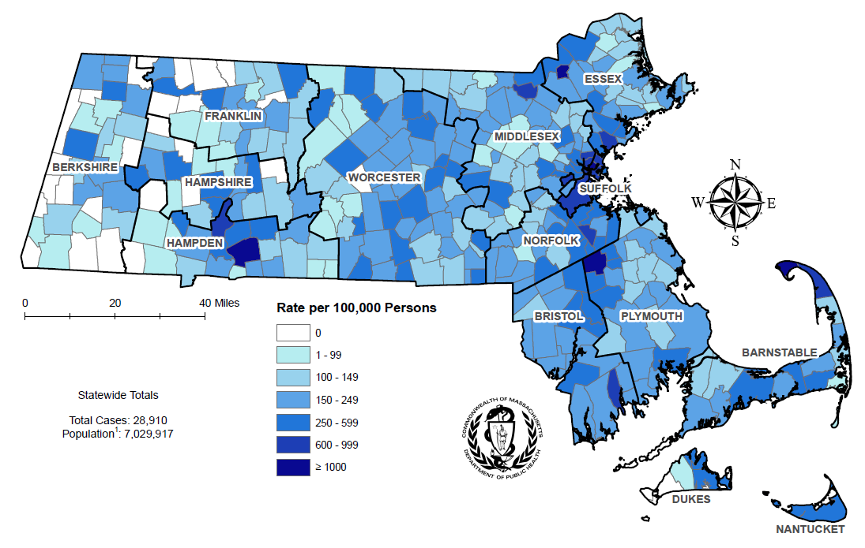
Incidence rate of confirmed chlamydia cases per 100,000 population reported by city/town, Massachusetts 2023¹
¹ Please consider the impact of the COVID-19 pandemic on infectious disease screening, treatment, and surveillance in the interpretation of data from 2020 to 2023.
Note: regional data include individuals tested in a correctional facility.
There are no city/towns with <10 cases of chlamydia that fall within the top two rate categories (≥600 cases per 100,000)
Data Source: Bureau of Infectious Disease and Laboratory Sciences, data are current as of 7/22/2024 and subject to change
Notes:
The figure is a rate map of Massachusetts displaying the incidence rate of chlamydia cases per 100,000 population by city/town. Cities and towns are in one of seven categories: no reported cases, less than or equal to 99 per 100,000, 100 – 149 per 100,000, 150 - 249 per 100,000, 250 - 599 per 100,000, or 600 - 999 per 100,000 and greater than or equal to 1000 per 100,000.
Chlamydia cases continue to be reported throughout Massachusetts, with concentrations in the most populated cities.
The five cities² with the highest chlamydia incidence rates in 2023³ were Provincetown (2,156.1 per 100,000),⁴ Brockton (1,335.6 per 100,000), Springfield (1,040.9 per 100,000), Chelsea (1,012.6 per 100,000), and Lawrence (1,010.7 per 100,000).
In 2023, the statewide chlamydia incidence rate of 411.2 per 100,000 population was lower than the 2022 national rate of 495.0 per 100,000.⁵
While Louisiana ranked first and Vermont ranked 50th, Massachusetts ranked 36th in chlamydia incidence rate among the 50 states in 2022, the last year for which these national data are publicly available.⁶
¹ Population based on University of Massachusetts Donahue Institute Estimates.
² Among cities that reported at least 12 confirmed chlamydia cases in 2023.
³ Please consider the impact of the COVID-19 pandemic on infectious disease screening, treatment, and surveillance in the interpretation of data from 2020 to 2023.
⁴ The chlamydia incidence rate for Provincetown is high because of small population size (2,583), as opposed to the number of cases (79).
⁵ Centers for Disease Control and Prevention, Sexually Transmitted Infections Surveillance 2022, available at https://www.cdc.gov/std/statistics/2021/default.htm
⁶ Centers for Disease Control and Prevention. Sexually Transmitted Infections Surveillance 2022 Atlanta: U.S. Department of Health and Human Services; 2024. Please note, 2022 state rankings are presented because 2023 rankings were not yet available at the time of this publication.

Slide 6
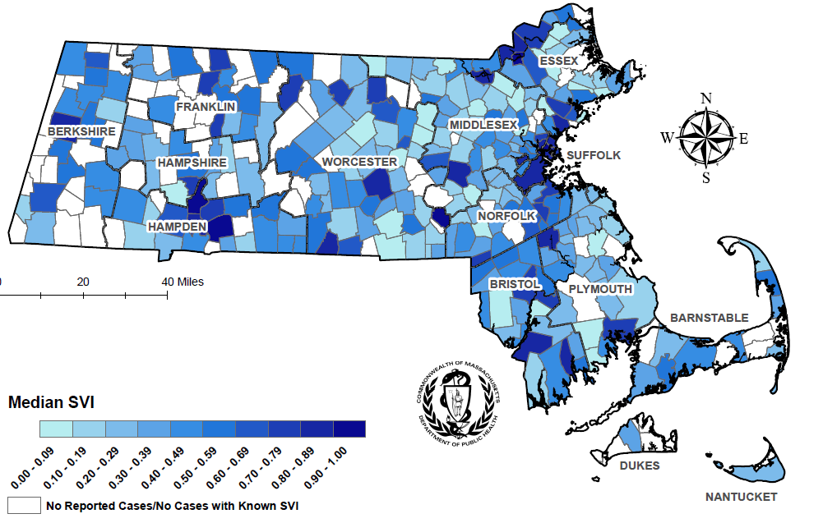
Median overall Social Vulnerability Index (SVI) by city/town for confirmed chlamydia cases, Massachusetts 2023¹
¹ Please consider the impact of the COVID-19 pandemic on infectious disease screening, treatment, and surveillance in the interpretation of data from 2020 to 2023.
Note: Census tract level overall SVI values for 2020 were obtained from the CDC/Agency for Toxic Substance and Disease Registry and assigned to all cases based on their street address at diagnosis, 1,084 cases were excluded from this analysis because address was unknown or the individuals were homeless. City/Town level median is calculated from the median SVI score for that city/town among gonorrhea cases. Values range from 0 to 1, with higher values implying greater social vulnerability. Map should be interpreted with caution as it displays median SVI scores for cities/towns with one or more cases. Data Sources: CDC/Agency for Toxic Substance and Disease, Bureau of Infectious Disease and Laboratory Sciences, data are current as of 7/22/2024 and subject to change.
Notes:
The figure is a map of Massachusetts displaying the Median overall Social Vulnerability Index (SVI) by city/town. The SVI index ranges from 00.00 to 1.00, with increasing darkness in blue color indicating higher SVI index. Cities with no reported cases are white. SVI rankings were grouped into quartiles (low, <0.25; mid low, 0.25 - <0.5; mid high, 0.5 - <0.75; high >0.75).
In 2023,¹ the median SVI score among confirmed chlamydia cases in Massachusetts was 0.747, which would be categorized as highly vulnerable.
The five cities with the highest SVI scores (i.e., the most highly vulnerable) among confirmed chlamydia cases in 2023 were Holyoke (0.938), Lawrence (0.934), Milford (0.911), Chelsea (0.910), and Springfield (0.894).
¹ Please consider the impact of the COVID-19 pandemic on infectious disease screening, treatment, and surveillance in the interpretation of data from 2020 to 2023

Slide 7
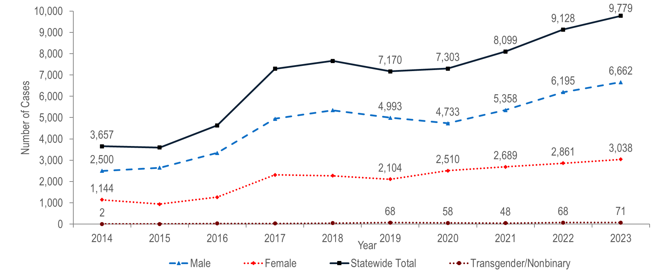
Number of confirmed gonorrhea cases reported by gender, Massachusetts 2014–2023 ¹
¹ Please consider the impact of the COVID-19 pandemic on infectious disease screening, treatment, and surveillance in the interpretation of data from 2020 to 2023.
Note: Cases with no gender reported (2014–2023: N=39) are included in the statewide total but are not depicted in Figure separately due to small numbers
Data Source: Bureau of Infectious Disease and Laboratory Sciences, data are current as of 7/22/2024 and subject to change
Notes:
The figure is a trendline graph displaying the annual number of gonorrhea cases for four groups (male gender, female gender, transgender/nonbinary and statewide total) for each year of the ten-year period.
After a sharp 57% increase from 2016 (N=4,638) to 2017 (N=7,293), gonorrhea incidence remained relatively stable through 2020 (N=7,303), and then increased by 34% to 9,779 in 2023.¹
Between 2014 and 2023, the number of laboratory confirmed gonorrhea cases reported among males increased by 2.7 times (from 2,500 to 6,662, respectively). The number of gonorrhea cases among males in 2023 was more than double the number among females (3,038), resulting in a male-to-female ratio of 2.19 (2.19 = 6,662/3,038).
The number of gonorrhea cases reported among females increased by 2.7 times from 1,144 in 2014 to 3,038 in 2023.
In 2023, 71 gonorrhea cases were reported among individuals of transgender experience and/or nonbinary individuals.²
¹ Please consider the impact of the COVID-19 pandemic on infectious disease screening, treatment, and surveillance in the interpretation of data from 2020 to 2023.
² Please note reported numbers among individuals of transgender experience and individuals who are nonbinary are likely to be underestimates, for more information see Interpreting HIV, STI, and Viral Hepatitis Data.

Slide 8
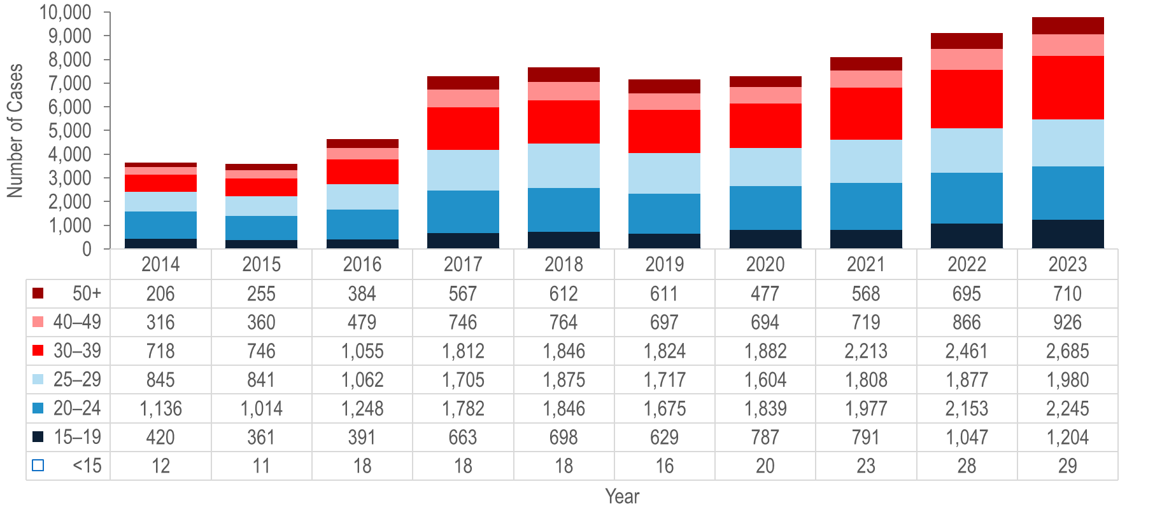
Number of confirmed gonorrhea cases reported by age group (years), Massachusetts 2014–2023 ¹
¹ Please consider the impact of the COVID-19 pandemic on infectious disease screening, treatment, and surveillance in the interpretation of data from 2020 to 2023.
Note: Cases missing age (2014–2023: N=12) are not included in this figure
Data Source: Bureau of Infectious Disease and Laboratory Sciences, data are current as of 7/22/2024 and subject to change
Notes:
The figure is a stacked bar chart displaying the annual number of gonorrhea cases for seven age groups (<15, 15-19, 20-24, 25-29, 30-39, 40-49, and 50+) each year for the most recent ten-year period.
Each year from 2014 to 2023,¹ about half (43% to 54%) of gonorrhea cases were reported among individuals aged 20–24 or 25–29 years.
From 2014 to 2023, the largest increase in the number of reported gonorrhea cases was among individuals aged 30–39 years (by 3.7 times from 718 to 2,685).

Slide 9
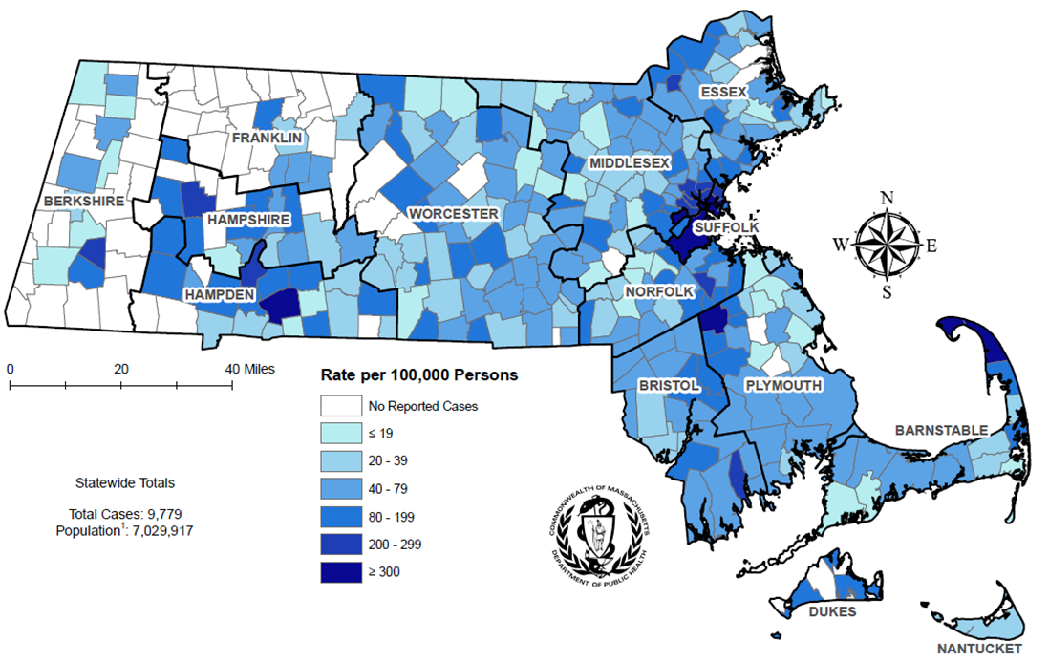
Incidence rate of confirmed gonorrhea cases per 100,000 population¹ reported by city/town, Massachusetts 2023 ²
¹ Population based on University of Massachusetts Donahue Institute Estimates
² Please consider the impact of the COVID-19 pandemic on infectious disease screening, treatment, and surveillance in the interpretation of data from 2020 to 2023.
There are two city/towns with <10 cases of gonorrhea that fall within the top two rate categories (≥200 cases per 100,000): Chesterfield, and Tyringham.
Note: regional data include individuals tested in a correctional facility.
Data Source: Bureau of Infectious Disease and Laboratory Sciences, data are current as of 7/22/2024 and subject to change
Notes:
The figure is a rate map of Massachusetts displaying the incidence rate of gonorrhea cases per 100,000 population by city/town. Cities and towns are in one of seven categories: no reported cases, less than or equal to 19 per 100,000, 20 - 39 per 100,000, 40 - 79 per 100,000, 80 - 199 per 100,000, or 200 - 299 per 100,000, and greater than or equal to 300 per 100,000.
Gonorrhea cases continued to be clustered in the most populated cities in Massachusetts in 2023.
The five cities² with the highest gonorrhea incidence rates in 2023 were Provincetown (2,865.7 per 100,000),³ Truro (489.0 per 100,000), Boston (412.8 per 100,000), Brockton (408.0 per 100,000), and Chelsea (328.5 per 100,000).
In 2023,² the statewide gonorrhea incidence rate of 139.1 per 100,000 population was lower than the 2022 national rate of 194.4 per 100,000.⁴
While Mississippi ranked first and Vermont ranked 50th, Massachusetts ranked 38th in gonorrhea incidence rate among the 50 states in 2022, the last year for which these national data are publicly available.⁵
¹ Population based on University of Massachusetts Donahue Institute Estimates
² Among cities that reported at least 12 confirmed gonorrhea cases in 2023.
³ The gonorrhea incidence rate for Provincetown is high because of small population size (2,583), as opposed to the number of cases (104).
⁴ Please consider the impact of the COVID-19 pandemic on infectious disease screening, treatment, and surveillance in the interpretation of data from 2020 to 2023.
⁵ Centers for Disease Control and Prevention, Sexually Transmitted Infections Surveillance 2022, available at https://www.cdc.gov/std/statistics/2021/default.htm
⁶ Centers for Disease Control and Prevention. Sexually Transmitted Infections Surveillance 2022 Atlanta: U.S. Department of Health and Human Services; 2024. Please note, 2022 state rankings are presented because 2023 rankings were not yet available at the time of this publication.

Slide 10
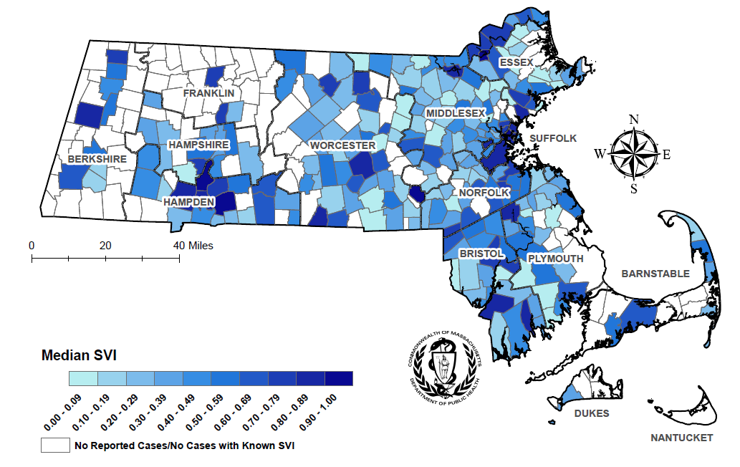
Median overall Social Vulnerability Index (SVI) by city/town for confirmed gonorrhea cases, Massachusetts 2023 ¹
¹ Please consider the impact of the COVID-19 pandemic on infectious disease screening, treatment, and surveillance in the interpretation of data from 2020 to 2023.
Note: Census tract level overall SVI values for 2020 were obtained from the CDC/Agency for Toxic Substance and Disease Registry and assigned to all cases based on their street address at diagnosis, 338 cases were excluded from this analysis because address was unknown or the individuals were homeless. City/Town level median is calculated from the median SVI score for that city/town among gonorrhea cases. Values range from 0 to 1, with higher values implying greater social vulnerability. Map should be interpreted with caution as it displays median SVI scores for cities/towns with one or more cases.
Data Sources: CDC/Agency for Toxic Substance and Disease, Bureau of Infectious Disease and Laboratory Sciences, data are current as of 7/22/2024 and subject to change.
Notes:
The figure is a map of Massachusetts displaying the Median overall Social Vulnerability Index (SVI) by city/town. The SVI index ranges from 00.00 to 1.00, with increasing darkness in blue color indicating higher SVI index. Cities with no reported cases are white. SVI rankings were grouped into quartiles (low, <0.25; mid low, 0.25 - <0.5; mid high, 0.5 - <0.75; high >0.75).
In 2023,¹ the median SVI score among confirmed gonorrhea cases in Massachusetts was 0.739, which would be categorized as moderately highly vulnerable.
The five cities with the highest SVI scores (i.e., the most highly vulnerable) among confirmed gonorrhea cases in 2023 were Lawrence (0.952), Holyoke (0.938), Milford (0.911), Chelsea (0.910), and Springfield (0.894).

Slide 11
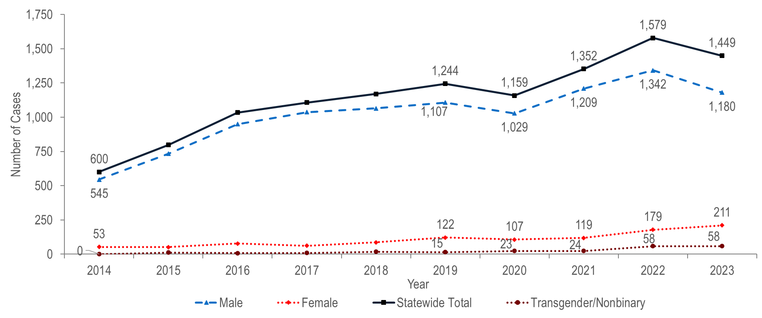
Number of confirmed and probable infectious syphilis cases reported by gender, Massachusetts 2014–2023 ¹
¹ Please consider the impact of the COVID-19 pandemic on infectious disease screening, treatment, and surveillance in the interpretation of data from 2020 to 2023.
Note: Cases with no gender reported (2014–2023: N=3) are included in the statewide total but are not depicted in Figure 10 separately due to small numbers
Data Source: Bureau of Infectious Disease and Laboratory Sciences, data are current as of 7/22/2024 and subject to change
Notes:
The figure is a trendline graph displaying the number of infectious syphilis cases for four groups (male gender, female gender, transgender/nonbinary and statewide total) for each year of the ten-year period.
The total number of reported confirmed and probable infectious syphilis cases¹ increased to a ten-year high of 1,579 in 2022 and subsequently decreased to 1,449 in 2023.² A ten-year high was observed in 2022 among males (N=1,342) and in 2023 among females (N=211).
The total number of confirmed and probable infectious syphilis cases increased by 2.4 times from 2014 (N=600) to 2023 (N=1,449). In the most recent five years from 2019 to 2023 the number of cases increased by 16% (from 1,244 to 1,449).
Between 2014 and 2023, the proportion of confirmed and probable infectious syphilis cases among males remained between 81% and 94% each year. In 2023, there were 5.6 times as many syphilis cases reported among males (N=1,180) as among females (N=211).
In 2023, 58 confirmed and probable infectious syphilis cases were reported among individuals of transgender experience and/or nonbinary individuals.³
¹ Infectious syphilis includes diagnoses made in the primary, secondary, and early non-primary non-secondary stages of infection (latent asymptomatic syphilis where infection occurred in the past 12 months).
² Please consider the impact of the COVID-19 pandemic on infectious disease screening, treatment, and surveillance in the interpretation of data from 2020 to 2023.
³ Please note reported numbers among individuals of transgender experience and individuals who are nonbinary are likely to be underestimates, for more information see Interpreting HIV, STI, and Viral Hepatitis Data.

Slide 12
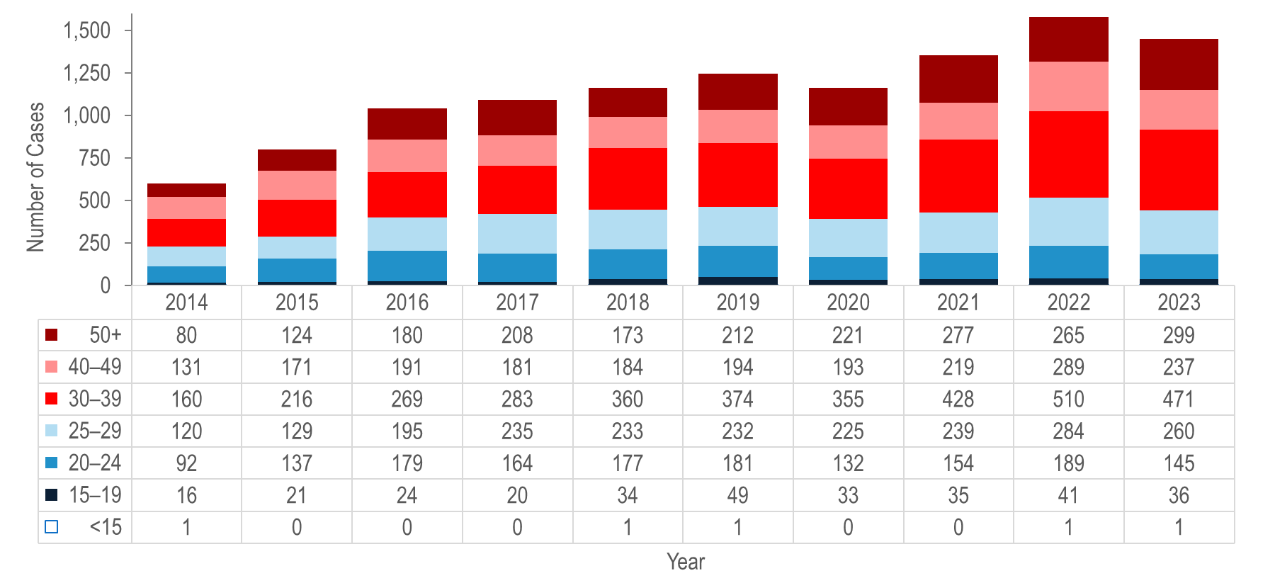
Number of confirmed and probable infectious syphilis cases reported by age group (years), Massachusetts 2014–2023 ¹
¹ Please consider the impact of the COVID-19 pandemic on infectious disease screening, treatment, and surveillance in the interpretation of data from 2020 to 2023.
Note: All syphilis cases from 2013 to 2022 were reported with age, none were excluded from this figure; Infectious syphilis includes diagnoses made in the primary, secondary, and early non-primary non-secondary stages of infection (latent asymptomatic syphilis where infection occurred in the past 12 months). Data Source: Bureau of Infectious Disease and Laboratory Sciences, data are current as of 7/22/2024 and subject to change
Notes:
The figure is a stacked bar chart displaying trends in the annual number of syphilis cases for seven age groups (<15, 15-19, 20-24, 25-29, 30-39, 40-49, and 50+) for the ten-year period.
From 2014 to 2023,² the largest increases in the number of reported confirmed and probable infectious syphilis cases were among individuals aged 50 years and above (by 3.7 times from 80 to 299) and 30–39 years (by 2.9 times from 160 to 471).
The largest number of reported confirmed and probable infectious syphilis cases was among 30–39 year-olds for the past decade.
¹ Infectious syphilis includes diagnoses made in the primary, secondary, and early non-primary non-secondary stages of infection (latent asymptomatic syphilis where infection occurred in the past 12 months).
² Please consider the impact of the COVID-19 pandemic on infectious disease screening, treatment, and surveillance in the interpretation of data from 2020 to 2023.

Slide 13
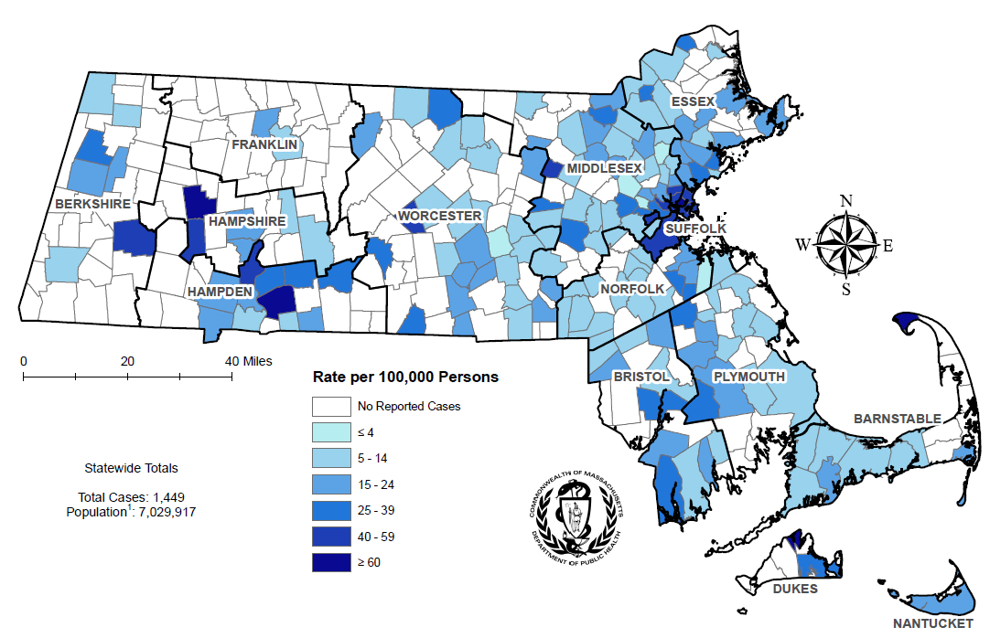
Incidence rate of confirmed and probable infectious syphilis cases per 100,000 population¹ reported by city/town, Massachusetts 2023 ²
¹ Population based on University of Massachusetts Donahue Institute Estimates.
² Please consider the impact of the COVID-19 pandemic on infectious disease screening, treatment, and surveillance in the interpretation of data from 2020 to 2023.
There are seven city/towns with <10 cases of syphilis that fall within the top two rate categories (≥40 cases per 100,00): Chesterfield, Tisbury, Boxborough, Oakham, Becket, Huntington, and Winthrop.
Note: regional data include individuals tested in a correctional facility.
Data Source: Bureau of Infectious Disease and Laboratory Sciences, data are current as of 7/22/2024 and subject to change
Notes:
The figure is a rate map of Massachusetts displaying the incidence rate of syphilis cases per 100,000 population by city/town. Cities and towns are in one of seven categories: no reported cases, less than or equal to 4 per 100,000, 5 - 14 per 100,000, 15 - 24 per 100,000, 25 - 39 per 100,000, or 40 - 59 per 100,000, and greater than or equal to 60 per 100,000.
The statewide confirmed and probable infectious syphilis² incidence rate decreased from a ten-year high of 22.7 in 2022 to 20.6 in 2023.³
The five cities⁴ with the highest confirmed and probable infectious syphilis incidence rates were Provincetown (409.4 per 100,000),⁵ Chelsea (80.9 per 100,000), Springfield (72.5 per 100,000), Boston (53.9 per 100,000), and Holyoke (47.1 per 100,000).
While South Dakota ranked first and Vermont ranked 50th, Massachusetts ranked 34th in primary and secondary syphilis incidence rate among the 50 states in 2022, the last year for which these national data are publicly available.⁶
² Infectious syphilis includes diagnoses made in the primary, secondary, and early non-primary non-secondary stages of infection (latent asymptomatic syphilis where infection occurred in the past 12 months).
³ Please consider the impact of the COVID-19 pandemic on infectious disease screening, treatment, and surveillance in the interpretation of data from 2020 to 2023.
⁴ Among cities that reported at least 12 confirmed syphilis cases in 2023.
⁵ The syphilis incidence rate for Provincetown is high because of small population size (2,583), as opposed to the number of cases (15).
⁶ Centers for Disease Control and Prevention. Sexually Transmitted Infections Surveillance 2022 Atlanta: U.S. Department of Health and Human Services; 2024. Please note, 2022 state rankings are presented because 2023 rankings were not yet available at the time of this publication.

Slide 14
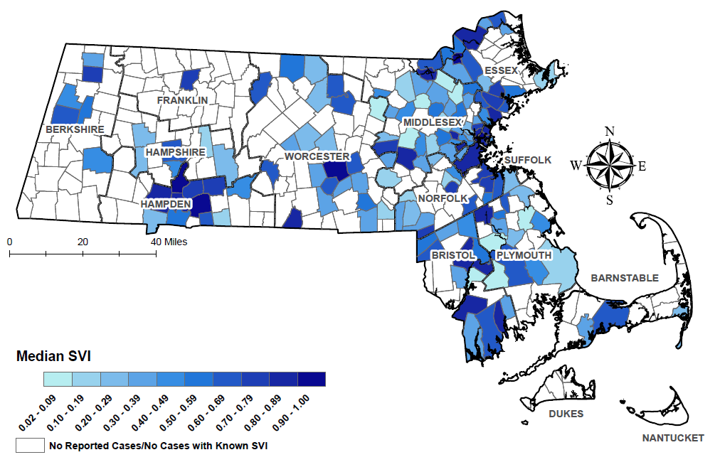
Median overall Social Vulnerability Index (SVI) by city/town for confirmed and probable infectious syphilis cases, Massachusetts 2023 ¹
¹ Please consider the impact of the COVID-19 pandemic on infectious disease screening, treatment, and surveillance in the interpretation of data from 2020 to 2023.
Note: Census tract level overall SVI values for 2020 were obtained from the CDC/Agency for Toxic Substance and Disease Registry and assigned to all cases based on their street address at diagnosis, 58 cases were excluded from this analysis because address was unknown or the individuals were homeless. City/Town level median is calculated from the median SVI score for that city/town among infectious syphilis cases. Values range from 0 to 1, with higher values implying greater social vulnerability. Map should be interpreted with caution as it displays median SVI scores for cities/towns with one or more cases.
Data Sources: CDC/Agency for Toxic Substance and Disease, Bureau of Infectious Disease and Laboratory Sciences, data are current as of 7/22/2024 and subject to change.
Notes:
The figure is a map of Massachusetts displaying the Median overall Social Vulnerability Index (SVI) by city/town. The SVI index ranges from 00.00 to 1.00, with increasing darkness in blue color indicating higher SVI index. Cities with no reported cases are white. SVI rankings were grouped into quartiles (low, <0.25; mid low, 0.25 - <0.5; mid high, 0.5 - <0.75; high >0.75).
In 2023,¹ the median SVI score among confirmed and probable infectious syphilis cases in Massachusetts was 0.748, which is highly vulnerable.
The five cities with the highest SVI scores (i.e., the most highly vulnerable) among confirmed and probable infectious syphilis cases in 2023 were Holyoke (0.975), Chelsea (0.944), Lawrence (0.928), Springfield (0.917), and Worcester (0.906).
¹ Please consider the impact of the COVID-19 pandemic on infectious disease screening, treatment, and surveillance in the interpretation of data from 2020 to 2023.

Slide 15
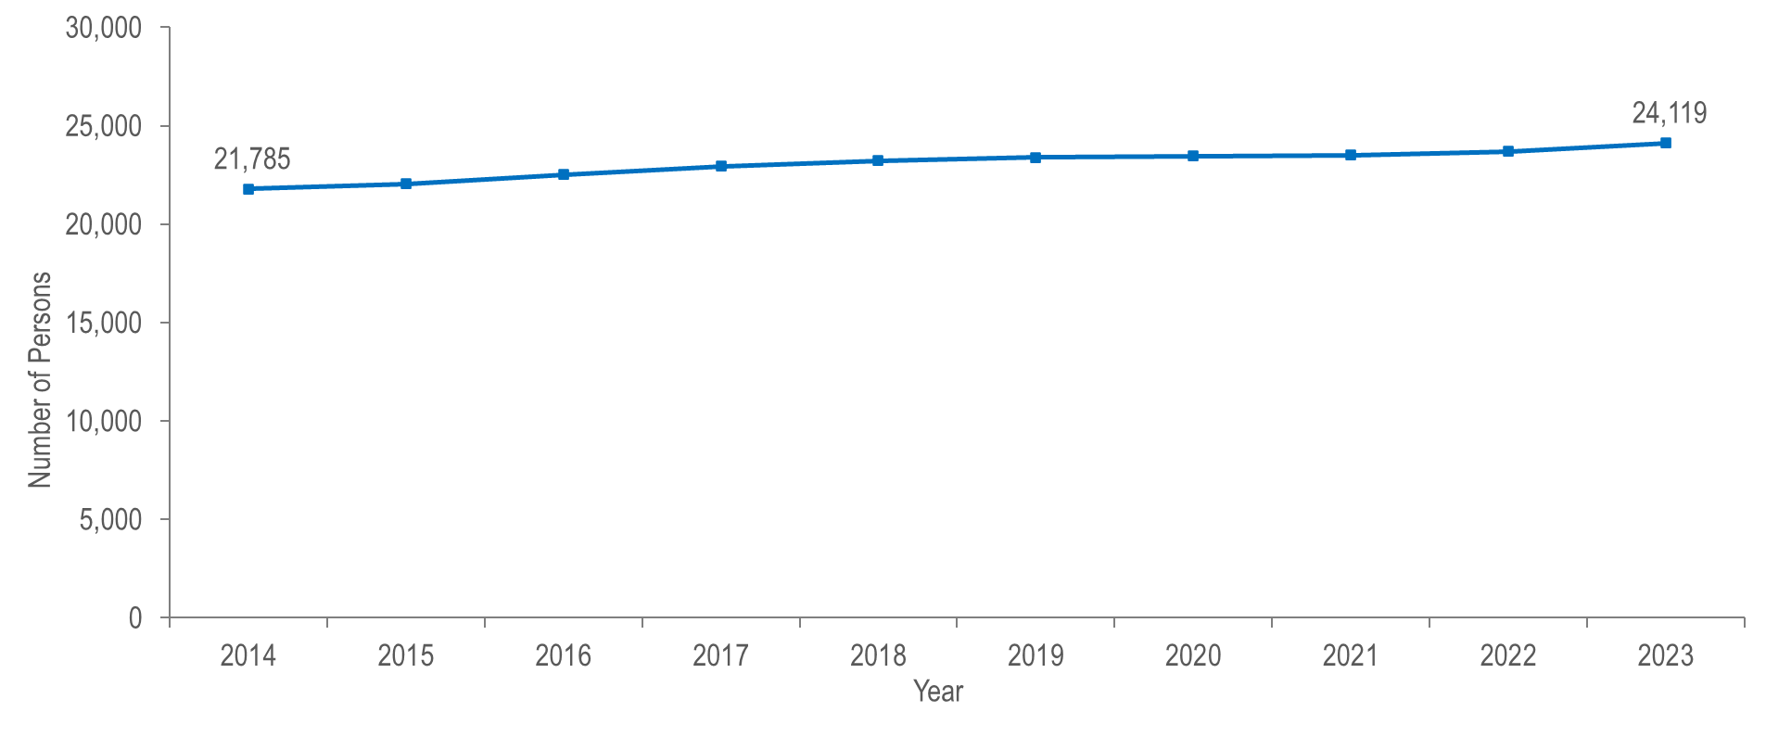
Number of persons living with HIV infection, Massachusetts 2014–2023 ¹
¹ Please consider the impact of the COVID-19 pandemic on infectious disease screening, treatment, and surveillance in the interpretation of data from 2020 to 2023.
Note: 2023 HIV prevalence data are preliminary and subject to change.
Data Source: Bureau of Infectious Disease and Laboratory Sciences, data are current as of 7/1/2024 and subject to change
Notes:
The figure is a trendline displaying the annual number of individuals living with HIV infection from 2014 (N=21,785) to 2023 (N=24,119).
The number of persons living with HIV infection (PLWH) in Massachusetts increased by 11% from 21,785 at the end of 2014 to 24,119 at the end of 2023.^{2,3}
² Please consider the impact of the COVID-19 pandemic on infectious disease screening, treatment, and surveillance in the interpretation of data from 2020 to 2023.
³ 2023 HIV prevalence data are preliminary and subject to change.

Slide 16
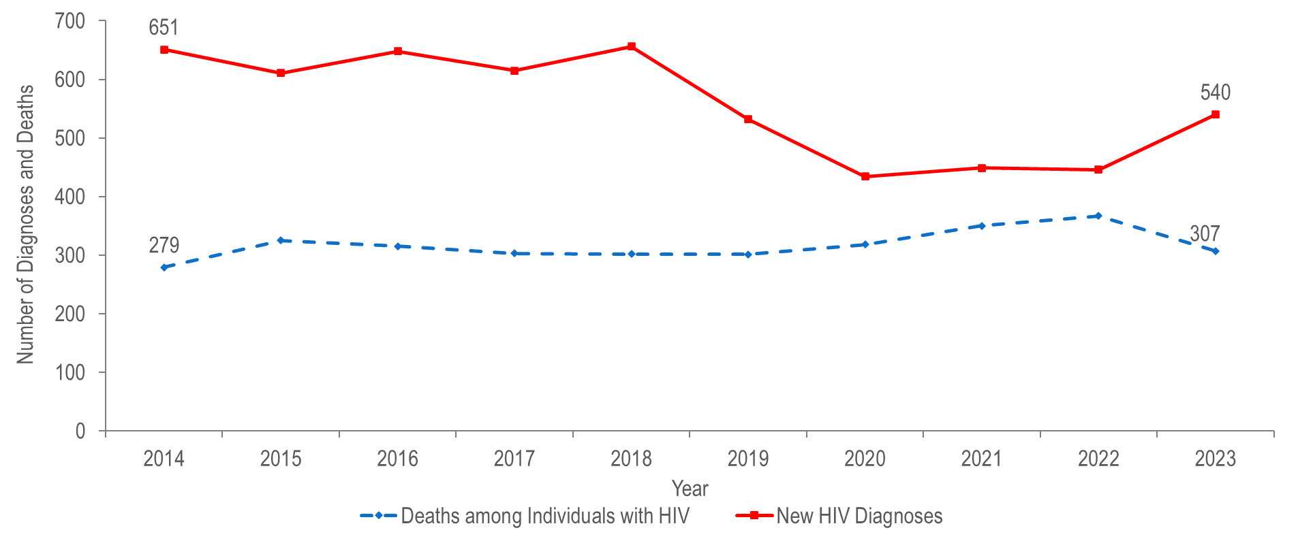
Number of HIV infection diagnoses and deaths from any cause among persons with HIV, Massachusetts 2014–2023 ¹
¹ Please consider the impact of the COVID-19 pandemic on infectious disease screening, treatment, and surveillance in the interpretation of data from 2020 to 2023.
Data Source: Bureau of Infectious Disease and Laboratory Sciences, data are current as of 7/1/2024 and subject to change
Notes:
The figure is a trendline displaying annual changes in the number of new HIV diagnoses and the number of deaths among individuals with HIV for the ten-year period.
After averaging approximately 640 diagnoses per year from 2014 to 2018 (five-year average = 636), the number of new HIV infection diagnoses declined to 532 in 2019. In 2020, the number of new HIV infection diagnoses further declined to 434 and then remained at this lower level in 2021 and 2022, when there were 449 and 446 diagnoses, respectively. In 2023, the number of new HIV infection diagnoses (N=540) returned to pre-pandemic levels, increasing by 94 diagnoses, or 21%, compared to the prior year. By exposure mode, the largest increase in HIV diagnoses from 2022 to 2023 was among individuals with male-to-male sex (MSM) exposure mode (by 59 diagnoses, from 168 to 227), followed by presumed heterosexual (by 23 diagnoses, from 59 to 82), and no identified risk (NIR) (by 17 diagnoses, from 134 to 151) exposure modes.¹
The number of deaths due to any cause among individuals reported with HIV infection increased by 32% from 279 in 2014 to a peak of 367 in 2022, and then decreased by 16% to 307 in 2023.
¹ Please consider the impact of the COVID-19 pandemic on infectious disease screening, treatment, and surveillance in the interpretation of data from 2020 to 2023.

Slide 17
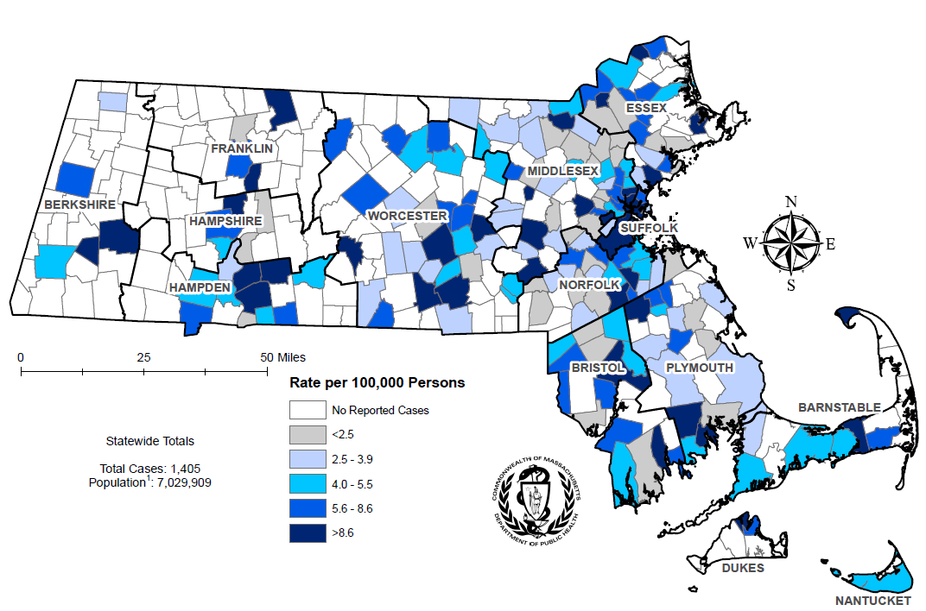
Average annual rate of HIV diagnosis per 100,000 population¹ by city/town, Massachusetts 2021–2023 ²
¹ Population based on University of Massachusetts Donahue Institute Estimates.
² Please consider the impact of the COVID-19 pandemic on infectious disease screening, treatment, and surveillance in the interpretation of data from 2020 to 2023.
Note: regional HIV data exclude individuals diagnosed in a correctional facility.
Data Source: Bureau of Infectious Disease and Laboratory Sciences, data are current as of 7/1/2024 and subject to change
Notes:
The figure is a rate map of Massachusetts displaying the average annual rate of diagnosis per 100,000 population by city/town. Cities and towns are in one of six categories: no reported cases, less than 2.5 per 100,000, 2.5-3.9 per 100,000, 4.0-5.5 per 100,000, 5.6-8.6 per 100,000, or greater than 8.6 per 100,000.
The cities and towns² with the highest average annual rate of HIV infection diagnosis during 2021 to 2023³ included Brockton (23.7 per 100,000), Boston (17.3), Chelsea (17.2), Malden (14.6), and Lynn (14.5).
Boston had the highest number of new HIV infection diagnoses from 2021–2023 (N=351), followed by Brockton (N=75), and Worcester (N=70).
² Among cities that reported at least 12 HIV infections during 2021-2023. City/town is based on residence at HIV infection diagnosis and excludes individuals diagnosed in a correctional facility.
³ Please consider the impact of the COVID-19 pandemic on infectious disease screening, treatment, and surveillance in the interpretation of data from 2020 to 2023.

Slide 18
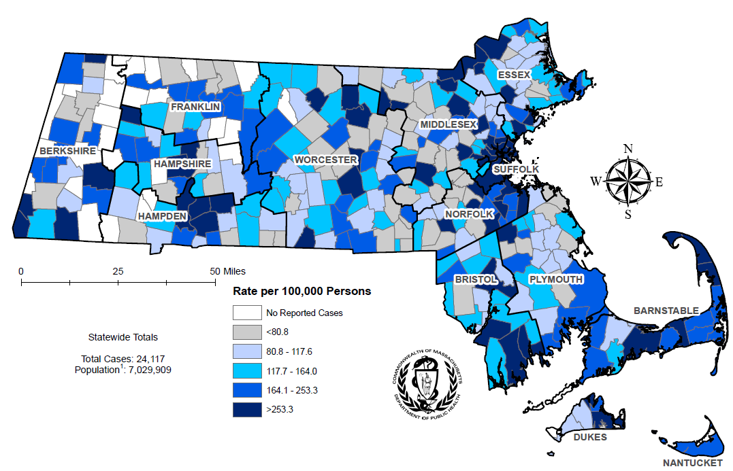
Prevalence rate of persons living with HIV infection (PLWH) per 100,000 population¹ by city/town, Massachusetts 2023 ²
¹ Population based on University of Massachusetts Donahue Institute Estimates.
² Please consider the impact of the COVID-19 pandemic on infectious disease screening, treatment, and surveillance in the interpretation of data from 2020 to 2023.
Note: regional HIV data may include PLWH who may have been incarcerated in 2023.
Data Source: Bureau of Infectious Disease and Laboratory Sciences, data are current as of 7/1/2024 and subject to change
Notes:
The figure is a rate map of Massachusetts displaying the HIV prevalence rate per 100,000 population by city/town. Cities and towns are in one of six categories: no reported cases, less than 80.8 per 100,000, 80.8-117.6 per 100,000, 117.7-164.0 per 100,000, 164.1-253.3 per 100,000, or greater than 253.3 per 100,000.
The cities and towns² with the highest prevalence rate of PLWH in 2023³ included Provincetown (12,259.0 per 100,000), Shirley (847.8), Springfield (845.9), Boston (836.4), and Ayer (790.2).⁴
Boston and Springfield had the highest numbers of PLWH in 2023, at 5,651 and 1,319, respectively.
² Among cities that reported at least 50 PLWH in 2023. City/town is based on residence at HIV infection diagnosis and may include PLWH who may have been incarcerated in 2023.
³ Please consider the impact of the COVID-19 pandemic on infectious disease screening, treatment, and surveillance in the interpretation of data from 2020 to 2023.
⁴ The rates of HIV prevalence for Provincetown, Shirley, and Ayer are high because of small population sizes (3,663, 7,431, and 8,479, respectively), as opposed to the number of cases (449, 63, and 67, respectively). The rates of HIV prevalence in Shirley and Ayer are also high due to the inclusion of incarcerated individuals housed at Massachusetts Correctional Institute (MCI) Shirley and Federal Medical Center (FMC) Devens, respectively.

Slide 19
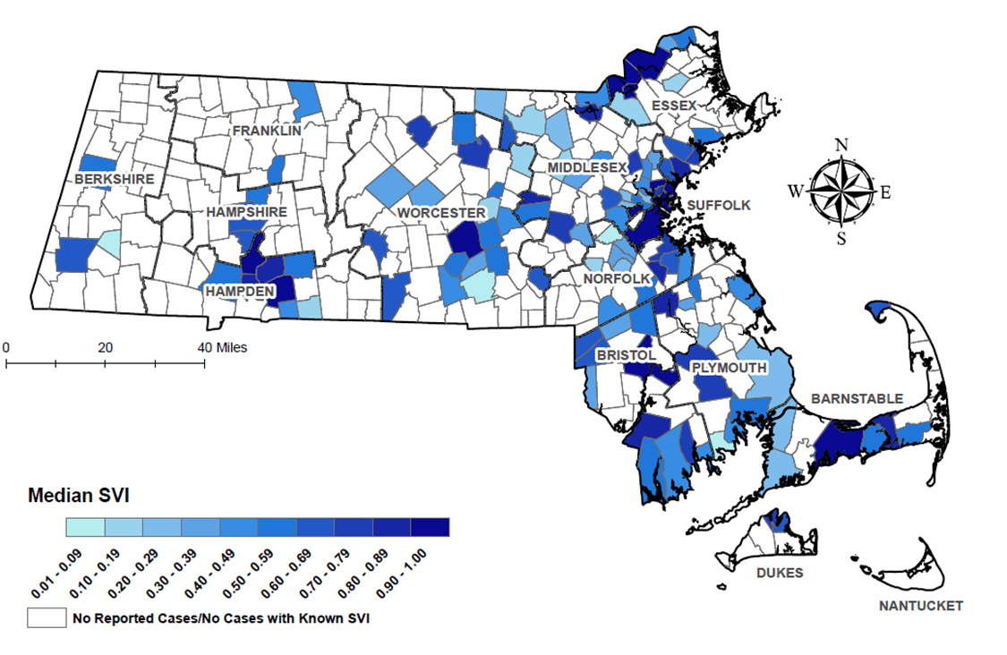
Median overall Social Vulnerability Index (SVI) by city/town for HIV infection diagnoses, Massachusetts 2023 ¹
¹ Please consider the impact of the COVID-19 pandemic on infectious disease screening, treatment, and surveillance in the interpretation of data from 2020 to 2023. Note: Census tract level overall SVI values for 2020 were obtained from the CDC/Agency for Toxic Substance and Disease Registry and assigned to all cases based on their street address at diagnosis, 49 cases were excluded from this analysis because address was unknown or the individuals were homeless. City/Town level median is calculated from the median SVI score for that city/town among HIV infection diagnoses. Values range from 0 to 1, with higher values implying greater social vulnerability. Map should be interpreted with caution as it displays median SVI scores for cities/towns with one or more cases. Data Sources: CDC/Agency for Toxic Substance and Disease, Bureau of Infectious Disease and Laboratory Sciences, data are current as of 7/1/2024 and subject to change.
Notes:
The figure is a map of Massachusetts displaying the Median overall Social Vulnerability Index (SVI) by city/town. The SVI index ranges from 00.00 to 1.00, with increasing darkness in blue color indicating higher SVI index. Cities with no reported cases are marked with cross-hatch.
SVI rankings were grouped into quartiles (low, <0.25; mid low, 0.25 - <0.5; mid high, 0.5 - <0.75; high >0.75).
In 2023, the median SVI score among HIV infection diagnoses in Massachusetts was 0.797, which equates to highly vulnerable.²
The five cities with the highest SVI scores (i.e., the most highly vulnerable) among HIV infection diagnoses in 2023 were Haverhill (0.983), Lawrence (0.936), Taunton (0.934), Malden (0.929), and Holyoke (0.926).
² SVI rankings were grouped into quartiles (low, <0.25; mid low, 0.25 - <0.5; mid high, 0.5 - <0.75; high >0.75).

Slide 20
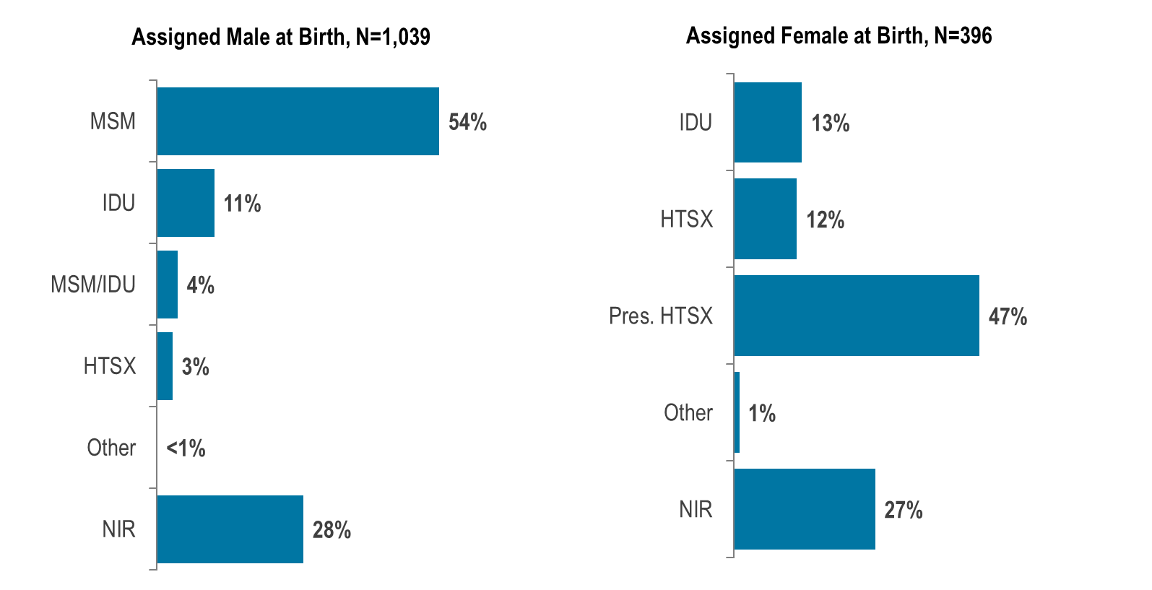
Percentage of HIV infection diagnoses by sex assigned at birth ¹ and exposure mode, Massachusetts 2021–2023 ²
¹ Data reflect sex assigned at birth and therefore not gender identity or gender expression of transgender individuals.
² Please consider the impact of the COVID-19 pandemic on infectious disease screening, treatment, and surveillance in the interpretation of data from 2020 to 2023. MSM=male-to-male sex; IDU=injection drug use; HTSX=heterosexual sex; Pres. HTSX=presumed heterosexual exposure, includes individuals assigned female at birth with a negative history of injection drug use who report having sex with an individual that identifies as male of unknown HIV status and risk; NIR=no identified risk; Data Source: Bureau of Infectious Disease and Laboratory Sciences, data are current as of 7/1/2024 and subject to change
Notes:
The figure is a set of two bar charts, one on the left displaying the distribution of individuals assigned male at birth (N=1,039) and diagnosed with HIV infection by exposure mode and the other on the right displaying the distribution of individuals assigned female at birth (N=396) and diagnosed with HIV infection by exposure mode.
From 2021 to 2023,² of the 1,435 HIV infections newly diagnosed in Massachusetts, 1,039 (72%) were among individuals assigned male at birth (AMAB) and 396 (28%) were among individuals assigned female at birth (AFAB). Among the 1,435 HIV infections, 18 (1%) were among individuals of transgender experience,³ and 1,417 (99%) were among cisgender individuals.⁴
From 2021 to 2023, the most frequently reported known exposure mode among individuals AMAB was male-to-male sex (54%) and among individuals AFAB was presumed heterosexual sex⁵ (47%). A substantial proportion of diagnoses among both individuals AMAB and AFAB were reported with no identified risk (28% and 27%, respectively).
Among individuals AMAB, the proportion of HIV infection diagnoses with injection drug use (IDU) exposure mode increased from a low of 4% (N=19/486) in 2014 to 17% (N=76/456) in 2017, decreased to 9% (N=34/392) in 2019, increased to 18% in 2021 (N=55/314), and then decreased again to 6% (N=25/397) in 2023.
Among individuals AFAB, the proportion of HIV infection diagnoses with IDU exposure mode increased from a low of 7% (N=12/165) in 2014 to 25% (N=40/159) in 2017, decreased to 18% (N=25/140) in 2019, increased to 22% in 2020 (N=27/121), and then decreased again to 9% (N=13/143) in 2023.
¹ Data reflect sex assigned at birth and therefore not gender identity or gender expression of transgender individuals.
² Please consider the impact of the COVID-19 pandemic on infectious disease screening, treatment, and surveillance in the interpretation of data from 2020 to 2023.
³ Please note reported numbers among individuals of transgender experience and individuals who are nonbinary are likely to be underestimates, for more information see Interpreting HIV, STI, and Viral Hepatitis Data.
⁴ Persons whose current gender identity corresponds with their sex assigned at birth.
⁵ Presumed heterosexual exposure includes individuals assigned female at birth with a negative history of injection drug use who report having sex with an individual that identifies as male of unknown HIV status and risk.

Slide 21
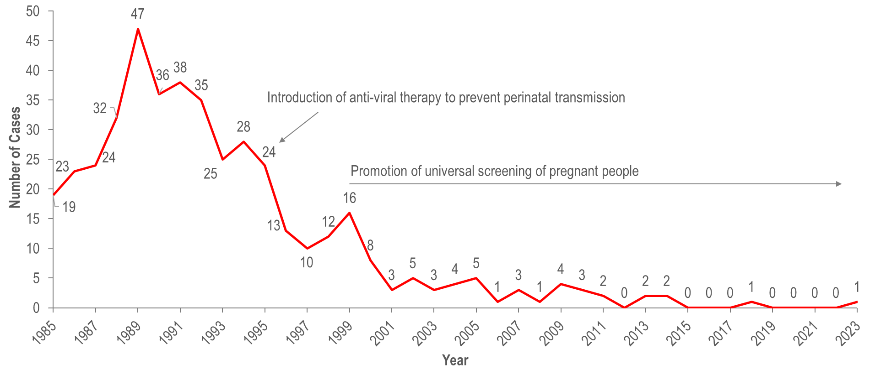
Number of reported cases of perinatal transmission of HIV infection, by year of birth, Massachusetts 1985–2023 ¹
¹ Please consider the impact of the COVID-19 pandemic on infectious disease screening, treatment, and surveillance in the interpretation of data from 2020 to 2023.
Data Source: Bureau of Infectious Disease and Laboratory Sciences, data are current as of 7/1/2024 and subject to change
Notes:
The figure is a trendline graph displaying changes in the annual number of cases of perinatal transmission of HIV infection each year from 1985 to 2023 by year of birth. The text, “Introduction of anti-viral therapy to prevent perinatal transmission” has an arrow indicating that this happened in the year 1995 and the text “Promotion of universal screening of pregnant people” has a long arrow indicating that this began in 1999.
Since the mid-1990s, there has been a dramatic reduction in perinatal transmission of HIV infection related to high rates of antiretroviral treatment of HIV positive people and promotion of HIV screening during pregnancy.
There were only two cases identified in the past nine years (one in 2018 and one in 2023).

Slide 22
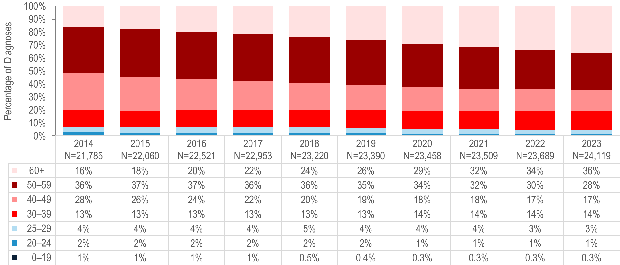
Percentage distribution of individuals living with HIV infection by age on December 31, Massachusetts 2014–2023 ¹
¹ Please consider the impact of the COVID-19 pandemic on infectious disease screening, treatment, and surveillance in the interpretation of data from 2020 to 2023.
Data Source: Bureau of Infectious Disease and Laboratory Sciences, data are current as of 7/1/2024 and subject to change
Notes:
The figure is a stacked bar chart displaying the percentage distribution of persons living with HIV infection by age (0-19, 20-24, 25-29, 30-39, 40-49, 50-59, 60+ years) for each year of the ten-year period.
Because of effective HIV treatment, people diagnosed with HIV infection are living longer, healthier lives. The proportion of people living with HIV infection who were aged 60 years or older increased from 16% on December 31, 2014 to 36% on December 31, 2023.^{1,2}
¹ Please consider the impact of the COVID-19 pandemic on infectious disease screening, treatment, and surveillance in the interpretation of data from 2020 to 2023.
² 2023 HIV prevalence data are preliminary and subject to change.

Slide 23
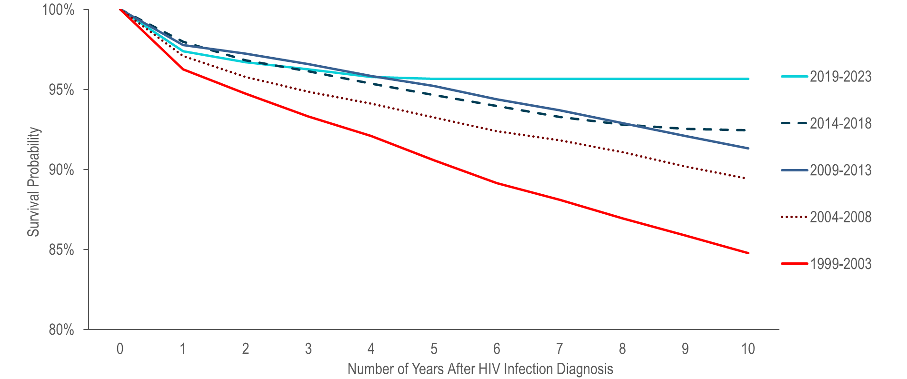
Ten-year survival probability among individuals with HIV infection by year of diagnosis, Massachusetts 1999–2023
(Total number of HIV diagnoses from 1999–2023, N=18,618) ¹
¹ Please consider the impact of the COVID-19 pandemic on infectious disease screening, treatment, and surveillance in the interpretation of data from 2020 to 2023.
Please note that actual ten-year survival is only available for individuals diagnosed in 2014 in the 2014–2018 cohort and not available for any individuals diagnosed in the most recent cohort (2019–2023).
Data Source: Bureau of Infectious Disease and Laboratory Sciences, data are current as of 7/1/2024 and subject to change
Notes:
The figure is a trendline that displays the percent of individuals alive less than 1 – 10 years after HIV infection diagnosis for 5 cohorts by year of HIV infection diagnosis: 1999-2003, 2004-2008, 2009-2013, 2014-2018, 2019-2023.
Survival of individuals diagnosed with HIV infection has increased over time. In the earliest cohort of HIV infection diagnoses (1999–2003), estimated survival at ten years after HIV infection diagnosis was 85%, compared to 89% among individuals diagnosed from 2004–2008, 91% among individuals diagnosed from 2009–2013, and 93% among individuals diagnosed from 2014–2018, and 96% among individuals diagnosed from 2019–2023.¹
¹ Please note that actual ten-year survival is only available for individuals diagnosed in 2014 in the 2014–2018 cohort and not available for any individuals diagnosed in the most recent cohort (2019–2023).

Slide 24
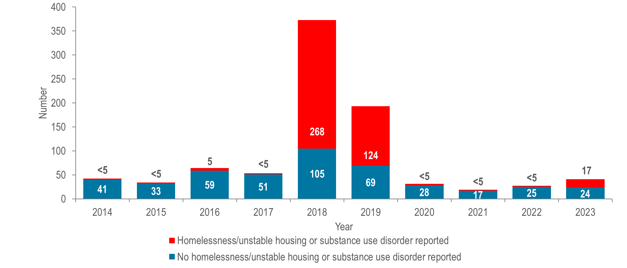
Number of hepatitis A cases reported by year, housing status, and presence of substance use disorder, Massachusetts 2014–2023 ¹
¹ Please consider the impact of the COVID-19 pandemic on infectious disease screening, treatment, and surveillance in the interpretation of data from 2020 to 2023.
Data Source: Bureau of Infectious Disease and Laboratory Sciences, data are current as of 7/17/2024 and subject to change
Notes:
The figure is a stacked bar chart displaying the number of hepatitis A cases reported each year of the ten-year period by housing status (homelessness/unstable housing) and presence of substance use disorder. The number of cases each year with homelessness/unstable housing or substance use disorder reported verses those with no homelessness/unstable housing or substance use disorder reported is displayed.
Between 2018 and 2020, the Massachusetts Department of Public Health (DPH) and local health departments investigated an outbreak of hepatitis A. The populations most affected by the outbreak were those reported with recent homelessness or unstable housing, and/or substance use disorder, accounting for 72% (N=268/373) and 64% (N=124/193) of cases in 2018 and 2019, respectively. DPH partnered with clinical and community-based providers to implement a hepatitis A (HAV) vaccination response by deploying mobile vaccination providers to shelters, correctional facilities, harm reduction programs, and outreach venues. The outbreak was declared over in spring of 2020 and case counts among individuals with homelessness/unstable housing or substance use disorder remained low through 2022. A second, smaller outbreak affecting the same populations was detected in fall 2023, prompting additional vaccination efforts.¹ This outbreak ended in May of 2024 with a total of 24 cases. DPH encourages continued vaccination of populations at high risk of acquiring hepatitis A in accordance with recommendations from the Advisory Committee on Immunization Practices.²
¹ Please consider the impact of the COVID-19 pandemic on infectious disease screening, treatment, and surveillance in the interpretation of 2020 to 2022 data.
² Nelson NP, Weng MK, Hofmeister MG, et al. Prevention of Hepatitis A Virus Infection in the United States: Recommendations of the Advisory Committee on Immunization Practices, 2020. MMWR Recomm Rep 2020;69(No. RR-5):1–38. DOI: http://dx.doi.org/10.15585/mmwr.rr6905a1

Slide 25
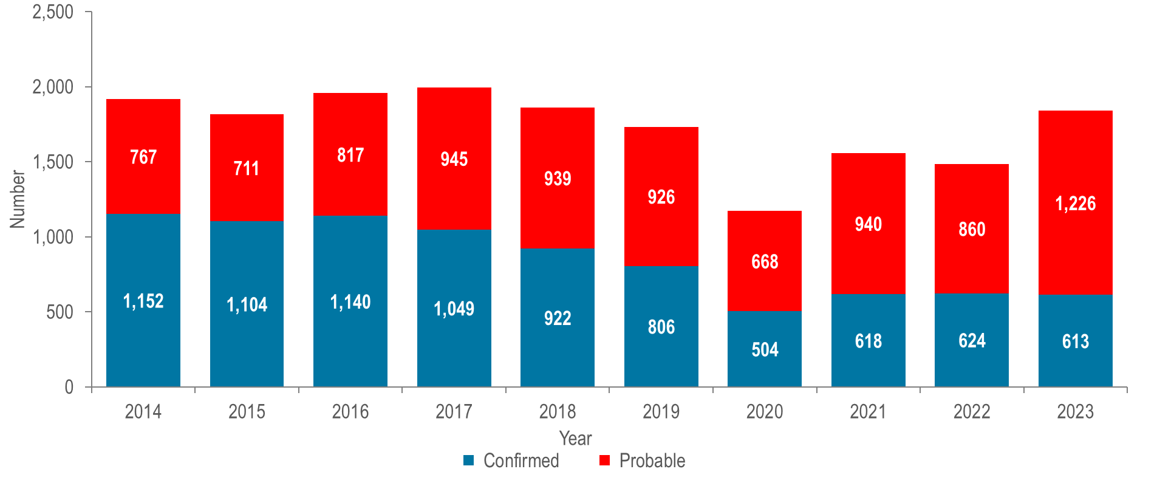
Number of confirmed and probable chronic hepatitis B cases reported by year, Massachusetts 2014–2023 ¹
¹ Please consider the impact of the COVID-19 pandemic on infectious disease screening, treatment, and surveillance in the interpretation of data from 2020 to 2023.
Data Source: Bureau of Infectious Disease and Laboratory Sciences, data are current as of 7/17/2024 and subject to change
Notes:
The figure is a stacked bar chart displaying the number of both confirmed and probable chronic hepatitis B cases each year for the ten-year period.
From 2014 to 2023,¹ an average of 1,733 cases of confirmed and probable chronic hepatitis B virus (HBV) infection were reported each year (with a low of 1,172 in 2020 and a high of 1,994 in 2017). Changes in testing behaviors and travel due to the COVID-19 pandemic likely influenced the number of reported cases and may contribute to the decrease in 2020, followed by the rebound from 2021 to 2023.
The surveillance case definition for chronic HBV requires two positive tests; for certain test types, these two tests must be taken at least six months apart. Reported cases are classified as "probable" following the initial test result and are re-classified as "confirmed" if additional test results are received. During the most recent year of data, 2023, some cases currently reported as probable may be eventually confirmed in future reports as additional information is obtained.²
¹ Please consider the impact of the COVID-19 pandemic on infectious disease screening, treatment, and surveillance in the interpretation of data from 2020 to 2023.
² For more information, see HIV, STI, and Viral Hepatitis Case Classifications.

Slide 26
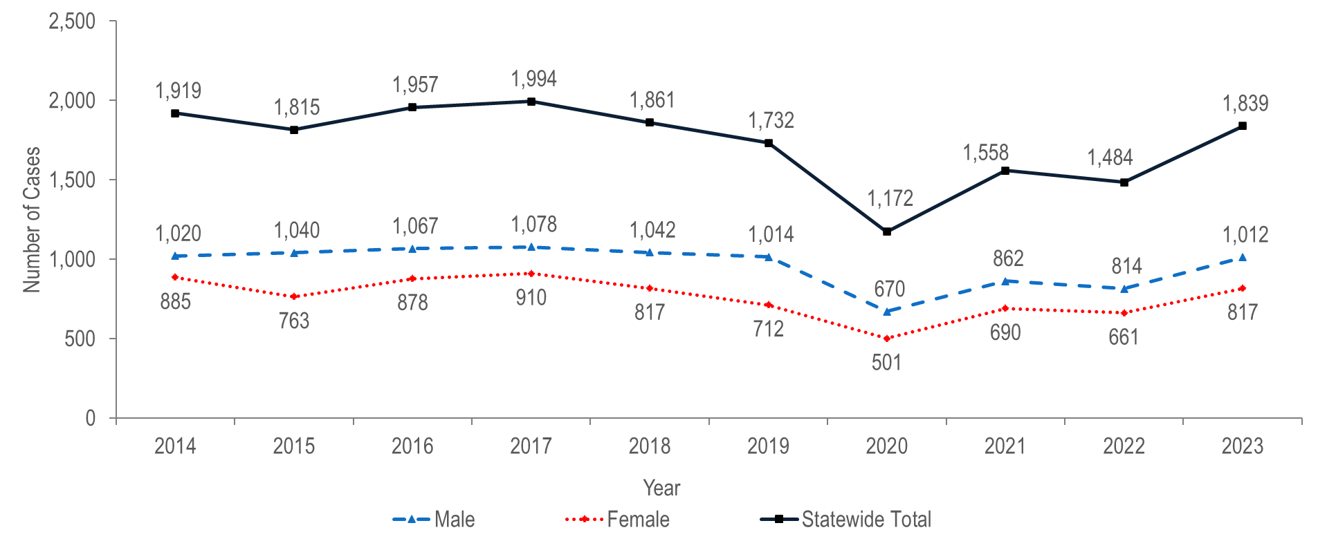
Number of confirmed and probable chronic hepatitis B cases reported by female and male gender, Massachusetts 2014–2023 ¹
¹ Please consider the impact of the COVID-19 pandemic on infectious disease screening, treatment, and surveillance in the interpretation of data from 2020 to 2023.
Note: Cases reported as transgender or missing gender (2014–2023: N=78) are included in the statewide total but are not depicted in Figure separately due to small numbers.
Data Source: Bureau of Infectious Disease and Laboratory Sciences, data are current as of 7/17/2024 and subject to change
Notes:
The figure is a trendline graph displaying the number confirmed and probable chronic hepatitis B cases for three groups (female and male gender and statewide total) for each year for the most recent ten-year period.
In 2023,¹ 1,012 (55%) cases of confirmed and probable chronic HBV infection were newly reported among males, 817 (45%) were reported among females, and fewer than five were reported among individuals of transgender experience.²
Hepatitis B in people of childbearing age is of particular concern due to the risk of transmission from pregnant person to infant at birth. Perinatal HBV transmission can be prevented by identifying HBV-positive pregnant people and providing post-exposure prophylaxis (PEP) to their infants within 12 hours of birth. The DPH Perinatal Hepatitis B Prevention Program provides case management to pregnant people who are HBV-positive and their infants to ensure appropriate PEP, vaccination, and post-vaccination serologic testing.
¹ Please consider the impact of the COVID-19 pandemic on infectious disease screening, treatment, and surveillance in the interpretation of data from 2020 to 2023.

Slide 27
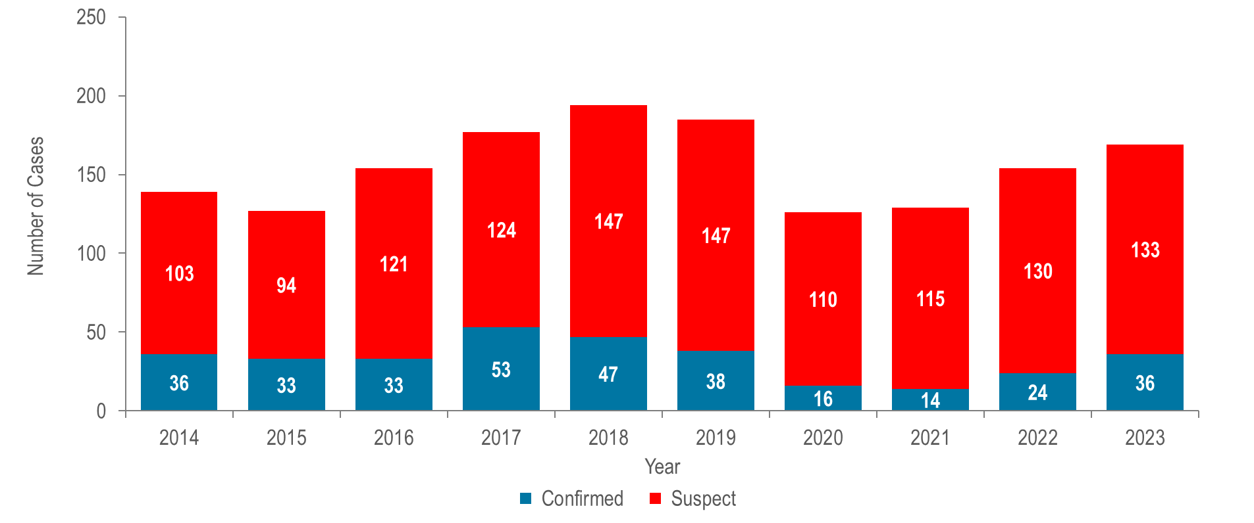
Number of confirmed and suspect acute hepatitis B cases reported by year, Massachusetts 2014–2023 ¹
¹ Please consider the impact of the COVID-19 pandemic on infectious disease screening, treatment, and surveillance in the interpretation of data from 2020 to 2023.
Data Source: Bureau of Infectious Disease and Laboratory Sciences, data are current as of 7/17/2024 and subject to change
Notes:
The figure is a stacked bar chart displaying the number of both confirmed and suspect acute hepatitis B cases each year for the most recent ten-year period.
In 2023,¹ there were 36 confirmed acute and 133 suspect acute HBV cases for a total of 169 acute cases.²
The total number of confirmed acute HBV cases reported decreased from 53 cases in 2017 to 14 cases in 2021 and subsequently increased to 36 cases in 2023.
Injection drug use (IDU) is a significant, and increasingly important, risk factor for acquisition of acute HBV infection.
¹ Please consider the impact of the COVID-19 pandemic on infectious disease screening, treatment, and surveillance in the interpretation of data from 2020 to 2023.
² Case definitions and classifications can be found in the Technical Notes.

Slide 28
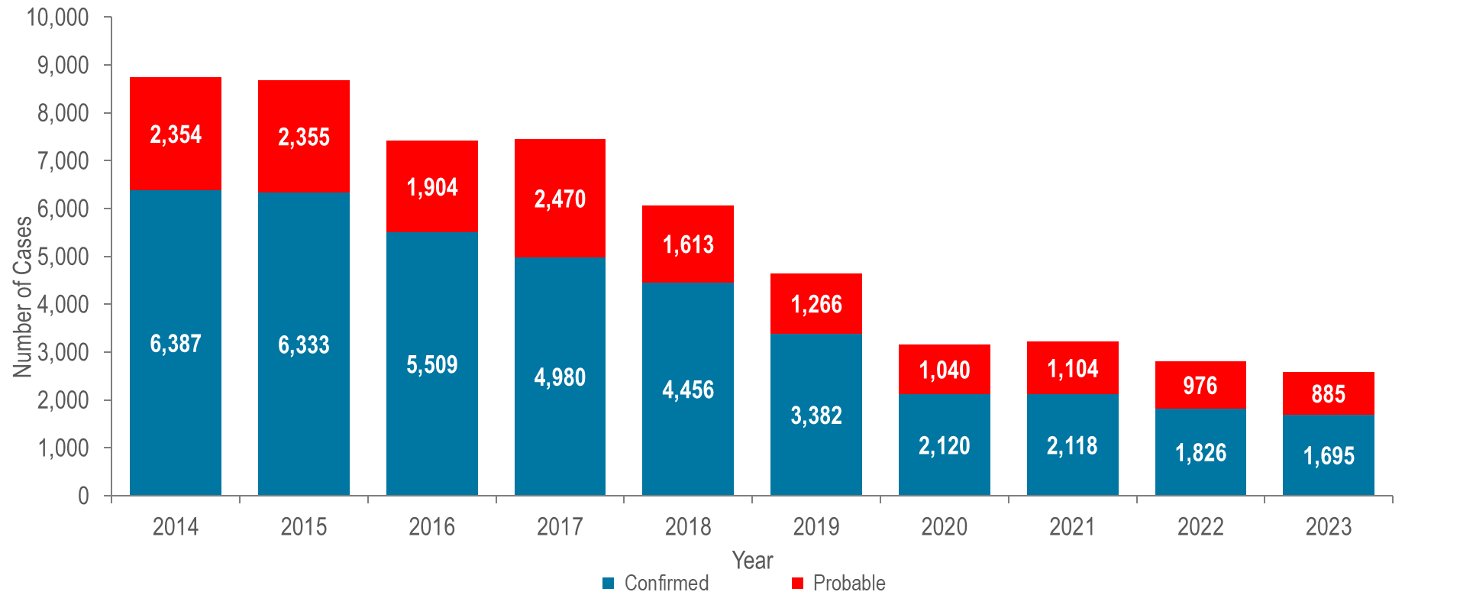
Number of confirmed and probable hepatitis C cases reported by year, Massachusetts 2014–2023 ¹
¹ Please consider the impact of the COVID-19 pandemic on infectious disease screening, treatment, and surveillance in the interpretation of data from 2020 to 2023.
Data Source: Bureau of Infectious Disease and Laboratory Sciences, data are current as of 7/31/2024 and subject to change
Notes:
The figure is a stacked bar chart displaying the number of both confirmed and probable HCV cases for each year of the most recent ten-year period.
The total number of reported confirmed and probable HCV cases decreased from 8,741 in 2014 to 2,580 in 2023.¹
Most reported cases are chronically infected and DPH currently estimates that there are over 250,000 people living with HCV infection in Massachusetts.
¹ Please consider the impact of the COVID-19 pandemic on infectious disease screening, treatment, and surveillance in the interpretation of data from 2020 to 2023.
Please note, in 2016, revised case definitions for acute and chronic HCV infection were implemented that contain significant changes from the case definitions for 2012 to 2015. For further information see https://wwwn.cdc.gov/nndss/conditions/

Slide 29
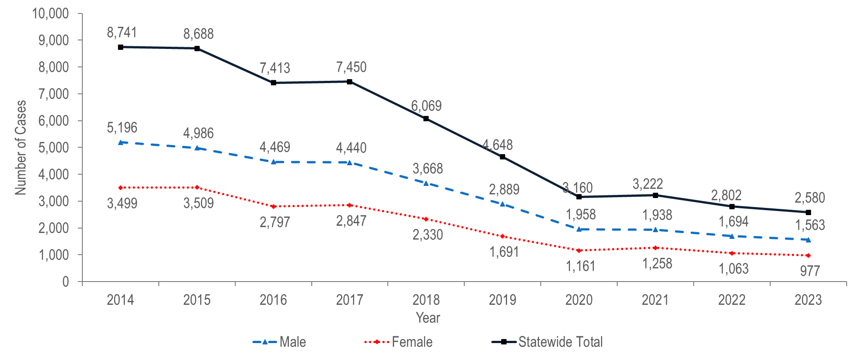
Number of confirmed and probable hepatitis C cases reported by female and male gender, Massachusetts 2014–2023 ¹
¹ Please consider the impact of the COVID-19 pandemic on infectious disease screening, treatment, and surveillance in the interpretation of data from 2020 to 2023.
Note: Cases reported as transgender or missing gender (2014–2023: N=840) are included in the statewide total but are not depicted in Figure separately due to small numbers.
Data Source: Bureau of Infectious Disease and Laboratory Sciences, data are current as of 7/31/2024 and subject to change
Notes:
The figure is a trendline graph displaying the number confirmed and probable chronic HCV cases for three groups (female and male gender and statewide total) for each year of the most recent ten-year period.
In 2023,¹ 1,563 (61%) cases of confirmed and probable HCV infection were newly reported among males, 977 (38%) were reported among females, and 40 (1%) were reported among Individuals with transgender experience or unknown gender.²
¹ Please consider the impact of the COVID-19 pandemic on infectious disease screening, treatment, and surveillance in the interpretation of data from 2020 to 2023.
² Please note reported numbers among individuals of transgender experience and individuals who are nonbinary are likely to be underestimates, for more information see Interpreting HIV, STI, and Viral Hepatitis Data.

Slide 30
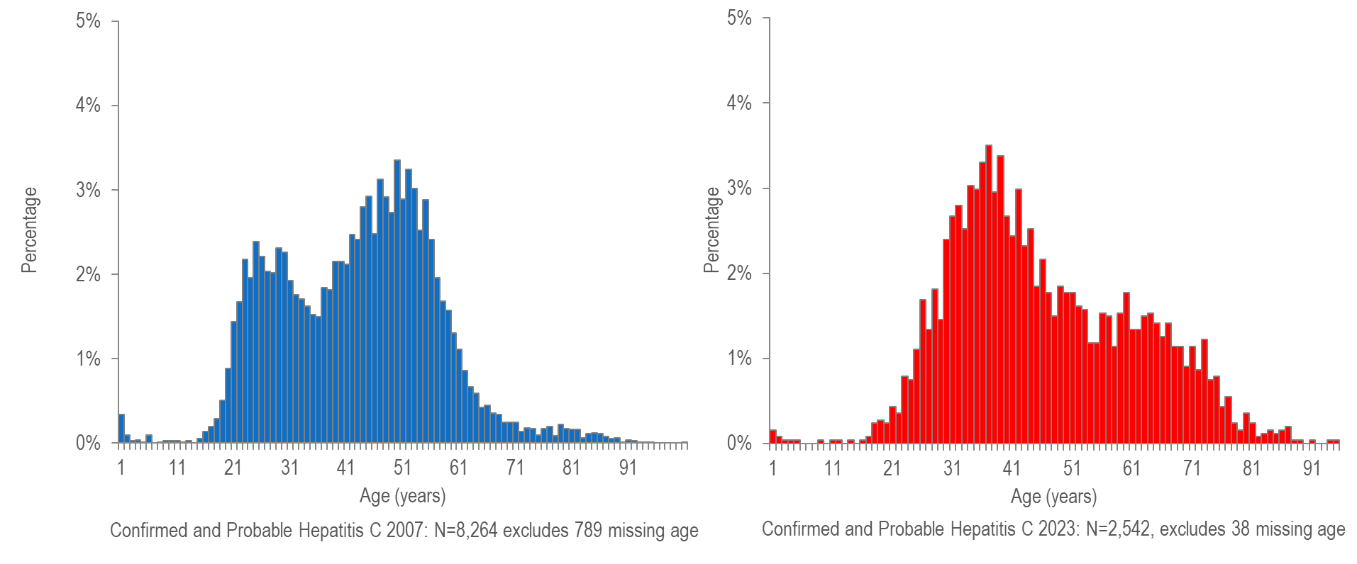
Distribution of confirmed and probable hepatitis C cases by age: 2007 versus 2023 ¹
¹ Please consider the impact of the COVID-19 pandemic on infectious disease screening, treatment, and surveillance in the interpretation of data from 2020 to 2023.
Data Source: Bureau of Infectious Disease and Laboratory Sciences, data are current as of 7/31/2024 and subject to change
Notes:
The figure is a series of two bar charts side by side displaying the percentage distribution of HCV cases by age in 2007 (N=8,264 excludes 789 missing age) on the left and 2023 on the right (N=2,542, excludes 38 missing age).
In 2007, reported cases of HCV were distributed in a curve with two age peaks, with the lower peak at age 24 years and the higher peak at age 49 years.
In 2023,¹ the reported cases were again distributed in a bi-modal curve, but with the higher peak at age 36 years, and a lower, smaller peak at 59 years, reflecting a continuing shift in the age profile of newly reported cases.
¹ Please consider the impact of the COVID-19 pandemic on infectious disease screening, treatment, and surveillance in the interpretation of data from 2020 to 2023

Slide 31
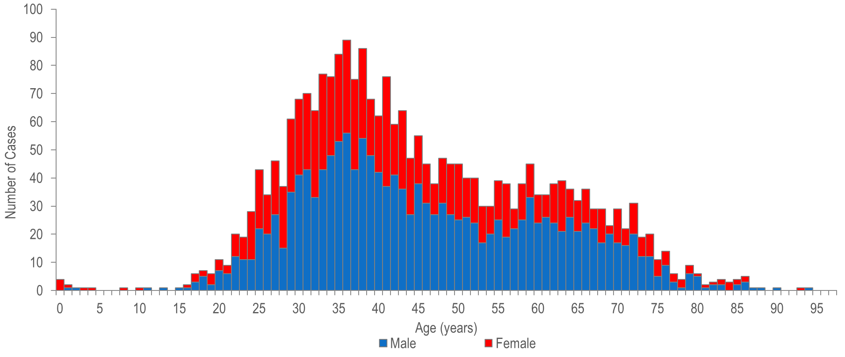
Number of confirmed and probable hepatitis C cases reported by age, and female and male gender, Massachusetts 2023 ¹
¹ Please consider the impact of the COVID-19 pandemic on infectious disease screening, treatment, and surveillance in the interpretation of data from 2020 to 2023.
Note: Confirmed and Probable HCV 2023: N=2,542, excludes 38 missing age and/or gender. Cases reported as transgender are not depicted in Figure separately due to small numbers.
Data Source: Bureau of Infectious Disease and Laboratory Sciences, data are current as of 7/31/2024 and subject to change.
Notes:
The figure is a stacked bar chart displaying the number of both male and female HCV cases reported at each age from 0 to 95 years.
In 2023,¹ 1,563 (61%) confirmed and probable HCV cases were reported among males, 977 (38%) were reported among females, and fewer than five were reported among individuals of transgender experience.²
Fifty-three percent (N=182/343) of confirmed and probable HCV infection cases in those less than 30 years of age were reported among males, 47% (N=161/343) were reported among females, and none were reported among individuals of transgender experience.
For newly reported HCV infections among persons less than 30 years of age with a known risk history, injection drug use was the most commonly reported risk factor for infection.
¹ Please consider the impact of the COVID-19 pandemic on infectious disease screening, treatment, and surveillance in the interpretation of data from 2020 to 2023.

Slide 32
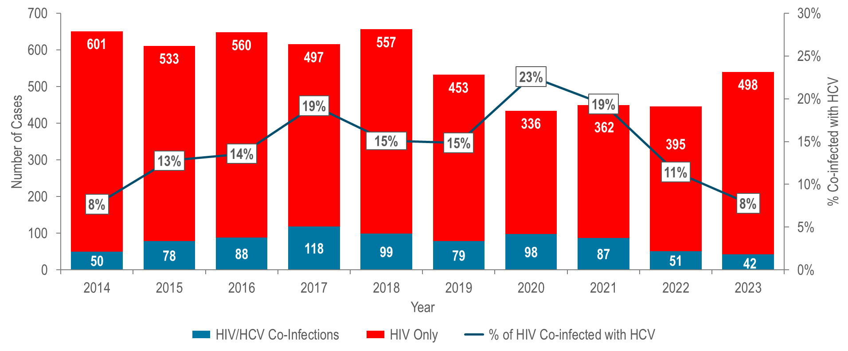
Number of individuals diagnosed with HIV infection only, and ever co-infected with hepatitis C by year of HIV infection diagnosis,
Massachusetts 2014–2023 ¹
¹ Please consider the impact of the COVID-19 pandemic on infectious disease screening, treatment, and surveillance in the interpretation of data from 2020 to 2023.
Data Source: Bureau of Infectious Disease and Laboratory Sciences, data are current as of 7/1/2024 and subject to change
Notes:
The figure is a stacked bar chart displaying the number of individuals diagnosed with HIV infection only and the number of individuals co-diagnosed with HIV infection and HCV each year from 2014 to 2023. An overlayed trendline displays the percentage of HIV infection diagnoses that were co-infected with HCV by year.
The percentage of individuals diagnosed with HIV infection who were co-infected with HCV increased from 8% (N=50/651) in 2014 to 19% (N=118/615) in 2017, decreased to 15% in 2018 (N=99/656), increased again to a ten-year high of 23% (N=98/434) in 2020 and then decreased to 8% (N=42/540) in 2023.^{1,2} This trend mirrors that among HIV infection diagnoses with a primary exposure mode of injection drug use and is likely related to two outbreaks of HIV infection among persons who inject drugs. The first outbreak occurred from 2016 to 2018 in the northeastern part of the state and the second was identified in 2019 in the Boston area and is still ongoing (see Specific Populations – Persons Who Inject Drugs for more information).
¹ Total number of annual HIV diagnoses now excludes those first diagnosed in another state. Previously, all HIV diagnoses, including those first made in another state, were included in the co-infection analysis.
² Please consider the impact of the COVID-19 pandemic on infectious disease screening, treatment, and surveillance in the interpretation of data from 2020 to 2023.

Slide 33
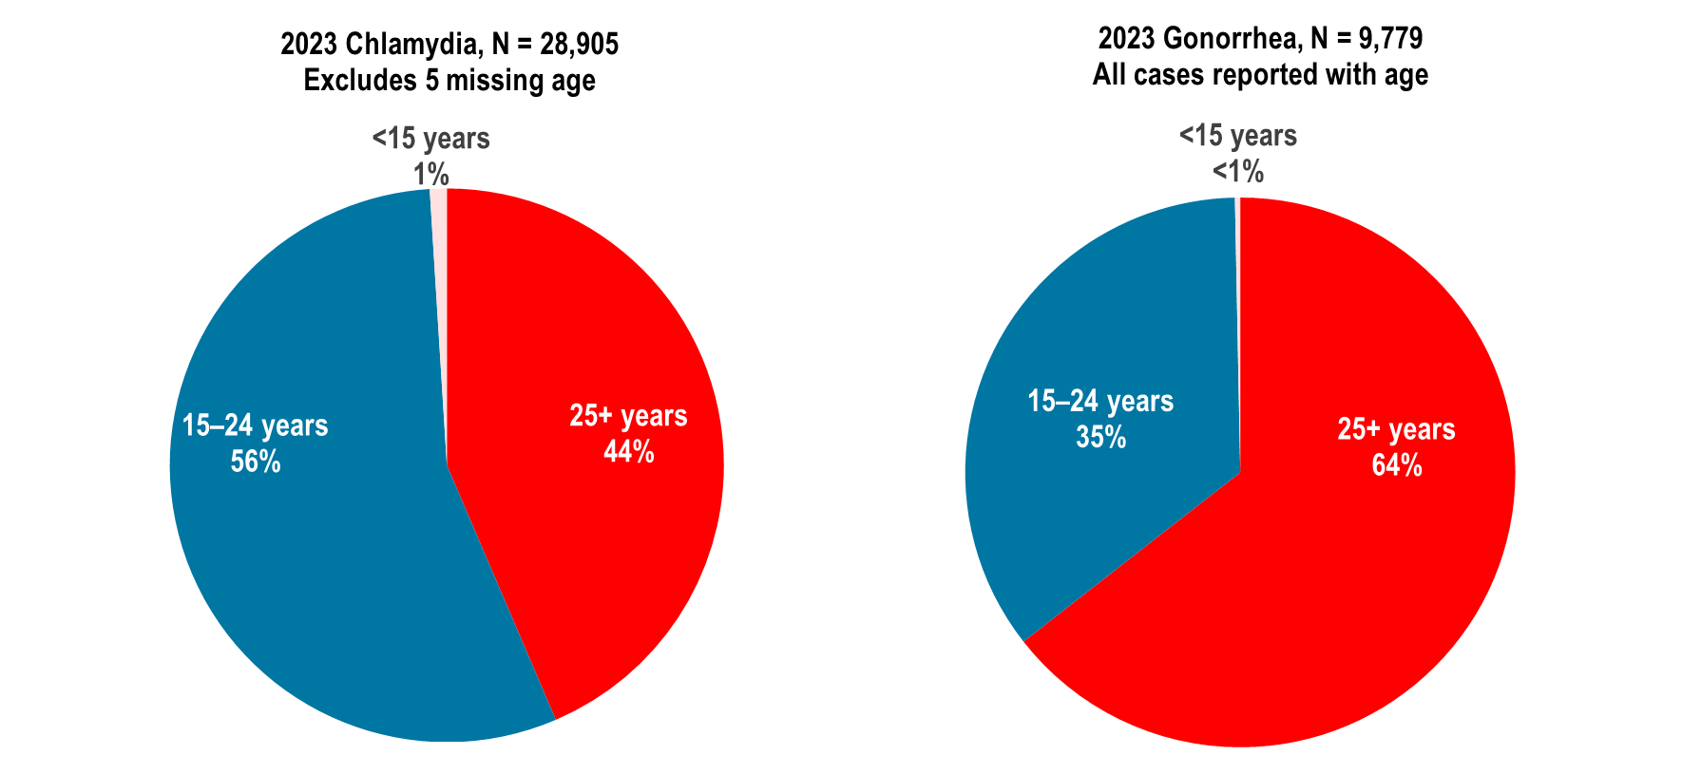
Distribution of confirmed chlamydia and gonorrhea cases reported by age group (years), Massachusetts 2023 ¹
¹ Please consider the impact of the COVID-19 pandemic on infectious disease screening, treatment, and surveillance in the interpretation of data from 2020 to 2023.
Data Source: Bureau of Infectious Disease and Laboratory Sciences, data are current as of 7/22/2024 and subject to change
Notes:
The figure is a set of two side by side pie charts displaying the distribution by age group (15-24 or 25+) for 2023 chlamydia cases (N = 28,905 Excludes 5 missing age) on the left and 2023 gonorrhea cases (N = N = 9,779 All cases reported with age) on the right.
In 2023,¹ in Massachusetts, 56% of chlamydia cases and 35% of gonorrhea cases were reported among adolescents and young adults aged 15–24 years.
Nationally, 58% of chlamydia cases and 40% of gonorrhea cases were reported among adolescents and young adults aged 15–24 years in 2022.²
¹ Please consider the impact of the COVID-19 pandemic on infectious disease screening, treatment, and surveillance in the interpretation of data from 2020 to 2023.
² Centers for Disease Control and Prevention. Sexually Transmitted Infections Surveillance 2022. Atlanta: U.S. Department of Health and Human Services; 2024. National percentages among 15-24 year-olds also exclude cases of unknown age for comparability with Massachusetts percentages. Please note, 2022 percentages are presented because 2023 percentages by age were not yet available at the time of this publication.

Slide 34
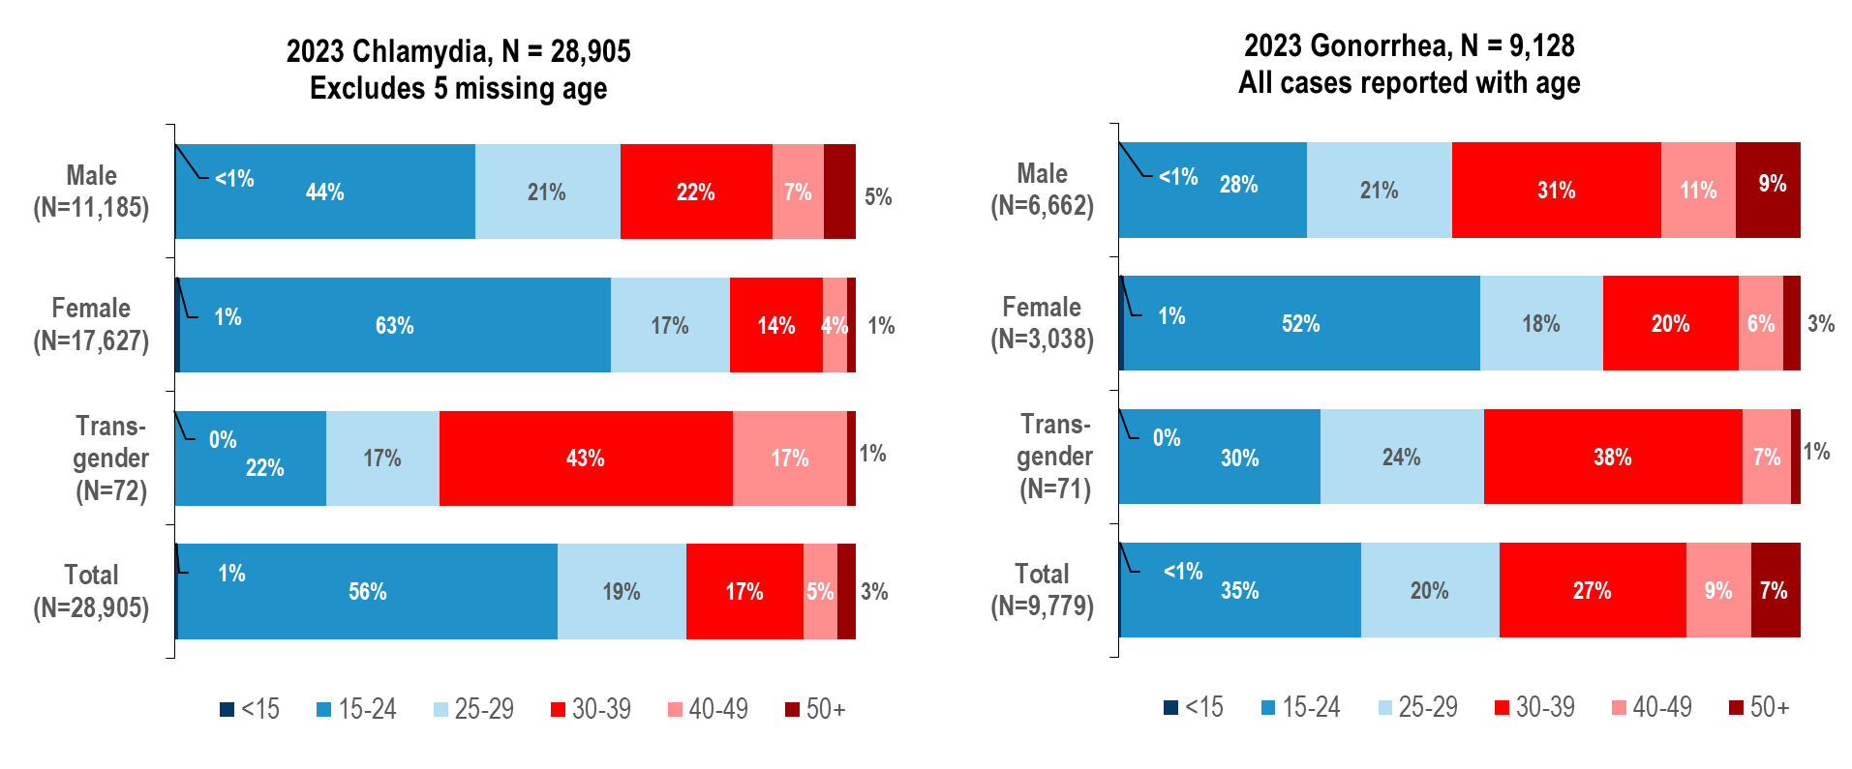
Distribution of confirmed chlamydia and gonorrhea cases reported by age group (years) and gender, Massachusetts 2023 ¹
¹ Please consider the impact of the COVID-19 pandemic on infectious disease screening, treatment, and surveillance in the interpretation of data from 2020 to 2023.
Data Source: Bureau of Infectious Disease and Laboratory Sciences, data are current as of 7/22/2024 and subject to change
Notes:
The figure is a series of two stacked bar charts displaying the distribution by age group (<15,15-24, 25-29, 30-39, 40-49, 50+) for four groups (male gender, female gender, transgender, and total) for chlamydia cases on the left and gonorrhea cases on the right for the most recent year.
In 2023,¹ in Massachusetts, 44% of chlamydia cases reported among males, 63% among females, 22% among individuals of transgender experience,² and 56% of total cases were reported among adolescents and young adults aged 15–24 years.
Nationally in 2022, 46% of chlamydia cases reported among males, 65% among females, and 58% of total cases were reported among adolescents and young adults aged 15–24 years.²
In 2023, in Massachusetts, 28% of gonorrhea cases reported among males, 52% among females, 30% among individuals of transgender experience, and 35% of total cases were reported among adolescents and young adults aged 15–24 years.
Nationally in 2022, 32% of gonorrhea cases reported among males, 53% among females, and 40% of total cases were reported among adolescents and young adults aged 15–24 years.³
¹ Please consider the impact of the COVID-19 pandemic on infectious disease screening, treatment, and surveillance in the interpretation of data from 2020 to 2023
² Please note reported numbers among individuals of transgender experience and individuals who are nonbinary are likely to be underestimates, for more information see Interpreting HIV, STI, and Viral Hepatitis Data.
³ Centers for Disease Control and Prevention. Sexually Transmitted Infections Surveillance 2022. Atlanta: U.S. Department of Health and Human Services; 2024. National percentages among 15-24 year-olds also exclude cases of unknown age for comparability with Massachusetts percentages. Please note, 2022 national data are presented because 2023 data by age and gender were not yet available at the time of this publication.

Slide 35
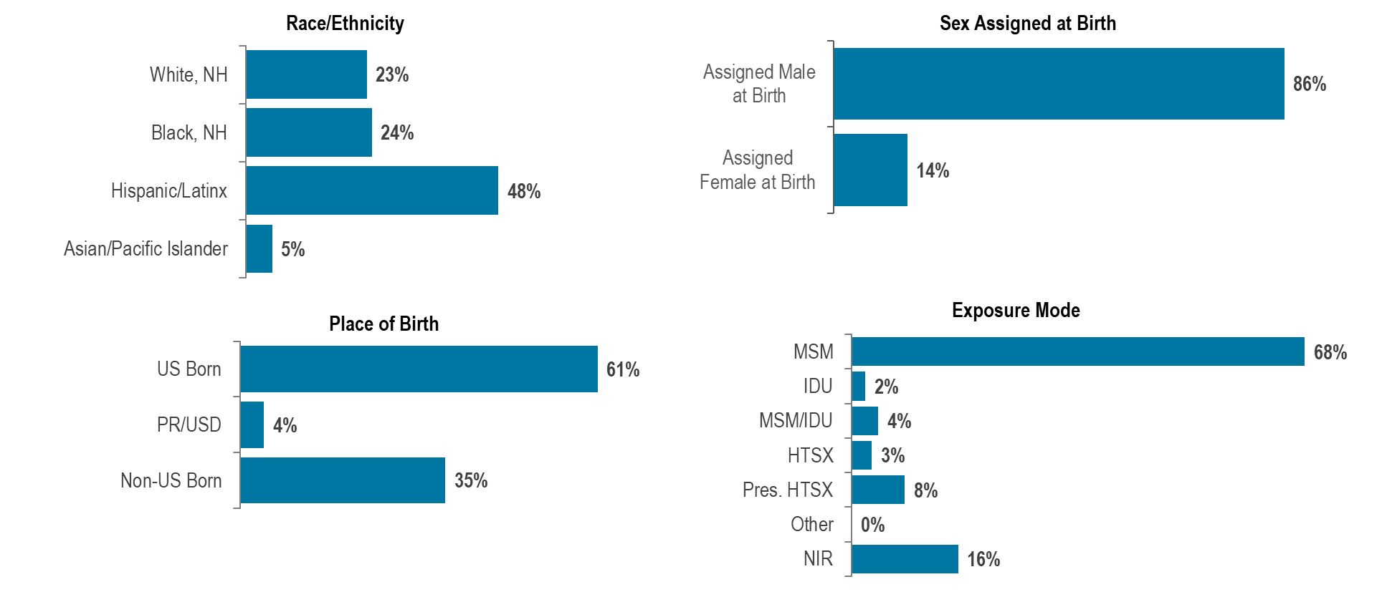
Distribution of HIV infection diagnoses in adolescents and young adults (aged 15–24 years) by race/ethnicity, exposure mode, place of birth, and sex assigned at birth, Massachusetts 2021–2023, N=157 ¹
¹ Please consider the impact of the COVID-19 pandemic on infectious disease screening, treatment, and surveillance in the interpretation of data from 2020 to 2023.
Data Source: Bureau of Infectious Disease and Laboratory Sciences, data are current as of 7/1/2024 and subject to change
Notes:
The figure is a series of four bar charts displaying the distribution of adolescents and young adults diagnosed with HIV infection by race/ethnicity, place of birth, sex assigned at birth, and exposure mode.
During 2021 to 2023, 11% (N=157/1,435) of HIV infection diagnoses were reported among adolescents and young adults aged 15–24 years.
Adolescent and young adults aged 15–24 years newly diagnosed with HIV infection in Massachusetts during 2021 to 2023 were predominantly Hispanic/Latinx (48%) or Black (non-Hispanic) (24%), assigned male at birth (86%), and US born (61%), with an exposure mode of male-to-male sex (68%).

Slide 36
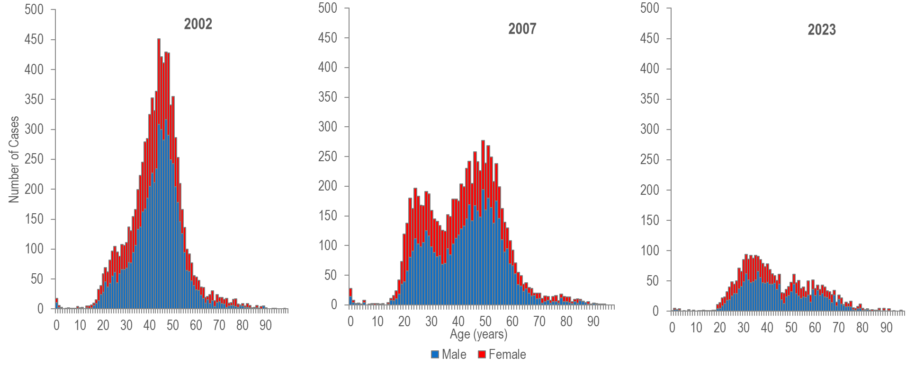
Number of confirmed and probable hepatitis C cases reported by age and female and male gender, Massachusetts 2002, 2007, 2023 ¹
¹ Please consider the impact of the COVID-19 pandemic on infectious disease screening, treatment, and surveillance in the interpretation of data from 2020 to 2023.
Note: Probable and Confirmed HCV 2002, N=9,046 (excludes 159 with missing age and/or gender), 2007 N=8,264 (excludes 789 with missing age and/or gender), 2023 N=2,542 (excludes 38 with missing age and/or gender). Cases reported as transgender are not depicted in Figure 35 separately due to small numbers. Data Source: Bureau of Infectious Disease and Laboratory Sciences, data are current as of 7/31/2024 and subject to change..
Notes:
The figure is a series of three stacked bar charts displaying the number of both male and female HCV cases reported at each age from 0 to 95 years for the years 2002, 2007 and 2023.
The age distribution of HCV cases reported in Massachusetts changed between 2002 and 2023¹ with a significant increase in cases among young persons who inject drugs.
In 2002, reported HCV cases were distributed in a curve with one age peak at 44 years.
In 2007, reported cases of HCV were distributed in a curve with two age peaks, with the lower peak at age 24 years and the higher peak at age 49 years.
In 2023, HCV cases among young adults who inject drugs outnumbered newly reported cases among the older (“baby boomer”) age cohort.
The proportion of cases among young adults (aged 20-39 years) was higher in 2007 (38%, N=3,179/8,264) and 2023 (42%, N=1,066/2,542) compared to 2002 (31%, N=2,801/9,046).
The primary risk for HCV infection in younger adults is injection drug use. While the primary exposure mode for HIV infection in younger adults is male-to-male sex, recent increases in the number of HIV infections attributed to injection drug use have been observed, particularly among young adults (aged 13-29 years).
¹ Please consider the impact of the COVID-19 pandemic on infectious disease screening, treatment, and surveillance in the interpretation of data from 2020 to 2023

Slide 37
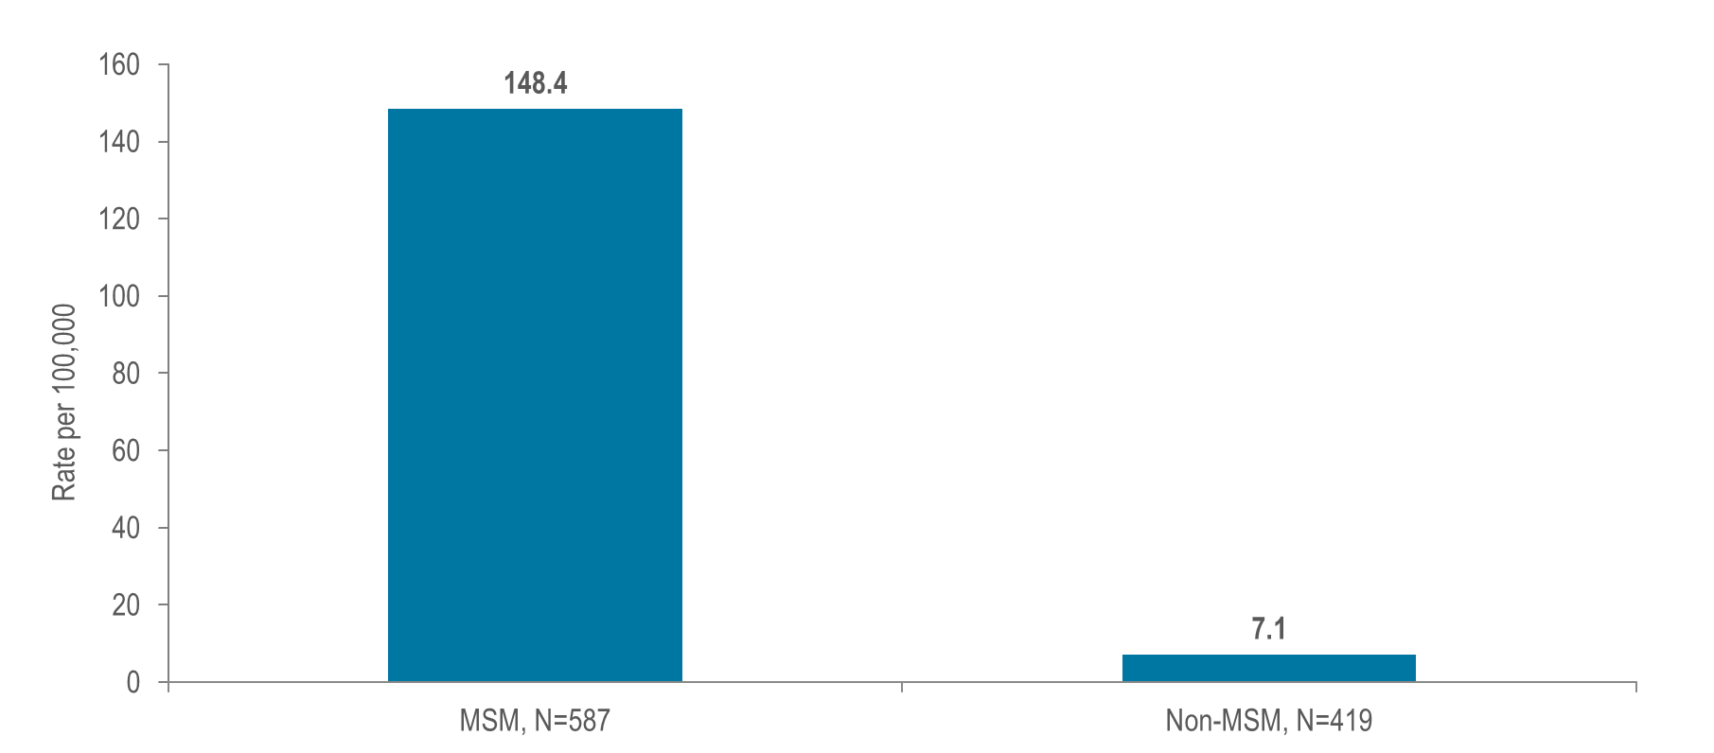
Estimated¹ average annual HIV diagnosis rate per 100,000 population: MSM (men who have sex with men) compared to non-MSM (males) ages 18–64 years: Massachusetts 2021–2023 ²
¹ Multiple source estimation method for MSM rate (2020-2022 BRFSS, UMDI Interim 2020 Population Estimates by Age, Sex, Race, and Municipality, UMass Donahue Institute Population Estimates Program, March 1, 2022; and MDPH Bureau of Infectious Disease and Laboratory Sciences, data as of 7/1/2024)
² Please consider the impact of the COVID-19 pandemic on infectious disease screening, treatment, and surveillance in the interpretation of data from 2020 to 2023.
Notes:
The figure is a bar chart displaying the average annual HIV diagnosis rate for MSM on the left, compared to the average annual HIV diagnosis rate for non-MSM males on the right.
At 148.4 per 100,000 population (95% confidence interval [CI]: 123.0–190.8 per 100,000), the estimated average rate of HIV diagnosis from 2021 to 2023² among MSM (ages 18–64 years) was 21 times the rate of infection in men who did not report sex with men (7.1 per 100,000 [95% CI: 7.0–7.2 per 100,000]).
¹ Multiple source estimation method for MSM rate (2020-2022 BRFSS, UMDI Interim 2020 Population Estimates by Age, Sex, Race, and Municipality, UMass Donahue Institute Population Estimates Program, March 1, 2022; and MDPH Bureau of Infectious Disease and Laboratory Sciences, data as of 7/1/2024)
² Please consider the impact of the COVID-19 pandemic on infectious disease screening, treatment, and surveillance in the interpretation of data from 2020 to 2023.

Slide 38
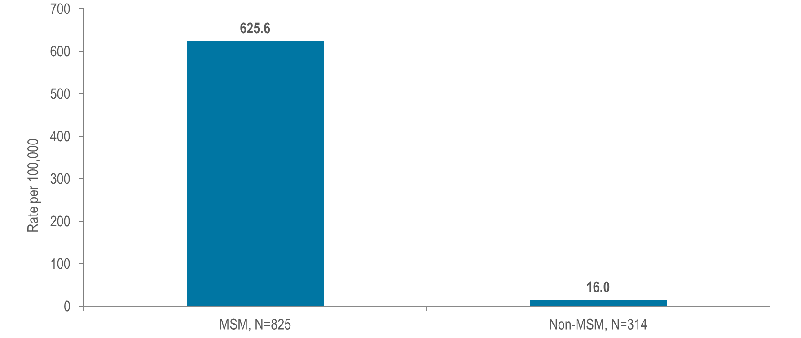
Estimated¹ confirmed and probable infectious syphilis² rate per 100,000 population: MSM compared to non-MSM (males) ages 18–64 years: Massachusetts 2023 ³
¹ Multiple source estimation method for MSM rate (2020–2022 BRFSS, UMDI Interim 2020 Population Estimates by Age, Sex, Race, and Municipality, UMass Donahue Institute Population Estimates Program, March 1, 2022, and MDPH Bureau of Infectious Disease and Laboratory Sciences, data as of 7/22/2024)
² Infectious syphilis includes diagnoses made in the primary, secondary, and early non-primary non-secondary stages of infection (latent asymptomatic syphilis where infection occurred in the past 12 months).
³ Please consider the impact of the COVID-19 pandemic on infectious disease screening, treatment, and surveillance in the interpretation of data from 2020 to 2023.
Notes:
The figure is a bar chart displaying the estimated infectious syphilis rate per 100,000 for MSM on the left, compared to the estimated infectious syphilis rate per 100,000 for non-MSM males on the right.
At 625.6 per 100,000 population (95% confidence interval [CI]: 518.6–804.3 per 100,000), the estimated infectious syphilis rate in 2023³ among MSM (ages 18–64) was 39 times the rate of infection in men who did not report sex with men (16.0 per 100,000 [95% CI: 15.8–16.2 per 100,000]).
¹ Multiple source estimation method for MSM rate (2020–2022 BRFSS, UMDI Interim 2020 Population Estimates by Age, Sex, Race, and Municipality, UMass Donahue Institute Population Estimates Program, March 1, 2022, and MDPH Bureau of Infectious Disease and Laboratory Sciences, data as of 7/21/2023)
² Infectious syphilis includes diagnoses made in the primary, secondary, and early non-primary non-secondary stages of infection (latent asymptomatic syphilis where infection occurred in the past 12 months).
³ Please consider the impact of the COVID-19 pandemic on infectious disease screening, treatment, and surveillance in the interpretation of data from 2020 to 2023.

Slide 39
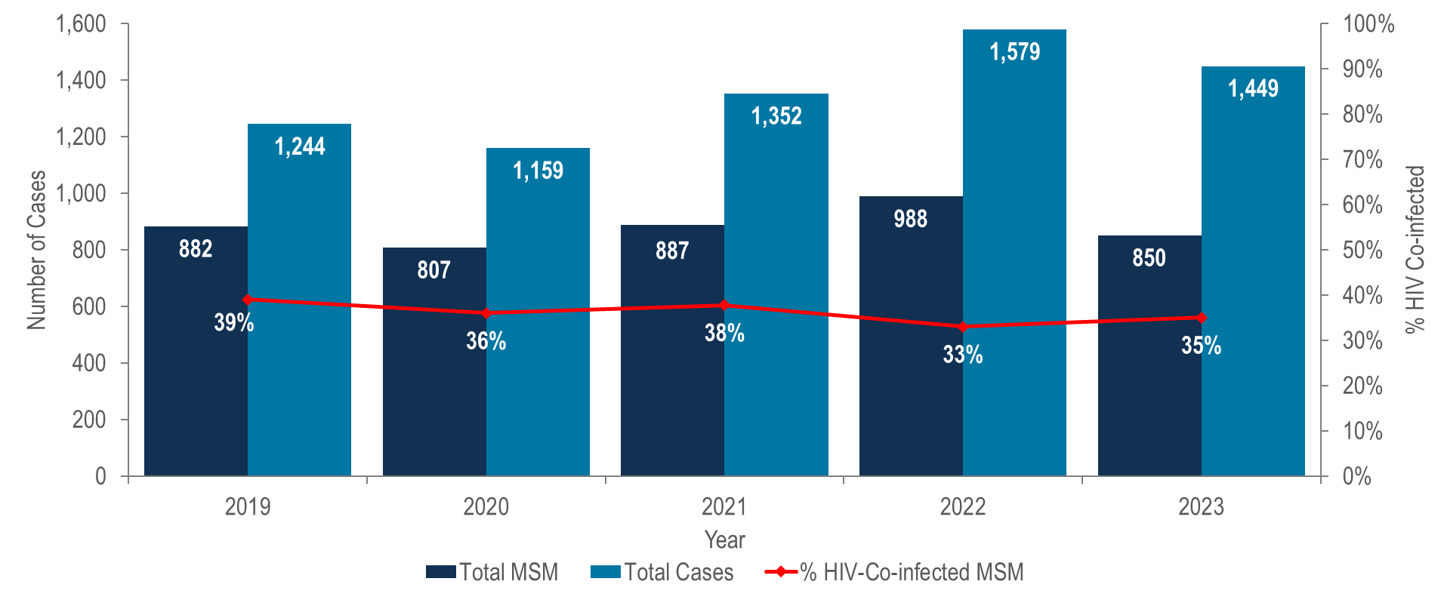
Number of confirmed and probable infectious syphilis ¹ cases among MSM and the percent of cases among MSM known to ever be co-infected with HIV, Massachusetts 2019–2023 ²
¹ Infectious syphilis includes diagnoses made in the primary, secondary, and early non-primary non-secondary stages of infection (latent asymptomatic syphilis where infection occurred in the past 12 months).
² Please consider the impact of the COVID-19 pandemic on infectious disease screening, treatment, and surveillance in the interpretation of data from 2020 to 2023.
Data Source: Bureau of Infectious Disease and Laboratory Sciences, data are current as of 7/22/2024 and subject to change
Notes:
The figure is a bar chart displaying the number of syphilis cases among MSM and total syphilis cases for each year from 2019 to 2023 with an overlaid trendline displaying the percentage of syphilis cases among MSM that were also HIV positive in each of those years.
The incidence of syphilis in Massachusetts increased by 27% from 2019 to 2022 and subsequently decreased by 8% in 2023; MSM represented the majority of cases (59% in 2023).
In 2023,² 35% (N=296/850) of infectious syphilis cases among men reporting sex with men also self-reported co-infection with HIV.³
² Please consider the impact of the COVID-19 pandemic on infectious disease screening, treatment, and surveillance in the interpretation of data from 2020 to 2023.
³ Please note that the syphilis/HIV co-infection rate among MSM is based on self-report; not database matching analyses, which were used to calculate HIV/syphilis co-infection rates elsewhere in this report.

Slide 40
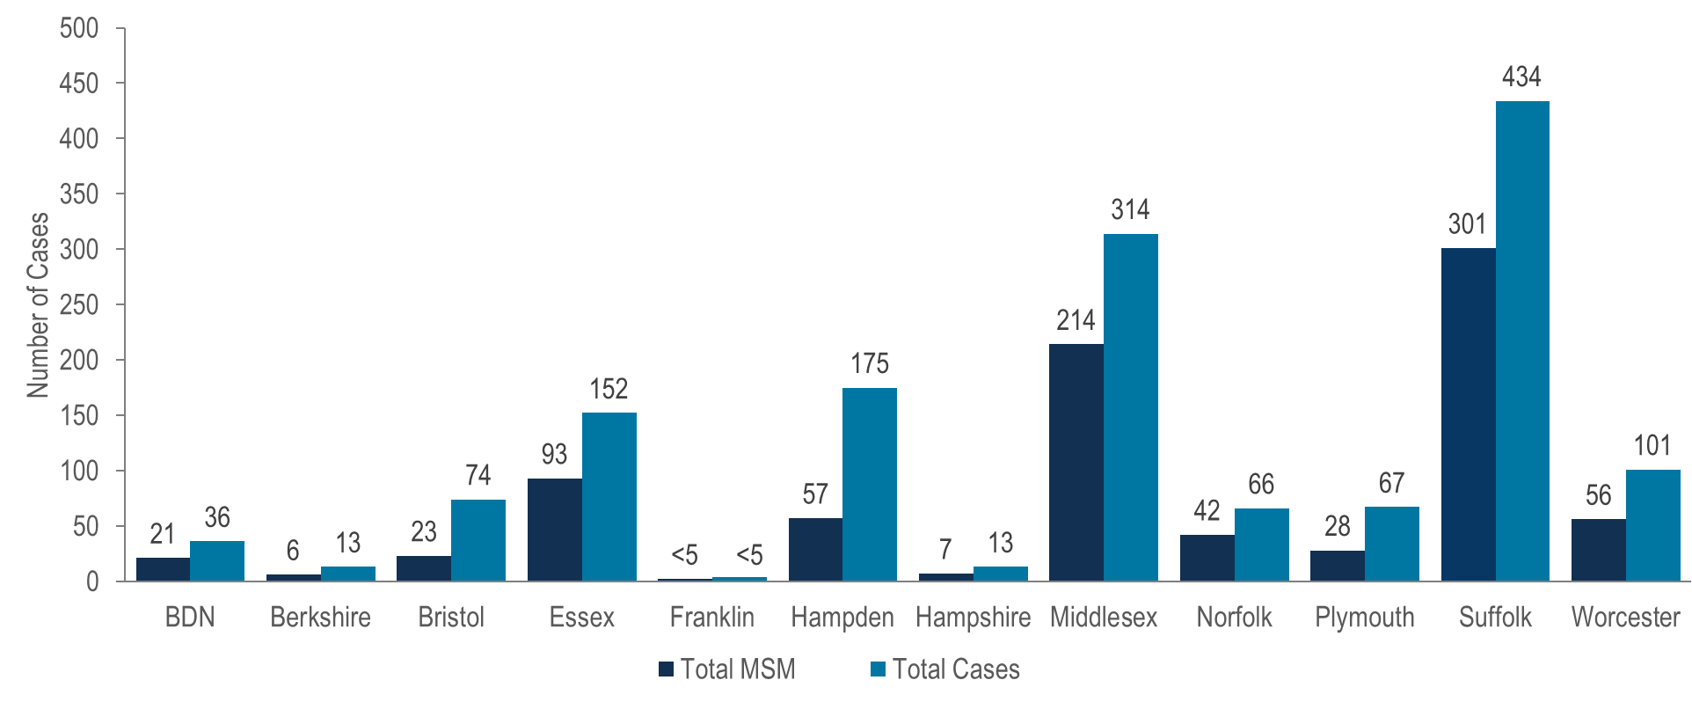
Total number of confirmed and probable infectious syphilis ¹ cases and number among MSM by county, Massachusetts 2023 ²
¹ Infectious syphilis includes diagnoses made in the primary, secondary, and early non-primary non-secondary stages of infection (latent asymptomatic syphilis where infection occurred in the past 12 months).
² Please consider the impact of the COVID-19 pandemic on infectious disease screening, treatment, and surveillance in the interpretation of data from 2020 to 2023.
Note: MSM N=850, missing risk information N=142, total cases N=1,449 ; BDN = Barnstable, Dukes and Nantucket Counties, combined because of small numbers.
Data Source: Bureau of Infectious Disease and Laboratory Sciences, data are current as of 7/22/2024 and subject to change.
Notes:
The figure is a bar chart which displays both the total number of syphilis cases and the number of syphilis cases among MSM in each Massachusetts county: Barnstable/Dukes/Nantucket, Berkshire, Bristol, Essex, Franklin, Hampden, Hampshire, Middlesex, Norfolk, Plymouth, Suffolk, and Worcester.
In 2023,¹ the largest proportions of MSM among infectious syphilis cases were reported in Suffolk (69%, N=301/434) and Middlesex (68%, N=214/314) counties.
¹ Please consider the impact of the COVID-19 pandemic on infectious disease screening, treatment, and surveillance in the interpretation of data from 2020 to 2023

Slide 41
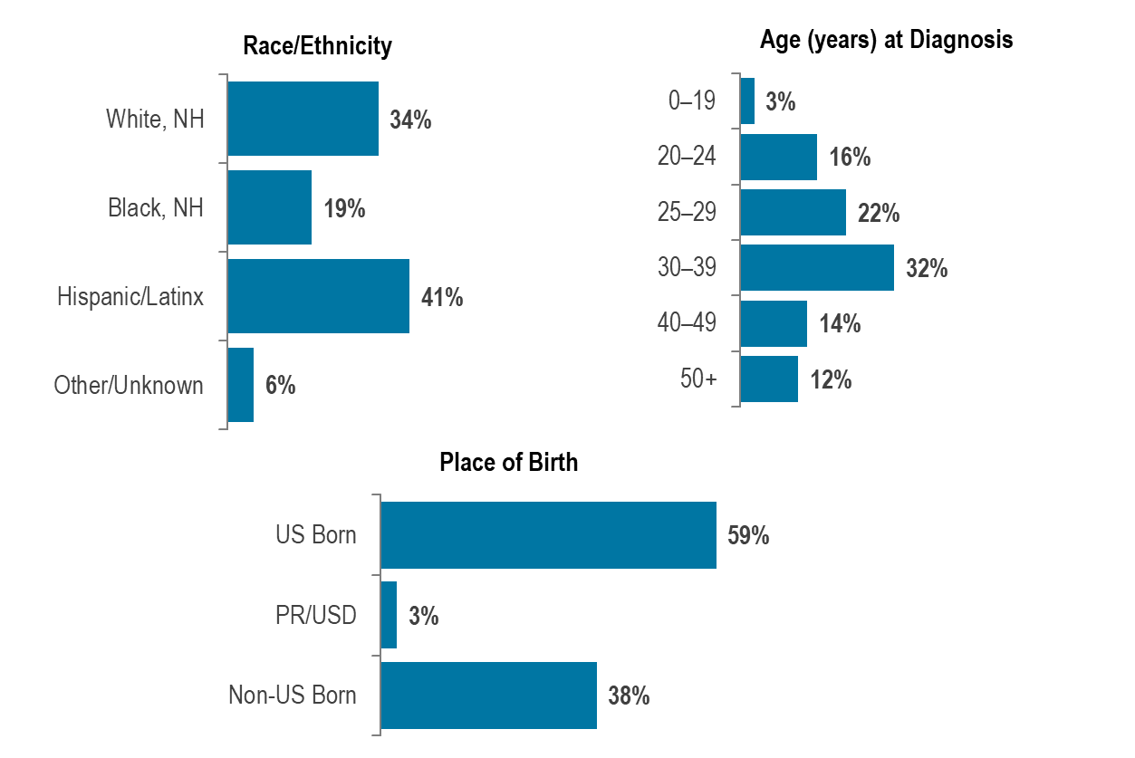
HIV infection diagnoses among men reporting sex with men by race/ethnicity, age at diagnosis, and place of birth, Massachusetts 2021–2023 (N=559) ¹
¹ Please consider the impact of the COVID-19 pandemic on infectious disease screening, treatment, and surveillance in the interpretation of data from 2020 to 2023.
Data Source: Bureau of Infectious Disease and Laboratory Sciences, data are current as of 7/1/2024 and subject to change
Notes:
The figure is a series of three bar chart displaying the percentage distribution of individuals diagnosed with HIV infection with MSM exposure mode by race/ethnicity, age, and place of birth.
Black (non-Hispanic) and Hispanic/Latinx individuals represented 7% and 13% of men in Massachusetts, compared to 19% and 41%, respectively, of men recently diagnosed with HIV infection with MSM exposure mode.
Individuals with MSM exposure mode newly diagnosed with HIV infection in Massachusetts during 2021 to 2023¹ were predominantly in their twenties or thirties (38% 20–29 year-olds, 32% 30–39 year-olds), Hispanic/Latinx (41%) or White (non-Hispanic) (34%), and US born (59%).
¹ Please consider the impact of the COVID-19 pandemic on infectious disease screening, treatment, and surveillance in the interpretation of data from 2020 to 2023

Slide 42
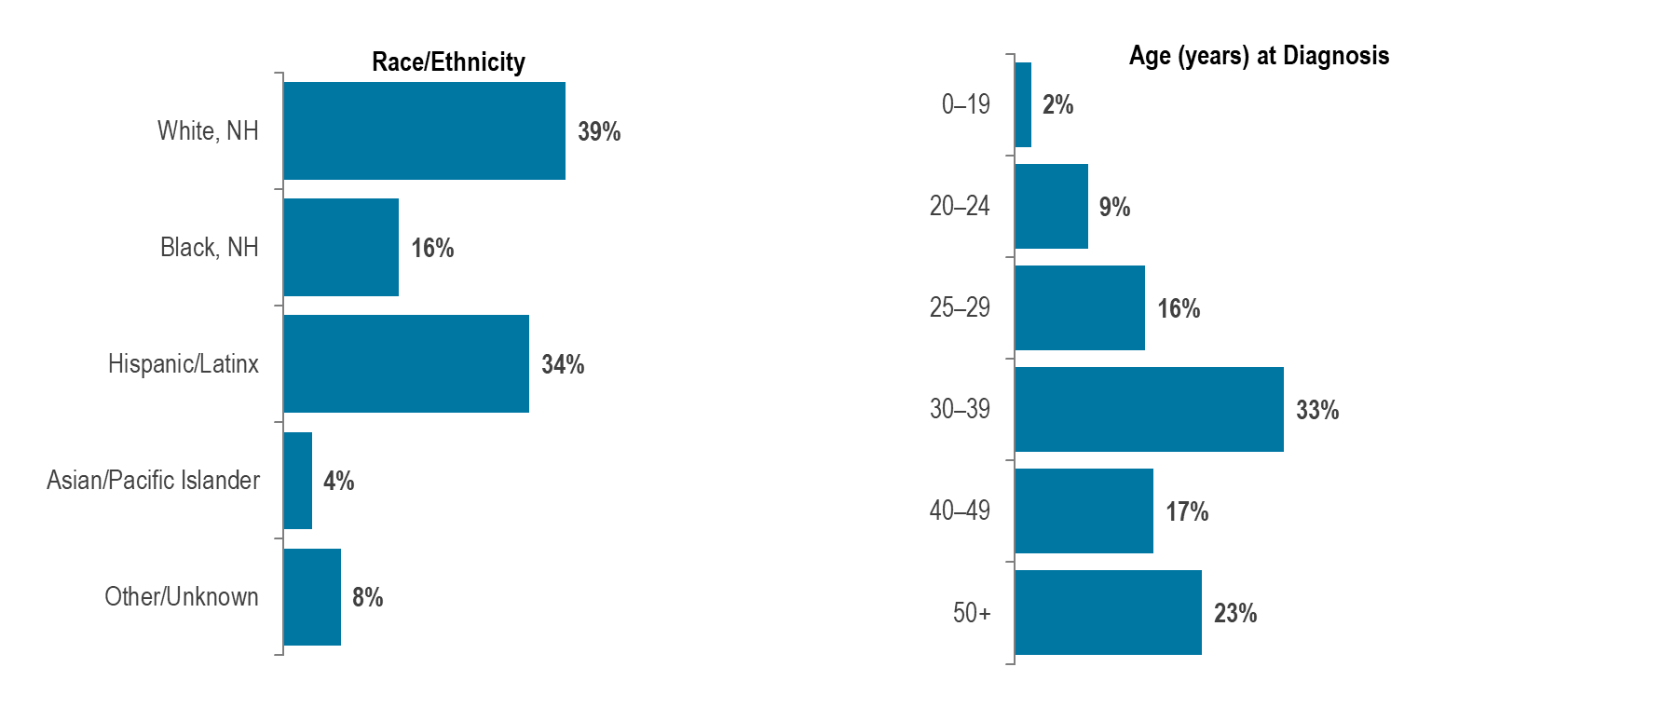
Confirmed and probable infectious syphilis¹ cases among men reporting sex with men, by race/ethnicity and age, Massachusetts 2023 (N=850) ²
¹ Infectious syphilis includes diagnoses made in the primary, secondary, and early non-primary non-secondary stages of infection (latent asymptomatic syphilis where infection occurred in the past 12 months).
² Please consider the impact of the COVID-19 pandemic on infectious disease screening, treatment, and surveillance in the interpretation of data from 2020 to 2023..
Data Source: Bureau of Infectious Disease and Laboratory Sciences, data are current as of 7/22/2024 and subject to change
Notes:
The figure is a series of two bar charts displaying the percentage distribution of infectious syphilis cases among men who have sex with men by race/ethnicity on the left and age at diagnosis on the right.
Black (non-Hispanic) and Hispanic/Latinx individuals represented 7% and 13% of men in Massachusetts, compared to 16% and 34%, respectively, of infectious syphilis cases among men reporting sex with men in 2023.
In 2023,¹ infectious syphilis cases among men reporting sex with men were predominantly White (non-Hispanic) (39%), and age 30 years and above (72% 30+ year-olds).
¹ Please consider the impact of the COVID-19 pandemic on infectious disease screening, treatment, and surveillance in the interpretation of data from 2020 to 2023

Slide 43
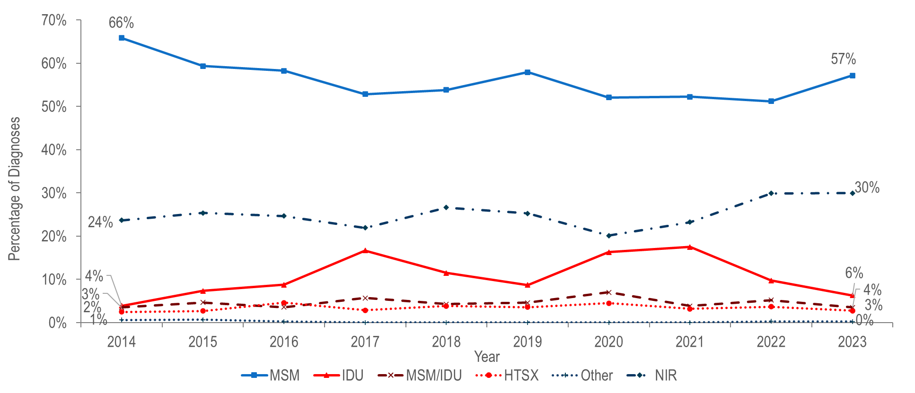
Percentage distribution of individuals assigned male at birth (AMAB) diagnosed with HIV infection by exposure mode, Massachusetts 2014–2023 ¹
¹ Please consider the impact of the COVID-19 pandemic on infectious disease screening, treatment, and surveillance in the interpretation of data from 2020 to 2023.
Data Source: Bureau of Infectious Disease and Laboratory Sciences, data are current as of 7/1/2024 and subject to change
Notes:
The figure is a trendline displaying the percentage distribution of HIV infection diagnoses among males by exposure mode (male-to-male sex, injection drug use, male-to-male sex/injection drug use, heterosexual sex, no identified risk, and Other) for the most recent ten-year period.
Among individuals AMAB, the proportion of HIV infection diagnoses with male-to-male sex as the reported mode of exposure decreased from 66% in 2014 to 51% in 2022 and subsequently increased to 57% in 2023.¹ During the same time period, the proportion reported with no identified risk remained between 20% and 30%.
The proportion of cases among individuals AMAB attributed to injection drug use increased from 4% in 2014 to 17% in 2017 and then decreased to 9% in 2019. The increase in 2017 was primarily due to an outbreak among persons who inject drugs in the northeast part of the state between 2016 and 2018.² Following a focused public health response, the number of HIV infection diagnoses attributed to IDU in the northeast decreased. However, in early 2019, a new cluster of HIV infection was identified in Boston among PWID who were experiencing or had experienced recent homelessness, and the proportion of HIV infection diagnoses among individuals AMAB with IDU as the primary exposure increased to 18% in 2021. Following another focused public health response, the proportion decreased to 6% in 2023.³
¹ Please consider the impact of the COVID-19 pandemic on infectious disease screening, treatment, and surveillance in the interpretation of data from 2020 to 2023.
² For more information see: Charles Alpren et al. “Opioid Use Fueling HIV Transmission in an Urban Setting: An Outbreak of HIV Infection Among People Who Inject Drugs—Massachusetts, 2015–2018”, American Journal of Public Health 110, no. 1 (January 1, 2020): pp. 37-44.https://doi.org/10.2105/AJPH.2019.305366
³ For more information, see: Joint MDPH and BPHC Clinical Advisory: Increase in newly diagnosed HIV infections among persons who inject drugs in Boston, March 15, 2021, available at: https://www.mass.gov/doc/joint-mdph-and-bphc-clinical-advisory-hiv-transmission-through-injection-drug-use-in-boston-march-15-2021/download

Slide 44
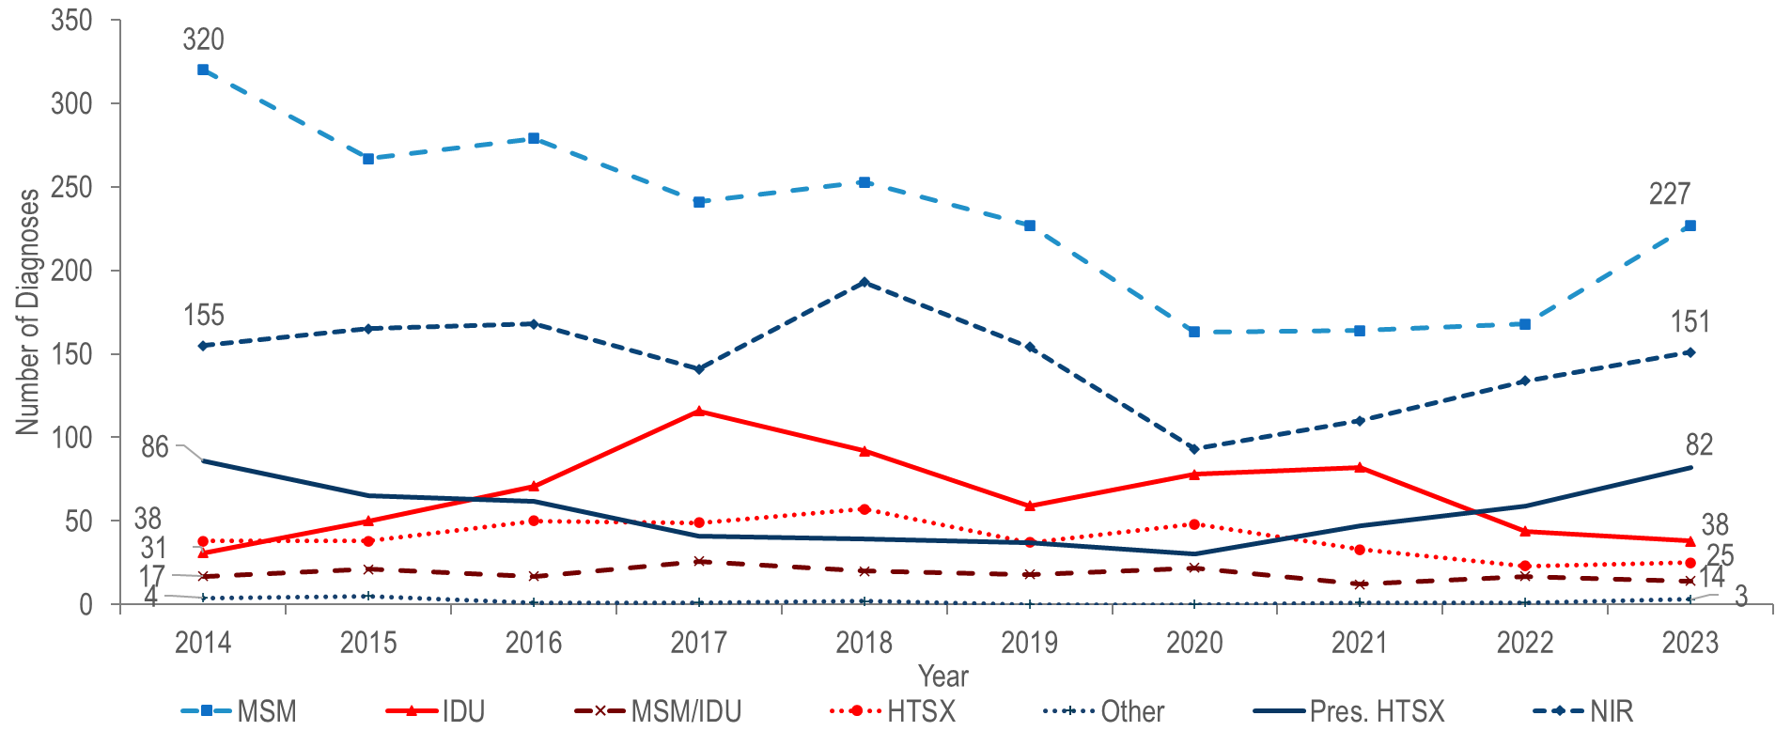
Individuals diagnosed with HIV infection by exposure mode, Massachusetts 2014–2023 ¹
¹ Please consider the impact of the COVID-19 pandemic on infectious disease screening, treatment, and surveillance in the interpretation of data from 2020 to 2023.
Data Source: Bureau of Infectious Disease and Laboratory Sciences, data are current as of 7/1/2024 and subject to change
Notes:
The figure is a trendline displaying the number of HIV infections diagnosed each year of the most recent ten-year period for each of seven exposure mode categories: male-to-male sex, injection drug use, male-to-male sex/injection drug use, heterosexual sex, other, presumed heterosexual sex, and no identified risk.
The number of reported cases with injection drug use (IDU) as the primary exposure mode increased from a low of 31 in 2014 to a peak of 116 in 2017, and then decreased to 59 in 2019. The increase in 2017 was primarily due to an outbreak among persons who inject drugs (PWID) in the northeast part of the state between 2016 and 2018.¹ Following a focused public health response, the number of HIV infection diagnoses attributed to IDU in the northeast has decreased.
However, in early 2019, a new cluster of HIV infection was identified in Boston among PWID who were experiencing or had experienced recent homelessness, and the total statewide number of reported cases with IDU as the primary exposure increased to 82 in 2021.² Following another focused public health response, the number of HIV infection diagnoses attributed to IDU decreased by 54% to 38 cases in 2023. As of July 1, 2024, a total of 213 cases diagnosed since November 2018 have been investigated and identified as part of the Boston cluster. As it is an active cluster of concern, additional cases will continue to be investigated and added. Continuing trends among those newly diagnosed in the Boston cluster (N=15 cases diagnosed in 2023) include an increase in polysubstance and methamphetamine use.³
¹ For more information, see: Charles Alpren et al. “Opioid Use Fueling HIV Transmission in an Urban Setting: An Outbreak of HIV Infection Among People Who Inject Drugs—Massachusetts, 2015–2018”, American Journal of Public Health 110, no. 1 (January 1, 2020): pp. 37-44. https://doi.org/10.2105/AJPH.2019.305366
² Please consider the impact of the COVID-19 pandemic on infectious disease screening, treatment, and surveillance in the interpretation of data from 2020 to 2023.
³ For more information, see: Joint MDPH and BPHC Clinical Advisory: Increase in newly diagnosed HIV infections among persons who inject drugs in Boston, March 15, 2021, available at: https://www.mass.gov/doc/joint-mdph-and-bphc-clinical-advisory-hiv-transmission-through-injection-drug-use-in-boston-march-15-2021/download

Slide 45
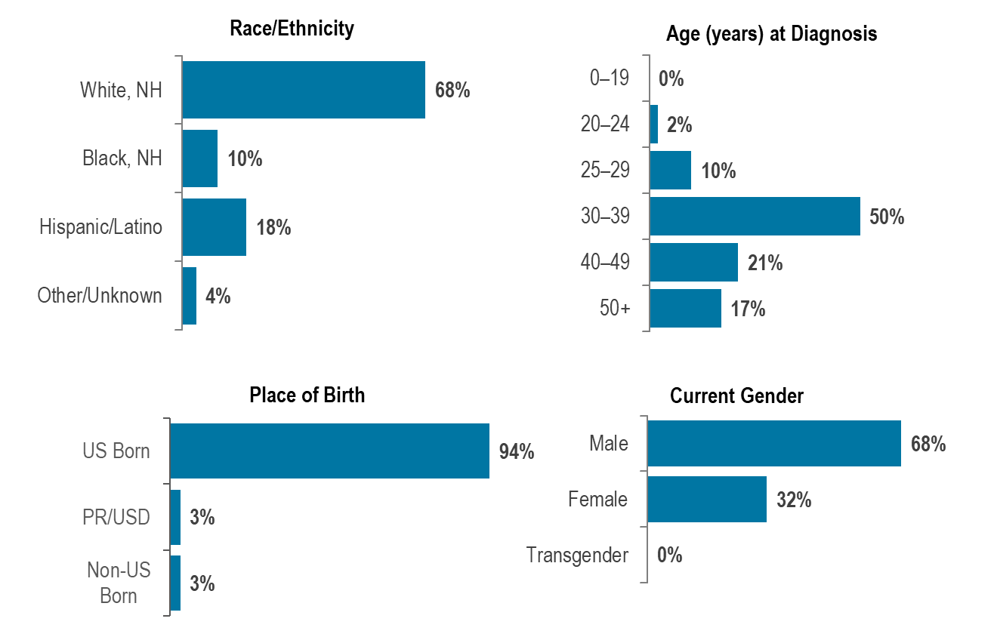
Percentage of individuals with IDU exposure mode diagnosed with HIV infection by race/ethnicity, age, place of birth and current gender,
Massachusetts 2021–2023 (N=164) ¹
¹ Please consider the impact of the COVID-19 pandemic on infectious disease screening, treatment, and surveillance in the interpretation of data from 2020 to 2023.
Data Source: Bureau of Infectious Disease and Laboratory Sciences, data are current as of 7/1/2024 and subject to change
Notes:
The figure is a series of four bar charts displaying the percentage distribution of individuals diagnosed with HIV infection with IDU exposure mode by race/ethnicity (White NH, Black NH, Hispanic/Latinx, Asian/Pacific Islander, Other/unknown), age at diagnosis (0-19, 20-24, 25-29, 30-39, 40-49, 50+), place of birth (US Born, PR/USD), non-US born), and gender (male, female, transgender).
Individuals with IDU exposure mode newly diagnosed with HIV infection in Massachusetts during 2021 to 2023¹ were predominantly White (non-Hispanic) (68%), between 30 and 39 years of age (50%), US born (94%), and male (68%).
¹ Please consider the impact of the COVID-19 pandemic on infectious disease screening, treatment, and surveillance in the interpretation of data from 2020 to 2023

Slide 46
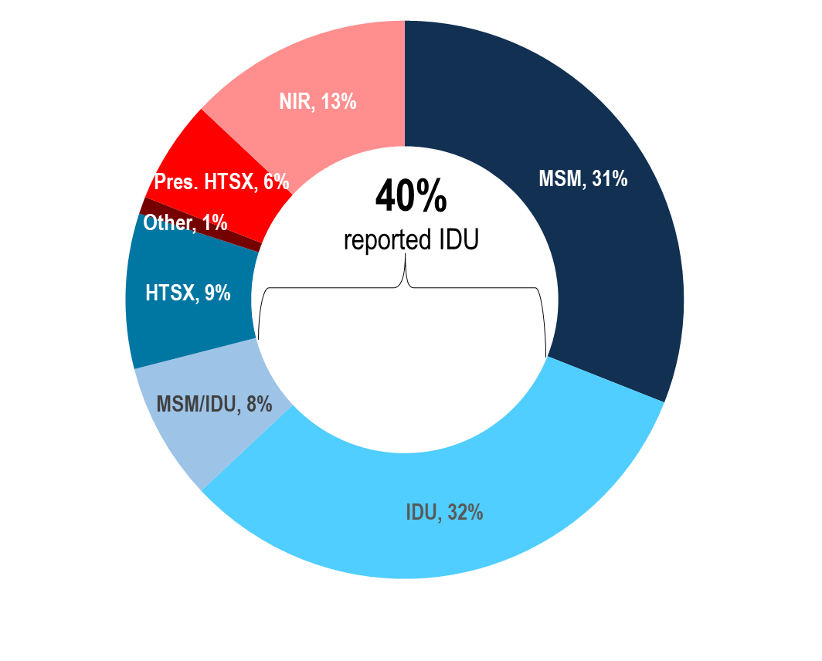
Deaths from any cause among individuals reported with HIV by exposure mode, Massachusetts 2023 (N=307) ¹
¹ Please consider the impact of the COVID-19 pandemic on infectious disease screening, treatment, and surveillance in the interpretation of data from 2020 to 2023.
Data Source: Bureau of Infectious Disease and Laboratory Sciences, data are current as of 7/1/2024 and subject to change
Notes:
The figure is an open pie chart which displays the distribution by exposure mode of deaths among individuals reported with HIV for the most recent year. Text in the center of the pie chart reads, "40% reported IDU".
The proportion of deaths from any cause among individuals with HIV with IDU exposure mode decreased from 42% in 2014 to 32% in 2023.¹ At 32%, the proportion among IDU remained the largest among exposure modes in 2023, followed closely by MSM at 31%, with an additional 8% reported with an exposure mode of MSM/IDU. Comparatively, IDU and MSM accounted for 7% and 3%, respectively, of new HIV diagnoses in that year.
¹ Please consider the impact of the COVID-19 pandemic on infectious disease screening, treatment, and surveillance in the interpretation of data from 2020 to 2023

Slide 47
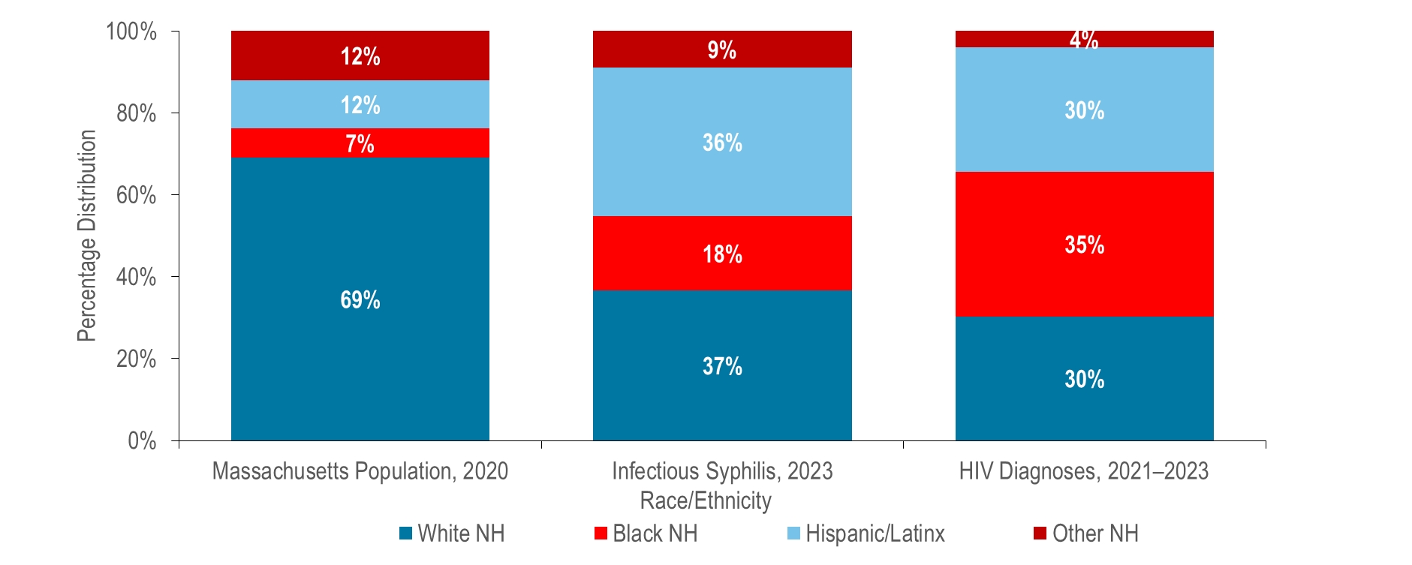
Distribution of the general population¹ and of individuals diagnosed with confirmed and probable infectious syphilis² in 2023, and HIV infection during 2021–2023 by race/ethnicity, Massachusetts ³
¹ Population Data Source: UMDI Interim 2020 Population Estimates by Age, Sex, Race, and Municipality, UMass Donahue Institute Population Estimates Program, March 1, 2022
² Infectious syphilis includes diagnoses made in the primary, secondary, and early non-primary non-secondary stages of infection (latent asymptomatic syphilis where infection occurred in the past 12 months).
³ Please consider the impact of the COVID-19 pandemic on infectious disease screening, treatment, and surveillance in the interpretation of data from 2020 to 2023.
Confirmed and Probable Infectious Syphilis 2023, N=1,404 and excludes 45 (3%) cases missing race/ethnicity; HIV Diagnoses 2021-2023, N=1,435
Data Source: Bureau of Infectious Disease and Laboratory Sciences, HIV data are current as of 7/1/2024, STD data are current as of 7/22/2024 and subject to change
Notes:
The figure is a stacked bar chart displaying the percentage distribution by race/ethnicity of three groups: the Massachusetts population, 2023 infectious syphilis cases, and 2021-2023 HIV Diagnoses.
In 2023,¹ Black (non-Hispanic) and Hispanic/Latinx individuals represented 7% and 12% of the total Massachusetts population and 18% and 36% of infectious syphilis cases (with known race/ethnicity), respectively.
During 2021 to 2023, Black (non-Hispanic) and Hispanic/Latinx individuals represented 35% and 30% of individuals diagnosed with HIV infection in Massachusetts, respectively.
¹ Please consider the impact of the COVID-19 pandemic on infectious disease screening, treatment, and surveillance in the interpretation of data from 2020 to 2023

Slide 48
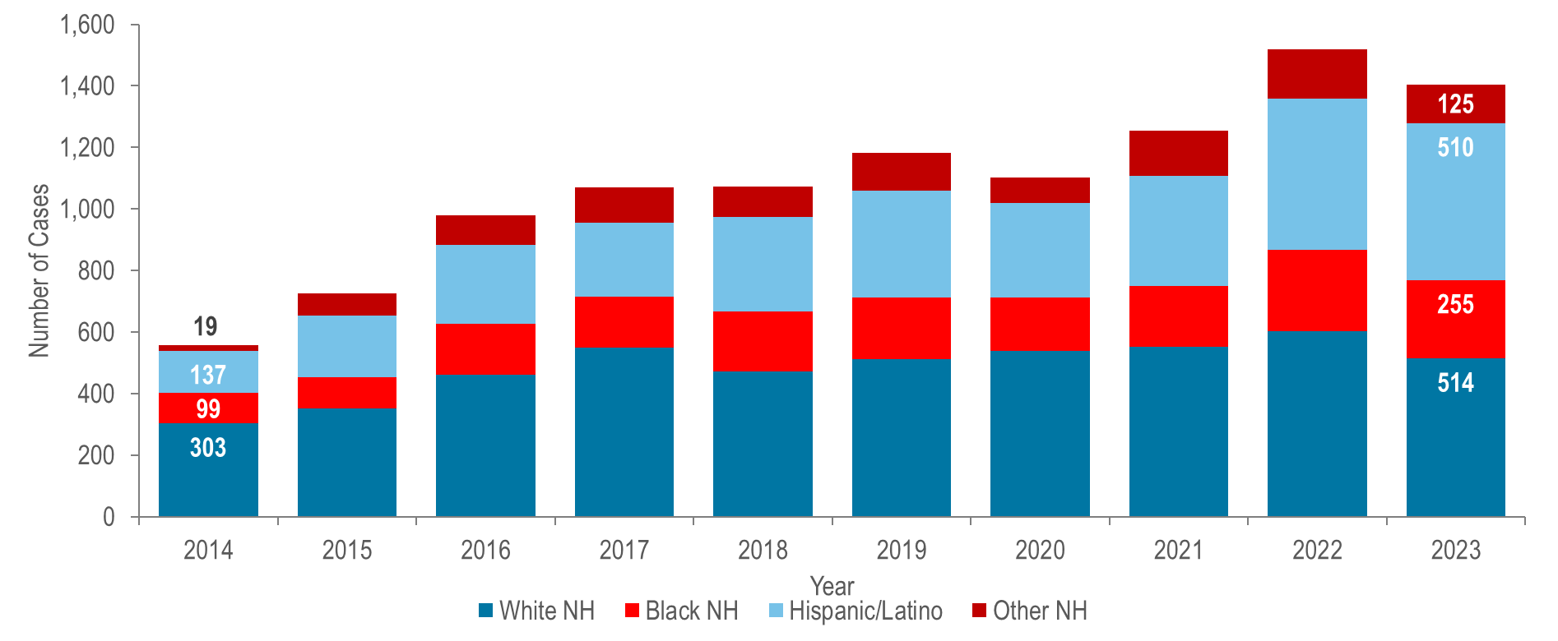
Number of confirmed and probable infectious syphilis¹ cases reported by race/ethnicity, Massachusetts 2014–2023 ²
¹ Infectious syphilis includes diagnoses made in the primary, secondary, and early non-primary non-secondary stages of infection (latent asymptomatic syphilis where infection occurred in the past 12 months).
² Please consider the impact of the COVID-19 pandemic on infectious disease screening, treatment, and surveillance in the interpretation of data from 2020 to 2023..
Note: Confirmed and Probable Syphilis 2014-2023 Total N=10,871; 600 (5%) cases missing race/ethnicity are not included in this figure
Data Source: Bureau of Infectious Disease and Laboratory Sciences, data are current as of 7/22/2024 and subject to change
Notes:
The figure is a stacked bar graph displaying the number of infectious syphilis cases reported each year for the most recent ten-year period among White non-Hispanic individuals, Black non-Hispanic individuals, Hispanic/Latinx individuals, and those of other non-Hispanic race/ethnicity.
The greatest number of infectious syphilis cases was among White (non-Hispanic) individuals each year from 2014 to 2023.²
From 2014 to 2023, the greatest proportionate increase in the number of infectious syphilis cases was reported among Hispanic/Latinx individuals (more than tripled from 137 to 510), followed by Black (non-Hispanic) individuals (more than doubled from 99 to 255), and White (non-Hispanic) (increased by 70% from 303 to 514).
From 2104 to 2023, the proportion of infectious syphilis cases among White (non-Hispanic) individuals decreased from 54% to 37% while it increased from 25% to 36% among Hispanic/Latinx individuals.
In 2023, the age-adjusted infectious syphilis incidence rate among Black (non-Hispanic) individuals (46.5 per 100,000) and Hispanic/Latinx individuals (55.2 per 100.000) were four and five times that of White (non-Hispanic) individuals (10.4 per 100,000), respectively.
¹ Infectious syphilis includes diagnoses made in the primary, secondary, and early non-primary non-secondary stages of infection (latent asymptomatic syphilis where infection occurred in the past 12 months).
² Please consider the impact of the COVID-19 pandemic on infectious disease screening, treatment, and surveillance in the interpretation of data from 2020 to 2023.

Slide 49
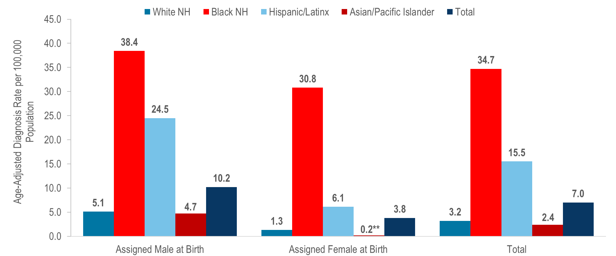
Average annual age-adjusted HIV diagnosis rate per 100,000 population¹ by sex assigned at birth and race/ethnicity, Massachusetts 2021–2023 (N=1,435) ²
**Rates based on numerators <12 are marked with an asterisk (*) and should be interpreted with caution.
¹ As of 1/1/2020, BIDLS calculates rates per 100,000 population using denominators estimated by the University of Massachusetts Donahue Institute: UMDI Interim 2020 Population Estimates by Age, Sex, Race, and Municipality, UMass Donahue Institute Population Estimates Program, March 1, 2022; Note that rates and trends calculated using previous methods cannot be compared to these. All rates are age-adjusted using the 2000 US standard population.
² Please consider the impact of the COVID-19 pandemic on infectious disease screening, treatment, and surveillance in the interpretation of data from 2020 to 2023.
Data Source: Bureau of Infectious Disease and Laboratory Sciences, data are current as of 7/1/2024 and subject to change
Notes:
The figure is a bar chart displaying the age-adjusted HIV diagnosis rate among individuals assigned male at birth, female at birth, and total cases for five groups: the total population, White non-Hispanic individuals, Black non-Hispanic individuals, Hispanic/Latinx individuals, and Asian Pacific Islanders.
In 2021–2023,¹ the average annual age-adjusted HIV diagnosis rate per 100,000 population of individuals assigned male at birth (AMAB) was three times that of individuals assigned female at birth (AFAB). There were large disparities in average annual age-adjusted HIV diagnosis rates for 2021 to 2023 by race/ethnicity. Compared to the rate among White (non-Hispanic) individuals, the rate among:
Black (non-Hispanic) individuals was 11 times greater, and
Hispanic/Latinx individuals was five times greater.
With respect to differences based on race/ethnicity and sex assigned at birth, the average annual age-adjusted HIV diagnosis rate for 2021 to 2023 among:
Black (non-Hispanic) individuals assigned male at birth (AMAB), was seven times that of White (non-Hispanic) individuals AMAB,
Hispanic/Latinx individuals AMAB was five times that of White (non-Hispanic) individuals AMAB,
Black (non-Hispanic) individuals assigned female at birth (AFAB) was 24 times that of White (non-Hispanic) individuals AFAB, and
Hispanic/Latinx individuals AFAB was five times that of White (non-Hispanic) individuals AFAB.
¹ Please consider the impact of the COVID-19 pandemic on infectious disease screening, treatment, and surveillance in the interpretation of data from 2020 to 2023

Slide 50
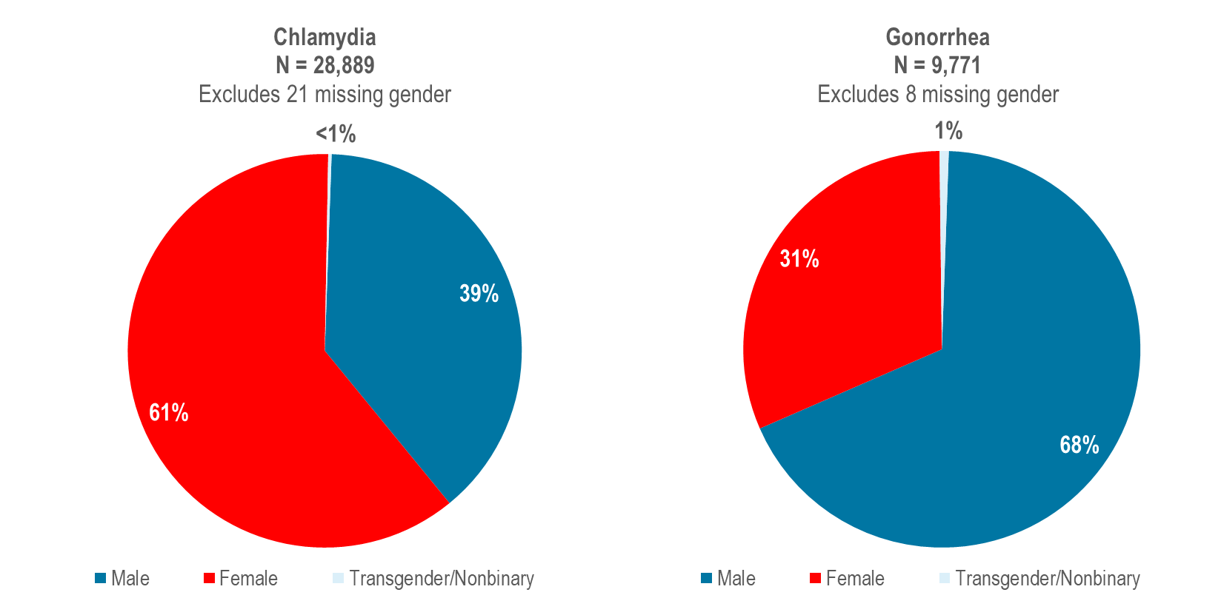
Distribution of confirmed chlamydia and gonorrhea cases reported by gender, Massachusetts 2023 ¹
¹ Please consider the impact of the COVID-19 pandemic on infectious disease screening, treatment, and surveillance in the interpretation of data from 2020 to 2023.
Data Source: Bureau of Infectious Disease and Laboratory Sciences, data are current as of 7/22/2024 and subject to change
Notes:
The figure is a series of two side by side pie charts displaying the distribution by gender of 2023 chlamydia cases (N = 28,889 Excludes 21 missing gender) on the left and 2023 gonorrhea cases (N = 9,771 Excludes 8 missing gender) on the right.
In 2023,¹ 61% of reported chlamydia cases were among females (N=17,630), 39% were among males (N=11,187), less than one percent (N=72) was among individuals of transgender experience, and no cases were reported among individuals who are nonbinary.²
In 2023, 31% of reported gonorrhea cases were among females (N=3,038), 68% were among males (N=6,662), and one percent (N=71) was among individuals of transgender experience or individuals who are nonbinary.
¹ Please consider the impact of the COVID-19 pandemic on infectious disease screening, treatment, and surveillance in the interpretation of data from 2020 to 2023
² Please note reported numbers among individuals of transgender experience and individuals who are nonbinary are likely to be underestimates, for more information see Interpreting HIV, STI, and Viral Hepatitis Data.

Slide 51
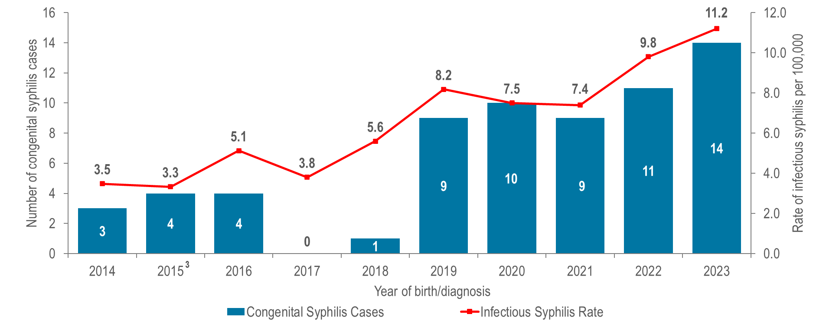
Number of confirmed and probable congenital syphilis¹ cases reported by year of birth and rate of confirmed and probable infectious syphilis per 100,000 individuals assigned female at birth (AFAB) of child-bearing age (15–44 years), Massachusetts 2014–2023 ²
¹ A condition caused by infection in utero with Treponema pallidum. A wide spectrum of severity exists, from inapparent infection to severe cases that are clinically apparent at birth. For more information see http://www.cdc.gov/std/stats/congenitalsyphilisdef-rev-jan-2015.pdf
² Please consider the impact of the COVID-19 pandemic on infectious disease screening, treatment, and surveillance in the interpretation of data from 2020 to 2023.
³ On January 1, 2015, the congenital case definition was updated to better define treatment and laboratory parameters for classifying cases. From 2019 through 2022, one confirmed case of congenital syphilis and 9 syphilitic stillbirths were reported. All other reportable cases from 2015 to 2022 met the case definition of probable congenital syphilis which uses the birthing person’s treatment adequacy and timing as the primary criteria for this classification status.
Data Source: Bureau of Infectious Disease and Laboratory Sciences, data are current as of 7/22/2024 and subject to change
Notes:
The figure is a bar chart displaying the total number of confirmed and probable congenital syphilis cases each year of the ten-year period with an overlaid trendline displaying the rate of infectious syphilis per 100,000 among females of child-bearing age for each of the same years.
Trends in congenital syphilis typically mirror trends in infectious syphilis among individuals AFAB of child-bearing age.² In Massachusetts, as the rate of infectious syphilis among individuals AFAB of child-bearing age increased to 11.2 per 100,000 in 2023,³ so too did the number of probable cases of congenital syphilis (N=14).
Nationally, the number of congenital syphilis cases reached 3,755 in 2022, with a rate of 102.5 cases per 100,000 live births, the highest rate reported since 1994. Massachusetts ranked 46th in congenital syphilis incidence rate among the 50 states in 2022.⁴
³ Please consider the impact of the COVID-19 pandemic on infectious disease screening, treatment, and surveillance in the interpretation of data from 2020 to 2023.
⁴ Centers for Disease Control and Prevention. Sexually Transmitted Infections Surveillance 2022 Atlanta: U.S. Department of Health and Human Services; 2024. Please note, 2022 state rankings are presented because 2023 rankings were not yet available at the time of this publication.

Slide 52

Percentage of individuals assigned female at birth and diagnosed with HIV infection by race/ethnicity, age, place of birth, and exposure mode, Massachusetts 2021–2023 (N=396) ¹
¹ Please consider the impact of the COVID-19 pandemic on infectious disease screening, treatment, and surveillance in the interpretation of data from 2020 to 2023.
Data Source: Bureau of Infectious Disease and Laboratory Sciences, data are current as of 7/1/2024 and subject to change
Notes:
The figure is a series of bar charts displaying the percentage distribution of women recently diagnosed with HIV infection by race/ethnicity, place of birth, age, and exposure mode.
Individuals assigned female at birth (AFAB) and newly diagnosed with HIV infection in Massachusetts during 2021–2023² were predominantly Black (non-Hispanic) (57%), 30 years of age or older (34% 30–39 year-olds, 22% 40–49 year-olds, 29% 50+ year-olds), with an exposure mode of presumed heterosexual sex (47%). While presumed heterosexual sex was the leading reported exposure mode, a large percentage of new HIV diagnoses were reported with no identified risk (NIR) (27%).
Among individuals AFAB, the proportion of HIV infection diagnoses with IDU exposure mode increased from 7% (N=12/165) in 2014 to 25% (N=40/159) in 2017, remained between 18% (2019, N=25/140) and 22% (2020, N=27/121) from 2018 through 2021, and then decreased to 9% (N=13/143) in 2023.
² Please consider the impact of the COVID-19 pandemic on infectious disease screening, treatment, and surveillance in the interpretation of data from 2020 to 2023.

Slide 53

Distribution of confirmed chlamydia, confirmed gonorrhea, and confirmed and probable infectious syphilis cases reported by age group (years), Massachusetts 2023 ¹
¹ Please consider the impact of the COVID-19 pandemic on infectious disease screening, treatment, and surveillance in the interpretation of data from 2020 to 2023.
Note: infectious syphilis includes diagnoses made in the primary, secondary, and early non-primary non-secondary stages of infection (latent asymptomatic syphilis where infection occurred in the past 12 months).
Data Source: Bureau of Infectious Disease and Laboratory Sciences, data are current as of 7/22/2024 and subject to change
Notes:
The figure is a stacked bar chart displaying the distribution by age (<15 years, 15-24 years, 25-29 years, 30-39 years, 40-49 years, 50-59 years, and 60+ years) for three groups: confirmed chlamydia, gonorrhea, and syphilis cases.
In 2023,¹ in Massachusetts, 1% of chlamydia cases, 2% of gonorrhea cases, and 6% of infectious syphilis cases were reported among individuals aged 60+ years. An additional 2% of chlamydia cases, 5% of gonorrhea cases, and 14% of infectious syphilis cases were reported among individuals aged 50–59 years.
¹ Please consider the impact of the COVID-19 pandemic on infectious disease screening, treatment, and surveillance in the interpretation of data from 2020 to 2023

Slide 54

Percentage of confirmed chlamydia and gonorrhea cases by age at diagnosis (<60 years vs. 60+ years) and gender, Massachusetts 2023 ¹
¹ Please consider the impact of the COVID-19 pandemic on infectious disease screening, treatment, and surveillance in the interpretation of data from 2020 to 2023.
Note: 2023 chlamydia N=28,884 (<60 N=28,669; 60+ N=215) and excludes cases missing gender and/or age (N=26). 2023 gonorrhea N=9,771 (<60 N=9,556; 60+ N=215) and excludes cases missing gender and/or age (N=7).
Data Source: Bureau of Infectious Disease and Laboratory Sciences, data are current as of 7/22/2024 and subject to change.
Notes:
The figure is a butterfly graph comparing the percentage distribution of people under 60 years to people aged 60+ years and diagnosed with chlamydia and gonorrhea by gender (male, female, transgender/nonbinary).
In 2023,¹ a much larger proportion of chlamydia cases among individuals aged 60 years or older (75%) than aged less than 60 years (38%) was male.
Similarly in 2023, a much larger proportion of gonorrhea cases among individuals aged 60 years or older (96%) than aged less than 60 years (68%) was male.
¹ Please consider the impact of the COVID-19 pandemic on infectious disease screening, treatment, and surveillance in the interpretation of data from 2020 to 2023

Slide 55

Percentage of confirmed and probable infectious syphilis cases by age at diagnosis (<60 years vs. 60+ years), gender, race/ethnicity, and risk, Massachusetts 2023 ¹
¹ Please consider the impact of the COVID-19 pandemic on infectious disease screening, treatment, and surveillance in the interpretation of data from 2020 to 2023.
Note: infectious syphilis includes diagnoses made in the primary, secondary, and early non-primary non-secondary stages of infection (latent asymptomatic syphilis where infection occurred in the past 12 months).
Data Source: Bureau of Infectious Disease and Laboratory Sciences, data are current as of 7/22/2024 and subject to change
Notes:
The figure is a butterfly graph comparing the percentage distribution of people under 60 years to people aged 60+ years and diagnosed with syphilis by gender, race/ethnicity, exposure mode and risk.
In 2023,¹ a larger proportion of infectious syphilis cases among individuals aged 60 years or older (97%) than aged less than 60 years (80%) was male.
A much larger proportion of infectious syphilis cases among individuals aged 60 years or older (68%) than aged less than 60 years (33%) was White non-Hispanic.
A slightly larger proportion of infectious syphilis cases among individuals aged 60 years or older (65%) and aged less than 60 years (58%) reported male-to-male sex.
¹ Please consider the impact of the COVID-19 pandemic on infectious disease screening, treatment, and surveillance in the interpretation of data from 2020 to 2023

Slide 56

Persons living with HIV infection by expanded age category, Massachusetts 2023 (N=24,119) ¹
¹ Please consider the impact of the COVID-19 pandemic on infectious disease screening, treatment, and surveillance in the interpretation of data from 2020 to 2023.
Data Source: Bureau of Infectious Disease and Laboratory Sciences, data are current as of 7/1/2024 and subject to change
Notes:
The figure is a bar chart displaying the percentage distribution of persons living with HIV infection by current age.
In 2023¹, 20% (N=4,891) of PLWH were aged 65 years or older, the age of eligibility for Medicare for individuals without a disability.
¹ Please consider the impact of the COVID-19 pandemic on infectious disease screening, treatment, and surveillance in the interpretation of data from 2020 to 2023

Slide 57

Number of years since HIV infection diagnosis among individuals aged 60 years and older living with HIV infection, Massachusetts 2023 (N=8,726) ¹
¹ Please consider the impact of the COVID-19 pandemic on infectious disease screening, treatment, and surveillance in the interpretation of data from 2020 to 2023.
Data Source: Bureau of Infectious Disease and Laboratory Sciences, data are current as of 7/1/2024 and subject to change
Notes:
The figure is a bar chart displaying the percentage distribution of persons living with HIV infection aged 60+years by number of years since HIV infection diagnosis.
In 2023,¹ the majority (68%) of PLWH aged 60 years and older were diagnosed with HIV infection at least 20 years ago. The average number of years since HIV infection diagnosis among PLWH aged 60 years and older was 22.8 years.
¹ Please consider the impact of the COVID-19 pandemic on infectious disease screening, treatment, and surveillance in the interpretation of data from 2020 to 2023

Slide 58

People aged 60 years and older living with HIV infection compared to people aged under 60 years by selected characteristics, Massachusetts 2023 ¹
¹ Please consider the impact of the COVID-19 pandemic on infectious disease screening, treatment, and surveillance in the interpretation of data from 2020 to 2023.
Data Source: Bureau of Infectious Disease and Laboratory Sciences, data are current as of 7/1/2024 and subject to change
Notes:
The figure is a butterfly graph comparing the percentage distribution of people under 60 years to people aged 60+ years and living with HIV infection by sex assigned at birth, gender, place of birth, race/ethnicity, and exposure mode.
In 2023,¹ the distributions of people living with HIV infection by place of birth, race/ethnicity, and exposure mode varied by age:
A larger proportion of individuals aged 60+ years (64%) than <60 years (55%) was born in the US.
A larger proportion of individuals aged 60+ years (45%) than <60 years (33%) was White (non-Hispanic), and a smaller proportion was Hispanic/Latinx (22% vs. 32%).
A larger proportion of individuals aged 60+ years (20%) than <60 years (11%) had injection drug use exposure mode and a smaller proportion had MSM exposure mode (35% vs. 43%). However, MSM was still the most frequently reported exposure mode for both age groups.
The distributions of people living with HIV infection by sex assigned at birth and current gender identity were similar for both age groups in 2023.¹
¹ Please consider the impact of the COVID-19 pandemic on infectious disease screening, treatment, and surveillance in the interpretation of data from 2020 to 2023

Slide 59

People aged 60 years and older diagnosed with HIV infection compared to people aged under 60 years by selected characteristics,
Massachusetts 2021–2023¹
¹ Please consider the impact of the COVID-19 pandemic on infectious disease screening, treatment, and surveillance in the interpretation of data from 2020 to 2023.
Data Source: Bureau of Infectious Disease and Laboratory Sciences, data are current as of 7/1/2024 and subject to change
Notes:
The figure is a butterfly graph comparing the percentage distribution of people under 60 years to people aged 60+ years and recently diagnosed with HIV infection by sex assigned at birth, gender, place of birth, race/ethnicity, and exposure mode.
When reviewing the data presentations on people diagnosed with HIV infection at age 60+ years, please note that the ascertainment of accurate initial diagnosis date/age is often more difficult for individuals born outside the United States than those born in the United States or Puerto Rico. This is due to limited access to clinical documentation and/or less access to testing in the patient’s country of origin. Differences between younger (<60) and older (60+) individuals diagnosed with HIV infection displayed in this report may be an artefact of this data quality discrepancy rather than actual age at diagnosis.
During 2021 to 2023,¹ the distributions of individuals diagnosed with HIV infection by sex assigned at birth, place of birth, race/ethnicity, and exposure mode varied by age:
A larger proportion of individuals aged 60+ years (47%) than <60 years (26%) was assigned female at birth.
A larger proportion of individuals aged 60+ years (48%) than <60 years (34%) was Black (non-Hispanic).
A larger proportion of individuals aged 60+ years (28%) than <60 years (12%) had presumed heterosexual exposure mode and a smaller proportion had MSM exposure mode (22% vs. 40%).
¹ Please consider the impact of the COVID-19 pandemic on infectious disease screening, treatment, and surveillance in the interpretation of data from 2020 to 2023

