Slide 1
Joint Committee on Bonding, Capital Expenditures and State Assets H4499 Judiciary IT Bond Bill
Judiciary Chief Information Officer Steven Duncan
March 29, 2022

Slide 2
Digital Transformation
Patchwork of Technologies
Integrated Business Processes
and Supporting Technology
A2J
E-Payment
Partial rollout
DataMart
Digital
Courthouse &
Courtroom
Appeal Digital
Docs
Wifi Pilot
MassCourts
Security
Redesign
E-Filing
Partial rollout
Modern &
Secure
Judiciary
VoIP
Partial
Virtual Evidence Pilot
Judicial Tools
Operations
Excellence
Information Security
Digital Infrastructure

Slide 3
E-filing process supplies paper workflow (TC)
“We’re e-collecting, not e-filing”
Deputy Court Administrator
User
E-file
Paper file
Manual update to MassCourts
Paper docket created
Clerk
Clerk
DMS
MassCourts
Clerk accepts & prints filing
Clerk
Source: Ripples Analysis
Notes:
Paper generating software
MassCourts & Paper (split record)
paperless court is impossible today without a workflow engine, convenient and usable access to the documents, and access to comprehensive information on the case (complete criminal history, for example)
“paperless court is impossible today without a workflow engine, convenient and usable access to the documents, and access to comprehensive information on the case (complete criminal history, for example).”
It’s difficult to manipulate forms and files – that’s why I print them and write on them or use a typewriter – scan and file
It’s near impossible to transfer data between departments

Slide 4
… still allowing critical functional gaps. E-filing process potential to kickoff paperless court
User
E-file
Paper file
E-file
Updates to MassCourts
Docket automatically created
Clerk accepts & digital queue starts
Clerk
Clerk
DMS
E-file
MassCourts
E-file
Clerk
Appellate CMS
Source: Ripples Analysis
Notes:
What is the barrier? The implementation of the judge’s workbench?

Slide 5
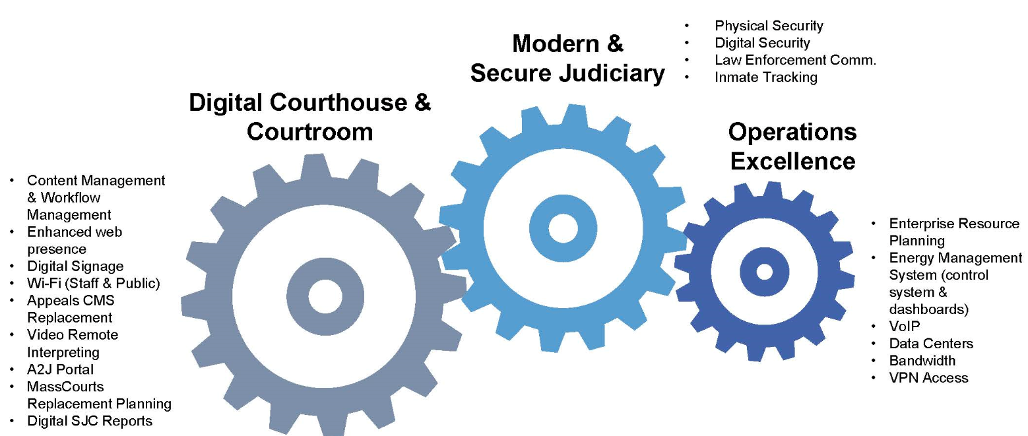
3 Elements of the Judiciary IT Bond Bill

Slide 6
Preliminary Bond Bill Roadmap
2022 | 2023 | 2024 | 2025 | 2026 | 2027 | 2028 | 2029
Digital Caseflow Planning
Digital Caseflow (Content Management & Workflow)
Appellate Planning
Appellate CMS Replacement
MassCourts Replacement Planning
MassCourts Replacement
Data Centers
A2J Portal
A2J Portal
Wifi (public & staff)
VOIP
Reports
VPN
Enterprise Resource Planning
Digital Signage
Video Remote Interpreting
Physical Security
Inmate Track’g
Digital Security
Energy Management System
Bandwidth
Law Enforce
Comm.

Slide 7
Governance
HR
SMEs
IT
Technology Governance Committee
Procurement
Finance
Training
Technology Advisory Group
Project Management Office
(including Change Management)
Project
Project
Project
Project
Project
Project

Slide 8
Digital Courtroom & Courthouse: $94M
Goals
Get documents right place, right time (esp. Judges and Clerks)
Support in-court docketing
Support comprehensive eFiling & ePayment
Improve digital access to case info
Support mobile access
Improve access to court info (public wifi)
Ensure comprehensive digital workflow
Minimize data entry
Initiative | IT cost | Implementation | IT Maintenance
Content and Workflow Management | $29.4M | $6.14M | $8.8M
Digital Signage | $16.9M | $1M | $3.9M
Wifi (Staff & Public) | $9.75M | $9.6M | $2M
Appeals Case Management Replacement | $5.5M | $3M | $1.1M
Video Remote Interpreting | $5.05M | $2.05M | $850K
A2J Portal | $1.4M | $2M | $700K
Case Management Replacement Planning |  | $1M
Digital Court Reports | $474K | $546K | $27K
Notes:
We’re also hearing a lot about Changes Management, Training, PMO, BPR

Slide 9
Modern & Secure Judiciary: $35M
Goals
Improve digital security
Improve physical security
Enhance disaster response
Initiative | IT cost | Implementation | IT Maintenance
Physical Security | $17.6M | $4M | $3M
Digital Security | $5.25M | $2M | $300K
Law Enforcement Comm. | $3.5M | $1.5M | $350K
Inmate Tracking | $725K | $819K | $80K
Notes:
We’re also hearing a lot about Changes Management, Training, PMO, BPR

Slide 10
Operations Excellence: $35M
Goals
Provide the infrastructure to support the digital transformation
Reduce manual processing
Improve timeliness of admin functions
Reduce communications costs (VOIP)
Prepare the court for continued digital future
Initiative | IT cost | Implementation | IT Maintenance
ERP | $9.8M | $2.4M | $2M
Energy Management System (EMS) | $5.25M | $2M | $525K
VoIP | $8M | $1.05M | $1.9M
Data Centers | $2.5M | $478K | $500K
Bandwidth | ----- | $1.61M | $5.45M
VPN Access | $115K | $819K | $95K
EMS Dashboards | $700K | ----- | $200K
Notes:
We’re also hearing a lot about Changes Management, Training, PMO, BPR

Slide 11
Questions

