Slide 1
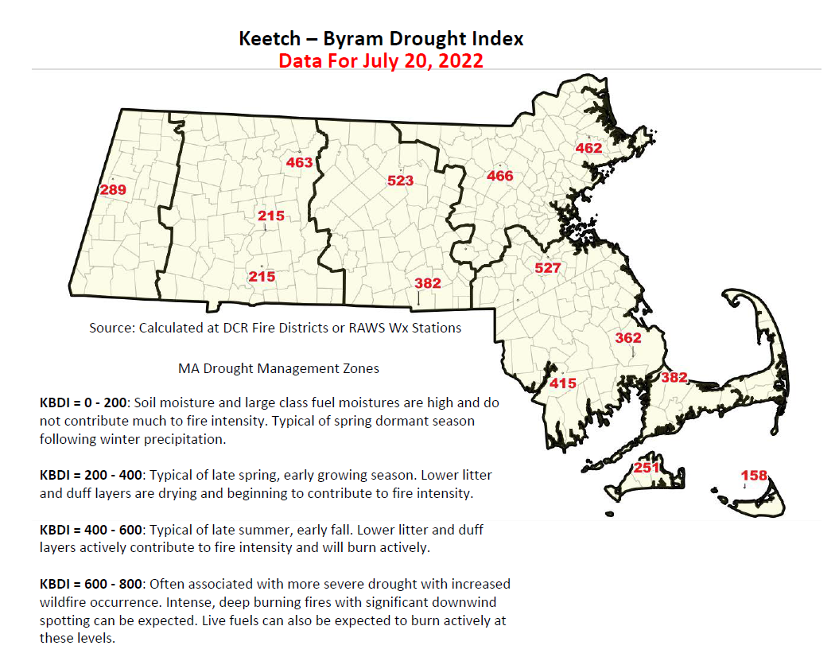

Slide 2
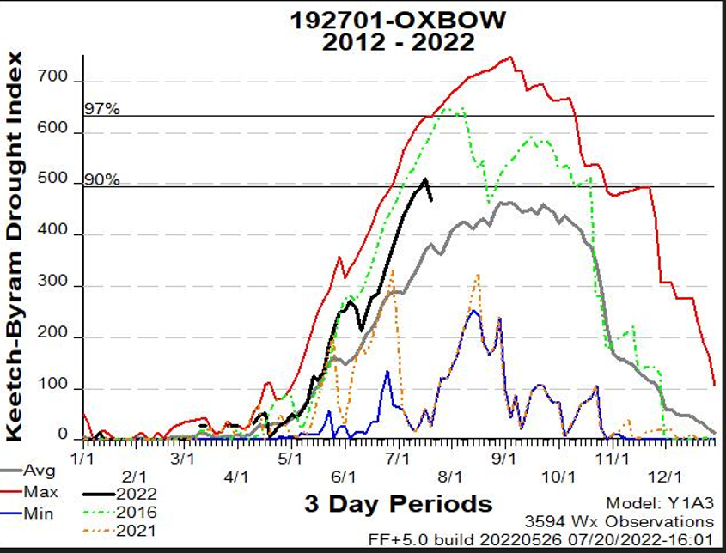
Oxbow RAWS Weather Station, Harvard, MA

