Slide 1

Alumni Roles & Mentorship

Slide 2
What does it mean to be a “Mentor”?
Mentors are people who use their experiences and leadership to help other people grow.
They share:
Guidance
Support
Encouragement
Knowledge
Notes:
Why It’s Important: Provides personal and professional growth.
Builds a supportive, inclusive community.
Helps mentees navigate challenges and reach their potential.

Slide 3
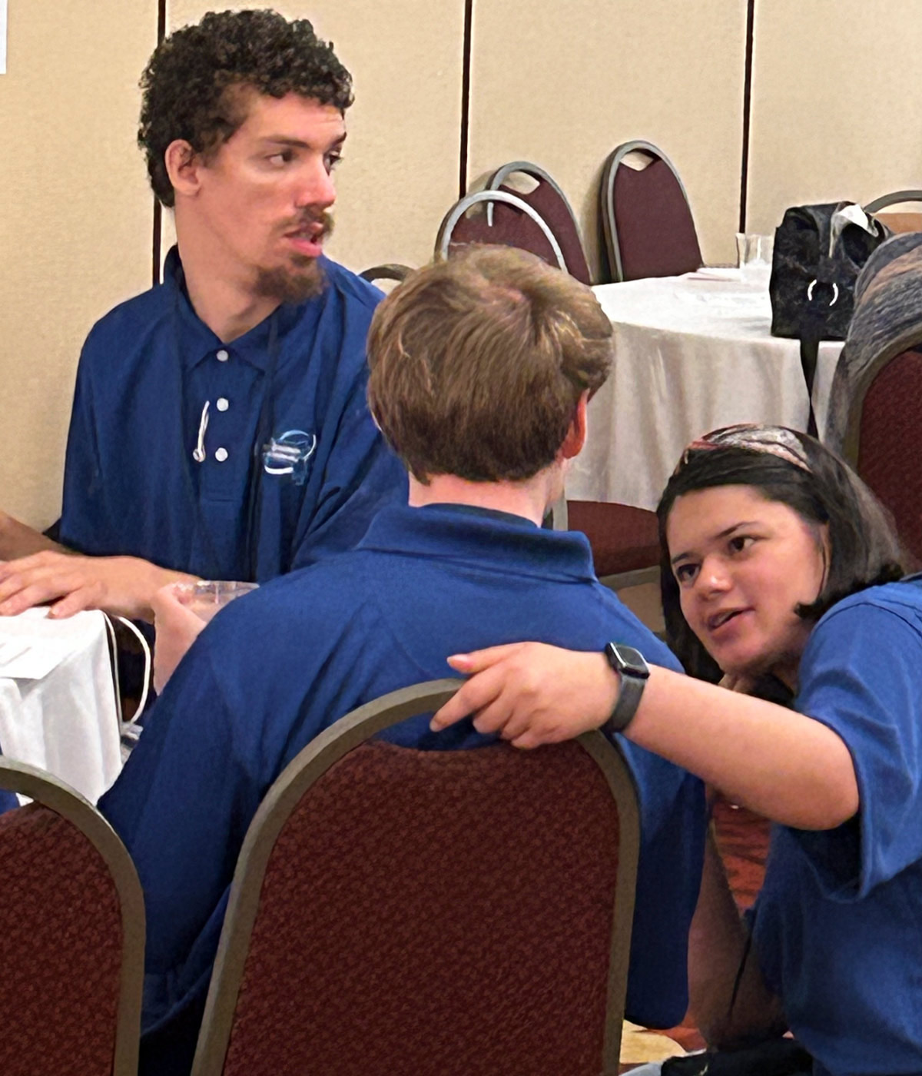
Mentorship at the Spooner Leadership Summit
Spooner Alumni are strong leaders and advocates.
Mentorship can be extra valuable when the mentor and mentee have shared identities or experiences. This includes disability.

Slide 4
Leadership Mindset
We are asking you to put on “leadership training goggles” to prepare to be a mentor for our new Spooner participants!
What are ways that you can be a mentor and help new Spooner participants at this year’s Summit?
Think about how someone could have helped you participate, learn, and grow last year!

Slide 5
Mentorship Ideas
Sit near other mentees during sessions and/or lunch so you can build your relationship.
Make plans together. Let them know if you are attending evening activities or getting breakfast.
Encourage mentees to speak up and participate in sessions. Say “[Mentee], what are your ideas about this?”
Lift them up. Give positive feedback when mentees participate! Tell others about the good work they are doing.
Check-in with mentees. Ask them “How can I support you?”

Slide 6




More Tips for Being a Good Mentor
Active Listening
Listen more than you speak.
Ask your mentee questions
Share your experience, but don’t overshadow your mentee’s journey!
Nurture Growth
Give positive feedback
Empower your mentee to find solutions on their own
Help your mentee participate in the Summit sessions.
Be a Team
Make your mentee feel safe and comfortable.
Celebrate their successes!
Help introduce your mentee to other leaders
Show Flexibility
Adapt to your mentee’s learning style and needs
Find new ways to build connections
Notes:
Value the mentee as a person
Develop mutual trust and respect
Maintain confidentiality
Listen both to what is being said and how it is being said
Advise, do not manage
Stay in your zone of expertise/experience
Focus on the mentee's development, interests, and desired career goals
Help extend the mentee's network – suggest additional mentors to address unique needs

Slide 7
Mentorship Checklist
Do
Create a safe, welcoming environment for your mentee.
Focus on your mentee’s goals and interests
Ask questions to understand their goals and challenges.
Celebrate their successes!
Be adaptable to their learning style and needs.
Don’t
Be unavailable or disengaged.
Dominate the conversation, or talk too much about your views.
Dismiss their feelings or concerns.
Assume you know what’s best for your mentee
Overwhelm them with too much information at once.

Slide 8
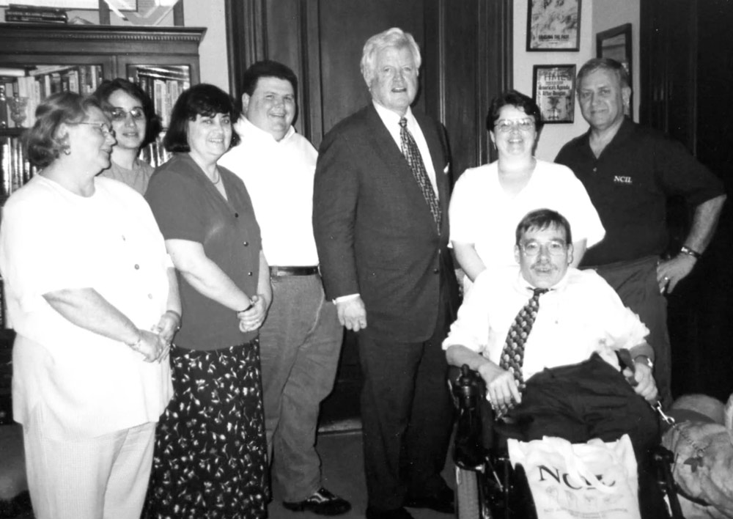
Your mentorship will help build future leaders in the disability community!

Slide 9
Let’s Practice!

Slide 10
Vignette 1: Quiet and Shy Mentee
Scenario: Your mentee is quiet and not participating during the sessions. They avoid group discussions and do not seem engaged.
Goal: How can you encourage your mentee to feel more comfortable sharing their thoughts or asking questions?
Notes:
Questions for Discussion:
How can you encourage your mentee to participate more without making them uncomfortable?
What are some strategies to help them feel included and supported?

Slide 11
Vignette 2: Disrespectful Behavior
Scenario: Your mentee interrupts others during discussions and makes comments that are disrespectful about other participants’ interests. They say that the topics they care about are more important.
Goal: How can you help your mentee be a better teammate to other Spooner participants?
Notes:
Questions for Discussion:
How can you explain to your mentee the importance of being respectful?
What are some ways to frame your feedback so that it helps them improve their behavior without feeling judged?

Slide 12
Vignette 3: Different Opinions
Scenario: During a group activity, your mentee expresses an opinion that is different from others in the group. This creates a disagreement, and people feel strongly on both sides.
Goal: How can you help your mentee navigate disagreement as a leader?
Notes:
Questions for Discussion:
How can you support your mentee in expressing their opinion while also encouraging them to listen to others’ perspectives?
How can you guide them through constructive dialogue?

