Slide 1
2024 Massachusetts Integrated HIV, STI, and Viral Hepatitis Surveillance Report
Massachusetts Department of Public Health
Bureau of Infectious Disease and Laboratory Sciences
December 2025
Notes:
Suggested citation:
Massachusetts Department of Public Health, Bureau of Infectious Disease and Laboratory Sciences. 2024 Massachusetts Integrated HIV, STI and Viral Hepatitis Surveillance Report, https://www.mass.gov/doc/2020-integrated-hivaids-std-and-viral-hepatitis-report/download Published December 2025. Accessed [date].
Bureau of Infectious Disease and Laboratory Sciences
Massachusetts Department of Public Health
Dr. Alfred DeMaria, Jr. Campus
305 South Street
Jamaica Plain, MA 02130
Questions about this report
Tel: (617) 983-6560
To speak to the on-call epidemiologist
Tel: (617) 983-6800
To reach the Reporting and Partner Services Line^{i}
Tel: (617) 983-6999
Questions about infectious disease reporting
Tel: (617) 983-6801
Requests for additional data
https://www.mass.gov/lists/infectious-disease-data-reports-and-requests
Slide set for 2024 Integrated Report
https://www.mass.gov/lists/std-data-and-reports
For additional contact information see HIV, STI, and Viral Hepatitis Program Staff Contact Information
Acknowledgments
We are grateful to healthcare providers and laboratories across the Commonwealth who report HIV, STI, and viral hepatitis diagnoses and corresponding clinical information to the Massachusetts Department of Health (DPH), Bureau of Infectious Disease and Laboratory Sciences (BIDLS). These reports are essential to perform timely epidemiologic investigations and to inform an effective public health response. We also wish to acknowledge the contributions of the many program staff within BIDLS who collect, manage, maintain, and analyze this information and who reviewed draft sections relevant to their areas of expertise.

Slide 2
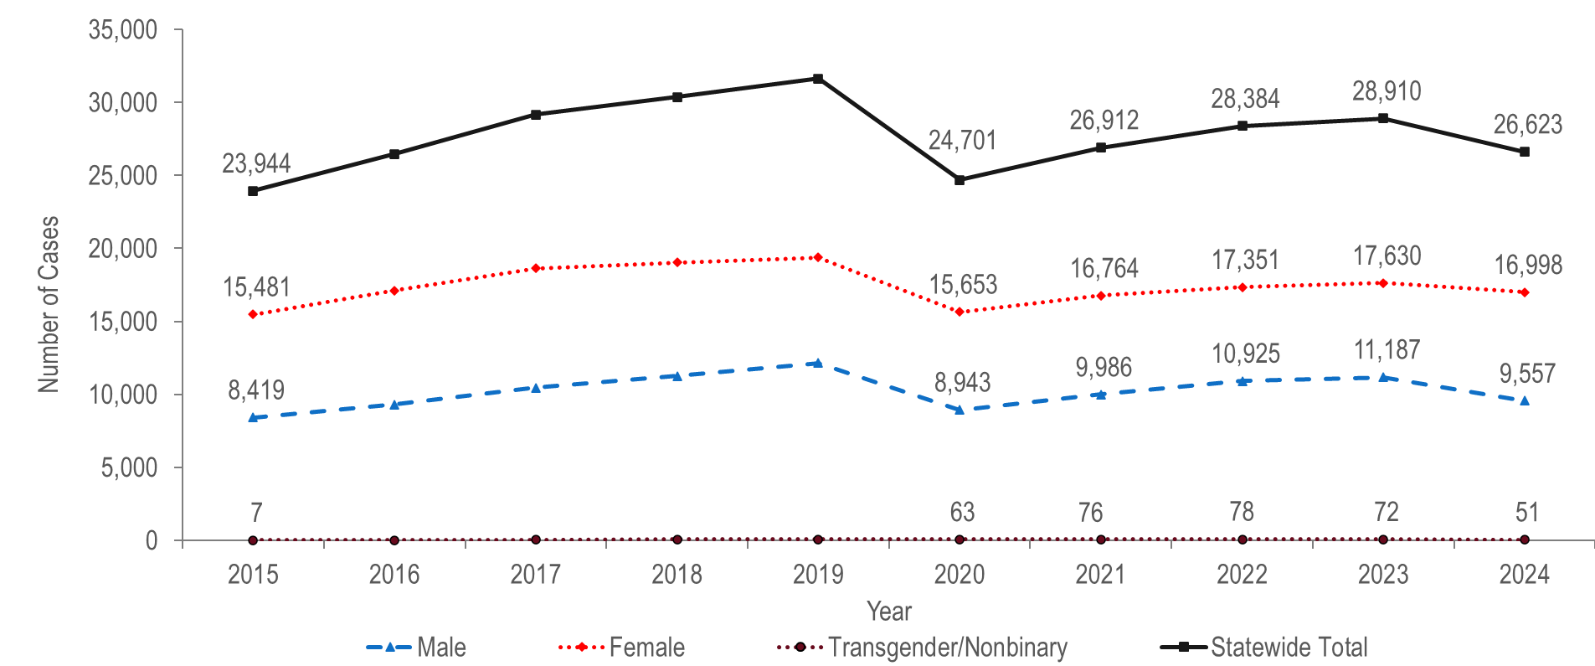
Number of confirmed chlamydia cases reported by gender,
Massachusetts 2015–2024¹
¹ Please consider the impact of the COVID-19 pandemic on infectious disease screening, treatment, and surveillance in the interpretation of data from 2020 to 2022.
Note: Cases with no gender reported (2015–2024: N=337) are included in the statewide total but are not depicted in Figure separately due to small numbers.
Data Source: Bureau of Infectious Disease and Laboratory Sciences, data are current as of 6/2/2025 and subject to change.
Notes:
The figure is a trendline graph displaying the annual number of chlamydia cases for four groups (male gender, female gender, transgender/non-binary, and Statewide total) for each year of the ten-year period.
The total number of confirmed chlamydia cases increased by 32% from 23,944 in 2015 to 31,633 in 2019, decreased to 24,701 in 2020, and then increased to 26,623 in 2024.* A decrease in chlamydia cases in 2020, followed by an increase in 2021 was also observed nationally.**
Each year from 2015 to 2024, nearly twice as many confirmed chlamydia cases were reported among females as among males. In 2024, the ratio of female-to-male chlamydia cases was 1.8 (1.8 = 16,998/9,557).
In 2024, 51 confirmed chlamydia cases were reported among individuals of transgender experience and/or individuals who are nonbinary.***
* Please consider the impact of the COVID-19 pandemic on infectious disease screening, treatment, and surveillance in the interpretation of data from 2020 to 2022.
**CDC, Trends in Reported Cases and Rates of Reported Cases for Nationally Notifiable STDs, United States, 2017-2021*, available at https://www.cdc.gov/std/statistics/2021/default.htm
Pagaoa, Melissa MPH; Grey, Jeremy PhD; Torrone, Elizabeth PhD; Kreisel, Kristen PhD; Stenger, Mark MA; Weinstock, Hillard MD Trends in ***Nationally Notifiable Sexually Transmitted Disease Case Reports During the US COVID-19 Pandemic, January to December 2020, Sexually Transmitted Diseases: October 2021 - Volume 48 - Issue 10 - p 798-804
Please note reported numbers among individuals of transgender experience and individuals who are nonbinary are likely to be underestimates. For more information, see Interpreting HIV, STD, and Viral Hepatitis Data.

Slide 3
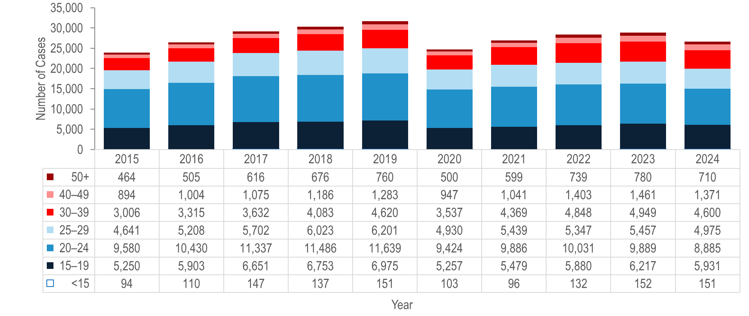
Number of confirmed chlamydia cases reported by age group (years),
Massachusetts 2015–2024¹
¹ Please consider the impact of the COVID-19 pandemic on infectious disease screening, treatment, and surveillance in the interpretation of data from 2020 to 2022.
Note: Cases with no age reported (2015–2024: N=70) are not included in this figure
Data Source: Bureau of Infectious Disease and Laboratory Sciences, data are current as of 6/2/2025 and subject to change
Notes:
The figure is a stacked bar chart displaying the annual number of chlamydia cases for seven age groups (<15, 15-19, 20-24, 25-29, 30-39, 40-49, and 50+) for each year of the ten-year period.
Each year from 2015 to 2024, the greatest number of confirmed chlamydia cases was reported among 20–24 year-olds, followed by 15–19 year-olds. In each of these years over half (56% to 62%) of confirmed chlamydia cases were reported among individuals in these age groups.*
From 2015 to 2024, the number of confirmed chlamydia cases increased among individuals aged under 15 years (by 61%), 30–39 years, 40–49 years, 50+ years, (each by 53%), 15–19 years (by 13%), and 25–29 years (by 7%), while it decreased among individuals aged 20–24 years (by 7%).
*Please consider the impact of the COVID-19 pandemic on infectious disease screening, treatment, and surveillance in the interpretation of data from 2020 to 2022.

Slide 4
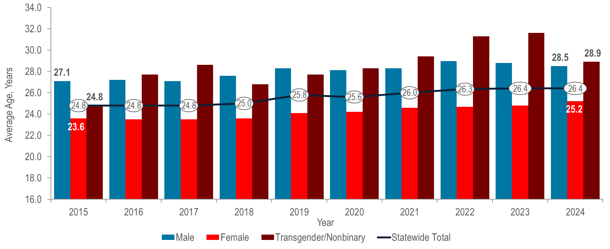
Average age of confirmed chlamydia cases reported by female and male gender, Massachusetts 2015–2024¹
¹ Please consider the impact of the COVID-19 pandemic on infectious disease screening, treatment, and surveillance in the interpretation of data from 2020 to 2022.
Note: Cases with no age reported (2015–2024: N=70) are not included in this analysis.
Data Source: Bureau of Infectious Disease and Laboratory Sciences, data are current as of 6/2/2025 and subject to change
Notes:
The figure is a bar chart displaying the trend in the average age of reported chlamydia cases for the ten-year period for male gender, female gender, transgender/non-binary and the statewide total.
The overall average age of confirmed chlamydia cases in Massachusetts increased from 24.8 years in 2015 to 26.4 years in 2024. This marks the sixth year that the average age has exceeded the CDC recommended screening age range of under 25 years for sexually active women.
From 2015 to 2024, the average age of confirmed chlamydia cases reported among males increased by 1.4 years compared to an increase of 1.6 years among females.
Please consider the impact of the COVID-19 pandemic on infectious disease screening, treatment, and surveillance in the interpretation of data from 2020 to 2022.

Slide 5
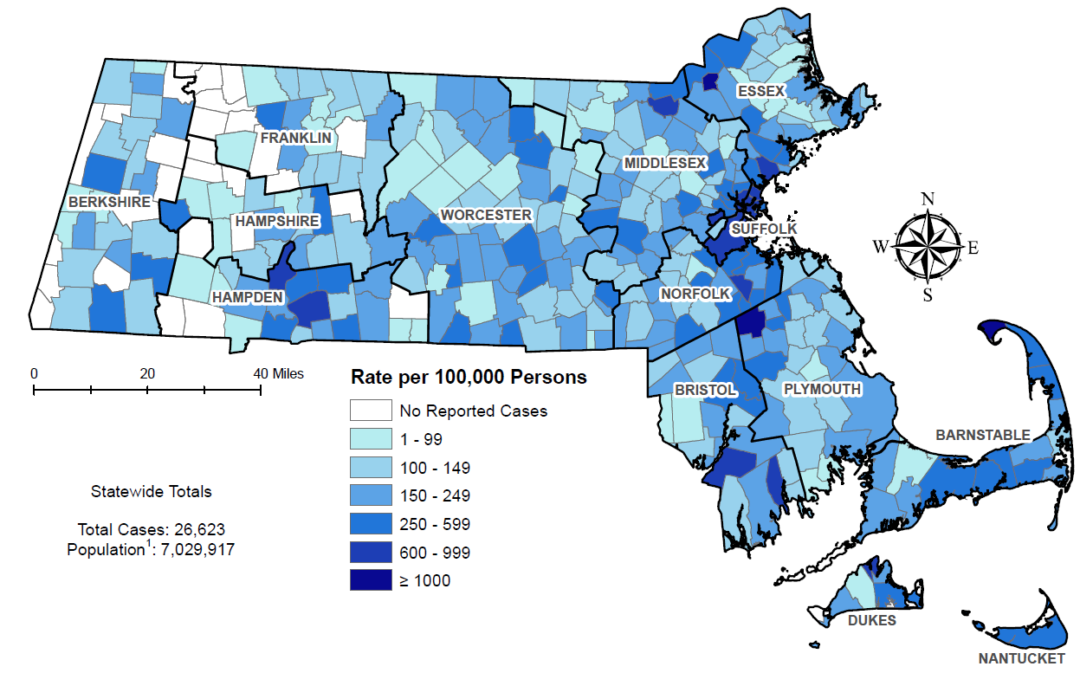
Incidence rate of confirmed chlamydia cases per 100,000 population reported by city/town, Massachusetts 2024
Note: regional data include individuals tested in a correctional facility.
There are no city/towns with <10 cases of chlamydia that fall within the top two rate categories (≥600 cases per 100,000)
Data Source: Bureau of Infectious Disease and Laboratory Sciences, data are current as of 6/2/2025 and subject to change
Notes:
The figure is a rate map of Massachusetts displaying the incidence rate of chlamydia cases per 100,000 population by city/town. Cities and towns are in one of seven categories: no reported cases, less than or equal to 99 per 100,000, 100 – 149 per 100,000, 150 - 249 per 100,000, 250 - 599 per 100,000, or 600 - 999 per 100,000 and greater than or equal to 1000 per 100,000.
Confirmed chlamydia cases continue to be reported throughout Massachusetts, with concentrations in the most populated cities.
The five cities* with the highest confirmed chlamydia incidence rates in 2024 were Provincetown (1,337.3 per 100,000),** Brockton (1,275.0 per 100,000), Lawrence (1,133.0 per 100,000), Chelsea (899.8 per 100,000), and Springfield (883.7 per 100,000).
In 2024, the statewide confirmed chlamydia incidence rate of 378.7 per 100,000 population was lower than the 2023 national rate of 492.2 per 100,000.
While Louisiana ranked first (highest rate) and New Hampshire ranked 50th (lowest rate), Massachusetts ranked 36th in chlamydia incidence rate among the 50 states in 2023, the last year for which these national data are publicly available.***
*Among cities that reported at least 12 confirmed chlamydia cases in 2024.
**The chlamydia incidence rate for Provincetown is high because of small population size (2,583), as opposed to the number of cases (79).
***Centers for Disease Control and Prevention, Sexually Transmitted Infections Surveillance 2023, available at https://www.cdc.gov/sti-statistics/annual/index.html
Centers for Disease Control and Prevention. Sexually Transmitted Infections Surveillance 2023 Atlanta: U.S. Department of Health and Human Services; 2025. Please note, 2023 state rankings are presented because 2024 rankings were not yet available at the time of this publication.

Slide 6
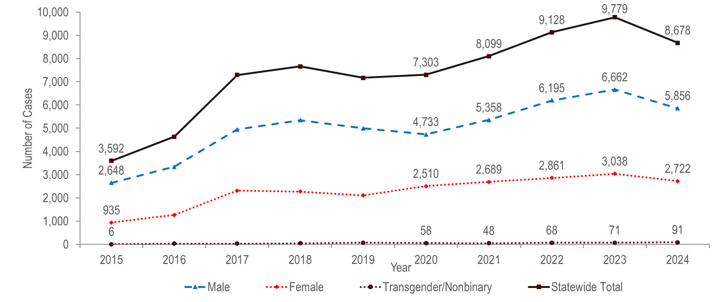
Number of confirmed gonorrhea cases reported by gender,
Massachusetts 2015–2024 ¹
¹ Please consider the impact of the COVID-19 pandemic on infectious disease screening, treatment, and surveillance in the interpretation of data from 2020 to 2022.
Note: Cases with no gender reported (2015–2024: N=37) are included in the statewide total but are not depicted in Figure separately due to small numbers
Data Source: Bureau of Infectious Disease and Laboratory Sciences, data are current as of 6/2/2025 and subject to change
Notes:
The figure is a trendline graph displaying the annual number of gonorrhea cases for four groups (male gender, female gender, transgender/nonbinary and statewide total) for each year of the ten-year period.
After a sharp 57% increase from 2016 (N=4,638) to 2017 (N=7,293), the number of confirmed gonorrhea cases remained relatively stable through 2020 (N=7,303), increased by 34% to 9,779 in 2023, and then decreased by 11% to 8,678 in 2024.¹
Between 2015 and 2024, the number of confirmed gonorrhea cases reported among males increased by 2.2 times (from 2,648 to 5,856, respectively). The number of confirmed gonorrhea cases among males in 2024 was more than double the number among females (2,722), resulting in a male-to-female ratio of 2.2 (2.2 = 5,856/2,722).
The number of confirmed gonorrhea cases reported among females increased by 2.9 times from 935 in 2015 to 2,722 in 2024.
In 2024, 91 confirmed gonorrhea cases were reported among individuals of transgender experience and/or nonbinary individuals.²
¹ Please consider the impact of the COVID-19 pandemic on infectious disease screening, treatment, and surveillance in the interpretation of data from 2020 to 2022.
² Please note reported numbers among individuals of transgender experience and individuals who are nonbinary are likely to be underestimates, for more information see Interpreting HIV, STI, and Viral Hepatitis Data.

Slide 7
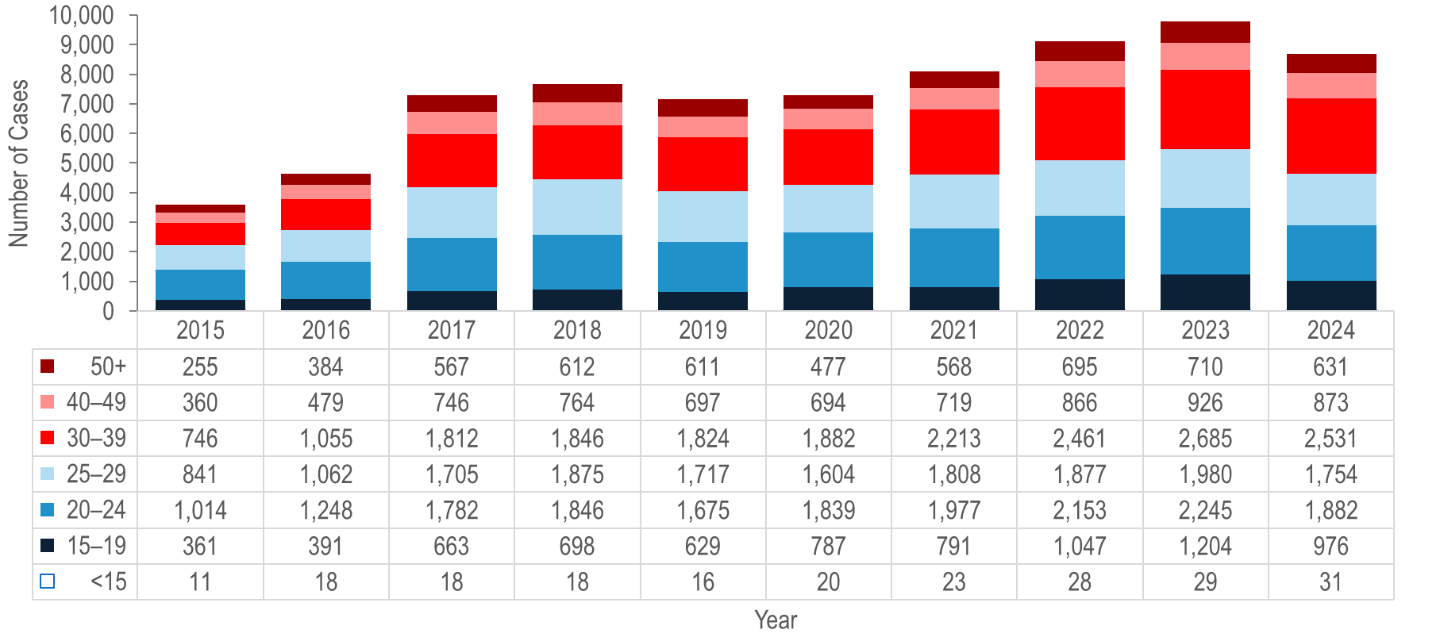
Number of confirmed gonorrhea cases reported by age group (years),
Massachusetts 2015–2024 ¹
¹ Please consider the impact of the COVID-19 pandemic on infectious disease screening, treatment, and surveillance in the interpretation of data from 2020 to 2022.
Note: Cases missing age (2015–2024: N=10) are not included in this figure
Data Source: Bureau of Infectious Disease and Laboratory Sciences, data are current as of 6/2/2025 and subject to change
Notes:
The figure is a stacked bar chart displaying the annual number of gonorrhea cases for seven age groups (<15, 15-19, 20-24, 25-29, 30-39, 40-49, and 50+) each year for the most recent ten-year period.
Each year from 2015 to 2024,¹ about half (42% to 52%) of confirmed gonorrhea cases were reported among individuals aged 20–24 or 25–29 years.
From 2015 to 2024, the largest increase in the number of confirmed gonorrhea cases was among individuals aged 30–39 years (by 3.4 times from 746 to 2,531).
¹ Please consider the impact of the COVID-19 pandemic on infectious disease screening, treatment, and surveillance in the interpretation of data from 2020 to 2022.

Slide 8
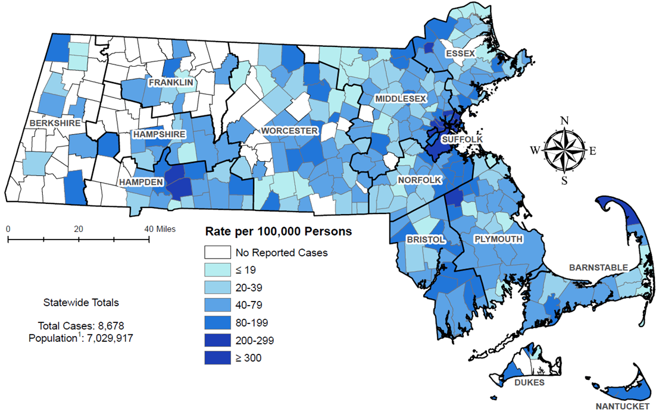
Incidence rate of confirmed gonorrhea cases per 100,000 population¹ reported by city/town, Massachusetts 2024
¹ Population based on University of Massachusetts Donahue Institute Estimates
There is one city/town with <10 cases of gonorrhea that falls within the top two rate categories (≥200 cases per 100,000): Truro.
Note: regional data include individuals tested in a correctional facility.
Data Source: Bureau of Infectious Disease and Laboratory Sciences, data are current as of 6/2/2025 and subject to change
Notes:
The figure is a rate map of Massachusetts displaying the incidence rate of gonorrhea cases per 100,000 population by city/town. Cities and towns are in one of seven categories: no reported cases, less than or equal to 19 per 100,000, 20 - 39 per 100,000, 40 - 79 per 100,000, 80 - 199 per 100,000, or 200 - 299 per 100,000, and greater than or equal to 300 per 100,000.
Confirmed gonorrhea cases continued to be clustered in the most populated cities in Massachusetts in 2024.
The five cities² with the highest incidence rates of confirmed gonorrhea in 2024 were Provincetown (2,538.2 per 100,000),³ Boston (344.6 per 100,000), Brockton (319.0 per 100,000), Springfield (313.0 per 100,000), and Chelsea (286.9 per 100,000).
In 2024, the statewide incidence rate of confirmed gonorrhea of 123.4 per 100,000 population was lower than the 2023 national rate of 179.5 per 100,000.⁴
While Alaska ranked first (highest rate) and Vermont ranked 50th (lowest rate), Massachusetts ranked 31st in gonorrhea incidence rate among the 50 states in 2023, the last year for which these national data are publicly available.⁵
¹ Population based on University of Massachusetts Donahue Institute Estimates
² Among cities that reported at least 12 confirmed gonorrhea cases in 2024.
³ The gonorrhea incidence rate for Provincetown is high because of small population size (2,583), as opposed to the number of cases (93).
⁴ Centers for Disease Control and Prevention, Sexually Transmitted Infections Surveillance 2023, available at https://www.cdc.gov/sti-statistics/annual/index.html
⁵ Centers for Disease Control and Prevention. Sexually Transmitted Infections Surveillance 2023 Atlanta: U.S. Department of Health and Human Services; 2025. Please note, 2023 state rankings are presented because 2024 rankings were not yet available at the time of this publication.

Slide 9
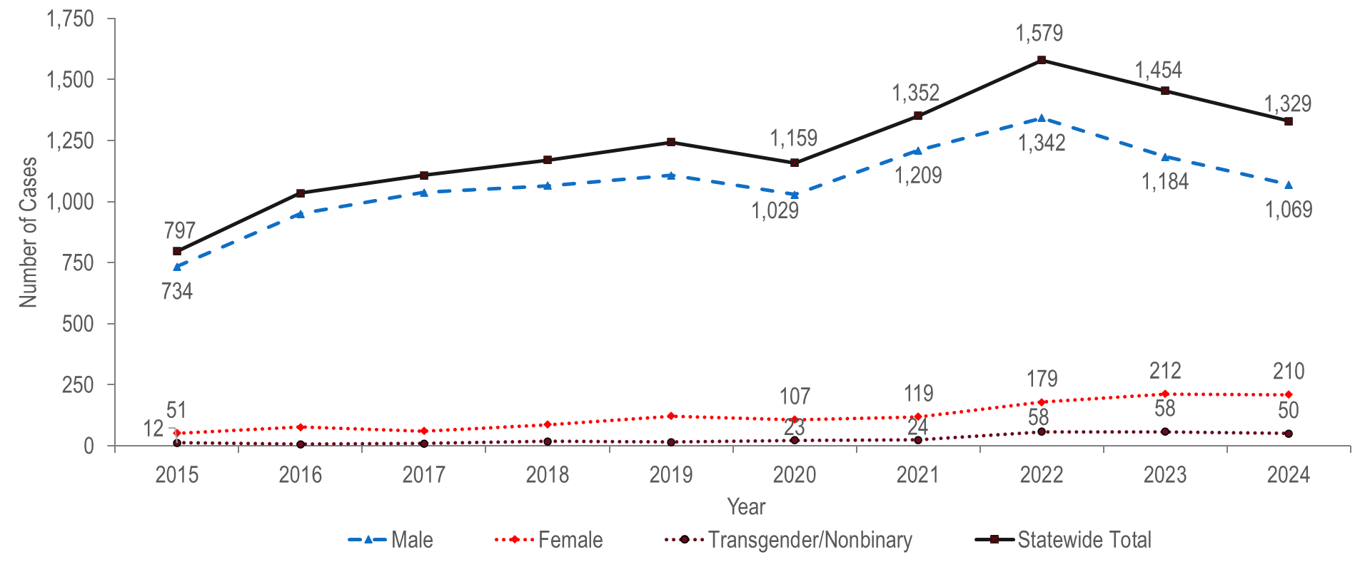
Number of confirmed and probable infectious syphilis cases reported by gender, Massachusetts 2015–2024¹
¹ Please consider the impact of the COVID-19 pandemic on infectious disease screening, treatment, and surveillance in the interpretation of data from 2020 to 2022.
Note: Cases with no gender reported (2015–2024: N=1) are included in the statewide total but are not depicted in Figure separately due to small numbers
Data Source: Bureau of Infectious Disease and Laboratory Sciences, data are current as of 6/2/2025 and subject to change
Notes:
The figure is a trendline graph displaying the number of infectious syphilis cases for four groups (male gender, female gender, transgender/nonbinary and statewide total) for each year of the ten-year period.
The total number of reported confirmed and probable infectious syphilis cases¹ increased to a ten-year high of 1,579 in 2022 and subsequently decreased to 1,329 in 2024.² A ten-year high was observed in 2022 among males (N=1,342) and in 2023 among females (N=212).
The total number of confirmed and probable infectious syphilis cases increased by 1.7 times from 2015 (N=797) to 2024 (N=1,329). In the most recent five years from 2020 to 2024 the number of cases increased by 15% (from 1,159 to 1,329).
Between 2015 and 2024, the proportion of confirmed and probable infectious syphilis cases among males remained between 80% and 94% each year. In 2024, there were 5.1 times as many syphilis cases reported among males (N=1,069) as among females (N=210).
In 2024, 50 confirmed and probable infectious syphilis cases were reported among individuals of transgender experience and/or nonbinary individuals.³
¹ Infectious syphilis includes diagnoses made in the primary, secondary, and early non-primary non-secondary stages of infection (latent asymptomatic syphilis where infection occurred in the past 12 months).
² Please consider the impact of the COVID-19 pandemic on infectious disease screening, treatment, and surveillance in the interpretation of data from 2020 to 2022.
³ Please note reported numbers among individuals of transgender experience and individuals who are nonbinary are likely to be underestimates, for more information see Interpreting HIV, STI, and Viral Hepatitis Data.

Slide 10
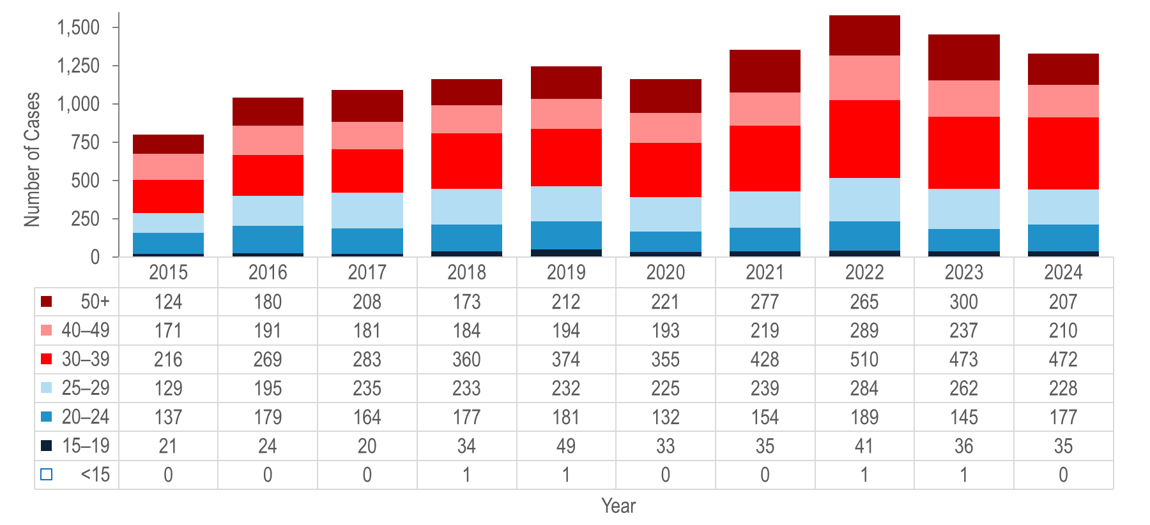
Number of confirmed and probable infectious syphilis cases reported by age group (years), Massachusetts 2015–2024 ¹
¹ Please consider the impact of the COVID-19 pandemic on infectious disease screening, treatment, and surveillance in the interpretation of data from 2020 to 2022.
Note: All syphilis cases from 2015 to 2024 were reported with age, none were excluded from this figure; Infectious syphilis includes diagnoses made in the primary, secondary, and early non-primary non-secondary stages of infection (latent asymptomatic syphilis where infection occurred in the past 12 months). Data Source: Bureau of Infectious Disease and Laboratory Sciences, data are current as of 6/2/2025 and subject to change
Notes:
The figure is a stacked bar chart displaying trends in the annual number of syphilis cases for seven age groups (<15, 15-19, 20-24, 25-29, 30-39, 40-49, and 50+) for the ten-year period.
From 2015 to 2024,¹ the largest increases in the number of reported confirmed and probable infectious syphilis cases were among individuals aged 30–39 years (by 2.2 times from 216 to 472) and 25–29 years (by 77% from 137 to 177).
The largest number of reported confirmed and probable infectious syphilis cases was among 30–39 year-olds for the past decade.
¹ Please consider the impact of the COVID-19 pandemic on infectious disease screening, treatment, and surveillance in the interpretation of data from 2020 to 2022.

Slide 11
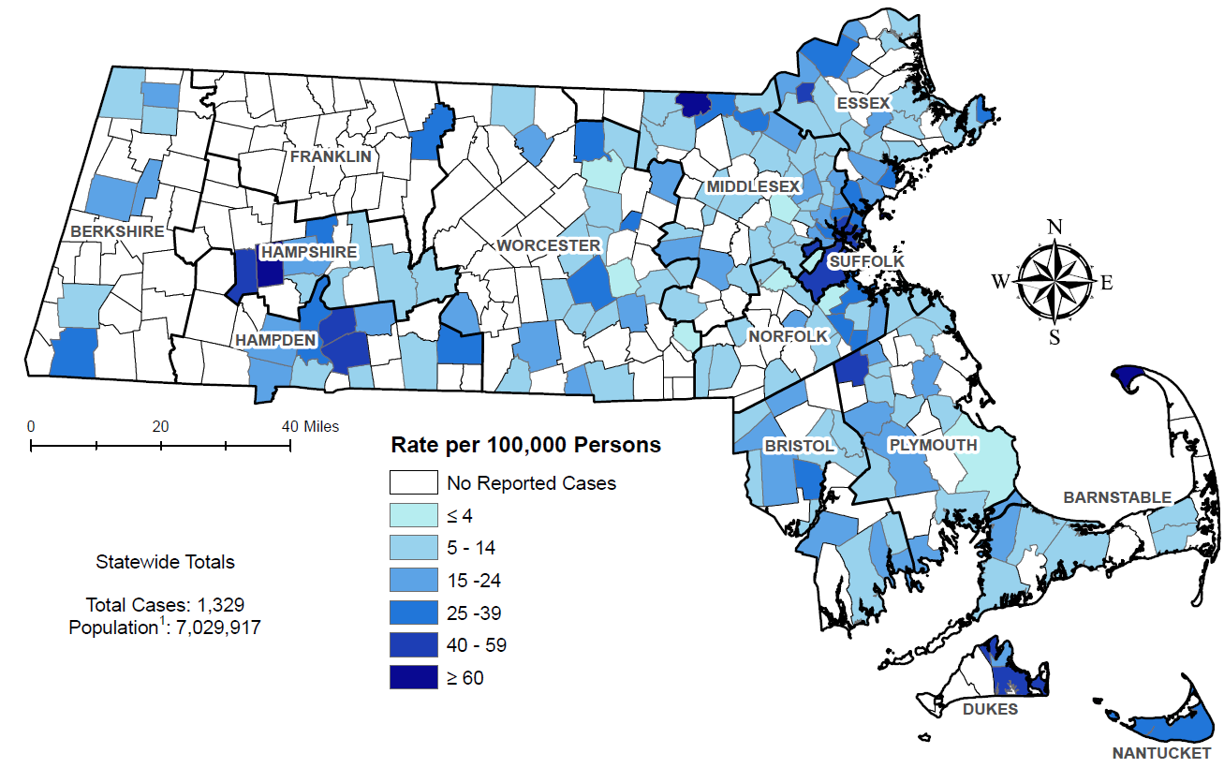
Incidence rate of confirmed and probable infectious syphilis cases per 100,000 population¹ reported by city/town, Massachusetts 2024
¹ Population based on University of Massachusetts Donahue Institute Estimates.
There are seven city/towns with <10 cases of syphilis that fall within the top two rate categories (≥40 cases per 100,00): Huntington, Westhampton, Dunstable, Nahant, Tisbury, Edgartown and Provincetown.
Note: regional data include individuals tested in a correctional facility.
Data Source: Bureau of Infectious Disease and Laboratory Sciences, data are current as of 6/2/2025 and subject to change
Notes:
The figure is a rate map of Massachusetts displaying the incidence rate of syphilis cases per 100,000 population by city/town. Cities and towns are in one of seven categories: no reported cases, less than or equal to 4 per 100,000, 5 - 14 per 100,000, 15 - 24 per 100,000, 25 - 39 per 100,000, or 40 - 59 per 100,000, and greater than or equal to 60 per 100,000.
The statewide confirmed and probable infectious syphilis² incidence rate decreased from a ten-year high of 22.7 in 2022 to 18.9 in 2024.³
The five cities⁴ with the highest confirmed and probable infectious syphilis incidence rates were Lawrence (58.3 per 100,000), Springfield (56.4 per 100,000), Chelsea (56.4 per 100,000), Everett (48.9 per 100,000), and Chicopee (46.8 per 100,000).
While South Dakota ranked first (highest rate) and Vermont ranked 50th (lowest rate), Massachusetts ranked 34th in primary and secondary syphilis incidence rate among the 50 states in 2023, the last year for which these national data are publicly available.⁵
¹ Population based on University of Massachusetts Donahue Institute Estimates.
² Infectious syphilis includes diagnoses made in the primary, secondary, and early non-primary non-secondary stages of infection (latent asymptomatic syphilis where infection occurred in the past 12 months).
³ Please consider the impact of the COVID-19 pandemic on infectious disease screening, treatment, and surveillance in the interpretation of data from 2020 to 2022.
⁴ Among cities that reported at least 12 confirmed syphilis cases in 2024.
⁵ Centers for Disease Control and Prevention. Sexually Transmitted Infections Surveillance 2023 Atlanta: U.S. Department of Health and Human Services; 2025. Please note, 2023 state rankings are presented because 2024 rankings were not yet available at the time of this publication.

Slide 12
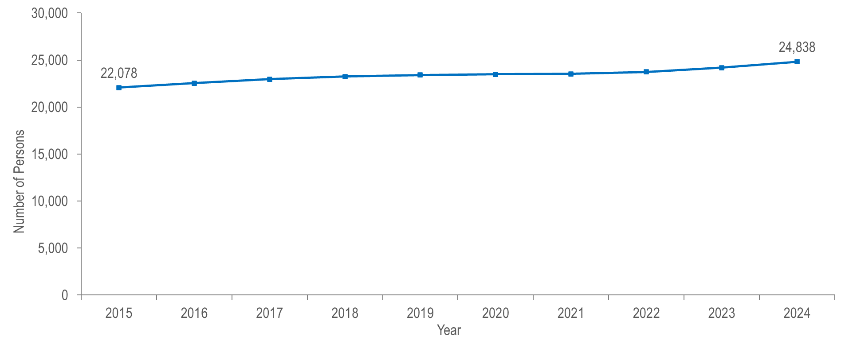
Number of persons living with HIV infection, Massachusetts 2015–2024 ¹
¹ Please consider the impact of the COVID-19 pandemic on infectious disease screening, treatment, and surveillance in the interpretation of data from 2020 to 2022.
Note: 2024 HIV prevalence data are preliminary and subject to change.
Data Source: Bureau of Infectious Disease and Laboratory Sciences, data are current as of 7/1/2025 and subject to change
Notes:
The figure is a trendline displaying the annual number of individuals living with HIV infection from 2015 (N=22,078) to 2024 (N=24,838).
The number of persons living with HIV infection (PLWH) in Massachusetts increased by 13% from 22,078 in 2015 to 24,838 in 2024.^{2,3}
² Please consider the impact of the COVID-19 pandemic on infectious disease screening, treatment, and surveillance in the interpretation of data from 2020 to 2022.
³ 2024 HIV prevalence data are preliminary and subject to change.

Slide 13
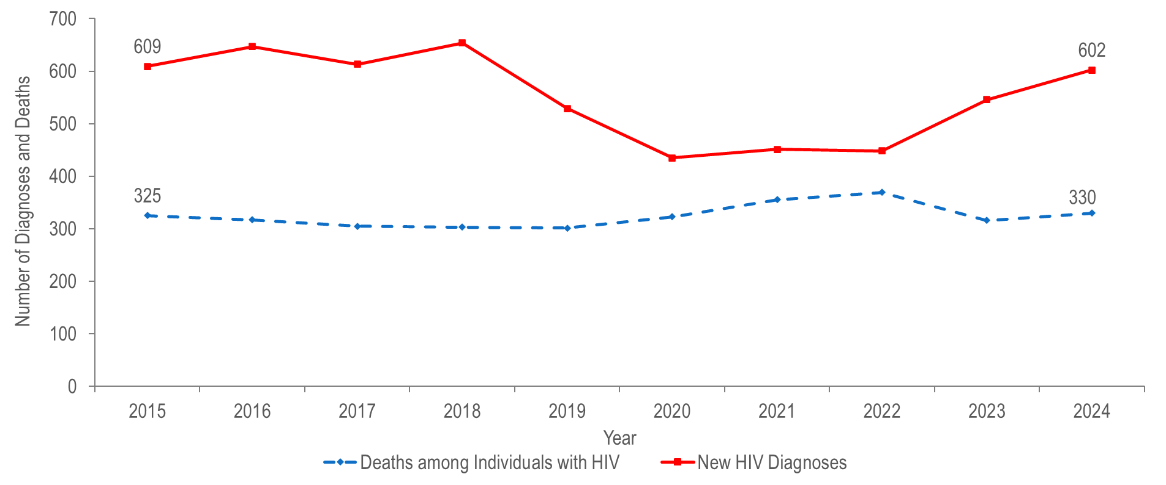
Number of HIV infection diagnoses and deaths from any cause among persons with HIV, Massachusetts 2015–2024 ¹
¹ Please consider the impact of the COVID-19 pandemic on infectious disease screening, treatment, and surveillance in the interpretation of data from 2020 to 2022.
Data Source: Bureau of Infectious Disease and Laboratory Sciences, data are current as of 7/1/2025 and subject to change
Notes:
The figure is a trendline displaying annual changes in the number of new HIV diagnoses and the number of deaths among individuals with HIV for the ten-year period.
After ranging from 609 to 654 from 2015 to 2018, the number of new HIV infection diagnoses declined to 529 in 2019. In 2020, the number of new HIV infection diagnoses further declined to 435 and then remained at this lower level in 2021 and 2022, when there were 451 and 448 diagnoses, respectively. However, caution should be used in the interpretation of this decline and subsequent stabilization due to the impact of COVID-19 on access to HIV testing and care services, and case surveillance activities. The number of new HIV infection diagnoses returned to pre-pandemic levels in 2023 (N=546), increasing by 22% compared to the prior year, and then by an additional 10% in 2024 (N=602).¹
The number of deaths due to any cause among individuals reported with HIV infection increased by 14% from 325 in 2015 to a peak of 369 in 2022 and then decreased by 11% to 330 in 2024.
¹ Please consider the impact of the COVID-19 pandemic on infectious disease screening, treatment, and surveillance in the interpretation of data from 2020 to 2022.

Slide 14
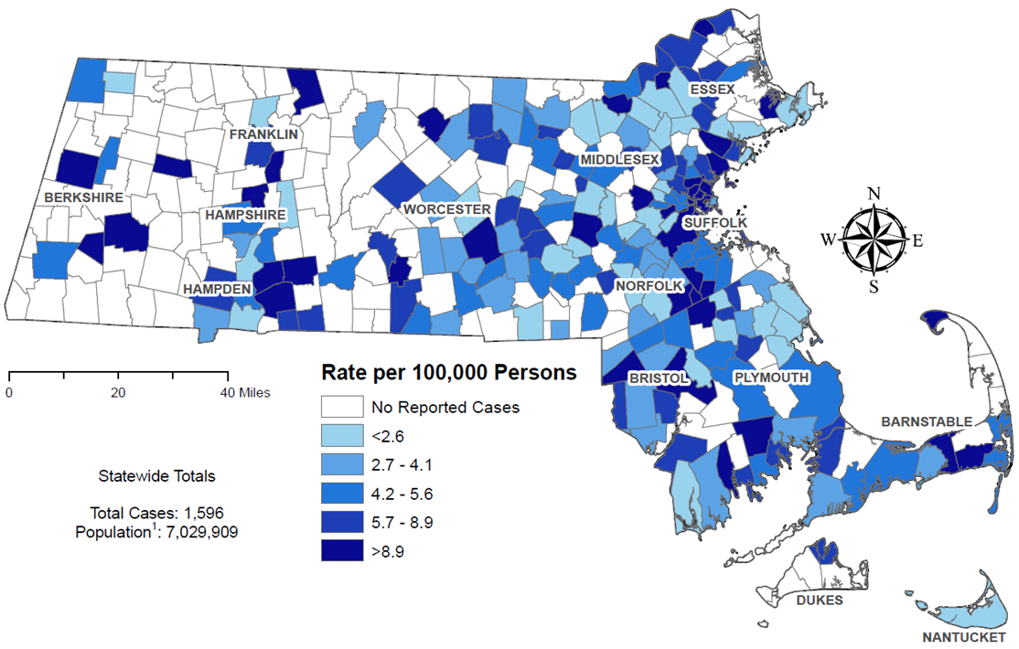
Average annual rate of HIV diagnosis per 100,000 population¹ by city/town, Massachusetts 2022–2024 ²
¹ Population based on University of Massachusetts Donahue Institute Estimates.
² Please consider the impact of the COVID-19 pandemic on infectious disease screening, treatment, and surveillance in the interpretation of data from 2020 to 2022.
Note: regional HIV data exclude individuals diagnosed in a correctional facility.
Data Source: Bureau of Infectious Disease and Laboratory Sciences, data are current as of 7/1/2025 and subject to change
Notes:
The figure is a rate map of Massachusetts displaying the average annual rate of diagnosis per 100,000 population by city/town. Cities and towns are in one of six categories: no reported cases, less than 2.6 per 100,000, 2.7-4.1 per 100,000, 4.2-5.6 per 100,000, 5.7-8.9 per 100,000, or greater than 8.9 per 100,000.
The cities and towns² with the highest average annual rate of HIV infection diagnosis during 2022 to 2024³ included Brockton (30.3 per 100,000), Everett (21.1), Chelsea (19.6), Randolph (18.1), and Boston (17.4).
Boston had the highest number of new HIV infection diagnoses from 2022–2024 (N=352), followed by Brockton (N=96).
² Among cities that reported at least 12 HIV infections during 2022-2024. City/town is based on residence at HIV infection diagnosis and excludes individuals diagnosed in a correctional facility.
³ Please consider the impact of the COVID-19 pandemic on infectious disease screening, treatment, and surveillance in the interpretation of data from 2020 to 2022.

Slide 15
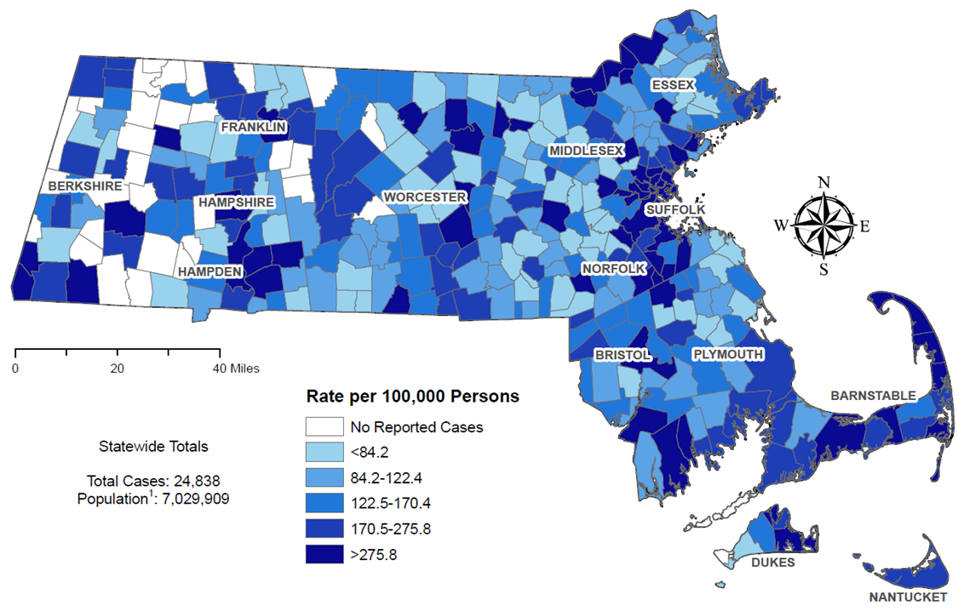
Prevalence rate of persons living with HIV infection (PLWH) per 100,000 population¹ by city/town, Massachusetts 2024
¹ Population based on University of Massachusetts Donahue Institute Estimates.
Note: regional HIV data may include PLWH who may have been incarcerated in 2023.
Data Source: Bureau of Infectious Disease and Laboratory Sciences, data are current as of 7/1/2025 and subject to change
Notes:
The figure is a rate map of Massachusetts displaying the HIV prevalence rate per 100,000 population by city/town. Cities and towns are in one of six categories: no reported cases, less than 84.2 per 100,000, 84.2-122.4 per 100,000, 122.5-170.4 per 100,000, 170.5-275.8 per 100,000, or greater than 275.8 per 100,000.
The cities and towns² with the highest prevalence rate of PLWH in 2024 included Provincetown (12,313.6 per 100,000), Ayer (861.0), Boston (853.0), Springfield (846.5), and Chelsea (789.5).³
Boston and Springfield had the highest numbers of PLWH in 2024, at 5,763 and 1,320, respectively.
² Among cities that reported at least 50 PLWH in 2024. City/town is based on residence at HIV infection diagnosis and may include PLWH who may have been incarcerated in 2024.
³ The rates of HIV prevalence for Provincetown, and Ayer are high because of small population sizes (3,663 and 8,479, respectively), as opposed to the number of cases (451 and 73, respectively). The rate of HIV prevalence in Ayer is also high due to the inclusion of incarcerated individuals housed at Federal Medical Center (FMC) Devens.

Slide 16
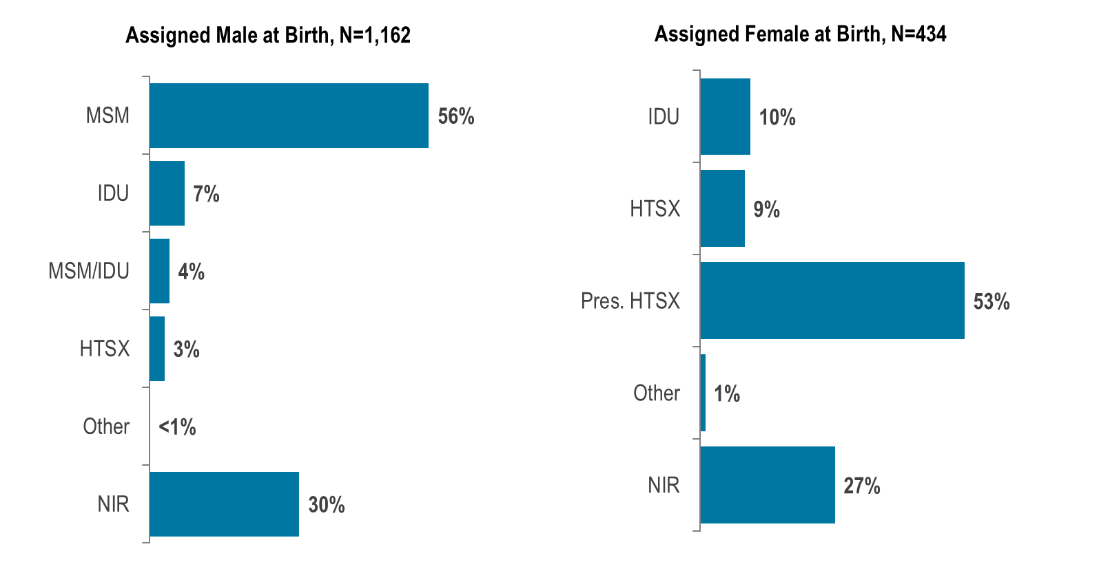
Percentage of HIV infection diagnoses by sex assigned at birth ¹ and exposure mode, Massachusetts 2022–2024 ²
¹ Data reflect sex assigned at birth and therefore not gender identity or gender expression of transgender individuals.
² Please consider the impact of the COVID-19 pandemic on infectious disease screening, treatment, and surveillance in the interpretation of data from 2020 to 2022. MSM=male-to-male sex; IDU=injection drug use; HTSX=heterosexual sex; Pres. HTSX=presumed heterosexual exposure, includes individuals assigned female at birth with a negative history of injection drug use who report having sex with an individual that identifies as male of unknown HIV status and risk; NIR=no identified risk; Data Source: Bureau of Infectious Disease and Laboratory Sciences, data are current as of 7/1/2025 and subject to change
Notes:
The figure is a set of two bar charts, one on the left displaying the distribution of individuals assigned male at birth (N=1,162) and diagnosed with HIV infection by exposure mode and the other on the right displaying the distribution of individuals assigned female at birth (N=434) and diagnosed with HIV infection by exposure mode.
From 2022 to 2024,² of the 1,596 HIV infections newly diagnosed in Massachusetts, 1,162 (73%) were among individuals assigned male at birth (AMAB) and 434 (27%) were among individuals assigned female at birth (AFAB). Among the 1,596 HIV infections, 33 (2%) were among individuals of transgender experience,³ and 1,563 (98%) were among cisgender individuals.⁴
From 2022 to 2024, the most frequently reported known exposure mode among individuals AMAB was male-to-male sex (56%) and among individuals AFAB was presumed heterosexual sex⁵ (53%). A substantial proportion of diagnoses among both individuals AMAB and AFAB were reported with no identified risk (30% and 27%, respectively).
Among individuals AMAB, the proportion of HIV infection diagnoses with injection drug use (IDU) exposure mode increased from 7% (N=33/447) in 2015 to 16% (N=75/456) in 2017, decreased to 9% (N=35/389) in 2019, increased to 17% in 2021 (N=55/316), and then decreased again to 6% (N=24/432) in 2024.
Among individuals AFAB, the proportion of HIV infection diagnoses with IDU exposure mode increased from 10% (N=17/162) in 2015 to 25% (N=40/157) in 2017, decreased to 18% (N=25/140) in 2019, increased to 22% in 2020 (N=27/122), and then decreased again to 11% (N=19/170) in 2024.
² Please consider the impact of the COVID-19 pandemic on infectious disease screening, treatment, and surveillance in the interpretation of data from 2020 to 2022.
³ Please note reported numbers among individuals of transgender experience and individuals who are nonbinary are likely to be underestimates, for more information see Interpreting HIV, STI, and Viral Hepatitis Data.
⁴ Persons whose current gender identity corresponds with their sex assigned at birth.
⁵ Presumed heterosexual exposure includes individuals assigned female at birth with a negative history of injection drug use who report having sex with an individual that identifies as male of unknown HIV status and risk.

Slide 17
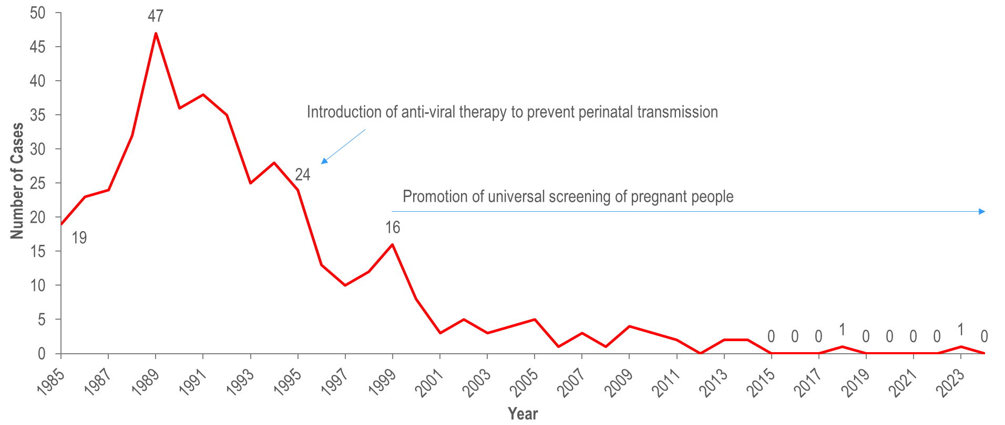
Number of reported cases of perinatal transmission of HIV infection, by year of birth, Massachusetts 1985–2024 ¹
¹ Please consider the impact of the COVID-19 pandemic on infectious disease screening, treatment, and surveillance in the interpretation of data from 2020 to 2022.
Data Source: Bureau of Infectious Disease and Laboratory Sciences, data are current as of 7/1/2025 and subject to change
Notes:
The figure is a trendline graph displaying changes in the annual number of cases of perinatal transmission of HIV infection each year from 1985 to 2024 by year of birth. The text, “Introduction of anti-viral therapy to prevent perinatal transmission” has an arrow indicating that this happened in the year 1995 and the text “Promotion of universal screening of pregnant people” has a long arrow indicating that this began in 1999.
Since the mid-1990s, there has been a dramatic reduction in perinatal transmission of HIV infection related to high rates of antiretroviral treatment of HIV positive people and promotion of HIV screening during pregnancy.
There were only two cases identified in the past ten years (one in 2018 and one in 2023).

Slide 18
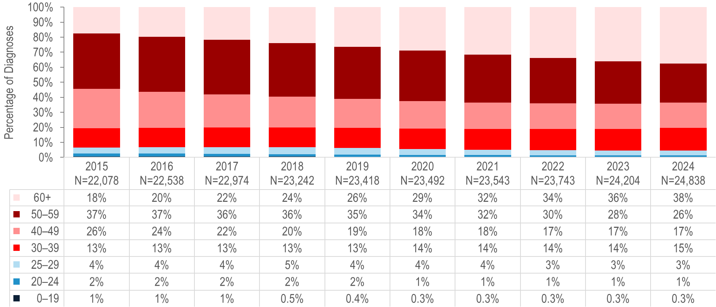
Percentage distribution of individuals living with HIV infection by age on
December 31, Massachusetts 2015–2024 ¹
¹ Please consider the impact of the COVID-19 pandemic on infectious disease screening, treatment, and surveillance in the interpretation of data from 2020 to 2022.
Data Source: Bureau of Infectious Disease and Laboratory Sciences, data are current as of 7/1/2025 and subject to change
Notes:
The figure is a stacked bar chart displaying the percentage distribution of persons living with HIV infection by age (0-19, 20-24, 25-29, 30-39, 40-49, 50-59, 60+ years) for each year of the ten-year period.
Because of effective HIV treatment, people diagnosed with HIV infection are living longer, healthier lives. The proportion of people living with HIV infection who were aged 60 years or older increased from 18% on December 31, 2015 to 38% on December 31, 2024.^{1,2}
¹ Please consider the impact of the COVID-19 pandemic on infectious disease screening, treatment, and surveillance in the interpretation of data from 2020 to 2022.
² 2024 HIV prevalence data are preliminary and subject to change.

Slide 19
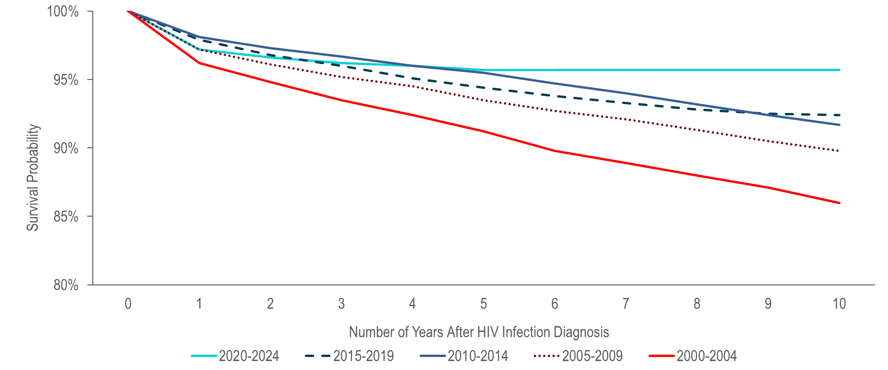
Ten-year survival among individuals with HIV infection by year of diagnosis,
Massachusetts 2000–2024 (Total number of HIV diagnoses from 2000–2024, N=17,912) ¹
¹ Please consider the impact of the COVID-19 pandemic on infectious disease screening, treatment, and surveillance in the interpretation of data from 2020 to 2022.
Please note that actual ten-year survival is only available for individuals diagnosed in 2015 in the 2015–2019 cohort and not available for any individuals diagnosed in the most recent cohort (2020–2024).
Data Source: Bureau of Infectious Disease and Laboratory Sciences, data are current as of 7/1/2025 and subject to change
Notes:
The figure is a trendline that displays the percent of individuals alive less than 1 – 10 years after HIV infection diagnosis for 5 cohorts by year of HIV infection diagnosis: 2000-2004, 2005-2009, 2010-2014, 2015-2019, 2020-2024.
Survival of individuals diagnosed with HIV infection has increased over time. In the earliest cohort of HIV infection diagnoses (2000–2004), estimated survival at ten years after HIV infection diagnosis was 86%, compared to 90% among individuals diagnosed from 2005–2009, 92% among individuals diagnosed from 2010–2014 and from 2014–2018, and 96% among individuals diagnosed from 2020–2024.^{1,2}
¹ Please consider the impact of the COVID-19 pandemic on infectious disease screening, treatment, and surveillance in the interpretation of data from 2020 to 2022.
² Please note that actual ten-year survival is only available for individuals diagnosed in 2015 in the 2015–2019 cohort and not available for any individuals diagnosed in the most recent cohort (2020–2024).

Slide 20
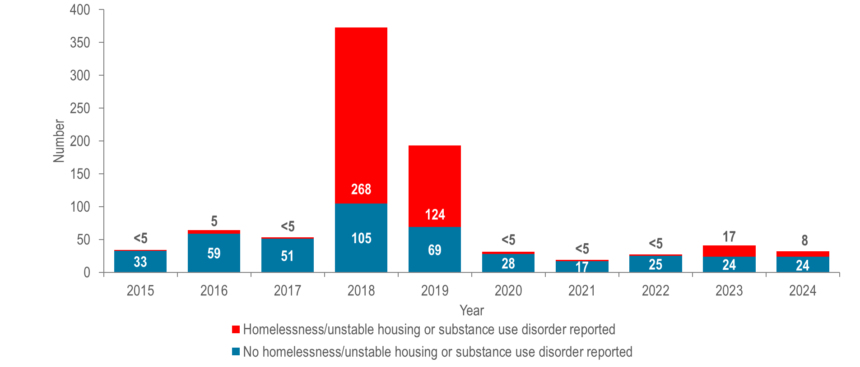
Number of hepatitis A cases reported by year, housing status, and presence of substance use disorder, Massachusetts 2015–2024 ¹
¹ Please consider the impact of the COVID-19 pandemic on infectious disease screening, treatment, and surveillance in the interpretation of data from 2020 to 2022.
Data Source: Bureau of Infectious Disease and Laboratory Sciences, data are current as of 9/3/2025 and subject to change
Notes:
The figure is a stacked bar chart displaying the number of hepatitis A cases reported each year of the ten-year period by housing status (homelessness/unstable housing) and presence of substance use disorder. The number of cases each year with homelessness/unstable housing or substance use disorder reported verses those with no homelessness/unstable housing or substance use disorder reported is displayed.
Between 2018 and 2020, the Massachusetts Department of Public Health (DPH) and local health departments investigated an outbreak of hepatitis A. The populations most affected by the outbreak were those reported with recent homelessness or unstable housing, and/or substance use disorder, accounting for 72% (N=268/373) and 64% (N=124/193) of cases in 2018 and 2019, respectively. DPH partnered with clinical and community-based providers to implement a hepatitis A (HAV) vaccination response by deploying mobile vaccination providers to shelters, correctional facilities, harm reduction programs, and outreach venues. The outbreak was declared over in spring of 2020 and case counts among individuals with homelessness/unstable housing or substance use disorder remained low through 2022. A second, smaller outbreak affecting the same populations was detected in fall 2023, prompting additional vaccination efforts.¹ This outbreak ended in May of 2024 with a total of 24 cases. DPH encourages continued vaccination of populations at high risk of acquiring hepatitis A in accordance with recommendations from the Advisory Committee on Immunization Practices.²
¹ Please consider the impact of the COVID-19 pandemic on infectious disease screening, treatment, and surveillance in the interpretation of 2020 to 2022 data.
² Nelson NP, Weng MK, Hofmeister MG, et al. Prevention of Hepatitis A Virus Infection in the United States: Recommendations of the Advisory Committee on Immunization Practices, 2020. MMWR Recomm Rep 2020;69(No. RR-5):1–38. DOI: http://dx.doi.org/10.15585/mmwr.rr6905a1

Slide 21
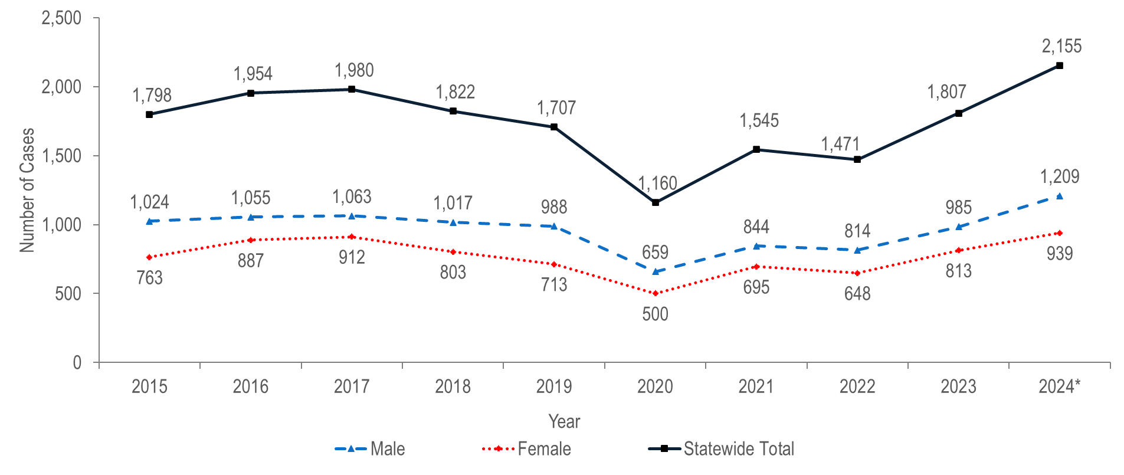
Number of confirmed and probable chronic hepatitis B cases reported by female and male gender, Massachusetts 2015–2024 ¹
¹ Please consider the impact of the COVID-19 pandemic on infectious disease screening, treatment, and surveillance in the interpretation of data from 2020 to 2022.
* Note Hepatitis B case definitions were revised in 2024. Note: Cases reported as transgender or missing gender (2015–2024: N=68) are included in the statewide total but are not depicted in this Figure separately due to small numbers.
Data Source: Bureau of Infectious Disease and Laboratory Sciences, data are current as of 9/03/2025 and subject to change.
Notes:
The figure is a trendline graph displaying the number confirmed and probable chronic hepatitis B cases for three groups (female and male gender and statewide total) for each year for the most recent ten-year period.
From 2015 to 2024,¹ an average of 1,740 cases of confirmed and probable chronic hepatitis B virus (HBV) infection were reported each year (with a low of 1,160 in 2020 and a high of 2,155 in 2024). Changes in testing behaviors and travel due to the COVID-19 pandemic likely influenced the number of reported cases and may contribute to the decrease in 2020, followed by the rebound from 2021 to 2024. Please note that HBV case definitions were revised in 2024. The updated definitions added a probable case classification for acute HBV and broadened the criteria for both chronic and acute HBV.² The recent increase in reported chronic cases may also be partially due to updated screening recommendations introduced in 2023.³
In 2024, 1,209 (56%) of cases of confirmed and probable chronic HBV infection were newly reported among males and 939 (44%) were reported among females.
Hepatitis B in people of childbearing age is of particular concern due to the risk of transmission from pregnant person to infant at birth. Perinatal HBV transmission can be prevented by identifying HBV-positive pregnant people and providing post-exposure prophylaxis (PEP) to their infants within 12 hours of birth. The DPH Perinatal Hepatitis B Prevention Program provides case management to pregnant people who are HBV-positive and their infants to ensure appropriate PEP, vaccination, and post-vaccination serologic testing.
¹ Please consider the impact of the COVID-19 pandemic on infectious disease screening, treatment, and surveillance in the interpretation of data from 2020 to 2022.
² For more information, see: HIV, STI, and Viral Hepatitis Case Classifications
³ For more information, see https://www.cdc.gov/hepatitis-b/hcp/diagnosis-testing/index.html

Slide 22
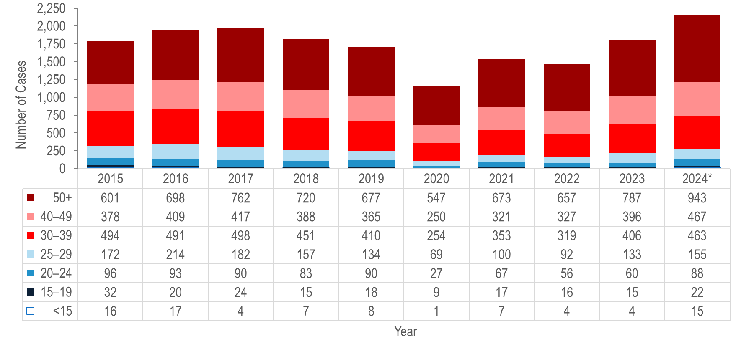
Number of confirmed and probable chronic hepatitis B cases reported by age group (years), Massachusetts 2015–2024 ¹
¹ Please consider the impact of the COVID-19 pandemic on infectious disease screening, treatment, and surveillance in the interpretation of data from 2020 to 2022.
* Note Hepatitis B case definitions were revised in 2024. Note: Cases with no age reported (2015–2024: N=48) are not included in this figure.
Data Source: Bureau of Infectious Disease and Laboratory Sciences, data are current as of 9/03/2025 and subject to change.
Notes:
The figure is a stacked bar chart displaying trends in the annual number of hepatitis B cases for seven age groups (<15, 15-19, 20-24, 25-29, 30-39, 40-49, and 50+) for the ten-year period.
From 2015 to 2024,¹ the largest increase in the number of reported confirmed and probable hepatitis B cases was among individuals aged 50 years and older (by 57% from 601 to 943), followed by individuals aged 40–49 years (by 24% from 378 to 467).
During the same time period, the largest decrease in the number of confirmed and probable hepatitis B cases was among individuals aged 15–19 years (by 31% from 32 to 22), followed by individuals aged 25–29 years (by 10% from 172 to 155).
¹ Please consider the impact of the COVID-19 pandemic on infectious disease screening, treatment, and surveillance in the interpretation of data from 2020 to 2022.

Slide 23
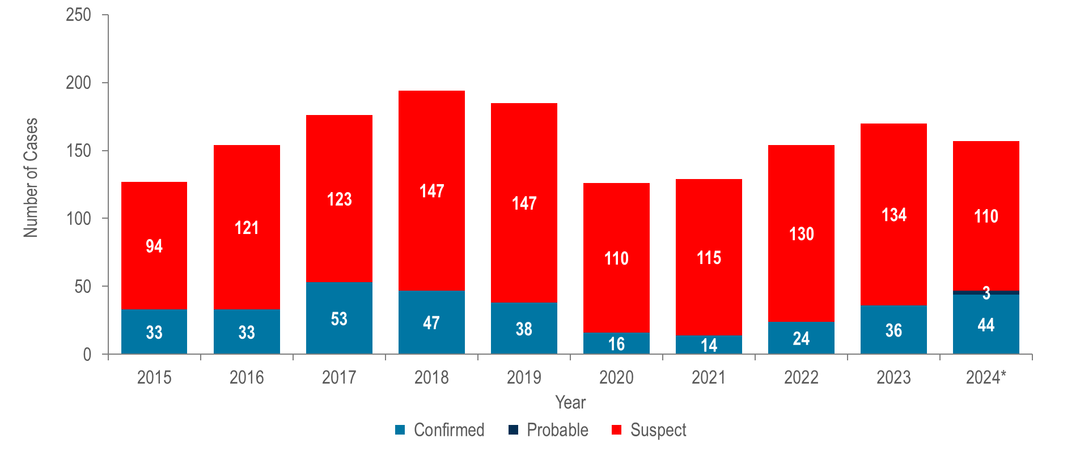
Number of confirmed, probable, and suspect acute hepatitis B cases reported by year, Massachusetts 2015–2024 ¹
¹ Please consider the impact of the COVID-19 pandemic on infectious disease screening, treatment, and surveillance in the interpretation of data from 2020 to 2022.
* Note Hepatitis B case definitions were revised in 2024.
Data Source: Bureau of Infectious Disease and Laboratory Sciences, data are current as of 9/3/2025 and subject to change
Notes:
The figure is a stacked bar chart displaying the number of confirmed, probable, and suspect acute hepatitis B cases each year for the most recent ten-year period.
In 2024, there were 44 confirmed acute, 110 suspect acute, and three probable acute HBV cases for a total of 157 acute cases. Please note that HBV case definitions were revised in 2024. The updated definitions added a probable case classification for acute HBV and broadened the criteria for both chronic and acute HBV.² The updated definition for acute HBV, in particular, means that certain cases that would have been classified as suspect acute in 2023 and earlier are now classified as confirmed acute.
The total number of confirmed acute HBV cases reported decreased from 53 cases in 2017 to 14 cases in 2021 and subsequently increased to 44 cases in 2024. Caution should be used in the interpretation of this decline and subsequent increase due to the impact of COVID-19 on testing behaviors.
Injection drug use (IDU) is a significant, and increasingly important, risk factor for acquisition of acute HBV infection. As shown in Figure 44, 31% (N=41/134) of people reported with acute HBV from 2020 to 2024 reported injection drug use in their incubation period.

Slide 24
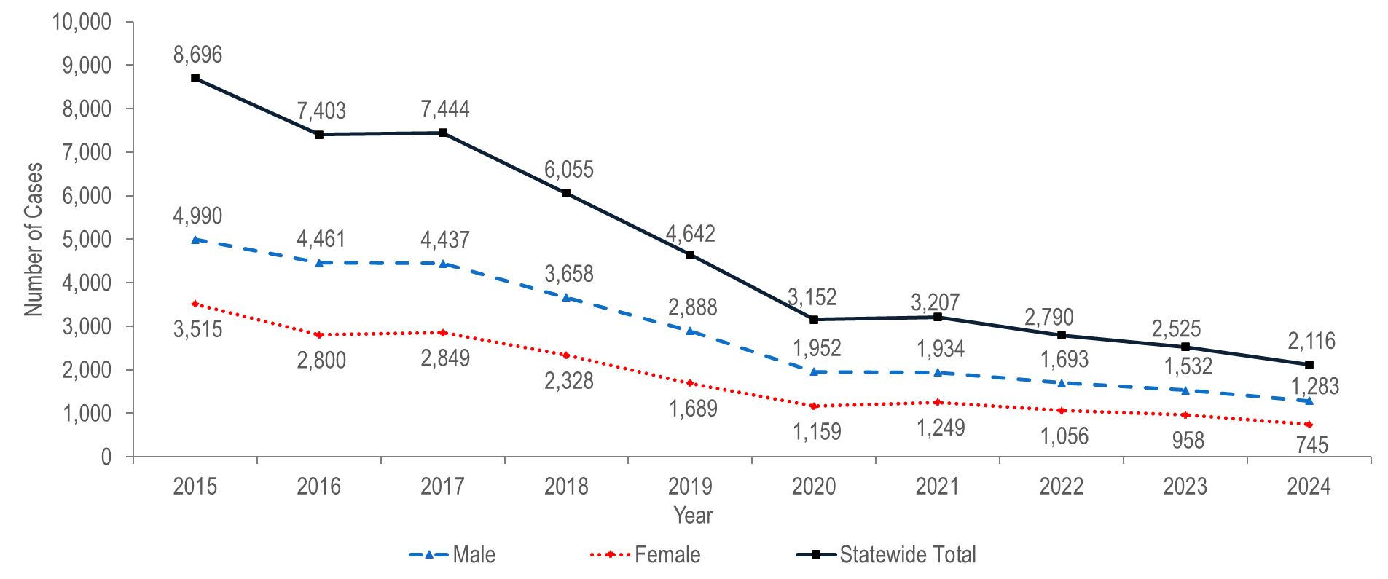
Number of confirmed and probable hepatitis C cases reported by female and male gender, Massachusetts 2015–2024 ¹
¹ Please consider the impact of the COVID-19 pandemic on infectious disease screening, treatment, and surveillance in the interpretation of data from 2020 to 2022.
Note: Cases reported as transgender or missing gender (2015–2024: N=854) are included in the statewide total but are not depicted in Figure separately due to small numbers.
Data Source: Bureau of Infectious Disease and Laboratory Sciences, data are current as of 6/18/2025 and subject to change
Notes:
The figure is a trendline graph displaying the number confirmed and probable chronic HCV cases for three groups (female and male gender and statewide total) for each year of the most recent ten-year period.
The total number of reported confirmed and probable HCV cases decreased by 76% from 8,696 in 2015 to 2,116 in 2024.¹
Most reported cases are chronically infected and DPH currently estimates that there are over 250,000 people living with HCV infection in Massachusetts.
In 2024, 1,283 (61%) cases of confirmed and probable HCV infection were newly reported among males, 745 (35%) were reported among females, and 88 (4%) were reported among individuals with transgender experience or unknown gender.²
¹ Please consider the impact of the COVID-19 pandemic on infectious disease screening, treatment, and surveillance in the interpretation of data from 2020 to 2022.
Please note, in 2016, revised case definitions for acute and chronic HCV infection were implemented that contain significant changes from the case definitions for 2012 to 2015. For further information see https://wwwn.cdc.gov/nndss/conditions/
² Please note reported numbers among individuals of transgender experience and individuals who are nonbinary are likely to be underestimates, for more information see Interpreting HIV, STI, and Viral Hepatitis Data.

Slide 25
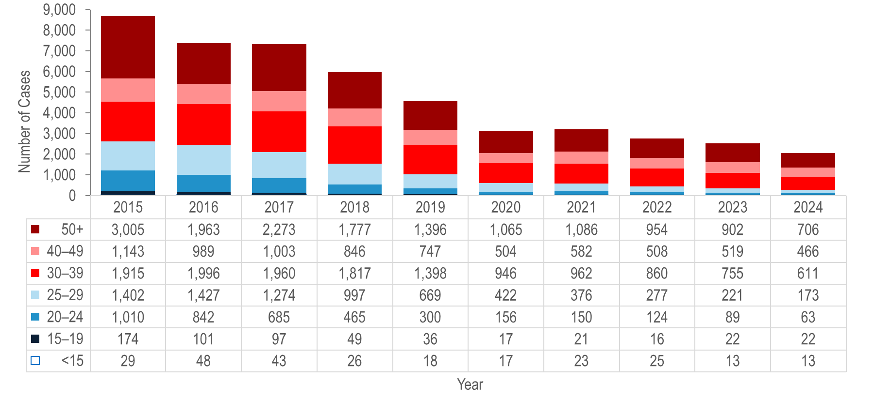
Number of confirmed and probable chronic hepatitis C cases reported by age group (years), Massachusetts 2015–2024 ¹
¹ Please consider the impact of the COVID-19 pandemic on infectious disease screening, treatment, and surveillance in the interpretation of data from 2020 to 2022.
Note: Cases with no age reported (2015–2024: N=444) are not included in this figure.
Data Source: Bureau of Infectious Disease and Laboratory Sciences, data are current as of 6/18/2025 and subject to change.
Notes:
The figure is a stacked bar chart displaying trends in the annual number of hepatitis C cases for seven age groups (<15, 15-19, 20-24, 25-29, 30-39, 40-49, and 50+) for the ten-year period.
Forty percent (N=847/2,116) of HCV cases reported in 2024 were among young adults (age 20–39 years), reflecting ongoing transmission among young people who inject drugs.
From 2015 to 2024, the largest percentage decrease in the number of reported confirmed and probable hepatitis C cases was among individuals aged 20–24 years (by 94% from 1,010 to 63), followed by individuals aged 25–29 years (by 88% from 1,402 to 173) and individuals aged 15–19 years (by 87% from 174 to 22).

Slide 26
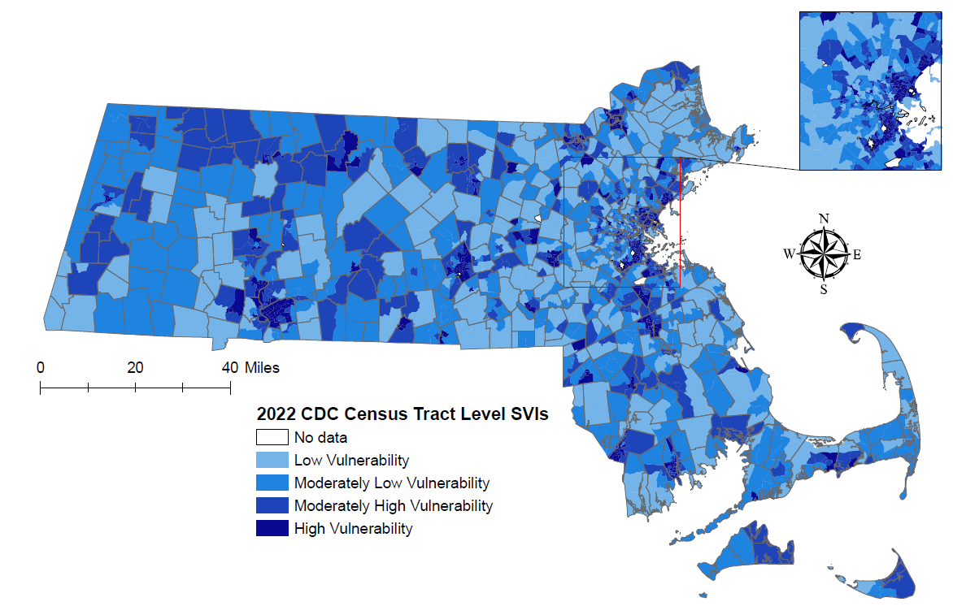
Social Vulnerability Index (SVI) by census tract, Massachusetts
SVI quartiles: (low: <0.25, moderately low: 0.25 – 0.49, moderately high: 0.50 – 0.74, high: ≥0.75)
Note: Census tract level overall SVI values for 2022 were obtained from the CDC/Agency for Toxic Substance and Disease Registry. Values range from 0 to 1, with higher values implying greater social vulnerability. Data Sources: CDC/Agency for Toxic Substance and Disease, Bureau of Infectious Disease and Laboratory Sciences, data are current as of 6/02/2025 and subject to change
Notes:
The figure is a map of Massachusetts displaying the Social Vulnerability Index (SVI) by census tract. The SVI index ranges from 00.00 to 1.00, with increasing darkness in blue color indicating higher SVI index. Census tracts with no reported cases are white. SVI rankings were grouped into quartiles (low, <0.25; moderately low, 0.25 – 0.49; moderately high, 0.5 - 0.74; high >=0.75).
The social vulnerability index (SVI)¹ is a tool to identify socially vulnerable communities that was created by CDC and the Agency for Toxic Substances and Disease Registry (ATSDR). The CDC/ATSDR SVI uses U.S. Census data to determine the social vulnerability of every census tract. The SVI ranks each tract on 16 social factors, including poverty, lack of vehicle access, and crowded housing, and groups them into four related themes: socioeconomic status, household characteristics, racial and ethnic minority status, and housing type/transportation. Each census tract receives a separate ranking for each of the four themes, as well as an overall ranking. Originally developed to incorporate social determinants of health into emergency response and recovery efforts for environmental and natural disasters, more recently, higher SVI has been linked to higher HIV² and STI³ diagnosis rates, COVID-19 mortality, and lower COVID-19 vaccination coverage.⁴
Large cities such as Boston, Springfield, Worcester, Lawrence, Brockton, and Lowell contain the greatest number of census tracts with high social vulnerability (≥ 0.75).
Census tracts with high social vulnerability also appear in many smaller cities and suburbs across the state but are limited to one or a few tracts.
Overall, there are dense urban clusters with widespread high vulnerability and scattered pockets of extreme vulnerability in smaller municipalities.
¹ For more information, see: https://www.atsdr.cdc.gov/placeandhealth/svi/index.html
² Gant, Z., Dailey, A., Hu, X. et al. A Census Tract–Level Examination of Diagnosed HIV Infection and Social Vulnerability among Black/African American, Hispanic/Latinx, and White Adults, 2018: United States. J. Racial and Ethnic Health Disparities (2022). https://doi.org/10.1007/s40615-022-01456-7
³ Copen CE, Haderxhanaj LT, Renfro KJ, Loosier PS. County-Level Chlamydia and Gonorrhea Rates by Social Vulnerability, United States, 2014-2018. Sex Transm Dis. 2022 Dec 1;49(12):822-825.
⁴ Dasgupta S, Bowen VB, Leidner A, et al. Association Between Social Vulnerability and a County’s Risk for Becoming a COVID-19 Hotspot — United States, June 1–July 25, 2020. MMWR Morb Mortal Wkly Rep 2020;69:1535–1541. DOI: http://dx.doi.org/10.15585/mmwr.mm6942a3

Slide 27
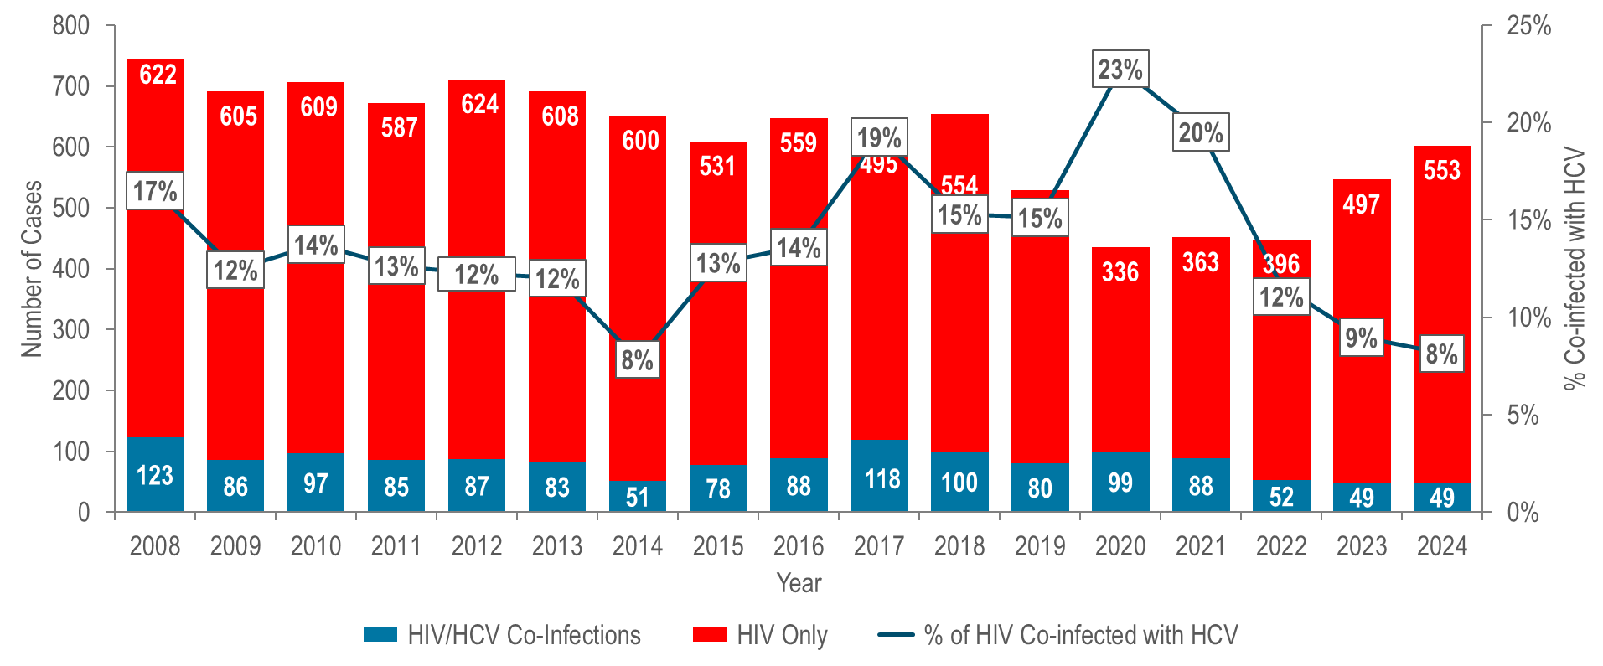
Number of individuals diagnosed with HIV infection only, and ever co-infected with HCV by year of HIV infection diagnosis, Massachusetts 2008–2024 ¹
¹ Please consider the impact of the COVID-19 pandemic on infectious disease screening, treatment, and surveillance in the interpretation of data from 2020 to 2022.
Data Source: Bureau of Infectious Disease and Laboratory Sciences, data are current as of 7/1/2025 and subject to change
Notes:
The figure is a stacked bar chart displaying the number of individuals diagnosed with HIV infection only and the number of individuals co-diagnosed with HIV infection and HCV each year from 2008 to 2024. An overlayed trendline displays the percentage of HIV infection diagnoses that were co-infected with HCV by year.
The percentage of individuals diagnosed with HIV infection who were co-infected with HCV decreased from 17% (N=123/745) in 2008 to 8% (N=51/651) in 2014, increased to 19% (N=118/613) in 2017, decreased to 15% in 2018 (N=100/654), increased again to a 25-year high of 23% (N=99/435) in 2020, and then decreased to 8% (N=49/602) in 2024.^{1,2} This trend mirrors that among HIV infection diagnoses with a primary exposure mode of injection drug use and is likely related to two outbreaks of HIV infection among persons who inject drugs. The first outbreak occurred from 2016 to 2018 in the northeastern part of the state and the second was identified in 2019 in the Boston area and is still ongoing (see Specific Populations – Persons Who Inject Drugs for more information).
¹ Total number of annual HIV diagnoses now excludes those first diagnosed in another state. Previously, all HIV diagnoses, including those first made in another state, were included in the co-infection analysis.
² Please consider the impact of the COVID-19 pandemic on infectious disease screening, treatment, and surveillance in the interpretation of data from 2020 to 2022.

Slide 28
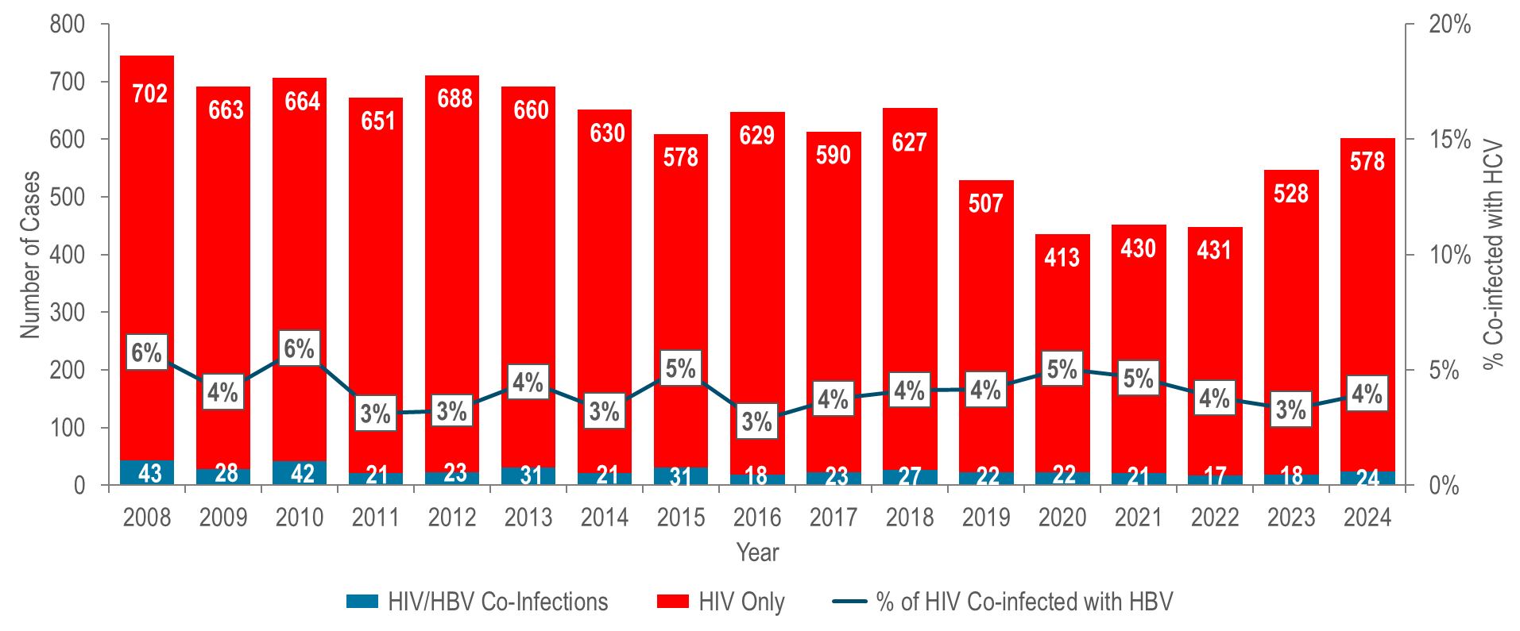
Number of individuals diagnosed with HIV infection only, and ever co-infected with HBV by year of HIV infection diagnosis, Massachusetts 2008–2024 ¹
¹ Please consider the impact of the COVID-19 pandemic on infectious disease screening, treatment, and surveillance in the interpretation of data from 2020 to 2022.
Data Source: Bureau of Infectious Disease and Laboratory Sciences, data are current as of 7/1/2025 and subject to change
Notes:
The figure is a stacked bar chart displaying the number of individuals diagnosed with HIV infection only and the number of individuals co-diagnosed with HIV infection and HBV each year from 2008 to 2024. An overlayed trendline displays the percentage of HIV infection diagnoses that were co-infected with HBV by year.
The percentage of individuals diagnosed with HIV infection who were co-infected with HBV ranged from 3% to 6% from 2008 to 2024.^{1,2}
¹ Total number of annual HIV diagnoses excludes those first diagnosed in another state.
² Please consider the impact of the COVID-19 pandemic on infectious disease screening, treatment, and surveillance in the interpretation of data from 2020 to 2022

Slide 29
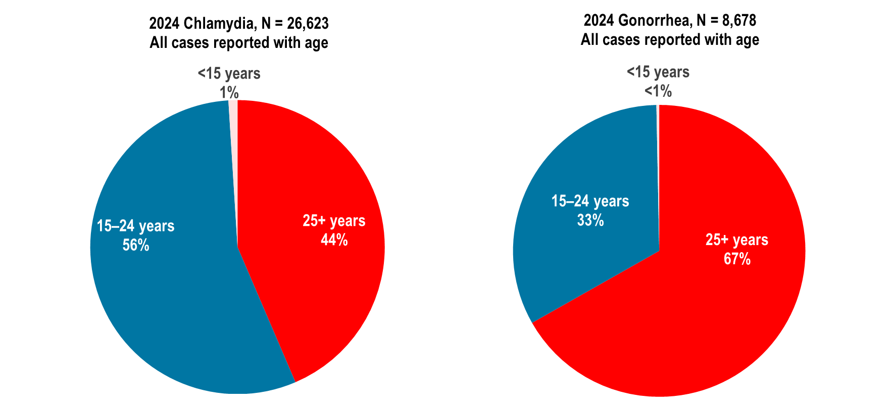
Distribution of confirmed chlamydia and gonorrhea cases reported by age group (years), Massachusetts 2024
Data Source: Bureau of Infectious Disease and Laboratory Sciences, data are current as of 6/2/2025 and subject to change
Notes:
The figure is a set of two side by side pie charts displaying the distribution by age group (15-24 or 25+) for 2024 chlamydia cases (N = 26,623 All cases reported with age) on the left and 2023 gonorrhea cases (N = 8,678 All cases reported with age) on the right.
In 2024, in Massachusetts, 56% of confirmed chlamydia cases and 33% of confirmed gonorrhea cases were reported among adolescents and young adults aged 15–24 years.
Nationally, 57% of chlamydia cases and 39% of gonorrhea cases were reported among adolescents and young adults aged 15–24 years in 2023.¹
¹ Centers for Disease Control and Prevention. Sexually Transmitted Infections Surveillance 2023. Atlanta: U.S. Department of Health and Human Services; 2025. National percentages among 15-24 year-olds also exclude cases of unknown age for comparability with Massachusetts percentages. Please note, 2023 percentages are presented because 2024 percentages by age were not yet available at the time of this publication.

Slide 30
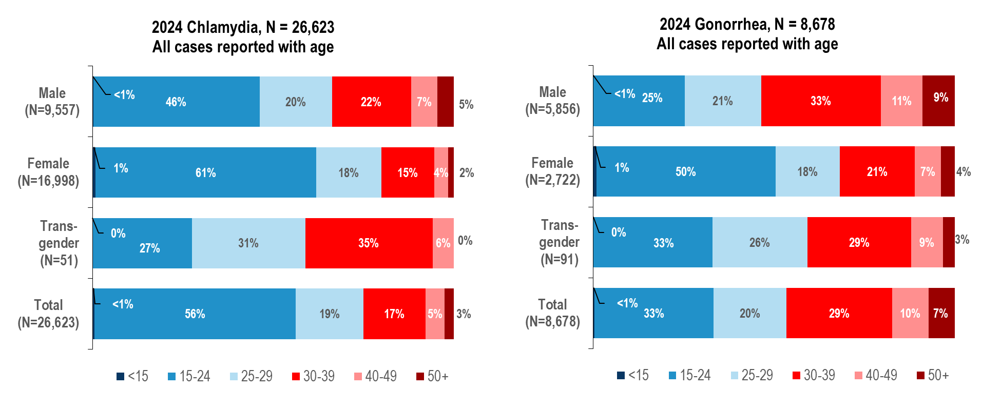
Distribution of confirmed chlamydia and gonorrhea cases reported by age group (years) and gender, Massachusetts 2024
Data Source: Bureau of Infectious Disease and Laboratory Sciences, data are current as of 6/2/2025 and subject to change
Notes:
The figure is a series of two stacked bar charts displaying the distribution by age group (<15,15-24, 25-29, 30-39, 40-49, 50+) for four groups (male gender, female gender, transgender, and total) for chlamydia cases on the left and gonorrhea cases on the right for the most recent year.
In 2024, in Massachusetts, 46% of confirmed chlamydia cases reported among males, 61% among females, 27% among individuals of transgender experience,¹ and 56% of total cases were reported among adolescents and young adults aged 15–24 years.
Nationally in 2023, 46% of chlamydia cases reported among males, 64% among females, and 57% of total cases were reported among adolescents and young adults aged 15–24 years.²
In 2024, in Massachusetts, 25% of confirmed gonorrhea cases reported among males, 50% among females, 33% among individuals of transgender experience, and 33% of total cases were reported among adolescents and young adults aged 15–24 years.
Nationally in 2023, 31% of gonorrhea cases reported among males, 53% among females, and 39% of total cases were reported among adolescents and young adults aged 15–24 years.²
¹ Please note reported numbers among individuals of transgender experience and individuals who are nonbinary are likely to be underestimates, for more information see Interpreting HIV, STI, and Viral Hepatitis Data.
² Centers for Disease Control and Prevention. Sexually Transmitted Infections Surveillance 2023. Atlanta: U.S. Department of Health and Human Services; 2025. National percentages among 15-24 year-olds also exclude cases of unknown age for comparability with Massachusetts percentages. Please note, 2023 national data are presented because 2024 data by age and gender were not yet available at the time of this publication.

Slide 31
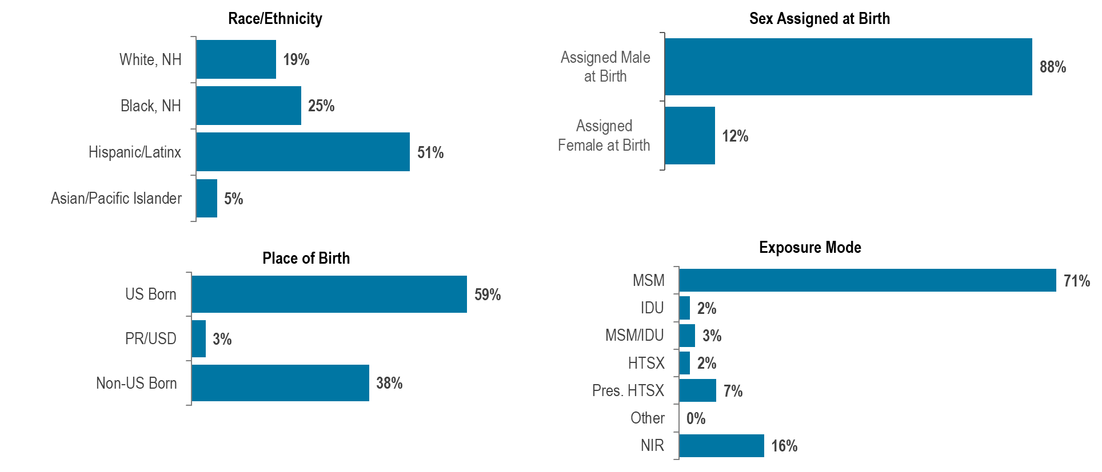
Distribution of HIV infection diagnoses in adolescents and young adults (aged 15–24 years) by race/ethnicity, exposure mode, place of birth, and sex assigned at birth, Massachusetts 2022–2024, N=194 ¹
¹ Please consider the impact of the COVID-19 pandemic on infectious disease screening, treatment, and surveillance in the interpretation of data from 2020 to 2022.
Data Source: Bureau of Infectious Disease and Laboratory Sciences, data are current as of 7/1/2025 and subject to change
Notes:
The figure is a series of four bar charts displaying the distribution of adolescents and young adults diagnosed with HIV infection by race/ethnicity, place of birth, sex assigned at birth, and exposure mode.
During 2022 to 2024, 12% (N=194/1,596) of HIV infection diagnoses were reported among adolescents and young adults aged 15–24 years.
Adolescent and young adults aged 15–24 years newly diagnosed with HIV infection in Massachusetts during 2022 to 2024 were predominantly Hispanic/Latinx (51%), assigned male at birth (88%), and US born (59%), with an exposure mode of male-to-male sex (71%).

Slide 32
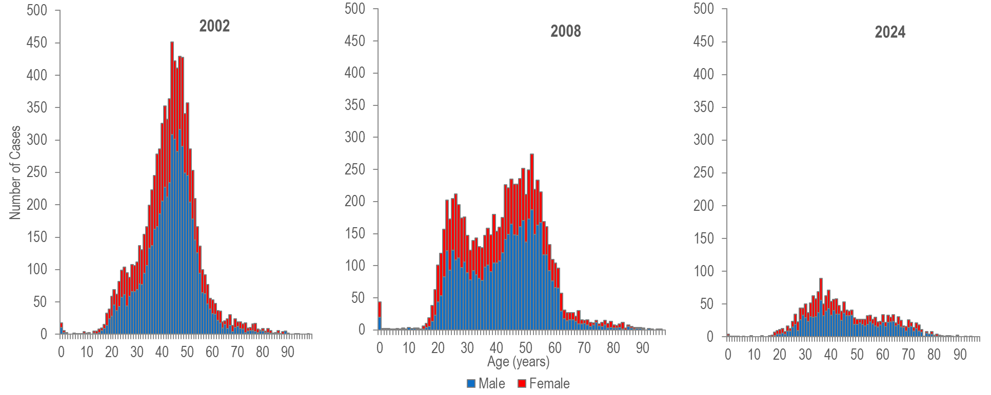
Number of confirmed and probable hepatitis C cases reported by age and female and male gender, Massachusetts 2002, 2008, 2024 ¹
¹ Please consider the impact of the COVID-19 pandemic on infectious disease screening, treatment, and surveillance in the interpretation of data from 2020 to 2022.
Note: Probable and Confirmed HCV 2002, N=9,053 (excludes 159 with missing age and/or gender), 2008 N=8,091 (excludes 595 with missing age and/or gender), 2024 N=2,028 (excludes 88 with missing age and/or gender). Cases reported as transgender are not depicted in this Figure separately due to small numbers. Data Source: Bureau of Infectious Disease and Laboratory Sciences, data are current as of 6/18/2025 and subject to change..
Notes:
The figure is a series of three stacked bar charts displaying the number of both male and female HCV cases reported at each age from 0 to 95 years for the years 2002, 2008 and 2024.
The age distribution of HCV cases reported in Massachusetts changed between 2002 and 2024¹ with a significant increase in the proportion of cases represented by young persons who inject drugs.
In 2002, reported HCV cases were distributed in a curve with one age peak at 44 years.
In 2008, reported cases of HCV were distributed in a curve with two age peaks, with the lower peak at age 26 years and the higher peak at age 52 years.
In 2024, HCV cases among young adults who inject drugs outnumbered newly reported cases among the older (“baby boomer”) age cohort.
The proportion of cases among young adults (aged 20-39 years) was higher in 2008 (39%, N=3,158/8,091) and 2024 (41%, N=837/2,028) compared to 2002 (31%, N=2,803/9,053).
The primary risk for HCV infection in younger adults is injection drug use. While the primary exposure mode for HIV infection in younger adults is male-to-male sex, recent increases in the number of HIV infections attributed to injection drug use have been observed, particularly among young adults (aged 13-39 years).
¹ Please consider the impact of the COVID-19 pandemic on infectious disease screening, treatment, and surveillance in the interpretation of data from 2020 to 2022.

Slide 33
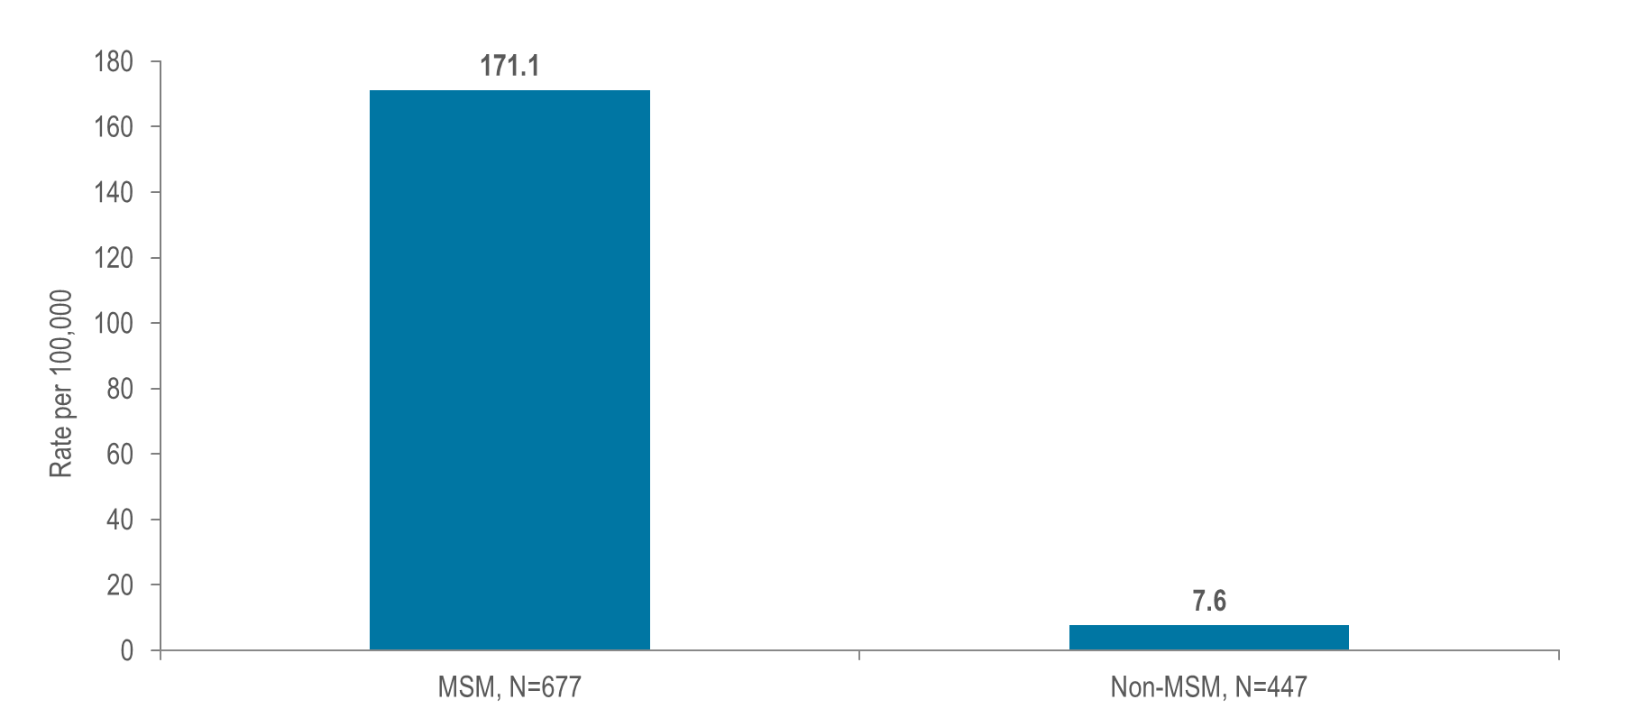
Estimated¹ average annual HIV diagnosis rate per 100,000 population: MSM (men who have sex with men) compared to non-MSM (males) ages 18–64 years: Massachusetts 2022–2024 ²
¹ Multiple source estimation method for MSM rate (2022-2024 BRFSS, UMDI Interim 2020 Population Estimates by Age, Sex, Race, and Municipality, UMass Donahue Institute Population Estimates Program, March 1, 2022; and MDPH Bureau of Infectious Disease and Laboratory Sciences, data as of 7/1/2025)
² Please consider the impact of the COVID-19 pandemic on infectious disease screening, treatment, and surveillance in the interpretation of data from 2020 to 2022.
Notes:
The figure is a bar chart displaying the average annual HIV diagnosis rate for MSM on the left, compared to the average annual HIV diagnosis rate for non-MSM males on the right.
At 171.1 per 100,000 population (95% confidence interval [CI]: 141.8–220.0 per 100,000), the estimated average rate of HIV diagnosis from 2022 to 2024² among MSM (ages 18–64 years) was 23 times the rate of infection in men who did not report sex with men (7.6 per 100,000 [95% CI: 7.5–7.7 per 100,000]).
¹ Multiple source estimation method for MSM rate (2020-2022 BRFSS, UMDI Interim 2020 Population Estimates by Age, Sex, Race, and Municipality, UMass Donahue Institute Population Estimates Program, March 1, 2022; and MDPH Bureau of Infectious Disease and Laboratory Sciences, data as of 7/1/2024)
² Please consider the impact of the COVID-19 pandemic on infectious disease screening, treatment, and surveillance in the interpretation of data from 2020 to 2022.

Slide 34
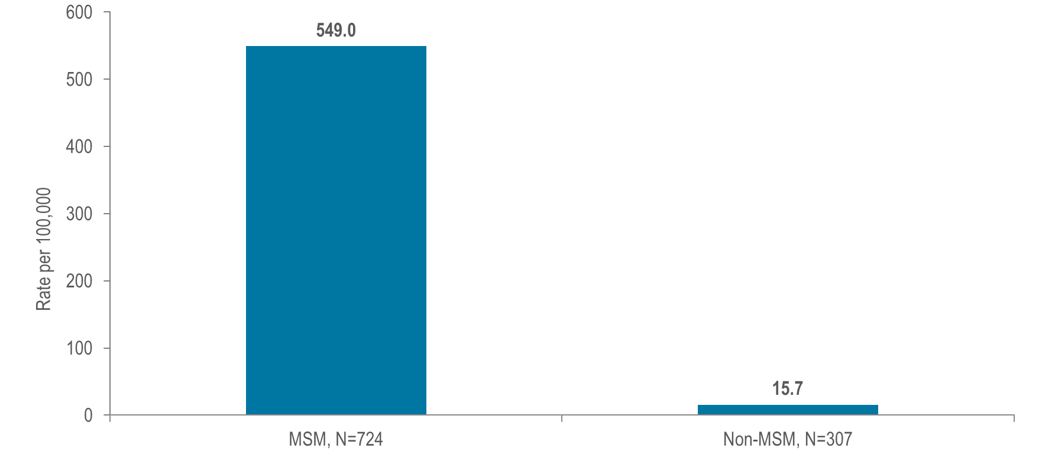
Estimated¹ confirmed and probable infectious syphilis² rate per 100,000 population: MSM compared to non-MSM (males) ages 18–64 years: Massachusetts 2024
¹ Multiple source estimation method for MSM rate (2022–2024 BRFSS, UMDI Interim 2020 Population Estimates by Age, Sex, Race, and Municipality, UMass Donahue Institute Population Estimates Program, March 1, 2022, and MDPH Bureau of Infectious Disease and Laboratory Sciences, data as of 6/2/2025)
² Infectious syphilis includes diagnoses made in the primary, secondary, and early non-primary non-secondary stages of infection (latent asymptomatic syphilis where infection occurred in the past 12 months).
Notes:
The figure is a bar chart displaying the estimated infectious syphilis rate per 100,000 for MSM on the left, compared to the estimated infectious syphilis rate per 100,000 for non-MSM males on the right.
At 549.0 per 100,000 population (95% confidence interval [CI]: 455.1–705.8 per 100,000), the estimated confirmed and probable infectious syphilis rate in 2024 among MSM (ages 18–64) was 35 times the rate of infection in men who did not report sex with men (15.7 per 100,000 [95% CI: 15.4–15.9 per 100,000]).
¹ Multiple source estimation method for MSM rate (2020–2022 BRFSS, UMDI Interim 2020 Population Estimates by Age, Sex, Race, and Municipality, UMass Donahue Institute Population Estimates Program, March 1, 2022, and MDPH Bureau of Infectious Disease and Laboratory Sciences, data as of 7/21/2023)
² Infectious syphilis includes diagnoses made in the primary, secondary, and early non-primary non-secondary stages of infection (latent asymptomatic syphilis where infection occurred in the past 12 months).
³ Please consider the impact of the COVID-19 pandemic on infectious disease screening, treatment, and surveillance in the interpretation of data from 2020 to 2022.

Slide 35
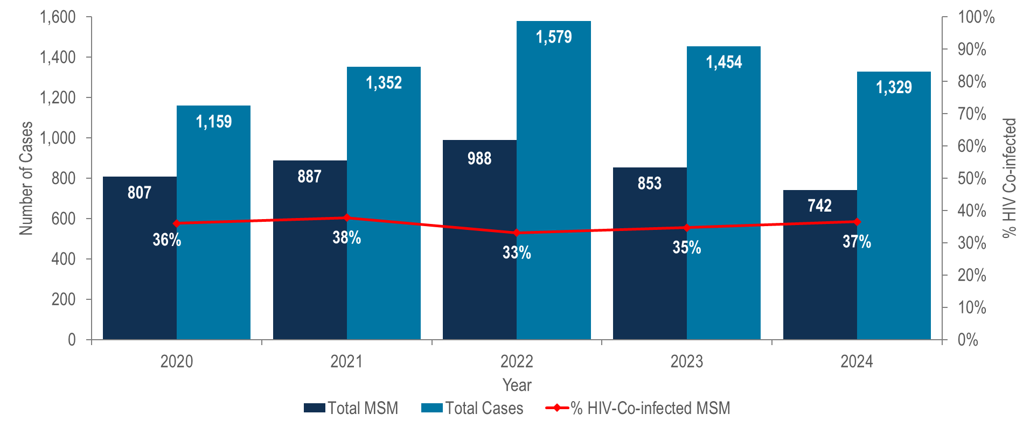
Number of confirmed and probable infectious syphilis ¹ cases among MSM and the percent of cases among MSM known to ever be co-infected with HIV, Massachusetts 2020–2024 ²
¹ Infectious syphilis includes diagnoses made in the primary, secondary, and early non-primary non-secondary stages of infection (latent asymptomatic syphilis where infection occurred in the past 12 months).
² Please consider the impact of the COVID-19 pandemic on infectious disease screening, treatment, and surveillance in the interpretation of data from 2020 to 2022.
Data Source: Bureau of Infectious Disease and Laboratory Sciences, data are current as of 6/2/2025 and subject to change
Notes:
The figure is a bar chart displaying the number of syphilis cases among MSM and total syphilis cases for each year from 2020 to 2024 with an overlaid trendline displaying the percentage of syphilis cases among MSM that were also HIV positive in each of those years.
The incidence of confirmed and probable infectious syphilis in Massachusetts increased by 36% from 2020 to 2022 and subsequently decreased by 16% in 2024; MSM represented the majority of cases (56% in 2024).²
In 2024, 37% (N=271/742) of confirmed and probable infectious syphilis cases among men reporting sex with men also self-reported co-infection with HIV.³
² Please consider the impact of the COVID-19 pandemic on infectious disease screening, treatment, and surveillance in the interpretation of data from 2020 to 2022.
³ Please note that the syphilis/HIV co-infection rate among MSM is based on self-report; not database matching analyses, which were used to calculate HIV/syphilis co-infection rates elsewhere in this report.

Slide 36
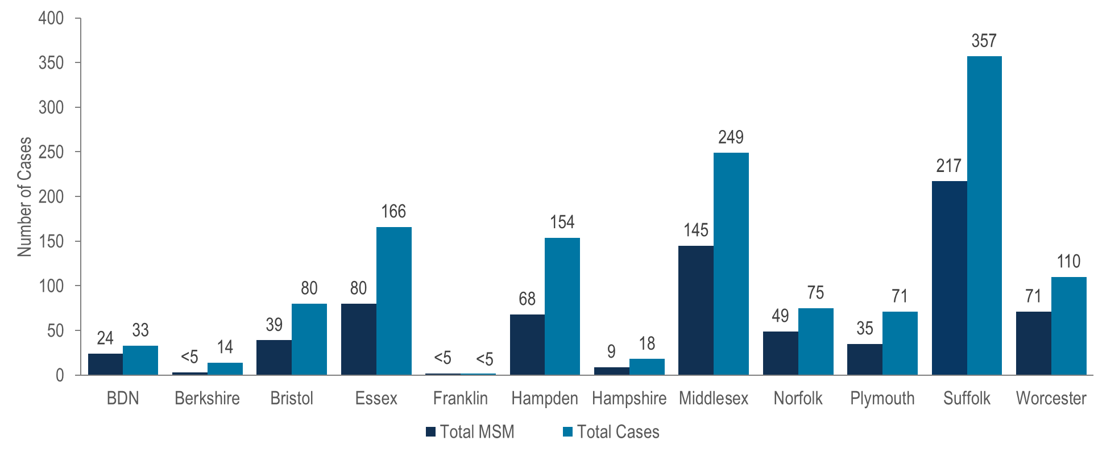
Total number of confirmed and probable infectious syphilis ¹ cases and number among MSM by county, Massachusetts 2024
¹ Infectious syphilis includes diagnoses made in the primary, secondary, and early non-primary non-secondary stages of infection (latent asymptomatic syphilis where infection occurred in the past 12 months).
Note: MSM N=742, missing risk information N=93, other risk N =13, total cases N=1,329; BDN = Barnstable, Dukes and Nantucket Counties, combined because of small numbers.
Data Source: Bureau of Infectious Disease and Laboratory Sciences, data are current as of 6/2/2025 and subject to change.
Notes:
The figure is a bar chart which displays both the total number of syphilis cases and the number of syphilis cases among MSM in each Massachusetts county: Barnstable/Dukes/Nantucket, Berkshire, Bristol, Essex, Franklin, Hampden, Hampshire, Middlesex, Norfolk, Plymouth, Suffolk, and Worcester.
In 2024, the largest proportions of MSM among confirmed and probable infectious syphilis cases were reported in Barnstable, Dukes and Nantucket (73%, N=24/33), Norfolk (65%, N=49/75), and Worcester (65%, N=71/110) counties.

Slide 37
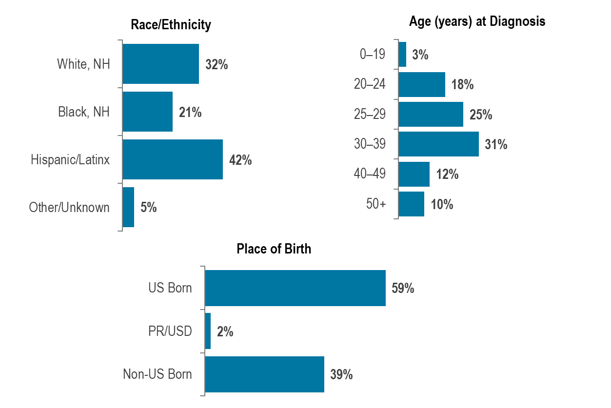
HIV infection diagnoses among men reporting sex with men by race/ethnicity, age at diagnosis, and place of birth, Massachusetts 2022–2024 (N=652) ¹
¹ Please consider the impact of the COVID-19 pandemic on infectious disease screening, treatment, and surveillance in the interpretation of data from 2020 to 2022.
Data Source: Bureau of Infectious Disease and Laboratory Sciences, data are current as of 7/1/2025 and subject to change
Notes:
The figure is a series of three bar chart displaying the percentage distribution of individuals diagnosed with HIV infection with MSM exposure mode by race/ethnicity, age, and place of birth.
Black (non-Hispanic) and Hispanic/Latinx individuals represented 7% and 13% of men in Massachusetts, compared to 21% and 42%, respectively, of men recently diagnosed with HIV infection with MSM exposure mode.
Individuals with MSM exposure mode newly diagnosed with HIV infection in Massachusetts during 2022 to 2024¹ were predominantly in their twenties or thirties (43% 20–29 year-olds, 31% 30–39 year-olds), Hispanic/Latinx (42%) or White (non-Hispanic) (32%), and US born (59%).
¹ Please consider the impact of the COVID-19 pandemic on infectious disease screening, treatment, and surveillance in the interpretation of data from 2020 to 2022

Slide 38
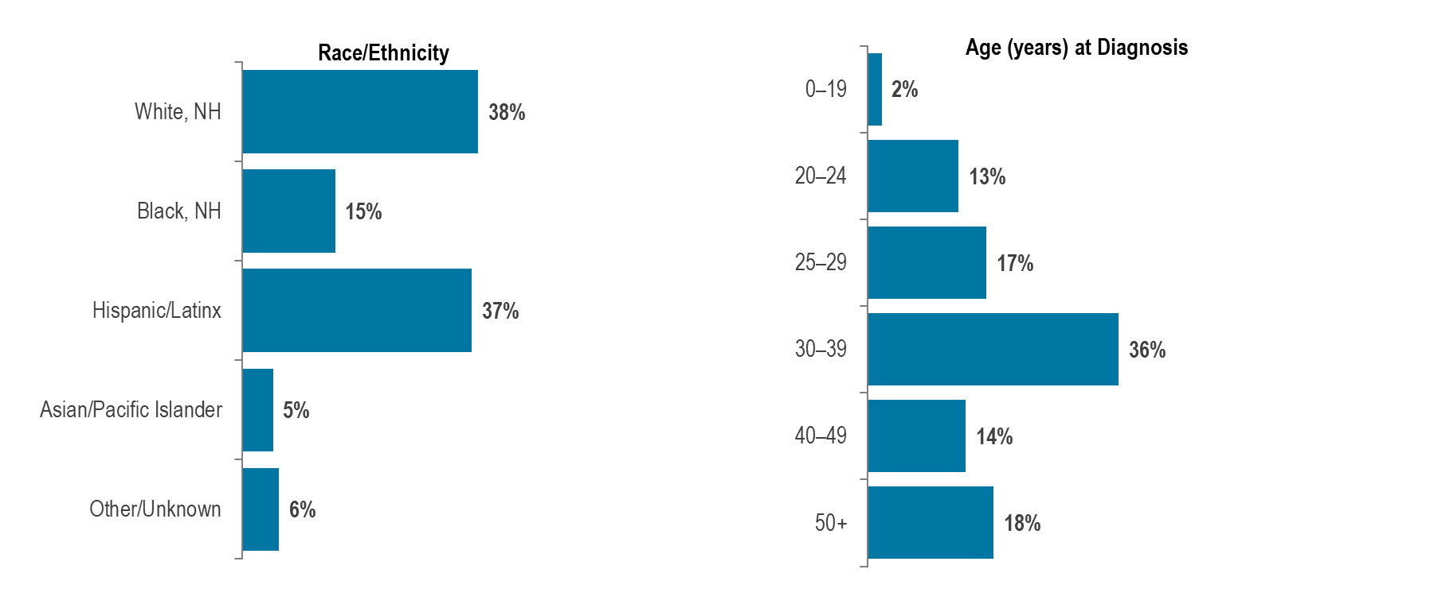
Confirmed and probable infectious syphilis¹ cases among men reporting sex with men, by race/ethnicity and age, Massachusetts 2024 (N=742)
¹ Infectious syphilis includes diagnoses made in the primary, secondary, and early non-primary non-secondary stages of infection (latent asymptomatic syphilis where infection occurred in the past 12 months).
Data Source: Bureau of Infectious Disease and Laboratory Sciences, data are current as of 6/2/2025 and subject to change
Notes:
The figure is a series of two bar charts displaying the percentage distribution of infectious syphilis cases among men who have sex with men by race/ethnicity on the left and age at diagnosis on the right.
Black (non-Hispanic) and Hispanic/Latinx individuals represented 7% and 13% of men in Massachusetts, compared to 15% and 38%, respectively, of confirmed and probable infectious syphilis cases among men reporting sex with men in 2024.
In 2024, confirmed and probable infectious syphilis cases among men reporting sex with men were predominantly White (non-Hispanic) (38%) or Hispanic/Latinx (37%), and age 30 years and above (69% 30+ year-olds).

Slide 39
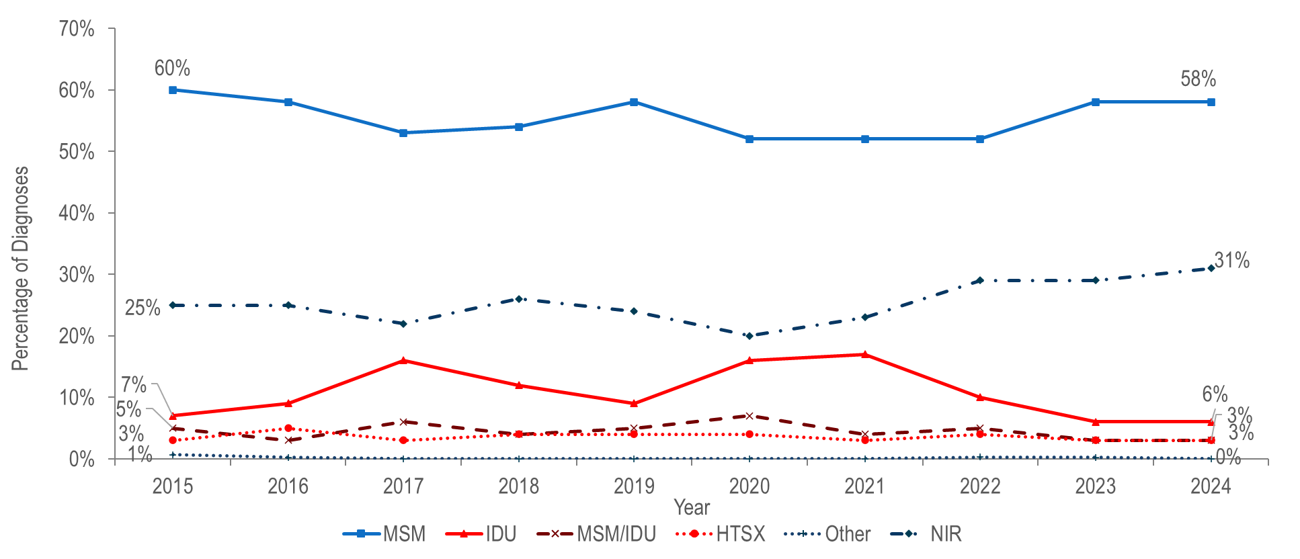
Percentage distribution of individuals assigned male at birth (AMAB) diagnosed with HIV infection by exposure mode, Massachusetts 2015–2024 ¹
¹ Please consider the impact of the COVID-19 pandemic on infectious disease screening, treatment, and surveillance in the interpretation of data from 2020 to 2022.
Data Source: Bureau of Infectious Disease and Laboratory Sciences, data are current as of 7/1/2025 and subject to change
Notes:
The figure is a trendline displaying the percentage distribution of HIV infection diagnoses among males by exposure mode (male-to-male sex, injection drug use, male-to-male sex/injection drug use, heterosexual sex, no identified risk, and Other) for the most recent ten-year period.
Among individuals AMAB, the proportion of HIV infection diagnoses with male-to-male sex as the reported mode of exposure decreased from 60% in 2015 to 52% in 2020 and subsequently increased to 58% in 2023 and 2024.¹ During the same time period, the proportion reported with no identified risk remained between 20% and 31%.
The proportion of cases among individuals AMAB attributed to injection drug use increased from 7% in 2014 to 16% in 2017 and then decreased to 9% in 2019. The increase in 2017 was primarily due to an outbreak among persons who inject drugs in the northeast part of the state between 2016 and 2018.² Following a focused public health response, the number of HIV infection diagnoses attributed to IDU in the northeast decreased. However, in early 2019, a new cluster of HIV infection was identified in Boston among PWID who were experiencing or had experienced recent homelessness, and the proportion of HIV infection diagnoses among individuals AMAB with IDU as the primary exposure increased to 17% in 2021. Following another focused public health response, the proportion decreased to 6% in 2024.³
¹ Please consider the impact of the COVID-19 pandemic on infectious disease screening, treatment, and surveillance in the interpretation of data from 2020 to 2022.
² For more information see: Charles Alpren et al. “Opioid Use Fueling HIV Transmission in an Urban Setting: An Outbreak of HIV Infection Among People Who Inject Drugs—Massachusetts, 2015–2018”, American Journal of Public Health 110, no. 1 (January 1, 2020): pp. 37-44.https://doi.org/10.2105/AJPH.2019.305366
³ For more information, see: Joint MDPH and BPHC Clinical Advisory: Increase in newly diagnosed HIV infections among persons who inject drugs in Boston, March 15, 2021, available at: https://www.mass.gov/doc/joint-mdph-and-bphc-clinical-advisory-hiv-transmission-through-injection-drug-use-in-boston-march-15-2021/download

Slide 40
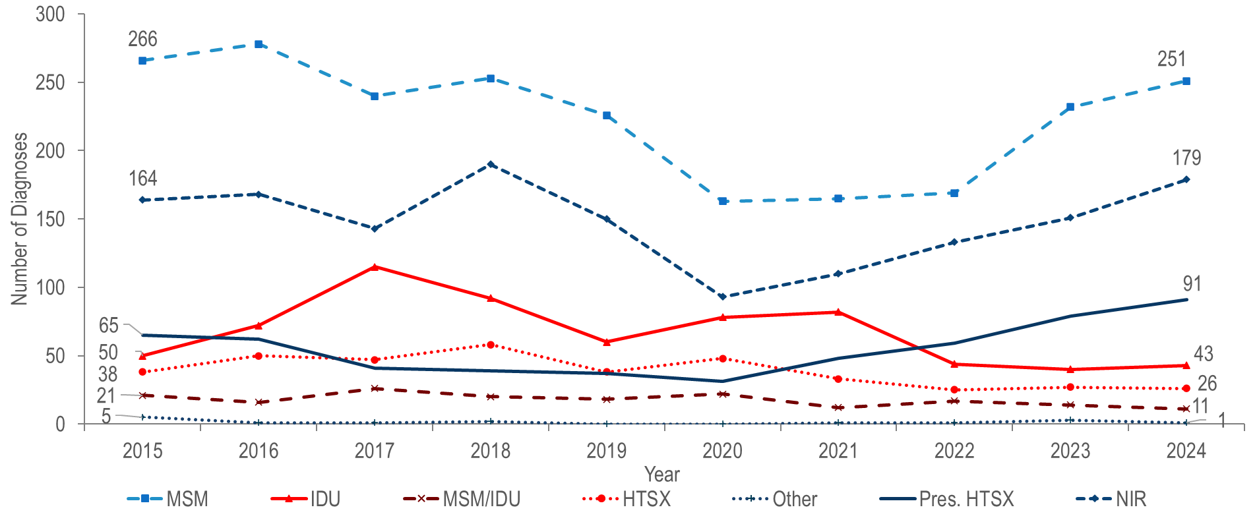
Individuals diagnosed with HIV infection by exposure mode,
Massachusetts 2015–2024 ¹
¹ Please consider the impact of the COVID-19 pandemic on infectious disease screening, treatment, and surveillance in the interpretation of data from 2020 to 2022.
Data Source: Bureau of Infectious Disease and Laboratory Sciences, data are current as of 7/1/2025 and subject to change
Notes:
The figure is a trendline displaying the number of HIV infections diagnosed each year of the most recent ten-year period for each of seven exposure mode categories: male-to-male sex, injection drug use, male-to-male sex/injection drug use, heterosexual sex, other, presumed heterosexual sex, and no identified risk.
The number of reported cases with injection drug use (IDU) as the primary exposure mode increased from 50 in 2015 to a peak of 115 in 2017 and then decreased to 60 in 2019. The increase in 2017 was primarily due to an outbreak among persons who inject drugs (PWID) in the northeast part of the state between 2016 and 2018.¹ Following a focused public health response, the number of HIV infection diagnoses attributed to IDU in the northeast decreased.
However, in early 2019, a new cluster of HIV infection was identified in Boston among PWID who were experiencing or had experienced recent homelessness, and the total statewide number of reported cases with IDU as the primary exposure increased to 82 in 2021.² Following another focused public health response, the number of HIV infection diagnoses attributed to IDU decreased by 48% to 43 cases in 2024. As of July 1, 2025, a total of 239 cases diagnosed since November 2018 have been investigated and identified as part of the Boston cluster. As it is an active cluster of concern, additional cases will continue to be investigated and added. Continuing trends among those newly diagnosed in the Boston cluster (N=16 cases diagnosed in 2024) include an increase in polysubstance and methamphetamine use.³
¹ For more information, see: Charles Alpren et al. “Opioid Use Fueling HIV Transmission in an Urban Setting: An Outbreak of HIV Infection Among People Who Inject Drugs—Massachusetts, 2015–2018”, American Journal of Public Health 110, no. 1 (January 1, 2020): pp. 37-44. https://doi.org/10.2105/AJPH.2019.305366
² Please consider the impact of the COVID-19 pandemic on infectious disease screening, treatment, and surveillance in the interpretation of data from 2020 to 2022.
³ For more information, see: Joint MDPH and BPHC Clinical Advisory: Increase in newly diagnosed HIV infections among persons who inject drugs in Boston, March 15, 2021, available at: https://www.mass.gov/doc/joint-mdph-and-bphc-clinical-advisory-hiv-transmission-through-injection-drug-use-in-boston-march-15-2021/download

Slide 41
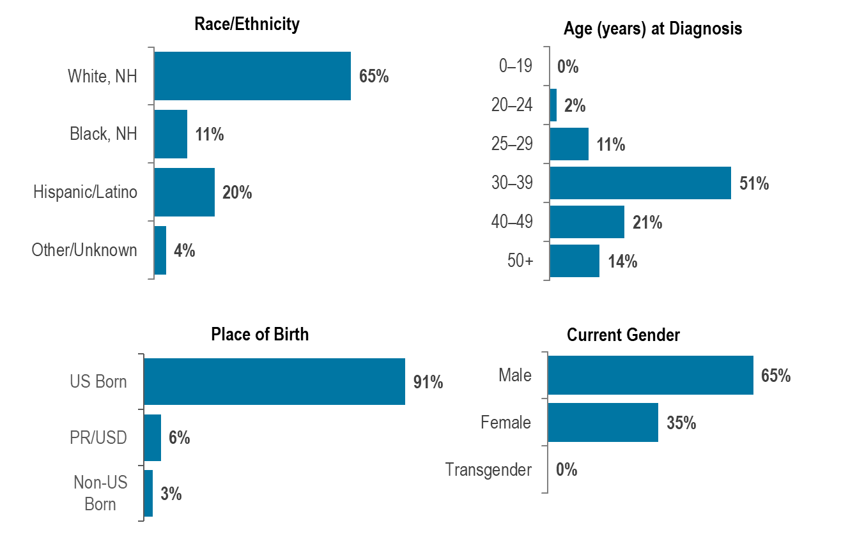
Percentage of individuals with IDU exposure mode diagnosed with HIV infection by race/ethnicity, age, place of birth and current gender,
Massachusetts 2022–2024 (N=127) ¹
¹ Please consider the impact of the COVID-19 pandemic on infectious disease screening, treatment, and surveillance in the interpretation of data from 2020 to 2022.
Data Source: Bureau of Infectious Disease and Laboratory Sciences, data are current as of 7/1/2025 and subject to change
Notes:
The figure is a series of four bar charts displaying the percentage distribution of individuals diagnosed with HIV infection with IDU exposure mode by race/ethnicity (White NH, Black NH, Hispanic/Latinx, Asian/Pacific Islander, Other/unknown), age at diagnosis (0-19, 20-24, 25-29, 30-39, 40-49, 50+), place of birth (US Born, PR/USD), non-US born), and gender (male, female, transgender).
Individuals with IDU exposure mode newly diagnosed with HIV infection in Massachusetts during 2022 to 2024¹ were predominantly White (non-Hispanic) (65%), between 30 and 39 years of age (51%), US born (91%), and male (65%).
¹ Please consider the impact of the COVID-19 pandemic on infectious disease screening, treatment, and surveillance in the interpretation of data from 2020 to 2022

Slide 42
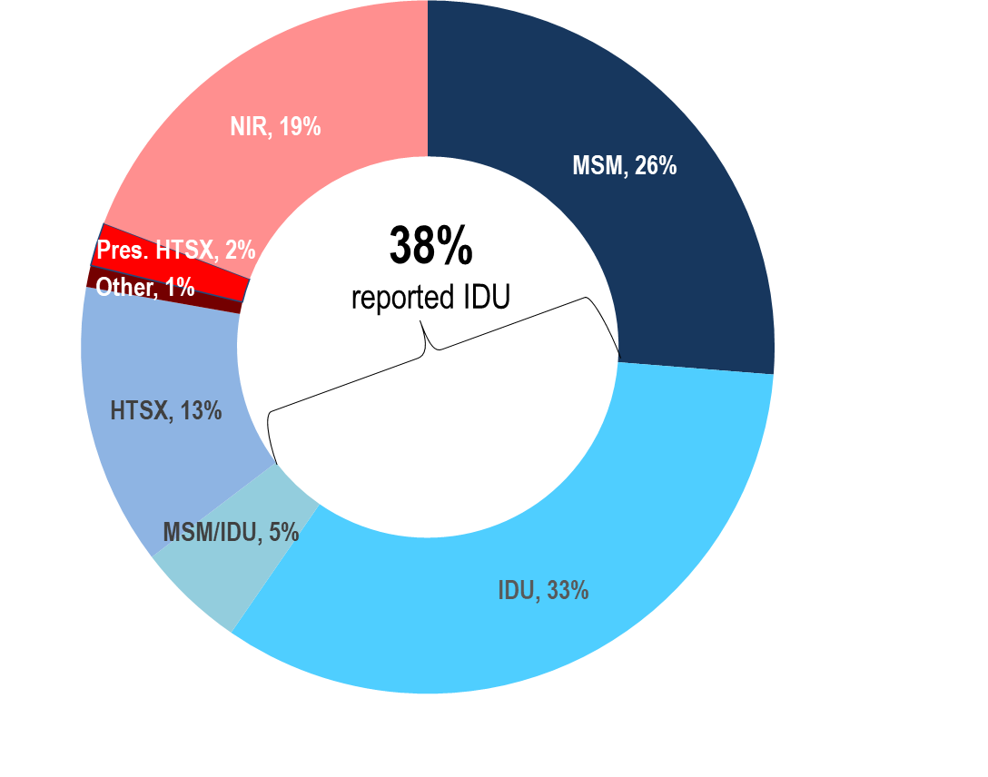
Deaths from any cause among individuals reported with HIV by exposure mode, Massachusetts 2024 (N=330)
Data Source: Bureau of Infectious Disease and Laboratory Sciences, data are current as of 7/1/2025 and subject to change
Notes:
The figure is an open pie chart which displays the distribution by exposure mode of deaths among individuals reported with HIV for the most recent year. Text in the center of the pie chart reads, “38% reported IDU".
The proportion of deaths from any cause among individuals with HIV with IDU exposure mode decreased from 42% in 2015 to 33% in 2024. At 33%, the proportion among IDU remained the largest among exposure modes in 2024, followed by MSM at 26%, with an additional 5% reported with an exposure mode of MSM/IDU. Comparatively, IDU and MSM/IDU accounted for 7% and 2%, respectively, of new HIV diagnoses in that year.

Slide 43
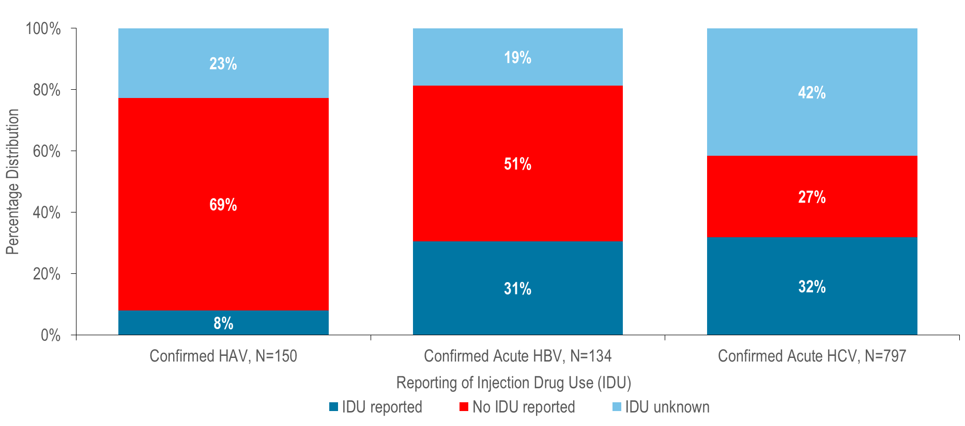
Confirmed acute hepatitis A, confirmed acute hepatitis B, and confirmed acute hepatitis C by reported risk of injection drug use (identified in incubation period), Massachusetts 2020–2024 ¹
¹ Please consider the impact of the COVID-19 pandemic on infectious disease screening, treatment, and surveillance in the interpretation of data from 2020 to 2022.
Data Source: Bureau of Infectious Disease and Laboratory Sciences, HAV and HBV data are current as of 9/3/2025, HCV data are current as of 6/18/2025 and subject to change
Notes:
The figure is a series of three stacked bar charts displaying the percentage distribution of confirmed HAV, confirmed acute HBV, and confirmed acute HCV by reporting of injection drug use (IDU reported, No IDU reported, IDU unknown).
A large number of acute viral hepatitis cases from 2020 to 2024¹ reported recent injection drug use: 8% (N=12/150) of hepatitis A cases, 31% (N=41/134) of hepatitis B cases, and 32% (N=254/797) of hepatitis C cases reported injection drug use in their incubation period.

Slide 44
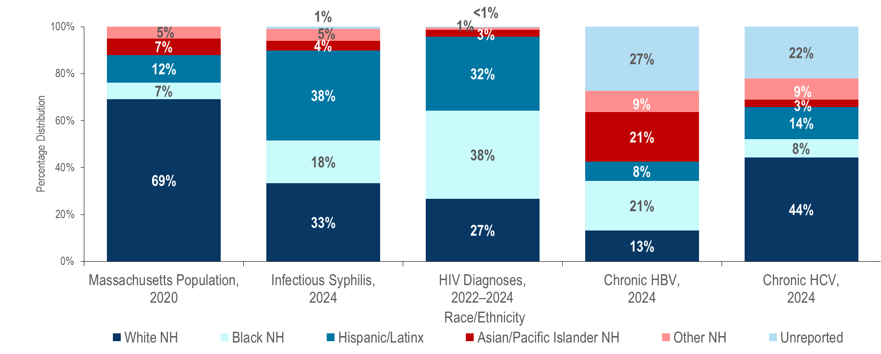
Distribution of the general population¹ and of individuals diagnosed with confirmed and probable infectious syphilis², confirmed and probable hepatitis B, confirmed and probable hepatitis C in 2024, and HIV infection during 2022–2024 by race/ethnicity, Massachusetts ³
¹ Population Data Source: UMDI Interim 2020 Population Estimates by Age, Sex, Race, and Municipality, UMass Donahue Institute Population Estimates Program, March 1, 2022
² Infectious syphilis includes diagnoses made in the primary, secondary, and early non-primary non-secondary stages of infection (latent asymptomatic syphilis where infection occurred in the past 12 months).
³ Please consider the impact of the COVID-19 pandemic on infectious disease screening, treatment, and surveillance in the interpretation of data from 2020 to 2022.
Confirmed and Probable Infectious Syphilis 2024, N=1,329; HIV Diagnoses 2022-2024, N=1,596; Confirmed and Probable Hepatitis B 2024, N=2,155, Confirmed and Probable Hepatitis C 2024, N=2,116
Data Source: Bureau of Infectious Disease and Laboratory Sciences, HIV data are current as of 7/1/2025, STI data are current as of 6/02/2025, HBV data are current as of 9/03/2025, HCV data are current as of 6/18/2025 and subject to change
Notes:
The figure is a stacked bar chart displaying the percentage distribution by race/ethnicity (White NH, Black NH, Hispanic/Latinx, API NH, Other NH, Unreported) of five groups: the Massachusetts population, 2024 infectious syphilis cases, 2022-2024 HIV Diagnoses, 2024 Chronic HBV cases, and 2024 Chronic HCV cases.
In 2024, Black (non-Hispanic), Hispanic/Latinx, and Asian/Pacific Islander (non-Hispanic) individuals represented 7%, 12%, and 7% of the total Massachusetts population and:
18%, 38%, and 4% of confirmed and probable infectious syphilis cases,
21%, 8%, and 21% of confirmed and probable chronic hepatitis B cases, and
8%, 14%, and 3% of confirmed and probable hepatitis C cases respectively.
During 2022 to 2024,³ Black (non-Hispanic), Hispanic/Latinx, and Asian/Pacific Islander (non-Hispanic) individuals represented 38%, 32%, and 3% of individuals diagnosed with HIV infection in Massachusetts, respectively.
¹ Population Data Source: UMDI Interim 2020 Population Estimates by Age, Sex, Race, and Municipality, UMass Donahue Institute Population Estimates Program, March 1, 2022
² Infectious syphilis includes diagnoses made in the primary, secondary, and early non-primary non-secondary stages of infection (latent asymptomatic syphilis where infection occurred in the past 12 months).
³ Please consider the impact of the COVID-19 pandemic on infectious disease screening, treatment, and surveillance in the interpretation of data from 2020 to 2022.

Slide 45
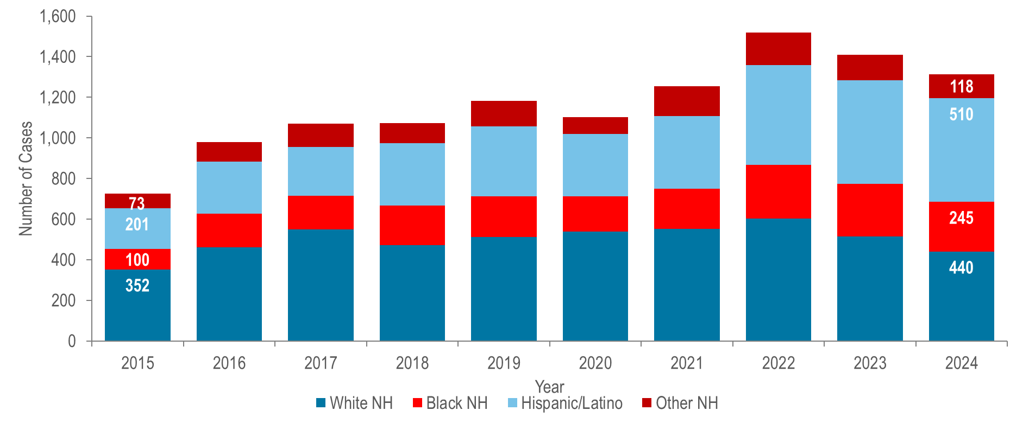
Number of confirmed and probable infectious syphilis¹ cases reported by race/ethnicity, Massachusetts 2015–2024 ²
¹ Infectious syphilis includes diagnoses made in the primary, secondary, and early non-primary non-secondary stages of infection (latent asymptomatic syphilis where infection occurred in the past 12 months).
² Please consider the impact of the COVID-19 pandemic on infectious disease screening, treatment, and surveillance in the interpretation of data from 2020 to 2022..
Note: Confirmed and Probable Syphilis 2015-2024 Total N=12,205; 574 (5%) cases missing race/ethnicity are not included in this figure
Data Source: Bureau of Infectious Disease and Laboratory Sciences, data are current as of 6/2/2025 and subject to change
Notes:
The figure is a stacked bar graph displaying the number of infectious syphilis cases reported each year for the most recent ten-year period among White non-Hispanic individuals, Black non-Hispanic individuals, Hispanic/Latinx individuals, and those of other non-Hispanic race/ethnicity.
The greatest number of confirmed and probable infectious syphilis cases was among White (non-Hispanic) individuals each year from 2015 to 2023. In 2024, the greatest number of cases was among Hispanic/Latinx individuals.²
From 2015 to 2024, the greatest proportionate increase in the number of confirmed and probable infectious syphilis cases was reported among Hispanic/Latinx individuals (increased by 2.5 times from 201 to 510) and Black (non-Hispanic) individuals (increased by 2.5 times from 100 to 245), followed by White (non-Hispanic) (increased by 25% from 352 to 440).
From 2015 to 2024, the proportion of confirmed and probable infectious syphilis cases among White (non-Hispanic) individuals decreased from 48% to 34% while it increased from 28% to 39% among Hispanic/Latinx individuals, and from 14% to 19% among Black (non-Hispanic) individuals.
In 2024, the age-adjusted confirmed and probable infectious syphilis incidence rates among Black (non-Hispanic) individuals (49.1 per 100,000) and Hispanic/Latinx individuals (53.2 per 100.000) were five and six times that of White (non-Hispanic) individuals (9.3 per 100,000), respectively.
¹ Infectious syphilis includes diagnoses made in the primary, secondary, and early non-primary non-secondary stages of infection (latent asymptomatic syphilis where infection occurred in the past 12 months).
² Please consider the impact of the COVID-19 pandemic on infectious disease screening, treatment, and surveillance in the interpretation of data from 2020 to 2022.

Slide 46
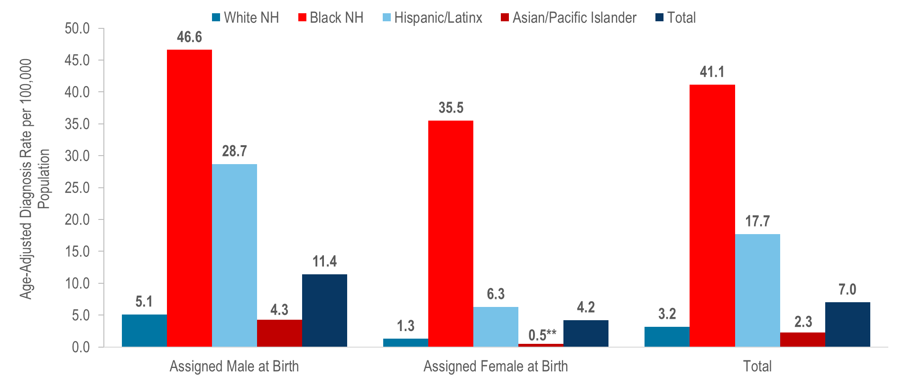
Average annual age-adjusted HIV diagnosis rate per 100,000 population¹ by sex assigned at birth and race/ethnicity, Massachusetts 2022–2024 (N=1,596) ²
**Rates based on numerators <12 are marked with an asterisk (*) and should be interpreted with caution.
¹ As of 1/1/2020, BIDLS calculates rates per 100,000 population using denominators estimated by the University of Massachusetts Donahue Institute: UMDI Interim 2020 Population Estimates by Age, Sex, Race, and Municipality, UMass Donahue Institute Population Estimates Program, March 1, 2022; Note that rates and trends calculated using previous methods cannot be compared to these. All rates are age-adjusted using the 2000 US standard population.
² Please consider the impact of the COVID-19 pandemic on infectious disease screening, treatment, and surveillance in the interpretation of data from 2020 to 2022.
Data Source: Bureau of Infectious Disease and Laboratory Sciences, data are current as of 7/1/2025 and subject to change
Notes:
The figure is a bar chart displaying the age-adjusted HIV diagnosis rate among individuals assigned male at birth, female at birth, and total cases for five groups: the total population, White non-Hispanic individuals, Black non-Hispanic individuals, Hispanic/Latinx individuals, and Asian Pacific Islanders.
In 2022–2024, the average annual age-adjusted HIV diagnosis rate per 100,000 population of individuals assigned male at birth (AMAB) was nearly three times that of individuals assigned female at birth (AFAB). There were large disparities in average annual age-adjusted HIV diagnosis rates for 2022 to 2024 by race/ethnicity. Compared to the rate among White (non-Hispanic) individuals, the rate among:
Black (non-Hispanic) individuals was 13 times greater, and
Hispanic/Latinx individuals was six times greater.
With respect to differences based on race/ethnicity and sex assigned at birth, the average annual age-adjusted HIV diagnosis rate for 2022 to 2024 among:
Black (non-Hispanic) individuals assigned male at birth (AMAB), was nine times that of White (non-Hispanic) individuals AMAB,
Hispanic/Latinx individuals AMAB was six times that of White (non-Hispanic) individuals AMAB,
Black (non-Hispanic) individuals assigned female at birth (AFAB) was 28 times that of White (non-Hispanic) individuals AFAB, and
Hispanic/Latinx individuals AFAB was five times that of White (non-Hispanic) individuals AFAB.

Slide 47
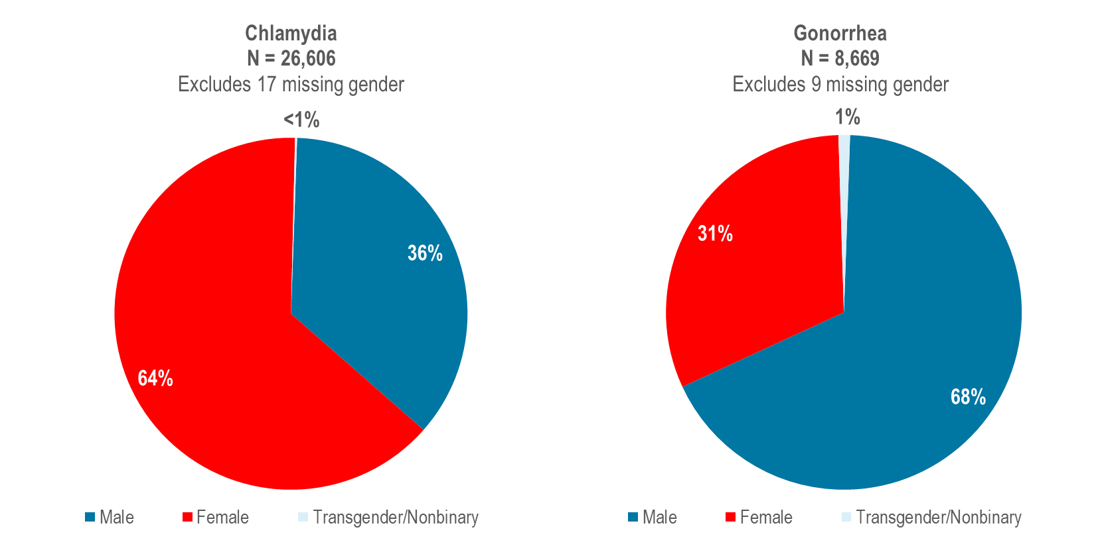
Distribution of confirmed chlamydia and gonorrhea cases reported by gender, Massachusetts 2024
Data Source: Bureau of Infectious Disease and Laboratory Sciences, data are current as of 6/2/2025 and subject to change
Notes:
The figure is a series of two side by side pie charts displaying the distribution by gender of 2023 chlamydia cases (N =26,606 Excludes 17 missing gender) on the left and 2023 gonorrhea cases (N = 8,669 Excludes 9 missing gender) on the right.
In 2024, 64% of confirmed chlamydia cases were among females (N=16,998), 36% were among males (N=9,557), and less than one percent (N=51) was among individuals of transgender experience or individuals who are nonbinary.¹
In 2024, 31% of confirmed gonorrhea cases were among females (N=2,722), 68% were among males (N=5,856), and one percent (N=91) was among individuals of transgender experience or individuals who are nonbinary.
¹ Please note reported numbers among individuals of transgender experience and individuals who are nonbinary are likely to be underestimates, for more information see Interpreting HIV, STI, and Viral Hepatitis Data.

Slide 48
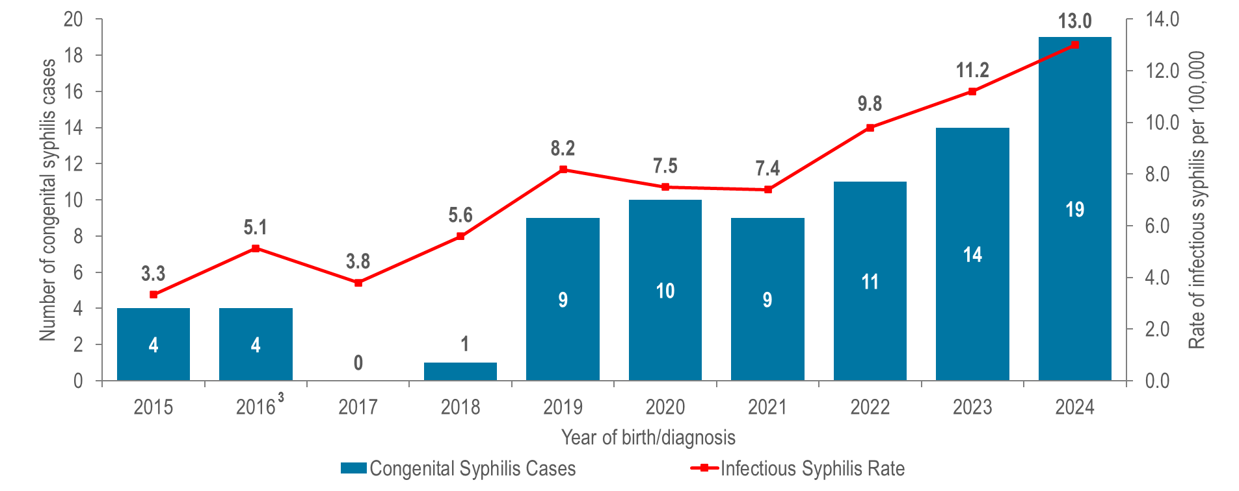
Number of confirmed and probable congenital syphilis¹ cases reported by year of birth and rate of confirmed and probable infectious syphilis per 100,000 individuals assigned female at birth (AFAB) of child-bearing age (15–44 years), Massachusetts 2015–2024 ²
¹ A condition caused by infection in utero with Treponema pallidum. A wide spectrum of severity exists, from inapparent infection to severe cases that are clinically apparent at birth. For more information see http://www.cdc.gov/std/stats/congenitalsyphilisdef-rev-jan-2015.pdf
² Please consider the impact of the COVID-19 pandemic on infectious disease screening, treatment, and surveillance in the interpretation of data from 2020 to 2022.
³ On January 1, 2015, the congenital case definition was updated to better define treatment and laboratory parameters for classifying cases. From 2015 through 2024, one confirmed case of congenital syphilis, two infant deaths associated with congenital syphilis, and 14 syphilitic stillbirths were reported. All other reportable cases from 2015 to 2024 met the case definition of probable congenital syphilis which uses the birthing person’s treatment adequacy and timing as the primary criteria for this classification status.Data Source: Bureau of Infectious Disease and Laboratory Sciences, data are current as of 6/2/2025 and subject to change
Notes:
The figure is a bar chart displaying the total number of confirmed and probable congenital syphilis cases each year of the ten-year period with an overlaid trendline displaying the rate of infectious syphilis per 100,000 among females of child-bearing age for each of the same years.
Trends in congenital syphilis typically mirror trends in infectious syphilis among individuals AFAB of child-bearing age.² In Massachusetts, as the rate of confirmed and probable infectious syphilis among individuals AFAB of child-bearing age increased to 13.0 per 100,000 in 2024,³ so too did the number of confirmed and probable cases of congenital syphilis (N=19).
Nationally, the number of congenital syphilis cases reached 3,882 in 2023, with a rate of 105.8 cases per 100,000 live births, the highest rate reported since 1994. Massachusetts ranked 44th in congenital syphilis incidence rate among the 50 states in 2023.⁴
³ Please consider the impact of the COVID-19 pandemic on infectious disease screening, treatment, and surveillance in the interpretation of data from 2020 to 2022.
⁴ Centers for Disease Control and Prevention. Sexually Transmitted Infections Surveillance 2023 Atlanta: U.S. Department of Health and Human Services; 2025. Please note, 2023 state rankings are presented because 2024 rankings were not yet available at the time of this publication.

Slide 49
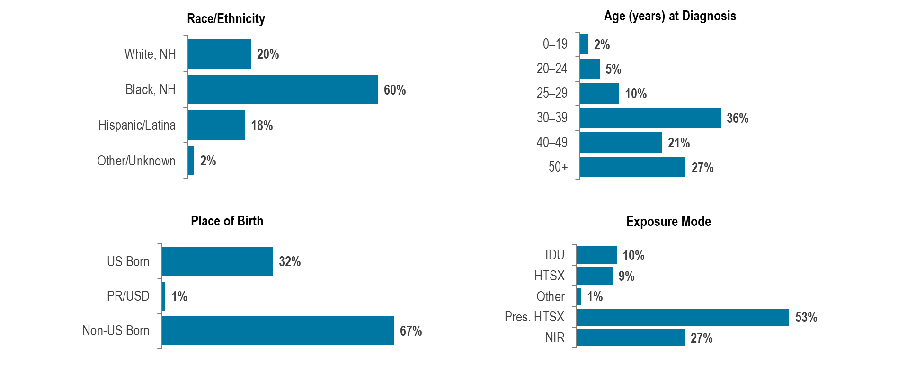
Percentage of individuals assigned female at birth and diagnosed with HIV infection by race/ethnicity, age, place of birth, and exposure mode, Massachusetts 2022–2024 (N=434) ¹
¹ Please consider the impact of the COVID-19 pandemic on infectious disease screening, treatment, and surveillance in the interpretation of data from 2020 to 2022.
Data Source: Bureau of Infectious Disease and Laboratory Sciences, data are current as of 7/1/2025 and subject to change
Notes:
The figure is a series of bar charts displaying the percentage distribution of women recently diagnosed with HIV infection by race/ethnicity, place of birth, age, and exposure mode.
Individuals assigned female at birth (AFAB) and newly diagnosed with HIV infection in Massachusetts during 2022–2024² were predominantly Black (non-Hispanic) (60%), 30 years of age or older (36% 30–39 year-olds, 21% 40–49 year-olds, 28% 50+ year-olds), with an exposure mode of presumed heterosexual sex (53%). While presumed heterosexual sex was the leading reported exposure mode, a large percentage of new HIV diagnoses were reported with no identified risk (NIR) (27%).
Among individuals AFAB, the proportion of HIV infection diagnoses with IDU exposure mode increased from 10% (N=17/162) in 2015 to 25% (N=40/157) in 2017, remained between 18% (2019, N=25/140) and 22% (2020, N=27/122) from 2018 through 2021, and then decreased to 11% (N=19/170) in 2024.
¹ Recent HIV diagnoses among women include 434 individuals assigned female sex at birth. Data included reflect sex assigned at birth and therefore not gender identity or gender expression of individuals of transgender experience (N=33 individuals of transgender experience diagnosed with HIV infection from 2022 – 2024).
² Please consider the impact of the COVID-19 pandemic on infectious disease screening, treatment, and surveillance in the interpretation of data from 2020 to 2022.

Slide 50
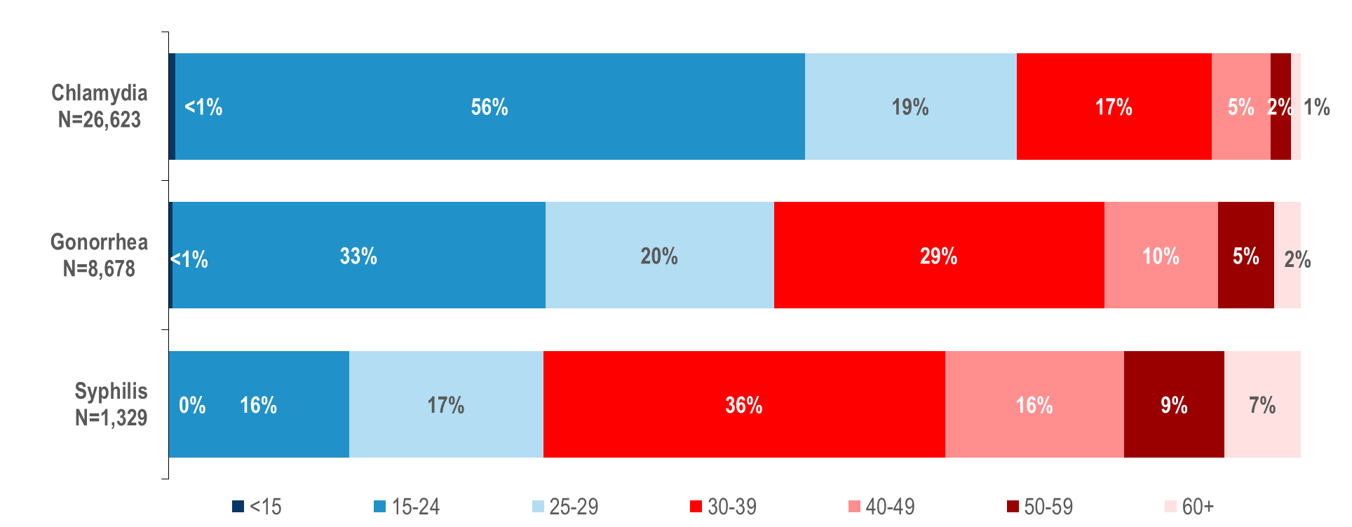
Distribution of confirmed chlamydia, confirmed gonorrhea, and confirmed and probable infectious syphilis cases reported by age group (years), Massachusetts 2024
Note: infectious syphilis includes diagnoses made in the primary, secondary, and early non-primary non-secondary stages of infection (latent asymptomatic syphilis where infection occurred in the past 12 months).
Data Source: Bureau of Infectious Disease and Laboratory Sciences, data are current as of 6/2/2025 and subject to change
Notes:
The figure is a stacked bar chart displaying the distribution by age (<15 years, 15-24 years, 25-29 years, 30-39 years, 40-49 years, 50-59 years, and 60+ years) for three groups: confirmed chlamydia, gonorrhea, and syphilis cases.
In 2024, in Massachusetts, 1% of confirmed chlamydia cases, 2% of confirmed gonorrhea cases, and 7% of confirmed and probable infectious syphilis¹ cases were reported among individuals aged 60+ years. An additional 2% of confirmed chlamydia cases, 5% of confirmed gonorrhea cases, and 9% of confirmed and probable infectious syphilis cases were reported among individuals aged 50–59 years.
¹ Infectious syphilis includes diagnoses made in the primary, secondary, and early non-primary non-secondary stages of infection (latent asymptomatic syphilis where infection occurred in the past 12 months).

Slide 51
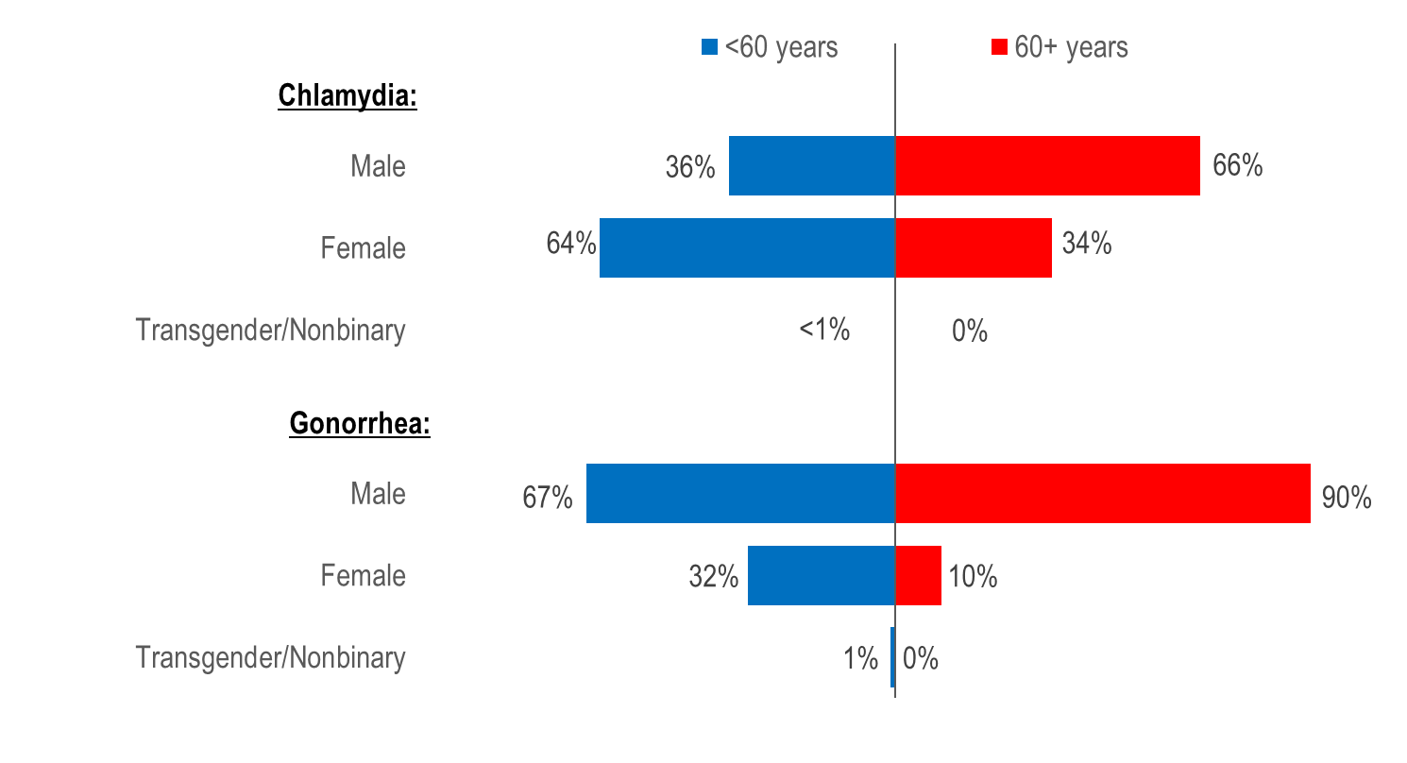
Percentage of confirmed chlamydia and gonorrhea cases by age at diagnosis
(<60 years vs. 60+ years) and gender, Massachusetts 2024
Note: 2024 chlamydia N=26,606 (<60 N=26,383; 60+ N=223) and excludes cases missing gender and/or age (N=17). 2024 gonorrhea N=8,669 (<60 N=8,467; 60+ N=202) and excludes cases missing gender and/or age (N=9).
Data Source: Bureau of Infectious Disease and Laboratory Sciences, data are current as of 6/2/2025 and subject to change.
Notes:
The figure is a butterfly graph comparing the percentage distribution of people under 60 years to people aged 60+ years and diagnosed with chlamydia and gonorrhea by gender (male, female, transgender/nonbinary)
In 2024, a much larger proportion of confirmed chlamydia cases among individuals aged 60 years or older (66%) than aged less than 60 years (36%) was male.
Similarly in 2024, a much larger proportion of confirmed gonorrhea cases among individuals aged 60 years or older (90%) than aged less than 60 years (67%) was male.

Slide 52

Percentage of confirmed and probable infectious syphilis cases by age at diagnosis (<60 years vs. 60+ years), gender, race/ethnicity, and risk, Massachusetts 2024
Note: infectious syphilis includes diagnoses made in the primary, secondary, and early non-primary non-secondary stages of infection (latent asymptomatic syphilis where infection occurred in the past 12 months)
2024 syphilis N=1,329 (<60 N=1,240; 60+ N=89), no cases were excluded from this analysis
Data Source: Bureau of Infectious Disease and Laboratory Sciences, data are current as of 6/2/2025 and subject to change
Notes:
The figure is a butterfly graph comparing the percentage distribution of people under 60 years to people aged 60+ years and diagnosed with syphilis by gender, race/ethnicity, exposure mode and risk.
In 2024, a larger proportion of confirmed and probable infectious syphilis cases among individuals aged 60 years or older (93%) than aged less than 60 years (80%) was male.
A much larger proportion of confirmed and probable infectious syphilis cases among individuals aged 60 years or older (69%) than aged less than 60 years (31%) was White non-Hispanic.
A similar proportion of confirmed and probable infectious syphilis cases among individuals aged 60 years or older (60%) and aged less than 60 years (56%) reported male-to-male sex.

Slide 53

Persons living with HIV infection by expanded age category, Massachusetts 2024 (N=24,838)
Data Source: Bureau of Infectious Disease and Laboratory Sciences, data are current as of 7/1/2025 and subject to change
Notes:
The figure is a bar chart displaying the percentage distribution of persons living with HIV infection by current age.
In 2024, 22% (N=5,441) of PLWH were aged 65 years or older, the age of eligibility for Medicare for individuals without a disability.

Slide 54

Number of years since HIV infection diagnosis among individuals aged 60 years and older living with HIV infection, Massachusetts 2024 (N=9,471)
Data Source: Bureau of Infectious Disease and Laboratory Sciences, data are current as of 7/1/2025 and subject to change
Notes:
The figure is a bar chart displaying the percentage distribution of persons living with HIV infection aged 60+years by number of years since HIV infection diagnosis.
In 2024, the majority (70%, N=6,663) of PLWH aged 60 years and older were diagnosed with HIV infection at least 20 years ago. The average number of years since HIV infection diagnosis among PLWH aged 60 years and older was 23.5 years.

Slide 55

People aged 60 years and older living with HIV infection compared to people aged under 60 years by selected characteristics, Massachusetts 2024
Note: 2024 People living with HIV infection: N=24,838 (<60 N=15,367; 60+ N=9,471), no cases were excluded from this analysis.
Data Source: Bureau of Infectious Disease and Laboratory Sciences, data are current as of 7/1/2025 and subject to change
Notes:
The figure is a butterfly graph comparing the percentage distribution of people under 60 years to people aged 60+ years and living with HIV infection by sex assigned at birth, gender, place of birth, race/ethnicity, and exposure mode.
In 2024, the distributions of people living with HIV infection by place of birth, race/ethnicity, and exposure mode varied by age:
A larger proportion of individuals aged 60+ years (64%) than <60 years (53%) was born in the US.
A larger proportion of individuals aged 60+ years (45%) than <60 years (31%) was White (non-Hispanic), and a smaller proportion was Hispanic/Latinx (22% vs. 32%).
A larger proportion of individuals aged 60+ years (19%) than <60 years (10%) had injection drug use exposure mode and a smaller proportion had MSM exposure mode (36% vs. 43%). However, MSM was still the most frequently reported exposure mode for both age groups.
The distributions of people living with HIV infection by sex assigned at birth and current gender identity were similar for both age groups in 2024.

Slide 56

People aged 60 years and older diagnosed with HIV infection compared to people aged under 60 years by selected characteristics,
Massachusetts 2022–2024¹
¹ Please consider the impact of the COVID-19 pandemic on infectious disease screening, treatment, and surveillance in the interpretation of data from 2020 to 2022.
Note: 2022–2024 HIV diagnoses: N=1,596 (<60 N=1,481; 60+ N=115), no cases were excluded from this analysis; Data Source: Bureau of Infectious Disease and Laboratory Sciences, data are current as of 7/1/2025 and subject to change
Notes:
The figure is a butterfly graph comparing the percentage distribution of people under 60 years to people aged 60+ years and recently diagnosed with HIV infection by sex assigned at birth, gender, place of birth, race/ethnicity, and exposure mode.
When reviewing the data presentations on people diagnosed with HIV infection at age 60+ years, please note that the ascertainment of accurate initial diagnosis date/age is often more difficult for individuals born outside the United States than those born in the United States or Puerto Rico. This is due to limited access to clinical documentation and/or less access to testing in the patient’s country of origin. Differences between younger (<60) and older (60+) individuals diagnosed with HIV infection displayed in this report may be an artefact of this data quality discrepancy rather than actual age at diagnosis.
During 2022 to 2024,¹ the distributions of individuals diagnosed with HIV infection by sex assigned at birth, race/ethnicity, and exposure mode varied by age:
A larger proportion of individuals aged 60+ years (47%) than <60 years (26%) was assigned female at birth.
A larger proportion of individuals aged 60+ years (49%) than <60 years (37%) was Black (non-Hispanic).
A larger proportion of individuals aged 60+ years (30%) than <60 years (13%) had presumed heterosexual exposure mode and no identified risk (40% vs. 28%) and a smaller proportion had MSM exposure mode (19% vs. 43%).
¹ Please consider the impact of the COVID-19 pandemic on infectious disease screening, treatment, and surveillance in the interpretation of data from 2020 to 2022

