Slide 1
2025 DOER Town Hall
January 27, 2025
Elizabeth Mahony
Commissioner

Slide 2
Agenda
Welcome
Introduction to DOER
2024 Accomplishments
2025 Goals and Projects
Questions and Answers

Slide 3
About DOER
We are an agency
of the Executive Office of Energy and Environmental Affairs (EEA)
Mission: To create a clean, affordable, resilient, and equitable energy future for all in the Commonwealth.
Who We Are: As the State Energy Office, DOER is the primary energy policy agency for the Commonwealth. DOER supports the Commonwealth’s clean energy goals as part of a comprehensive Administration-wide response to the threat of climate change. DOER focuses on transitioning our energy supply to lower emissions, reducing and shaping energy demand, and improving our energy system infrastructure.
What We Do: To meet our objectives, DOER connects and collaborates with energy stakeholders to develop effective policy. DOER implements this policy through planning, regulation, and providing funding. DOER provides tools to individuals, organizations, and communities to support their clean energy goals. DOER is committed to transparency and education, supporting the accessible access to energy information and knowledge.
Department of Energy Resources
Energy Efficiency
Policy, Planning & Analysis
Cross-Divisional Support
Coordination & Engagement
Federal Funding, Energy Security, Legal, Finance
Green Communities
Renewable & Alternative Energy
Leading By Example
Siting & Permitting

Slide 4
2024 Key Accomplishments
Federal Funding Success
Three-Year Plan
Regulations
Energy Efficiency, Green Communities, Leading by Example Grants
Climate Leaders
MOR-EV Rebates
Offshore Wind Procurement
Interagency Rates Working Group Short-Term Recommendations
Solar Incentive (SMART) Program Straw Proposal
Building Capacity to Meet Mandates

Slide 5
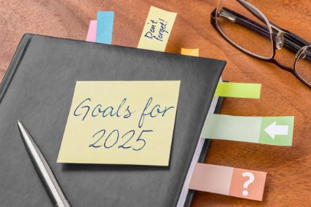
2025 Policy Goals
Implement Core and New Programs and Regulations
Disburse Funding through Grant Programs to Maximize Impact
Develop Strategic and Effective Policy
Ensure Transparency and Robust Stakeholder Engagement
Increase Language Access
Catalyze Pathways for Decarbonization
Coordinate with Neighboring States and Regions

Slide 6
2025 Key Projects
Website Reorganization
Procurements: Offshore Wind (83C), Energy Storage (83E), Regional
Federal Funding Deployment – IRA Home Energy Rebate Programs (HER / HEAR), Solar for All, etc.
Merrimack Valley Renewal Fund (MVRF)
Climate Leader Communities and State Government Decarbonization
Interagency Rates Working Group
Solar: SMART 3.0, Low-Income Services Solar Program
Clean Energy Siting & Permitting Division

Slide 7
Coordination & Engagement
Goals for 2025
Continued Coordination with Internal and External Partners
ResilientMass
Energy Security
Office of Climate, Innovation, and Resilience
EEA Federal and Regional Affairs
EEA Office of Environmental Justice and Equity
Support Cross Divisional Policies and Goals
Energy Justice and Equity
Resilience

Slide 8
Coordination & Engagement
2025 Key Projects
Implement External Engagement Improvements
Website Reorganization
Comprehensive Strategy for Public Engagement
Implement Federal Funding
Home Energy Rebates, PowerUp New England, and many more!
2025 Timelines
Summer: Website Reorganization
Public Engagement Opportunities
Website Reorganization will Highlight Engagement Opportunities for Program and Policy Implementation

Slide 9
Energy Efficiency
Goals for 2025
Support Building Decarbonization in the Commonwealth
Collaborate with Mass Save program on customer enhancements
Ensure Lawrence, Andover and North Andover homes and businesses are served through Merrimack Valley Renewal Fund
Updated building codes, Commercial PACE (Property Assessed Clean Energy) guidelines, training and technical assistance
Continue Affordable Housing Decarbonization Grants
Secure and begin to use federal grant money
Improve opportunities for public understanding and feedback on Energy Efficiency
Launch Building Energy Reporting, which requires all owners of buildings over 20,000 square feet to report building energy use, develop guidelines to support compliance

Slide 10
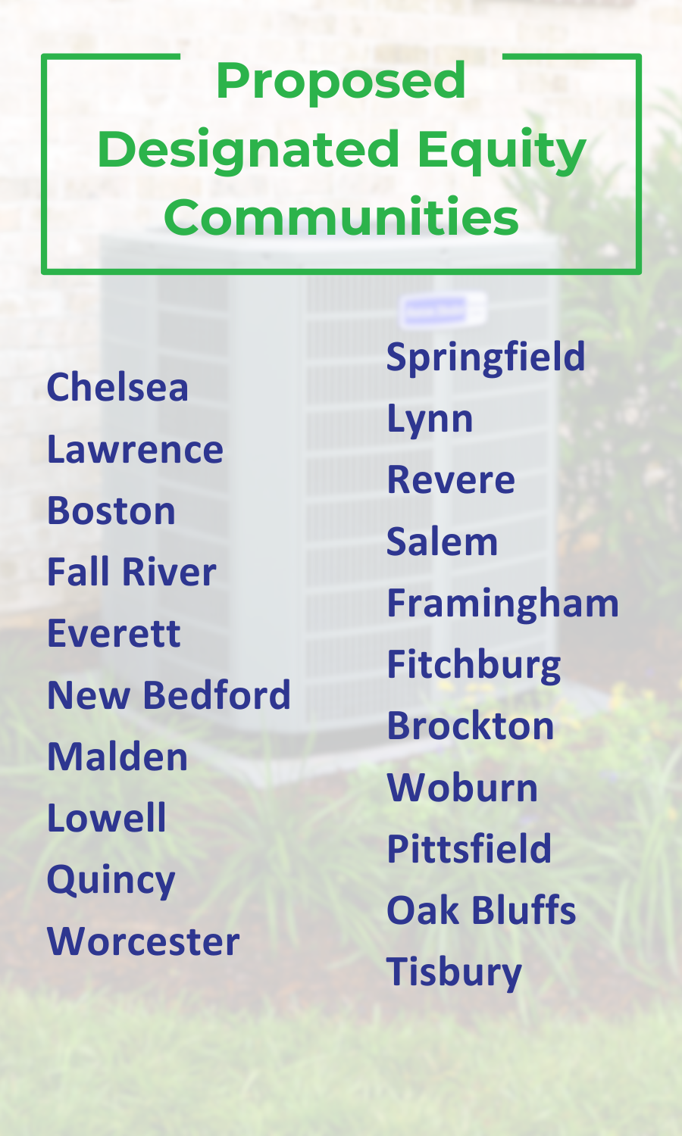
Energy Efficiency
2025 Key Projects
2025 Timelines
Ongoing work with Mass Save Program Administrators on 2025-2027 Three-Year Plan
No cost weatherization, heat pumps through facilitated delivery for Moderate Income customers statewide and renters in Designated Equity Communities
Launch of home scorecards and decarbonization consultations
Improve opportunities for public awareness of Energy Efficiency Division work
Roll out Home Energy Rebate Program for municipal light plant customers, Home Electrification Appliance Rebate Program through Mass Save program
February: Expected Order on 2025-2027 Three-Year Plan
June: Rollout of IRA funding
Ongoing: public engagement improvements
Public Engagement Opportunities
February: Commercial PACE public feedback on proposed guideline revisions
Ongoing: through EEAC monthly public meetings
Ongoing: Energy Code feedback through stretchcode@mass.gov and Mass Save program sponsored training
Ongoing: stakeholder feedback on Building Energy Reporting Guidelines, DOER.BER@mass.gov

Slide 11
Green Communities
Goals for 2025
Support and encourage equitable municipal decarbonization efforts to further MA’s climate objectives
Certify first Climate Leader Communities
Reach 300 Green Communities

Slide 12
Green Communities
2025 Key Projects
Grants:
Municipal Energy Technical Assistance (META)
GC Competitive
Municipal Decarbonization Roadmap Assistance
Climate Leader Tech Support
Regional School District
Regional Energy Planning Assistance
Climate Leader Decarbonization Accelerator
Coordinate municipal decarbonization efforts with new Three-Year Plan
Model solar and battery storage bylaw development
Municipal capacity building
Green Communities Summit
2025 Timelines/Deadlines
Visit our website to see important deadlines
2025 Calendar Green Communities Program
Public Engagement Opportunities
Summer-Fall: Model bylaw stakeholder sessions
Fall: Green Communities Summit
Ongoing: Topical webinars throughout the year – join our e-blast list to receive notifications of grants and other opportunities

Slide 13
Leading By Example
Goals for 2025
LBE Executive Order 594 Implementation
Support electrification of the state fleet
Facilitate continued reductions in onsite fossil fuel at state sites
Identify opportunities to use/pilot alternative fuels for medium-/heavy-duty state fleet electrification
Increase deployment of solar and battery energy storage at state sites, lowering state costs and adding clean resources on the grid
MOR-EV Rebate Program and MA Clean Cities Coalition
Better prioritize EV access for low- and moderate-income (LMI) residents and improve program cost-effectiveness
Advance medium- and heavy-duty vehicle electrification through MOR-EV rebates, with additional incentives for fleets operating in Environmental Justice Communities

Slide 14
Leading By Example
2025 Key Projects
LBE Executive Order 594 Implementation
Launch $20M grant program to support larger state building decarbonization
Accelerate grant awards for fleet EV charging, new solar deployment + energy storage, equipment decarbonization, and solar PV repairs
Finalize 50+ state fleet vehicle electrification plans by June
2025 Timelines
Early Spring: Implement CHDV Grant
Early Spring: Launch large-scale decarbonization implementation grants for state sites
Summer: Finalize updates to MOR-EV Regulations
Winter: Host annual LBE Awards
MOR-EV Rebates and MA Clean Cities Coalition
Expand engagement and outreach to promote broader EV access for disadvantaged communities and priority populations
Implement $5.8 million US EPA Grant to electrify 28 heavy-duty private fleet vehicles, launch a new EV truck technician training certification program at Massasoit Community College
Revise MOR-EV regulations to more cost-effectively target funding for low- and moderate-income residents
Public Engagement Opportunities
Early Spring: MOR-EV Regulations revision and public comment process
Fall: Issue MOR-EV report to legislature
Fall: Open LBE Award application for state agencies, campuses, municipalities, and individuals

Slide 15
Policy, Planning & Analysis
Goals for 2025
Advocate for electrification, resilience, and the transition beyond natural gas through transparent and holistic grid planning
Advance changes to electric rate design that improve energy affordability while encouraging adoption of heat pumps and electric vehicles
Design effective market and procurement structures to secure clean energy supply resources

Slide 16
Policy, Planning & Analysis
2025 Key Projects
Grid Modernization Advisory Council (GMAC) will host monthly public meetings in 2025 to discuss electric grid planning and investments
Rates Task Force will convene stakeholders to advance recommendations from the Interagency Rates Working Group
Procurements Effectiveness Study will provide recommendations for improvements to offshore wind and other clean energy procurements
Coordination & Regulatory Intervention to ensure electric and gas utility planning and investments are transparent and reflect state clean energy goals
2025 Timelines
January: Kickoff Rates Task Force
April: DOER intervention in Climate Compliance Plans (CCPs) from gas companies
June: Municipal Guidance on Offshore Wind
July: Procurements Effective Study published
Summer: 83C Round 5 Offshore Wind Procurement
Public Engagement Opportunities
Monthly (Ongoing): GMAC public meetings
Early 2025: Public meetings on gas company Climate Compliance Plans
Spring: Public comment on 83C Round 5 offshore wind procurement
Summer: GMAC public sessions on grid planning

Slide 17
Renewable & Alternative Energy
Goals for 2025
Roll out programs and funding to support renewables across the Commonwealth
Modernize program metrics and data reporting
Improve existing solar consumer protection and education
Support a balanced approach to deploying clean energy infrastructure and protecting high value natural lands
Support renewables readiness across the Commonwealth policies
Interconnection
Grid Planning
Rate Making

Slide 18
Renewable & Alternative Energy
2025 Key Projects
Solar Massachusetts Renewable Target (SMART) Program: issue draft regulations, engage stakeholders on next program iteration
Solar for All: programs will open, including the first offering for single family homes
Low-Income Solar Services Program (LISSP): accept applications for technical support and funding
Energy Storage Grant Program: coordinate with stakeholders, develop and launch $50M program
Energy Storage (83E): in coordination with DOER, EDCs will draft and release a Request for Proposal (RFP) to procure energy storage
2025 Timelines
Early 2025: Publish Massachusetts’ Hydrogen Outlook
Spring: Draft SMART regulation filing
Spring: Solar for All launch
Summer: LISSP launch
July 31: 83E RFP posting
Fall: Energy Storage Grant program launch
Public Engagement Opportunities
Spring/Summer: SMART rulemaking engagement
Spring: Straw Proposal for Energy Storage Grants program
Spring: Solar Canopy Working Group

Slide 19
Siting & Permitting
2025 Key Projects
2025 Timelines
Staffing & Operations:
Stand up new Division
Build DOER Capacity
Stakeholder Engagement & Outreach
Draft Regulations
Winter-Summer: Hiring
Spring: Targeted Stakeholder Engagement
Spring: Interagency Consultations
Summer: Technical Sessions
Late Summer-Fall: Publish Draft Regulations
Fall-Winter: Public Comments
Public Engagement Opportunities
Summer: Technical Sessions
Fall-Winter: Public Comment Period

Slide 20
Questions and Answers
Have a Question?
Please type your question in the Q&A box or click “raise hand” in your Zoom navigation bar
If speaking, please introduce yourself before asking your question
Please keep questions brief and respectful so we can get to as many as possible
If you are in a channel with an interpreter and you have a question, please type your question in the Q&A box so it can be interpreted
*The Town Hall, including the Q&A portion, is being recorded and will be posted on DOER’s website

Slide 21
DOER Wants to Hear From You
Please submit written comments to doer.energy@mass.gov by 5 PM on February 17
All comments will be posted publicly on DOER’s website
Comments may respond to these questions:
Do you have feedback on DOER’s plans for 2025?
How do DOER programs impact you?
Was there anything you learned today about which you’d like to learn more?
Do you have any recommendations for DOER’s future public engagement?
What do you think DOER’s priorities should be?

Slide 22
Contact Us
100 Cambridge St. - 9th Floor - Boston, MA 02114
doer.energy@mass.gov
(617) 626-7300
www.mass.gov/orgs/massachusetts-department-of-energy-resources
Visit our website to subscribe to DOER's email lists

