Slide 1




Housekeeping
Please keep your line muted unless asking a question
You can use the chat, raise your hand or unmute your line to ask a question
Both this slide deck and the recording will be shared early next week
Please introduce yourself in the chat

Slide 2

WIOA Title I
YOUTH PROGRAM
https://www.mass.gov/masshire-career-centers
October 2025
MassHire Programs & Services are funded in full by US Department of Labor (USDOL) Employment and Training Administration grants.
• Additional details furnished upon request.

Slide 3
Topics
Importance of WIOA
Eligibility criteria for in-school youth and out-of-school youth
WIOA Title I Youth Eligibility Policy 100 DCS 19.101.4
Source Documentation
Individual Service Strategy (ISS)
Youth ISS In MOSES
The 14 Program Elements
Career Pathways and leveraging partner programs

Slide 4

Importance of the Workforce Innovation and Opportunity Act (WIOA)
WIOA increases access to opportunities for employment, education, training, and support services to individuals, particularly those with barriers to succeed in the labor force.
WIOA provides funding for local areas to offer programs for in-school and out-of-school youth that provide a pathway to attain a GED, HiSET, high school diploma, higher education, industry-recognized training and a career.
Notes:
WIOA was signed into law July 22, 2014 and replaced WIA the Workforce Investment Act. This program provides funding for training and education for in demand skills across the 16 areas in Massachusetts as well as nation wide from the USDOL.

Slide 5
Out of School Youth Eligibility
US Citizen or Work Eligible, Selective Service Compliant, Not attending school, 16 – 24 years at the time of enrollment and:
One or more of the following:
  School dropout
  Within the age of compulsory school* attendance, but has not attended school for at least the most recent complete school year calendar quarter
  HS Grad/HiSET who is low-income and basic skills deficient or an English language learner
  An offender
  Homeless individual, a homeless child or youth, or a runaway
  In foster care or has aged out of the foster care system
  Pregnant or parenting
  An individual with a disability
  Low-income individual who requires additional assistance to enter or complete an educational program or to secure or hold employment
  * Compulsory school age means the age in which you are required to attend school. In Massachusetts students must attend school until the age of 16.
Notes:
For not attending youth this can be either graduated or stopped attending. Basic skills deficient is anyone with learning levels below 9th grade.

Slide 6
When is low-income not an eligibility criteria for OSY?
Majority of OSY are not required to be low-income to be eligible for WIOA services.
OSY are not required to be low-income if they are: a US Citizen or Work Eligible, not attending school, 16 – 24 years old and meet one or more of the following criteria:
  School dropout
  Within the age of compulsory school attendance, but has not attended school for at least the most recent complete school year calendar quarter
  An offender
  Homeless individual, a homeless child or youth, or a runaway
  In foster care or has aged out of the foster care system
  Pregnant or parenting
  An individual with a disability
Examples:
  A high school dropout
  A high school graduate that has a disability
  A HiSET recipient that is an offender
  A HiSET recipient that is pregnant or a parent

Slide 7
When is low-income an eligibility criteria for OSY?
OSY are required to be low-income if they are: a US citizen or Work Eligible, Not attending school, 16 – 24 years old and meets one of the following criteria:
  High School Graduate/HiSET recipient and basic skills deficient or an English language learner
  Individual who requires additional assistance to enter or complete an educational program or to secure or hold employment
Examples:
  A HiSET recipient that is an English language learner and does not have any of the other 7 OSY barriers.
  A high school graduate or a HiSET recipient that is not basic skills deficient or an English language learner and does not have any of the other 7 OSY barriers but meets the locally defined definition of a youth requiring additional assistance.
Notes:
Youth requiring additional assistance is defined by local area policy.

Slide 8
In School Youth Eligibility
US Citizenship or Work Eligible, Selective Service Compliant, In School, 14 – 21 years old, Low Income and one or more of the following barriers:
  Basic skills deficient
  English language learner
  An offender
  Homeless individual, a homeless child or youth, or a runaway
  In foster care or has aged out of the foster care system
  Pregnant or parenting
  Individual with a Disability
  Requires additional assistance to enter or
  complete an educational program or to secure or hold employment
    (not more than 5% allowed using this item)
Notes:
All in school youth must be low income unless you are using the 5% window allowance which we will go over in the next couple of slides.

Slide 9
What is Low Income for WIOA?
A WIOA youth participant will be considered Low Income if any of the following are true:
  They are receiving public assistance (TAFDC, EAEDC, SNAP, SSI)
  Their family income is at or below 70% of the Lower Living Standard (LLS)
    (or below Poverty Line for family of one (1))
  They reside in a High Poverty Area
  They have any of the following barriers:
    Homeless or Runaway (as defined in McKinney Act)
    Foster Care
  They are in school and on a free or reduced lunch program
Notes:
The Lowel Living Standard levels are updated in Moses annually and can be found at the bottom of the General Information tab in Moses. The section is labeled Economically Disadvantaged.

Slide 10
Low-Income status for youth can also be determined by the following:
Free and Reduced Price Lunch – Richard B. Russell National School Lunch Act
  ISY Only
  ISY that attend a designated low-income school do not automatically qualify as low-income
      (Community Eligibility Provision)
Applicant Statement – Schools not providing Free/Reduced Lunch documentation
High Poverty Area
    ISY and OSY
    Poverty rate of 25 percent – where at least 25 percent of the residents are economically disadvantaged.
* Instructions for Determining if an Individual Lives in a High-Poverty Area Based on Their Street Address
MassWorkforce Resources: WIOA Title I Youth Program | Mass.gov
Notes:
If you are using the Free and Reduced Price Lunch for eligibility be sure the youth would qualify based on their family income. Under the Community Eligibility Program some schools have free or reduce priced lunch programs for all students because their area has 50% or more of the students qualifying for the benefit. Statewide Massachusetts schools offer free lunch to all students regardless of income level. In this case you, may choose to use an Applicant Statement providing you follow local policy regarding the use of Applicant Statements. For determining High-Poverty Areas use the blue link to enter the participants address.

Slide 11

Low Income Exception
(5% Window Eligibility)
Five percent of WIOA youth participants, who would ordinarily be required to be low-income for eligibility, and who meet all other eligibility requirements, may be non-low income.
The 5% calculation is based on the percent of youth newly enrolled in the program year and served by the program in the local area’s WIOA Youth Program
DCS 100 19.105 5% Income Exception for Non-Income “Covered Individuals”
Notes:
This would only be for 5% of all newly enrolled ISY and OSY for the program year. It’s a good option if you have a young person who would greatly benefit from the program, but their family income is above the requirements, but still needs help.

Slide 12
Source Documentation
Documentation is necessary to support WIOA Title I Youth Eligibility
Local Areas must verify and confirm that youth are eligible to participate in WIOA youth services through an examination of documents.
Documentation may be stored electronically, however documentation must be available to program, fiscal monitors, and auditors for monitoring purposes.
Local Areas must retain records for a period of at least three (3) years after the submittal of the final closeout expenditure report for that funding period.
Notes:
Documents can be collected by digital means or paper copies.

Slide 13
WIOA Eligibility Documentation in a Virtual Environment - 100 DCS 18.111
Policy Highlights
  Verifying Eligibility Documentation via Live Stream
  Allows verification of eligibility documentation through livestream or video sharing such as Zoom, WebEX, Adobe Connects or other virtual media platforms.
  A printout or an electronic copy of a screenshot containing the eligibility document verified must be included in the participant's file.
  Electronic Signatures
  Participants must still sign documents when required.
  Fillable forms for the use of electronic signatures are allowed.
  Staff may have the participant email agreement to the content of the required form.
  The email must be kept in the participant’s file.
  Documenting MOSES
  Staff must document the “Notes” section in MOSES when eligibility documentation was viewed via live stream and that either a printout or screen shot of the eligibility document is included in the participant’s file.
Notes:
This a newer policy developed during the pandemic to allow for centers to continue to collect eligibility documents and enroll participants in programs who were not able to provide them in person. Definitely read this policy fully if you use this method for collecting documentation.

Slide 14
Applicant Statement
DOL encourages grant recipients to consider the impacts on equity and accessibility when developing source documentation policies and procedures.
As referenced in TEGL 23-19 Change 2 – career centers/workforce boards considering restrictions on the use of self-attestation should consider while other documentation sources are preferred when practical, self-attestation is an important option for populations with barriers to obtaining eligibility and reporting documents (such as disconnected youth, American Indian and Alaska Native populations, individuals experiencing homelessness, justice involved individuals, refugees, disaster impacted individuals, and others) and help ensure such populations are able to equitably access services.
TEGL 23-19 Change 2 | U.S. Department of Labor (dol.gov)
Notes:
In regards to use of Applicant Statements, you will want to be sure to fully read TEGL 23-19-1 Change 2. We do not want to exclude anyone who is having issues with providing documentation, but it should be used as a last resort. Moses notes must be clear and very detailed in these cases.

Slide 15
Examples of Acceptable Source Documentation
WIOA Title I Youth Eligibility Policy 100 DCS 19.101.4
Youth is out of school and homeless (Example include but not limited to the following:)
Age – Birth Certificate/US Passport
US Citizenship/Work Authorization – Birth Certificate/Unexpired Alien Registration Card with Authorization to Work
Selective Service Compliant – Selective Service Online Verification
Out of School Verification – HSD/ HiSET Certificate/ HS Transcript/Applicant Statement
Homeless – Letter from shelter/ Applicant Statement
Youth is in school and an offender (Example include but not limited to the following:)
Age – Federal, State or local government identification card that includes date of birth
US Citizenship/Work Authorization – Certificate of Naturalization
Selective Service Compliant – Stamped post office receipt of registration
In School Youth Verification – Report Card/ Letter on school letter head
Low-Income – School lunch verification form with youth’s name/ Print out from Poverty Threshold Census Tract database
Offender – Court documentation/ Written statement from State/Local agency

Slide 16
WIOA Youth Program Provisions
Out–of–School Youth
Local areas must spend a minimum of 75 percent of program funds on OSY.
Paid and Unpaid Work Experiences for ISY and OSY
At least 20% of local Youth formula funds must be used for work experiences
  Summer and other employment opportunities throughout the school year
  Pre-apprenticeship programs
  Internships and job-shadowing
  On-the-Job training opportunities
Allowable Work Experience Expenditures Include:
  Participant work experience orientation sessions
  Classroom training or the required academic component directly related to the work experience
  Staff time working with employers to ensure a successful work experience
  Staff time spent evaluating the work experience
  For a complete listing of allowable work experience expenditures visit:
MassWorkforce Issuance 100 DCS 19.106.1: WIOA Title I Youth Work Experience Expenditure Requirement

Slide 17
WIOA Youth Program Provisions continued
  Incentive payments (§ 681.640)are permitted to youth participants for recognition and achievement directly tied to training activities. The local program must have written policies and procedures in place governing the award of incentives and must ensure that such incentive payments are:
  (a) Tied to the goals of the specific program;
  (b) Outlined in writing before the commencement of the program that may provide incentive payments;
  (c) Align with the local program's organizational policies; and
  (d) Are in accordance with the requirements contained in 2 CFR part 200. (cost principles)

Slide 18

WIOA Youth Program Provisions continued
Stipends are allowable payment for participation in activities such as occupational skills training or classroom activities, including high school equivalency preparation, work readiness, or employability skills training.
  Local areas have flexibility in determining when and how to pay stipends, however they must have a policy in place guiding the payment of those stipends.
Notes:
Incentive payment and stipends are allowed, but must have a local policy in place before they are issued to define when, how, why and how much the payments will be for these provisions.

Slide 19

Enrollment
To participate in the WIOA Youth Program the following must occur:
  Eligibility determination
  Objective assessment
  Development of the Individual Service Strategy (ISS)
  Participation in any of the 14 program elements

Slide 20
Assessments
Assessments are important in determining the appropriate services for youth.
The ISS is based on an objective assessments that includes a review of participant’s:
  Skill Levels (academic and occupational)
  Work Experiences
  Service Needs
  Strengths and Assets
Basic Skills Deficient – is a youth that is below the 9th grade level in English reading, writing, or computing skills as evidenced by a generally accepted standardized test.
Testing tools for measuring educational functioning levels (EFLs) must be on the National Reporting Systems (NRS) federally approved list of assessments. (CASAS, TABE, MAPT, etc.)
WorkKeys assessment crosswalk tools | Mass.gov
Notes:
There is a WorkKeys Assessment Crosswalk link at the bottom that is very helpful in determining testing score equivalency across different testing programs. TABE to CASAS or MAPT and what the equivalent score would be for each program. A quick tip on testing, you can use improved testing scores as Measurable Skill Gains as well.

Slide 21
Assessments
Local areas may use formalized testing tools that are valid and reliable. Testing tools should also be appropriate, fair, and cost effective and easy to administer and interpret results.
Assessment Tool Examples:
  MassHire CIS
  Work Keys Placement Quiz
  My Next Move
  Career One-Stop - GetMyFuture
  MySkills MyFuture
Notes:
These may vary depending upon what your center has available but are all good tools for assessments.

Slide 22

Individual Service Strategy Plan (ISS)
An Individual Service Strategy (ISS) plan must be developed for each youth participant and must include:
  Career planning and the results of objective assessments
  Education and employment goals
  Achievement objectives and services
  Directly link to one or more performance indicators
  Identify an appropriate career pathway
WIOA Youth Individual Service Strategy: 100 DCS 19.107
  MassWorkforce Issuance 100 DCS 08.112.3: Career Planning for WIOA Youth, Adult and Dislocated Worker Customers
  Career Planning Elements: Attachment A
  Instructions for Documenting Youth ISS Section in MOSES: Attachment B
Notes:
It is very important to link the ISS to one or more performance indicators like obtaining employment or enrolling in training or a secondary credential.
The ISS is the young persons Road Map for Success in their Career Pathway and is a living document.

Slide 23
ISS Development
Consider
Dedicate enough time to complete the ISS with the youth. Allow time to brainstorm and develop their “road map” and how they plan on accomplishing their goals.
Introduce the concept of and encourage the youth to develop SMART goals (specific, measurable, achievable, relevant, and time-bound).
Encourage the youth to lead and take ownership of the ISS process.
Celebrate successes and create learning opportunities from setbacks.
Include
Address key goal areas in education, training, employment and personal development
Include short and long-term goals
Tie the goals to the 14 WIOA Youth Program elements/service areas
Include objectives and actions steps
Include needed referrals for services and support services
Include timelines with start, review and end dates
Include appropriate individuals involved in ISS implementation (support staff and partners)
Address potential barriers
Include youth-staff agreements, 1st and 2nd review dates, and signatures of the youth and staff responsible for development of the ISS
Notes:
Working closely with the young person and allowing them to take ownership in their ISS is very important. This can be an overwhelming process and should broken down into steps.

Slide 24
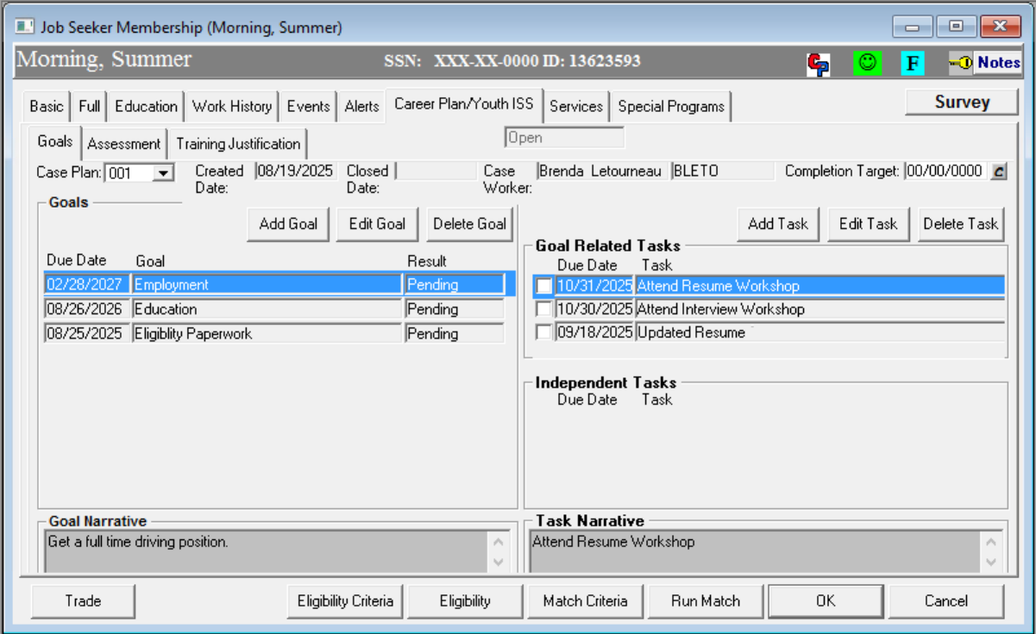
Youth ISS in MOSES
Notes:
On the assessment tab in the Career Plan/Youth ISS area of Moses. You want to make sure you have completed a full summary of the young person. If they do not have any work history note it. Or if there is a cori or sori issue. Make note on any skills, education or testing issues. Then of course our favorite, a good complete summary for the LMR of the young persons possible career path to help them understand the skills and education needed, salary and outlook of their chosen career path.

Slide 25
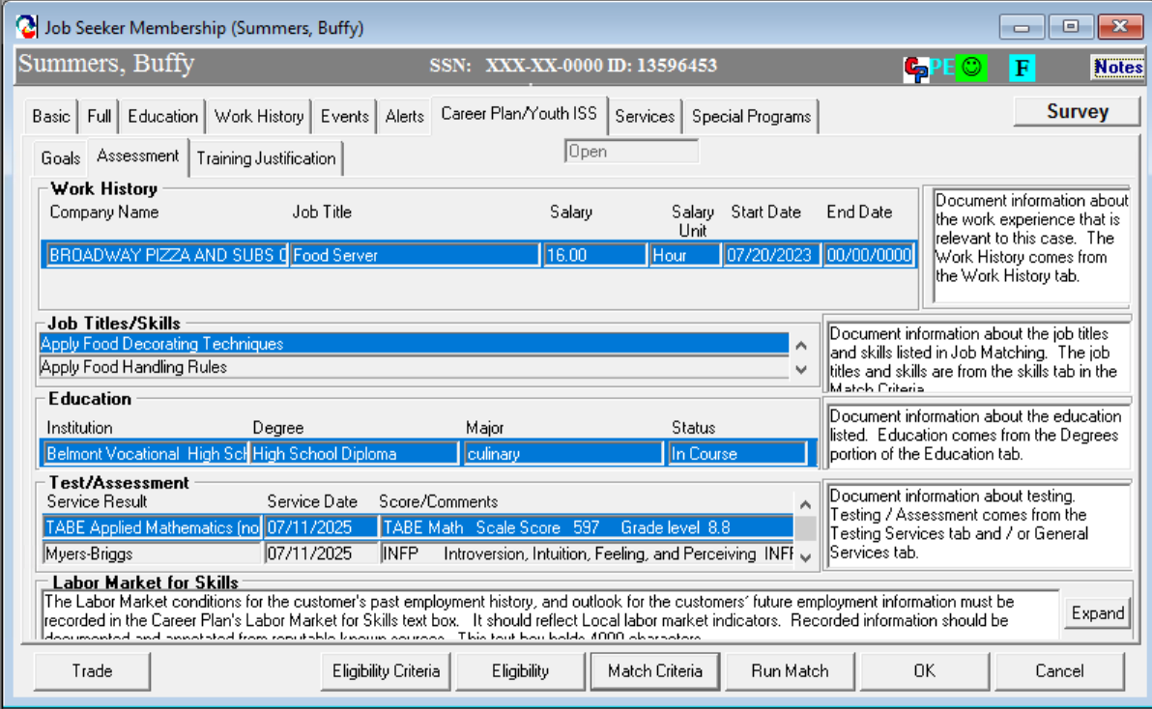
Youth ISS in MOSES
Notes:
On the assessment tab in the Career Plan/Youth ISS area of Moses. You want to make sure you have completed a full summary of the young person. If they do not have any work history note it. Or if there is a cori or sori issue. Make note on any skills, education or testing issues. Then of course our favorite, a good complete summary for the LMR of the young persons possible career path to help them understand the skills and education needed, salary and outlook of their chosen career path.

Slide 26
Enrollment in Program Service Elements
Youth receiving WIOA services must be enrolled in a Program Service Element
Youth who have completed the Program Service Element must:
  Enter a new program service element as appropriate; or
  Prepare to be exited if no other services are planned
  Remember there is 90-day window before auto-exit happens, if no blue/bold services are provided they will be auto-exited.
  Staff should not add blue/bold services to delay the exit date.
  Follow-up should begin when the youth has completed the Program Service Element, the outcome has been added, and no other activities have been decided for the youth.
Notes:
Any youth who is not planned to be enrolled in another Program Service Element within 90 days needs to prepared for auto-exit. The date of the last blue/bold service will become the young persons exit date.

Slide 27
MOSES
Documenting MOSES

Slide 28
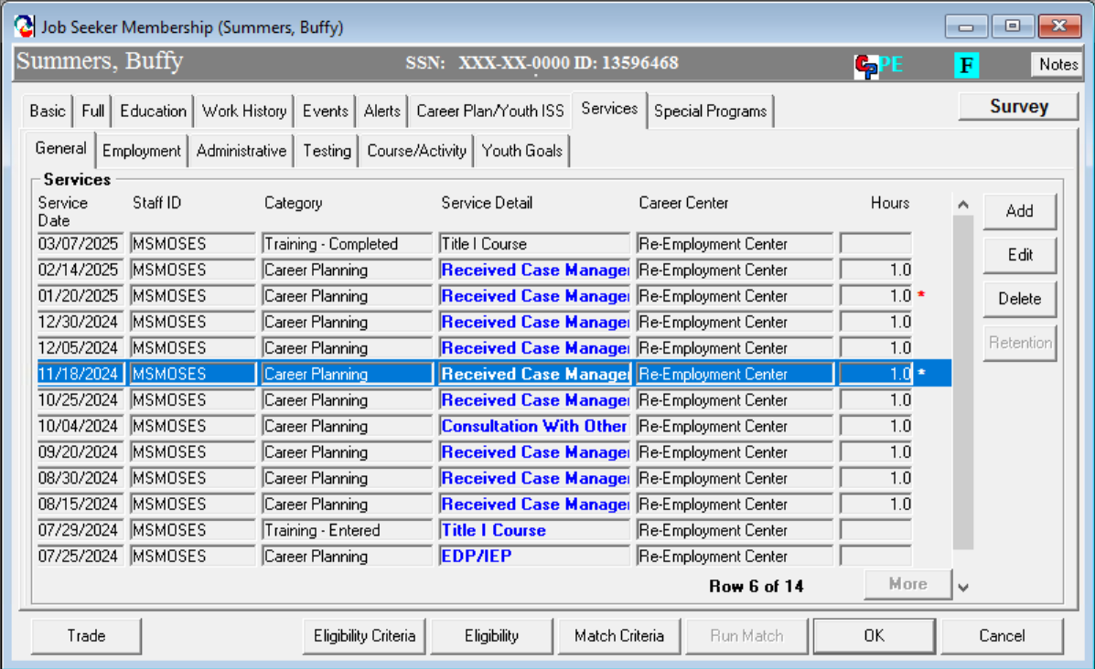


Correct Use of Blue/Bold Services to Protect Against Auto-Exit
Make sure to add notes in that describe the BLUE/BOLD service provided.
Notes:
You can see here the young person was enrolled in a program then received blue/bold services every 30 days or less until they completed their training. Any blue/bold service will count, it does not only have to be Career Planning. If there are no further planned enrollments there should be no further blue/bold services entered. Notes should be entered in Moses to detail the services received.

Slide 29
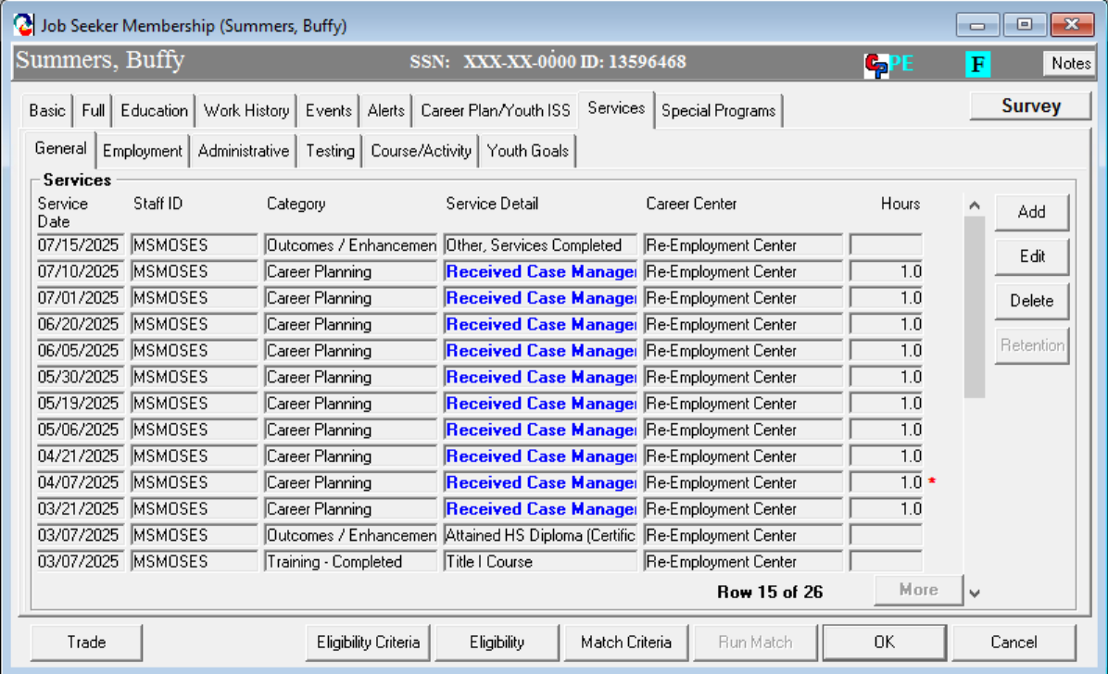


Incorrect Use of Blue/Bold Services to Keep a Youth from Auto-Exiting
If no new Youth Element is added within 90 days, no more BLUE/BOLD services added
Notes:
Here you can see in June the young person attained their High School Diploma but was not enrolled in another program element but kept receiving blue/bold services. This delays the exit and the federal auditors are always looking for this. If you have backdated any service be sure the auto exit has not already occurred. She your manager if you see this.

Slide 30
WIOA Program Elements – Documenting in MOSES
All youth must have access to the 14 WIOA program service elements
Program Element | Description | MOSES Activity and/or Service
Tutoring, Study Skills Training, Instruction | Development of educational achievement skills that leads to the completion of the requirements for a secondary or postsecondary school diploma/credential. | Activity Categories: Educational Training, HiSET/ASE, Dropout Prevention/Tutoring, Basic ABE, Basic ESL/ESOL, Adult Educ/Literacy w/Training
Alternative Secondary School | Alternative secondary school services or drop out recovery services. | Activity Categories: Alternative School
Work Experience Summer Employment Pre apprenticeship programs Internships/Job Shadowing OJT Opportunities | Work experiences which include summer employment, year-round employment, pre-apprenticeship, internships/Job-Shadow and In/On-the-job training opportunities. | Activity Categories: Work Experience/Summer Youth Academic/Occ. Learning – Summer Work Experience, Pre-Apprenticeship, In or On the Job Training, Workplace Training/Coop Education Programs, Internship, Job Shadowing
WIOA Program Elements will be entered as either an Activity or Service on the Service Tab.
Activities are added in the Course/Activity tab
Services are added on the General tab
Notes:
Each of the following 14 Program Elements will be added as a blue/bold service or enrolled as an activity. The first column is the program element, the next is the description and the last is weather the element will be an activity or service. All of these will on this slide will be enrolled as Activities.

Slide 31
WIOA Program Elements
Program Element | Description | MOSES Activity and/or Service
Education concurrently w/Workforce Prep | Integrated education and training that occur concurrently and contextually with workforce preparation. | Activity Categories: Education w/Workforce Prep
Leadership Development | Opportunities that encourage responsibility, confidence, employability, self-determination and other positive social behaviors. | Activity Categories: Community Service Leadership Development
Supportive Services | Services that enable youth to participate in program activities such as assistance with book, fees, school supplies, transportation, and legal aid services. | Service Categories: Supportive Services – except Needs Related Payment
Adult Mentoring (12 months min) | Participants receive adult mentoring for a period of not less than 12 months that connects to the youth’s goals. | Activity Categories: Mentoring
Notes:
On these there are a couple that can be enrolled as an activity or service.

Slide 32
WIOA Program Elements
Program Element | Description | MOSES Activity and/or Service
Comprehensive Guidance & Counseling | Individualized counseling which includes drug and alcohol abuse, and mental health counseling, and referral to partner programs. | Activity Categories: Comprehensive Guidance and Counseling
Financial Literacy Education | Support the ability of participants to create budgets, learn how to manage spending, credit, and debt. | Activity Categories: Financial Literacy Education Service Categories: Counseling/ Financial Counseling
Entrepreneurial Skills Training | Entrepreneurial skills training provides the basics of starting and operating a small business. | Activity Categories: Entrepreneurial Skills Training
Labor Market Services | Participants receive access to career counseling, career exploration, career awareness, and the use of labor market tools. | Service Categories: Job Search Automated Labor Exch Job Order Search Labor Market Info Resource Room
Notes:
And notice Financial Literacy Education can be entered as either an activity or a service.

Slide 33
WIOA Program Elements
Program Element | Description | MOSES Activity and/or Service
Follow-up Services (12 months) | Follow-up services are provided for 12 months unless the participants declines to receive follow-up services or cannot be located or contacted. | Service Categories: Follow-Up (Title I)
Occupational Skills Training | An organized program of study that provides specific vocational skills that lead to proficiency in performing actual tasks and technical functions required by certain occupational fields. | Activity Categories: Occupational Skills Training Skill Upgrade and Retraining
Transition to Post Secondary Education | Participants receive access to job exploration counseling, work based learning experiences, instruction in self-advocacy, work readiness training. | Activity Categories: Post Sec/Training Transition Activities Service Categories: Counseling Trans to Post Sec Ed/Training
Notes:
The same with Transition to Post Secondary Education, it can be an activity or service. If it is either an activity or service a note must be added as well. Every service or enrollment must have notes in Moses.

Slide 34
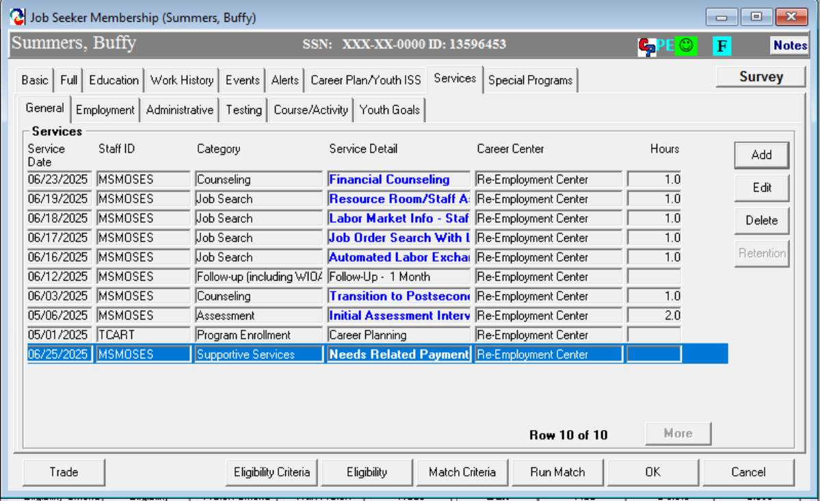



To Add a Service Program Element
Notes:
If your Youth Program Element is a service, you would add it on the General Tab under the Services Tab by clicking Add.

Slide 35
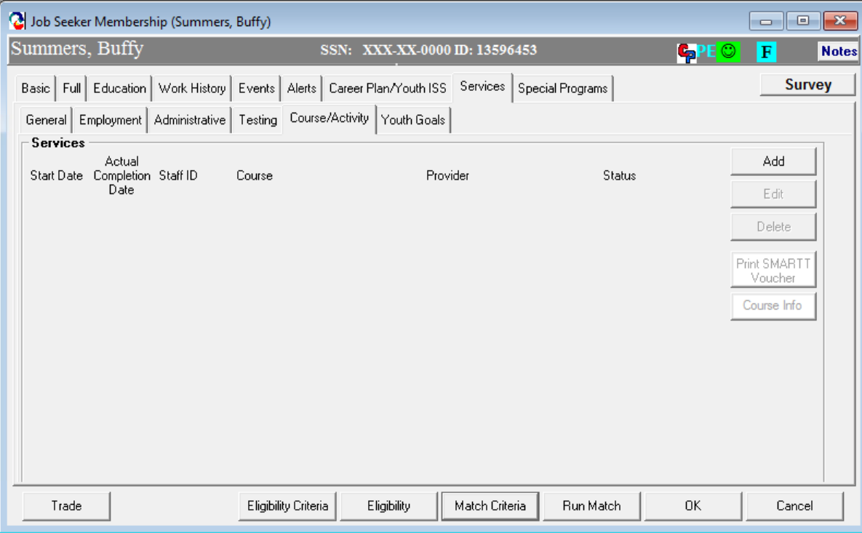


To Add an Activity Program Element
Notes:
If your Youth Program Element is an Activity you would add it on the Course/Activity Tab under the Services tab.

Slide 36
WIOA Career Pathway
CAREER PATHWAY—The term ‘‘career pathway’’ means a combination of rigorous and high-quality education, training, and other support services that—
Aligns with the current skills needed by industries;
Prepares individuals to be successful in education options;
Includes counseling to support education and career goals;
Includes contextualized learning within an occupational cluster;
Organizes education, training, and other services that accelerates education and career advancement;
Enables the attainment of a secondary and at least one postsecondary credential;
Supports entrance or advancement within a specific occupation or occupation cluster.

Slide 37
Career Pathway Concept using a customer centered design approach
Education
Training
Support Services
Putting the individuals needs at the center of service delivery.
Notes:
This graphic pulls it all together, everything we do focuses on supporting the young person in their Career Pathway to success.

Slide 38
Identify Appropriate Career Pathways
What should you do?
Provide youth with information that allows for exploration of career options along with the education, training, and or skills needed to be successful in those careers.
Provide information on career options to assist youth in setting career goals and to make informed decisions about appropriate career pathways.
Note, career goals for younger youth must be age appropriate and may identify a career interest that can be developed into a career goal.
Recognize that goals may change as youth get older and interests broaden this must be reflected in a revision of the ISS and documented in case notes.
Work in conjunction with the youth to determine interests, aptitudes, skills, and values that are important to the youth in identifying an appropriate career pathway.
Notes:
Everyone of our young people are coming from a different place and are heading towards a different career pathway. This pathway may change as a young person is exposed to new experiences and discovers new things about themselves.

Slide 39






Leveraging Partner Programs
Case management is important for service alignment and to avoid duplication!
WIOA Joint Partner Shared Customers 01.2018
Notes:
Good news! We do not do this alone! WIOA mandates we have relationships with required partners to help our young people with other barriers we may not be able to assist with but are barriers to their education and employment success. Any shared partner customers must be noted in Moses and must avoid duplication of services. There is a link at the bottom to bring you to the full policy.

Slide 40
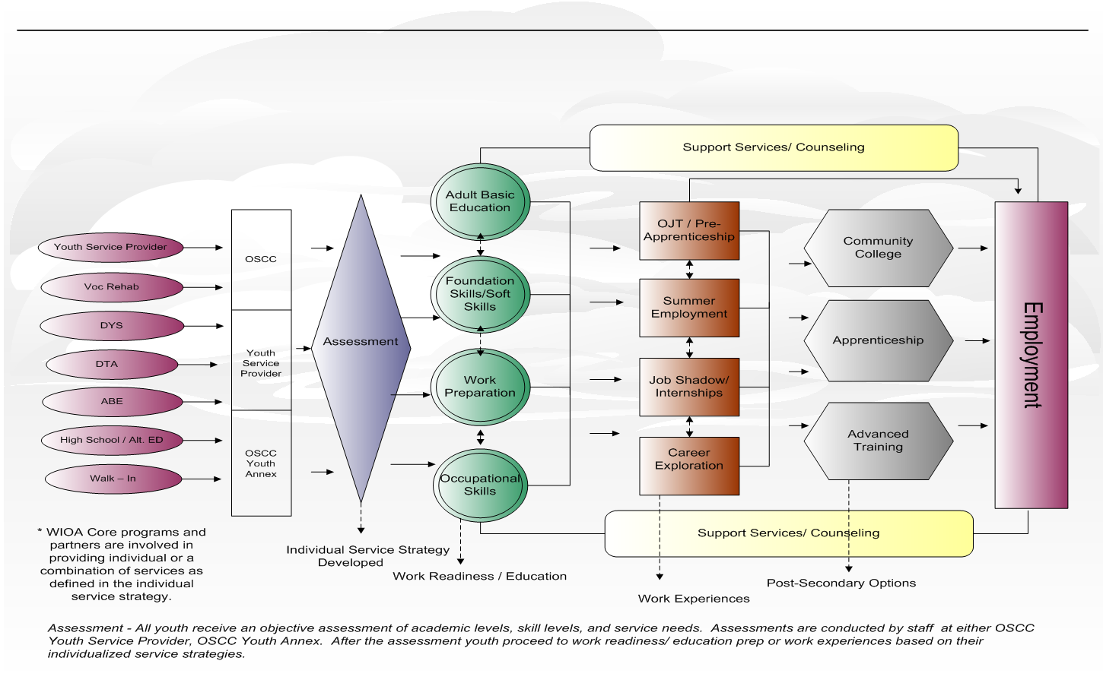
Youth Service Delivery Framework

Slide 41

Questions?
?
?
?
Questions
?
?
?
?
?
?
?
?

Slide 42
Resources
Massachusetts WIOA Youth Program Page
WIOA Youth Program Resources – Workforce GPS
Massachusetts Career Information System
Workforce Innovation and Opportunity Act
  Workforce Innovation and Opportunity Act: USDOL Only – Final Rule
MassHire list of Issuances and resource
Workforce GPS – Yes, WIOA Can!
  MassWorkforce Issuance 100 DCS 08.112.3: Career Planning for WIOA Youth, Adult and Dislocated Worker Customers
  Career Planning Elements: Attachment A
  Instructions for Documenting Youth ISS Sections in MOSES Attachment B
Notes:
These are some fanatic resources especially the WIOA Final rule at 399 pages.

