Slide 1
Joint AHA Commission Development Cost Briefing
May 29, 2025

Slide 2
Agenda
Call to Order | N/A
Development Costs: Context, Data, & Trends | 3 – 12
Developer Context: Case Studies & Discussion | 13 – 45
Next Steps | 46 – 47

Slide 3
Development Costs: Context, Data, & Trends

Slide 4
Context (I/II): Overview
Rising development costs are among the primary limiting factors of housing production in Massachusetts. Rising costs are driven by a variety of factors, ranging from local challenges in the development review process to national variables like interest rates and tariffs.
To produce more housing, particularly housing for communities not adequately served by the market, we need to:
i) undertake an honest accounting of these costs,
ii) recognize how costs have changed and will continue to change overtime,
iii) identify ways to reduce the costs that don't support our shared goals, and
iv) better align, and thus increase the efficiency of, policies and programs which do support these shared goals
Identifying these potential efficiencies not only drives more robust housing production overall but also allows the Commonwealth to put more resources toward the programs that do drive forward our goals.

Slide 5
Context (II/II): UPHC Findings
Context
Several key development cost drivers, from restrictive zoning and land-use regulations to increased cost of building materials, were recently examined by the Unlocking Housing Production Commission (UHPC), created by Governor Healey in October 2023 (via EO #622).
The UHPC’s final report, “Building For Tomorrow,” was released in Feb 2025 includes over 50 recommendations of actions that MA can take to move the needle on housing production.
Key Findings
Over the past 5 years, material costs have increased by over 40% nationwide; MA, in particular, has among the highest construction costs in the country.
Local zoning laws and inflexible state code requirements can make it more difficult to develop higher-density housing, exacerbating development cost challenges.
MA faces a challenging fiscal environment, and it will be critical to optimize existing resources, such as funds allocated from the record-setting $5.2B Affordable Homes Act, to have the greatest impact.
Additional zoning, land-use, code, and process reforms (especially those that are no/low cost) are needed to maximize the impact of the Commonwealth’s housing investments.

Slide 6
Making it Pencil (I/VIII): Capital Cost Drivers*
Massachusetts has the 3rd highest development costs in the Country and will likely see costs continue to increase
Tariffs – Tariffs increase the costs of imported good. MA developers import varying construction materials, such as lumber from Canada, that are now more costly due to imposed tariffs.
Budget Cuts – Proposed congressional budget cuts to programs including CDBG, HOME, CDFI will likely require developers to rely on a higher-level of State sources
Interest Rates and Capital Markets – Economic uncertainty, downgraded federal credit ratings, and increasing federal debt have the potential to drive up interest rates and/or investor return expectations, making it more difficult to assemble project financing.
Federal
Labor – MA has some of the highest labor costs in the U.S. due to the high cost of living and limited labor pool. Certain funding sources and projects also require developers to comply with specific labor requirements (e.g. PLAs, Davis-Bacon) which provide important protections and benefits to laborers on these projects, but which can also increase costs when compared to nonunionized labor.
Regulation and Permitting – State permitting requirements, environmental review, and the timeline for approval increase costs often due to incurred loan interests
Infrastructure – Lack of public water and waster water infrastructure requires developers to build these systems onsite and at a significant project cost
State
Permitting – Many municipalities have stricter environmental regulatory standards than current State standards. Permitting approval timeline, due diligence requirements, parking requirements, zoning approval and resulting project revisions to receive approval can significantly drive up costs
Community Opposition – Local opposition often results in increased costs resulting from concessions to reach approval (e.g. project revisions, staffing, etc.), longer entitlement process and carrying costs, and sometimes legal costs due to community
Infrastructure – Increased debt obligation require increased operating revenues. Developers are less inclined to move forward with projects and/or face significant barriers to financing projects already underway
Local – Project Specific
*List is non-exhaustive

Slide 7
Making It Pencil (II/VIII): Capital Cost Trends*
Total development costs have grown significantly over the last decade, driven by increases in input and financing costs, heightened regulatory requirements, and restrictive local permitting processes.
Land | Avg. cost: $80K/acre (statewide) Regionally: $20K/acre (Berkshire), $365k/acre (Essex), $5.6M/acre (Dukes); prohibitive zoning also increases the price of developable land by artificially limiting supply
Labor | Rising Cost of Labor Massachusetts' high, and increasing cost of living means labor costs significantly more here than elsewhere in the U.S. While union labor costs more, this makes possible improved wages, benefits, and protections for union laborers.
Materials | Overall material costs: +40% (since COVID-19) Some costs have risen even more sharply: Copper: +43%; Steel: +53%; Natural Gas: +147%; tariffs will likely further increase these costs for imported goods like lumber and steel.
Green Energy | Overall dev. costs: +5-10% (to comply with updated green energy requirements) Compliance with these requirements may reduce utility costs overtime.
Permitting | Projects need numerous approvals for compliance with local and state fire, septic, plumbing, environmental, and other regulations. Waiting for these approvals, and making requested adjustments to receive approval, lengthens project timelines, and increases costs – most notably in interest accrued on loans.
Interest Rates | Financing costs: +5% (multifamily, since COVID-19) On average, developers borrow roughly 50% of total project costs. Permitting and other project delays not only increase accrued interest, but also make investors less willing to invest to cover these cost escalations, often increasing the premium these investors demand when compared to alternative, safer investments options.
*List is non-exhaustive and specific costs will vary due to a multitude of factors (e.g. specialized type of labor, region, etc.)

Slide 8
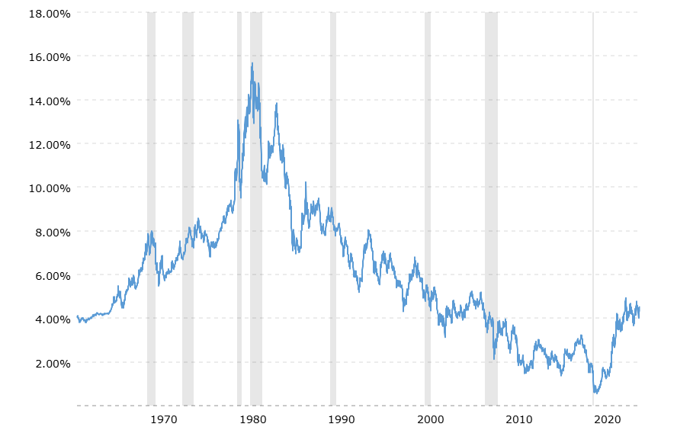
Making it Pencil (III/VIII): Interest Rates
While interest rates have increased substantially since 2020, they are still relatively low compared to historical rates.
Cost pressures from interest rates thus arise less from these rates being unreasonably high, and more from their rapid increase and the compounding effect that increase has on other cost pressures.

Slide 9
Making It Pencil (IV/VIII): Operating and Staffing Costs*
Operating Costs
Property Management Fees
Maintenance staff including housekeeping
Maintenance, repair, and housekeeping (trash, extermination, landscaping, snow removal, repairs, painting, elevators)
Utilities
Marketing and leasing (advertising, processing applications, credit checks)
Security staff and systems
Taxes and insurance
Administrative staff (rent collection, bookkeeping, receptionist)
Operating and replacement reserves
Fringe & benefits for all staff
Food and meals (entire building)
Staffing Costs
Case management
Resident Service Coordinators
Childcare/parenting support
Legal assistance
Employment training/support
Money management/budgeting
Mental Health or Substance Use Disorder services (e.g. recovery
Transportation
Operating Revenue Sources
Vouchers -> Amount and type of vouchers per project
Rental income -> How much rent do you collect from tenants? What are the underlying assumptions and policy for ELI populations (e.g. PSH)
Other Government/Philanthropic Sources -> Projects serving primarily ELI households often rely on grants and outside sources to offset operating losses
Staffing and Supportive Services
MassHealth -> (OTLSS, HRSN, etc.)
State Agency funding (EOAI, DMH, etc.)
Federal (HUD-CoC, SAMSHA, VA, etc.)
*List is non-exhaustive

Slide 10
Making It Pencil (V/VIII): Potential Cost Savings
Costs have increased almost universally, but not all costs are created equal.
While some costs increase without offering additional benefits (e.g. materials, interest rates), other costs come with benefits, financial and otherwise.
For example: compliance with enhanced green energy requirements increases total development cost. However, these requirements may offer significant energy cost savings over the long term. More broadly, these increased costs will also help to build a healthier and more sustainable future for Massachusetts.
It can be difficult to quantify the benefits of certain increases in cost. However, some examples illustrate potential savings clearly, such as savings generated from the improved health outcomes experienced by people who live in housing which matches their needs.

Slide 11
Making It Pencil (VI/VIII): Cost Savings Examples
Senior affordable housing with “place based supports” can reduce medical care needs and associated costs
Senior Affordable Housing properties bring together large numbers of older adults, in one building, providing an opportunity to more efficiently deploy community health and well-being strategies. Studies have shown that these “place based supports” have a beneficial impact on the health outcomes of older adults, by reducing calls to Emergency Medical Services, and preventing emergency room visits and hospital admissions.
A national study of senior affordable housing found that the presence of a Resident Service Coordinator onsite was found to decrease the odds of having at least one acute inpatient admission by 18%
One local model demonstrated a 16% decline in inpatient hospitalization rate and 22% decline in 30-day hospital readmission rates, 19% decrease in trips to the emergency room, and a 25% decline in total days admitted to a hospital per resident.
Another model and subsequent evaluation demonstrated a slower growth of annual Medicare expenditures by an estimated $1,100-$1,450 per beneficiary per year.
Supportive housing reduces health care costs and promotes more appropriate health care utilization for vulnerable residents
A study of formerly homeless residents of permanent supportive housing receiving Medicaid funded services found that initiation of services was associated with up to an $11,900 reduction in annual per-person health care costs as well as significant reductions in inpatient and outpatient behavioral health and medical costs
Individuals enrolled in permanent supportive housing programs received significantly more mental health services than a similar group of chronically homeless individuals. However, the cost of the higher average utilization of mental health services among those enrolled in permanent supportive housing was more than offset by their lower utilization of inpatient and emergency department services relative to a similar group of chronically homeless individuals.

Slide 12
Making It Pencil (VII/VIII): Total Development Cost Over Time
Total development cost per unit for EOHLC-funded new construction statewide exceeded $650,000 in 2024.
One quarter of developments cost more than $750,000 per unit, including some in Metro Boston, Cape Cod, Islands, and Western MA.
Costs of adaptive reuse are comparable to new construction.
Development costs per unit rose 78% over a six-year period, driven by increases in construction (up 82%) and 'general development' costs (up 110%).
Cost for preservation/acquisition has risen even faster than cost of new construction.
Subsidies provide an increasing share of total development cost.
*Statistics are provisional and subject to revision

Slide 13
Making It Pencil (VIII/VIII): Funding Sources Overview
Funding Sources*
Capital
Federal and State Low Income Housing Tax Credit (LIHTC)
Community Development Block Grant
HOME Funds
Facilities Consolidation Fund
Affordable Housing Trust Fund
Housing Stabilization Fund
Housing Innovations Fund
Facilities Consolidation Fund
Capital Improvement and Preservation Fund
Housing Development Incentive Program
Operating
HUD-Continuum of Care
Community Based Housing
Massachusetts Rental Voucher Program (MRVP)
Assisted Housing Voucher Program (AHVP)
DMH Rental Subsidy Program
Federal Rental Vouchers (Section 8, HCVP, FSS,FUP)
Flexible/Supportive Services
MassHealth
CSP-HI, CSP-JI, CSP-TPP
OTLSS service
Home and Community Based Services
MassHealth Community Support Program
Substance Abuse and Mental Health Services Administration Funds
Bureau of Substance Addiction Services Low-Threshold Funding
Home & Healthy for Good
HUD - Continuum of Care Funds
*Lists are non-exhaustive and do not include all sources

Slide 14
Questions?

Slide 15
Developer Context: Case Studies & Discussion

Slide 16
Amy Schectman 2Life Communities

Slide 17
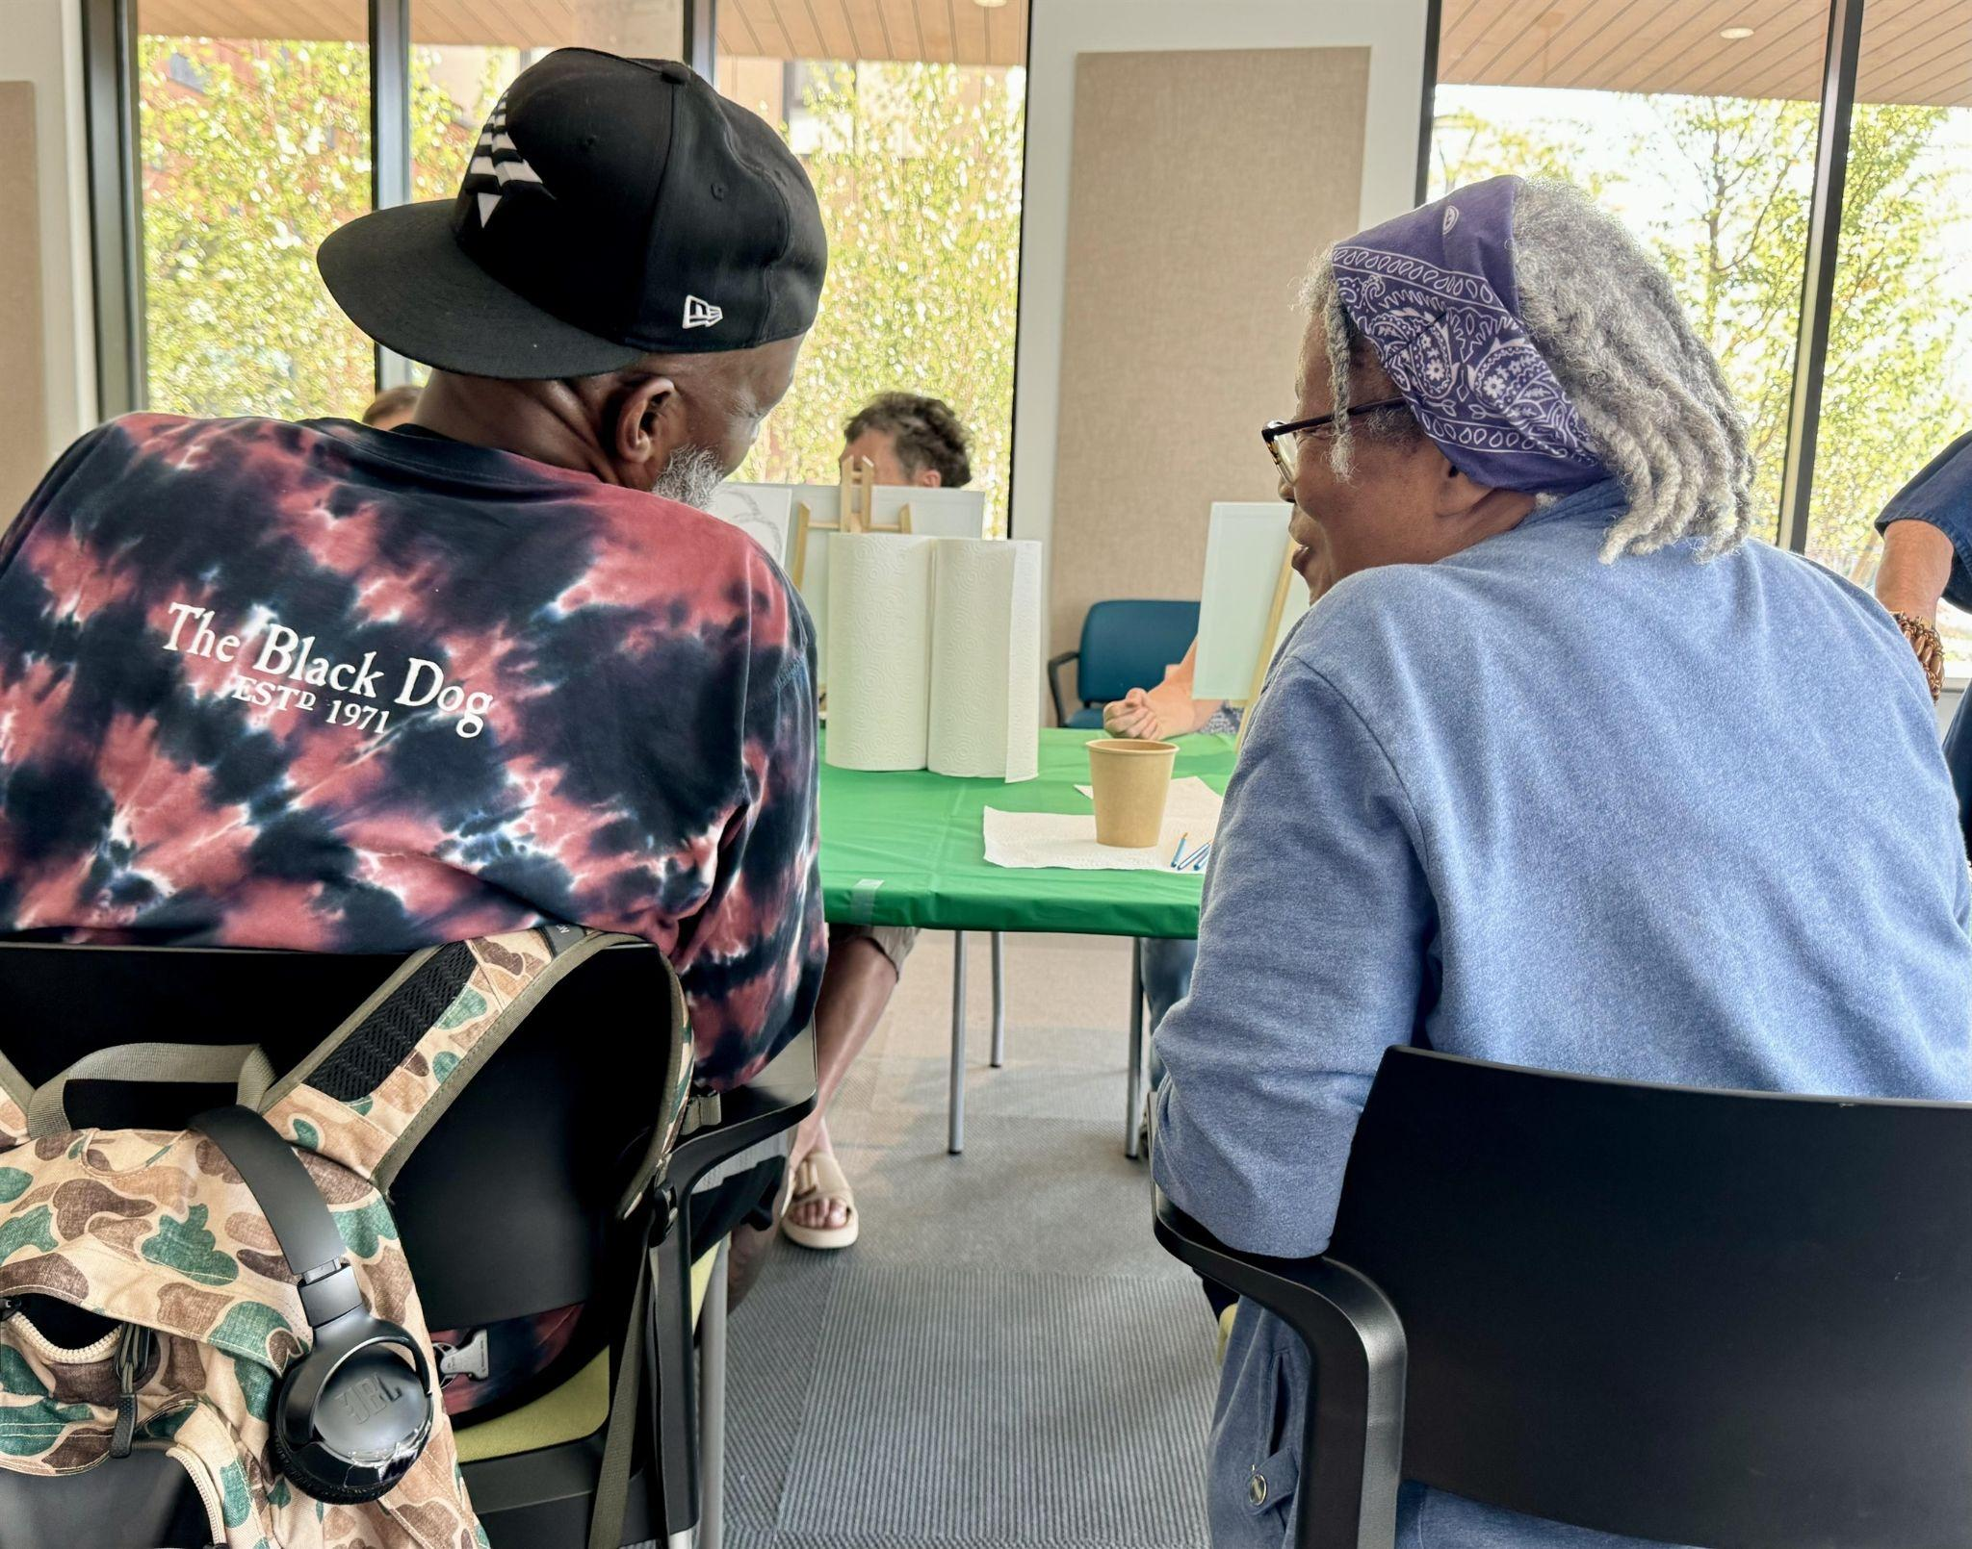
Goals of Senior Affordable Housing
Provide affordability
Underwrite LIHTC rents significantly less than maximum
Pair w/significant # vouchers
Address loneliness
Sufficient community spaces
Staffing to support community life
Preserve tenancies for entire lives
Adaptability of all apartments
24/7 staffing
RSCs

Slide 18
Low Income Housing Tax Credit (LIHTC) and seniors
Senior incomes distribution lower than AMI – few can afford LIHTC-only
Seniors’ incomes effectively decline over time—LIHTC rents don’t adjust
Eligibility for LTSS and other supports stops where LIHTC begins
MA agrees about importance of RSCs but doesn’t account for them in underwriting
Locations w/in MA can restrict feasibility
Scale that creates operating efficiency is hard to achieve

Slide 19
AMI-based income brackets in 2024 dollars
 | <30% AMI (under $34,000) | 30-50% AMI ($34,301-$57,099) | 50-60% AMI ($57,101-$68,519) | 60-80% AMI ($68,520 - $91,199) | 80%+ (>$91,200) | Total
Age 62+
# 1 person hh’s | 110,619 | 41,740 | 14,556 | 20,811 | 40,293 | 228,019
Age 62-79
 | 72,540 | 27,880 | 10,760 | 16,726 | 32,610 | 160,516
 | 45% | 18% | 7% | 10% | 20% | 100%
Age 80+
 | 38,079 | 13,860 | 3,796 | 4,085 | 7,683 | 67,503
 | 56% | 21% | 6% | 6% | 11% | 100%
Figures correlate to 2024 Boston-Cambridge-Newton, MA-NH Metropolican Statistical Area (MSA) Prepared by Center for Social & Demographic Research on Aging, University of Massachusetts Boston in November, 2024, using 2018-2022 5-year file of the American Community Survey – income values were adjusted to 2024 dollars using the Consumer Price Index for all Urban Consumers, data.bls.gov

Slide 20
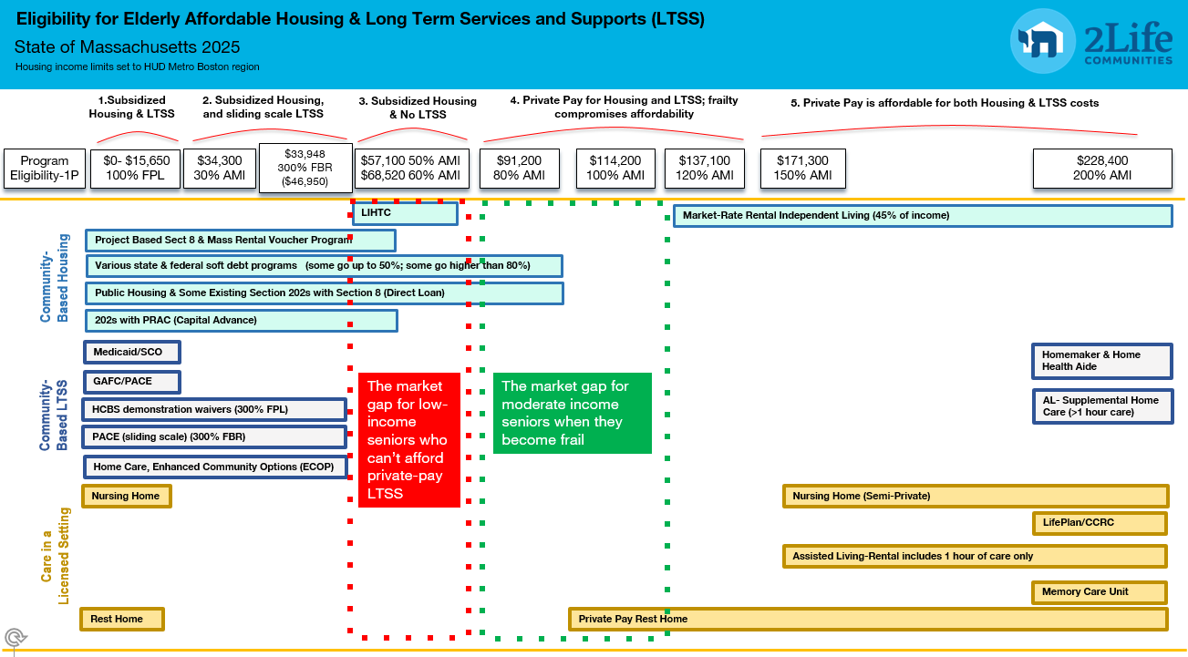

Slide 21
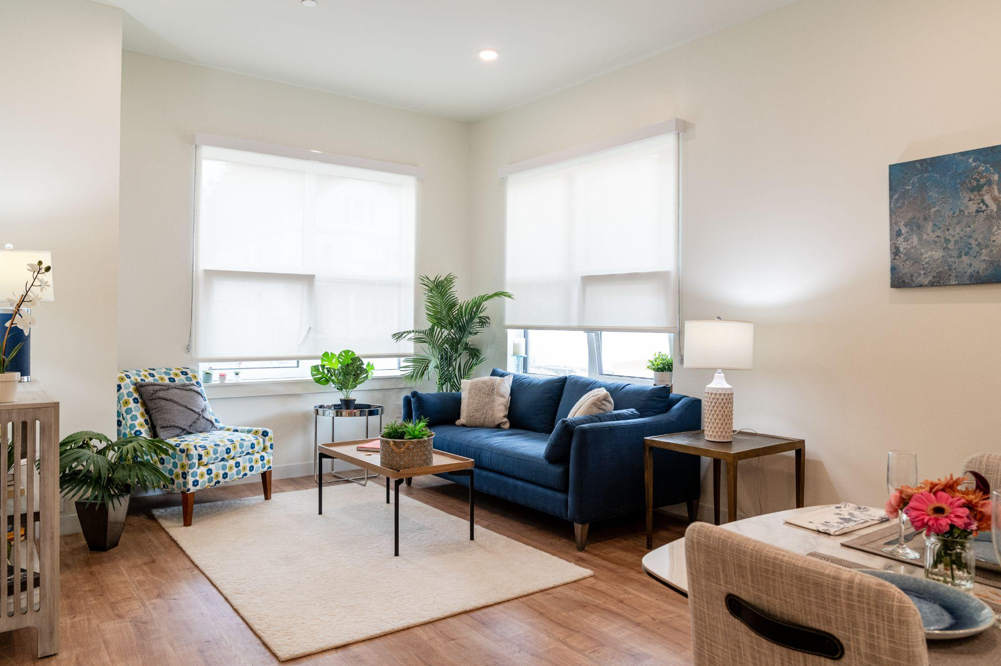
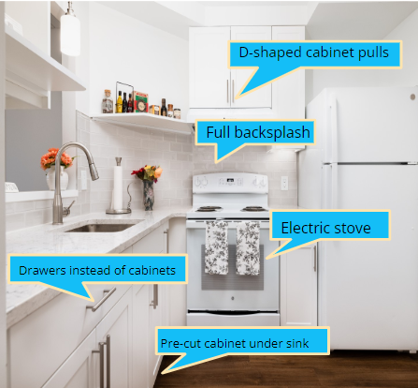
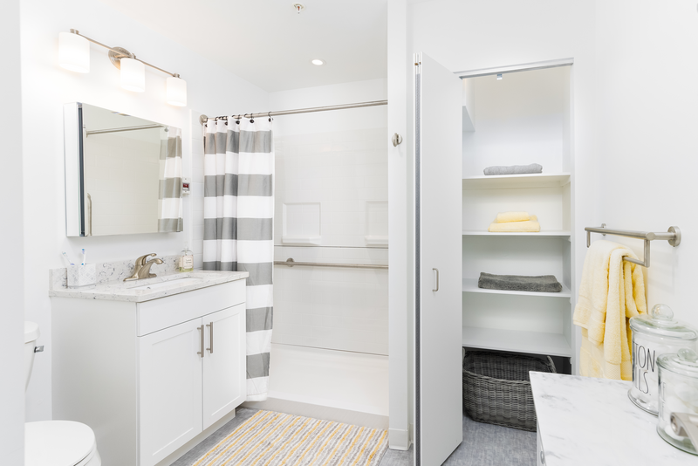
A 2Life Adaptive Apartment
Bright LED and natural light
Easy open windows
Higher outlets
Non-slip flooring
Towel bar as grab bar; continuous blocking
Removable curb shower
Non-slip, threshold-free floors

Slide 22
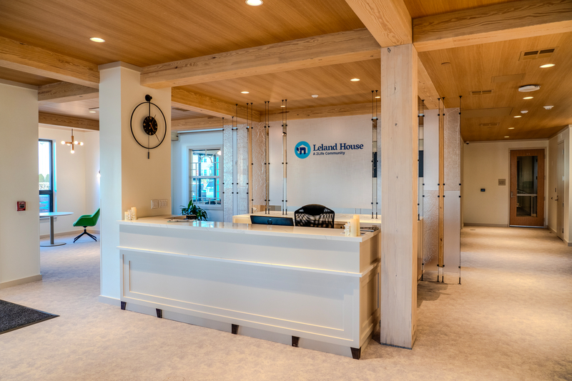
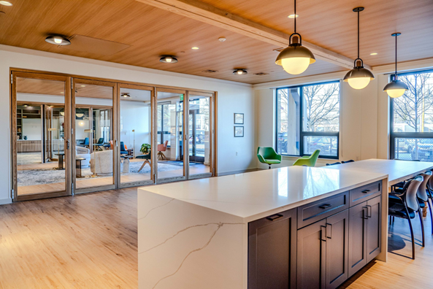
Leland House, Waltham
68 apartments → 100% affordable
24 PBVs (8 Section 8 and 16 MRVP) – at 30% AMI
42 non-vouchered LIHTC
2 site rep apts
100% electric, Passive House building
Village Center w/lobby and reception area, multipurpose rooms
Close proximity to transit and retail, abuts the Waltham Senior Center
$38.2 million TDC ($562,000/apt), 12 funding sources
LIHTC Rent (60% AMI) = $1,862/mo for 1-BR
Leland Rent = $1,250/mo for 1-BR*
Made possible by underwriting to 70% of max rent*

Slide 23
Incremental Costs/Funding
DDA boost @$4 million
100% adaptability @$12k/unit incremental cost
Incremental cost of village center @$3.3MM for Leland
$6 MM in CPA funds obviated need for philanthropy (not typical)
Amount of increased capital to allow for underwriting lower LIHTC rents @$1.5MM

Slide 24
Benefits beyond quality of life
Housing ecosystem (family opportunities)
Reduced nursing home use
Lower hospitalizations, ER use
Longer lives

Slide 25
Andrew McKenzie-DeFranza Harborlight Homes

Slide 26
Andrew McKenzie-DeFranza Harborlight Homes

Slide 27
Andrew McKenzie-DeFranza Harborlight Homes

Slide 28
Andrew McKenzie-DeFranza Harborlight Homes

Slide 29
Andrew McKenzie-DeFranza Harborlight Homes

Slide 32
Aaron Gornstein Preservation of Affordable Housing (POAH)

Slide 33
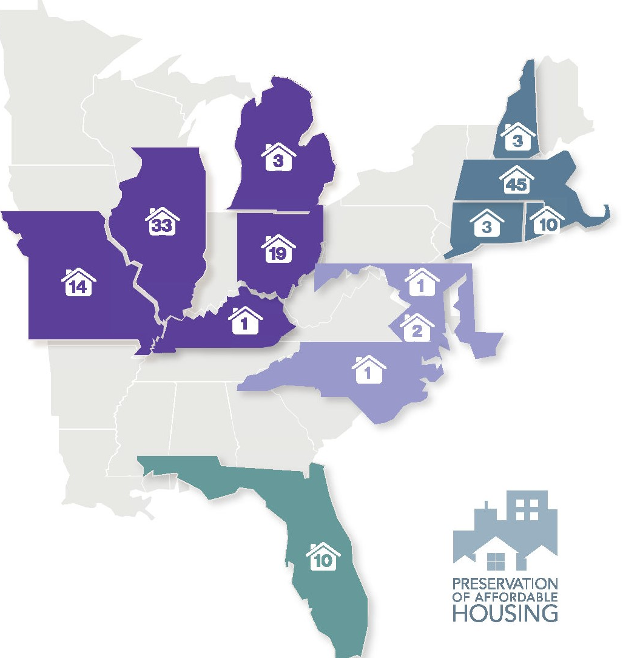
About Preservation of Affordable Housing (POAH)
Nonprofit organization whose mission is to preserve, create, and sustain affordable, healthy homes that support economic security and access to opportunity for all.
Built or preserved over 14,000 homes in 13 states, including about 4,000 in MA
Provides extensive property management and residents services across the portfolio
Notes:
33

Slide 34
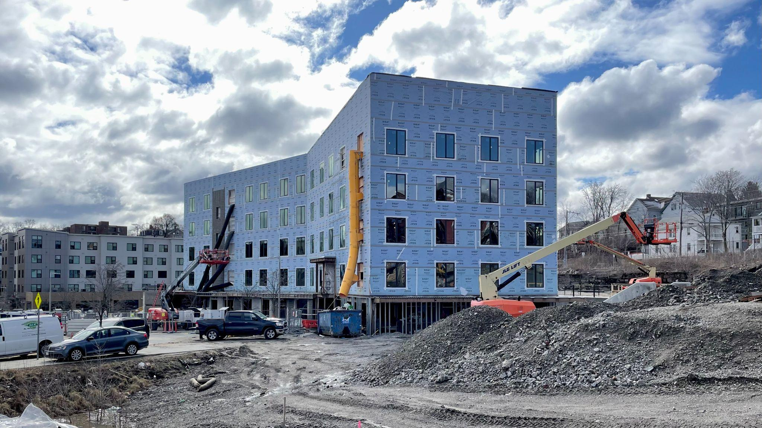
Context: Key Cost Drivers
Key factors driving project costs:
Community process + scarce funding > lengthy project timelines
Long timelines magnify impacts of inflation
Sponsors add project features responsive to community + funder interests
Project complexity drives significant soft costs
Notes:
34

Slide 35
Project Example: The Kenzi at Bartlett Station
Partnership with Nuestra Comunidad as part of revitalization of former Bartlett Yards in Roxbury.
50 apartments for seniors, 55 years of age and older
Some replacement units for Whittier Choice Neighborhood
Funded with 4% LIHTC, tax-exempt mortgage, and numerous soft funding sources (EOHLC, DND,MHFA, CEDAC)
Notes:
35

Slide 36
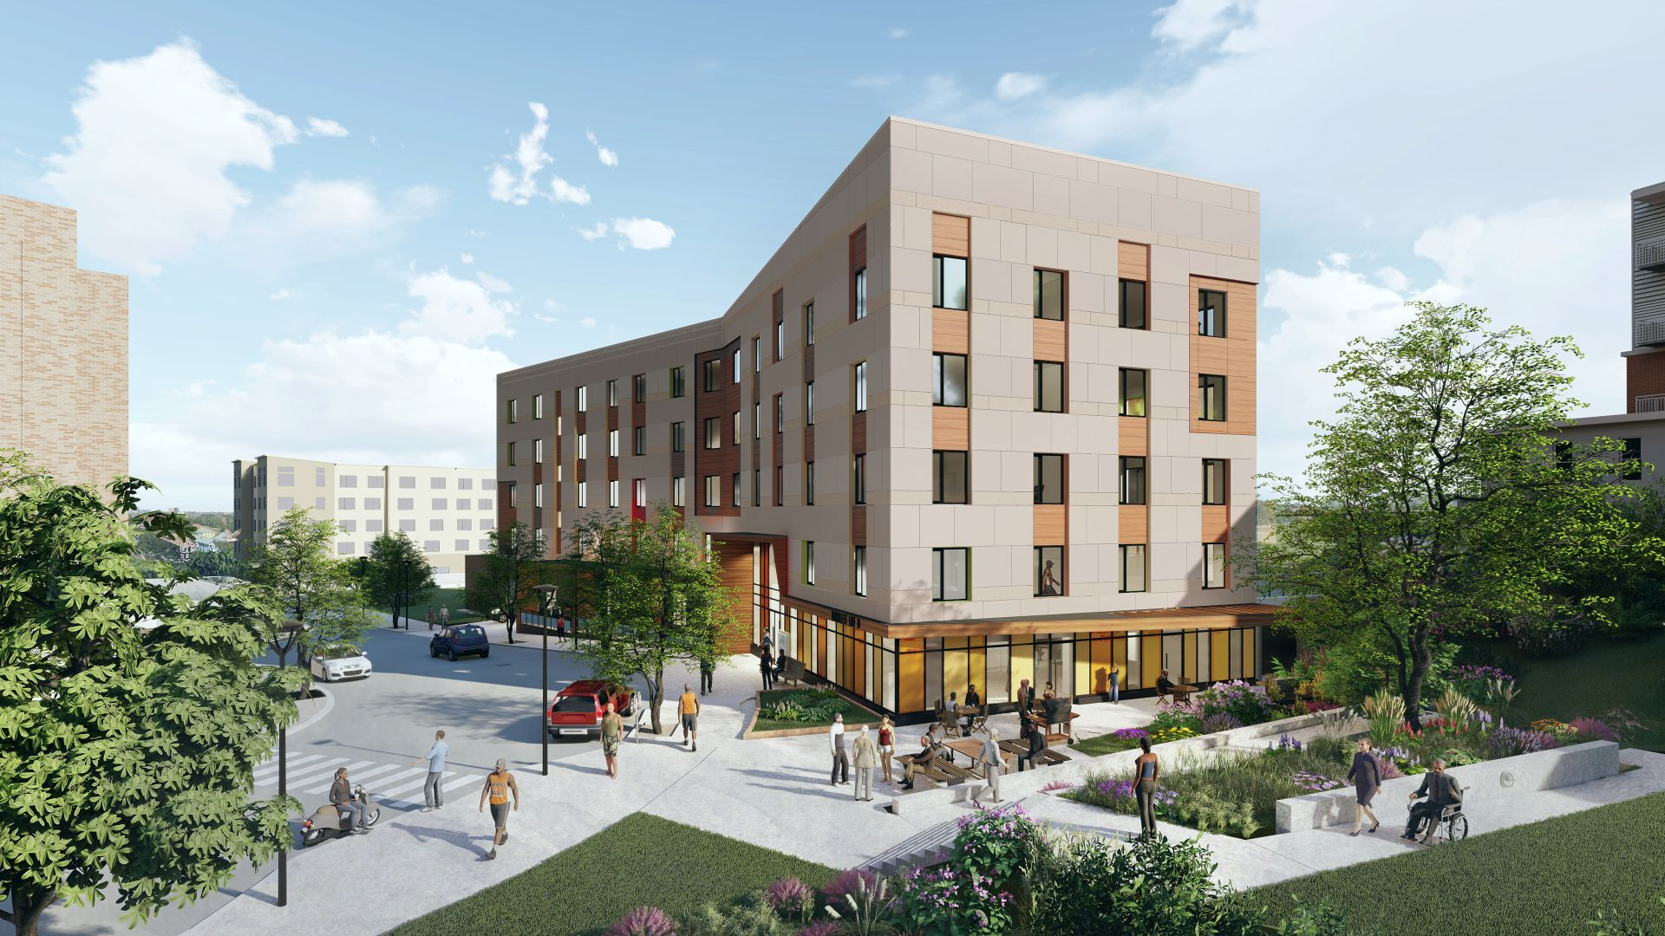
Unique Features: The Kenzi at Bartlett Station
Mixed income: 30% AMI, 50% AMI, 60% AMI, 80% AMI, and market rate
Partnership with Boston Medical Center for both capital investment and on-site services with clinical space.
First all-electric development in Boston over 4 stories, including battery-powered generator. Passive house-designed.
Commercial gallery space for local artists.
All units are "accessible ready"
Notes:
36

Slide 37
Drivers: Non-Housing Policy Goals
Housing projects are a vehicle for other policy goals
Sponsors add features to satisfy stakeholders / win resources
Each is worthy, but each adds costs:
Soil disposal (urban infill) +$500K
Passive House ($800K) + solar (+$250K) + battery backup (+$500K)
MWBE hiring (60%/15%) +$500K
Community amenities – health visit space, gallery, outdoor “oasis”
Notes:
37

Slide 38
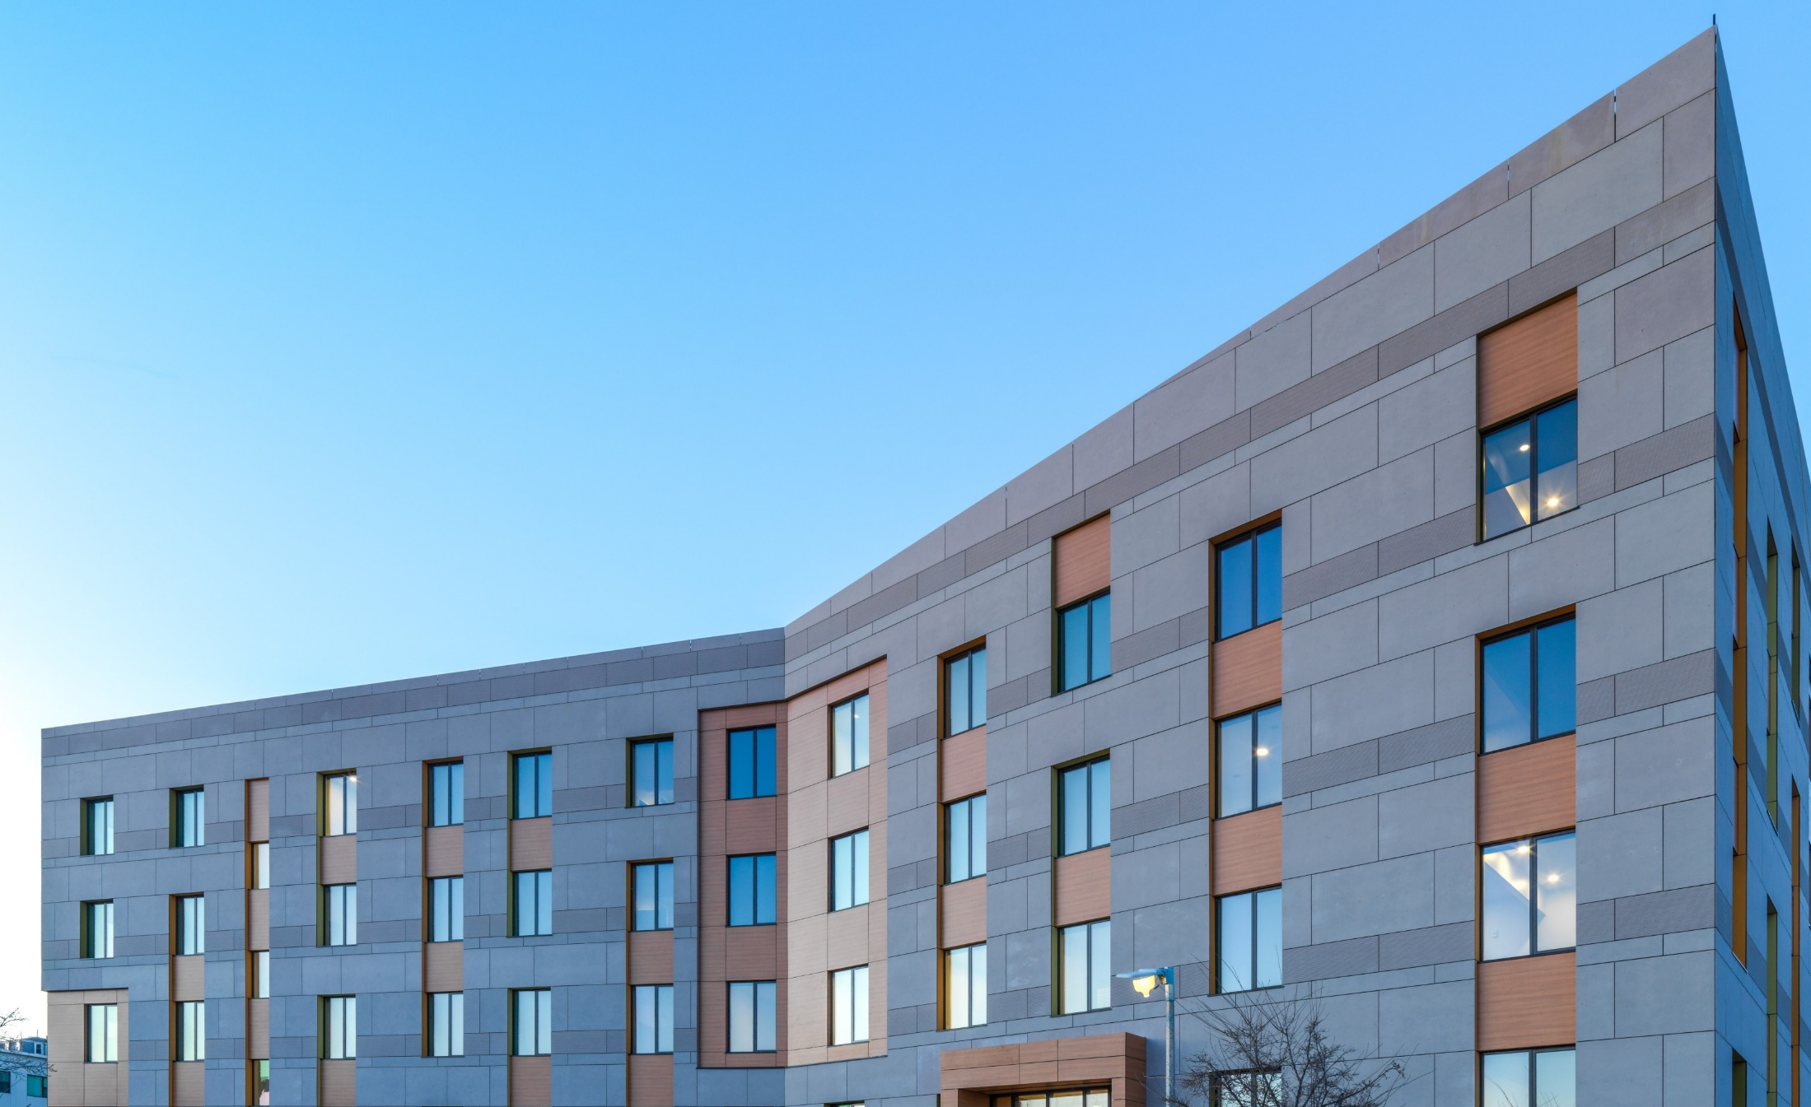
Drivers: Timeline / Cost Inflation
Rapid post-COVID cost inflation + long predevelopment timeline = significant cost increase from project start to closing
The Kenzi timeline / costs:
8/2018 POAH board approval: $23.3M TDC
2/2020 Funding App: $25.0M
9/2021 Closing: $28.2M
Notes:
38

Slide 39
Drivers: Complexity & Soft Costs
Soft costs are a significant cost driver
Project complexity & timeline magnify soft costs.
Key soft costs:
Design (A&E): $1.44M (5% of TDC)
Financing fees: $930K (3%)
Legal: $450K (1.4%)
Construction loan interest: $2.3M (7%)
Notes:
39

Slide 40
Bill Grogan Planning Office of Urban Affairs (POUA)

Slide 46
Questions?

Slide 47
Next Steps

Slide 48
Next Steps
June: Commissions meet separately to discuss challenges and solutions identified by members
July: Commissions prioritize challenges and solutions, begin developing recommendations

