Slide 1
Accessible Housing
Commission:
Initial Recommendations
August 14, 2025

Slide 2
Agenda
Call to Order, Approval of Minutes | N/A
Initial Working Group Recommendations | 3 – 8
Center for Living and Working Presentation | 9 – 13
Next Steps | 14 – 15

Slide 3
Initial Working Group Recommendations

Slide 4
Initial Working Group Recommendations:
Accessible Development & Market Dynamics (Page 1 of 2)
Expand Mass. Architectural Access Board regulations to address more types of disability
  Level of Action: Regulatory
  Type of Action: Program Improvement
  Summary: The working group recommends that the Massachusetts Architectural Access Board develop standards for housing for people with mental disabilities (Intellectual and Developmental Disabilities (IDD), Neurodivergence, Mental Health, etc.)
Study the demographics of disability to support informed policy-making
  Level of Action: Legislative
  Type of Action: New Program
  Summary: The working group recommends that the Commonwealth provide resources to an appropriate agency to study the demographics of disability on a current and ongoing basis to guide future policy decisions.
  This study should include analysis of disability type, gender, race, age, income level, household configuration, housing preferences.
  This initiative should start with the issuance of a report on current demographics, and updating it on an ongoing basis.

Slide 5
Initial Working Group Recommendations:
Accessible Development & Market Dynamics (Page 2 of 2)
Provide additional funding for affordable accessible dwelling units.
  Level of Action: Legislative
  Type of Action: Funding
  Summary: The working group recommends that Recommend additional and/or re-prioritized funding for the development of affordable accessible dwelling units, including but not limited to: accessible ADUs on existing DDS & DMH community residences; additional points on grant processes for housing that supports individuals with disabilities including persons with mental disabilities (IDD, Neurodivergence, Mental Health, etc.); funding that addresses the unmet need of persons with disabilities not addressed HIF, CBH, FCF, and others.
Develop standard/model designs to facilitate accessible & inclusive units.
  Level of Action: Administrative
  Type of Action: New Program
  Summary: Recommend that appropriate agencies (BBRS, EOHLC, etc.) develop standardized and/or model designs for accessible and inclusive dwelling units & sleeping rooms, including but not limited to ADUs, and that going forward anytime designs are developed or competitions are created the requirement for accessible and inclusive design are included.

Slide 6
Initial Working Group Recommendations:
2) Housing Search, Tenant Selection & Discrimination (Page 1 of 3)
Create a Centralized Housing Resource for People with Disabilities
  Level of Action: Administrative
  Type of Action: New Program (New resource site)
  Summary: The working group recommends that EOHLC and the Mass. Office on Disability (MOD) build on comprehensive information available on MOD's website and EOHLC resources to create a new centralized website that provides “one-stop shopping” for individuals with disabilities seeking information about all aspects of housing search, tenant selection, retaining existing housing eligibility/recertification, and civil rights. The website should also include general housing resources such as information on the state sanitary code, and funding for tenants and landlords to make modify units for improved accessibility.
Improve Housing Application Document & Process Accessibility (Part 1 of 2)
  Level of Action: Administrative
  Type of Action: Program Improvement
  Summary: The working group recommends that EOHLC:
    establish best practices for local housing authorities (LHAs) and regional administering agencies (RAAs) on inclusion of a black box notice with contact information to request reasonable accommodation. Notices should also clarify that reasonable accommodation may be requested for any part of the application process, from completing paperwork to attending meetings.
    Build on the Model Reasonable Accommodation Policy for LHA's to provide model black box notices to LHAs and RAAs
    Provide training to LHAs and regional administering agencies (RAAs) on implementation of these notices

Slide 7
Initial Working Group Recommendations:
2) Housing Search, Tenant Selection & Discrimination (Page 2 of 3)
Improve Housing Application Document & Process Accessibility (Part 2 of 2)
  Level of Action: Administrative
  Type of Action: Technical Fix
  Summary: The working group further recommends that, in determining emergency status, the Common Housing Application for Massachusetts Programs (CHAMP) accepts letters documenting no-fault loss of housing from the Mass. Commission for the Blind (MCB), the Mass. Commission for the Deaf and Hard of Hearing, the Department of Mental Health (DMH), the Department of Developmental Services (DDS), and MassAbility. This would replace the current requirement of a court order, which is impossible for some application to obtain.
Enhance Housing Navigator Massachusetts
  Level of Action: Administrative
  Type of Action: Program Improvement/Funding
  Summary: The working group further recommends that Housing Navigator develop the following functions, and be provided any funding necessary to do so:
    Improve Housing Navigator and CHAMP integration to make Housing Navigator the "front door" for CHAMP
    Provide word search capability or filtering for people seeking disability-specific accessibility features, with tags such as "deaf/hard of hearing," "blind/visually-impaired," and other tags to reflect unit features supporting the needs of people living with autism and other intellectual and developmental disabilities (IDD), including sensory, communication and safety features

Slide 8
Initial Working Group Recommendations:
2) Housing Search, Tenant Selection & Discrimination (Page 3 of 3)
Increase Utilization of Accessible Units by People with Disabilities
  Level of Action: Legislative
  Type of Action: New Legislation
  Summary: The working group further recommends that M.G.L. c.151B § 4A(3) be amended in the following ways:
    Replace outdated references to the Mass. Rehabilitation Commission (now MassAbility)
    Require property owners to post fully accessible units and units with accessibility features on the Massachusetts Housing Navigator, shifting the burden from prospective tenants who must now inquire directly to learn about accessing these units or unit features
    Increase the current minimum 15-day vacancy notice period to at least 30 days
    Expand the law's scope from wheelchair accessibility to include units with deaf/hard of hearing, blind/visually impaired, and IDD accessibility features
    Direct EOHLC to track utilization of accessible units in state-funded programs

Slide 9
Center for Living and Working Presentation

Slide 10
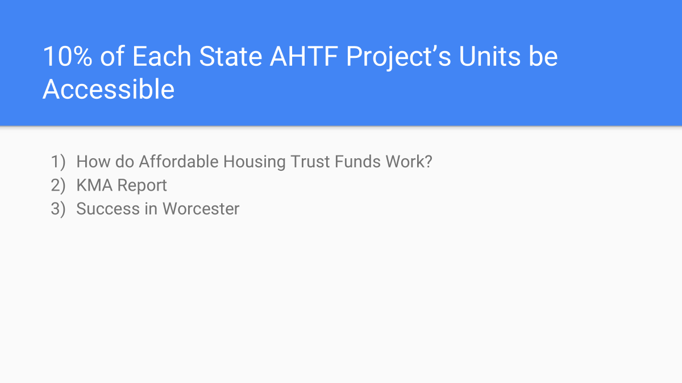
2) Process Overview
Challenges & Solutions: HLC has summarized Commissioners' survey responses (full summary in appendix). Today, Commissioners will add to or amend these challenges and solutions in discussion.
Sections: HLC hopes to use topic area sections to structure more focused, small group discussions on recommendation development in each section. Today, Commissioners will review proposed sections based on commissioner survey feedback and edit as needed to establish work streams to develop recommendations.
Section Leads: HLC will ask for volunteers to a) lead small group discussions focusing on each established section and b) further develop topical recommendations alongside participants. HLC will also ask for volunteers to participate in each of these small group discussions
Section Discussions: Section leads convene participants to further develop recommendations
Next Meetings: Section leads and participants present on development of further recommendations
Before Finalizing: Meet to discuss any proposals not yet included in recommendations as presented by small groups

Slide 11
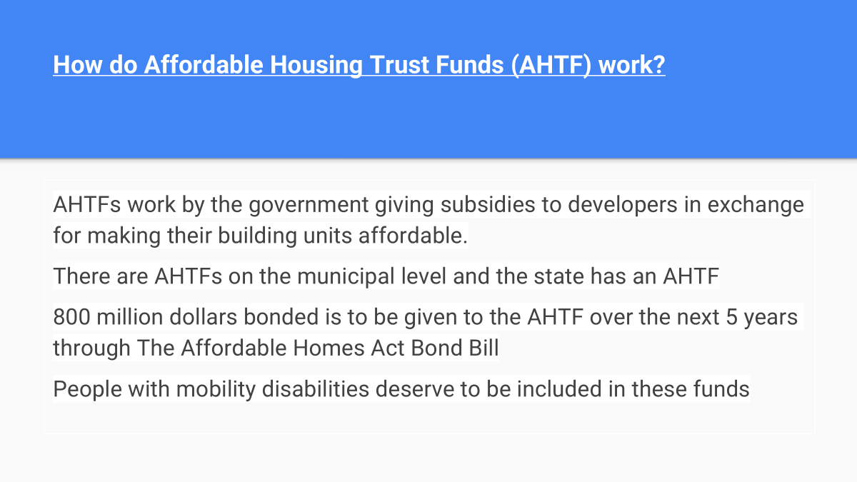
Identified Challenges & Solutions

Slide 12
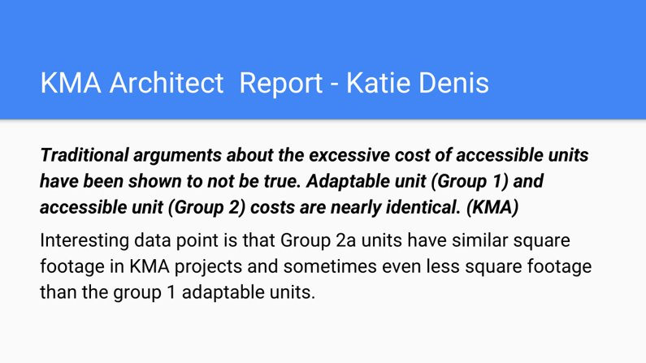
3) Identified Challenges & Solutions

Slide 13
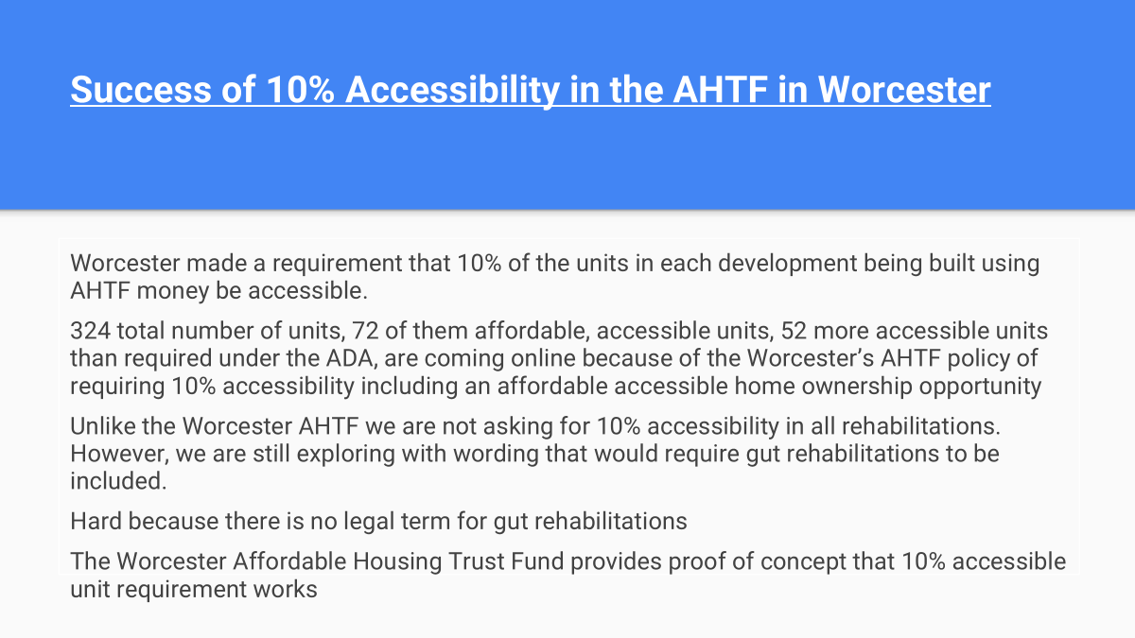
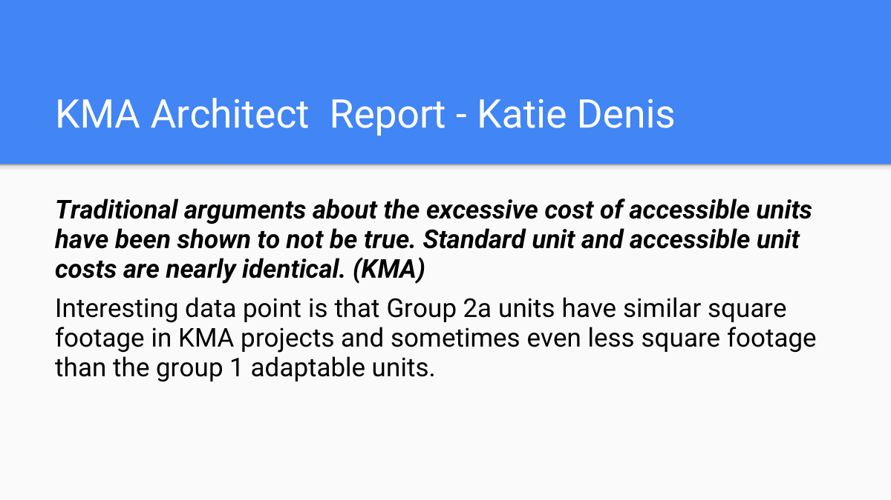
3) Identified Challenges & Solutions
Accessible Development & Market Dynamics | Improvements & Supports in Existing Buildings | Housing Search & Tenant Selection | Discrimination
Enhance prioritization of projects above the legal minimum for accessible units | Provide increased funding for property owners to make reasonable accommodations for tenants | Inventory whether tenants need accessibility features in units, better match tenants with needed features | Provide increased funding for investigation and enforcement of housing discrimination against people with disabilities
Provide enhanced tax or funding incentives for accessible development | Continue strong funding for public housing modernization | Require property management companies to maintain waiting lists for accessible units in their portfolio | Enhance enforcement capabilities of the AGO and MCAD
Disincentivize non-transitional vacancies through policies like a vacancy tax | Expand the redevelopment of housing authority properties, particularly through RAD-like programs which unlock private capital | Use CHAMP system to assist people with disabilities in finding and applying for affordable, accessible units
Provide increased support for development types which enabled multigenerational living, such as ADUs, duplex, and triplexes | Create or enhance on-site support services, particularly for tenants with autism or intellectual disabilities | Increase awareness of reasonable accommodation rights among people with disabilities, particularly those with autism
Provide additional points in award processes for projects using design standards which suit the needs of people with autism | Expand the PCA program to cover drop-in services for people with autism | Provide those with autism or intellectual disabilities with support in completing the necessary forms to obtain and maintain affordable housing

Slide 14
Next Steps

Slide 15
5) Next Steps
Rest of August: Working Groups continue to meet, develop recommendations
September: Working Groups continue to meet, develop recommendations; present next tranche of recommendations to full Commission
October: Working Groups continue to meet, develop recommendations; present final tranche of recommendations at full Commission meeting
November: EOHLC drafts report based on recommendations
December: Early: EOHLC returns draft report for Commission review, adjusts for feedback Mid-to-Late: EOHLC sends report to Legislature

