Slide 1
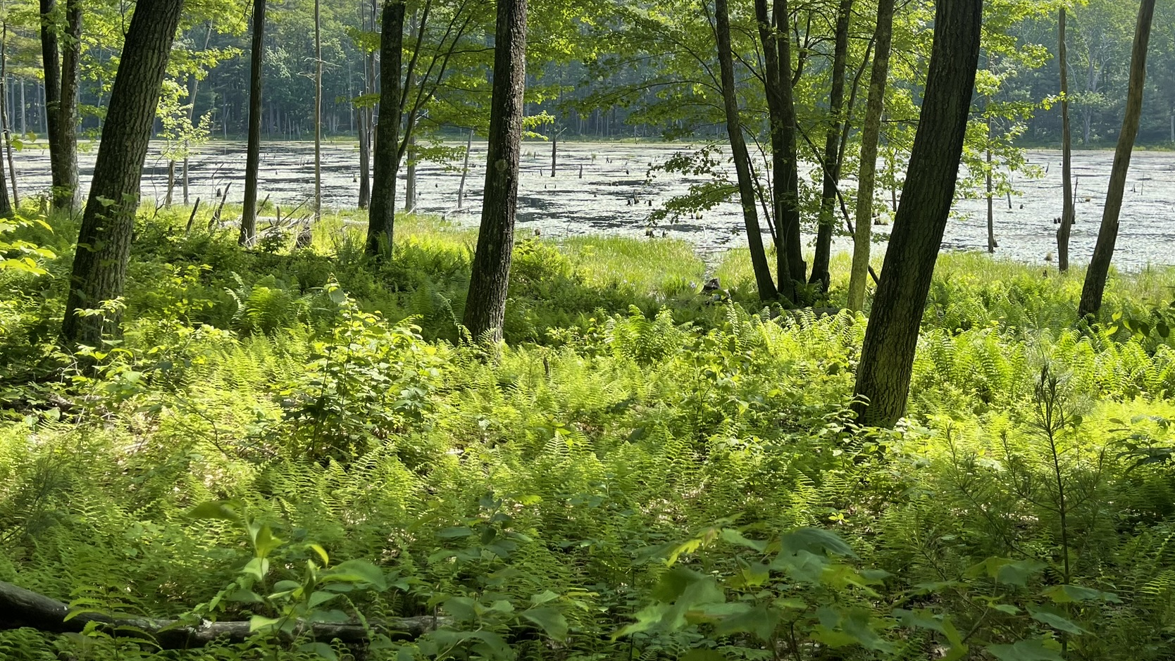

Brimfield State Forest
Trail System Master Plan
November 17, 2025 - Public Meeting
Photo by BSC Group

Slide 2



Commonwealth of Massachusetts
Governor
Maura T. Healey
Lieutenant Governor
Kimberley Driscoll
Energy and Environmental Affairs Secretary
Rebecca L. Tepper
Department of Conservation and Recreation Commissioner
Nicole LaChapelle

Slide 3

DCR Mission
To protect, promote and enhance our
commonwealth of natural, cultural
and recreational resources
for the well-being of all.

Slide 4
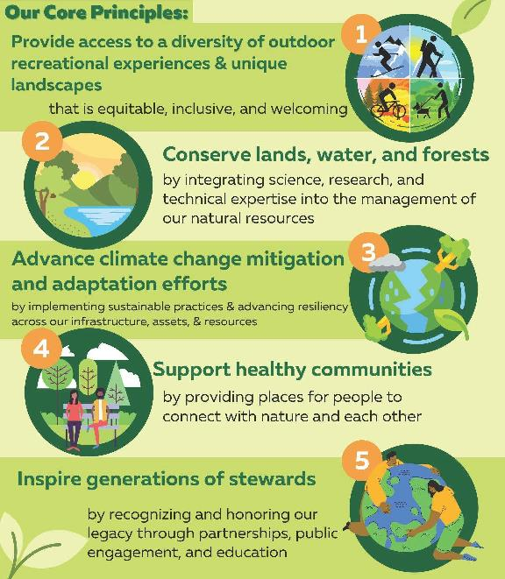

Core Principles

Slide 5
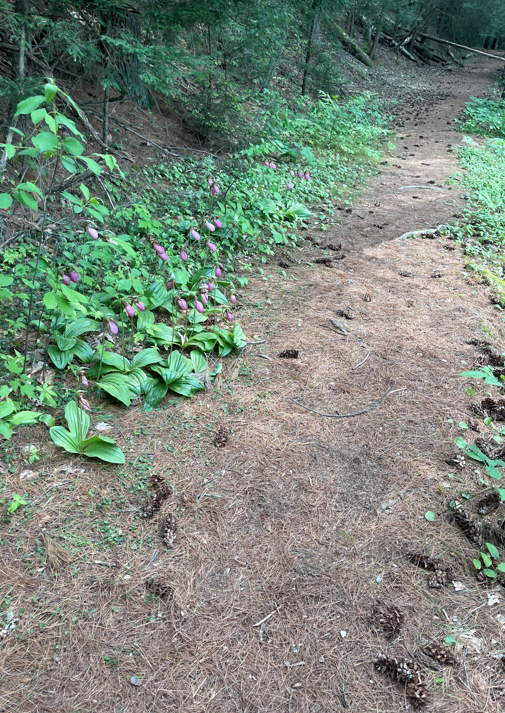
Meeting Logistics
During the meeting:
Use Q&A feature – comments go to moderator ​
Raise your hand using the Zoom function, and you will be given permissions to unmute and speak
After the meeting, through December 1st : ​
DCR Public Comments
  https://www.mass.gov/forms/dcr-public-comments ​
Please note that this public meeting- is being recorded; the recording will be public record
Photo: Brimfield State Forest

Slide 6

Agenda
Introduction to Project and Team
Project Goals
Planning Process and Timeline
Inventory and Analysis Maps
  Current Trails and Conditions
  Sensitive Resources Areas
Community Input
  Feedback to Date
  Public Meeting

Slide 7
Trail Planning Process - Today
Get to Know the Property
  Trail Inventory
  Resource Area Mapping
  Identify Critical Management Roads
  Assess Use Patterns and Demand
  Involve Collaborators
Identify Points of Interest and Experiences
  Identify Main Parking and Access Points
  Identify Critical Connections
  Survey Users to Understand Desired Recreational Experiences
Identify Constraints, Issues and Problem Areas
  Highlight Trail Problem Areas
  Identify Redundant Trails
  Identify Culturally and Ecologically Sensitive Areas
Make a Plan
  Establish a sustainable trail system/network for the park
  Re-route and Restore Problem Trails
  Identify Stewardship Partners and Opportunities
  Identify Necessary Trail Use Policies
  Develop Education and Enforcement Strategies

Slide 8
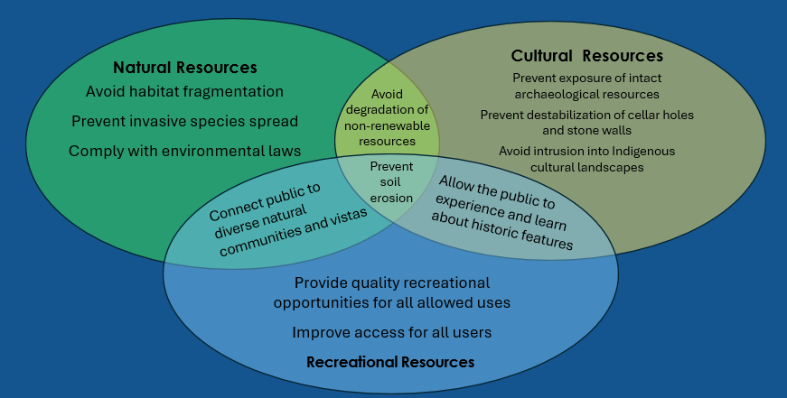
Trail Network Planning with DCR’s Mission in Mind
4,700 miles of trails​
450,000 acres

Slide 9
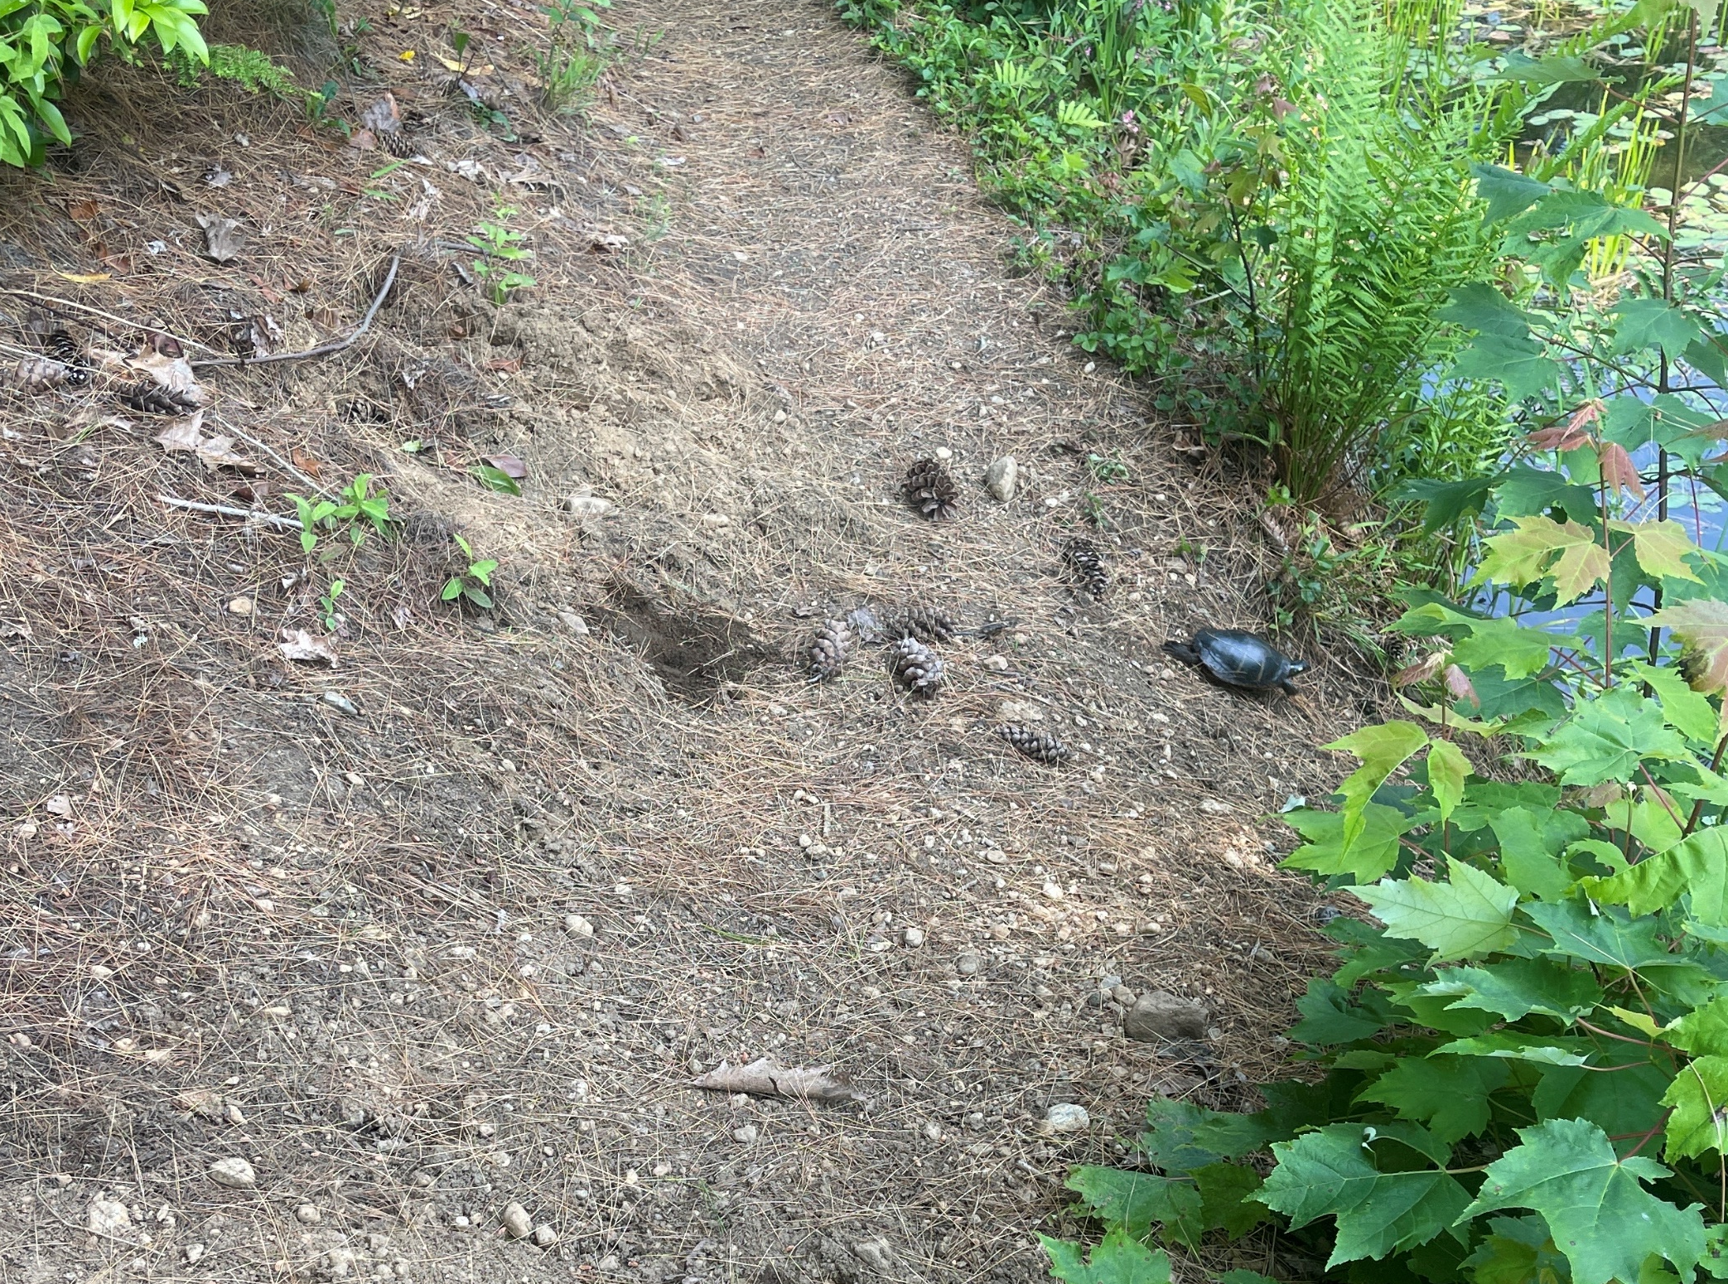
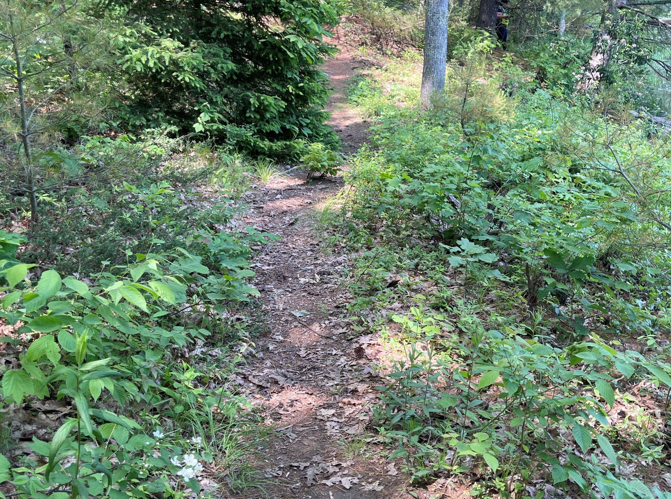
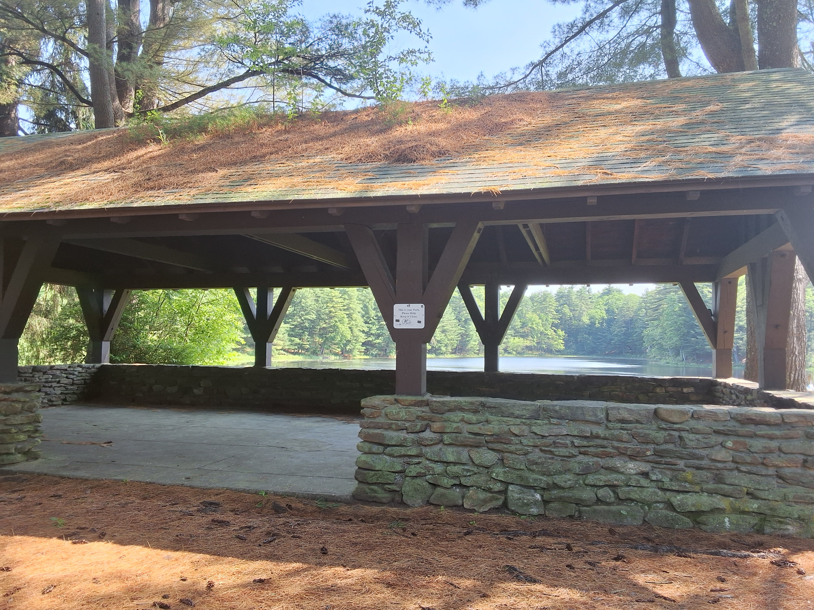
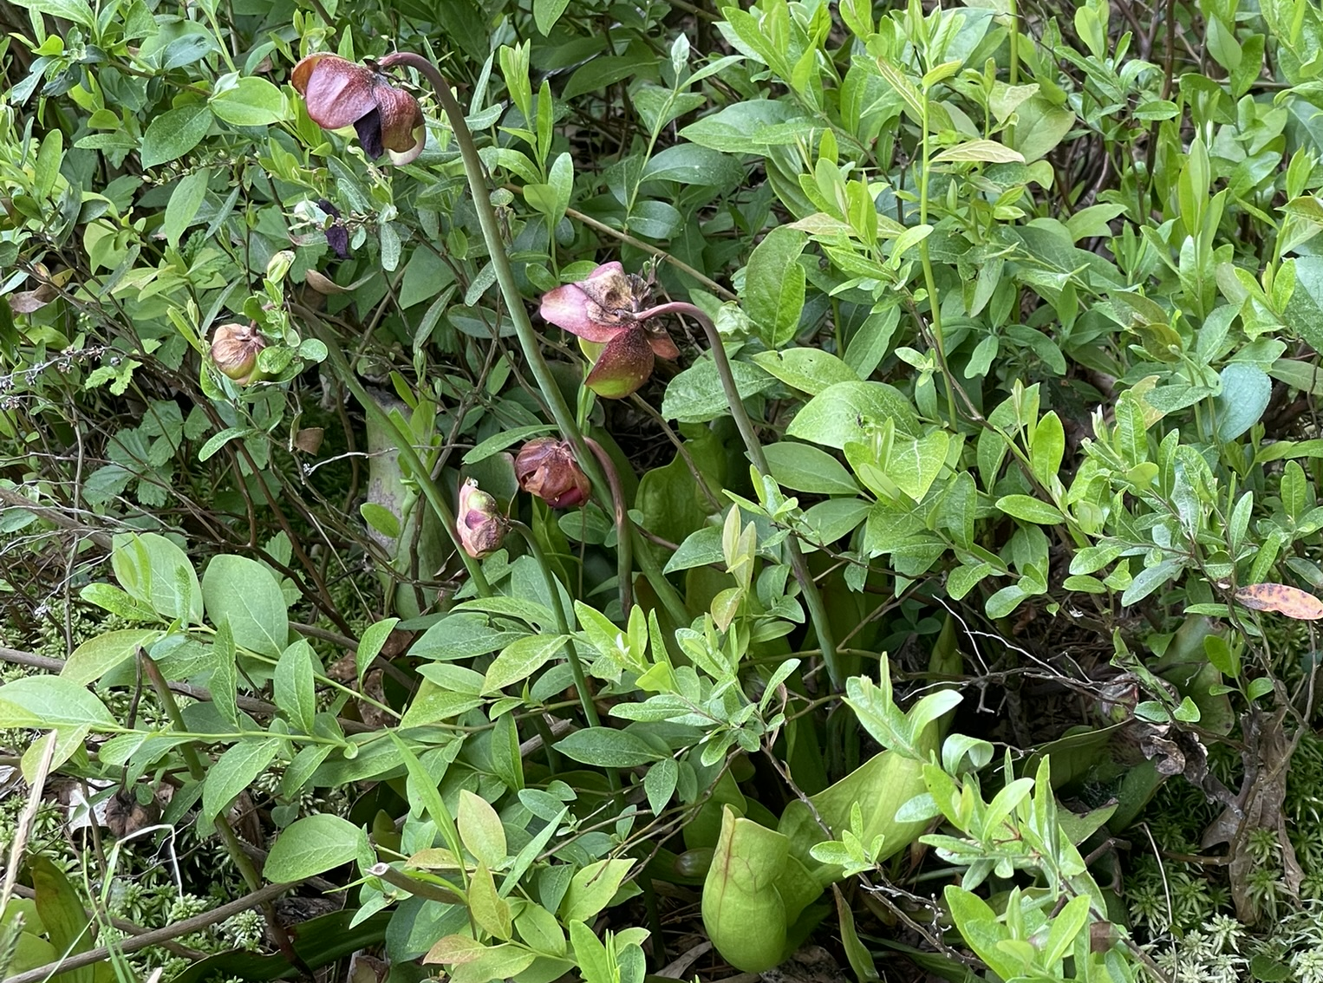
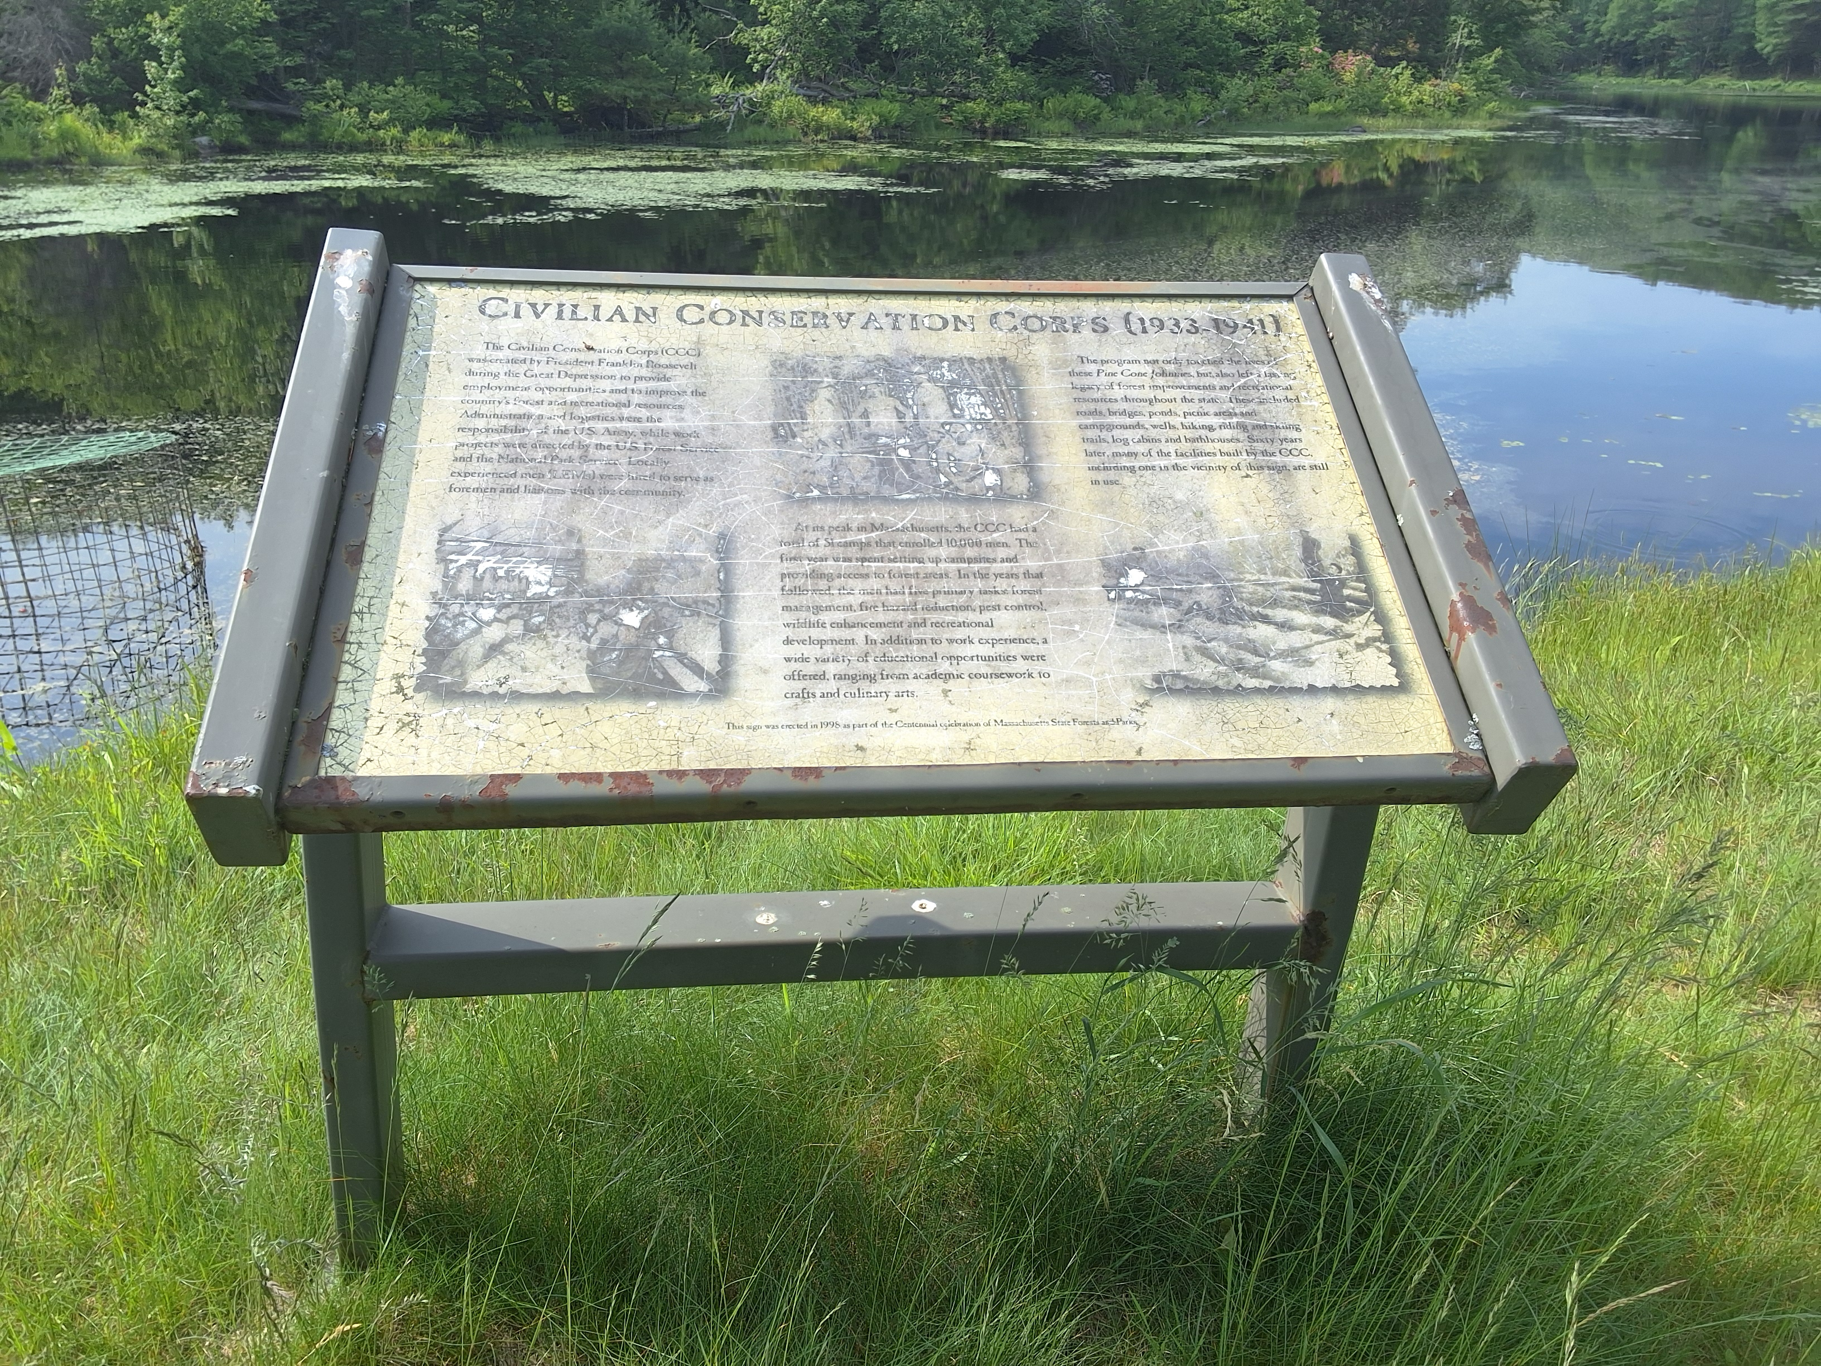
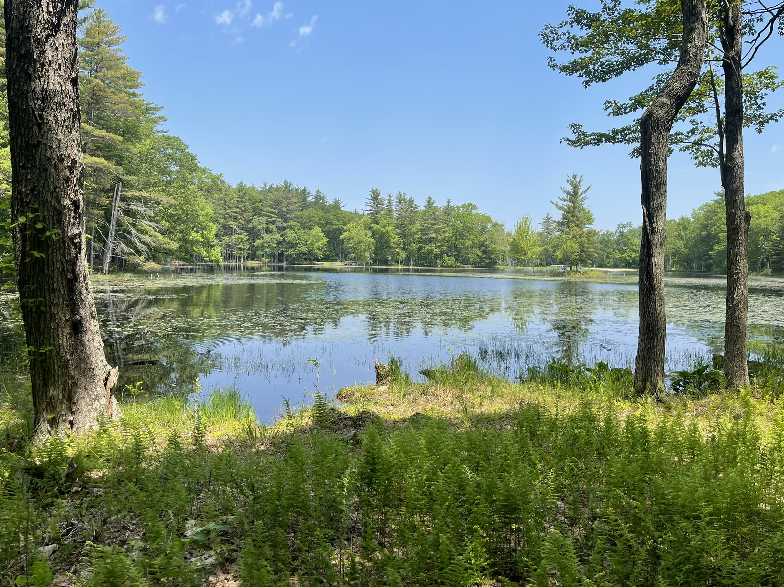
Natural and Cultural Resources
Wildlife Habitat, Turtle Nesting
CCC Historic Structures and Landscapes
Trail Based Recreational Opportunities
Unique Plants, Purple Pitcher Plant
Interpretive Signs
Scenic Views, Dean Pond

Slide 10
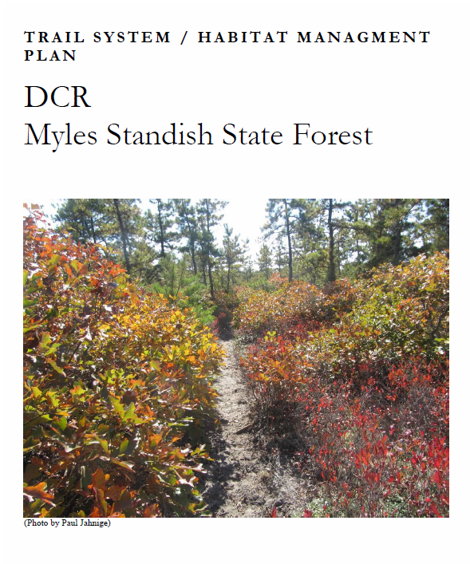
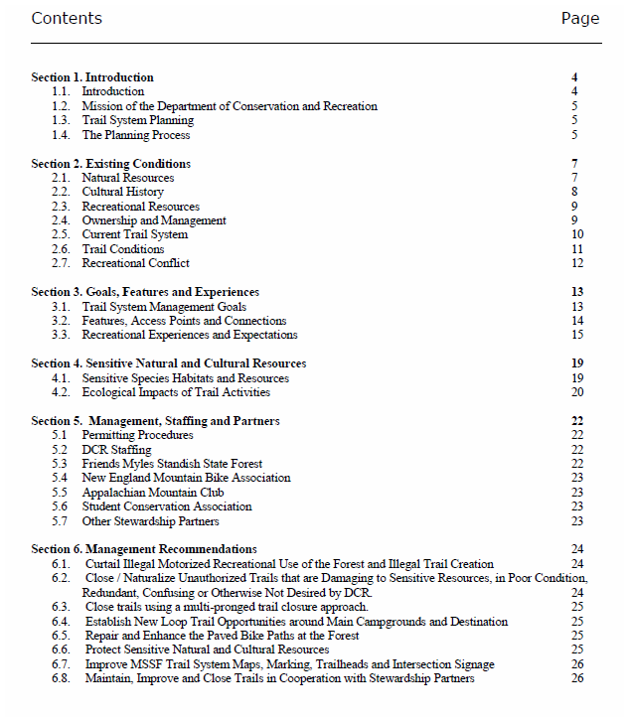
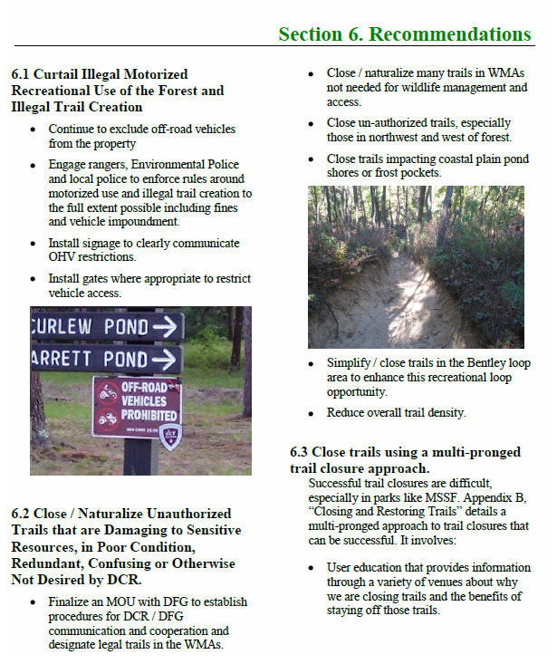
Trail System Plans

Slide 11
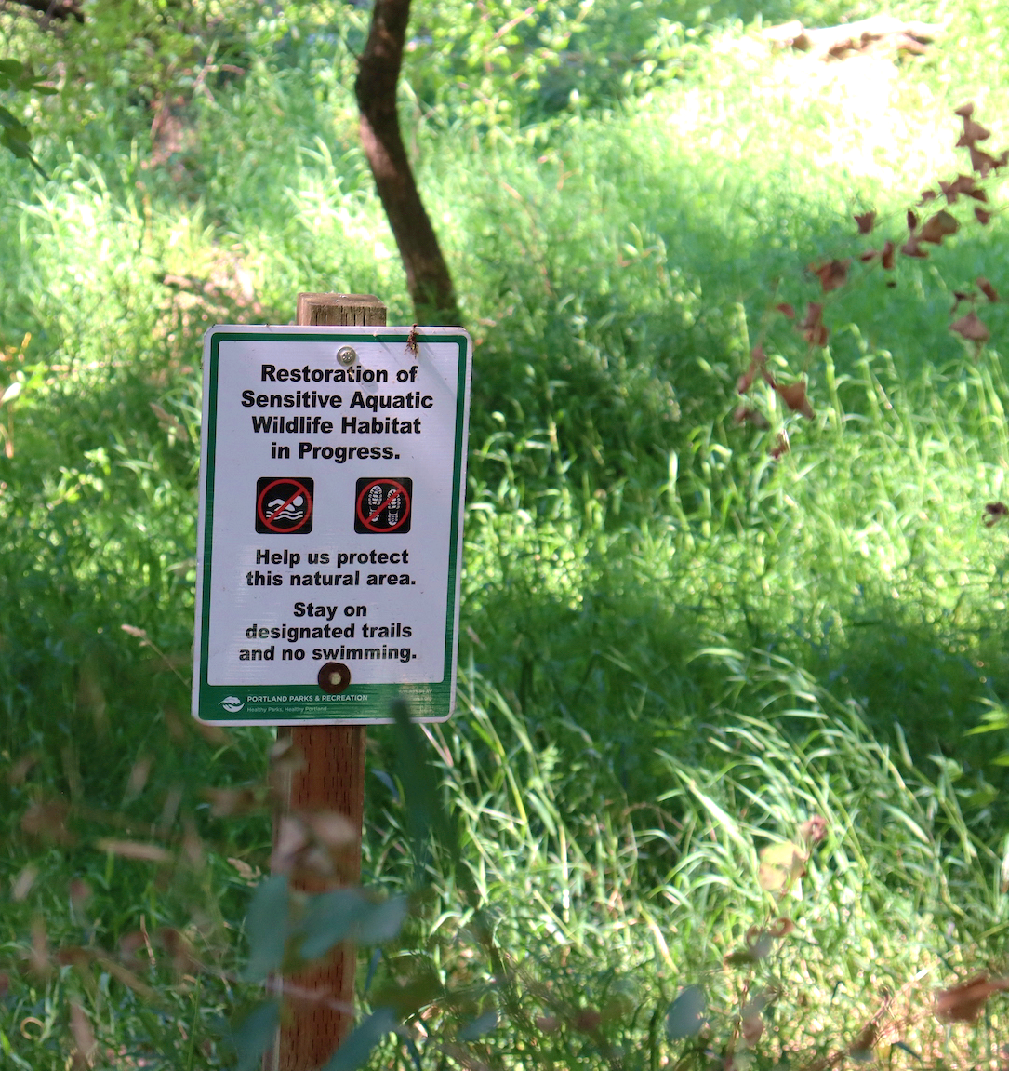
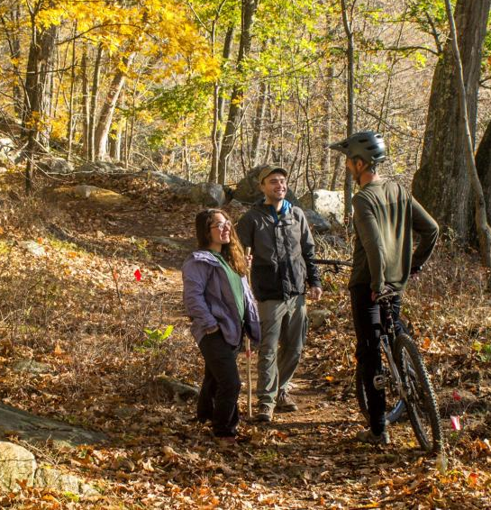
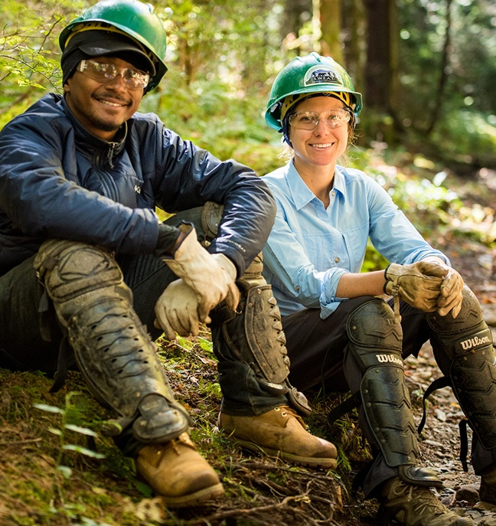
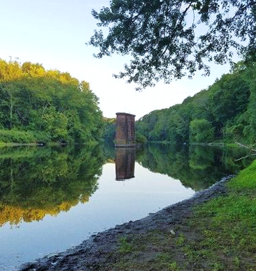
Trail System Plan
Anticipated Results
Develop/promote a network of sustainable trails by prioritizing trail amendments & maintenance needs
Enhanced partners and stewards collaboration
Guide the management of trails within the context of natural and cultural resources
Adapt to changing fiscal, social & environmental conditions

Slide 12
Trail Planning Timeline
 |  |  | 2025 |  |  | 2026
Task # | Task | Spring | Summer | Fall | Winter | Spring | Summer+
 | Phase 1. Area Inventory & Analysis
1 | Trail Inventory
2 | Resource Mapping & Analysis
3 | DCR Staff Meeting
 | Phase 2. Trail Options & Preferred Plan
4 | Collaborator Meeting
5 | Public Meeting
6 | Synthesis & Recommendations
7 | Updated Trail Network
 | Phase 3. Final Trails Plan
8 | Second Public Meeting
9 | Final Report
 | Phase 4. Project planning/permitting
10 | E.g., Data, signage, permitting

Slide 13
Inventory & Assessment Identified…
Moderate trail densities
Impacts to rare species and wildlife
Impacts to wetland resources

Slide 14
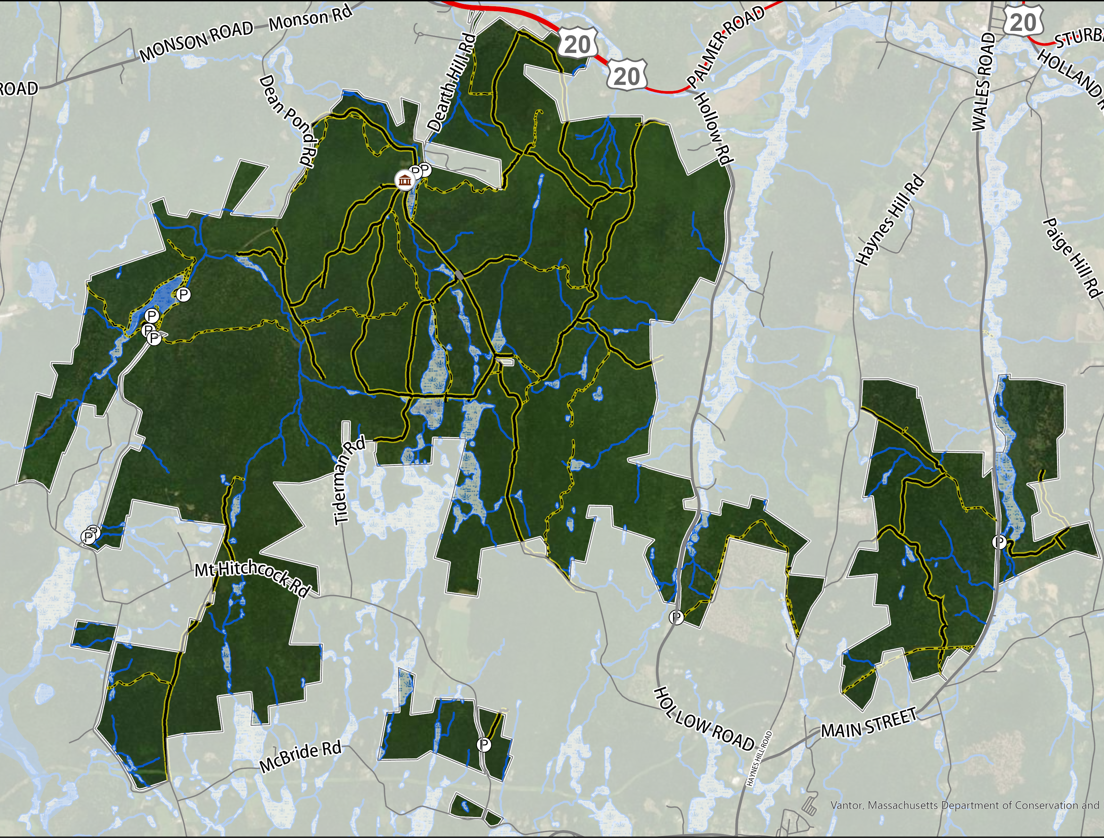
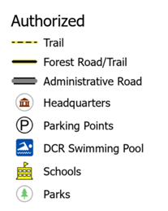
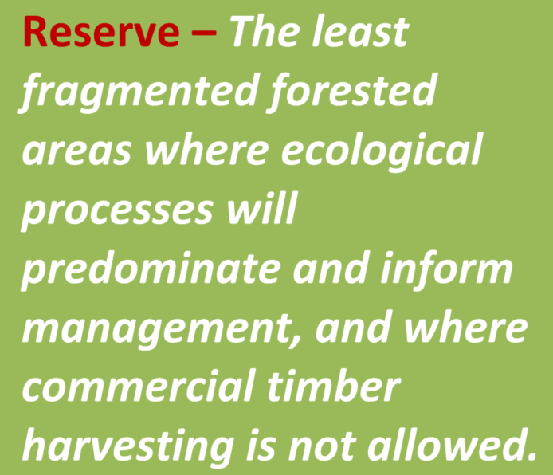
Brimfield State Forest
LEGEND
Headquarters
Inventory & Assessment Maps
Dearth Hill Pond
Dean Pond
Woodman Pond
N

Slide 15
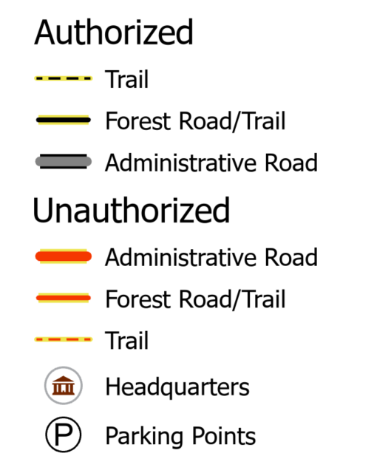
Existing Trail System (1/3)
26.5 Miles - Authorized Trails
26% “Good” Condition
57% “Fair” Condition
17% “Poor” Condition
Landscape Designation | Density | Metric
Reserve | Low | <3 km/sqkm
Woodland | Moderate | 3-6 km/sqkm
Parkland | High | 6-9 km/sqkm
-------- | Excessive | >9 km/sqkm
Brimfield Trail Density Analysis
Trail Type | km/sq km | Trail Density | Trail Density Metric
Authorized Trails | 2.8 | Low | <3 km/sq km
All Trails | 5.5 | Moderate | 3-6 km/sq km

Slide 16
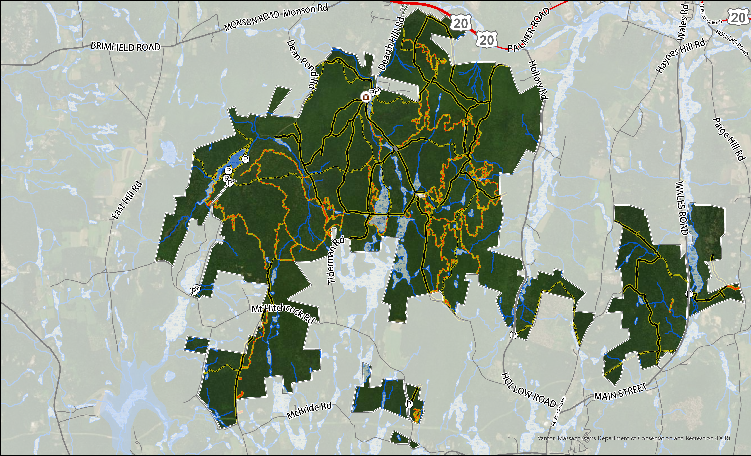
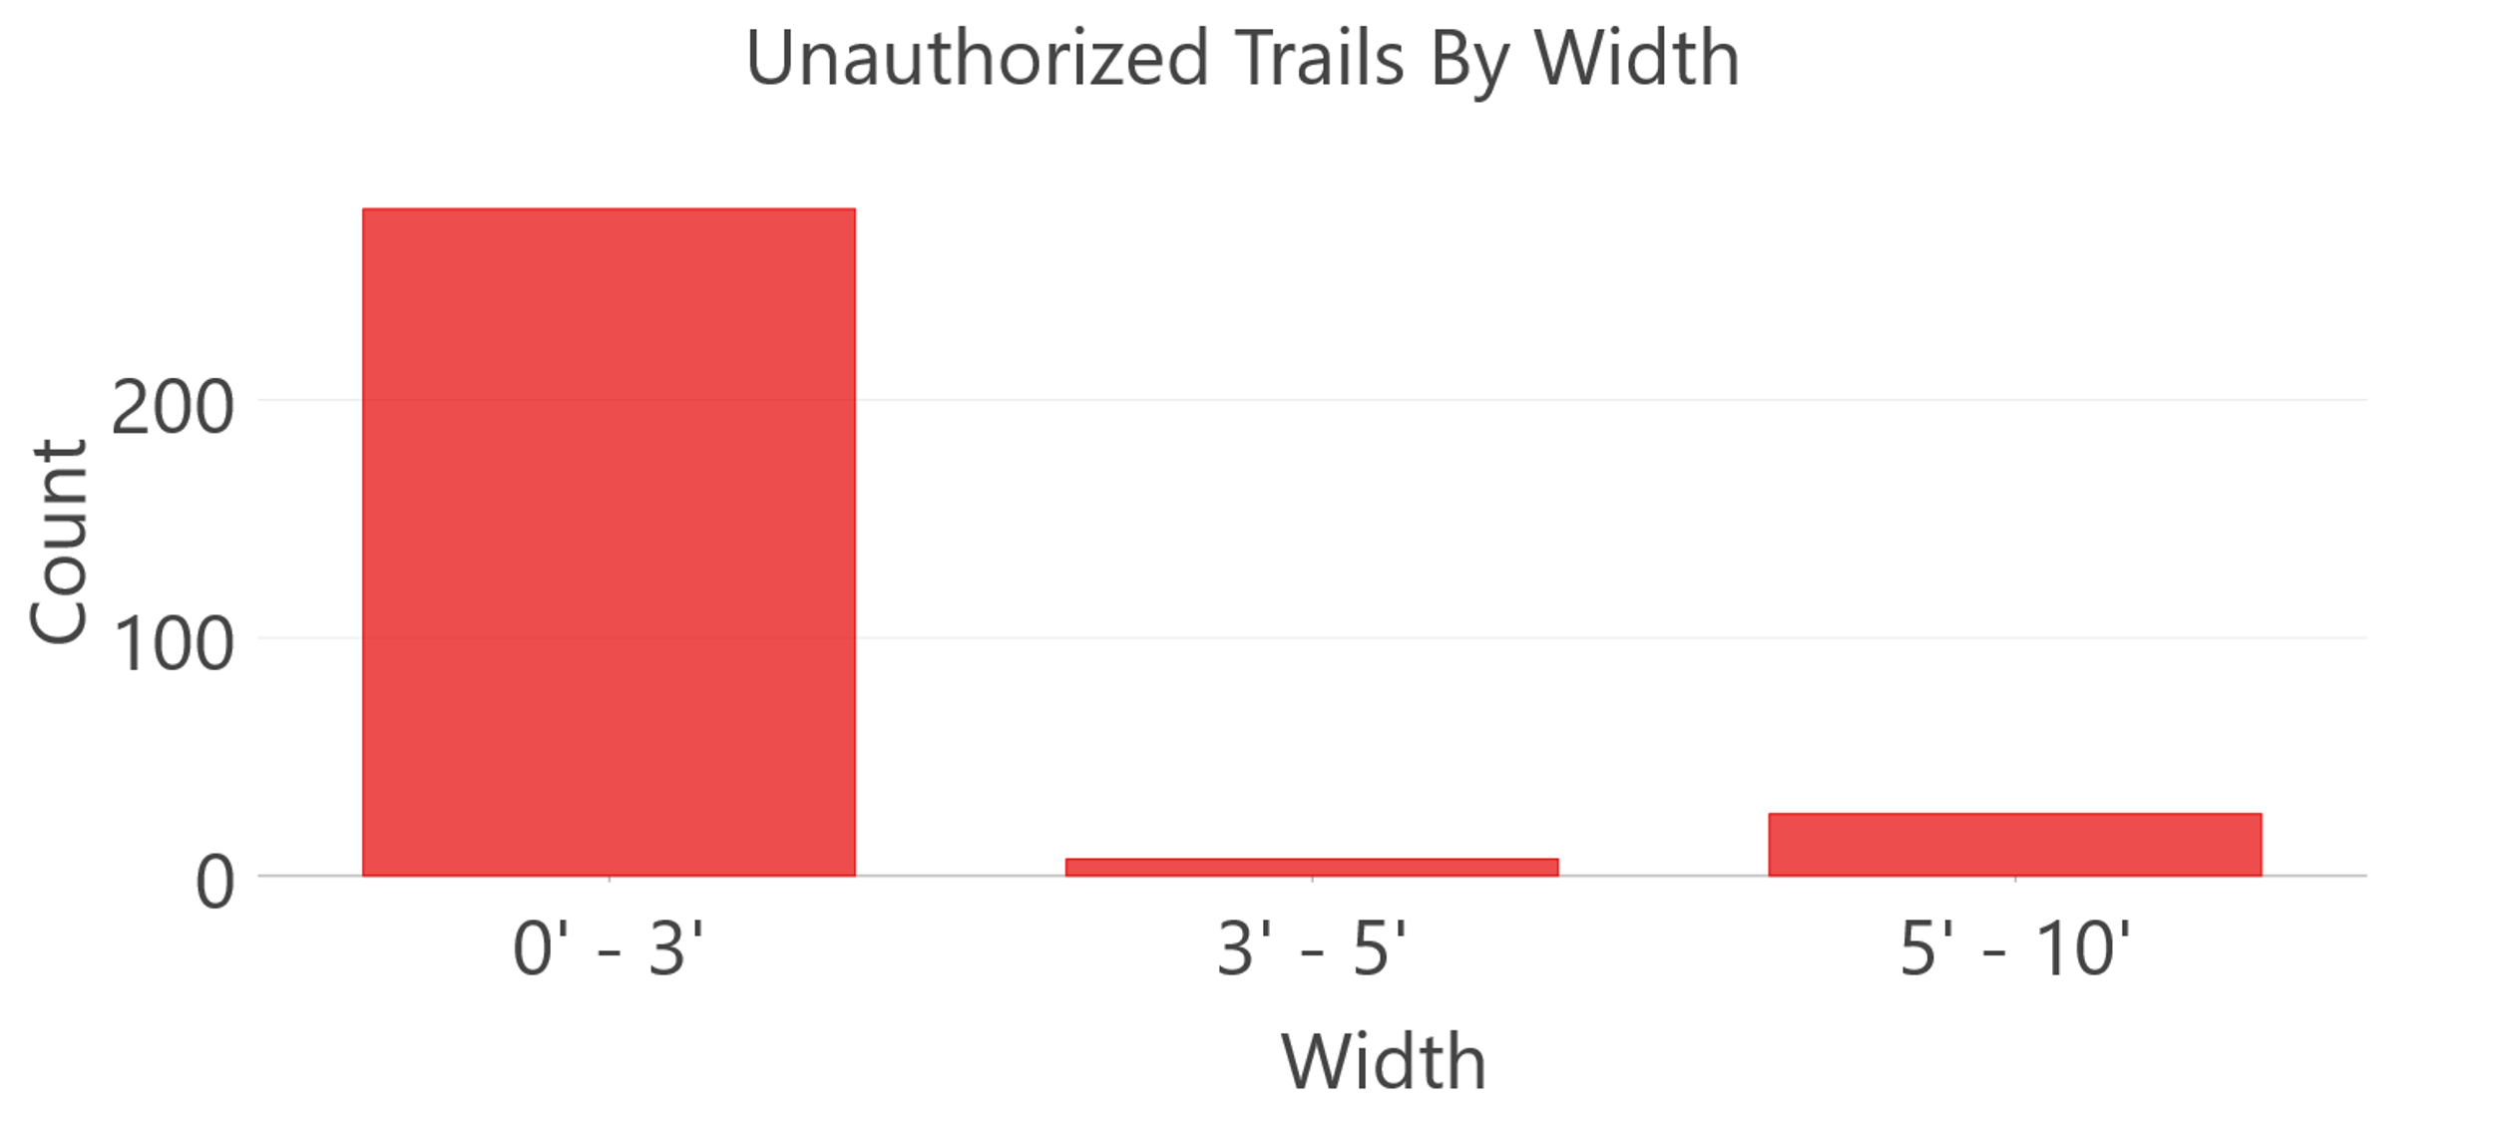
Existing Trail System (2/3)
27.8 Miles - Unauthorized Trails
Landscape Designation | Density | Metric
Reserve | Low | <3 km/sq km
Woodland | Moderate | 3-6 km/sq km
Parkland | High | 6-9 km/sq km
-------- | Excessive | >9 km/sq km
Brimfield Trail Density Analysis
Trail Type | km/sq km | Trail Density | Trail Density Metric
Authorized Trails | 2.8 | Low | <3 km/sq km
All Trails | 5.5 | Moderate | 3-6 km/sq km

Slide 17
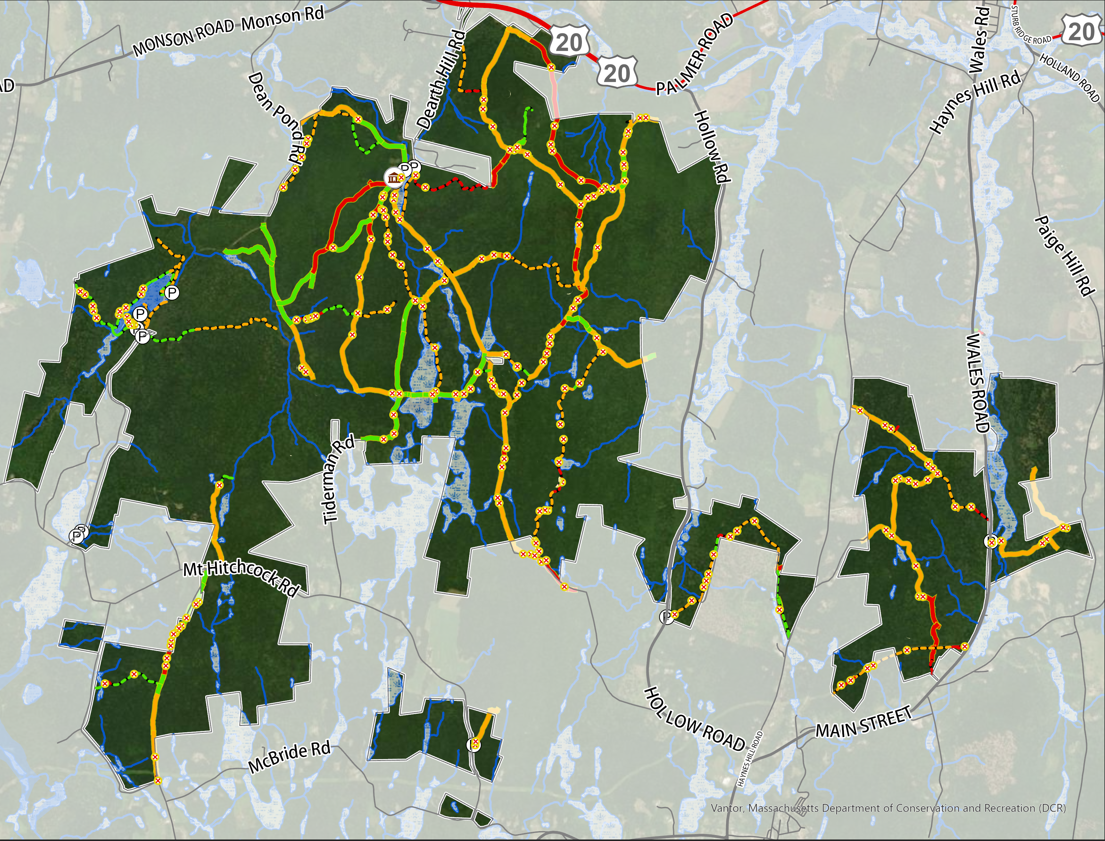
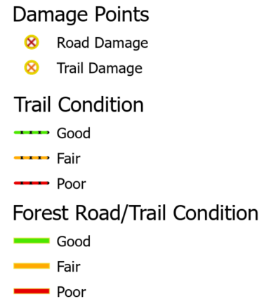
Existing Trail System (3/3)
Existing Trail System
Trail Conditions & Damage
26% “Good” Condition
57% “Fair” Condition
17% “Poor” Condition
Erosion & Washouts
Rutting
Mud Holes
Trail Braiding & Widening

Slide 18
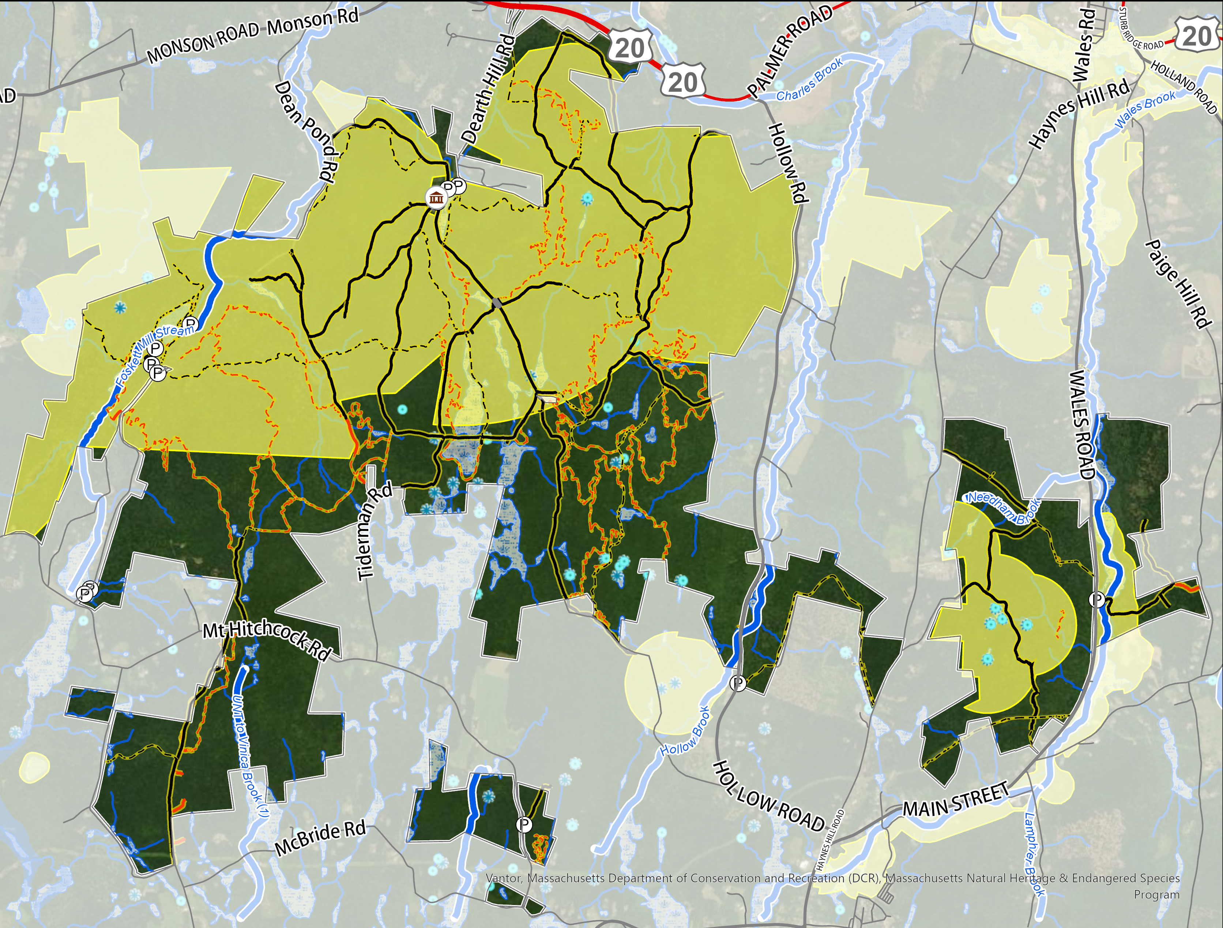
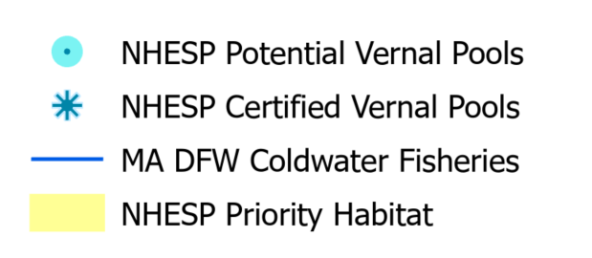
Sensitive Resource Areas (1/3)
Rare Species Habitat
(MESA/NHESP)
50.5% is Rare Species Habitat
7 Rare Species
  5 Animals
  2 Insects
Vernal Pools
Coldwater Fisheries
For additional information, please visit:
https://www.mass.gov/info-details/regulatory-maps-priority-estimated-habitats

Slide 19
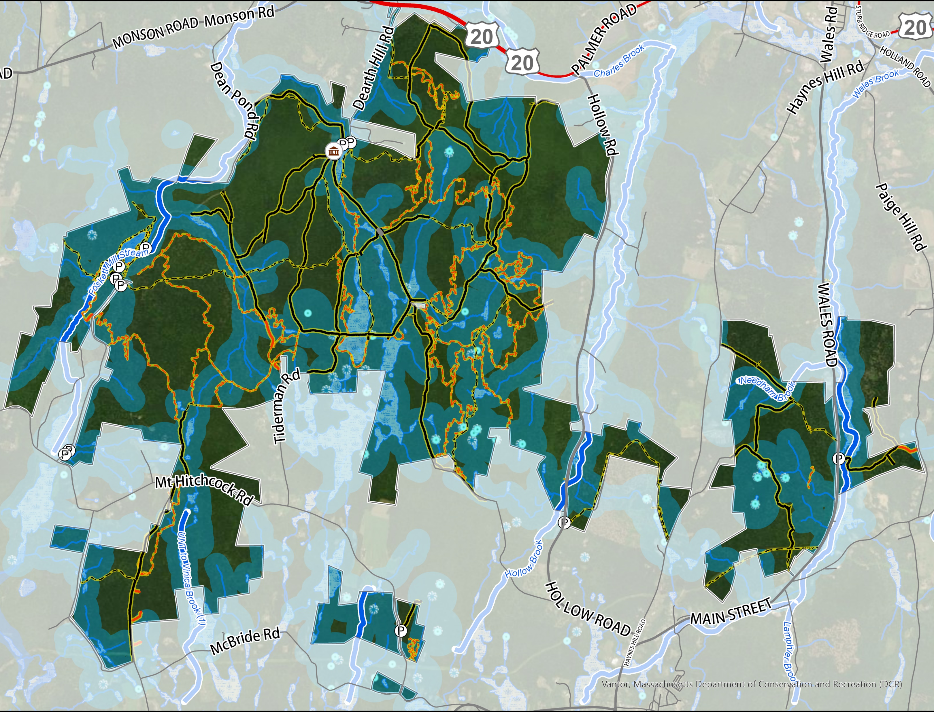
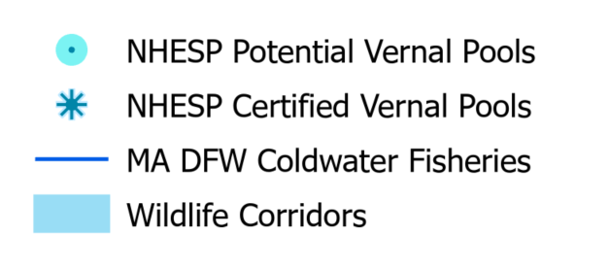
Sensitive Resource Areas (2/3)
Wetlands, Waterbodies & Wildlife Corridors
Rivers, streams and wetlands are critical resources for wildlife
Function as wildlife corridors

Slide 20
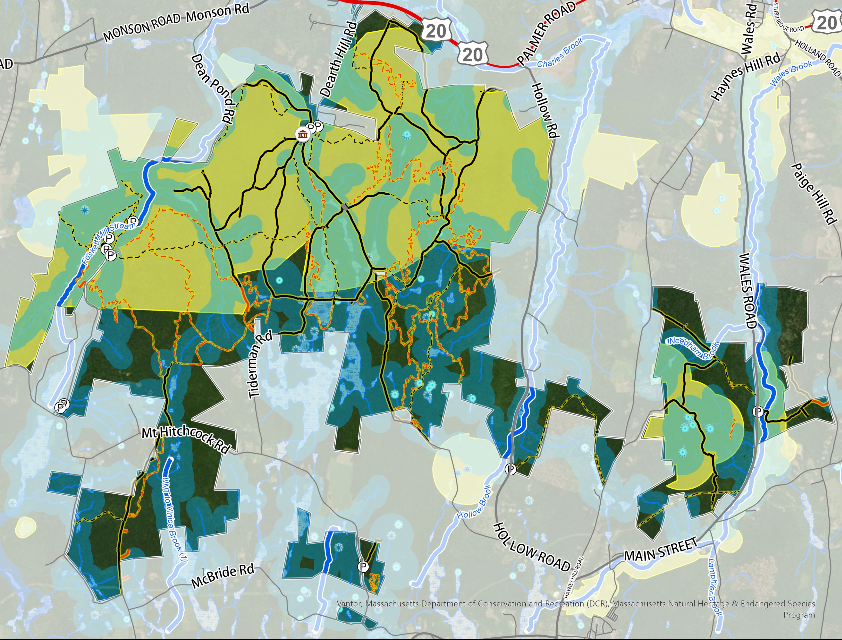
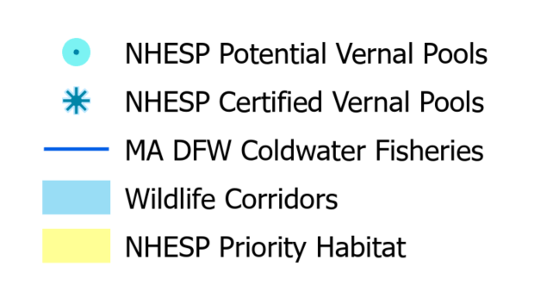
Sensitive Resource Areas (3/3)
NHESP & Wildlife Corridors
Rivers, streams and wetlands are critical resources for wildlife
Function as wildlife corridors
Most wildlife needs upland and wetland habitats.

Slide 21
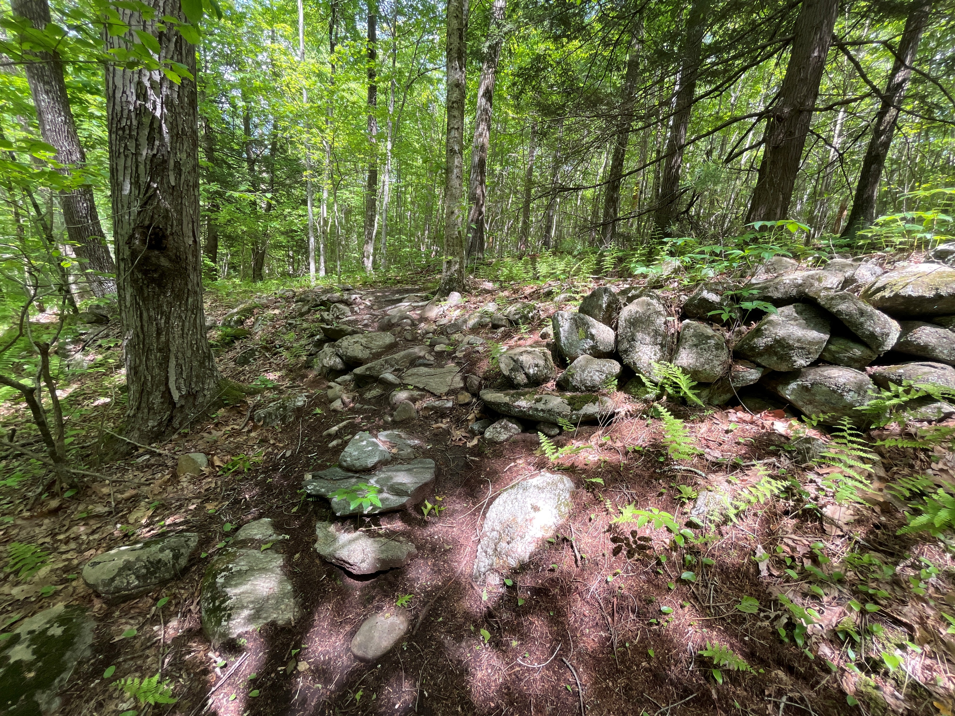
Sensitive Resource Areas
Most of BSF is Mapped as Natural Heritage Cultural Sensitivity Area
Civilian Conservation Corps (CCC) Structures
Midstate Trail
Indigenous Artifacts & Structures
394 Potential Cultural Resources
62 Confirmed Cultural Resources
Stone Wall
The First Peoples First Stewards Partnership works to build reciprocal relationships between the DCR and Tribal Governments and Indigenous Community Stakeholders. These relationships will enhance DCR’s work through providing an additional lens of culturally responsive stewardship while providing access and opportunities for Native people to connect with the land, water, and our natural world. As part of this project, we have initiated the first steps to collaborating and partnering with Tribal Nations linked to this property.

Slide 22
Public Survey Results To-Date
49 responses received as of November 5th for Brimfield State Forest
  486 total responses received across six Trail System Master Plan projects
  Predominantly mountain bikers, followed by hiking/walking, and dog walking as respondents’ current uses.
Responses are on a scale of 1 to 5 where:
  1 equals STRONGLY DISAGREE
  5 equals STRONGLY AGREE
Surveys are still open. Please encourage others to share their thoughts!
https://www.mass.gov/forms/shape-the-future-of-our-trails-share-your-experience

Slide 23
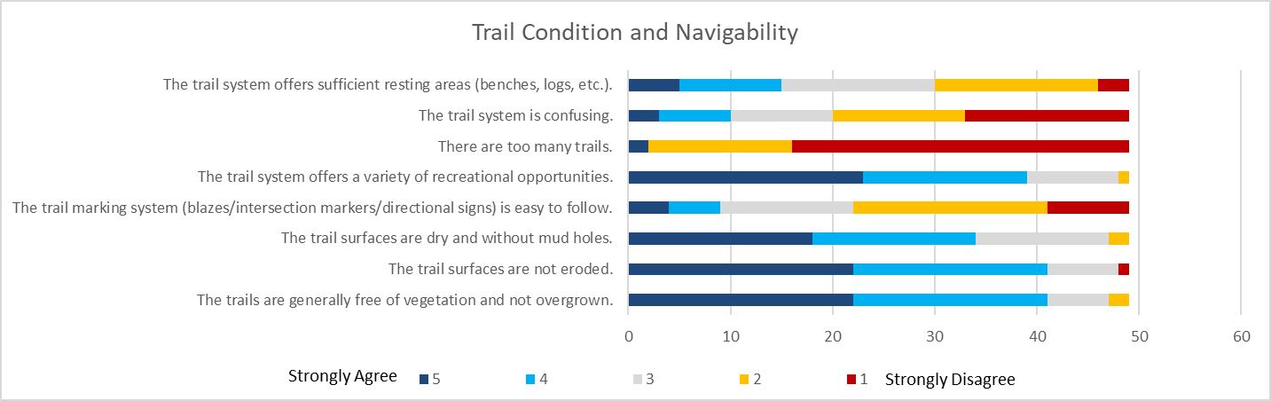
Public Survey Results To-Date
(Overall, Trail Condition & Navigability))

Slide 24
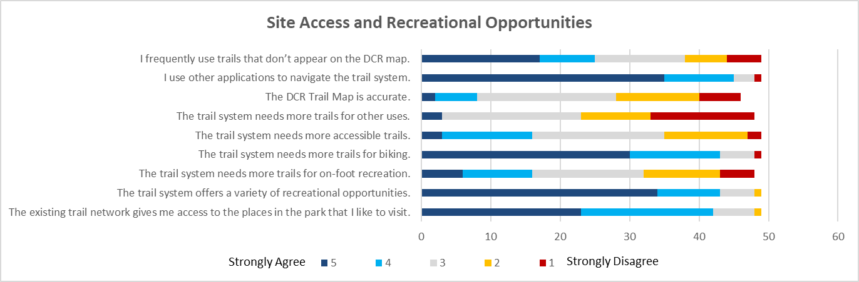
Public Survey Results To-Date
(Site Access and Recreational Opportunities)

Slide 25
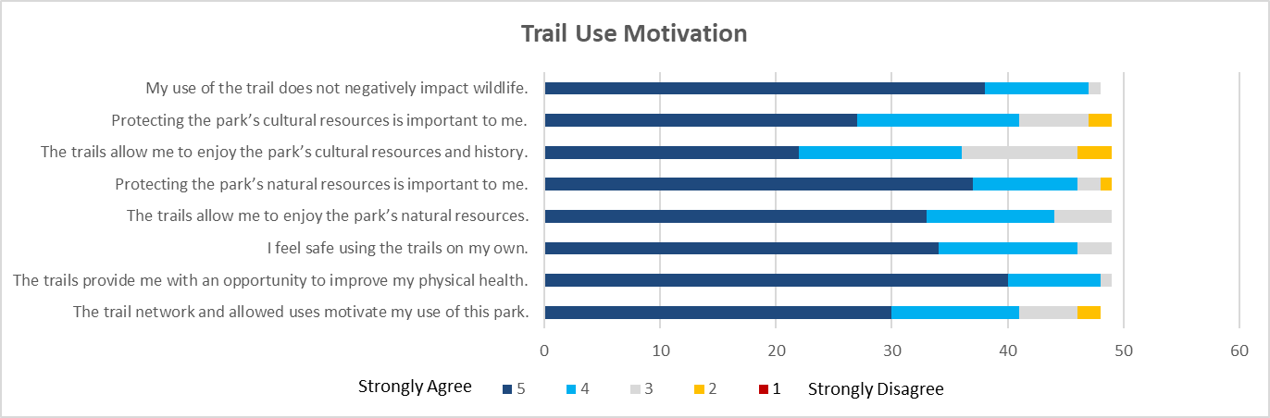
Public Survey Results To-Date
(Trail Use Motivation)

Slide 26
Public Comment
General Guidelines​
Raise your virtual hand​
Please wait to be recognized by the moderator​
Introduce yourself as well as any Affiliation (if speaking on behalf of a group)​
To assist us, please make comments in the context of the follow up questions presented in the previous slide and shared in the chat

Slide 27

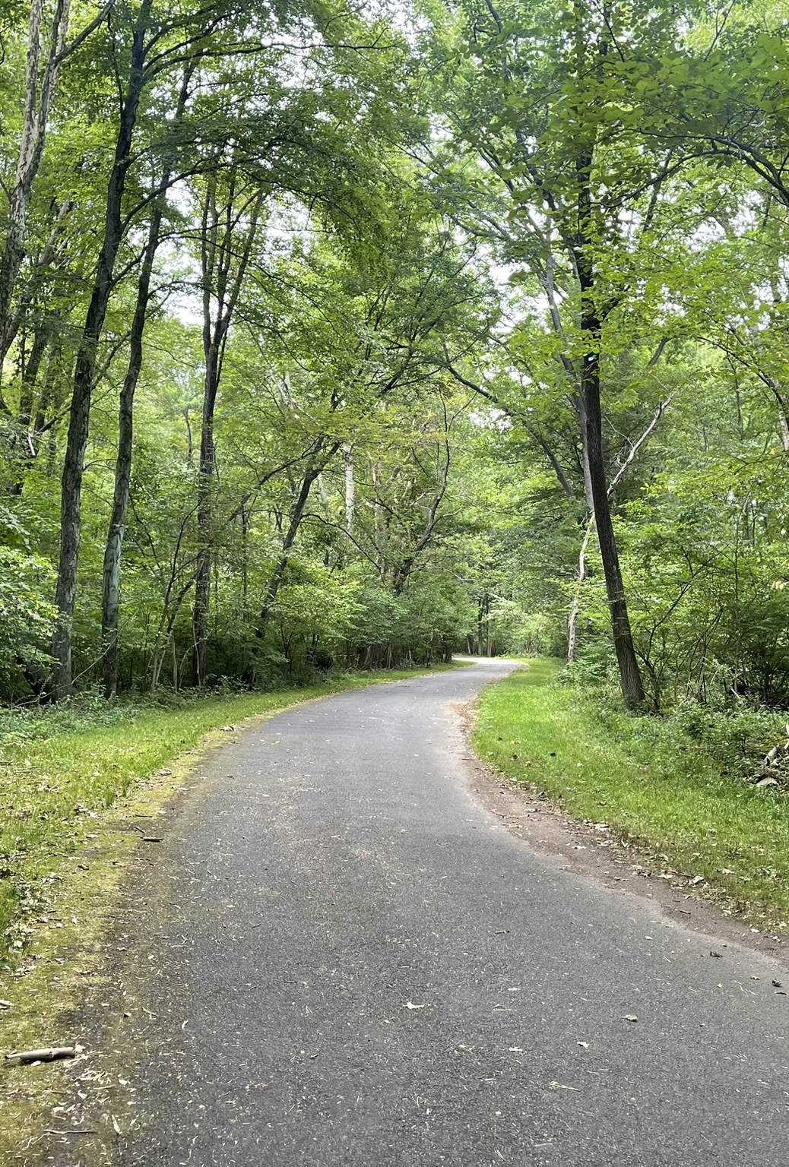


Discussion Questions
How do you use the trails in this park?
What is your favorite trail at this park and why?
What is your least favorite trail and why?
What, if anything, prevents you from fully enjoying the trails at this park?
What activities, facilities, or services would make you feel more welcome or more satisfied with your trail experience in this park?
What is the biggest challenge facing this park's trails?
Any other information about this park's trails that you think is important for us to know

Slide 28
Map of Brimfield State Forest
Notes:
Dan- Q/A section

Slide 29
Next Steps
Recording and tonight’s slide deck will be available at: https://www.mass.gov/dcr-public-meetings-information​
If you have comments on this project: ​
  Submit online: https://www.mass.gov/forms/dcr-public-comments ​
  Deadline: December 1, 2025
  Please note: the contents of comments submitted to DCR, including your name, town and zip code, will be posted on DCR’s website. Additional contact information provided, notably email address, will only be used for outreach on future updates to the subject project or property.​
If you wish to subscribe to a DCR general information or project-related listserv: contact DCR’s Office of Community Relations via email at mass.parks@mass.gov

Slide 30
Map of Brimfield State Forest (discussion reference)

Slide 31
end

