Slide 1

Career Clusters
Redesigned

Slide 2
Housekeeping
Class time from 9:00 to 10:00 am
Attendance is recorded / taken
Please leave your camera on
Class is not muted, so ask questions
Limit noise where you are (or mute yourself)

Slide 3




The National Career Clusters®
https://careertech.org/career-clusters/
In development / redesign since 2022, the modernized career clusters are launching August 2025 in the CIS.

Slide 4
The National Career Clusters®
Department of Education:
An organizing tool for Career Technical Education (CTE) programs, curriculum design, and instruction.
Bureau of Labor Standards:
Involved and impacted by standardizing labor market statistics and reporting using the new clusters.
Department Of Labor:
Impacts employment and training administration (ETA) and the world of work.
All partners in its redesign.
The new clusters serve as a bridge between education, work and statistical reporting and serve as a central building block for consistently designed and high-quality CTE programs.

Slide 5
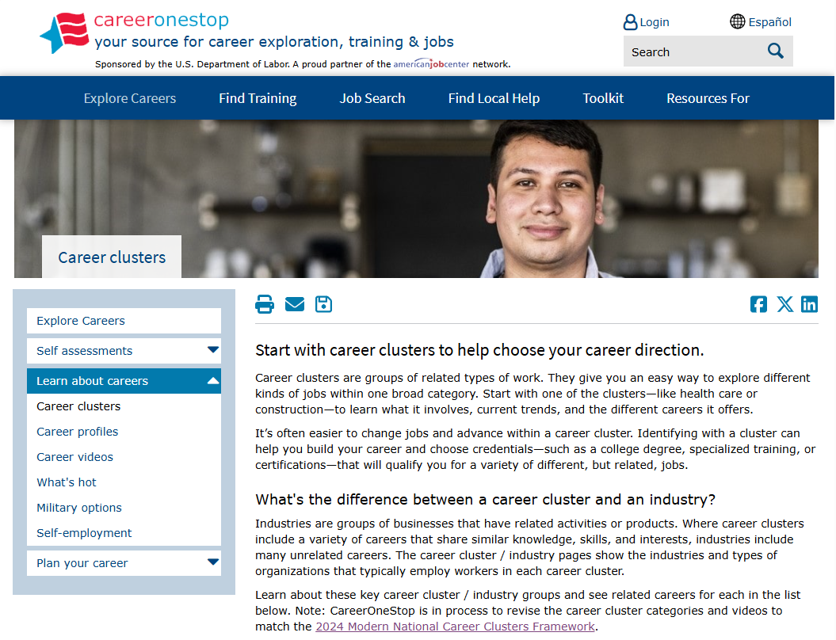
Career Clusters: Career One Stop

Slide 6
Department of Labor CTE 14 Career Clusters
The Department of Labor's Career and Technical Education (CTE) framework includes 14 industry-oriented, sector-specific Career Clusters and 72 Sub-Clusters.
These clusters are designed to provide a standardized and consistent structure for Career Technical Education programs, ensuring that learners have access to meaningful career exploration and preparation experiences.

Slide 7
CTE Releases Modernized Career Clusters Framework
It will be up to each state how it uses the new Framework. While most states used the previous iteration in some form, variations were made to reflect the needs of states and local communities.
States may adopt the new Framework in whole or in part or decide to use it in different ways.
One policy implication of the new Framework is for federal reporting. The U.S. Department of Education will require states to align Perkins data with the modernized Framework starting with the 2025-26 academic year and submit data for the federal Perkins Consolidated Annual Report (CAR) starting in January 2027.
This will not necessarily require any programmatic changes but rather cross-walking current programs to the new Clusters for reporting on student enrollment and performance.

Slide 8
CTE Releases Modernized Career Clusters Framework (cont.)
To support implementation, Advance CTE has developed a suite of resources, including explainers, messaging tools, and a crosswalk listing each Career Cluster and Sub-Cluster with corresponding North American Industry Classification System (NAICS), Standard Occupational Classification System (SOC) and Classification of Instructional Programs (CIP) codes. The organization will also be providing ongoing implementation support.
The modernization of the Framework has been a two-year process, incorporating feedback from more than 4,000 people across state and local secondary and postsecondary leaders, employers, national organizations including educator groups and career technical student organizations, CTE instructors, and other partners.

Slide 9
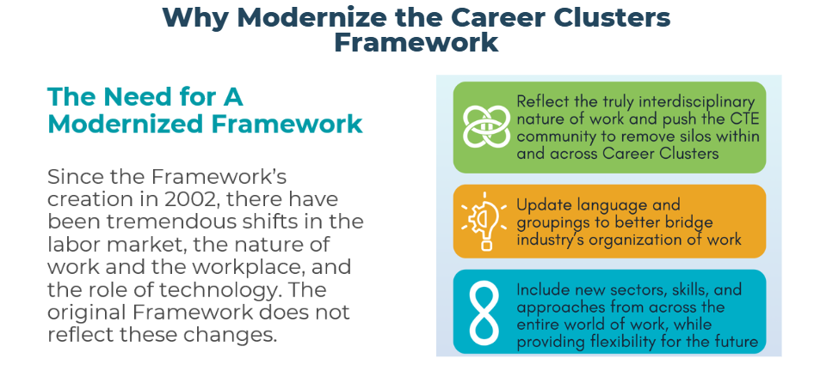
Career Clusters

Slide 10
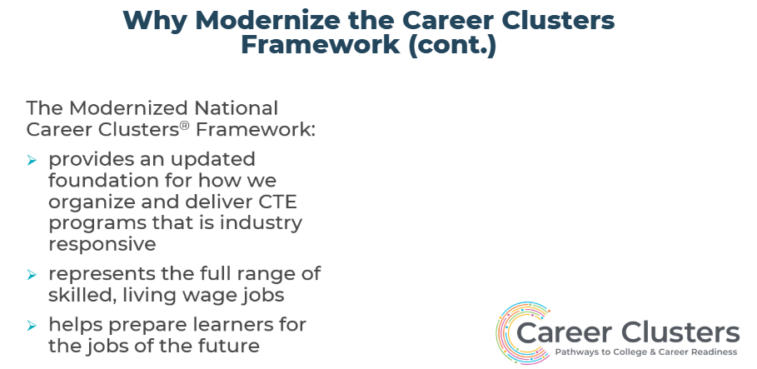
Career Clusters

Slide 11
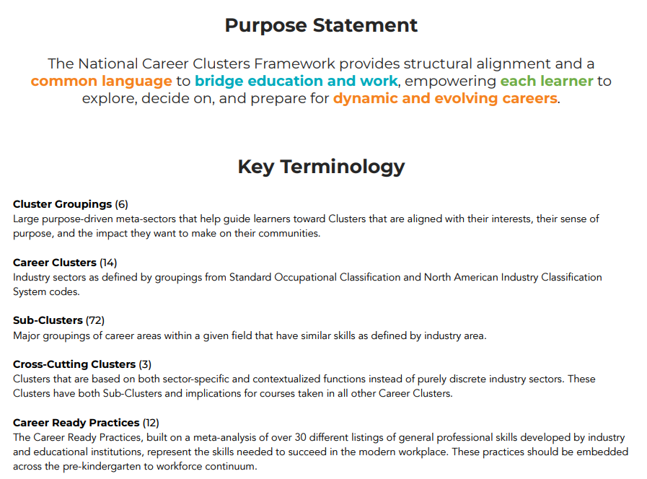
Career Clusters

Slide 12
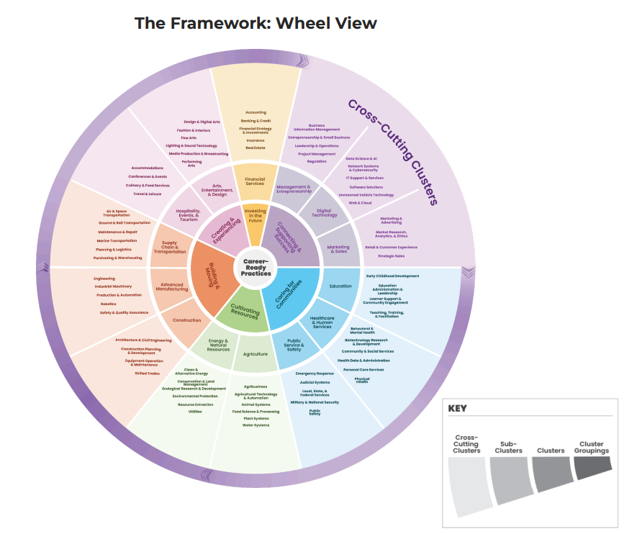
Career Clusters

Slide 13
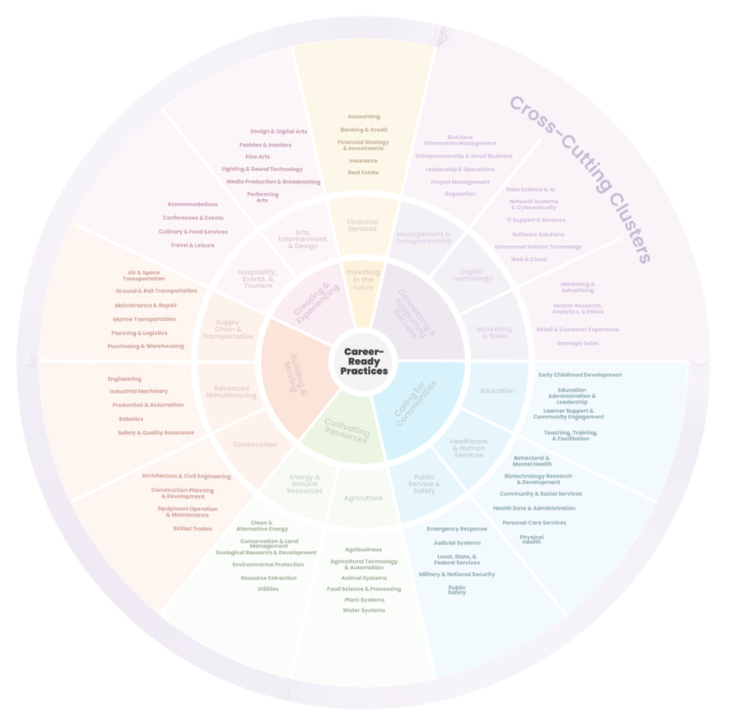
Career Clusters: Framework

Slide 14
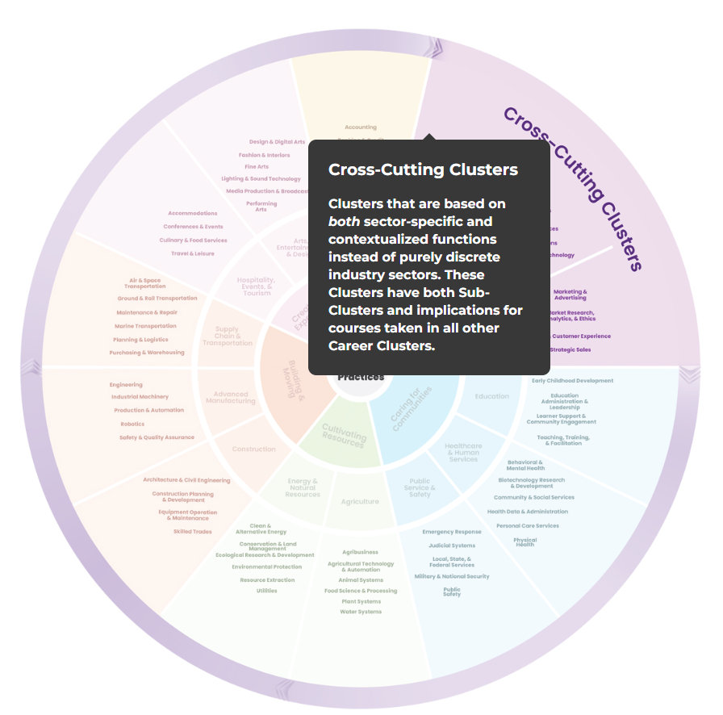
Career Clusters: Framework
Cross-Cutting Clusters (3)
Clusters that are based on both sector-specific and contextualized functions instead of purely discrete industry sectors. These Clusters have both Sub-Clusters and implications for courses taken in all other Career Clusters.

Slide 15
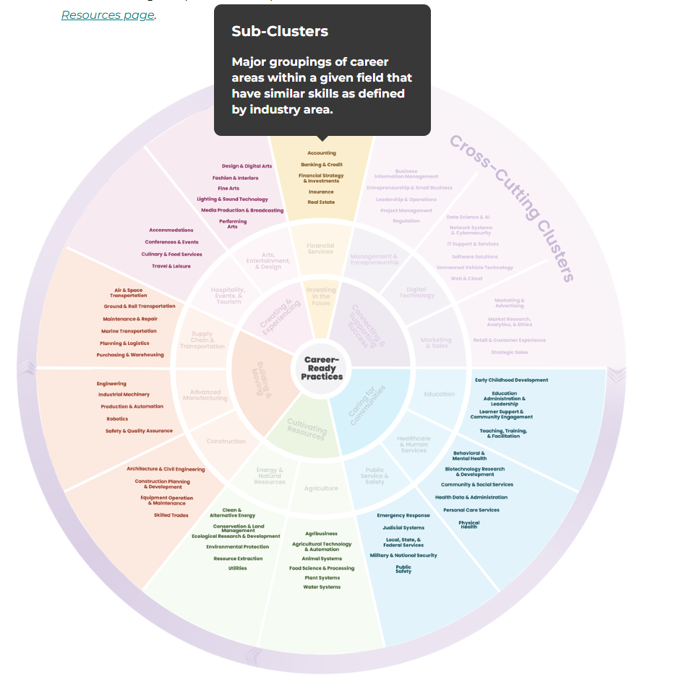
Career Clusters: Framework
Sub-Clusters (72)
Major groupings of career areas within a given field that have similar skills as defined by industry area.

Slide 16
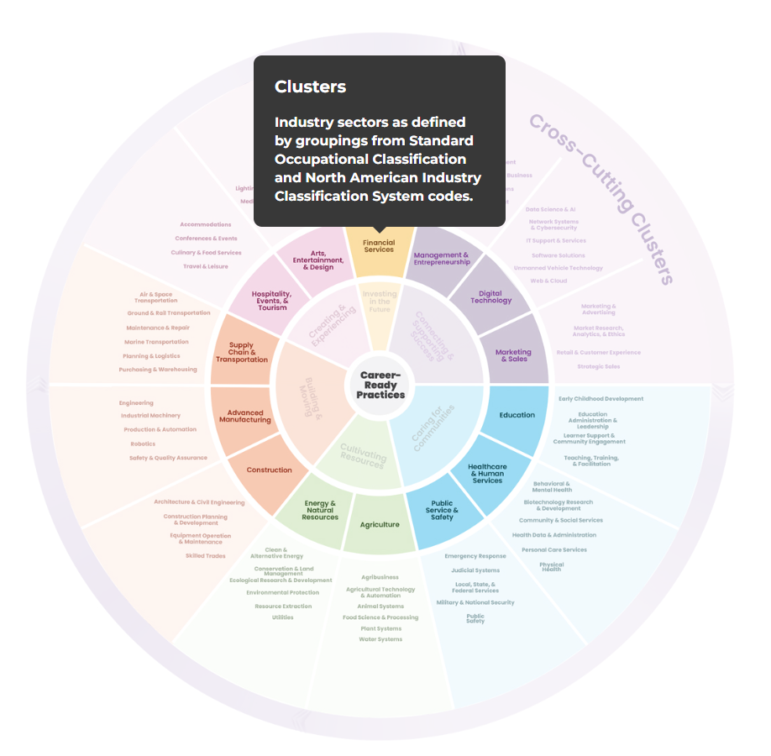
Career Clusters: Framework
Career Clusters (14)
Industry sectors as defined by groupings from Standard Occupational Classification and North American Industry Classification System codes.

Slide 17
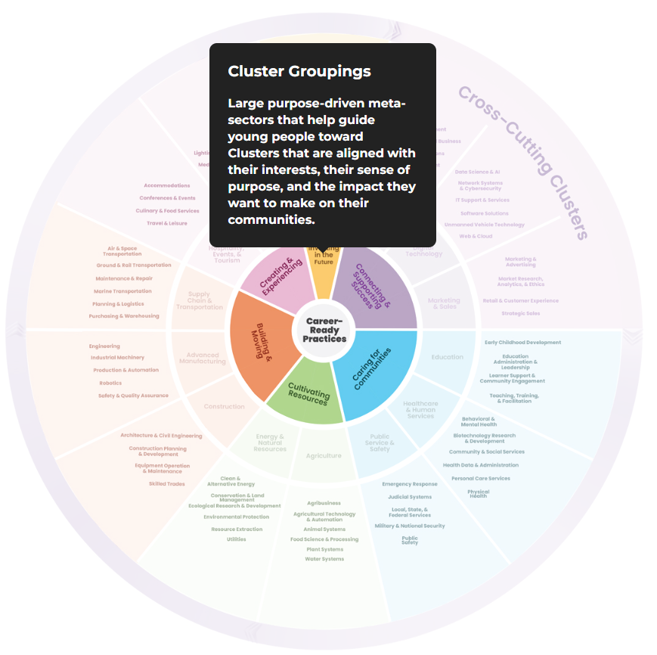
Career Clusters: Framework
Cluster Groupings (6)
Large purpose-driven meta-sectors that help guide learners toward Clusters that are aligned with their interests, their sense of purpose, and the impact they want to make on their communities.

Slide 18
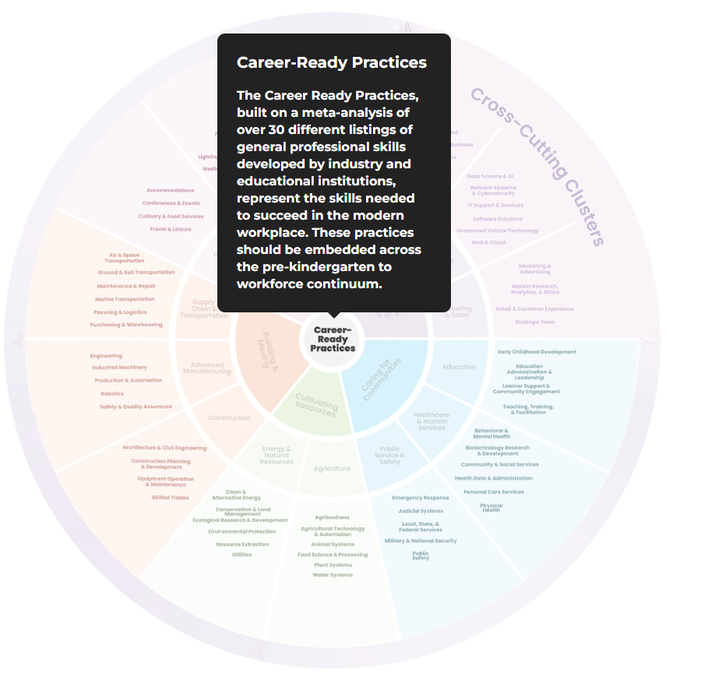
Career Clusters: Framework
Career Ready Practices (12)
The Career Ready Practices, built on a meta-analysis of over 30 different listings of general professional skills developed by industry and educational institutions, represent the skills needed to succeed in the modern workplace. These practices should be embedded across the pre-kindergarten to workforce continuum.

Slide 19
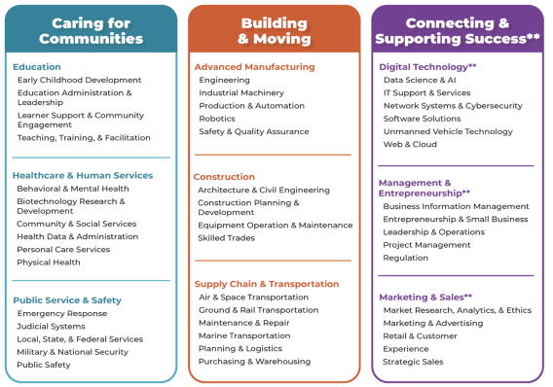
The Framework

Slide 20
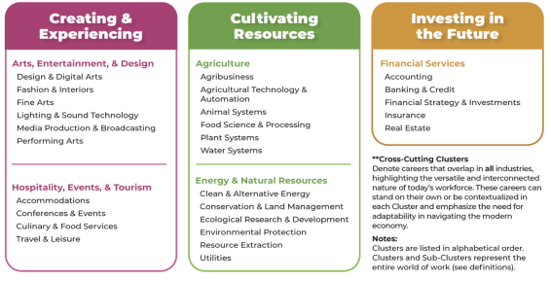
The Framework

Slide 21
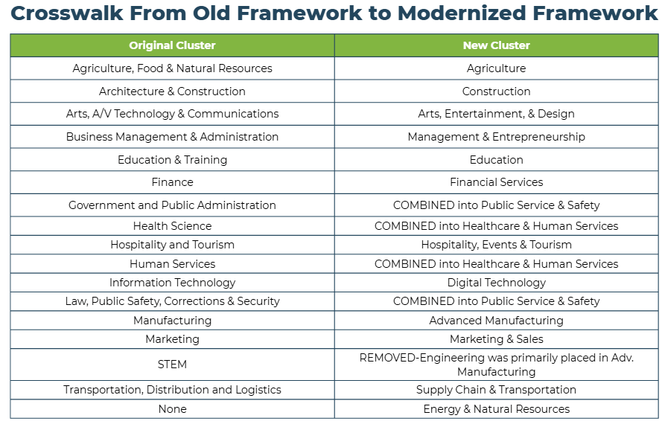
Career Clusters

Slide 22
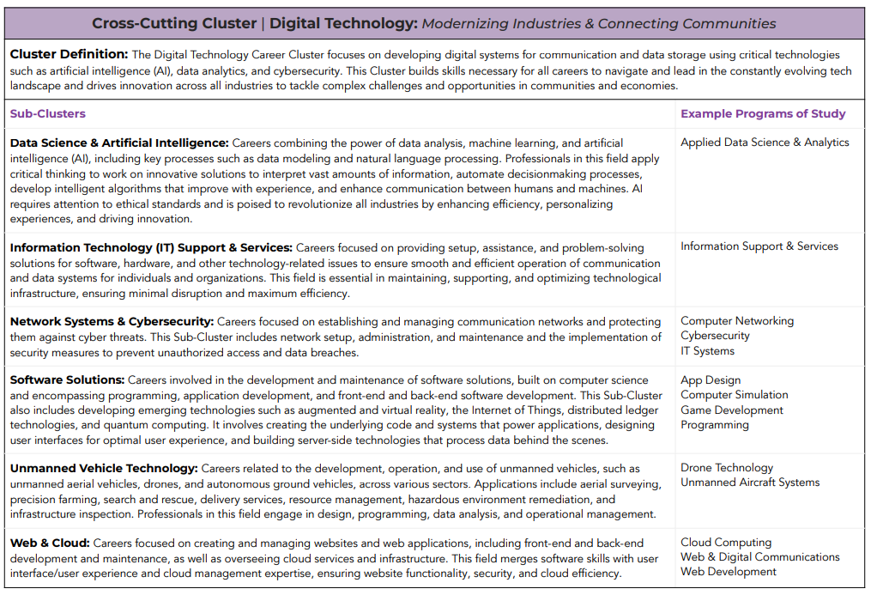
Career Clusters

Slide 23
Cross-Cutting Cluster | Digital Technology: Modernizing Industries & Connecting Communities
Cluster Definition:
The Digital Technology Career Cluster focuses on developing digital systems for communication and data storage using critical technologies such as artificial intelligence (AI), data analytics, and cybersecurity.
This Cluster builds skills necessary for all careers to navigate and lead in the constantly evolving techlandscape and drives innovation across all industries to tackle complex challenges and opportunities in communities and economies.

Slide 24
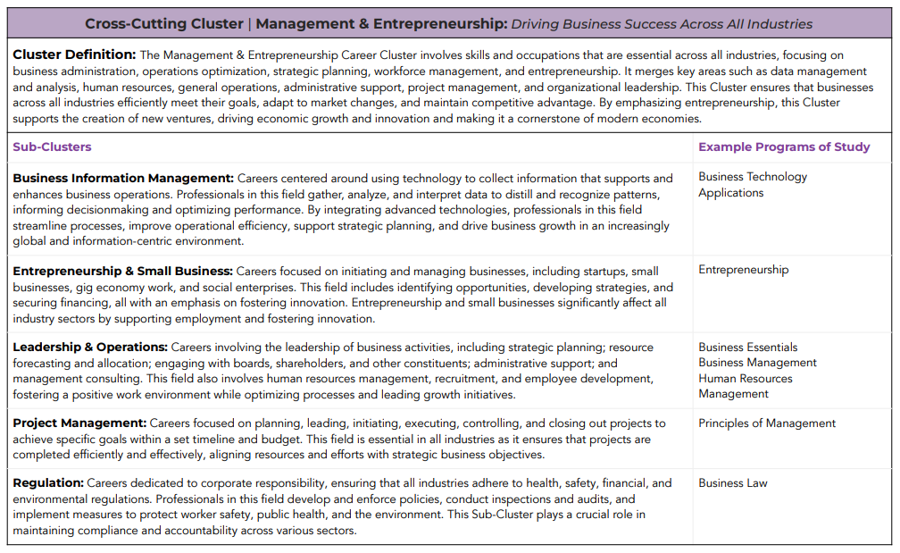
Career Clusters

Slide 25
Cross-Cutting Cluster | Management & Entrepreneurship: Driving Business Success Across All Industries Cluster
Cluster Definition:
The Management & Entrepreneurship Career Cluster involves skills and occupations that are essential across all industries, focusing on business administration, operations optimization, strategic planning, workforce management, and entrepreneurship.
It merges key areas such as data management and analysis, human resources, general operations, administrative support, project management, and organizational leadership.
This Cluster ensures that businesses across all industries efficiently meet their goals, adapt to market changes, and maintain competitive advantage.
By emphasizing entrepreneurship, this Cluster supports the creation of new ventures, driving economic growth and innovation and making it a cornerstone of modern economies.

Slide 26
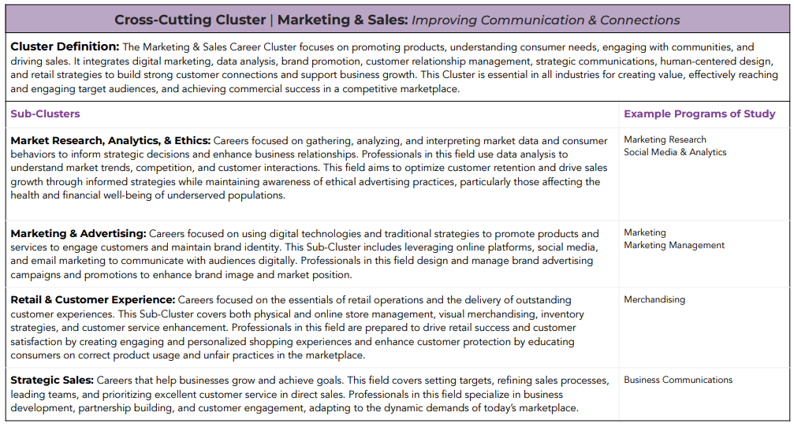
Career Clusters

Slide 27
Cross-Cutting Cluster | Marketing & Sales: Improving Communication & Connections
Cluster Definition:
The Marketing & Sales Career Cluster focuses on promoting products, understanding consumer needs, engaging with communities, and driving sales.
It integrates digital marketing, data analysis, brand promotion, customer relationship management, strategic communications, human-centered design, and retail strategies to build strong customer connections and support business growth.
This Cluster is essential in all industries for creating value, effectively reaching and engaging target audiences and achieving commercial success in a competitive marketplace.

Slide 28
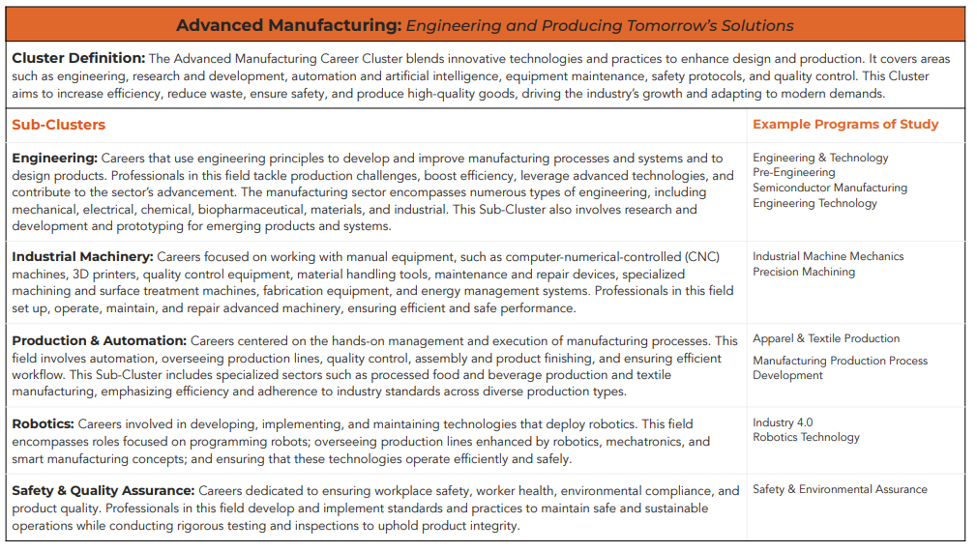
Career Clusters

Slide 29
Advanced Manufacturing: Engineering and Producing Tomorrow’s Solutions
Cluster Definition:
The Advanced Manufacturing Career Cluster blends innovative technologies and practices to enhance design and production.
It covers areas such as engineering, research and development, automation and artificial intelligence, equipment maintenance, safety protocols, and quality control.
This Cluster aims to increase efficiency, reduce waste, ensure safety, and produce high-quality goods, driving the industry’s growth and adapting to modern demands

Slide 30
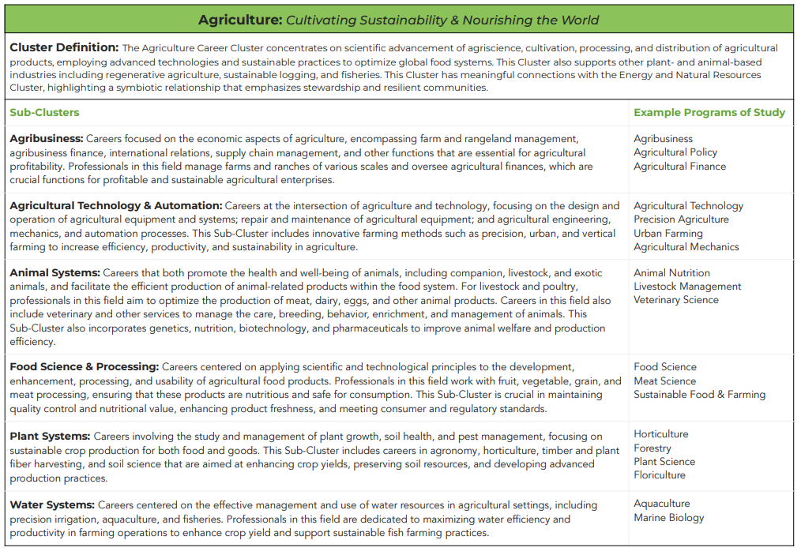
Career Clusters

Slide 31
Agriculture: Cultivating Sustainability & Nourishing the World
Cluster Definition:
The Agriculture Career Cluster concentrates on scientific advancement of agriscience, cultivation, processing, and distribution of agricultural products, employing advanced technologies and sustainable practices to optimize global food systems.
This Cluster also supports other plant- and animal-based industries including regenerative agriculture, sustainable logging, and fisheries.
This Cluster has meaningful connections with the Energy and Natural Resources Cluster, highlighting a symbiotic relationship that emphasizes stewardship and resilient communities.

Slide 32
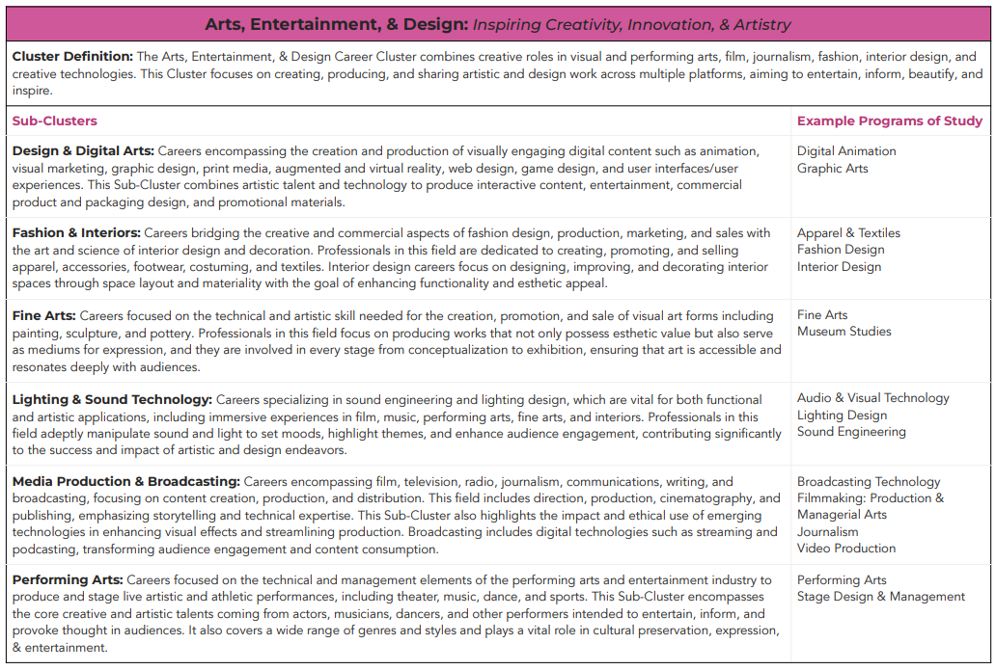
Career Clusters

Slide 33
Arts, Entertainment, & Design: Inspiring Creativity, Innovation, & Artistry
Cluster Definition:
The Arts, Entertainment, & Design Career Cluster combines creative roles in visual and performing arts, film, journalism, fashion, interior design, and creative technologies.
This Cluster focuses on creating, producing, and sharing artistic and design work across multiple platforms, aiming to entertain, inform, beautify, and inspire.

Slide 34
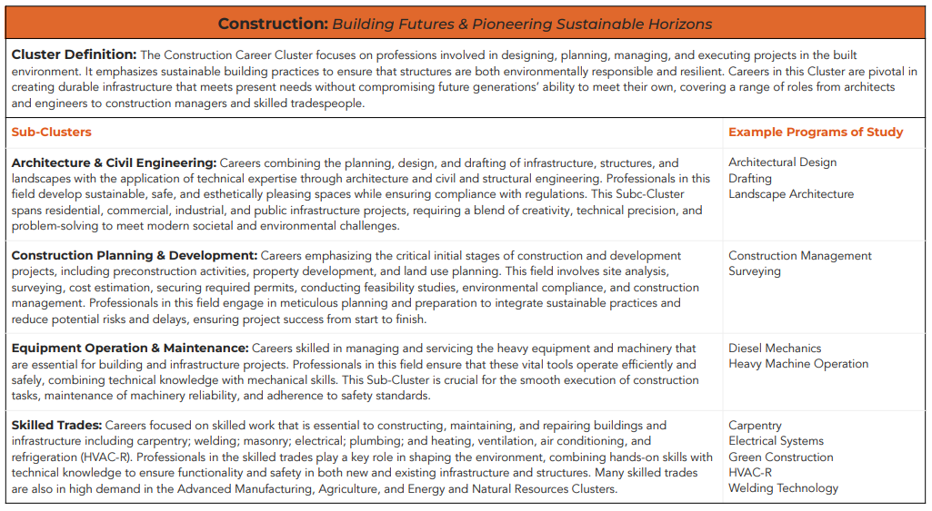
Career Clusters

Slide 35
Construction: Building Futures & Pioneering Sustainable Horizons
Cluster Definition:
The Construction Career Cluster focuses on professions involved in designing, planning, managing, and executing projects in the built environment.
It emphasizes sustainable building practices to ensure that structures are both environmentally responsible and resilient.
Careers in this Cluster are pivotal in creating durable infrastructure that meets present needs without compromising future generations’ ability to meet their own, covering a range of roles from architects and engineers to construction managers and skilled tradespeople.

Slide 36
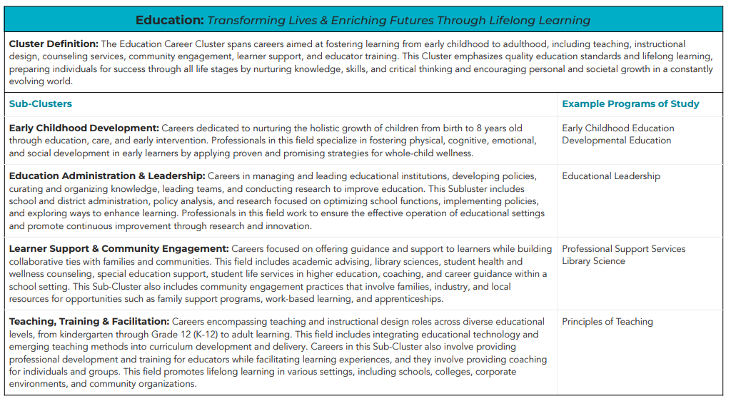
Career Clusters

Slide 37
Education: Transforming Lives & Enriching Futures Through Lifelong Learning
Cluster Definition:
The Education Career Cluster spans careers aimed at fostering learning from early childhood to adulthood, including teaching, instructional design, counseling services, community engagement, learner support, and educator training.
This Cluster emphasizes quality education standards and lifelong learning, preparing individuals for success through all life stages by nurturing knowledge, skills, and critical thinking and encouraging personal and societal growth in a constantly evolving world.

Slide 38
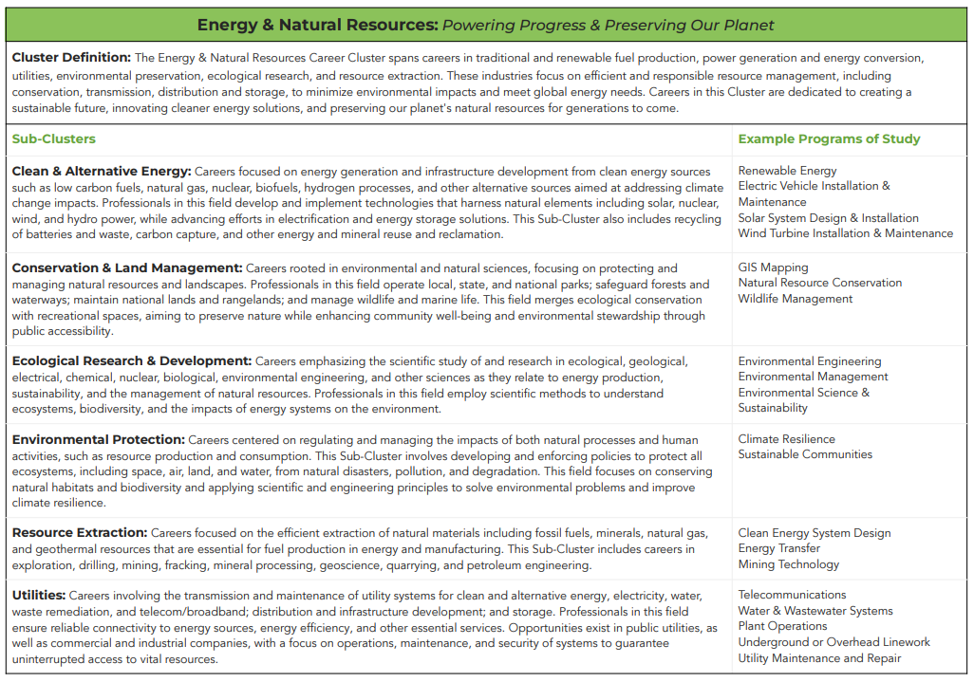
Career Clusters

Slide 39
Energy & Natural Resources: Powering Progress & Preserving Our Planet
Cluster Definition:
The Energy & Natural Resources Career Cluster spans careers in traditional and renewable fuel production, power generation and energy conversion, utilities, environmental preservation, ecological research, and resource extraction.
These industries focus on efficient and responsible resource management, including conservation, transmission, distribution and storage, to minimize environmental impacts and meet global energy needs.
Careers in this Cluster are dedicated to creating a sustainable future, innovating cleaner energy solutions, and preserving our planet's natural resources for generations to come.

Slide 40
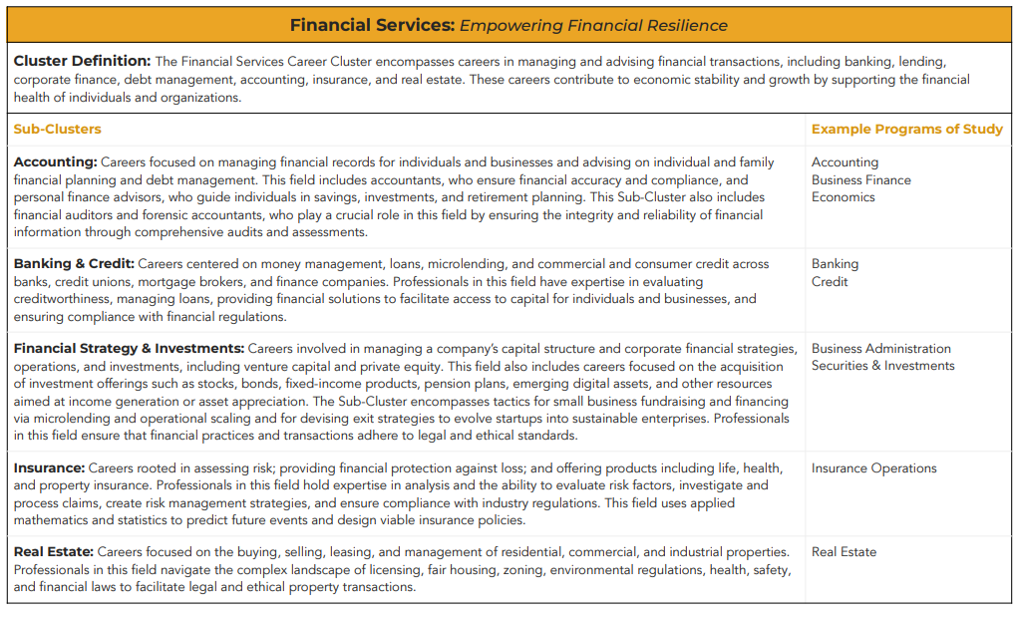
Career Clusters

Slide 41
Financial Services: Empowering Financial Resilience
Cluster Definition:
The Financial Services Career Cluster encompasses careers in managing and advising financial transactions, including banking, lending, corporate finance, debt management, accounting, insurance, and real estate.
These careers contribute to economic stability and growth by supporting the financial health of individuals and organizations.

Slide 42
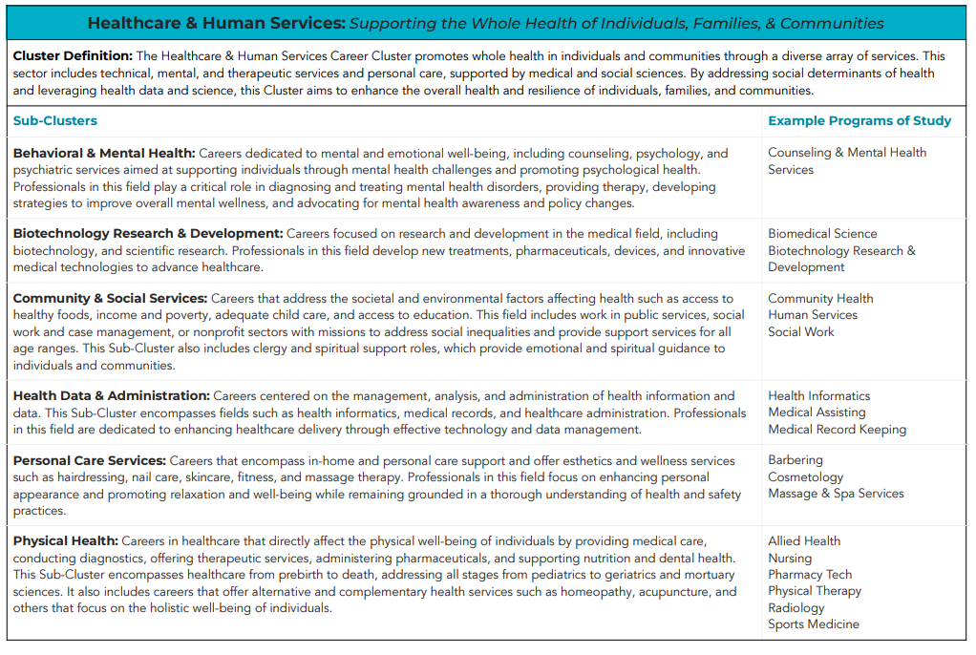
Career Clusters

Slide 43
Healthcare & Human Services: Supporting the Whole Health of Individuals, Families, & Communities
Cluster Definition:
The Healthcare & Human Services Career Cluster promotes whole health in individuals and communities through a diverse array of services.
This sector includes technical, mental, and therapeutic services and personal care, supported by medical and social sciences.
By addressing social determinants of health and leveraging health data and science, this Cluster aims to enhance the overall health and resilience of individuals, families, and communities.

Slide 44
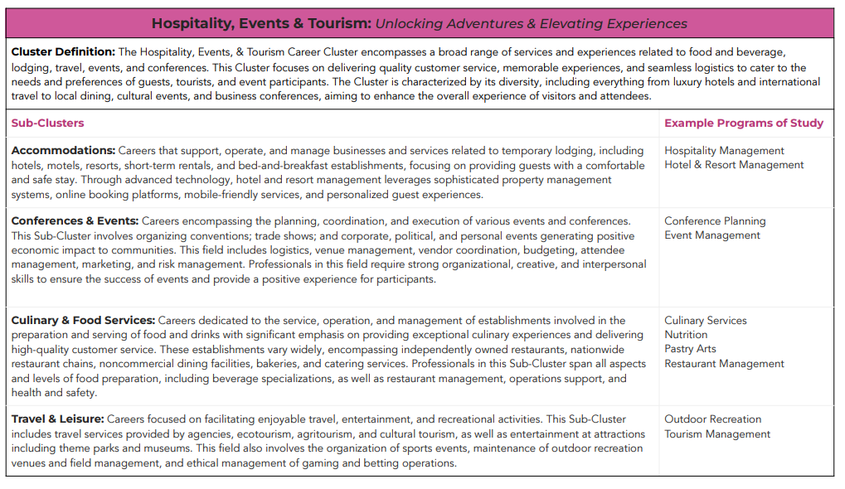
Career Clusters

Slide 45
Hospitality, Events & Tourism: Unlocking Adventures & Elevating Experiences
Cluster Definition:
The Hospitality, Events, & Tourism Career Cluster encompasses a broad range of services and experiences related to food and beverage, lodging, travel, events, and conferences.
This Cluster focuses on delivering quality customer service, memorable experiences, and seamless logistics to cater to the needs and preferences of guests, tourists, and event participants.
The Cluster is characterized by its diversity, including everything from luxury hotels and international travel to local dining, cultural events, and business conferences, aiming to enhance the overall experience of visitors and attendees.

Slide 46
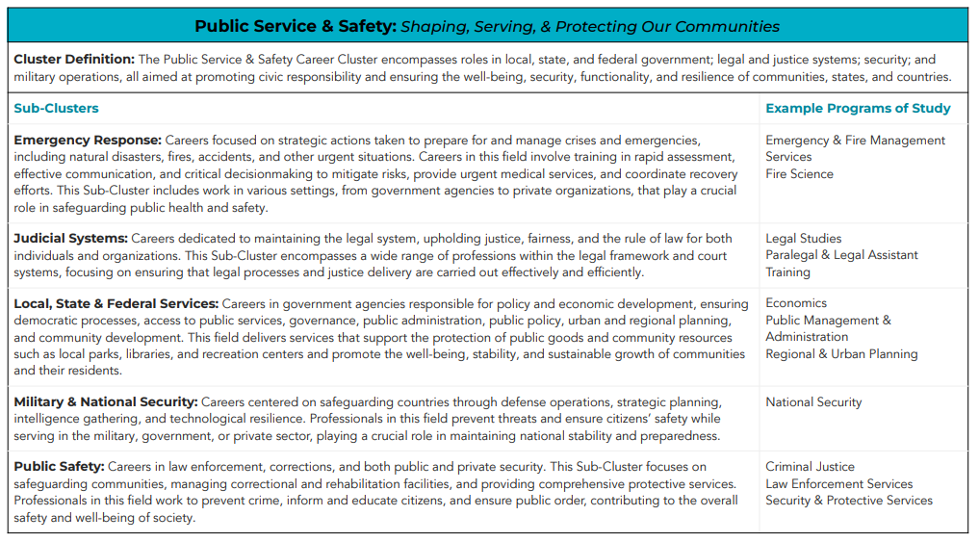
Career Clusters

Slide 47
Public Service & Safety: Shaping, Serving, & Protecting Our Communities
Cluster Definition:
The Public Service & Safety Career Cluster encompasses roles in local, state, and federal government; legal and justice systems; security; and military operations, all aimed at promoting civic responsibility and ensuring the well-being, security, functionality, and resilience of communities, states, and countries.

Slide 48
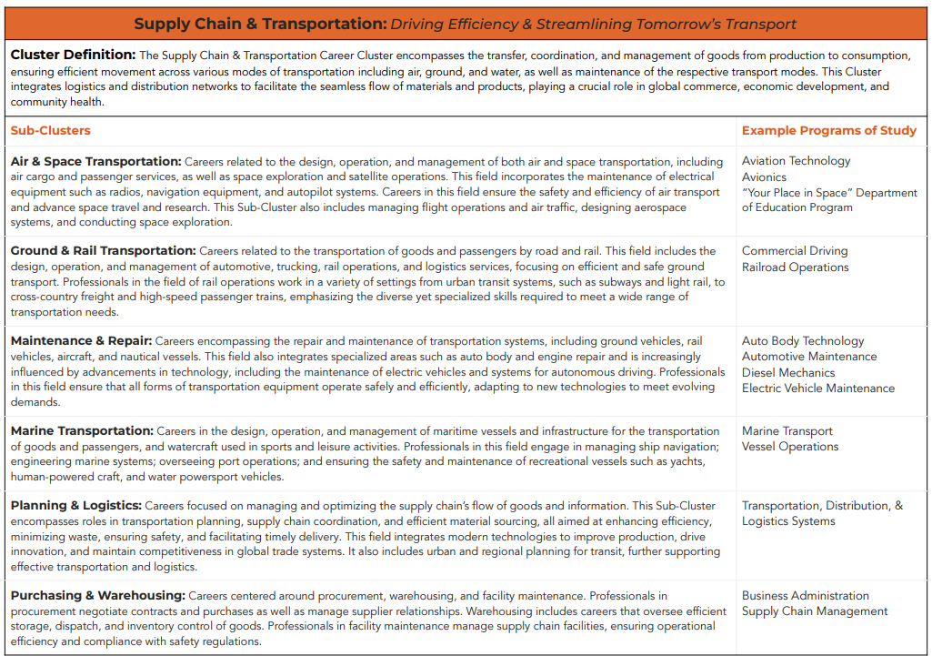
Career Clusters

Slide 49
Supply Chain & Transportation: Driving Efficiency & Streamlining Tomorrow’s Transport
Cluster Definition:
The Supply Chain & Transportation Career Cluster encompasses the transfer, coordination, and management of goods from production to consumption, ensuring efficient movement across various modes of transportation including air, ground, and water, as well as maintenance of the respective transport modes.
This Cluster integrates logistics and distribution networks to facilitate the seamless flow of materials and products, playing a crucial role in global commerce, economic development, and community health.

Slide 50
Career Clusters

Slide 51
Career Clusters: CIS 360 Updates
Implemented on August 1, 2025
And beyond

Slide 52
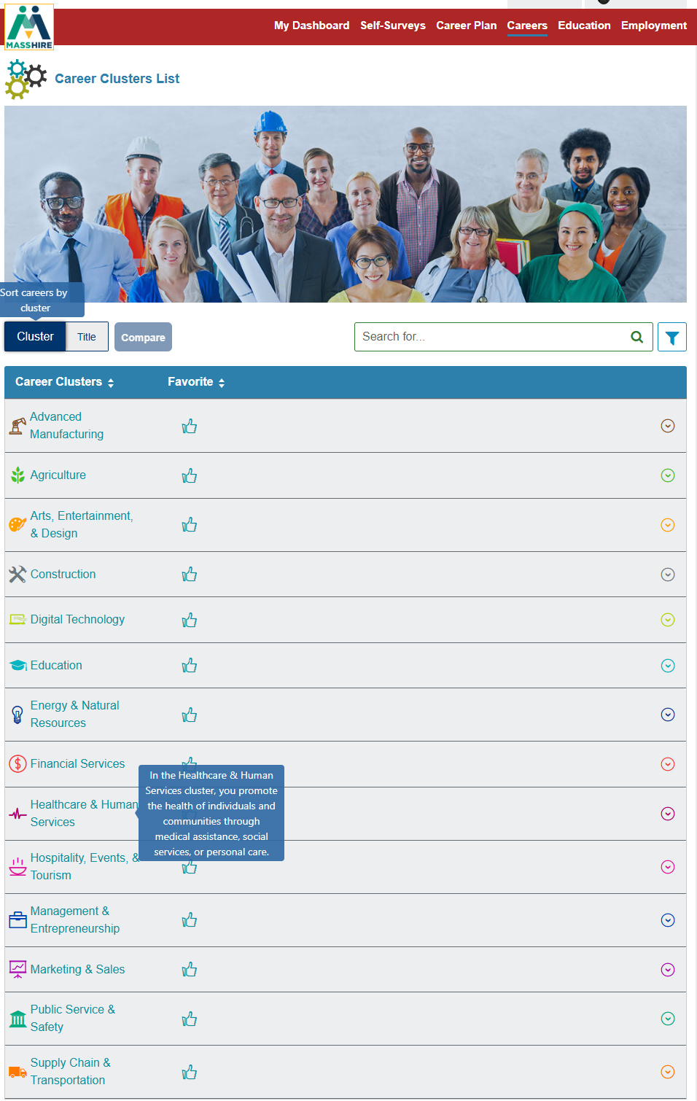


CIS Updates

Slide 53
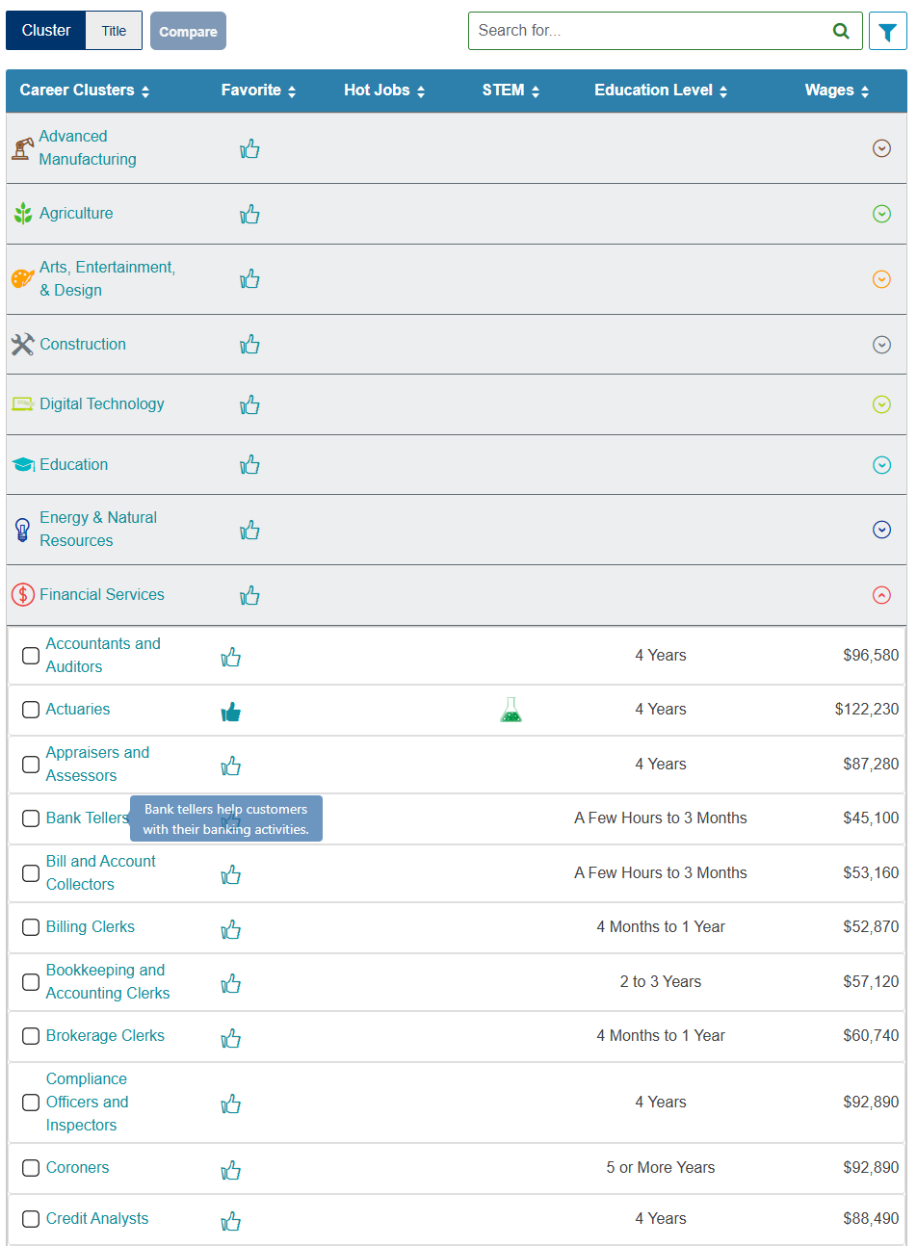
CIS Updates
Career Clusters:
Drop menu with associated Careers

Slide 54
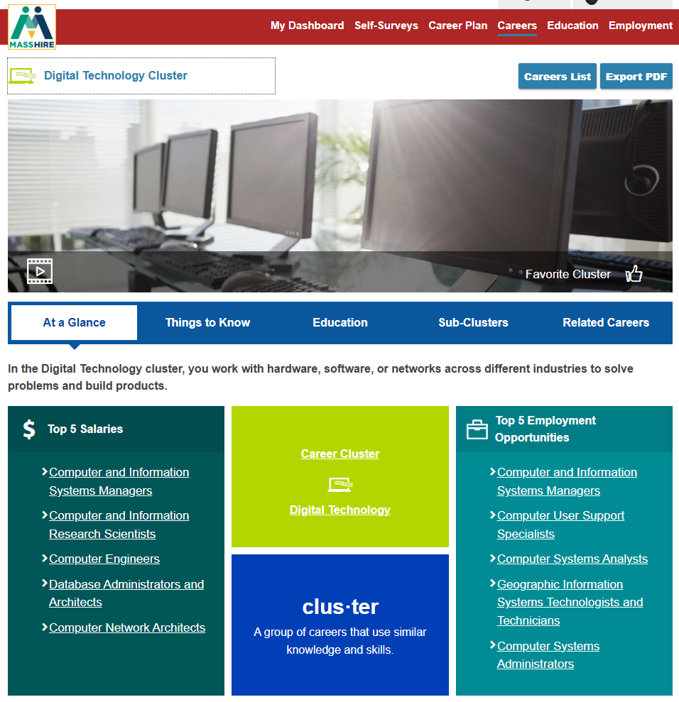
CIS Updates
Career Cluster:
At A Glance

Slide 55
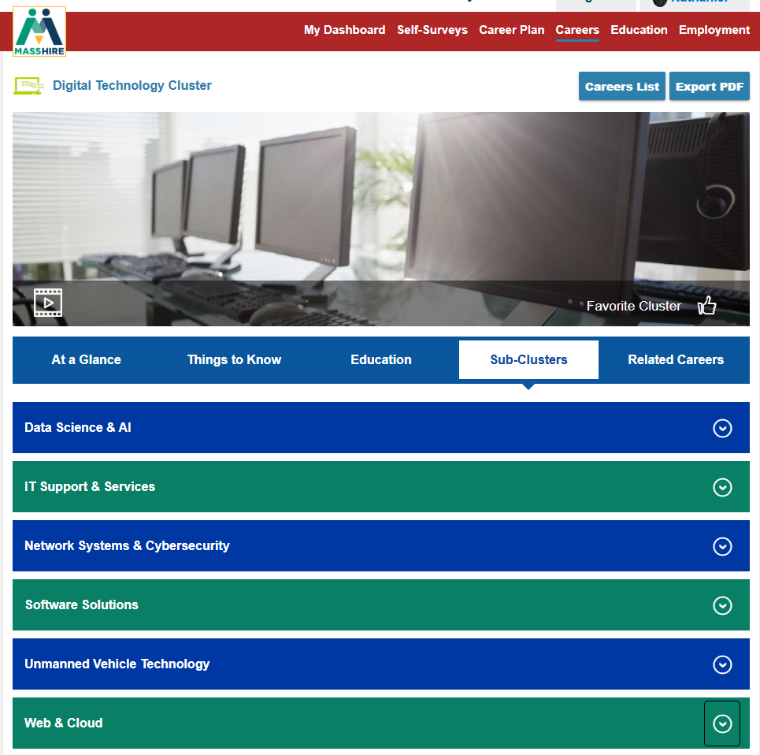
CIS Updates
Career Cluster:
At a Glance
Sub-Clusters - sub tab

Slide 56
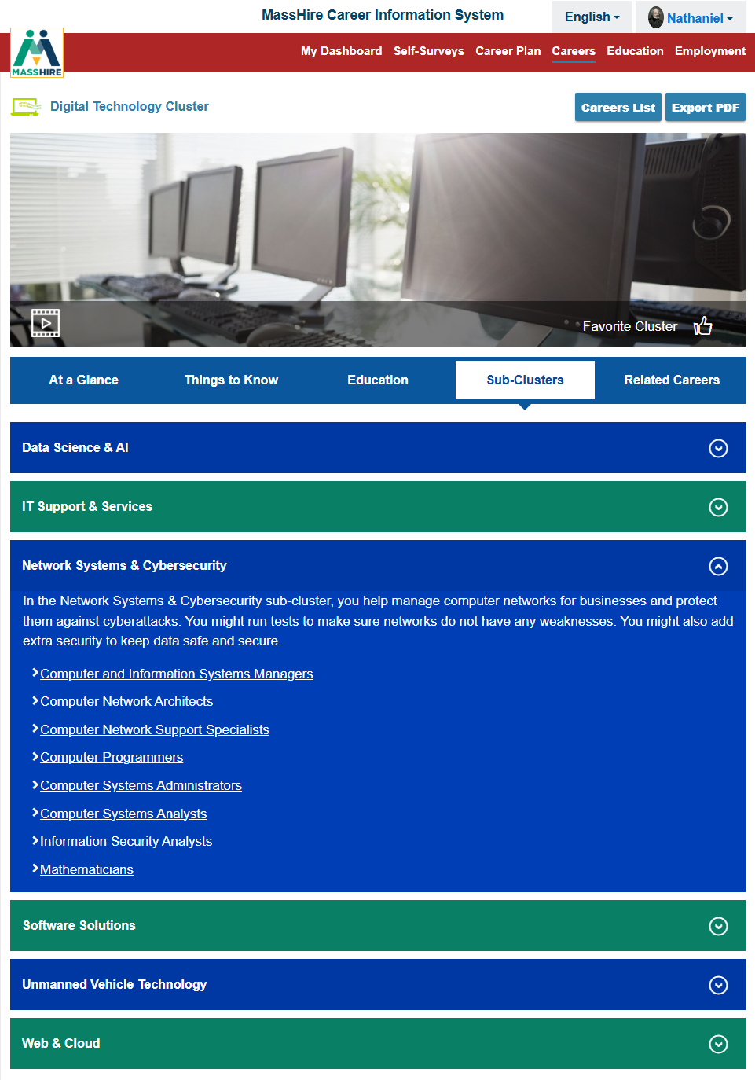
CIS Updates
Career Cluster:
At a Glance
Sub-Clusters - sub tab
Drop Menu:
Associated Occupations

Slide 57
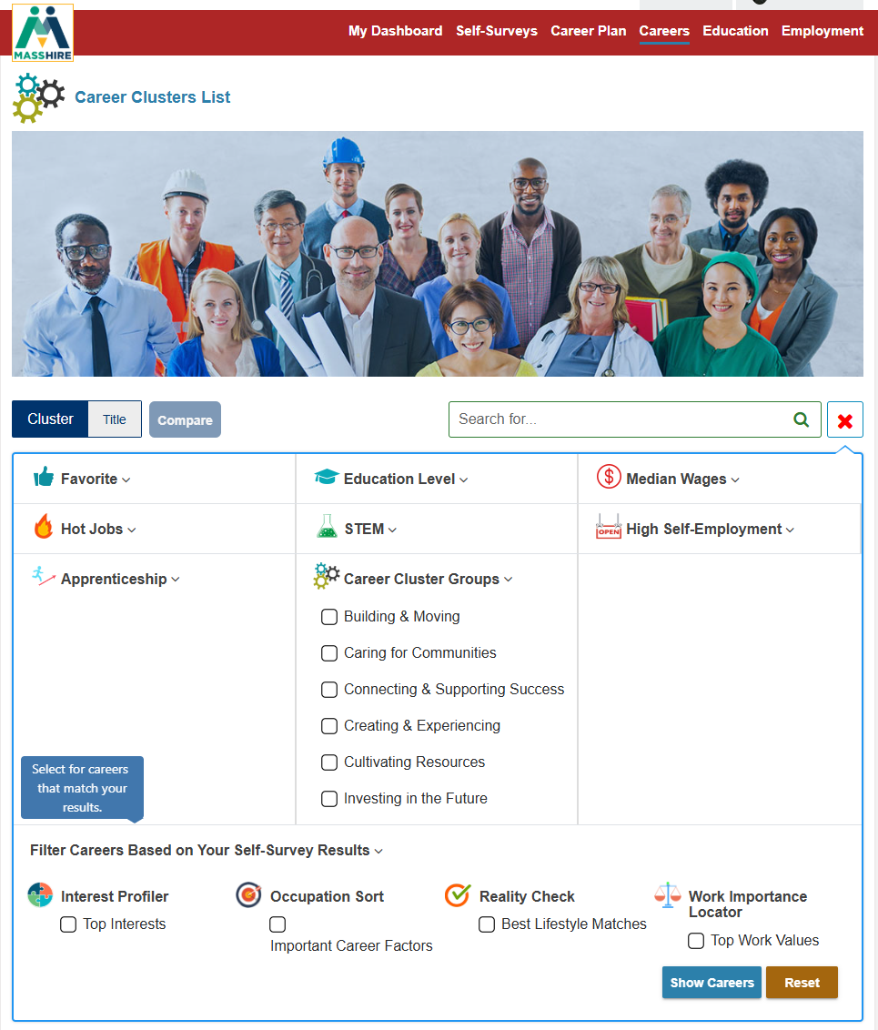
CIS Updates

Slide 58
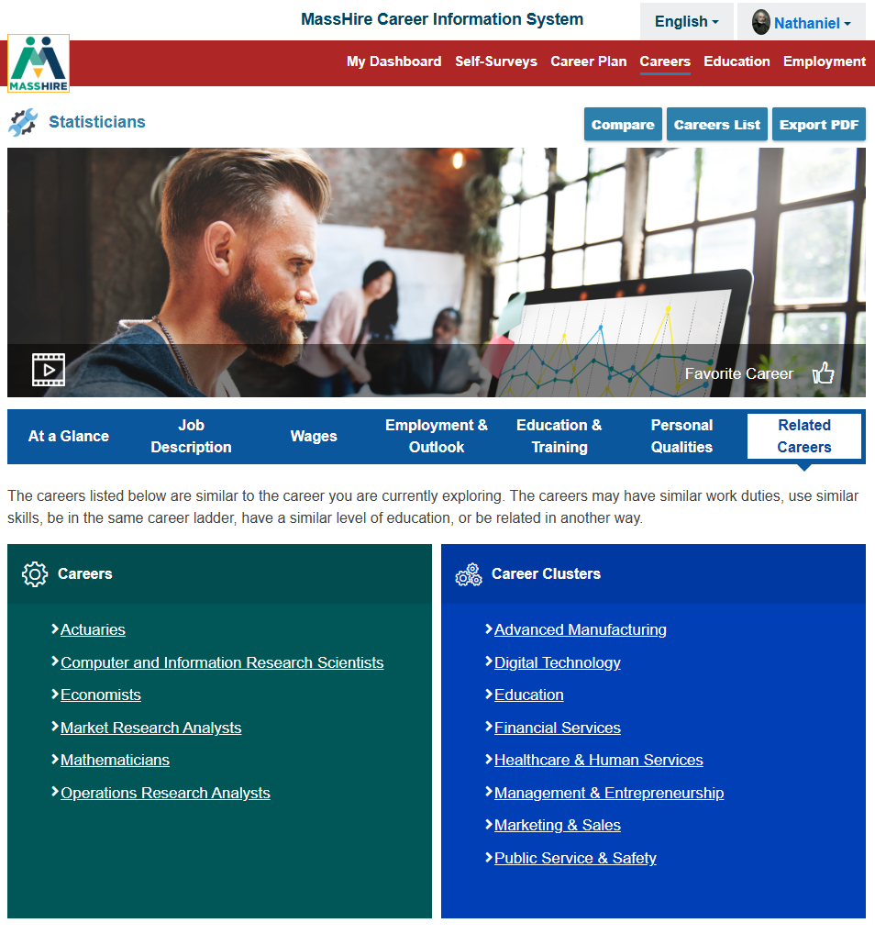
CIS Updates
Some Careers are in multiple Career Clusters

Slide 59
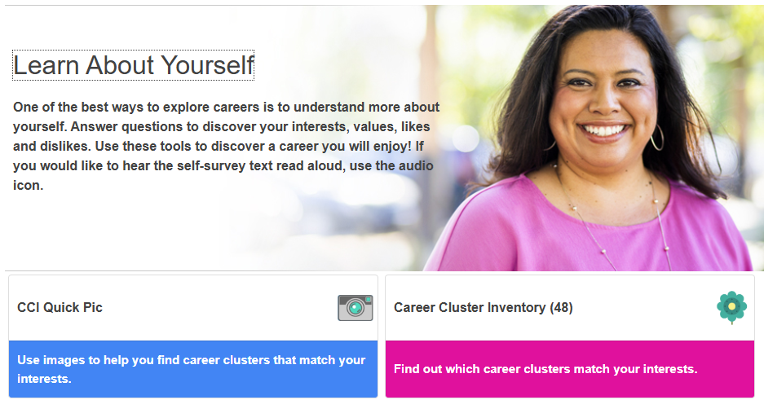
CIS Updates
Updated Assessments with new Clusters.
If taken previously , they are erased. Need to take the Assessment again.

Slide 60
Career Clusters:
CIS 360 Updates coming
360 Adult Site Manual
360 Adult Operator Manual
360 HS Site Manual
360 HS Operator Manual
360 JR Site Manual
360 JR Operator Manual
Printable Career Plan Activities JR
Printable Career Plan Activities HS
Career Plan Activity Library JR and HS
Career Plan Activity Library College and Adult

Slide 61
Career Clusters:
CIS 360 Updates coming
360 Reality Check Quick Start JR
360 Reality Check Quick Start HS
360 CCI Quick Pic Quick Start JR
360 CCI Quick Pic Quick Start HS
360 Career Cluster Inventory Quick Start
CIS 360 Careers Tips and Tricks Canva and pdfs
IDEAS
CCI Quick Pic Curriculum
CCI Curriculum

Slide 62
Career Clusters:
CIS 360 Updates coming
CIS portfolios :
  All saved items will be converted to new 14 sectors:
    Assessments
    Careers
    Programs of Study / Education
    Career Plan

Slide 63
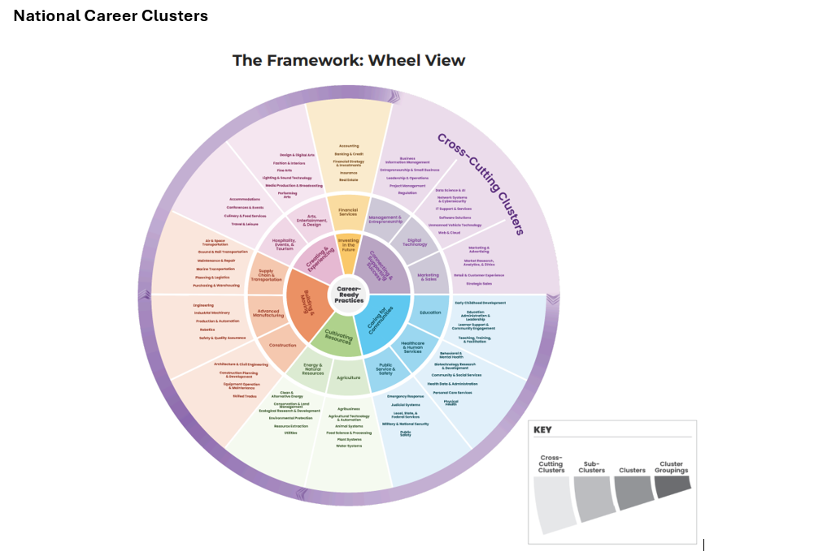
Materials
Manual with full review of each career cluster.
https://www.mass.gov/info-details/masshire-cis-360-material

Slide 64
Career Clusters: Resources
https://careertech.org/career-clusters/
https://careertech.org/wp-content/uploads/2025/06/Guidebook-National-Career-Clusters-Framework.pdf (English version)
https://careertech.org/wp-content/uploads/2025/07/ESP_Guidebook_National_Career_Clusters_Framework_07_2025.pdf (Spanish Version)

Slide 65
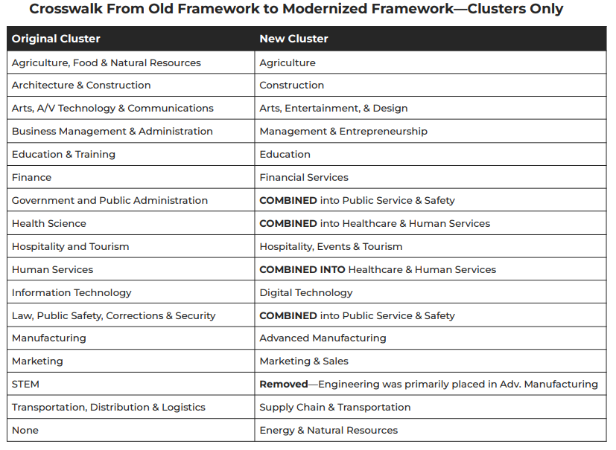
Career Clusters

Slide 66

Questions?
?
?
?
Questions?
?
?
?
?
?
?
?
?

