Slide 1
Housekeeping
Please keep your line muted unless asking a question
You may use the chat, raise your hand or unmute your line to ask a question
Both this training deck and the recording will be shared early next week
Please introduce yourself in the chat

Slide 2

WIOA PERFORMANCE TRAINING
https://www.mass.gov/masshire-career-centers
April 2026
  MassHire Programs & Services are funded in full by US Department of Labor (USDOL) Employment and Training Administration grants. (Additional details furnished upon request.)

Slide 3
WIOA Performance Indicators
Performance Topics:
  Brief Background on Federal Reporting
  WIOA Performance Indicators
  MOSES Data Entry Impact
  Review Performance Scenarios
  Blue/Bold Services Discussion
  Notes, Exits, and the 90 Day Clock

Slide 4
  Quarterly Federal Reporting
Each calendar quarter, the PIRL (Participant Individual Record Layout) report is submitted to the USDOL.
The PIRL gathers data from both MOSES and Wage databases (SWIS and DUA)
The PIRL contains both active participants as well as those that have exited up to 2 ½ years ago!
Once submitted, the data in the PIRL is used to calculate our federal performance for the quarter.
PIRL
USDOL
Wage Data
MOSES Data
SWIS
DUA
SWIS = State Wage Interchange System
DUA = Department of Unemployment Assistance
Notes:
This is how DOL establishes goals and funding for each state. They review participant by participant data and demographics from Moses and wage records received from DUA and SWIS systems. The SWIS system enables us to collect wage data from all 50 states as well as DC, PR , US Virgin Islands.

Slide 5
WIOA Performance Indicators
Exit Quarter - Represents the calendar quarter in which the date of exit is recorded for the participant.
2023 |  |  | 2023 |  |  | 2023 |  |  | 2023
JAN | FEB | MAR | APR | MAY | JUN | JUL | AUG | SEP | OCT | NOV | DEC
Exit Quarter
1st Qtr. After Exit
2nd Qtr. After Exit
2024 |  |  | 2024 |  |  | 2024 |  |  | 2024
JAN | FEB | MAR | APR | MAY | JUN | JUL | AUG | SEP | OCT | NOV | DEC
3rd Qtr. After Exit
4th Qtr. After Exit
Notes:
Everything starts with a participants exit quarter. Here is a breakdown for the quarters for 2023 and 2024. For example if the participant exits in April, May or June of 2023 this is considered to be their exit quarter. Their 1st quarter after exit would be anytime during July, August or September. The 2nd quarter after exit would be October, November and December. The 3rd quarter after exit will be January, February, March 2024. Finally the 4th quarter after exit would be April, May or June of 2024. At first you will want to refer to a calendar to learn the quarters because it changes with each participant exit. Keep this in mind as we go through the performance measures.

Slide 6
WIOA Performance Indicators
Performance Measure | FY2024 Cohort [Exit*] Range
Adult/DW: Employment in the 2nd Quarter After Exit Youth: Employment, or Education/Training in 2nd Quarter After Exit | July 2023 - June 2024
Adult/DW: Employment in the 4th Quarter After Exit Youth: Employment, or Education/Training in 4th Quarter After Exit | Jan 2023 - Dec 2023
Median Wages 2nd Quarter After Exit | July 2023 - June 2024
Credential Attainment | Jan 2023 - Dec 2023
Measurable Skill Gain *[Participants] | July 2023 - June 2024
Effectiveness in Serving Employers | Jan 2023 – Dec 2023
TEGL 1-16 Change 3: Performance Accountability Guidance for WIOA Core Programs
Notes:
The annual report is due to the DOL on October 1st of each year. People who exit during the cohort range are contained in this report.

Slide 7
WIOA Performance Indicators
Employment 2nd Quarter After Exit
In Employment during the 2nd Quarter After Exit:
  The percentage of participants who are employed during the second quarter after their exit.
  i.e.; the participants who had a job in 2nd quarter after exit
  # exiters in cohort
For Youth: In Employment, Education, or Training during the 2nd Quarter After Exit:
  The percentage of participants who are employed, or in education, or in advanced training during the second quarter after their exit.
  i.e.; the participants who had a job in 2nd quarter after exit, or p/s or s/ed or training
  # exiters in cohort
Employment:
Wage records (DUA or SWIS)
Someone who is employed by the Federal Government, a religious organization or is self-employed see TEGL 26-16 for adding wages when no wage record is found.
Education or Training (Youth only):
Retention Services on the General tab of MOSES
  Career Center Performance Report [CCPR]
Notes:
At bottom there is a link to the Career Center Performance Report also known as CCPR, these are the numbers used to calculate the performance indicators. This report is available for download by anyone and is broken out by reporting quarters. Tab 10, 11,12 is where you will find the statewide performance data.

Slide 8
Employment 2nd Quarter After Exit
Scenario
Nancy is a WIOA dislocated worker who was laid off from her job at a medical supply company and is working with a career counselor on her specific interests. The counselor is aware of a training in her field and after discussing the details and completes eligibility with her, Nancy is enrolled in the program.
Nancy exits the training program and WIOA Dislocated Worker program in January 2024 and gets a job immediately. In August 2024, Nancy moves to another state, buts finds a new job and continues working.
Is Nancy a positive outcome in the Employment Rate 2nd Quarter After Exit?
Notes:
Let's use the calendar to see how this works.

Slide 9
WIOA Performance Indicators
Exit Quarter - Represents the calendar quarter in which the date of exit is recorded for the participant.
2024 |  |  | 2024 |  |  | 2024 |  |  | 2024
JAN | FEB | MAR | APR | MAY | JUN | JUL | AUG | SEP | OCT | NOV | DEC
Exit Quarter
1st Qtr After Exit
2nd Qtr After Exit
2025 |  |  | 2025 |  |  | 2025 |  |  | 2025
JAN | FEB | MAR | APR | MAY | JUN | JUL | AUG | SEP | OCT | NOV | DEC
Notes:
Nancy exits the program in January 2024 and gets a job immediately. In August she moves to another state but finds a new job. Using the SWIS system, we will be able to obtain her wage data from the other state. As long as she is working anytime in the quarter she will be a positive outcome. So yes, Nancy is a positive outcome.

Slide 10
WIOA Performance Indicators
Employment 4th Quarter After Exit
In Employment during the 4th Quarter After Exit:
  The percentage of participants who are employed during the fourth quarter after their exit.
  i.e.; the participants who had a job in 4th quarter after exit
  # exiters in cohort
For Youth: In Employment, Education, or Training during the 4th Quarter After Exit:
  The percentage of participants who are employed, or in education, or in advanced training during the fourth quarter after their exit.
  i.e.; the participants who had a job in 4th quarter after exit, or p/s or s/ed or training
  # exiters in cohort
Employment:
Wage records (DUA or SWIS)
(see TEGL 26-16 for adding wages when no wage record found; e.g. someone who is employed by the Federal Government, a religious organization or self-employed)
Education or Training (Youth only):
Retention Services on the General tab of MOSES
  Career Center Performance Report [CCPR]
Notes:
The 4th quarter after exit is the same as the 2nd quarter after exit.

Slide 11
Employment 4th Quarter After Exit
Scenario
Sara is an OSY participant, participating in mentoring and internship. After completing her internship, the employer hires her full time and she also exits the WIOA Youth program.
She remains employed through her 2nd and 3rd quarter after exit, but loses her job in the first month of her 4th quarter after exit.
Is Sara a positive outcome in the Employment/Education Rate 2nd Quarter After Exit?
Is Sara a positive outcome in the Employment/Education Rate 4th Quarter After Exit?

Slide 12
WIOA Performance Indicators
Median Wages 2nd Quarter After Exit:
  The median wage of those exiters employed in the 2nd quarter after exit.
  Employment:
  Wage records (DUA, SWIS, Supplemental MOSES Data)
  The difference between average and median:
  The average of {5, 6, 7, 9, 28} = 11
  The median of {5, 6, 7, 9, 28} = 7
Notes:
The wage records are received from DUA and SWIS, or Supplemental Data. Wage records will override supplemental data. If you are using supplemental data you will want to review TEL 26-16 for full details from the link in the pervious slide.

Slide 13
WIOA Performance Indicators
Recognized Post-Secondary Credential
  Section 3(52) of WIOA defines “recognized postsecondary credential” as a credential consisting of an industry-recognized certificate or certification, a certificate of completion of an apprenticeship, a license recognized by the State involved or Federal Government, or an associate or baccalaureate degree*.
* Note that a graduate degree is not included in the definition above. Also, while allowable for Trade and Vocational Rehabilitation program participants, it is not a positive outcome in performance.
Notes:
Performance indicators are extremely important for future funding. This is for all programs not just WIOA. These are also used for Trade and NDWG

Slide 14
Types of Post Secondary Credentials
Credential Attainment
Industry-recognized certification
  e.g. Microsoft Certified IT Professional (MCITP), National Institute for Automotive Service Excellence certification
Apprenticeship certification
  e.g. Certificate from Massachusetts Division of Apprentice Standards
License issued by a State or Federal government
  e.g. State licensed asbestos inspector, Federal Aviation Administration aviation mechanic license
Associate or Bachelor’s degree (but not a graduate degree!)
  USDOL Credential Tool
Notes:
A couple of examples of a Post Secondary Credential would be a C.N.A. or CDL. Any nationally recognized credential or something that offers reciprocity. An example of something that is not a recognized credential would be ServSafe, CPR or OSHA. These can be used towards a Measurable Skills Goal but not as an outcome attainment. If you are unsure if your credential would be recognized, you can use the link below for the US DOL Credential Tool. It asks a series of questions to help determine if it would be accepted.

Slide 15
WIOA Performance Indicators
  Credential Attainment measure:
  Number of participants who exited during the reporting period or cohort that were in an education or training program (excluding OJT and Customized Training) and who obtained a recognized postsecondary credential during the program or within one year after exit;
  plus the number of participants who exited that were in a secondary education program and who obtained a secondary education diploma or its equivalent during the program or within one year after exit AND who were also employed or enrolled in an education or training program leading to a recognized postsecondary credential within one year after exit.
Notes:
Why would OJT or Customized Training not be included? Because they are focused on a specific companies need and training is tailored towards their way of doing things and not an industry wide focus. For the second part, as long as the participant is employed or enrolled in a post secondary program within one year after exit they will be a positive outcome. This information must entered in Moses to be measured.

Slide 16
Secondary School Diplomas/Equivalents
Credential Attainment
For those attaining a high school equivalency or diploma:
Only included as a positive outcome, if within one year after exit, the participant is:
  Employed
    OR
  Enrolled in education or training leading to a postsecondary credential
Notes:
For employment, we will confirm employment through wage data. For the postsecondary education or training, this must be entered in Moses with notes as well. In the next couple of sides there are examples to clear this up a little more.

Slide 17
WIOA Performance Indicators
Credential Attainment MOSES Tracking Steps:
  Recognized Post Secondary Credential
  Add the Attainment Service on the General tab of MOSES. Done!
  High School Diploma/Equivalency
  Add the Attainment Service on the General tab of MOSES
  Wage record
    OR
    Add Retention Service on the General tab of MOSES if in Advanced Training or Post Secondary Education

Slide 18
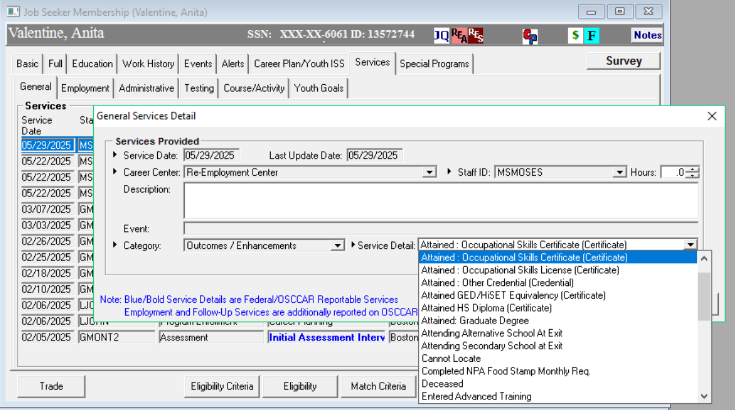
WIOA Performance Indicators
Credential Attainment – Step 1
Notes:
This needs to be done for everyone who has attained a credential. This is a performance measure that is solely met by Moses data entry.

Slide 19
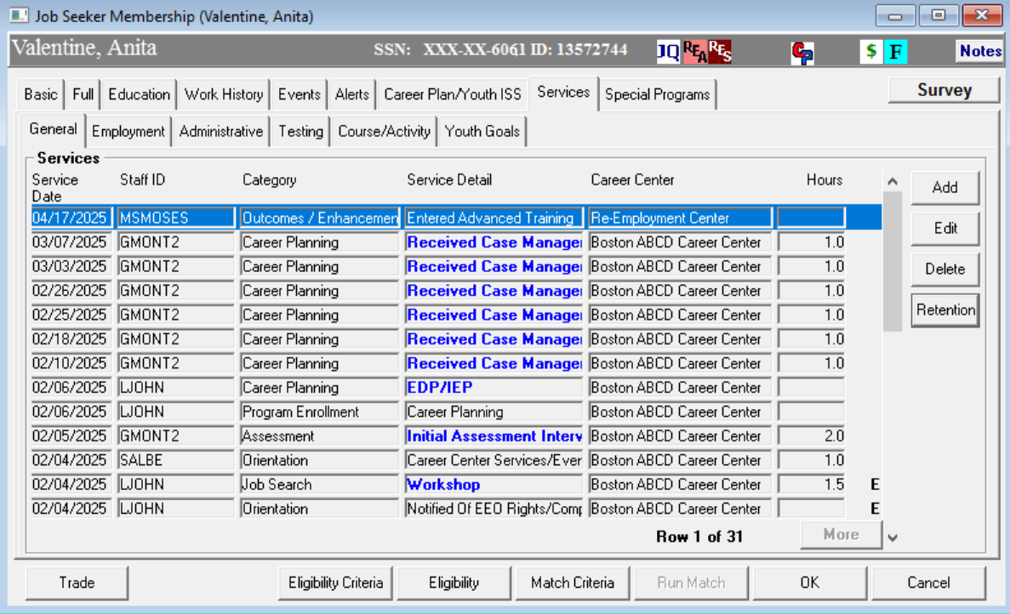
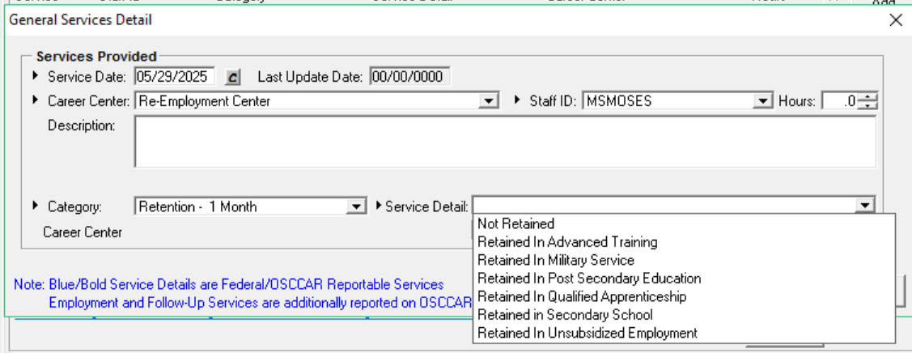
WIOA Performance Indicators
Credential Attainment – Step 2 (for those only achieving High School equivalency)
Retention Services – any month (1 – 12):
Notes:
Any participant attaining their High School equivalency must receive retention services for one year after exit for youth and adults. This is done by selecting the original service and the Retention button will become active. When you click on the retention button the General Services Detail window will appear. The Service Details highlighted in yellow are for federal performance reporting to obtain a positive outcome. Moses lists retention by months so to enter 2nd quarter after exit retention service you would select the 6 months option and for 4th quarter after exit you would select 12 months..

Slide 20
Credential Attainment
Scenario
Julia is a WIOA ISY attending high school. She graduates from high school, earns her diploma, and exits the WIOA Youth program shortly thereafter. In her 2nd quarter after exit, she is attending community college. By her 4th quarter after exit, she is no longer in community college, nor is she employed.
Is Julia included in the credential attainment rate?
Is Julia a positive outcome in the Credential Attainment rate?
Notes:
Yes, Julia is included in the credential attainment rate. Everyone enrolled in a WIOA program and is attending school or training is included.
Yes, she got her diploma and enrolled in postsecondary education. She was in college within the one-year period after she exited. Again, this example could be for youth or adults.

Slide 21
WIOA Performance Indicators
  Measurable Skill Gain (MSG) Indicator:
  The measurable skill gains indicator measures the percentage of program participants who, during a program year, are in an education or training and who are achieving progress, defined as documented gains in academic, technical, or occupational skills leading towards a credential or employment.
  MSG is not an exiter based performance indicator.
Notes:
We have workshops to focus on how to enter and manage MSGs in Moses. There are couple of screenshots coming up to for you to see.

Slide 22
WIOA Performance Indicators
Measurable Skill Gain
MSG Rules:
At least one measurable skill gain must be accomplished for each program year that a participant is enrolled in an education or training component.
A skill gain may count if attained after exit if still within the program year.
Notes:
WIOA program years run from July 1st - June 30th. Each program participant must have one or more MSG per program year participating. Carry-ins must have a new MSG for the new program after completing one for the previous year.

Slide 23
WIOA Performance Indicators
Who is in the Measurable Skill Gains measure?
  All WIOA participants in school are included!
  Adults/Dislocated Workers who are in any occupational skills training, including OJT, or in any secondary school programs (ABE/GED) including Trade and NDWG.
  Out of School Youth who are in any occupational skills training, not including OJT, or in any secondary education programs (ABE/GED), or YouthBuild or Job Corps.
Notes:
OJTs for youth are considered a Work Experience and cannot be used as an MSG.

Slide 24
WIOA Performance Indicators
Measurable Skill Gains
There are five (5) types of gains;
Educational Functioning Level Gain:
  Compare pre-test and post-test to see gain in educational functioning level based on standard National Reporting System (NRS) tests like TABE, CASAS, MAPT.
Diploma or Recognized Equivalent:
  HS diploma or state recognized equivalent (GED/HiSET)
Transcript or Report Card:
  The report card should demonstrate satisfactory achievement in all classes by the participant in secondary education for one semester.
  A Post Secondary transcript showing achievement with sufficient credit hours; 12+ hours per semester for full time, or 12+ hours over two semesters during a 12-month period for part time students.
  An Associate or Bachelor’s degree.

Slide 25
WIOA Performance Indicators
Measurable Skill Gains
Training Milestones:
  The gain is documented by a satisfactory or better progress report from an employer or trainer. Some examples are:
    Completion of OJT or apprenticeship program or steps to complete either
    Milestones for mastery of job skills
    Increased pay from improved skills or performance
Skills Progression (based on exams):
  Some examples are:
    Passing a ServSafe exam on way to a culinary certification
    Passing a CPR exam on way to a CNA certification
    Any industry recognized credential that is achieved through exam

Slide 26
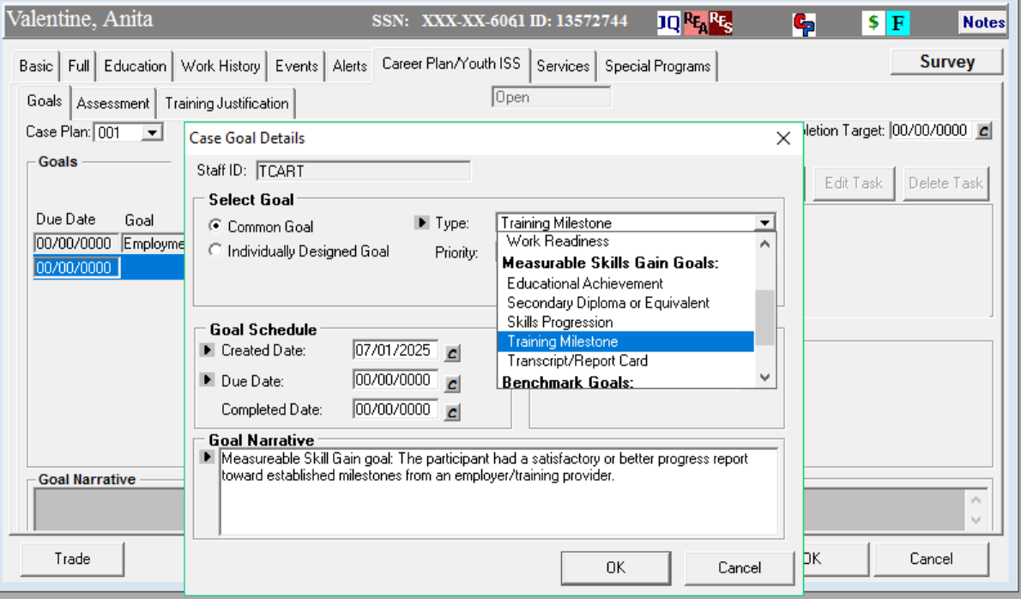
WIOA Performance Indicators
Tracking Measurable Skill Gains
On the Career Planning tab:
Notes:
To add a MSG you would go to the Career Plan/Youth ISS and to the Goals Tab to Add A Goal. From there you would select the appropriate Measurable Skills Gain Goal based upon your participant. Each MSG will give a definition in the Goal Narrative area at the bottom.

Slide 27
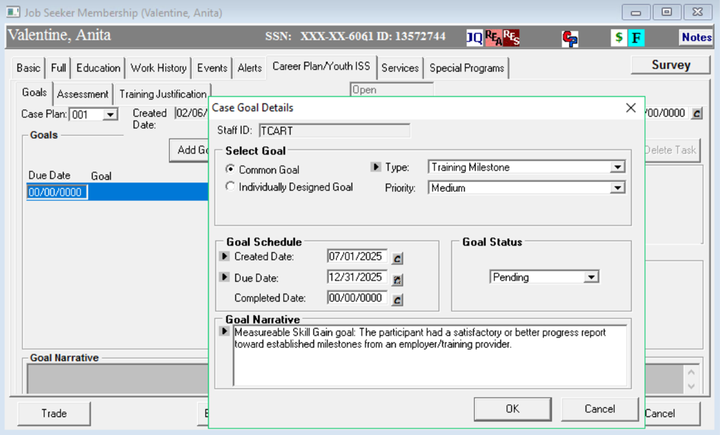
WIOA Performance Indicators
Tracking Measurable Skill Gains
On the Career Planning tab:
Notes:
After you have added the MSG the Goal Status will default to Pending.

Slide 28
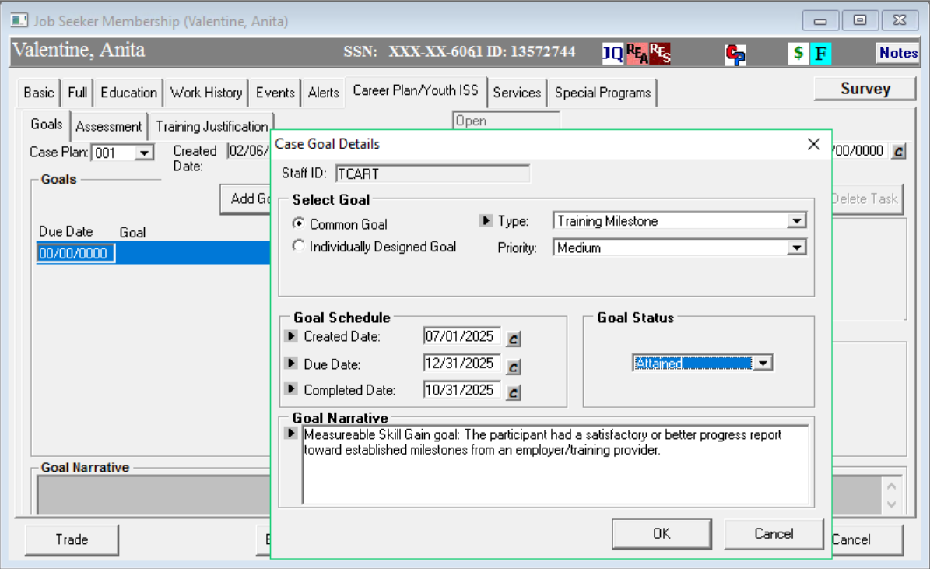

WIOA Performance Indicators
Tracking Measurable Skill Gains
On the Career Planning tab:
Notes:
Once marked as Attained or otherwise, the completed date will be the program year the PIRL Report will report the data attainment. You will also get a pop up reminder to enter Notes on why they Goal Status was changed in Notes.

Slide 29
Measurable Skill Gain
Scenario
Danny is a WIOA Adult participant who entered an OJT with a local software developer on January 15, 2024. He completed the training on May 7, 2024 at which time he became a full-time employee.
Is Danny included in the Measurable Skill Gains indicator for PY2024 (July 1, 2023 – June 30, 2024)?
Is Danny a positive outcome in the Measurable Skill Gain measure?
Notes:
Was Danny in training during the program year or July 2023 – June 2024? Yes, then he is included in the MSG for PY2024
Yes, Danny completed his OJT training in May 2024 before the program year end.

Slide 30
WIOA Performance Indicators
Measurable Skill Gains
DON’T FORGET:
  When entering a Secondary Diploma/Equivalency MSG, you must add the High School diploma/equivalency attainment service on the General tab of MOSES!!!!
  When entering an Educational Achievement MSG, you must add the pre and post test scores to the Testing tab of MOSES!!!
  Set an MSG for each customer in training/education!!!

Slide 31
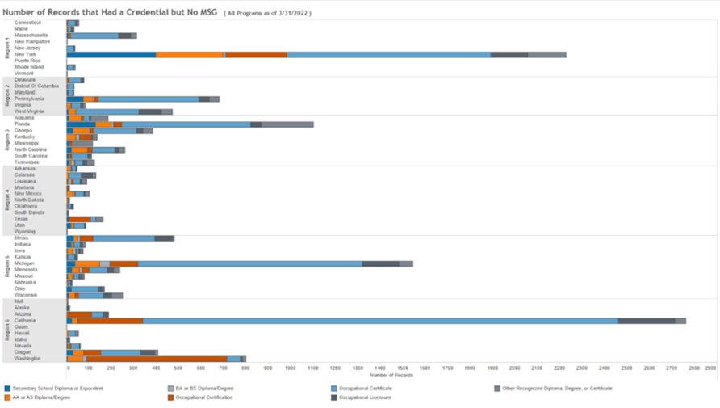
Credential Attained but No MSG
Notes:
Here a graphic of nationwide WIOA participants who had a credential but no MSG. For our region, region 1, highlighted in yellow we are not doing that well. Across the country we are in the middle but there is definitely room for improvement. There is also a Crystal Report on Mass.gov called WIOA Measurable Skills Gains Report to help you track this.

Slide 32
Staff Assisted (Blue/Bold) Services, etc.

Slide 33
Definition of WIOA Exit
20 CFR § 677.150(c)
An exit occurs when a participant has not received a [staff-assisted (blue/bold)] service for 90 consecutive days and no future services are planned. The exit date becomes the last date the participant receives services.
Notes:
The date of the last blue/bold service becomes the exit date.

Slide 34
Staff Assisted Services (Blue/Bold)
Staff assisted services trigger and/or extend participation in the program (i.e. any blue/bold service resets the 90-day clock to zero (0))
Staff assisted services provide some benefit to a customer and take substantial staff time.
Services like assessment or career planning or counseling are examples of staff assisted services.
Services like emailing a customer or leaving a phone message are examples of services that are not staff-assisted services.
All services entered should be accompanied by clear notes!!!

Slide 35
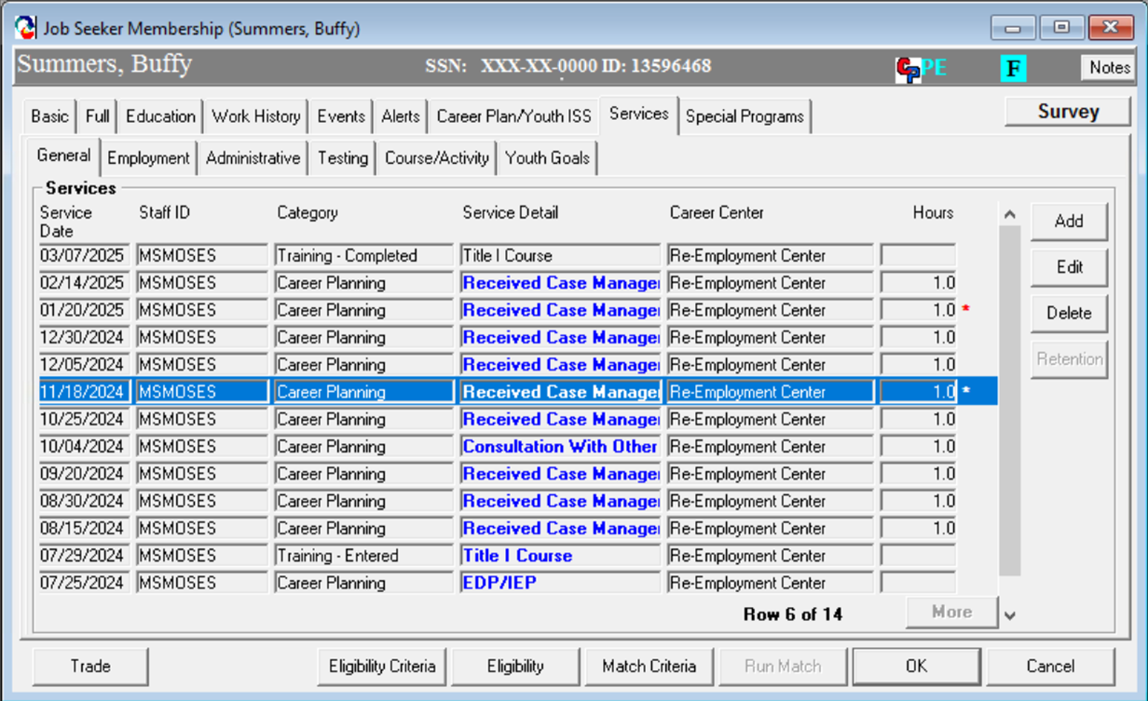

Correct Use of Blue/Bold Services to Avoid Inadvertent Auto Exit
Make sure to add notes in that describe the case management service provided.
Notes:
Participants must be enrolled in training, education or any of the 14 youth elements and receiving blue/bold services within every 90 days to avoid auto exit. The services can be any blue/bold service, it does not have to be Career Planning.

Slide 36
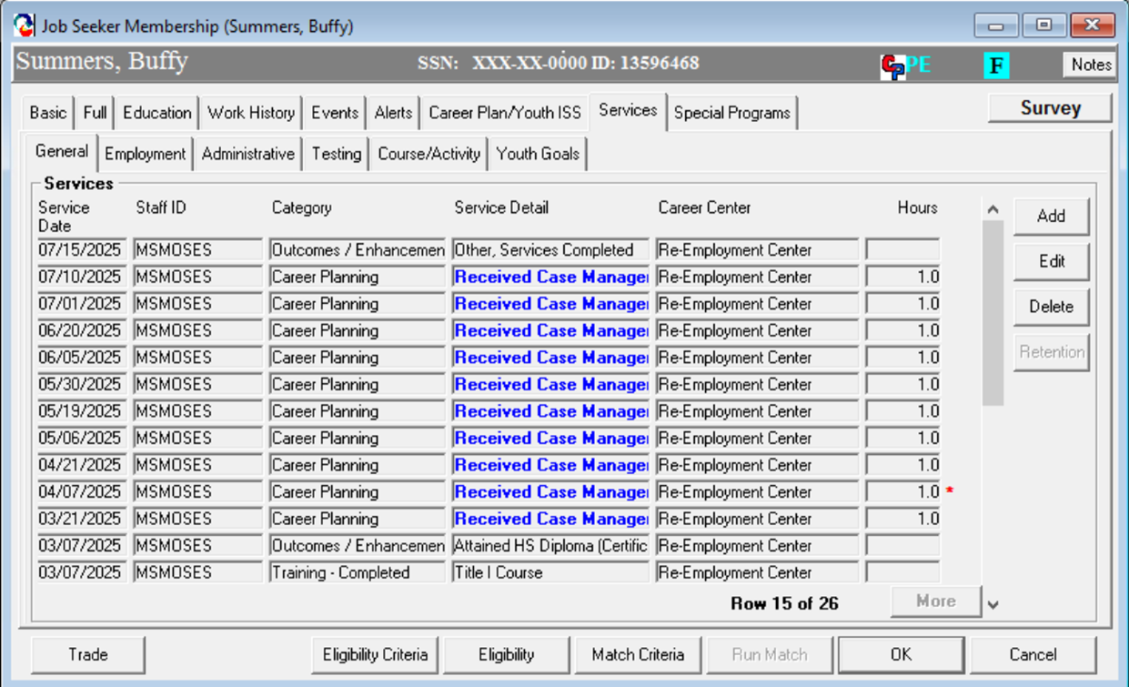

Incorrect Use of Blue/Bold Services to Avoid a Correct Auto Exit
Notes:
In this case the participant is not enrolled in training, education or any of the 14 youth elements but is still receiving blue/bold services to delay the auto exit. This stands out to the Federal auditors and will be scrutinized closely.

Slide 37
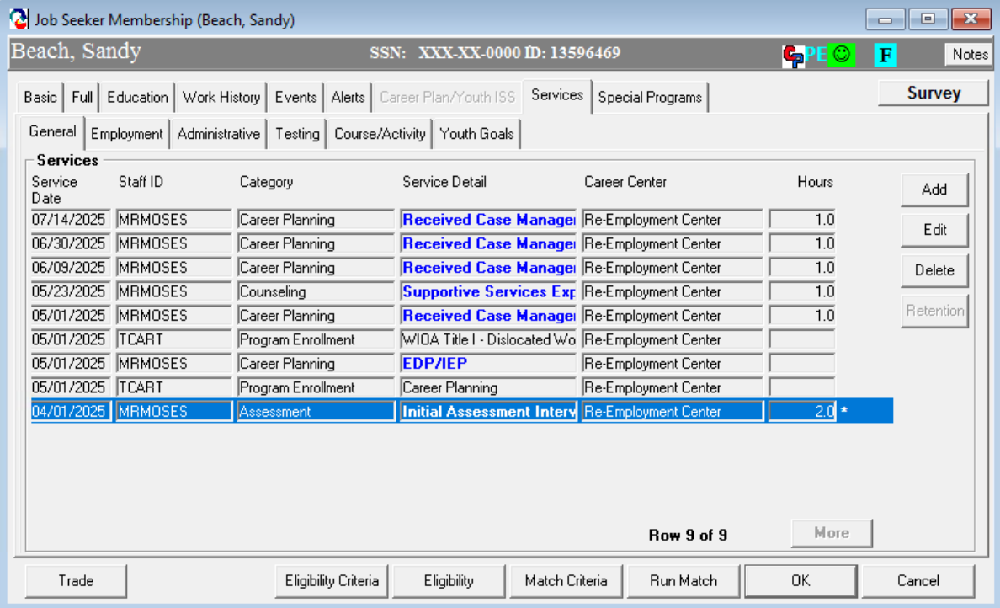
Correct Program Entry Alignment
The first blue/bold service is the same date as the enrollment into the program
Notes:
This is a correct program alignment, notice there is a blue/bold service on the same date the participant was enrolled in a program. The participant must receive a blue/bold service the same day they are enrolled in a program.

Slide 38
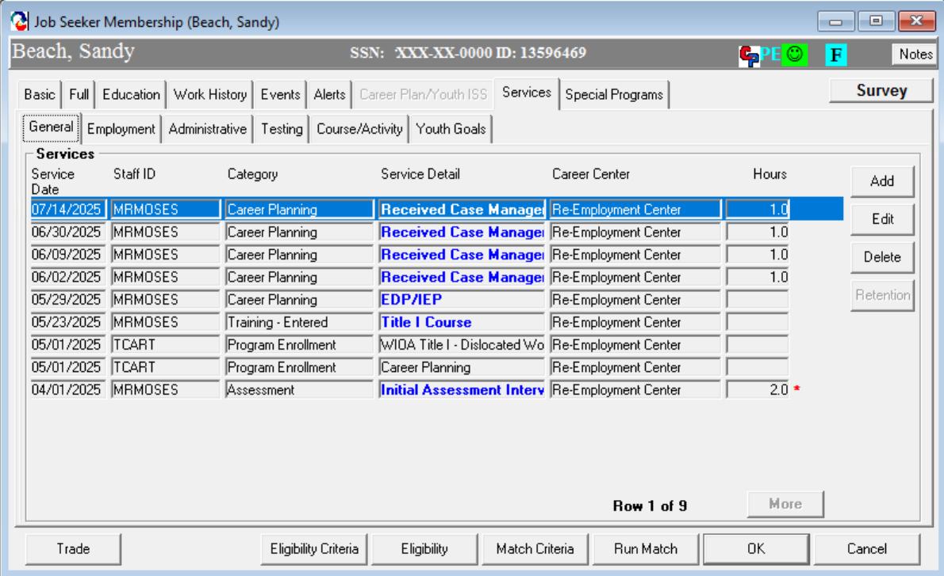


Incorrect Program Entry Alignment
The first blue/bold service must be on the same date as the enrollment into the program
Notes:
This is always one of the federal auditor's favorites. The participant was enrolled in WIOA Title I in November but did not receive a blue/bold service until December. This would be a finding by the feds. The participant must receive a blue/bold service as part of the program enrollment.

Slide 39
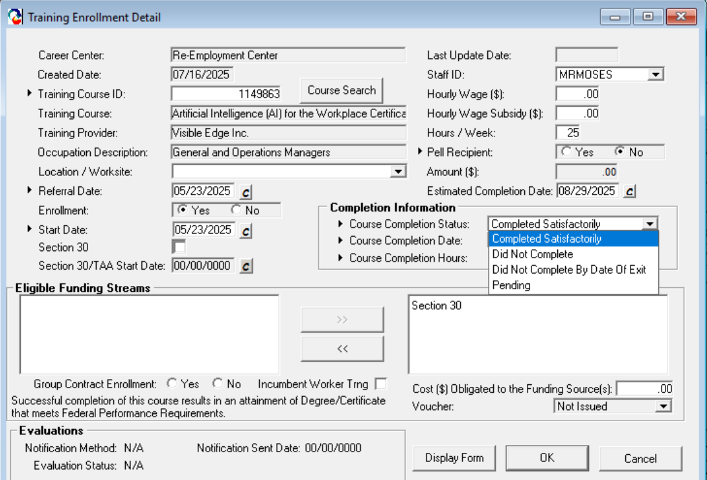
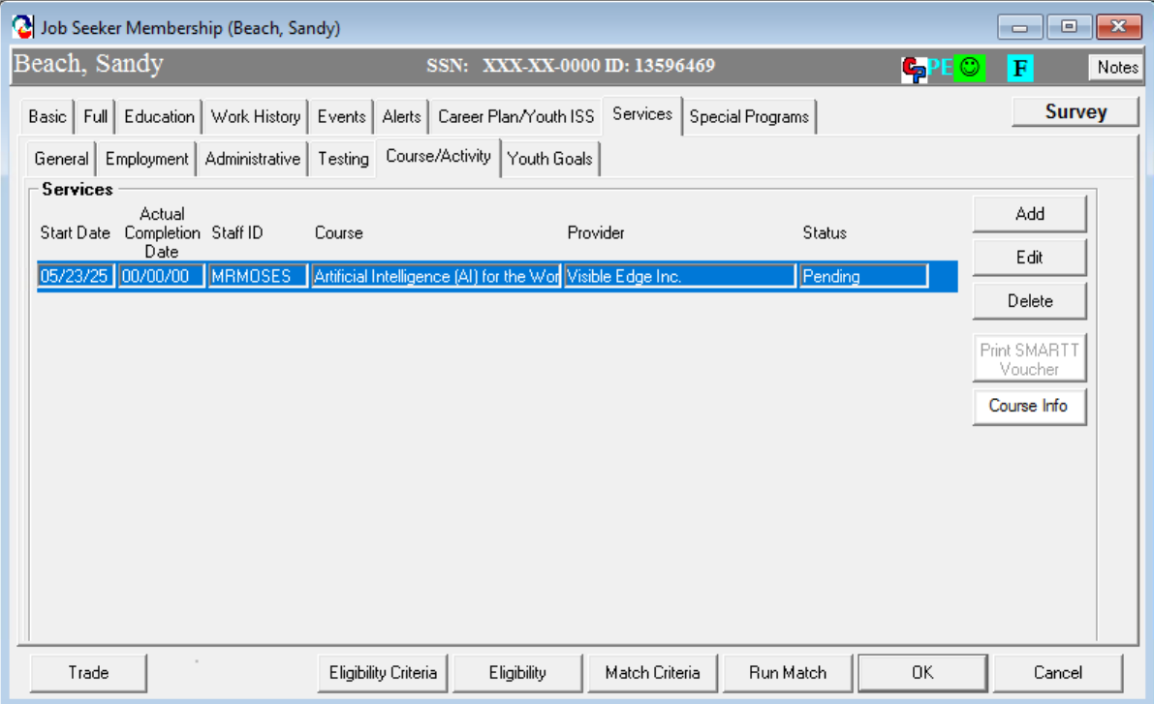
Training Completions
  Make sure to mark the training
  Completed Satisfactorily when done
Notes:
Once a participant completes training, education or a youth element it must also be updated in the Course/Activities tab under General Services as well as adding it as an outcome in the general services tab.
There is a crystal report on mass.gov called Pending Trainings Where Estimated Completion Date Has Elapsed in the Outlier Reports category to help you manage this.

Slide 40
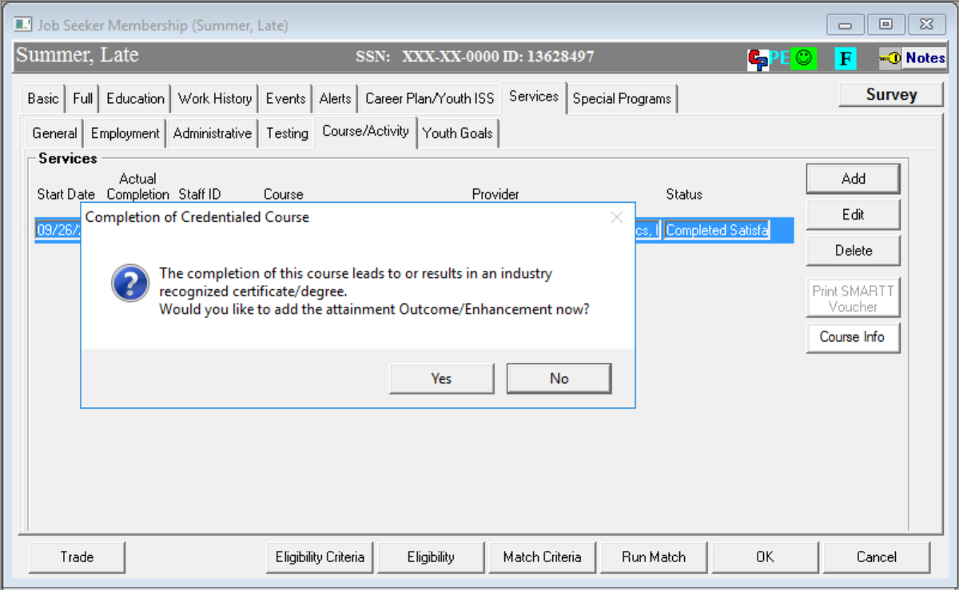
Training Completions
Notes:
You will receive a reminder to add the Attainment as an Outcome or Enhancement.

Slide 41
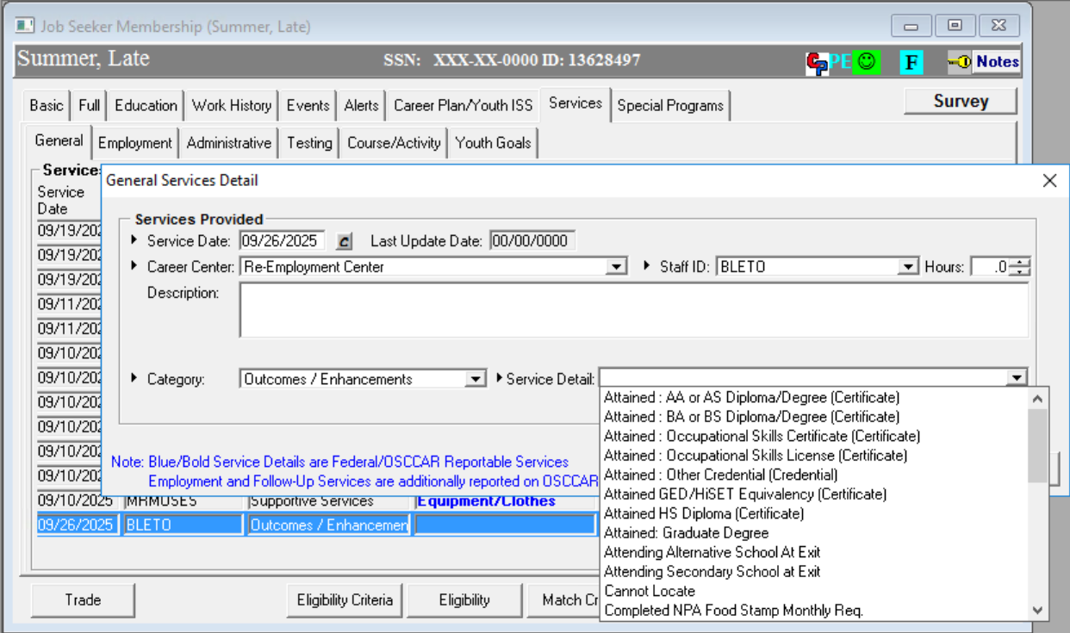
Training Completions
Notes:
In the General tab you will add an Outcome or Enhancements service.

Slide 42
Exclusions from Performance
Must be documented (scrutinized rigorously by feds)
  Institutionalized: The participant exits the program because the participant has become incarcerated in a correctional institution or has become a resident of an institution or facility providing 24-hour support such as a hospital or treatment center during the course of receiving services as a participant and is unable to receive services.
  Medical Care: The participant exits the program because of medical treatment and that treatment is expected to last longer than 90 days and precludes entry into unsubsidized employment or continued participation in the program.
  Deceased: The participant is deceased.
  Reservist Called to Active Duty: The participant exits the program because the participant is a member of the National Guard or other reserve military unit of the armed forces and is called to active duty for at least 90 days.
  Youth Mandated to Relocation Program/Foster Care: The participant is in the foster care system as defined in 45 CFR 1355.20(a) and exits the program because the participant has moved from the local workforce area as part of such a program or system.
Notes:
There are very few exclusions from performance allowed in WIOA policy. They are heavily scrutinized and need to have as much documentation and notes as you can collect. Once a participant is excluded it excludes all attainment if any were completed before being excluded.

Slide 43
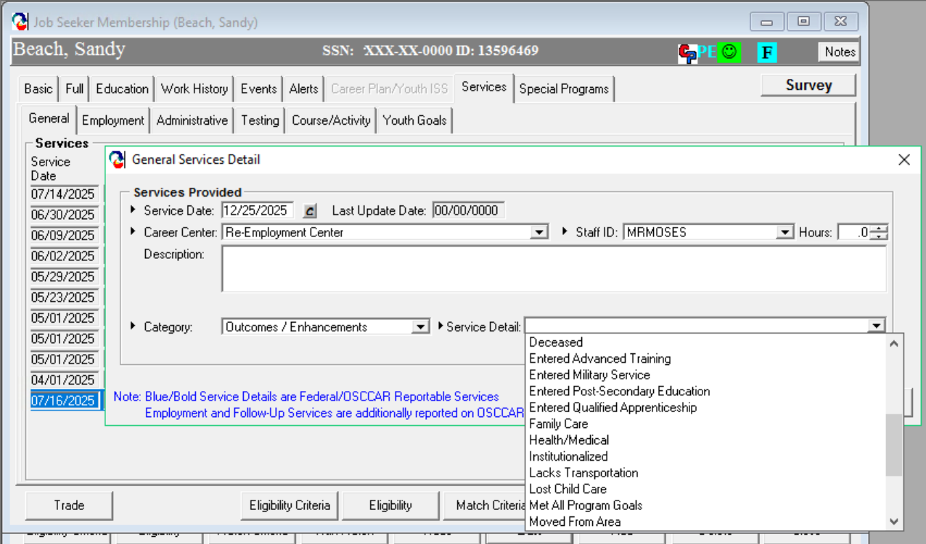
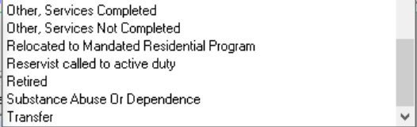
Exclusions from Performance
Notes:
This is where Exclusions are documented in Moses. They are documented as an Outcome/Enhancement and the select the appropriate reason. Again, I cant stress enough about adding detailed notes for these items.

Slide 44
Key MOSES Data Entry Points
Performance Measure | Tracking Point
In Employment or Education or Training in the 2nd Quarter After Exit | Employment Tab/General Services Tab Emp Follow-up Month 6 (Q2), (26-16 - supplemental) Retention Month 6 (Q2), (or all months as they occur for youth)
In Employment or Education or Training in the 4th Quarter After Exit | Employment Tab/General Services Tab Emp Follow-up Month 12 (Q4), (26-16 - supplemental) Retention Month 12 (Q4), (or all months as they occur for youth)
Credential Attainment | General Services tab Attainment services Plus for secondary credential, employment follow up and/or retention (any quarters for youth or adult)
Measureable Skill Gain | Case Management tab goals (plus any attainments, test scores, etc.)
Median Wages 2nd Quarter After Exit | SWIS and DUA systems or Supplemental MOSES Data

Slide 45

Two Worlds
USDOL data driven, performance reporting world
The real world; customers in pursuit of a more substantial career/life receiving good services from career center staff
Good service delivery in the real world will generally accomplish the performance outcomes desired in the data driven world.
-Leslie Abramowitz

Slide 46
Resources
  Workforce Innovation and Opportunity Act: Department of Labor Only – Final Rule
  Department of Labor TEGL 10-16 Change 3 Performance Accountability
Department of Labor TEGL 26-16 Supplemental Wage Information
Department of Labor TEN 25-19 Post Secondary Credentials
MDCS Participation and Exit Policy
USDOL Credential Tool
MassWorkforce Career Center Performance Reports (CCPR) | Mass.gov
MassHire WIOA Training Material | Mass.gov
Negotiations and Sanctions Guidance WIOA TEGL11-19 Change 1
Notes:
These are some fanatic resources especially the WIOA Final rule at 399 pages. My favorite is TEGL 10-16 Change 2 at 80 pages.

