Slide 1









LANGUAGE ACCESS
Massachusetts Department of Agricultural Resources

Slide 2

















What is Environmental Justice to MDAR?
EJ is the equal protection and meaningful involvement of all people with respect to the development, implementation, and enforcement of environmental laws, regulations, and policies and the equitable distribution of environmental benefits.​
meaningful involvement includes Language Access

Slide 3

Who Can I Contact for Language Services?
MDAR has a designated Language Access Coordinator (LAC)...
Internal EJ Coordinator: Olivia.Palmer@Mass.gov
...You can also contact MDAR’s EJ Team:
Director of Food + Climate Equity: Rebecca.Davidson@Mass.gov
EJ Outreach Coordinator: Dimple.J.Rana@Mass.gov

Slide 4







Language Services Overview:
  Translation/Interpretation Protocol
  Staff Training
  Pre-translated Material
  MDAR Farmers’ Market Spanish Language Course
  Accessibility Services

Slide 5

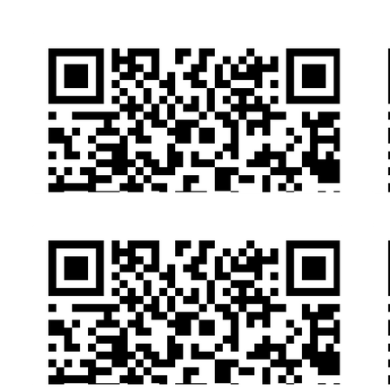





How Do I Request A Language Service?
Option 1: Fill out our Online Form

Slide 6




Option 2: Contact Any MDAR Staff Member
  Email
  Phone
  In-Person
  Etc.!
Make sure to include...
  The Language Needed
  The Document You Need Translated OR the Event You Need Interpretation Services to Attend.
  Your Contact Info

Slide 7



Option 3: For webinars or events with online registration...
Note your language request on your registration form!

Slide 8

Reminder: All Mass.Gov Pages Can Be Auto-Translated

Slide 9

What Do We Do Once We Receive A Request?
  MDAR’s LAC will determine if we can seek services from one of our vendors on state-wide contract.

Slide 10


2. MDAR’s LAC will work to secure the language service in a timely manner.
Please note...
  Translation services may take 5-7 business days to be returned to the constituent.
  An over-the-phone interpreter can be arranged in 1-2 business days.
  In-person interpreters may take up to 14 days to secure.
...please make language service requests as soon as you are able!

Slide 11

Are All Language Services Per Request?
No!
We are committed to providing non-English speaking constituents with access to documents vital to understanding MDAR’s programs and services alongside English-speaking constituents.
These Vital Documents are available both on MDAR’s website and in print in the top 10 languages spoken in MA.

Slide 12



These vital documents include....
Our Programs and Services Booklet + Flyer

Slide 13

“I Speak” - Information on Language Services

Slide 14




Mass Animal Fund Resources - Supports animals in MA including spay/neuter vouchers.

Slide 15


Mosquito Resources - Stay informed on measures to take to protect yourself against mosquitos

Slide 16


... and many more!
You can view a full list of translated MDAR material at this webpage:

Slide 17
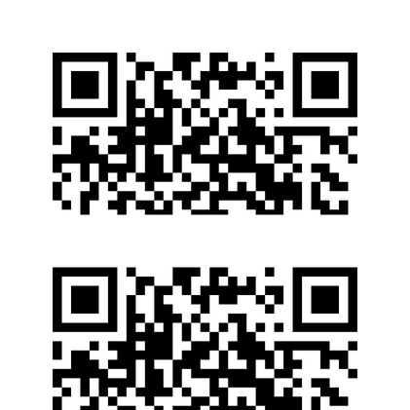
How Is MDAR Held Accountable?
Executive Order #615 to increase language access across state agencies required us to submit a Language Access Plan to the Office of Access and Opportunity
In response, MDAR created a Language Access Plan:
mass.gov/doc/mdar-language-access-plan

Slide 18
This Language Access Plan includes:
Alongside the information shared on translation/interpretation process....
  Staff Training Protocol
  Frequent Monitoring and Updates Every 2 Years
  Our Commitment to Hiring Multilingual Staff

Slide 19
How Are Staff Trained?
So far we have conducted....
  Individualized Language Access Trainings for specific MDAR Divisions
(Ex: MDAR’s Division of Animal Health)
  Held 2 Department-wide trainings on EJ and Language Access protocol
  Dispersed recorded trainings to staff unable to attend face-to-face

Slide 20

Select MDAR Staff also completed an MDAR-funded Spanish Language Course alongside Farmers’ Market Managers!
Look for these pins next time you attend select Farmers’ Markets to find a market staff member who completed this beginner course.

Slide 21
How Do I Request Accessibility Services?
MDAR’s Language Access Coordinator:
Olivia Palmer
Olivia.Palmer@Mass.gov
857-278-4908
EEA’s Accessibility Coordinator:
Gabriella Knight
Gabriella.Knight@Mass.gov
(857)-268-0629

Slide 22










Questions?
Olivia.Palmer@Mass.gov
857-278-4908

