Slide 1

520 CMR 6.00: Hoisting Machinery
Department of Public Safety
Trench Safety Training - June 2016
Notes:
Title Slide

Slide 2
Introductions
Cesar I. Lastra
Technical Code Coordinator – Engineering
cesar.lastra@state.ma.us
Department of Public Safety

Slide 3
Executive Office of Public Safety and Security
Emergency Management Agency
Department of Public Safety
Buildings Division
Engineering Division
Elevators Division
Department of Fire Services
State Police
Regulated Activities
Department of Correction
Who are we?
Department of Public Safety

Slide 4
Who are we?
The District Engineering Inspectors are located in 16 districts throughout the 351 cities and towns in the Commonwealth. Each district is designed by geographic location and the number of registered pressure vessels contained within the district.
The Department’s Main Office is in Boston and there are (3) three additional satellite offices located in Milford, Tewksbury, and Springfield.
Department of Public Safety

Slide 5
What do we do?
The Engineering Division is responsible for license applications review and examinations of over 47,000 licensed individuals throughout the Commonwealth
Department of Public Safety

Slide 6
What else do we do?
Compliance of the following professions:
Stationary Engineering – Power Plant & Boiler Operators
Pipefitting
Sprinklerfitting
Oil Burners
Refrigeration
Nuclear Power Engineering
Hydraulic or Hoisting Engineering
Horse and Carriage operations
Amusements Inspection and Maintenance Mechanics
Department of Public Safety

Slide 7
What else do we do?
The Engineering Division performs periodic compliance inspections to determine that individuals are licensed and operating safely.
We perform compliance investigations related to complaints received by the Department.
We perform Accident and Incident investigations.
We exam all licensed individuals at (5) five locations once a month in Charlestown, Amherst, Devens, Milford and Taunton every month excluding December.
Department of Public Safety

Slide 8
What is Hoisting?
≥500 lbs. or ≥10 feet or ≥¼ cubic yard
1A- Lattice Cranes
1B- Telescoping Boom w/ Wire Rope
1C- Telescoping Boom w/o Wire Rope
1D- Powered Industrial Fork Truck
Department of Public Safety

Slide 9
What is Hoisting?
≥500 lbs. or ≥10 feet or ≥¼ cubic yard
2A- Excavator (Tracks or Rubber Tires)
2B- Backhoe
2C- Front End Loader
2D- Compact Hoisting Machinery (<10,000 lbs.)
Department of Public Safety

Slide 10
What is Hoisting?
≥500 lbs. or ≥10 feet or ≥¼ cubic yard
3A- Tower / Electric and Air
Department of Public Safety

Slide 11
What is Hoisting?
≥500 lbs. or ≥10 feet or ≥¼ cubic yard
Specialty Series:
4A- Unlimited
4B- Drill Rigs
4C-Pipeline Side Booms
4D- Concrete Pumps
4E- Catch Basin Cleaner
4F- Sign Handling Equipment
4G- Specialty Lawn Mower
Department of Public Safety

Slide 12
Who needs a Hoisting License?
EVERYONE!
Exception: Agricultural Purposes Only
Department of Public Safety

Slide 13
Who needs a Hoisting License?
Exemptions*:
Utility Companies
(520 CMR 6.01(2) Utility. Any organization or company which provides electricity, natural gas, phone or cable services to the public.)
Companies Operating Solely on Company Property
Companies Operating Solely on Utility Property
*Must have In-Service Training Program that is approved
by the Department of Public Safety
Department of Public Safety

Slide 14
Hoisting License Renewal
Continuing Education is Required
4 Hours for each class of license being renewed excluding the 1D and specialty series 4B, 4C, 4D, 4E, 4F and 4G.
2 Hours for the 1D and each class of specialty series license being renewed.
So, a 1A, 2A, 3A, 4A, Unlimited License renewal would be 16 hours.
(4 + 4 + 4 + 4 = 16)
So, a 1C, 2A, 4G, License renewal would be 10 hours.
(4 + 4 + 2 = 10)
Department of Public Safety

Slide 15
520 CMR 14.00: Excavation and Trench Safety (Jackie’s Law)
Pursuant to 520 CMR 14.03(7)…
Excavators who utilize Hoisting Machinery subject to MGL c.146 shall only employ individuals licensed to operate said equipment pursuant to MGL c.146.
The trench permit shall be presented to the licensed Hoisting Machinery operator(s) before the start of the excavation.
* An operator’s Hoisting Machinery license shall be suspended or revoked for incompetence or untrustworthiness, pursuant to MGL c.146.
Department of Public Safety

Slide 16
Suspension or Revocation of a Hoisting License
Any license covered under 520 CMR 6.00 may be
revoked or suspended for the following reasons:
False or misleading information on application for examination or license renewal.
Operating Hoisting Machinery under the influence of alcohol or drugs.
Failure to pay excise tax or other taxes.
Failure to report Accidents as required by the DPS.
Failure to report a Serious Injury as required by DPS.
Operating in an unsafe manner.
Failure to comply with any provision of this regulation [520 CMR 6.00].
Failure to comply with 520 CMR 14.00.
Failure to comply with M.G.L. c. 146, §§53-56.
The fraudulent or otherwise improper issuance of Temporary Permits.
The fraudulent or otherwise improper issuance of any Company License.
Department of Public Safety

Slide 17
Hoisting Violations
The Engineering Division issues warnings and monetary fines for violations of the Hoisting Regulation 520 CMR 6.00.
Those found guilty will receive a *warning or fine.
First offense – fine of up to $1000.00
Second offense - $1000.00 up to $3000.00
Third offense - $3000.00 up to $5000.00
* Warnings and fines remain on file for (3) three years
Department of Public Safety

Slide 18
Compliance Inspections
Operators must carry the appropriate Hoisting License at all times while operating equipment.
Operators must have and carry a valid driver’s license.
Operators must have a current DOT Physical on file with the department.
Department of Public Safety

Slide 19
What to do during a compliance inspection?
The District Inspector will get your attention.
Safely stop Hoisting Operations.
Secure and exit the equipment.
Speak with the District Inspector and present your Hoisting and Drivers License for identification and inspection.
If you would like, request a business card for future questions.
Department of Public Safety

Slide 20
Common Misconceptions
“I do not need a Hoisting License to operate on my own property.”
FALSE: Either a Hoisting License or a Temporary Permit issued from a DPS approved Short-Term Rental Entity is required when operating in public or private property. Operators of Hoisting Machinery solely used for agricultural purpose are exempt from the licensing requirement of MGL c.146 § 53.
Department of Public Safety

Slide 21
Common Misconceptions
“At no point do I…
lift a load that weighs more than 500 lbs.
lift a load higher than 10 feet.
fill the ¼ cu. yd. bucket.
I do not need a Hoisting License.”
FALSE: If the Hoisting Machinery that you are operating is designed to meet or exceed any of the thresholds, the operator must be duly licensed.
Department of Public Safety

Slide 22
Common Misconceptions
“I am operating under the supervision of someone who holds the Hoisting License. I do not need a Hoisting License to operate.”
FALSE: Unless you are licensed under a DPS Approved In-service Training Program or are licensed as a Hoisting Apprentice, you may not operate under someone else's Hoisting License. Such actions may result in Civil Fines to both parties and the potential suspension/revocation of the Hoisting License.
Department of Public Safety

Slide 23
Common Misconceptions
“I am licensed in another state to operate Hoisting Machinery. I do not need the Massachusetts Hoisting License to operate Hoisting Machinery in Massachusetts.”
FALSE: Operators of Hoisting Machinery in Massachusetts must be licensed in accordance with MGL c. 146 § 53. There is no reciprocity.
* Exception: Declaration of State of Emergency by the Governor
Department of Public Safety

Slide 24
Notification/Investigation
Any Incident resulting in Serious Injury, Property Damage, or any condition that is necessary for the preservation of the public health or safety where Hoisting Machinery is operated must be reported by the licensed operator, or owner, or owner’s representative to the Department through the Department Incident Hotline at (508) 820-1444 within ONE (1) HOUR from the time that the Incident occurred or was discovered.
Hoisting Machinery shall not be moved or dismantled from the site of the Incident until the Department has investigated the Incident and approval is granted by an Inspector.
Exception: For preservation of life and property, the removal of injured persons or bodies or to permit the flow of emergency vehicles.
The Hoisting Machinery and area surrounding the Hoisting Machinery shall not be disturbed, cleaned, or altered in any way that will impede the investigation.
Department of Public Safety

Slide 25
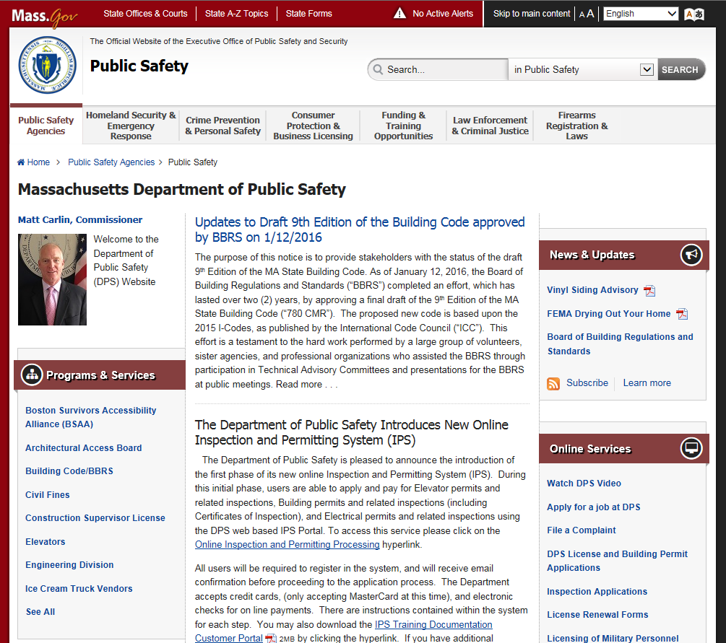
www.mass.gov/dps
Department of Public Safety

Slide 26
Any Questions?
Department of Public Safety

