Slide 1
988 Commission
2023-24 Annual Report
March 1, 2024

Slide 2
Table of Contents
  Background
  Overview of the Development and Implementation of 988 and the Behavioral Health Help Line
  Evaluation
  Current Funding Sources
  Overview of the National Landscape and Funding Mechanisms
  Plans for 2024
  Commission Recommendations
  Appendix: MAMH recommendations

Slide 3
Table of Contents
Background
Overview of the Development and Implementation of
988 and the Behavioral Health Help Line
Evaluation
Current Funding Sources
Overview of the National Landscape and Funding Mechanisms
Plans for 2024
Commission Recommendations
Appendix: MAMH recommendations

Slide 4
Background: Definitions of Components of the MA Crisis System
988 Suicide & Crisis Lifeline: Formerly known as the National Suicide Prevention Line (NSPL), this is a national network of call centers overseen by the Substance Abuse and Mental Health Services Administration (SAMHSA) and administered by Vibrant Emotional Health.
Behavioral Health Access and Crisis Intervention Trust Fund (BH Trust): Funds from an all-payer surcharge on commercial insurers that supports the statewide, payor-agnostic community behavioral health crisis system.
Behavioral Health Help Line (BHHL): A 10-digit phone line that connects individuals and families to the full range of clinical treatment services for mental health and substance use offered in Massachusetts. Anyone in Massachusetts can call, text, or chat at any time to receive individualized support, clinical assessment, and personalized treatment referrals.
Community Behavioral Health Center (CBHC): An entity that serves as a hub of coordinated and integrated behavioral health disorder treatment for individuals of all ages, including routine and urgent behavioral health outpatient services, mobile crisis services for adults and youth, and community crisis stabilization services for adults and youth.
Community Crisis Stabilization (CCS): A community-based program that serves as a medically necessary, less-restrictive alternative to inpatient psychiatric hospitalization when clinically appropriate and provides short-term staff-secure, safe, and structured crisis stabilization and treatment services for individuals with mental health and substance use disorders; services for adults and youth.
Equity and accessibility: Health equity is the state in which everyone has a fair and just opportunity to attain their highest level of health. Achieving this requires ongoing societal efforts to address historical and contemporary injustices; overcome economic, social, and other obstacles to health and health care; and eliminate preventable health disparities.¹ Access to health care means having the timely use of personal health services to achieve the best health outcomes.²
Mobile Crisis Intervention (MCI): A community-based behavioral health service available 24/7/365 that provides short-term mobile, on-site, face-to-face crisis assessment, intervention, and stabilization for people experiencing a behavioral health crisis. Services may be provided in community-based settings outside the CBHC, at the CBHC, or in emergency department sites of services to support stabilization for transition into the community, when necessary; services for adults and youth.
¹ Centers for Disease Control and Prevention: What is Health Equity? | Health Equity | CDC
² Agency for Healthcare Research and Quality: Access to Care | Agency for Healthcare Research and Quality (ahrq.gov)

Slide 5
Background: 988 Commission Statute Language
Legal Authority: Chapter 177 of the Acts of 2022
Summary
(1) There shall be a state 988 commission within the executive office of health and human services to provide ongoing strategic oversight and guidance in all matters regarding 988 service in the commonwealth.
(2) The commission shall review national guidelines and best practices and make recommendations for implementation of a statewide 988 suicide prevention and behavioral health crisis system, including any legislative or regulatory changes that may be necessary for 988 implementation and recommendations for funding that may include the establishment of user fees. The commission shall also advise on promoting the 988 number including, but not limited to, recommendations for including information about calling 988 on student identification cards and on signage in locations where there have been known suicide attempts.
(3) The commission shall consist of:
The secretary of health and human services or the secretary’s designee, who shall serve as chair;
The secretary of public safety and security or the secretary’s designee;
The commissioner of mental health or the commissioner’s designee;
The commissioner of public health or the commissioner’s designee;
The executive director of the Massachusetts Behavioral Health Partnership or the executive director’s designee;
The executive director of the state 911 department or the executive director’s designee;
The executive director of Mass 2-1-1 or the executive director’s designee;
A representative designated by the Massachusetts Chapter of the National Association of Social Workers, Inc.;
A 911 dispatcher designated by the Massachusetts Chiefs of Police Association Incorporated;
An emergency medical technician or first responder nominated by the Massachusetts Ambulance Association, Incorporated;

Slide 6
Background: 988 Commission Statute Language
Legal Authority: Chapter 177 of the Acts of 2022
Summary (continued)
And the following members to be appointed by the chair:
  1 representative from an emergency service provider, nominated by the Association for Behavioral Healthcare, Inc.;
  1 representative from the Association for Behavioral Healthcare, Inc.;
  1 representative from a suicide prevention hotline in the commonwealth, nominated by the Samaritans, Inc.;
  1 representative from the Riverside Community Care, Inc. MassSupport program;
  1 representative from the Massachusetts Coalition for Suicide Prevention;
  1 representative from the Children’s Mental Health Campaign;
  1 representative from the INTERFACE Referral Service at William James College, Inc.;
  1 representative from the National Alliance on Mental Illness of Massachusetts, Inc.;
  1 representative from the Parent/Professional Advocacy League, Inc.;
  1 representative from the Massachusetts Association for Mental Health, Inc.;
  1 representative from the Boston branch of the National Association for the Advancement of Colored People;
  1 representative from the American Civil Liberties Union of Massachusetts, Inc.;
  1 representative from the mental health legal advisors committee; and
  3 persons who are or have been consumers of mental health or substance use disorder supports or services.
Every reasonable effort shall be made to ensure representation from all geographic areas of the Commonwealth.
(4) Annually, not later than March 1, the commission shall submit its findings and recommendations to the clerks of the senate and house of representatives, the joint committee on mental health, substance use and recovery and the joint committee on health care financing.

Slide 7
Background: 988 Commission Members
988 Commission Members (as of January 2024):
Emily Bailey, Chair, Office of Behavioral Health, MassHealth, Executive Office of Health and Human Services (EOHHS), designee of the EOHHS Secretary
Rebecca Ames, Riverside Trauma Center, Riverside Community Care
Chris Carleton, Northborough Police Department
Kelly Casey, Department of Forensic & Clinical Services at William James College
Courtney Chelo, Massachusetts Society for the Prevention of Cruelty to Children (MSPCC)
Kerry Collins, Executive Office of Public Safety and Security (EOPSS)
Kelley Cunningham, Division of Violence and Injury Prevention, Department of Public Health
Commissioner Brooke Doyle, Department of Mental Health
Eriq Gasse, Cataldo Ambulance Service
Rebecca Gewirtz, National Association of Social Workers – MA & RI Chapter
Gloria Gonzalez, Samaritans Merrimack Valley
Sharon Hanson, Massachusetts Behavioral Health Partnership (MBHP)
Debbie Helms, Samarians Merrimack Valley
Jennifer Honig, Massachusetts Association for Mental Health (MAMH)
Pamela Hooks Sager, Parent/Professional Advocacy League (PPAL)
Charmain Jackman, InnoPsych, Inc.
Karin Jeffers, Clinical & Support Options, Inc.
Kathy Marchi, Samaritans, Inc.
Paul Mina, United Way of Tri-County & United Way of Pioneer Valley, Mass 211
Ivy Moody, Mental Health Legal Advisors Committee (MHLAC)
Kristen Rhodes, City of Northampton Division of Community Care
Myisha Rodrigues, National Alliance on Mental Illness Massachusetts (NAMI-MA)
Monna Wallace, State 911 Department

Slide 8
Background: 988 Commission Meeting Topics
Introductions, Overview, and Housekeeping (February 27, 2023)
Overview of 988 and the Behavioral Health Help Line (BHHL) (March 30, 2023)
    988 presented by Kelley Cunningham, Director for the Division of Violence & Injury Prevention, DPH, & Danielle Bolduc, Acting Director, Suicide Prevention Program, DPH
    BHHL presented by Julie Hwayoung Shepherd, Assistant Commissioner for Mental Health Services, DMH, and Mio Tamanaha, Director of the Behavioral Health Help Line, DMH
Continued conversation about 988 and the BHHL (April 24, 2023)
Synthesis of previous meetings and initial brainstorming about categories for annual report recommendations (May 22, 2023)
911 Overview and Implementation of Section 6-8 & 81 of Chapter 177 of the Acts of 2022 (June 26, 2023)
    Presented by Kerry Collins, Undersecretary for Forensic Sciences, EOPSS and Monna Wallace, Program Director, State 911 Department
Community Behavioral Health Centers (CBHC) and Mobile Crisis Intervention (MCI) (July 31, 2023)
    Presented by Rebecca Ames and Manny Oppong, Riverside Community Care
988: Year One and Two Priorities and State Policies and Funding Highlights (September 18, 2023)
    Presented by Moira Muir, Health Management Associates
Review and discussion of recommendations to date (November 13, 2023, rescheduled from October 30, 2023)
Continued discussion of recommendations to date (November 27, 2023)
Group editing and voting on recommendations (January 29, 2024)

Slide 9
Table of Contents
Background
Overview of the Development and Implementation of
988 and the Behavioral Health Help Line
Evaluation
Current Funding Sources
Overview of the National Landscape and Funding Mechanisms
Plans for 2024
Commission Recommendations
Appendix: MAMH recommendations

Slide 10
Overview of the Development and Implementation: 988
  Federal law created 988 in November 2020 as the dedicated 3-digit national number for mental health or suicidal crisis support
    988 went live on July 16, 2022
    This was formerly the National Suicide Prevention Line (NSPL): 1-800-273-8255
    This line is overseen by the Substance Abuse and Mental Health Services Administration (SAMHSA) and administered by Vibrant Emotional Health
    Call takers offer non-judgmental, emotional support and are not licensed mental health clinicians
    A caller does not need to be suicidal to call this number
  Only centers that are members of the NSPL network can answer 988 calls
    Five (5) Call Centers in Massachusetts are part of the NSPL Network:
      Call2Talk (part of United Way of TriCounty, Mass211)
      Samaritans of Cape Cod and the Islands
      Samaritans, Inc. (Boston)
      Samaritans of Merrimack Valley (part of Family Services of Merrimack Valley)
      Samaritans SouthCoast
    Membership requires meeting accreditation and training requirements and following guidelines set forth by Vibrant
    Centers receive calls from both 988 callers and callers using the local suicide prevention number; text/chat is answered by the national centers
  Calls are distributed to the closest local center based on the caller’s area code
    Geolocation is not available through 988, which means that if a caller with a Massachusetts area code is in another state when they call 988, the call will go to a Massachusetts call center
  Functionality includes text and chat options, as well as access for the Deaf and Hard of Hearing
    The Deaf and Hard of Hearing may use their preferred relay service or dial 711, then 988
    In addition to the relay service, there is also a video option in American Sign Language (ASL)

Slide 11
Overview of the Development and Implementation: Behavioral Health Help Line and the MA Crisis System
  Through a reform effort called the Roadmap for Behavioral Health Reform, the Commonwealth has reimagined the crisis system for all residents, regardless of insurance.
  The Behavioral Health Help Line (BHHL) is a single, insurance-blind, multi-channel entry point for people in the Commonwealth in search of mental health and substance use disorder (SUD) treatment. The BHHL is the front door for the MA behavioral health crisis system. Crisis services are delivered by Community Behavioral Health Centers, which are connected to the BHHL.
  Key elements include:
    Multi-channel access
      Available 24/7/365
      Multi-lingual, live response
      Phone, text, chat
      Includes informative website
    Knowledgeable clinical team
      MA- and BA-level clinicians, Peer Specialists
      Expertise in appropriate crisis identification and action, de-escalation, and stabilization
    Clinical assessment and triage
      Formalized assessment tool supports appropriate triage pathway
      Rapid determination of immediate crisis and completion of appropriate handoff
    Referral match and warm hand-off
      Staff search for and identify providers with appropriate expertise
      Warm hand-off to referring provider whenever possible and appropriate
    Consistent follow-up
      Process to ensure individual is successfully connecting with the right services
      Within 48 hours for crisis hand-offs
      Within 14 days for outpatient referrals

Slide 12
Overview of the Development and Implementation: 988 Required Training
  Required trainings for 988:
    National Administrator level (Vibrant)
      Establishes standards, policies, and best practices, including the Suicide Safety Policy and risk assessment standards
      Maintains resources and continuing education portal (Network Resource Center)
      Requires 4 core trainings:
  Fundamentals of Crisis Counseling
  Essential Skills in Crisis Counseling
  Assessing Safety and Suicide Risk
  Imminent Risk of Suicide
    State level (DPH)
      Emergency Services Program Warm Connection Policy and Training
      Assessing additional opportunities; waiting to understand Vibrant’s planning
    Center level (third-party accreditation; MA centers accredited through International Council of Helplines)
      Governance and Leadership
      Fiscal and Administrative
      Facilities, Equipment, and Safety
      Training
      Program Management
      Supervisions, Support, and Evaluation of Specialists
      Suicide Prevention and Intervention
      Management of Specific Contact Types
    Onboarding training: 21 core elements

Slide 13
Overview of the Development and Implementation: BHHL Required Training
Clinical
Cultural Humility
SUD
Policy and Procedures
Telephone Procedures, log-ons, passwords
No-Hold Conference function
Setting up Voice Mail
Sending Emails to Members (SOP if needed)
Setting up Signatures in Email
VCC Overview PPT
Verbal Scripts Tip Sheet /Note Templates /Coding Cheat Sheet
HIPAA Training (recorded)
State By State Minor Chart
Flags, Attachment, Where to find form
Building Temp Member File
Voiance Language Translation Services
Engagement Tip Sheets
Assessment and Referral
Columbia Videos
Columbia Videos
Practice Assessment and Referrals in Training Environment
Observing staff taking live calls
RR Follow - UP
Managing Risk and Risk Ratings PPT
Urgent Emergent Workflow
Reviewing the Urgent Emergent Folder on SharePoint
Safety Planning with voiceover PPT
MD Consult SOP
Quality of Care and Complaints Training
Handling Difficult Calls PPT
Supervisor Call Backs
Complaints Process SOP
Audits and NICE overview
Account Specific Trainings
Backline 911
CALM training SPRC website - -after completion, email certificate to trainer
Kansas - Accessing Mobile Crisis and uploading Forms
NH CT Suites Training
OPEN BEDS Training
3 Lifeline Simulation Trainings (this is assigned in a different platform)
Final Competency Assessment Role Play
Sensitivity and Engagement Training
Transgender 101: A Psychosocial Perspective
Working More Effectively with the LGBTQ+ Community
Building a Multicultural Care Environment
An Overview of Substance Use Disorders
Confidentiality in the Treatment of substance Use Disorders
Advanced Practice in Treating Individuals with Co-Occurring Disorders
Password Management
Agency Reporting Responsibilities
Identification of Community Referral Resources
Confidentiality of Protected Health Information (PHI)
Verification of Identity
Permitted Uses and Disclosure of Protect Health Information
EAP/HPS and Notice of Privacy Practices
Member’s Rights and Responsibilities
Language and Communications
Member Risk Assessment and Triage
Dealing with Explicit Threats
Internal Potential Quality of Care
Member Complaints and Complaint Appeals
Conflict of Interest
Inquiry Call Documentation
Cultural and Linguistic Literacy
ADA Compliance
Suicide Prevention
Self-Care
Suicide: Assess and Intervene Confidently
Preventing Suicide through effective postvention
Addressing Suicide in Adolescents and Transition Age Youth
Disease and Self-Management
Mindfulness, Meditation and Spirituality in Recovery
Youth Specific
MBHP Specific
Addressing the Needs of Transition Age Youth
Positive Behavior Support for Children
Traumatic Stress Disorders in Children and Adolescents
Calming Children in Crisis
Fire Setting - Childhood Pathology?
Living and Accessing Services with a Disability
English Language Proficiency
Signing up for MBHP Services
Relapse Prevention with SUD

Slide 14
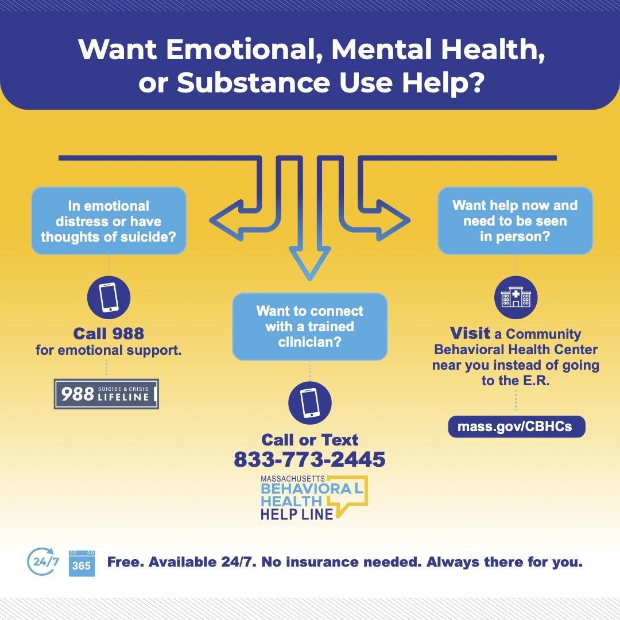
Overview of the Development and Implementation of 988 and the
Behavioral Health Help Line

Slide 15
Overview of the Development and Implementation of 988 and the
Behavioral Health Help Line
      SAMHSA 5-year vision: Transform America’s behavioral health crisis care system to one that saves lives by serving anyone, at any time, in a seamless way, from anywhere in the nation
Someone to talk to
  Service: 988
  SAMHSA 988 goal: 90%+ calls answered in-state
  MA: 88% calls answered in-state (as reported by Vibrant, the 988 vendor, in December 2023)
    97% calls answered in-state (as reported by DPH in December 2023)
  Deadline: 2023
Someone to respond
  Service: Behavioral Health Help Line (BHHL) for clinical assessment and connection to services
  SAMHSA 988 goal: 80%+ individuals have access to mobile crisis response
  MA: 100% of individuals who call the BHHL or call/visit a local CBHC have the opportunity to access to mobile crisis response
  Deadline: 2025
A safe place for help
  Service: Community Behavioral Health Centers
  SAMHSA goal: 80%+ individuals have access to community-based crisis care
  MA: 100% of individuals live within one of the 26 CBHC catchment areas and have access to community-based crisis care (i.e., CBHCs and Community Crisis Stabilization)
  Deadline: 2027
* SAMHSA External Convening on 988 Readiness, Spring 2022

Slide 16
Table of Contents
Background
Overview of the Development and Implementation of
988 and the Behavioral Health Help Line
Evaluation
Current Funding Sources
Overview of the National Landscape and Funding Mechanisms
Plans for 2024
Commission Recommendations
Appendix: MAMH recommendations

Slide 17
Evaluation: 988 Key Performance Indicators
Date Source: Vibrant 988 Broad State Metric Report, November 2023
*there is currently an 8pp discrepancy between nationally (89%) and locally (97%) measured answer rate

Slide 18
Evaluation: 988 Lifeline Awareness Campaign Reporting*
ThinkArgus, a marketing firm, enlisted a variety of research tactics to better understand the target audience and how to best connect with them. This included an environmental scan, digital ethnography, quantitative, and qualitative research. Based on the research findings, ThinkArgus developed four marketing objectives and a campaign position to inform the strategy and measurements for success.
Marketing Objectives:
Raise awareness of 988 while setting realistic expectations for the experience and outcomes
Lift the perceived value of the 988 experience - “calling is worth it”
Lower the barriers of entry including stigma, mistrust, and irrelevance
Differentiate 988 from other mental health and crisis support services
Campaign Dates: 7/25/23 - 1/7/24
Tactics: Digital display ads, social media (Facebook/Instagram), out-of-home (billboards, transit, convenience store posters, wildpostings)
Highlights:
  Digital click-to-call ads delivered 228 calls to the lifeline
  Ads delivered 34k+ visits to the website
Tactic | Impressions** | Clicks | CTR***
Digital display | 9720,561 | 29,180 | 0.30%
Social media (FB/IG) | 3,580,074 | 46,819 | 1.31%
Out-of-home | ~116,000,000 | - | -
Total* | ~129,300,635 | 75,999 | 0.57%
*Reporting as of 12/3/23
** Impressions are the number of times an ad or another form of media appars on a user’s screen
*** CTR: Click Through Rate or how many times something is clicked compared to how many times it is shown

Slide 19
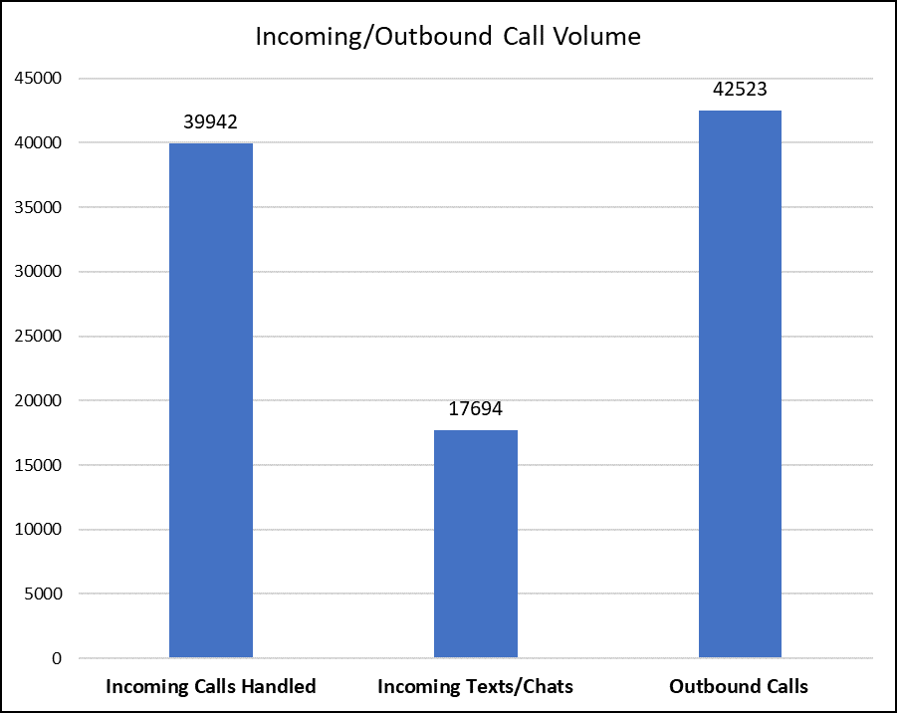
Evaluation: Behavioral Health Help Line Data
Behavioral Health Help Line
January 1 – December 9, 2023

Slide 20
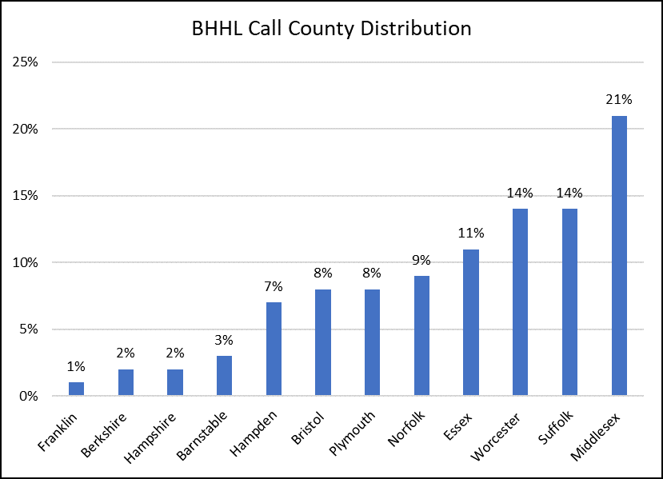
Evaluation: Behavioral Health Help Line Data
Behavioral Health Help Line
January 1 – September 30, 2023

Slide 21
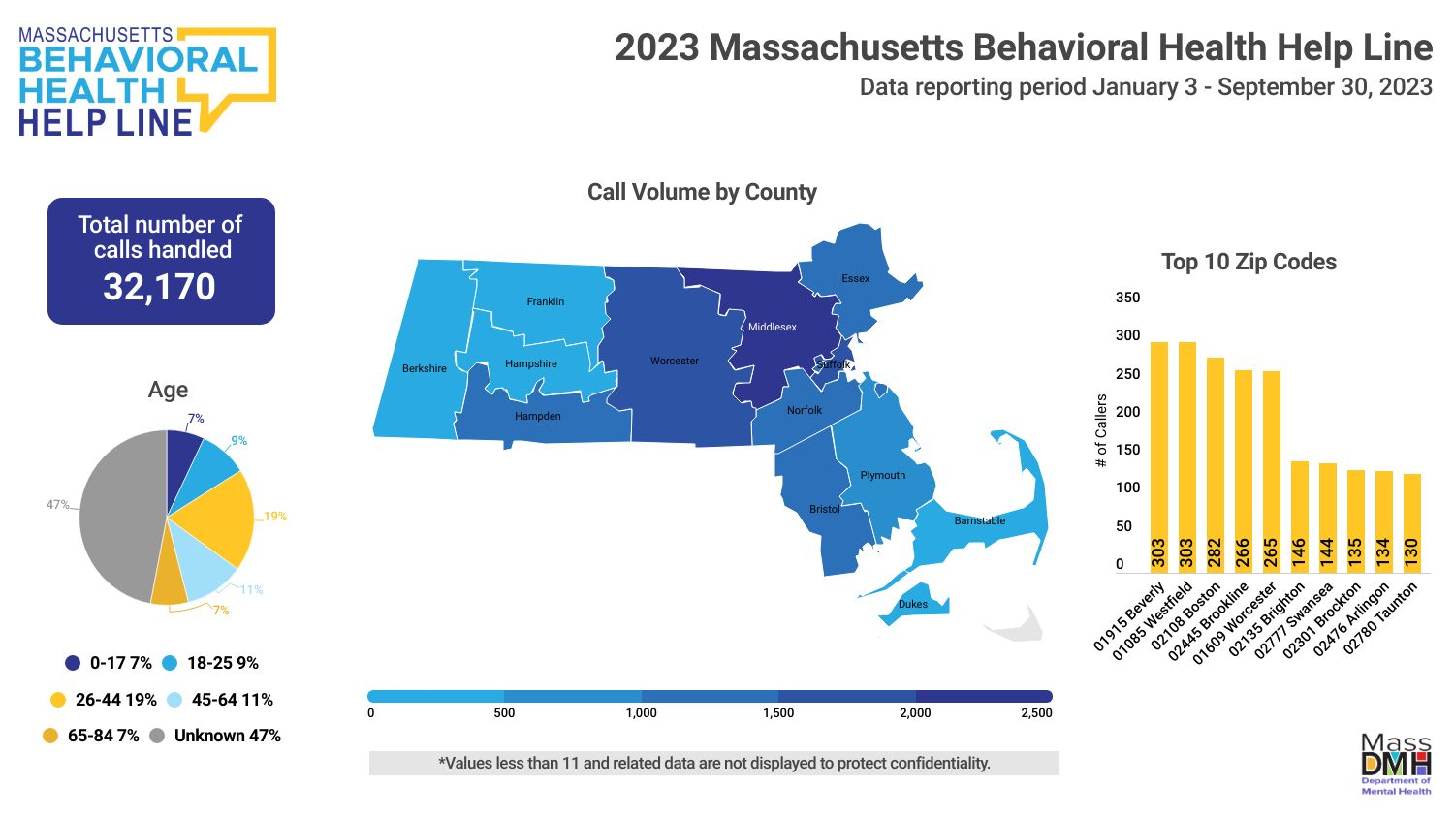
Evaluation: Behavioral Health Help Line Data

Slide 22
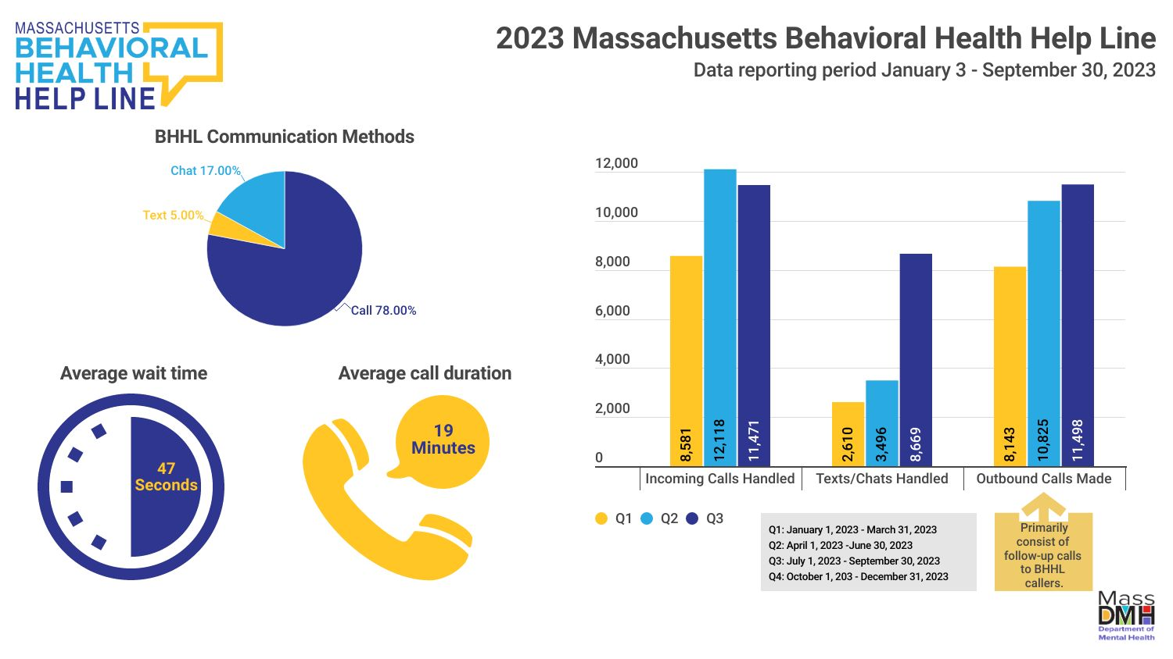
Evaluation: Behavioral Health Help Line Data

Slide 23
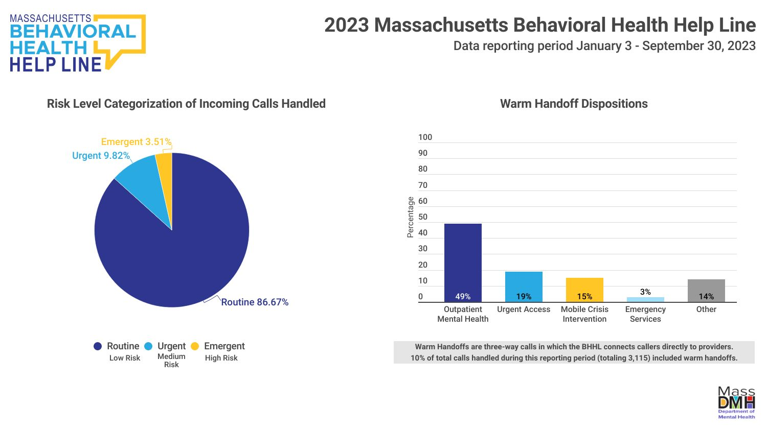
Evaluation: Behavioral Health Help Line Data

Slide 24
Evaluation: Behavioral Health Help Line Data
Performance benchmarks and improvement targets continue to be developed based on industry standards, Year 1 results and evaluation, and input from advisory groups. Data and reporting period January 3, 2023 – December 31, 2023.
Projection | Year 1
115,000 contacts | 107,383 contacts (calls, texts, chats, outbound calls)
Performance Metrics | Year 1
95% of calls will be answered live within 15 seconds. | 70%
100% of assessed need for crisis intervention have a documented completed warm hand off in accordance with the approved protocols. | 100%
95% of Clients calling the Help Line and requiring language services will be connected to language concordant Help Line staff or an interpreter within 45 seconds. | Average connection time = 18 seconds (currently unavailable as % of callers)
The Contractor shall ensure that systems are available 24/7/365 with 99.9% uptime and limited maintenance window. | 100% uptime for calls 99.5% uptime for text/chat

Slide 25
Table of Contents
Background
Overview of the Development and Implementation of
988 and the Behavioral Health Help Line
Evaluation
Current Funding Sources
Overview of the National Landscape and Funding Mechanisms
Plans for 2024
Commission Recommendations
Appendix: MAMH recommendations

Slide 26
Current Funding Sources
  988 FY23 funding
    State: $10 million supplemental funding
    Federal: $3.5 million SAMHSA grant (April 30, 2022 – April 29, 2024) (across multiple FYs)
  988 Funding supports:
    Expansion of center operational hours (24/7/365)
    Increased capacity through workforce and technology investments
    Workforce training
    Marketing and Communications Campaign (updated public transit awareness materials, workforce recruitment, and misinformation research)
  988 FY24 funding
    State: FY24 received $1 million in the state budget
    Federal: $4.1 million SAMHSA grant (September 30, 2023 – September 29, 2026)
  BHHL FY24 funding
    State: $18.7M funded partly by the Behavioral Health Access and Crisis Intervention Trust Fund and state appropriation through the DMH budget

Slide 27
Current Funding Sources
  Community Based Crisis Intervention funding
  Crisis intervention at non-hospital, community locations through Mobile Crisis Intervention (MCI) is provided by Community Behavioral Health Centers (CBHCs).
  Crisis services and post-crisis stabilization are covered by MassHealth and most commercial payers.
    Chapter 177 mandates commercial payors to cover MCI and Adult Community Crisis Stabilization services, including follow-up crisis services.
  For people not covered for these services through their insurance, services are funded otherwise:
    The FY23 budget created a $33.7 million surcharge on commercial insurers to fund the Behavioral Health Access and Crisis Intervention Trust Fund (BH Trust).
    Funding enables the BHHL and 24/7 mobile and community-based crisis intervention services to be accessible for all comers.
    The BH Trust is authorized through FY24 and will require reauthorization to continue covering uninsured and underinsured people.
    The FY23 budget requires the Health Policy Commission (HPC), in collaboration with EOHHS and CHIA, to issue a report on the use of the BH Helpline and BH crisis services and make recommendations for equitable and sustainable funding. The report must be submitted to the legislature by January 15, 2025.
    A recommendation is being made to maintain current funding levels to ensure all people are covered for crisis services in the community.

Slide 28
Table of Contents
Executive Summary
Overview of the Development and Implementation of
988 and the Behavioral Health Help Line
Evaluation
Current Funding Sources
Overview of the National Landscape and Funding Mechanisms
Plans for 2024
Commission Recommendations
Appendix: MAMH recommendations

Slide 29
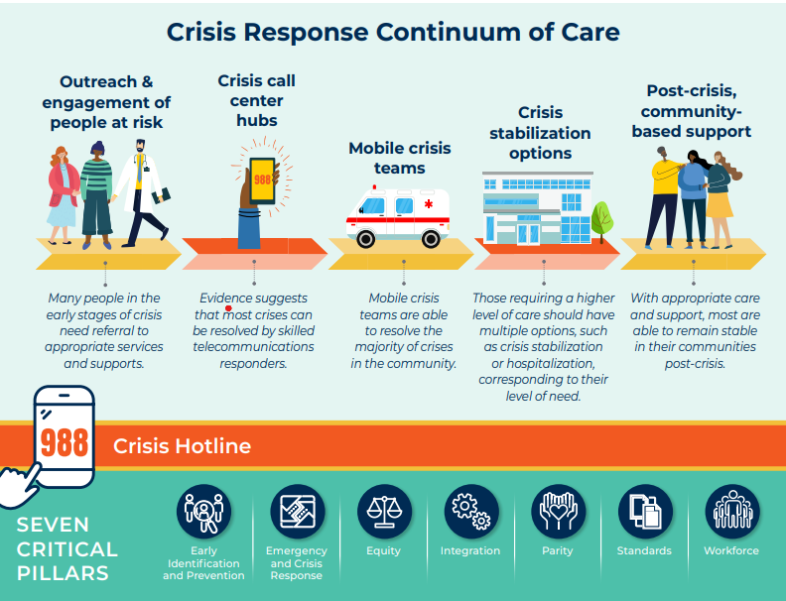
Overview of the National Landscape and Funding Mechanisms
Consensus Approach and Recommendations for the Creation of a Comprehensive Crisis Response System (November 2021)
Notes:
American Foundation for Suicide Prevention
American Psychiatric Association
American Psychological Association
MAMH
Meadows Mental Health Policy Institute
Mental Health America
National Association for Behavioral Healthcare
NAMI
National Council for Mental Wellbeing
One Mind
Peg's Foundation
Steinberg Institute
The Kennedy Forum
Treatment Advocacy Center
Well Being Trust

Slide 30
Overview of the National Landscape and Funding Mechanisms
In its first year, the Commission heard presentations regarding national best practices. While there are state-specific differences leading to variability in overall models, the Massachusetts model includes common national best practices while addressing the state’s unique population and geography.
  Best Practices: Georgia
    Georgia Crisis and Access Line (GCAL) is a call center integrated into the local healthcare system with 24-hour mobile crisis response coverage within 100 miles of every community.
    GCAL has real-time access to available crisis and detox beds throughout Georgia. It also provides phone, text, and chat intervention services, follow-up, and will make urgent and emergent appointments for callers.
    A 24/7/365 single point of entry exists for Mobile Crisis Dispatch, state contracted inpatient beds, and crisis stabilization units and state hospitals.
  Best Practices: Arizona
    Arizona has several crisis call centers that leverage and maximize the use of technology, including:
      Electronic health records that are customized for crisis calls;
      Electronic dispatch of mobile teams that include sharing of clinical information and automatic collection of time stamp of activity;
      GPS technology to see the location of mobile teams in the community;
      Mobile teams have electronic tools to receive dispatch, record time stamps, and receive and send information regarding the crisis and intervention needed; and
      Call centers can support mobile teams in electronically setting up appointments with community-based providers.

Slide 31
Overview of the National Landscape and Funding Mechanisms (continued)
  Best Practices: Washington state
    Washington has three statewide hubs that receive all 988 calls for their covered regions and provide emotional support, conduct telephonic triage, dispatch mobile crisis teams, manage involuntary inpatient psychiatric hospital bed finding, coordinate bidirectionally with 911, and refer moderate-risk callers for next day follow-up calls, outreach, and support.
  Best Practices in the 988 Massachusetts model:
    Phone, text, and chat
    988 has a bi-directional connection with the BHHL, the front door for the MA 24/7/365 behavioral health crisis system, including Community Behavioral Health Centers covering every city and town in the Commonwealth, which can provide Mobile Crisis Intervention (MCI) in the community or at the site.
    Community Crisis Stabilization (CCS) units are 24/7, non-hospital beds.
      988 can make warm hand-offs to the BHHL for MCI, urgent, and emergent appointments.
    Both 988 and the BHHL can make a warm hand-off to a caller’s local 911 department (if the caller’s location is known).

Slide 32
Overview of the National Landscape and Funding Mechanisms
Federal investments support some but not all costs to operationalize 988, and states are responsible for long-term funding and sustainability. While demonstrated best practices for financial sustainability have not yet emerged, the following summarizes current approaches to date.
  Although federal investments support 988 nationally, states are responsible for long-term funding of the local 988 crisis call centers, which have historically received minimal funding from the federal government (typically between $2,500-$5,000 annually).
  Under the National Suicide Hotline Designation Act of 2020, states can collect cell phone fees to help sustainably fund their local 988 call centers 988 legislation authorized states to collect cell phone fees to help sustainably fund 988 and other crisis services.
    The Wireless Communications and Public Safety Act of 1999 mandated 911 to be the country’s universal emergency number; since then, users have automatically been charged an average of about a dollar a month on their monthly phone bills to fund it.
  Trust funds and general funds appropriations have been set up by some states to support 988 crisis centers, but it is unclear whether these initiatives will sustainably support crisis centers’ long-term funding needs.
  Some states have considered billing Medicaid or other payers for crisis hotlines and other crisis services.
  26 states have enacted legislation to fund 988; 13 states are appropriating general fund dollars
    Eight of these states have imposed a telecommunications fee (CA, CO, DE, MN, NV, OR, VA, WA).
  The FCC (Federal Communications Commission) has the authority to levy a nationwide tax but has yet to do so.
Saunders, Heather. “Behavioral Health Crisis Response: Findings from a Survey of State Medicaid Programs.” KFF, May 25, 2023.
Saunders, Heather. “Taking a Look at 988 Suicide & Crisis Lifeline Implementation One Year After Launch.” KFF, July 14, 2023.
DeGuzman, C. A Year With 988: What Worked? What Challenges Lie Ahead? KFF Health News. July 26, 2023. Available here.

Slide 33
Table of Contents
Background
Overview of the Development and Implementation of
988 and the Behavioral Health Help Line
Evaluation
Current Funding Sources
Overview of the National Landscape and Funding Mechanisms
Plans for 2024
Commission Recommendations
Appendix: MAMH recommendations

Slide 34
Plans for 2024
  988
    Planning phase and implementation for local text and chat (supported by 2023-26 grant) (national text and chat already available)
    Extending online media buys
    Updating signage (e.g., public transit, bridges, highways)
    Exploring translation of materials into Portuguese and Haitian Creole
  BHHL
    Launch BHHL Treatment Connection Resource Directory (incorporating Massachusetts Association for Mental Health’s [MAMH] Network of Care and Massachusetts Behavioral Health Partnership’s [MBHP] Massachusetts Behavioral Health Access [MABHA])
    Adding staff dedicated to conducting follow-up calls (e.g., bridge support between treatment visits, checking on referrals, etc.)
    ForHealth Consulting (UMass Chan School of Medicine) evaluation reports due in 2024

Slide 35
Table of Contents
Background
Overview of the Development and Implementation of
988 and the Behavioral Health Help Line
Evaluation
Current Funding Sources
Overview of the National Landscape and Funding Mechanisms
Plans for 2024
Commission Recommendations
Appendix: MAMH recommendations

Slide 36
Commission Recommendations
  Commission recommendations are based on the goal to ensure that the consumer experience is seamless, meets each caller’s needs, is equitable, accessible, and continuously improving through quality assurance.
  Conduct a feasibility assessment of technology-supported information sharing, in compliance with state and federal privacy laws, to ensure a coordinated technology-supported interface between 988 and the crisis system.
  Implement a technology solution to enable one-touch, bi-directional transfer among the BHHL, MCI, and 988.
  Stand up an ongoing system-wide evaluation process that solicits information from both 988 and the BHHL that includes:
    Feedback from call-takers/staff about quality improvement opportunities.
    Caller feedback
      Direct feedback while ensuring compliance with the anonymous nature of 988.
      Aggregated consumer feedback through engagement with stakeholder and consumer advocacy groups that represent individuals who use 988 and the crisis system (e.g., KIVA center, NAMI, PPAL).
  Implement a feedback process with quality improvement activities for both 988, the BHHL, and MCI, and streamline input from the feedback QR codes, mailboxes, ombuds, advisory groups so there is a system-wide perspective on improvement opportunities.
  Develop a singular, streamlined directory to support all phone lines (988, BHHL, 211, etc.) to be updated regularly so that there is a source of accurate public information.
  Establish an ongoing process to review incidents of emergency calls from 988 and/or the BHHL to 911 to ensure that dispatch is only happening when necessary and appropriate and to initiate quality improvement opportunities.

Slide 37
Commission Recommendations (continued)
  Commission recommendations are based on the goal to ensure that the consumer experience is seamless, meets each caller’s needs, is equitable, accessible, and continuously improving through quality assurance.
  Reauthorize funding through budget appropriation with consideration to any increased operating cost or new operating expenses, and an adequate marketing budget.
  Stand up an ongoing evaluation process to explore whether there is fiscal efficiency in streamlining any aspect of 988 with any aspects of other call support and service lines, such as the BHHL.
  Require an EOHHS cross-agency point person to ensure cross department oversight of the 988, the BHHL, and MCI occurs, and policies, operations and funding are overseen centrally.
  Continuously involve consumer voices, including family voices, as an ongoing role in all evaluation, planning, and implementation decisions of 988 and the MA crisis system.
  List the 988 number on student identification cards.
  Near-term topics for this Commission to assess and provide ad hoc recommendations before the next annual report include options for fee-based funding, including potential telephonic tax and additional trainings related to police and crisis system intersection.

Slide 38
Commission Recommendations
  At the Commission meeting on January 29, 2024, the group voted on the recommendations in full:
 | In favor | Opposed | Abstained | Absent
988 Commission Annual Report recommendations | 17 | 0 | 2 | 5

Slide 39
Table of Contents
Background
Overview of the Development and Implementation of
988 and the Behavioral Health Help Line
Evaluation
Current Funding Sources
Overview of the National Landscape and Funding Mechanisms
Plans for 2024
Commission Recommendations
Appendix: MAMH recommendations

Slide 40
Appendix: Recommendations submitted by MAMH to the Commission (1/3)
  Establish an entity, staffed at EOHHS, responsible for coordinating the crisis services reform work of MassHealth, DMH, DPH, EOPSS, and Statewide 911 regarding 988/the BHHL/CBHCS/911/mobile crisis/crisis stabilization units/other crisis lines/regional responders.*,**
    This entity oversees, for purposes of integration of the Commonwealth’s behavioral health crisis response, all matters related to the 988 service system and other crisis response elements.
    This entity addresses 988 implementation, marketing and community engagement, financing, data collection, and workforce.
    This entity oversees 988 workgroups and councils, but its creation does not change existing reporting structures.
    This entity reports regularly to the 988 Commission.
988 Implementation Workgroup: Establish an interagency workgroup on 988 implementation.
    To ensure full 988 integration within the crisis system so that persons contacting 988 receive the most appropriate service whether from 988 or another service.
    To pursue a standardized framework and coding definitions for screening, triaging, and reporting behavioral health calls across 988, the Behavioral Health Help Line, the Substance Use Helpline, and PSAPs.**
    To ensure 988 is able to offer services by call, text, chat, and video-conference.
    To streamline and improve the client experience.
    To establish, review, and update 988 quality assessment measures, including through processes to collect, review, and respond to
      process data, using standardized measures aligned with other crisis responders*, **
      outcome data, including longer-term outcome data, using standardized measures aligned with other crisis responders*, **
      consumer feedback, and
      complaints.
*We note that a similar recommendation appears in the Crisis Services in the Commonwealth Report of the Community Policing and Behavioral Health Advisory Council.
**We note that a similar recommendation appears in the Massachusetts 911 Call Study: Assessing the Potential to Divert Behavioral Health Calls to Alternative Responses Report of EOHHS and EOPSS.

Slide 41
Appendix: Recommendations submitted by MAMH to the Commission (2/3)
    To work towards establishing cross-system data collection requirements/standards to assess and inform the capacity and performance of crisis services, including a statewide BH crisis dashboard that is public-facing and integrates 988, BHHL, MCI, hospital, and co-response data.*
    To review and update training requirements for the 988 workforce, in conjunction with other state agencies providing crisis services and with the participation of people with lived experience.** Training should address:
      cultural competence;
      issues of gender identity and sexual orientation;
      implicit bias and other BIPOC issues;
      developmentally appropriate responses to different age callers;
      youth, adolescent, young adult, adult, and older adult behavioral health issues and family support; and
      how to serve people with diverse behavioral health disabilities, particularly as such persons face situations which may not involve potential for suicidal.
    To improve the service directory supporting 988.
    To establish a process to review cases of police dispatch to persons contacting 988, to ensure that dispatch is occurring only when necessary and appropriate.
    To monitor and ensure 988 system alignment with national guidelines, including those of SAMHSA, National Association of State Mental Health Program Directors, and Technical Assistance Center TAC, including planning to integrate the three pillars of 988 (someone to call, someone to respond, safe place to go).
*We note that a similar recommendation appears in the Crisis Services in the Commonwealth Report of the Community Policing and Behavioral Health Advisory Council.
**We note that a similar recommendation appears in the Massachusetts 911 Call Study: Assessing the Potential to Divert Behavioral Health Calls to Alternative Responses Report of EOHHS and EOPSS.

Slide 42
Appendix: Recommendations submitted by MAMH to the Commission (3/3)
  Marketing and Community Engagement
  Establish an interagency workgroup on marketing and community engagement
    To develop an evaluation plan for consumer feedback, including from persons who decline to use 988 services, and identify gaps or opportunities for quality improvement.
    To review the 2023 evaluation of the 988 marketing plan.
    To make recommendations regarding efforts to reach communities most in need.
    To make recommendations regarding non-suicide related calls to 988.
  Establish a consumer advisory council to advise on marketing and community engagement.
    The council includes representation of people: from BIPOC communities; from historically underserved or marginalized communities; who identify as LGBTQ; with lived experience of behavioral health conditions; who work in the positions being addressed by the workgroup; and who work in the position of a certified peer support specialist.
    A single council member may not fill the requirement for more than one of these specially designated categories.
    Representation on the council should also include both persons who have experienced crisis related to suicide and persons who have experienced other types of crises.
Financing
  Establish an interagency workgroup on financing of 988
    To identify and report on one-time, ongoing, and potential costs associated with the 988 service system and its long-term sustainability.
    To identify and report on current and potential funding sources for the 988 service system, including but not limited to a telephony tax, including through review of other states’ models for funding and an analysis of what might constitute an appropriate telephonic tax and how the funds from such a tax would be used.
    To evaluate funding of other MA crisis and service lines to inform funding decisions regarding 988.
    To evaluate potential means to achieve fiscal efficiency, such as by streamlining any aspects of the 988 Suicide and Crisis Lifeline with any aspects of other call support and service lines.
*We note that a similar recommendation appears in the Crisis Services in the Commonwealth Report of the Community Policing and Behavioral Health Advisory Council.
**We note that a similar recommendation appears in the Massachusetts 911 Call Study: Assessing the Potential to Divert Behavioral Health Calls to Alternative Responses Report of EOHHS and EOPSS.

