Slide 1
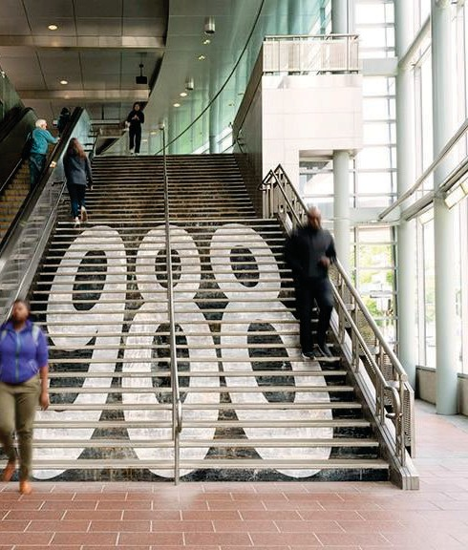
Massachusetts Department of Public Health
MA 988 Suicide and Crisis Lifeline Business Analysis and Planning
988 Commission Presentation
August 15, 2024
Copyright © 2023 Accenture. All rights reserved. 1
1

Slide 2
Overview of State Legislation from All 50 States
Majority of states have passed legislation to provide operational improvements to their 988 Lifeline or
develop sustainable funding for the program.
Operations
Revenue
Operational support funding helps 988 address stakeholder needs. Examples:
Revenue generation tools help 988 Lifelines sustainably grow. Examples:
Services Expansion
Insurance Coverage
Physical Infrastructure
Youth Programs
Line Surcharge Fees
Trust Fund
State General Appropriation
2

Slide 3
Sustainable Revenue Legislation Best Practices
As modeled by other states, fee-per-line models and trust funds give 988 programs consistent long- term revenue to operate and grow capabilities.
Surcharges
Trust Funds
Fee Per Line systems provide consistent revenue for 988
Flat rate monthly surcharges usually fall between $0.06 - $0.60
Differences between how fee is transferred from consumer to state for prepaid and postpaid lines
Relies on service providers as the middle-man
Trust Funds provide secure long-term funding through their perpetuities
Needs a large fund to be allocated in the beginning
Continues to generate revenue as money is withdrawn from the fund
3

Slide 4
Financial Sustainability Options
Other states have legislated for revenue structures that aim to fulfill a sustainable funding need for 988 programs
Category
Legislation Implementatio
n
Impact
Surcharges
Creates a 988 fee that is included in customers’ bills and collected by telecom providers
Funds are then remitted to the state
Legislation specifies the fee amount and outlines how these funds will be utilized
Provides sustainable funding for 988 hotlines
Amount can be adjusted through additional legislation to grow
alongside the program
Funds are protected through federal legislation which mandates that funds are used for 988
Operates similarly to 911 surcharges which has proven success in Massachusetts
Trust Funds
Establishes a 988 trust fund where contributions are derived from various sources (i.e., grants, private donations, state appropriations)
Fund enables contributions from and dedicated revenue streams, such as telecom fees
Provides a reliable source of funds for 988 hotlines
Funds within the trust grow over time through investment strategies and replenishment from fund sources
Ensures the continuity and effectiveness of crisis support services over time
Some states use their Trust Fund to provide reimbursements for costs associated with designating and maintaining 988 Lifeline
4

Slide 5
Surcharge to Fund 988
A surcharge fee passed by Commonwealth legislation would allow Massachusetts to adopt a consistent funding structure for 988 programs that already exists for 911 operation.
Fund
Design
Program Support
Existing Public
Buy-In
988 surcharge should be modeled off the pre- existing 911 surcharge
911 is currently set at $1.50 per line, monthly
Minimal initial set-up as current service provider partnerships can be leveraged
Revenue is reserved for 988 Programs and their operating costs
Similarly to 911, funds are mandated via state legislation and pooled into trust fund
When surveyed, 78% of Americans are willing to pay for a surcharge on their monthly phone bill for 988 after learning on average
$1.00 per month goes
to 911
Source: National Alliance on Mental Alliance Poll on Public Perspectives on 988 & Crisis Response (2023)
5

Slide 6
Estimated Revenue from 988 Surcharge
State Name 988 Fee
988 Fee
(Average)
Annual Fee
(Average)
Total Lines
(Wireless + Wired)
Estimated Total 988
Revenue
State
Population
Average 988 Cost
Per Resident
Minnesota | $0.00-0.25 | $0.13 | $1.56 | 7,077,935 | $10,616,903.13 | 5,737,915 | $1.85
Pennsylvania | $0.06 | $0.06 | $0.72 | 16,275,063 | $ 11,718,045.05 | 12,961,683 | $1.26
California | $0.08-0.30 | $0.19 | $0.96-3.60 | 49,853,056 | $113,664,966.67 | 38,965,193 | $1.28
Virginia | $0.12 | $0.12 | $1.44 | 9,339,115 | $13,448,325.61 | 8,715,698 | $1.54
Washington | $0.24 | $0.24 | $2.88 | 9,361,812 | $26,962,019.18 | 7,812,880 | $3.45
Delaware | $0.60 | $0.60 | $7.20 | 1,341,213 | $9,656,734.12 | 1,031,890 | $9.36
Vermont
$0.72
$0.72
$8.64
839,000
$7,248,960
647,464
$11.20
KEY TAKEAWAYS
988 collection is continuing to develop but it is still in its early stages
Colorado, Virginia, and Washington collected revenue funding from a fee-based phone surcharge funding in the last FY
Many states like California, Delaware, Minnesota, Pennsylvania, and Vermont will be collecting a statewide surcharge this FY
New York, Ohio, Colorado, Nevada, and Oregon are charging a surcharge at the municipality level
Minnesota has imposed a phone fee range, with exact amount to be recommended by the Health Commissioner
6

Slide 7
Massachusetts 988 Fee Models
988 Fee
Total Lines Charged
Estimated Total 988 Revenue
$0.05
9,160,075
$5,496,044.79
KEY TAKEAWAYS
Customizable: States using 988 fees can largely fund the program by aligning the charge to match their costs, with the ability to change it to meet needs over time
Affordable: A $0.05 increase in the monthly fee creates an estimated difference of $5,496,045 in revenue
➔ the fee can remain affordable while providing a significant impact
Sustainable: Revenue from the surcharge can grow with demand and be saved for later use as 988 volume rises
$0.10
9,160,075
$10,992,089.59
$0.15
9,160,075
$16,488,134.38
$0.20
9,160,075
$21,984,179.17
$0.25
9,160,075
$27,480,223.97
$0.30 | 9,160,075 | $32,976,268.76
$0.35 | 9,160,075 | $38,472,313.55
$0.40 | 9,160,075 | $43,968,358.34
$0.45 | 9,160,075 | $49,464,403.14
$0.50 | 9,160,075 | $54,960,447.93
7

