Slide 1
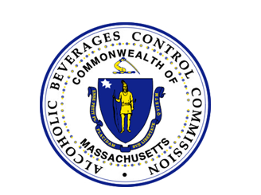
Massachusetts Alcoholic Beverages Control Commission/MASS Brewers Guild Presentation
February 24, 2025

Slide 2
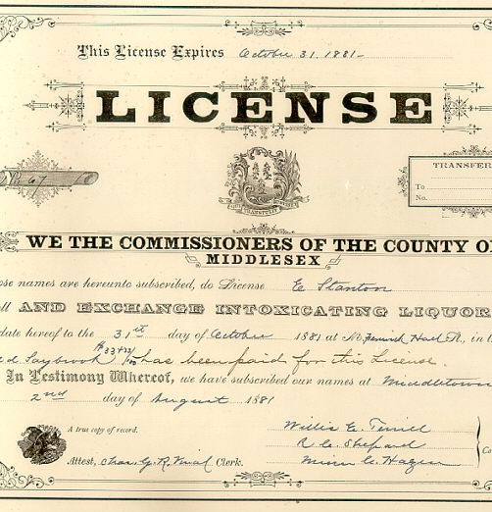
Changes to an existing license:
Change of Ownership
Transfer of Stock, Issuance of stock/new stockholders
Change of Name and/or change of d/b/a
Change of Officers/Directors/Trustees or change in the corporate structure (such as changing from INC to LLC)
Renovations or alterations to the premises (Abutter notification requirement.)
Change of Manager – or Change in the Management Operating Agreement Framingham Board of License Requires two weeks advanced notice prior to effective date of change
Change of Hours (including Sundays)
Change of location
MGL 138 Section 19H Alteration of Licensed Premise

Slide 3
ABCC Navigation of Website https://www.mass.gov/orgs/alcoholic-beverages-control-commission
Applications
Commission Advisories
Commission Decisions
Frequently Asked Questions and Guidelines in Multiple Languages

Slide 5
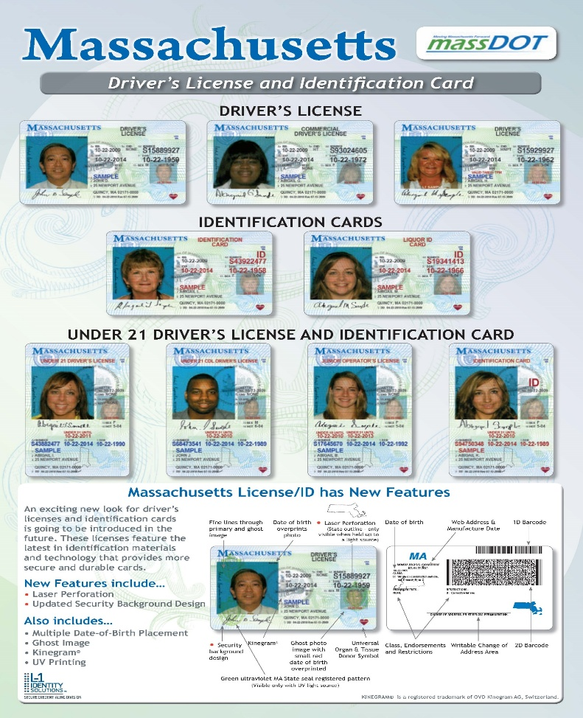
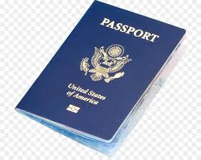
ALCOHOL SALES AND SERVICE REQUIRES THE LICENSEE TO CHECK IDs
Identification of Patrons. Licensees shall ensure that the identification of persons purchasing alcoholic beverages occurs at the point of sale or service.
KNOW THE SIX ACCEPTABLE FORMS OF IDENTIFICATION
Massachusetts Driver’s License
Massachusetts Liquor ID Card
Massachusetts ID Card
Passport Issued by the United States or a government that is officially recognized by the United States
A Passport Card for a Passport issued by the United States
A Military Identification Card
Valid Driver’s License issued by another state (beginning 4/8/2025)
Global Entry Card issued by US Customs and Border Protection (beginning 4/8/2025)
204 CMR 2.05(2)- Permitting an illegality on the licensed premises, to wit: M.G.L. c. 138, § 34C- Possession of an alcoholic beverage by a person under 21 years of age
Exception: 18,19, and 20 year olds may handle alcoholic beverages in the course of their employment. This includes selling and transporting alcoholic beverages as well as working as a bartender, stocking shelves, and removing alcoholic beverages from tables.
Employees 17 years old and under cannot handle alcoholic beverages in any manner during their employment.

Slide 6
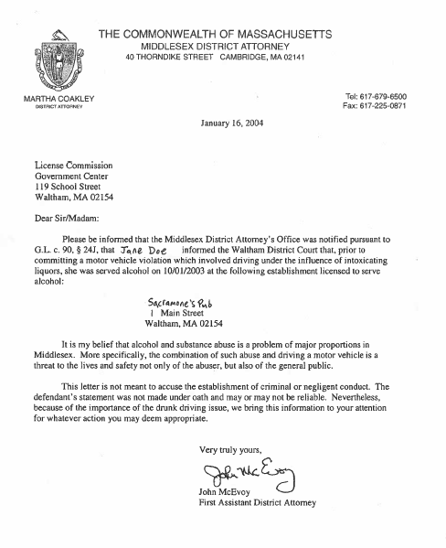
OVERSERVING COMES BACK TO THE LICENSEE “last place of drink” MGL c. 90 § 24J Prior to sentencing for conviction of DUI or guilty plea for DUI, the guilty party must identify the name and location of the last place at which the individual was served.

Slide 7
Mixed Drinks: To- Go
On April 30, 2024, Governor Maura Healey signed a bill into law creating M.G.L. c. 138, § 12 ½ which permanently allows on-premises licensees licensed for the sale of all alcoholic beverages, distilled spirits, or cordials/liqueurs to sell mixed drinks for off-premises consumption with the purchase of at least one item of food prepared on-site sufficient to serve one individual as part of the same transaction.
The following conditions must be met:
1) The mixed drink must be combined on the licensed premises;
2) The mixed drink shall not be sold to a person under 21 years of age;
3) Any delivery of mixed drinks for off-premises consumption shall not be made without verification that the person receiving the order has attained 21 years of age;
4) The mixed drink must be sold in a sealed container;
5) The mixed drink must be sold as part of the same transaction as the purchase of food, and any order that includes a mixed drink must be placed not later than the hour of which the establishment is licensed to sell alcohol or 12:00 A.M., whichever time is earlier; provided, that a transaction must include at least 1 item of food prepared on-site sufficient to serve 1 individual;
6) A customer is limited to 64 fluid ounces of mixed drinks per transaction consistent with #5 above;
7) If the mixed drink in a sealed container is to be transported by a motor vehicle, either by delivery or pick-up, the driver of the motor vehicle must transport the mixed drink in the trunk of the motor vehicle or an area that is not considered the passenger area, as defined by section 24I of chapter 90; and
8) The volume of distilled spirits, cordials, liqueurs, wines, malt beverages and mixers contained in a mixed drink must be of the same proportion and same price as if served for on-premises consumption.
Mixed drinks do not include premade cocktails with distilled spirits such as High Noon.
Vehicles involved in deliveries of mixed drinks must be covered by a M.G.L. c. 138, § 22 transportation permit.

Slide 8
Local Boards may now approve a license manager who is either a United States citizen or a “qualified alien under the Immigration and Nationality Act, 8 U.S.C. 1101.” If a proposed license manager is not a United States citizen, they must provide documentation from the United States federal government evidencing they are a “qualified alien under the Immigration and Nationality Act, 8 U.S.C. 1101.” Acceptable documentation includes but is not limited to a Permanent Resident Card “Green Card,” or Employment Authorization Document. The law also authorizes sole proprietors and partnerships to apply for retail alcoholic beverages licenses issued pursuant to M.G.L. c. 138, § 12 (on-premises) and M.G.L. c. 138, § 15 (off-premises) if all individuals applying are either United States citizens or “qualified alien(s) under the Immigration and Nationality Act, 8 U.S.C. 1101.” This applies to farmer series pouring permits issued pursuant to M.G.L. c. 138, §§ 19 B(n), C(n) and E(o) as well.
CHANGES TO M.G.L. c. 138, § 26- RETAIL LICENSE MANAGERS

Slide 9
Please be advised that it is unlawful to manufacture and/or sell food or beverages containing hemp derived CBD and/or THC. This applies to alcoholic and non-alcoholic beverages. These products must be taken off the shelf immediately. Any licensee found in violation of importing, manufacturing, transporting, selling, and/or possessing on its licensed premises food and/or beverages containing hemp derived CBD and/or THC faces potential suspension or revocation of its license. Wholesalers must retrieve all food and beverages containing hemp derived CBD and/or THC sold and/or delivered by them to retail licensed premises at or before their next delivery to each establishment. This Advisory does not apply to marijuana products manufactured under the jurisdiction of the Cannabis Control Commission. * It has always been illegal for alcoholic beverages to contain any CBD and/or THC. Alcoholic beverages containing CBD and/or THC are considered adulterated beverages.
FOOD AND BEVERAGES CONTAINING HEMP DERIVED CBD AND/OR THC ON LICENSED PREMISES

Slide 10
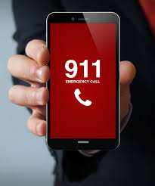
A Licensee’s duty to protect patrons may be triggered when the conduct of another patron puts the Licensee or its employees on notice that harm is imminent. A Licensee may discharge its duty to protect patrons by taking steps to prevent the harm, such as calling the police. It is the responsibility of each licensee to exercise close supervision of its premises to ensure compliance with the law. There has been an increase in non-consensual drugging at bars, clubs, and other licensed premises. Licensees are asked to be vigilant.
Licensees have a duty to protect their patrons and others from foreseeable harm

