Slide 1

Accessibility Microlearnings
For the Commonwealth of Massachusetts

Slide 2
What is “Inclusiveness”?
Accessibility is often a term used when describing disabilities and related issues, but it can apply to everyone.
“Disability” occurs when there is a barrier between a person and their environment. Physical, cognitive and social exclusion are the result of a mismatch between what a person wants to achieve, and an environment that does not support it. Commonwealth, alongside Microsoft, is devoted to making sure available products provide inclusion and accessibility for all, to empower everyone – not only some– to achieve more.
Did you know?
~70% of disabilities are invisible
  Chronic illness, cognitive or mobility issues, vision loss, and many others often give no visible indicators. When talking to people on the phone, via video conference, or in text, we can’t always tell if a disability is present, or even what technology is being used. However, what we do know is that, when we place people and context at the center of our design process, the benefits multiply.
Over 1 billion people on the planet have disabilities
  Computers provide access to services, education and jobs for people with or without disabilities. However, a recent report by The World Bank found that those who are disabled are still more likely to experience poverty. The unemployment rate for people with disabilities is more than twice the average. This population represents an enormous untapped talent pool.
This deck is designed to share five (5) quick tips on how assistive technology not only increases access and opportunity for Americans with disability but, also, provides everyone with the opportunity to be more inclusive when creating and presenting shareable content.

Slide 3
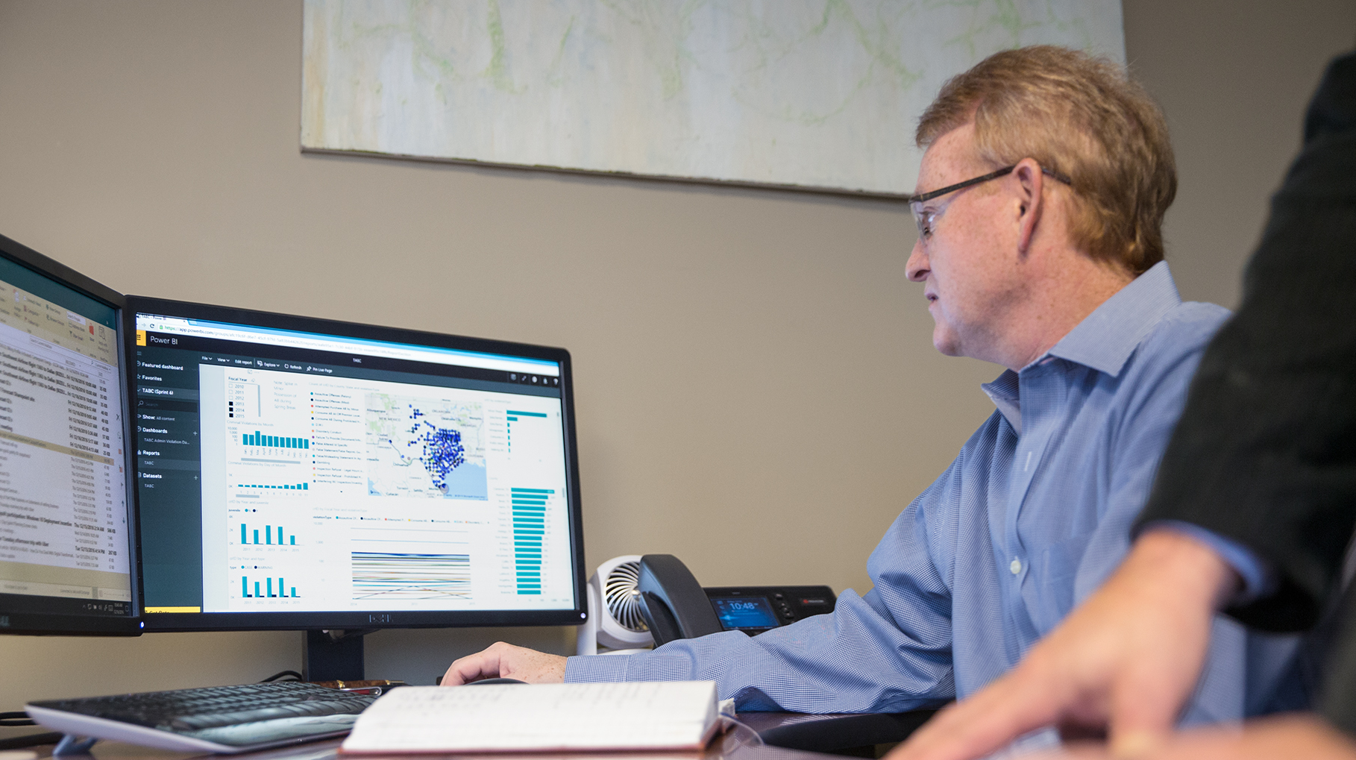
Microlearning #1: High contrast display in Windows
Computer screens can often leave us feeling tired or strain our eyes. The High Contrast accessibility feature in Windows 10 is meant to help with this issue.
Who Could Benefit: If you suffer from migraines, eye strain, or have low vision, you may want to consider this feature – particularly on days when you must do a lot of reading on your computer.
Benefits: Research has found that using High Contrast (i.e. white text on black background) displays assist individuals with low vision along with reducing eye strain and fatigue. It may also minimize the severity and frequency of migraine episodes.
What it looks like: This is an example of high contrast mode. You can also customize the colors.
How to Use it: To turn High Contrast on or off from the keyboard, press left Alt+left Shift+Print Screen. If you’d like more specific instructions, learn more about High Contrast Mode here.

Slide 4
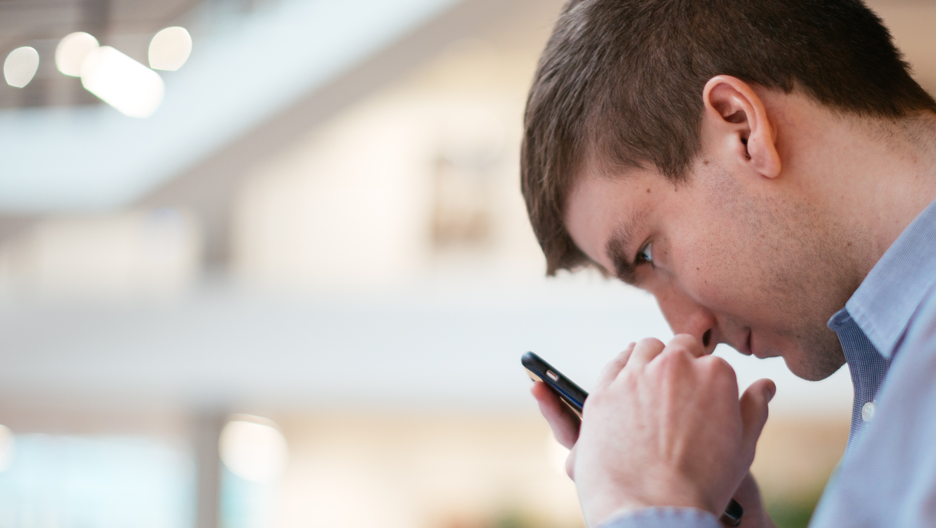
Microlearning #2: Accessible Fonts
It’s not just about the Font, Size, or Spacing, but a combination of all factors.
Which of these fonts do you find easiest to read?
1. The Commonwealth of Massachusetts (Freestyle Script, 18pt)
2. The Commonwealth of Massachusetts (Times New Roman, 14pt)
3. The Commonwealth of Massachusetts (Arial, 12pt)
Who Could Benefit: If you have vision impairment, a reading disability, or read long documents with many details.
Benefits: Accessible fonts can help readers glance through documents with ease and ensure that no important details are missed.
What it looks like: Times New Roman, Verdana, Arial, Tahoma, and Calibri are found to be very “reader-friendly” fonts, in size 12 or 14.
How to Use it: When working on a document or email, use the custom format options in the “Font” section. Additionally, Teams allows you to customize fonts when you compose messages.

Slide 5
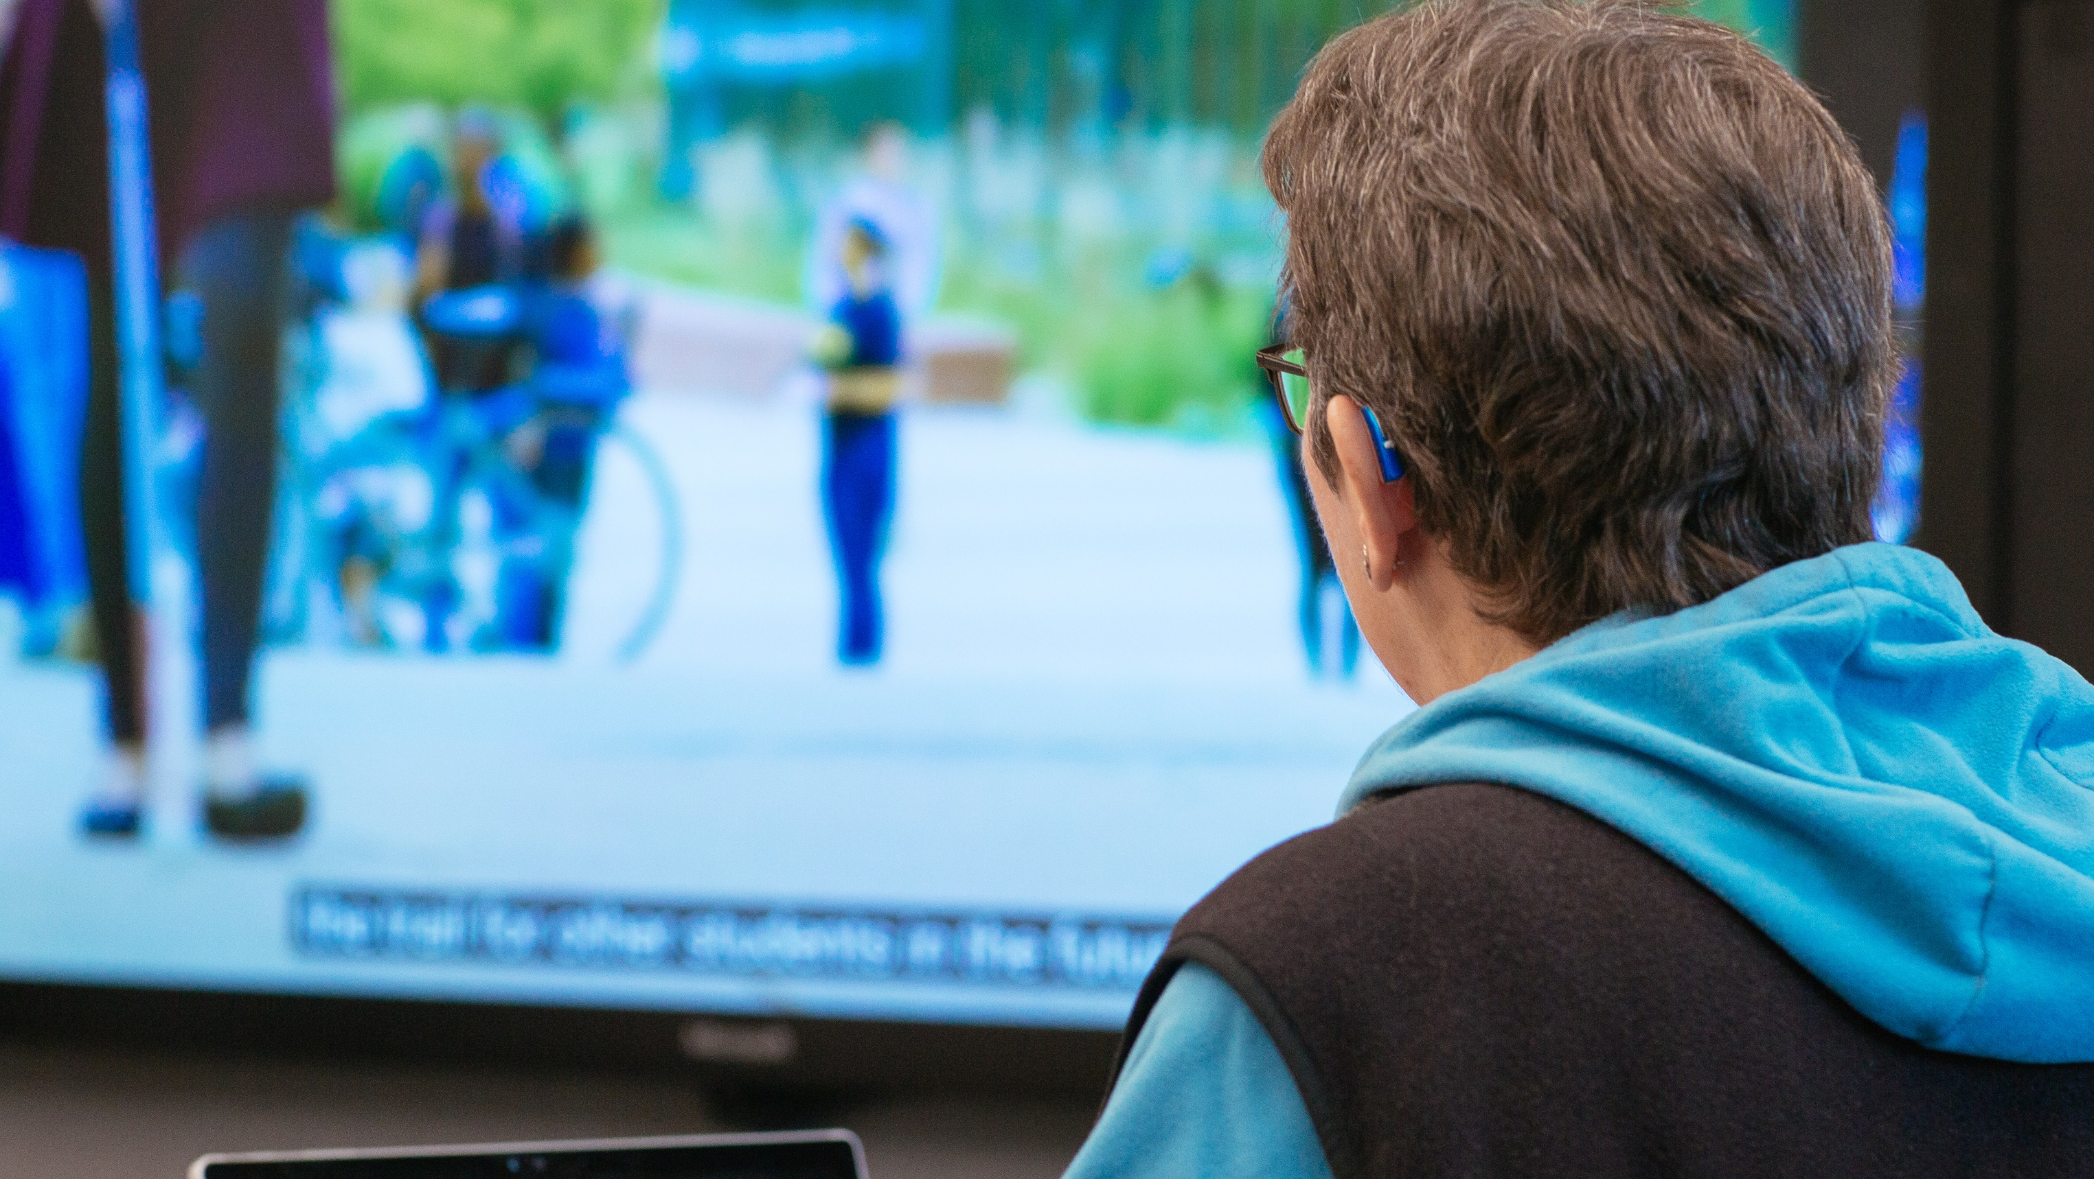
Microlearning #3: Meaningful Hyperlinks
How often do you see links titled “Click here” or “Click on this link”? These types of links do not inform you of their purpose or destination, especially to an individual with a disability who may be using assistive technology.
Who Could Benefit: Everyone
Benefits: Whether using assistive technology or not, it’s more secure, inclusive, and efficient to provide context for where a link will take you.
What it looks like: Want to learn more about the Massachusetts Office on Disability (MOD)? Click here or use this link.
Not sure where those links take you? Try this link: https://www.mass.gov/info-details/overview-of-the-massachusetts-office-on-disability#:~:text=MOD%27s%
Not quite there? Let’s give it one more try... Visit the Massachusetts Office on Disability (MOD) Homepage.
How to Use it: When sharing documents or websites using links, keep these best practices in mind – even though OneDrive often converts links for you.

Slide 6
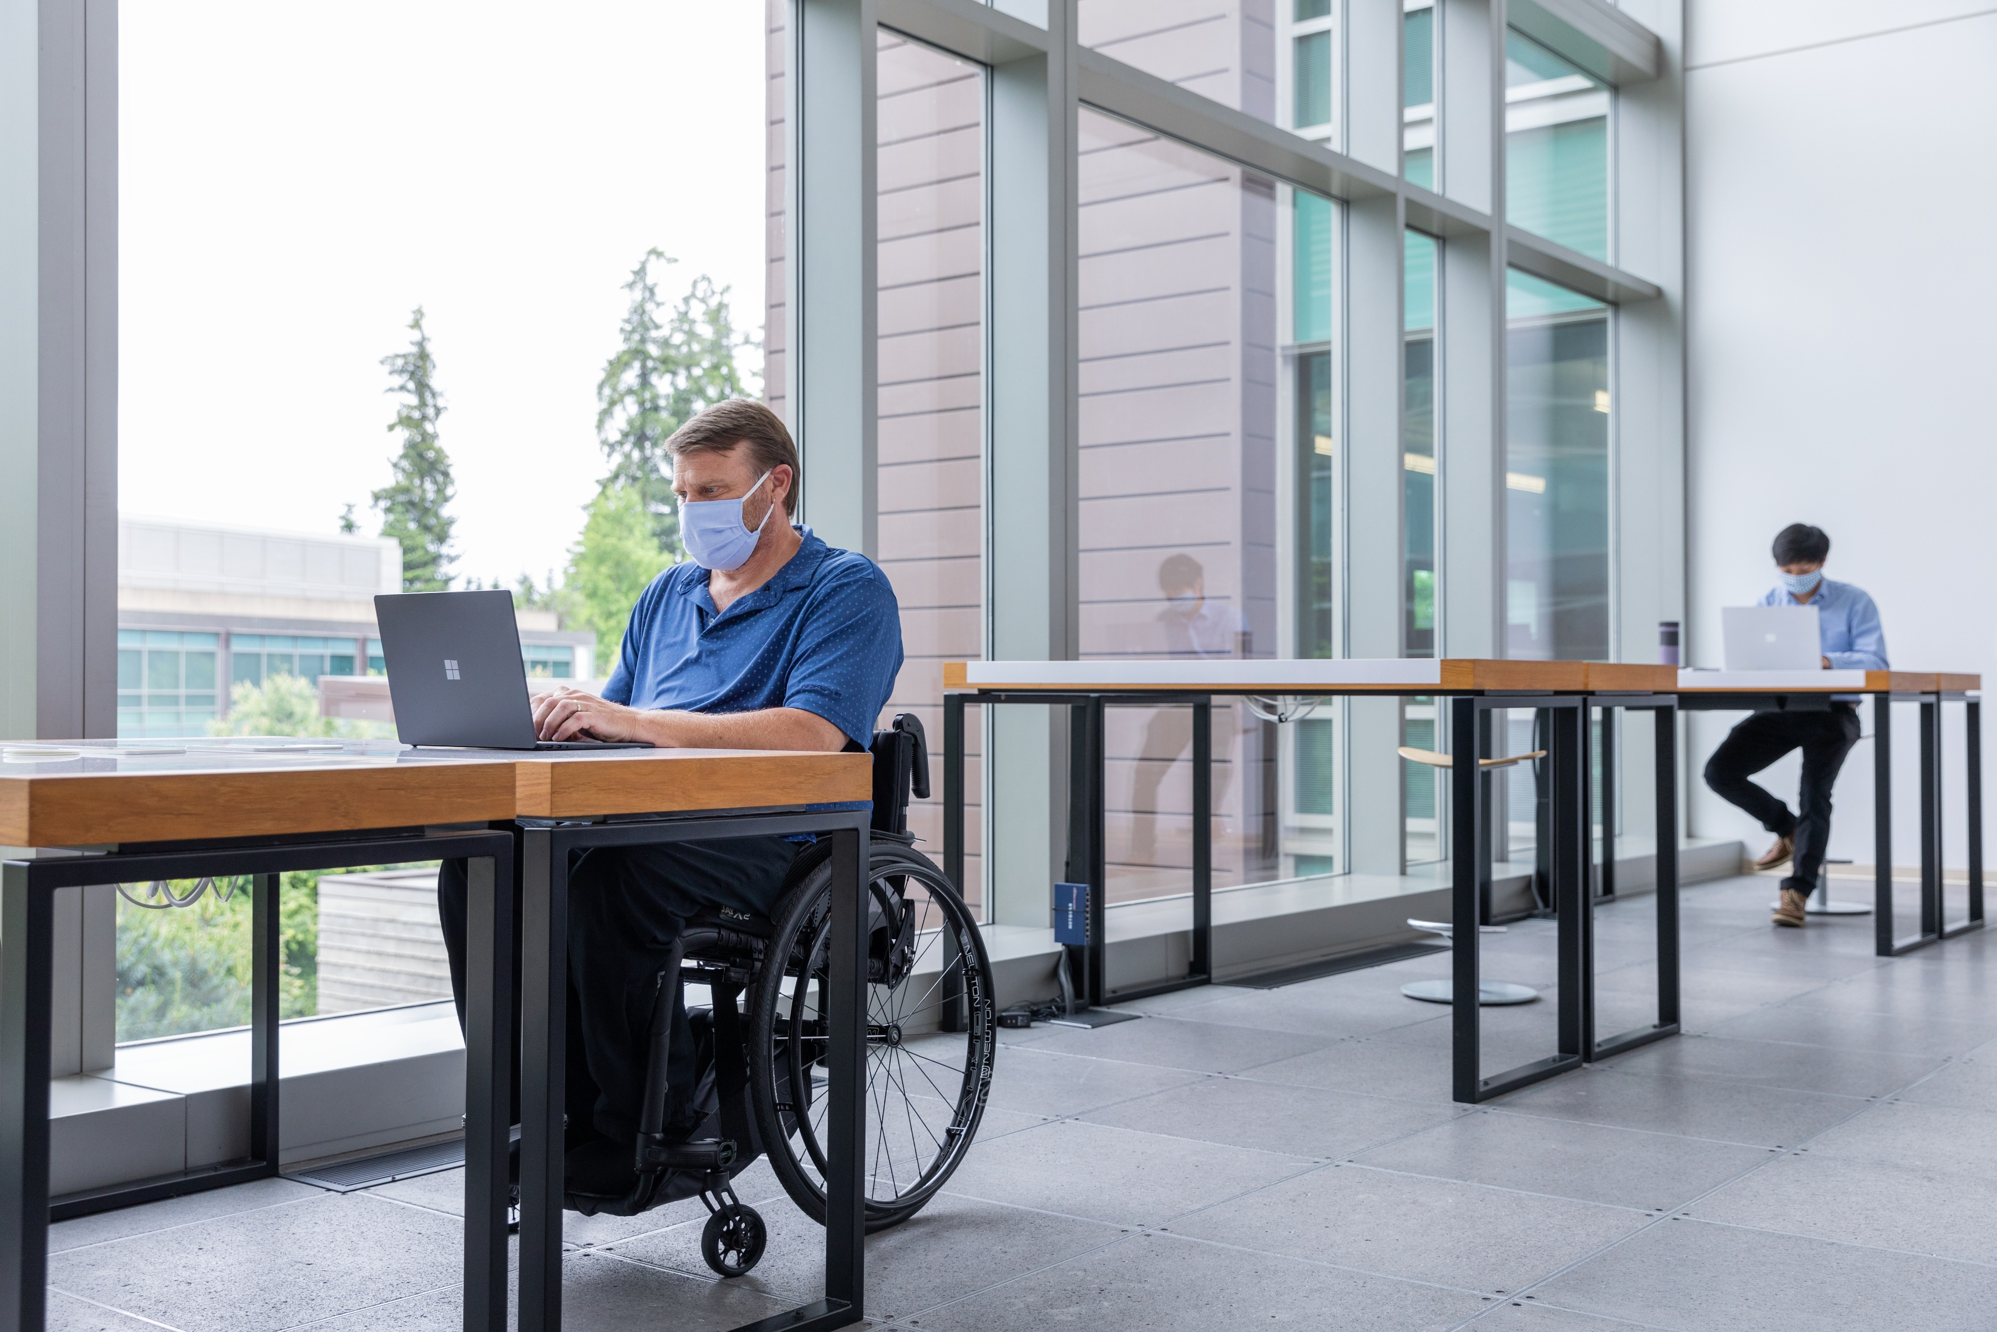
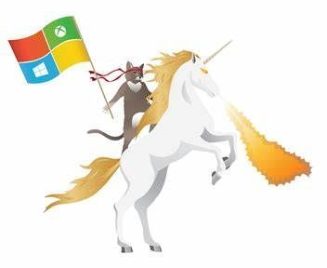
Microlearning #4: Alt Text
Adding a descriptor for a graphic, image, or picture is called Alt Text, which can be used in any Office 365 application.
Who Could Benefit: If you are unable to see an image, whether due to visual impairment or simply because your computer network is slow to download images.
Benefits: If an image is unable to display for any reason, Alt Text will appear in its place so that the user is still aware of what is being represented.
What it looks like: Try to picture the following image in your mind using these 4 descriptions:
1. Graphic
2. C:\Users\Desktop\photo-1492c751f4.jpg
3. Cat riding unicorn
4. A gray ninja cat riding a white fire-breathing unicorn while holding a Microsoft flag.
Which best describes the photo above? To use Alt Text, think about what most properly describes an image.
How to Use it: Learn how to use the Edit Alt Text feature when inserting an image into an Office document or email.

Slide 7
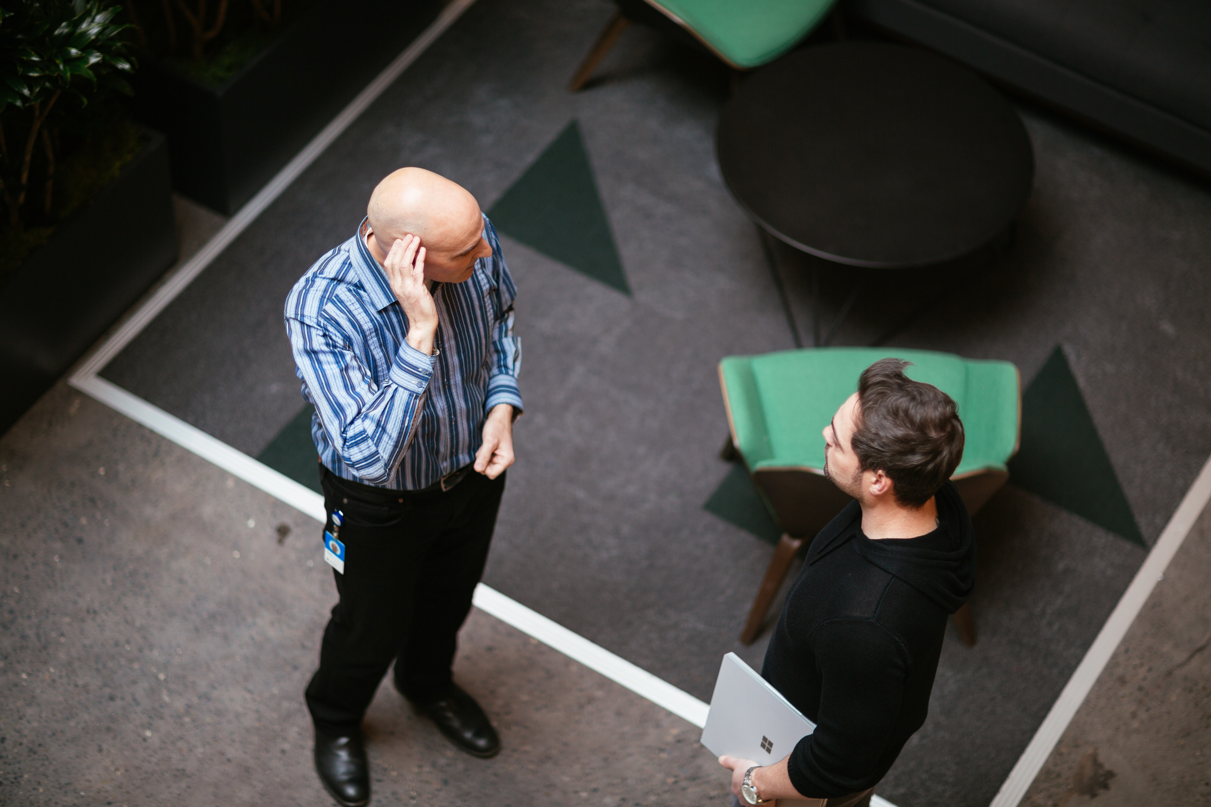
Microlearning #5: Accessibility Checker
What if the job applicant, colleague, or supervisor you are interacting with has a disability that impacts their ability to access materials? Accessibility Checker helps check your work to make sure you’re being inclusive.
Who Could Benefit: Everyone
Benefits: You may not be aware of all the exclusive features that could be present in your documents or emails. Accessibility Checker is an intelligent tool to inform you of these possible nuances.
What it looks like: Under the Accessibility section in Office applications or Outlook, you can find the Accessibility Checker, which will then open a pane to provide suggestions on how to make your document more inclusive.
How to Use it: You can find more information and instructions on how to access the Accessibility Checker here.

