Slide 1
ACCS Provider Webinar Series Session #1: DMH Provider Portal
May 9, 2018

Slide 2
Agenda
Welcome and Introduction
ACCS Provider Webinar Series
WebEx system
Presenters
DMH Provider Portal
Overview of solution
Phase 1 – Address Change and Event File
Upload and Data Validation
On-Boarding
ACCS Provider Survey
Questions and Next Steps

Slide 3
Scope
A secure website will be created to allow providers to upload ACCS Event data in XML format beginning July 1st, 2018.
The system will be built to allow the following at a later date:
Additional ACCS files to be uploaded (e.g. outcome reporting at time of IAP, staff vacancy, contingency funds)
Reporting for other DMH services

Slide 4
File Upload Process
Landing Page Provider user Uploads the XML File
1st Round Validation (Format)
E-mails specific error messages by row number.
1st Round Validation
If Valid, system moves the data to SQL server database
1st Round Complete System sends e-mail confirmation to user & on screen success message
2nd Round Validation (Content)
Data Verified Against DMH Warehouse
2nd Round Validation Verified Data is Stored. Unverified is E-mailed back with specific errors.

Slide 5
Address Change and Event File
Address and housing type changes (non-supervised settings)
Address (Street, City, State, Zip, Phone)
Date of Address Change
Housing Type (Provider Based Independent Setting, Independent Setting, Homeless)
Events
Type of Event (Incarceration, Medical or Psychiatric Hospitalization, Skilled Nursing Facility)
Start and End Dates
Facility Name
Critical Time Interventions
Date of First Face to Face Encounter (after referral)
Date of Care Transition Encounter (after return to community following an event)

Slide 6
Virtual Gateway Login

Slide 7
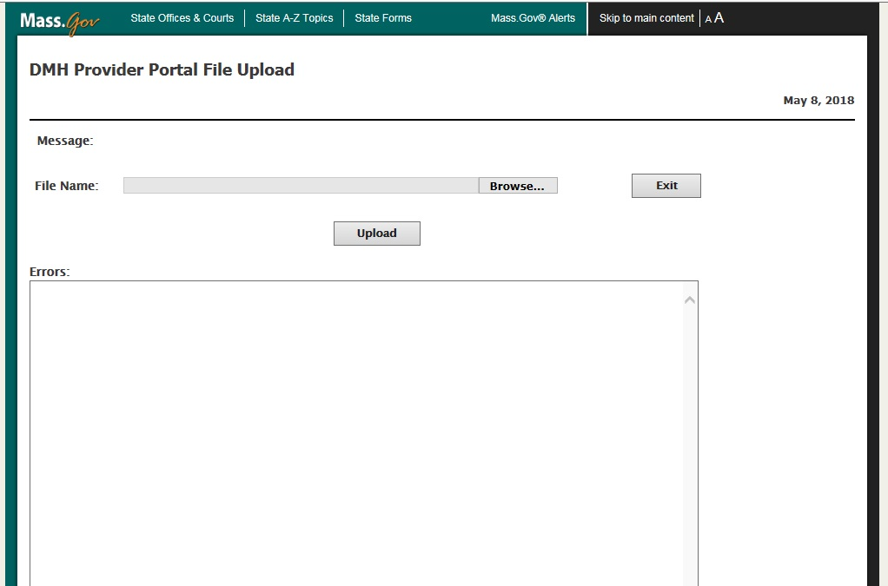
DMH Provider Portal Landing Page

Slide 8
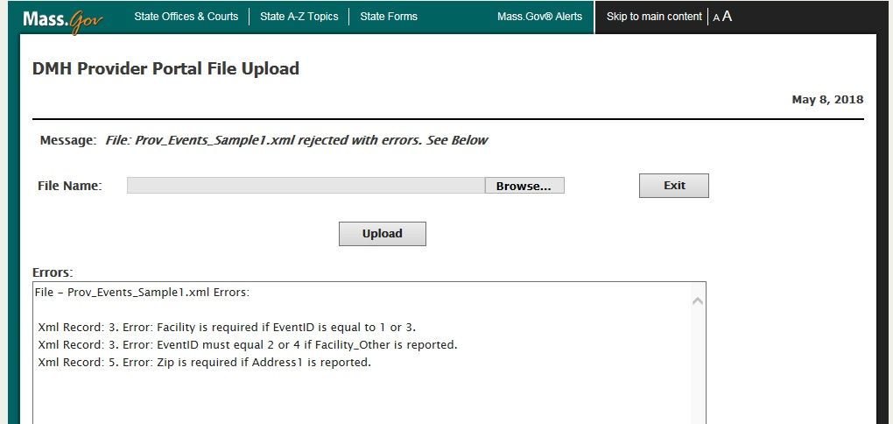
File Upload Errors

Slide 9
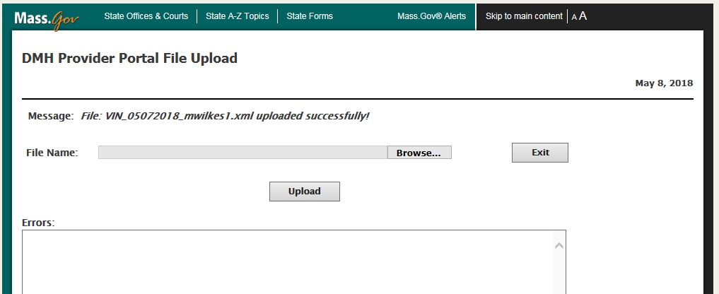
File Upload Success

Slide 10
2nd Round File Validation (next day)
Validate
Results
DMH Provider Portal
DMH Data Warehouse
Valid?
Program
AccountNumber
EventID
Dates
Etc.

Slide 11
2nd Round Notifications
Validation Success
Secure email sent indicating success
Validation Failure
Secure email sent indicating failure
Message will include specific record level messages
Providers will resubmit to the portal only the records which failed validation.
DMH Provider Portal

Slide 12
On-Boarding
Complete User Request Form
Beth Lucas to distribute to ACCS IT Contacts
Return to Beth.Lucas@massmail.state.ma.us by May 18th
Demonstration
Create secure email address
User Guide and webinar training on user interface anticipated in June

Slide 13
ACCS Provider Survey
https://www.surveymonkey.com/r/ACCSProviderSurvey

Slide 14
Questions?

Slide 15
Next Steps
Complete survey by Monday, May 14th
Return User Request Form to Beth.Lucas@massmail.state.ma.us by May 18th
Review final data requirements (to be distributed)
Upcoming Webinar Schedule
May 16th: CANCELLED
May 23rd: Invoicing

