Slide 1
ACCS Provider Webinar Series Session #5: DMH Provider Portal, Part 2
June 20, 2018

Slide 2
Agenda
Introductions
ACCS IT Responsibilities
ACCS Referral Process
DMH Provider Portal Training and Materials
Accessing the Provider Portal and Uploading a File
Validation Process
Reports
Questions
Next Steps

Slide 3
Introductions
Beth Lucas
Assistant Commissioner for Mental Health Services
Mary Merrill
DMH Data Warehouse Lead
Tony Longo
Director of Shared Application Teams and Services
Ursula Macmillan
EHS Business Analysis Team Lead

Slide 4
ACCS IT Responsibilities
One Time Responsibilities
Establish a Dedicated Mailbox
Receive automated data transmissions from DMH
Return Dedicated Mailbox Address to DMH
All ACCS providers have completed this step
Ongoing Responsibilities
Access the Internet to use Secure Mail and DMH Provider Portal
Process and Transmit XML files

Slide 5
Virtual Gateway
ACCS Providers will use the Virtual Gateway’s secure website to upload ACCS data in XML format.
All ACCS Providers have submitted a User Request Form to DMH.
After July 1st, additional users may be added by completing the DMH Provider Portal User Request Form
https://www.mass.gov/service-details/user-request-forms
Forms are emailed to: VirtualGatewayHelpDeskFaxes@massmail.state.ma.us

Slide 6
ACCS Referral Process
DMH refers the client to the provider by emailing the referral form to the provider via secure mail.
DMH Warehouse sends the Client Data Summary Notification to the providers dedicated mailbox via secure mail.
ACCS provider submits the date of the first face to face encounter to DMH.
The submission of the face to face date triggers the enrollment in an ACCS service.
At the time of enrollment, DMH Warehouse sends the Client Action Notification to the providers dedicated mailbox via secure mail.
The client’s record is available in EIM for Service Delivery Reporting (SDR).

Slide 7
DMH Provider Portal User Training
User Training scheduled for: Monday, June 25th, 1-2:30 pm
Documents
IT/Data Exchange Requirements, Version 1.0
Appendix A: Definitions, Acronyms and Abbreviations
Appendix B: ACCS Provider Mnemonics
Appendix C: ACCS RFR
Appendix D: ACCS Event Reporting
Appendix E: ACCS Facilities
Appendix F: Notifications/Reports Distributed to ACCS Providers (Sample)
Appendix G: XSD Template/Schema
Appendix H: Provider Events.xls
Appendix I: Round 1 – Validation Error Messages
Appendix J: ACCS Phase 1 – Data Elements

Slide 8
Data Reporting Requirements
Address and housing type changes (non-supervised settings)
Address (Street, City, State, Zip, Phone)
Date of Address Change
Housing Type (Provider Based Independent Setting, Independent Setting, Homeless)
Phone Number
Events
Type of Event (Incarceration, Medical or Psychiatric Hospitalization, Skilled Nursing Facility)
Start and End Dates
Facility Name
Critical Time Interventions
Date of First Face to Face Encounter (after referral)
Date of Care Transition Encounter (after return to community following an event)

Slide 9
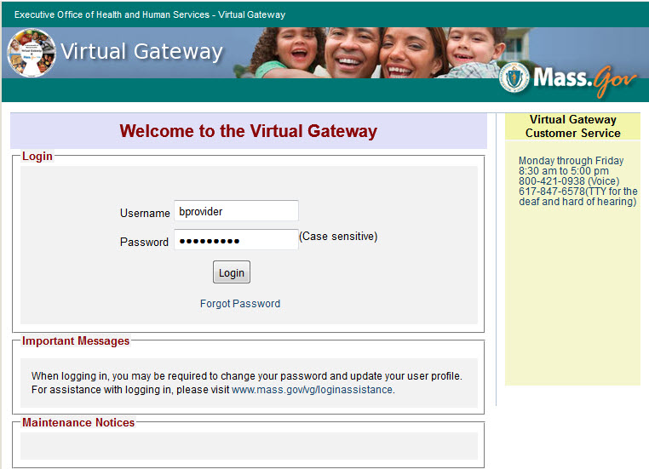
Accessing the DMH Provider Portal

Slide 10
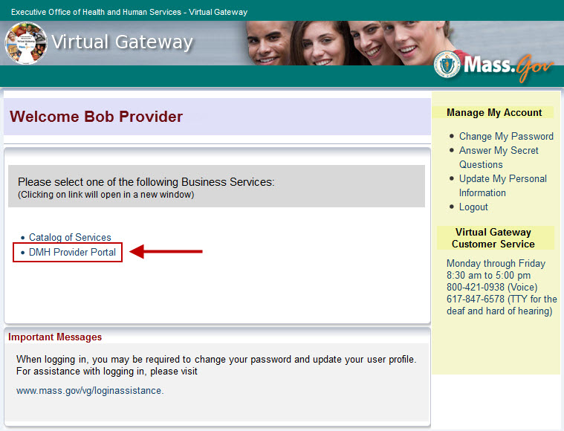

Slide 11
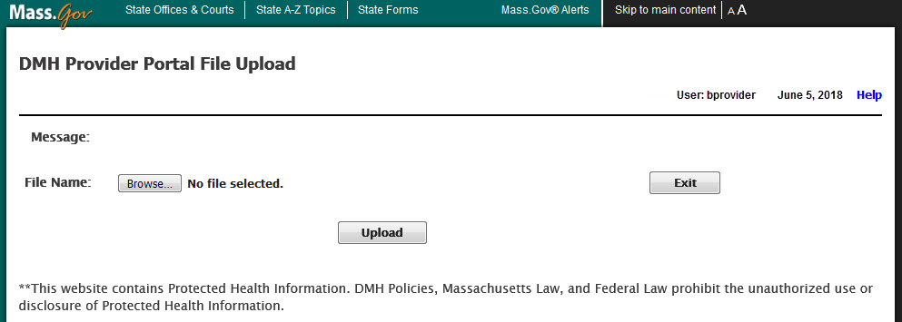
Uploading a File

Slide 12
Round 1 Validation
Virus: Scans file to be uploaded for possible virus.
File Name Convention: The file name follows the allowed file name convention:
Example of Acceptable File Name: PRO_20180529_Events1.xml
Example of Unacceptable File Name: PRO 20180601_Events1.xml
File Duplicate Name: No other previously uploaded file has the same name for a given day.
Required fields: All required fields, by row, are completed.
Format: All fields are in acceptable format.
.XML Extension: File must contain .XML extension.

Slide 13
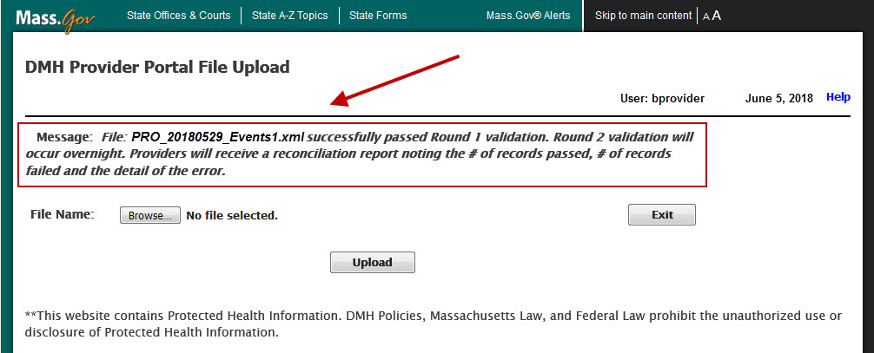
Round 1 Validation Success
Success validation message appears on Provider Portal screen when XML file meets all critera.

Slide 14
Round 1 Validation Success, continued
Confirmation email sent to Dedicated Mailbox
From:DONOTREPLY_DMHACCS@STATE.MA.US [mailto:DONOTREPLY_DMHACCS@STATE.MA.US] Sent: Day of Week, Month Date, YYYY00:00 AM/PM To: Provider Dedicated Mailbox Subject: Secure: Success Round 1 – UserID - FileName
Filename: PRO_20180529_Events1.xml_datesx1.xml uploaded at: 5/29/2018 3:03:46 PM.
Number of records uploaded: 3.
File: PRO_20180529_Events1.xml successfully passed Round 1 validation. Round 2 validation will occur overnight. Providers will receive a reconciliation report noting the # of records passed, # of records failed and the detail of the error.

Slide 15
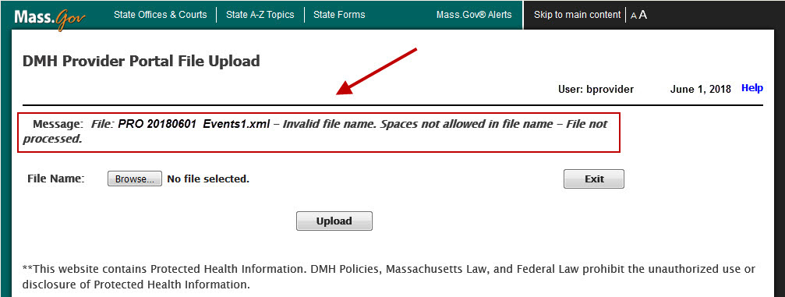
Round 1 Validation: Errors
Error validation message appears on Provider Portal screen when XML file fails to meet the criteria.
Provider reviews errors, makes corrections and resubmits file for processing

Slide 16
Sample Rejection Email Template
From:DONOTREPLY_DMHACCS@STATE.MA.US [mailto:DONOTREPLY_DMHACCS@STATE.MA.US] Sent:Day of Week, Month Date, YYYY00:00 AM/PM To: Provider Dedicated Mailbox Subject: Secure: Error Round 1 – UserID - leName
Filename: PRO_20180601_Event1.xml uploaded at: 06/01/2018 9:51:40 AM
Filename: PRO_20180601_Event1.xml rejected with errors
File Upload Errors:
XML Record | Client Name | ProgramID | Account Number | Error Message
8 | John Doe | PROACCS1 | FW000009999 | Address1 is required if HousingID = 1 or 2.
8 | John Doe | PROACCS1 | FW000009999 | City is required if HousingID equals 1 or 2.
8 | John Doe | PROACCS1 | FW000009999 | State is required if HousingID equals 1 or 2.
8 | John Doe | PROACCS1 | FW000009999 | Zip is required if HousingID equals 1 or 2.

Slide 17
Round 2 Validation
The record level validation process will be executed each night.
For every file processed the provider will receive an ACCS Reconciliation Report
(see Appendix F for sample – ACCS Reconciliation Report).
Provider reviews the report and correct any errors reported.
Only resubmit those records in error.

Slide 18
Notifications/Reports
Notification/Report | Action | Frequency
Client Data Summary | DMH: Client is Pre-Enrolled ACCS: Receive client’s account number and summary data Report first face-to-face encounter | Daily
Client Action Notification | DMH: Enrollment (including cancelled & modified dates) Disenrollment (including modified dates) ACCS: Submit address, phone, housing and/or event data as needed Client now available in EIM for billing | Daily
Program Census Report | Informational | Weekly, each Friday
Reconciliation Report | ACCS: Note records passed and records with errors that need to be corrected and resubmitted | Daily

Slide 19
Transition to ACCS
Initial Reports and Address Changes
As DMH enrolls clients into each program the DMH Warehouse will send an excel file to the ACCS provider with the census, including program/contract, account number and address.
ACCS provider reviews and updates addresses, submitting changes to DMH via xml file reporting.
DMH will begin distribution of the Client Data Summary and Client Action Reports with pre-enrollments/enrollments as of 7/2/18.
Face to Face Encounters
Face to Face dates for enrollments with a start date of 7/1/18 will be generated by DMH.
ACCS Providers report Face to Face dates for pre-enrollments as of 7/2/18 and forward.
Open Events at Time of Transition
For clients with an open event on 7/1/18, ACCS provider submits a new event with a start date of 7/1/18.

Slide 20
Contact Information
Questions regarding the DMH Provider Portal and Data Processing:
Virtual Gateway Customer Service
Monday through Friday 8:30 am to 5:00 pm 800-421-0938 (Voice) 617-847-6578 (TTY)
The Virtual Gateway Customer Service will create a ticket and assign to Tier 2 DMH.Provider Portal Group.

Slide 21
Next Steps
Tentative schedule of ACCS Provider Webinar Events:
6/27: ACCS Referral Process
7/4: Holiday
7/11: TBD
User Training scheduled for: Monday, June 25th, 1-2:30 pm
All ACCS provider staff that were included in the User Request Form will be send at email invitation from Mary Merrill.

