Slide 1
Public Listening Session:
HPC ACO Certification Program
January 23, 2019

Slide 2
Agenda
Overview of HPC ACO Certification Program
Review of Proposed 2019 Standards
Review of Proposed ACO Distinction Program
Timeline and Next Steps

Slide 3
Agenda
Overview of HPC ACO Certification Program
Review of Proposed 2019 Standards
Review of Proposed ACO Distinction Program
Timeline and Next Steps

Slide 4
Health Policy Commission Care Delivery Vision
The HPC’s care delivery transformation vision is that providers and payers are patient-centered and accountable for high-value care across a patient’s medical, behavioral, and health-related social needs.
ACO Certification Program Values
Support the HPC’s care delivery vision through certification standards-setting
Encourage ACOs to work with non-medical providers in the community as needed to support the full spectrum of patient needs
Commit to regular assessment of the program to ensure continuous improvement and market value
Increase public transparency while balancing administrative burden for providers in Massachusetts

Slide 5
ACO Certification aims to promote ongoing transformation and improvement over time
Current
Market
Multiple ACO programs in the market
  Medicare ACOs (i.e., MSSP, Next Gen)
  Commercial programs (e.g., BCBSMA’s AQC)
  MassHealth ACOs
Evidence on the relationship between ACO capabilities and outcomes is still developing
Initial Focus
of
HPC ACO Certification
Create a set of multi-payer standards for ACOs to enable care delivery transformation and payment reform
Build knowledge and transparency about ACO approaches
Facilitate learning across the care delivery system
Align with and complement other standards and requirements in the market, including MassHealth, Connector, and Dept. of Public Health
Develop the evidence base on how ACOs achieve improvements in quality, cost, and patient experience
Move certification standards from structural/process requirements to quality outcomes and cost performance requirements
Create a “model ACO” distinction program to recognize exceptional performance
Engage additional payers and purchasers
Vision for Certification

Slide 6
Agenda
Overview of HPC ACO Certification Program
Review of Proposed 2019 Standards
Review of Proposed ACO Distinction Program
Timeline and Next Steps

Slide 7



Overview of Proposed 2019 ACO Certification Requirements
Background
Information
Attestation or updates to
2017 standards
Supplemental
questions
  Assessment Criteria
Governance structure
Patient/consumer representation
Performance improvement activities
Population health management programs
Cross-continuum care
Optional new performance-based
Distinction program

Slide 8
Background Information: Summary of Applicant Organization, ACO Participants, and Risk Contracts
Summary of Applicant Organization
Descriptions of the applicant’s organization, history, and mission
Massachusetts regions in which the ACO provides care
Applicant organizational chart
ACO Participants
If not already apparent in MA-RPO data
List of participating primary care practices (site level) and hospitals
Narrative of any differences between the providers that participate in each risk contract
Risk Contracts and Performance
Completion of two templates reporting:
Details of each risk contract, including payer, number of covered lives, years in contract, and financial terms (e.g. full or partial risk, max. shared savings/losses, etc.)
For the two most recent performance years: final ACO-level quality performance on all measures included in risk contracts from the Massachusetts Aligned Measure Set, and any additional ambulatory measures in risk contracts

Slide 9
2019 Proposed Assessment Criteria Approach
1
Governance structure
No changes to the 2017 assessment standards or documentation requirements, except risk contract information will be collected in Background Information section
Applicants required to update 2017 responses to reflect any changes since submission
If there have been no changes, Applicants may attest that the 2017 response is still fully applicable
2
Patient/consumer representation
3
Performance improvement
4
Quality-based risk contracts
5
Population health management
6
Cross-continuum care

Slide 10
2019 Proposed Supplemental Questions Section
Two types of questions to address distinct, complementary goals. Responses could inform future ACO certification standards and “model ACO” development.
Adding to the Evidence Base
Questions aimed at adding to and/or filling identified gaps in the current evidence base. Topics may include:
Distribution of shared savings and performance-based provider compensation
Providing high-value care
Behavioral health integration into primary care
Advanced health information technology-enabled care coordination
  Adding to the Evidence Base
  Emerging Topics
Emerging Topics
Questions to explore ACO approaches to emerging areas of focus in integrated, patient-centered care delivery.
Topics may include:
Integrated, innovative care models
  Patient-centered advanced illness care
  Oral health integration
  Medication for addiction treatment strategy
  Care for co-occurring disorder
  Telemedicine
  Paramedicine/Mobile Integrated Health
Strategic focus on the SDH
  Food; housing; early childhood development
Workforce
  Use of recovery coaches, community health workers, etc.

Slide 11
Agenda
Overview of HPC ACO Certification Program
Review of Proposed 2019 Standards
Review of Proposed ACO Distinction Program
Timeline and Next Steps

Slide 12
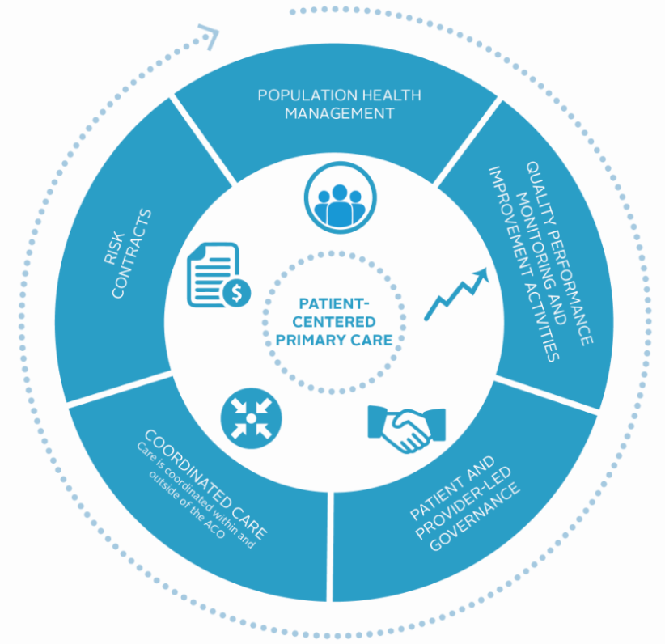

Proposed New Distinction Program for HPC-certified ACOs
A new, voluntary addition to basic ACO Certification, this program would recognize ACOs that have achieved performance improvements in the domains of the triple aim — health outcomes, care, and cost — plus health equity, and have made commitments to continue improving.

Slide 13
Agenda
Overview of HPC ACO Certification Program
Review of Proposed 2019 Standards
Review of Proposed ACO Distinction Program
Timeline and Next Steps

Slide 14
Timeline and Next Steps
Sept 2018-Nov 2018 | In-person stakeholder engagement: One-on-one meetings and convenings with ACOs, state agencies, and consumer groups to gather input
November 28, 2018 | HPC presents proposed 2019 program to Care Delivery Transformation (CDT) Committee
December 2018-February 2019 | Stakeholder engagement public comment period
January 23, 2019 | Public listening session
February 8, 2019 | Written public comment due
February 27, 2019 | HPC CDT Committee approves final 2019 ACO Certification standards
March-June 2019 | HPC develops and issues 2019 Application Requirements and Platform User Guide

