Slide 1
ACP, TPP, RAFT Program Reminders, & HHH Updates
EOHLC Office Hours
Thursday, January 29th, 2026

Slide 2
Welcome

Slide 3
Engagement Best Practices
Asking Questions
We will be monitoring the chat for questions
If at any point throughout today’s session you have any questions, please send those in the Teams Meeting Chat. We will also have two questions breaks during today's session as well.
You can also raise your hand during our question break if you would prefer to come off mute and share your question verbally
We will make sure to share today’s presentation and with everyone after the session

Slide 4
Agenda
Processing RAFT applications from Address Confidentiality Program (ACP) Participants
Tenancy Preservation Program (TPP) Reminders
Question Break
RAFT Program Reminders:
Zendesk tickets + Fraud Reminders
Omni Channel
Reassigning to Overflow Agencies (RAP Center)
HHH archiving & Job Aid
Question Break

Slide 5
RAFT Process for ACP: ACP Overview and EOHLC Exemption
The Address Confidentiality Program (ACP) is offered by the Secretary of the Commonwealth to protect the confidentiality of a domestic violence survivor's address. ACP provides its program participants with a safe substitute address, which state agencies must use as the participants' legal address in MA (unless ACP has granted the agency an exemption) ​
ACP has granted EOHLC an exemption from using the ACP substitute address to process RAFT applications. This means that when we check eligibility for the RAFT program, we are allowed to use an ACP participant’s current residential address or the address of the unit they are moving into instead of using the ACP substitute address
To comply with the exemption requirements, we must follow the steps outlined on the next slide

Slide 6
RAFT Process for ACP: Steps
Steps to follow (in this order):
RAA confirms that the RAFT applicant is a current ACP participant, which could be through their ACP identification card or a letter from ACP, or by reaching out to the ACP Program Manager, Liza Packer (Liza.Packer@sec.state.ma.us). However, RAA may not question an ACP participant about the details or circumstances of their inclusion in ACP
RAA emails EOHLC (Ricky) about the ACP-involved RAFT application. EOHLC may also identify ACP participants in its monthly review of the Housing Help Hub ACP participant report
EOHLC provides the ACP-involved applicant requesting use of ACP-issued substitute address with a copy of the EOHLC exemption letter by email
EOHLC notifies ACP by email that EOHLC has provided the exemption letter to the ACP-involved applicant
EOHLC enters the following Case Comment in HHH to indicate ACP involvement: “Applicant is participating in the Address Confidentiality Program (ACP) and disclosure of applicant address outside of Housing Help Hub is not permitted.”

Slide 7
RAFT Process for ACP: Further Information
RAAs should follow steps one and two in the previous slide, while EOHLC will take care of the other steps
When processing the RAFT application, RAAs cannot disclose the ACP participant’s address outside of Housing Help Hub!
For any questions about the RAFT process for ACP participants, please reach out to Ricky at ricky.hartman@mass.gov
To learn more about ACP, please refer to the November 6, 2025, Office Hours presentation and recording on the RAA Resource Portal

Slide 8
TPP Reminders
The Tenancy Preservation Program (TPP) is a short-term homelessness prevention program that works with individuals and families with disabilities, behavioral health disorders, and complex health needs who are facing an eviction related to the disability or health condition
TPP develops a housing stability plan for clients to maintain their tenancy and monitors the household until stabilized
Tenants who are ineligible or waitlisted for TPP services may receive consultations for information and referrals
RAFT Good Cause letters from TPP are available for TPP clients only (not consultations)
Referrals to TPP should not solely be based on obtaining a Good Cause letter
TPP eligibility criteria and contact information for the TPP agency in your region can be found in the October 9, 2025, Office Hours slides on the RAA Resource Portal

Slide 9
Question Break 1

Slide 10
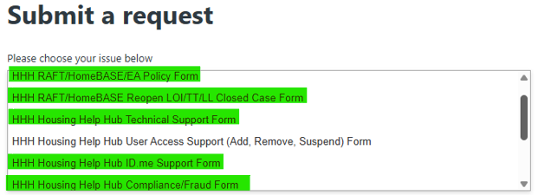
Zendesk Tickets, Forms & Urgency Levels
Please select the correct Zendesk ticket form for your inquiry:
Policy questions
Re-open cases
Technical issues
ID.me support/verification
Compliance & fraud
Other forms: payment-related issues, new vendors, Zendesk access
Urgency of tickets – definitions:
LOW
Not urgent, response can be 5+ business days
NORMAL
Not urgent, need a response in 3-5 business days
HIGH
Need a response within 2 business days
URGENT
Critical questions that require a response within 24 hours

Slide 11
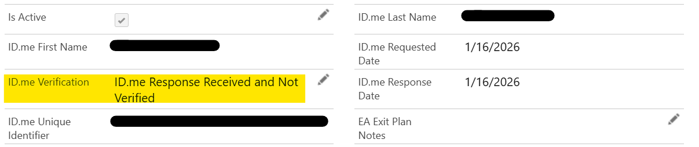
Zendesk Tickets, Fraud & ID.Me Reminders
Fraud-related Zendesk tickets
Recommend uploading checklist to the case if the RAA would like to proceed with payment despite any irregularities found in review.
Please refrain from submitting tickets for a second opinion.
Utilize the fraud review checklist & deny where appropriate.
If an applicant requests Administrative Review for a denial for suspected fraud and RAA is not confident upholding the denial, RAA may submit a ticket with a completed fraud review checklist.
ID.me support/verification tickets
If ID.me response is “ID.me Response Received and Not Verified”, RAA may submit a Zendesk ticket to request manual verification after confirming the identity.
Please include an explanation or justification for manual verification, i.e. RAA has met with the tenant and verified their identity.
Please note that we cannot manually verify the ID.me response if their name does not appear to match.

Slide 12
Zendesk Tickets, General Reminders & Resources
General Reminders
RAA Support/Resources
Direct questions to your supervisor first, then contact us via Zendesk as a point of escalation if needed.
Include as much relevant information as possible, including any helpful screenshots.
Make sure your question is clear.
Please include the entire, correct case number, including all preceding 0's.
Use Zendesk for case-specific questions, always including a case number, rather than hypothetical situations.
For general hypothetical questions, please confer with your internal team, then reach out to your Readiness Coordinator if further guidance is needed.
RAA Resource Portal: central resource to provide RAA staff with key updates, training and learning opportunities, and helpful information to support programs.
FY26 RAFT Admin Plan that provides additional program guidance.
Zendesk training materials offer helpful info on processing within HHH/Salesforce.

Slide 13
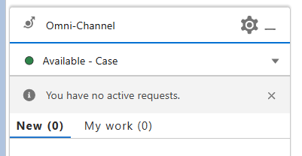
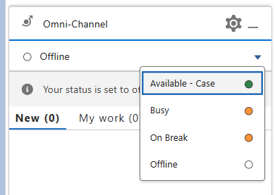
Omni Channel
Columns | Definition
"New" | Cases available for you to accept
"My Work" | Cases you have accepted and are working on
Statuses | Definition
Available | Cases will route to you
Offline | Cases will not route to you
Busy | Please do not use
Reminder: Manually assigning cases can disrupt case routing
Zendesk Video: How to Get Your Work in the Omni Channel

Slide 14
Re-assigning Cases to The Overflow RAA's (RAP Center)
If your RAA has a case that needs to be manually re-assigned to one of the Overflow RAA's to process, please inform your manager, so that they can escalate to your RAA's assigned readiness coordinator.
When managers are escalating to EOHLC Readiness Coordinators, please ensure to include the reason for the transfer request.
The case must be in "Chaser" stage for the case to appear in the overflow RAA's queue once transferred.
As always, please ensure to put a case comment in the case with the details of the transfer request.

Slide 15
HHH Own Archiving
Housing Help Hub (HHH) has a Salesforce data storage limit that EOHLC actively monitors to maintain system performance. To manage storage and prevent capacity issues, EOHLC has implemented OWN Archive, a Salesforce-integrated archiving tool.
OWN Archive automatically moves older, inactive cases out of HHH on a daily basis while still allowing staff to view them when needed.
What happens when a case is archived
Archived cases are no longer visible directly in HHH case lists
Archived cases remain accessible through Contact Cards
Archived cases do not appear in HHH reports or dashboards
Archived cases can be unarchived if necessary
Archiving runs automatically on a daily basis, with additional cases archived over time

Slide 16
Archiving Rules
Cases are archived on a rolling basis based on the following criteria:
Closed Cases
Closed date is more than 13 months old
Case is in one of the following statuses:
Tenant/Landlord Document Timeout
Tenant Document Timeout
Landlord Document Timeout
Cancelled
Duplicate
Withdrawn
App Timeout
Case is not associated with a Pallium list item
Denied Cases
Denial date is more than 18 months old
Case was not denied due to Suspected Fraud
Will be implemented in 1/29/26 build. Cases denied for Suspected Fraud prior to July 2024 are archived
Paid cases are not archived
All payment and approval data remains complete and available in HHH

Slide 17
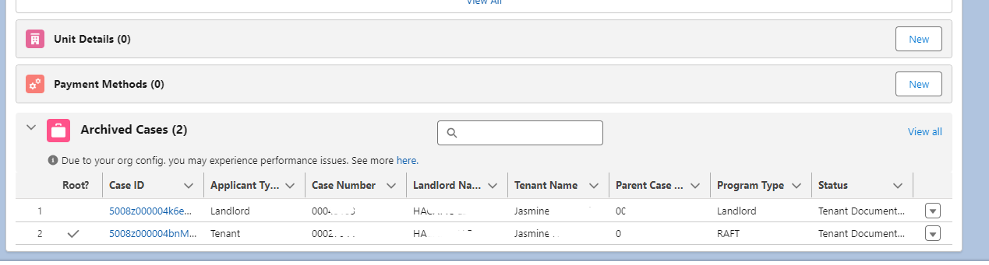
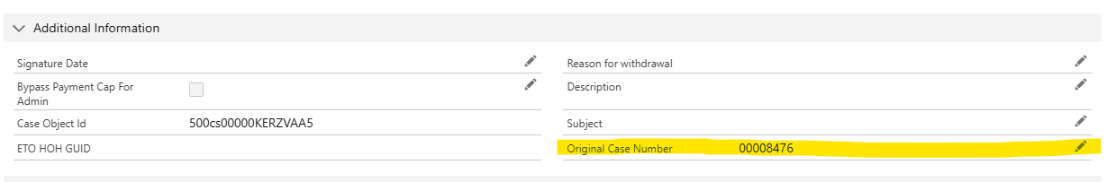
Archived Cases
How to View an Archived Case
Navigate to the Contact Card
Scroll to the bottom of the Related tab
Archived cases are listed there
Staff can open archived cases to view:
Case details
Related records
Documents
Unarchiving a Case
If a case needs to be restored, submit a Zendesk ticket to EOHLC
Use the HHH Technical Support form
Once unarchived:
The case will return to HHH
A new case number will be assigned

Slide 18
Own Archiving
Impact on Reporting
Archived case data does not pull into HHH reports or dashboards
Reports that look back more than one year (RAFT or HomeBASE data) will appear incomplete
Accessing Data for Archived Cases
If an RAA needs access to data including cases that have been archived, submit a Zendesk ticket to EOHLC
EOHLC has access to data back-ups that are done on a daily/weekly/monthly basis with different information
Data is stored in large .csv files that would need to be shared by secure transfer
EOHLC is working to include archived data in Snowflake, so that the archived data is more easily accessible

Slide 19
HHH Updates
January 29th Build:
RAFT
MH/DTA check for Movers
Omni Channel Re-Offering
Own Archive – Stop archiving suspected Fraud
RAFT Denial Reasons
Add – RAFT Does not solve Housing Crisis
(For Information on When to Use This New Denial Reason, Please Review The 1.15.26 Office Hours Here)
Remove – No funding
EOHLC will be sending out a full 1/29 build update tomorrow, please review and share with all staff

Slide 20
Question Break 2

Slide 21
RAA Resources
Resources
RAA Resource Portal
Only for RAA staff, this resource provides key updates, training and learning opportunities, and helpful information to support programs including FAQs.
Zendesk Training Materials
Only for RAA staff, this resource offers helpful info on processing within HHH/Salesforce
RAFT Public Resource and Training Portal
Resources are available for public community-based organizations and other partners with information about the RAFT program.

Slide 22












THANK YOU!
+

