Slide 1
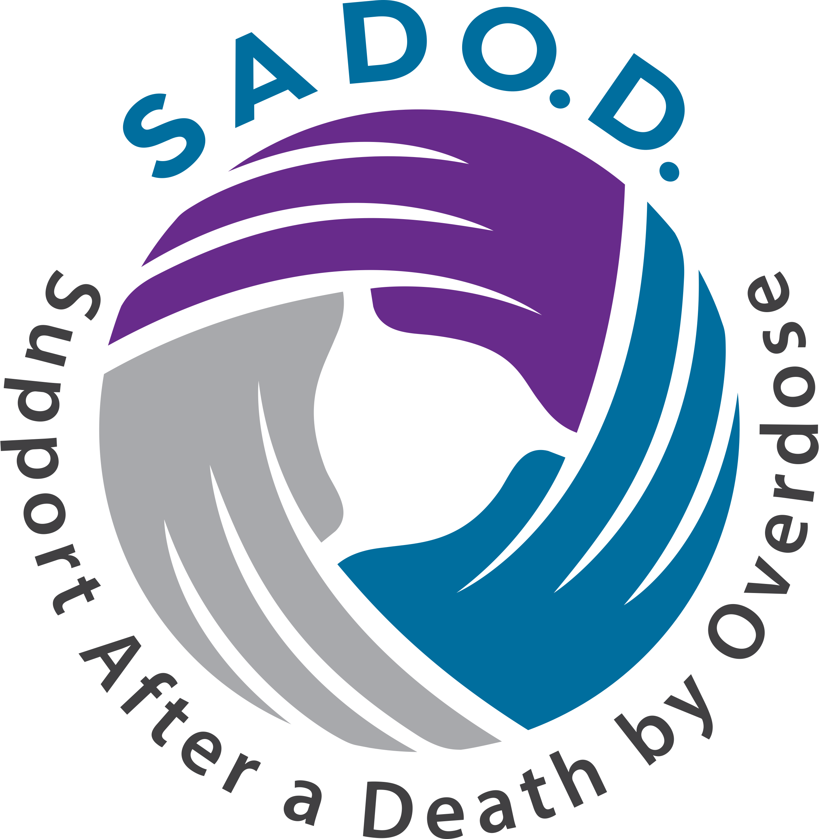
Post-Fatality Support in Response to the Opioid Epidemic
March 23, 2022
Funded by the Massachusetts Department of Public Health

Slide 2
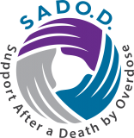
Support After a Death by Overdose
Project launched in 2019
Funded by the Department of Public Health
Develops and implements peer support programs that serve:
Bereaved people in MA communities
Frontline Service Providers
People In or Seeking Recovery
Provides training, technical assistance, and information
SADOD website & newsletter
Peer grief support groups
Peer Grief Ally Program: One-on-one peer support
Longtime relationships with service providers statewide
First state conference for people bereaved by substance use
October 2022
2
2

Slide 3
Post-Fatality Support Saves Lives
Post-fatality support is a vital component of responding to the opioid epidemic.
Strengthening post-fatality support in Massachusetts would:
Improve the outcomes of “OUD prevention, intervention, treatment, and recovery” programs.
“Mitigate the impacts of the opioid epidemic” on families, communities, and local and state government.
Save lives.
* Quotes from the Opioid Recovery and Remediation Fund Advisory Council Statute
3
3

Slide 4
330,000 Grieving People (2011-2021)
Bereaved people in MA communities:
2011-2020 = 15,688 deaths
2011-2020 = 15,688 deaths
21 people per fatality = “Very high degree of closeness” to the deceased
21 people per fatality = “Very high degree of closeness” to the deceased
329,448 people affected in the past decade
329,448 people affected in the past decade
2021 – 2030?
2021 – 2030?
Frontline Service Providers
130 agencies deliver treatment at 500 sites.
Overdose Deaths Top 100,000 Anually in US
130 agencies deliver treatment at 500 sites.
Overdose Deaths Top 100,000 Anually in US
2,000 licenses-certifications specializing in addictions
2,000 licenses-certifications specializing in addictions
10,000+ mental-health-related licenses-certifications for professionals who encounter substance abuse in the course of their work
10,000+ mental-health-related licenses-certifications for professionals who encounter substance abuse in the course of their work
People In or Seeking Recovery
2015 = 275,000 people in MA with OUD (4.6% of population >age 11)
4

Slide 5
Lack of Post-Fatality Support
Leaves bereaved people alone to face a sudden and stigmatized death.
Leaves Frontline Service Providers with insufficient resources to offer families in the wake of a client’s death.
Damages Frontline Service Providers’ health and causes burnout and turnover.
Overdose Deaths Top 100,000 Anually in US
Decreases program effectiveness for People In or Seeking Recovery.
Damages the health of People In or Seeking Recovery’s and makes it extra-difficult for them to be in recovery.
Results in more lives lost.
Statewide & Systematic Peer-Based Post-Fatality Support.
5
5

Slide 6
Goal: Workforce Development
- 38 in MA (20 virtual monthly)
- SADOD provides Training, Tech
Assist
- Special group start-ups
- Partnership with TSWR
Overdose Deaths Top 100,000 Anually in US
Peer Grief Support Groups
- Completed successful pilot with LTC
- 13 volunteers
- Second training under way
- Expanding beyond pilot
- People served mostly newly bereaved
One-on-One Peer Grief Allies
- Network of 25 PGHs
- Twice-monthly Peer Support for Peer
Helpers
- Monthly facilitator in-service-style
trainings
- PGHs originated HTM, PGAP, & 1st
conference
Peer Support for Peer Helpers
PEER HELPER WORKFORCE DEVELOPMENT
6

Slide 7
Massachusetts Is Leading the Way
“Finally, we’ve taken bold action to tackle the opioid crisis, and have shown the rest of the nation the way forward. Working together, we nearly tripled state spending on prevention and treatment, and what was a public policy catastrophe now offers hope for families.”
Governor Baker - Twitter · January 21, 2020
SADOD offers hope to families through post-fatality support
- Integrated statewide approach
- Strong Partnerships
- Peer-led program design
- Piloting programs
- Training volunteers
- Creating community
- Building Infrastructure
7
7

