Slide 1
Current Research efforts in the prevention and treatment of Alzheimer’s Disease (AD) and Related Dementias
Notes:
questions to ask:
Do you think it would be useful to add the slides presenting patient cases for each type of dementia?
Should we remain borad for all types of dementia’s prevention/treatment, or is it ok to go in detail for each?
Should it be all prvention and then all treatment or should be separate by type of dementia

Slide 2
What’s new?
New and More effective Biomarkers
New Diagnostic Framework :
New “A/T/N” Framework
New Framework conceptualizes AD as a continuum from pathophysiological, biomarker and clinical perspectives.
LATE (Limbic-predominant, Age-related, TDP-43 Encephalopathy) looks like Alzheimer’s disease
Alzheimer’s pathophysiology starts decades prior to clinical disease!

Slide 3
1. New and More Effective Biomarkers

Slide 4
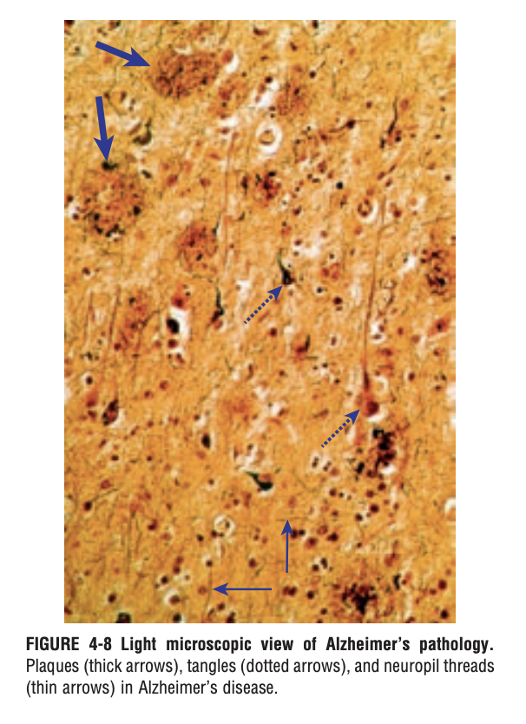
AD Pathology
Alzheimer’s Disease consists of two main features:
Senile plaques (β-amyloid)- earliest pathological event!
Neurofibrillary tangles (hyperphosphorylated tau)- primary culprit in cells death
Mechanism:
β-amyloid
hyperphosphorylated tau
tau spreads throughout the brain from neuron to neuron (Pooler et al, 2013).
Cell Death

Slide 5
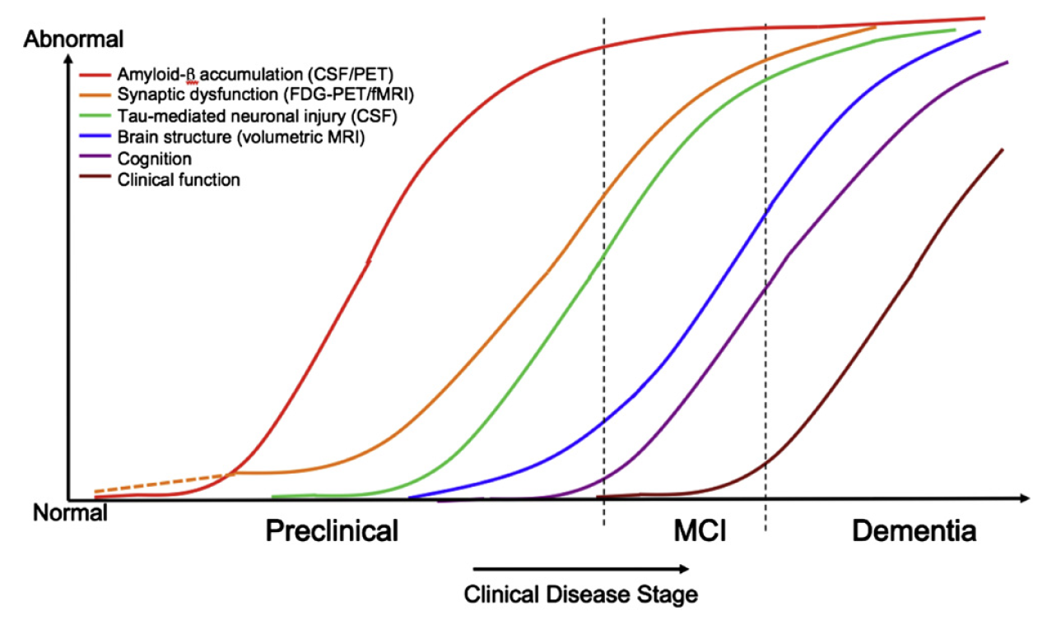
Biomarkers
Budson & Solomon, Practical Neurology 2012;12:88–96

Slide 6
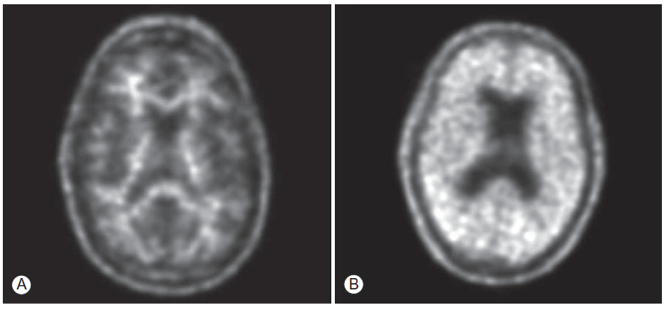
PET Amyloid Imaging was approved since 2012
Use when knowing that AD pathology is present in symptomatic patient would change management.
May detect amyloid plaques in asymptomatic patients who may not develop disease for 10-15+ years
Not paid for by Medicare or other insurance companies
Can obtain through Veterans Affairs hospitals, clinical trials/research studies, and self-pay.
Will have broader use when disease modifying therapies are available.
Alzheimer’s Disease
65 year old
MoCA 21
Non-AD dementia
From Budson & Solomon, 2016
Notes:
6

Slide 7
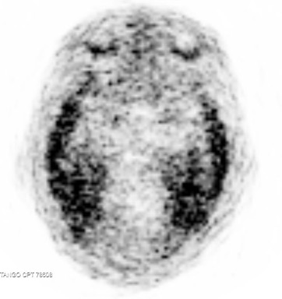
PET tau imaging : FDA approved May 2020
Use when knowing that AD pathology is present in symptomatic patient would change management.
Will detect AD tau tangles in symptomatic patients and should correlate with symptoms
May detect other types of tau tangles in other dementias (not yet clear)
Not paid for by Medicare or other insurance companies
Can obtain through Veterans Affairs hospitals, clinical trials/research studies, and self-pay.
Will have broader use when disease modifying therapies are available.
Notes:
7

Slide 8
New Research on the Genetics of AD
There is not a gene for AD however there is a susceptibility Gene: Apo E (3 alleles: ApoE2, ApoE3, ApoE4)
ApoE2: seems to be a protective factor
ApoE3: neutral
ApoE4: increases risk for AD
Recent work has shown that APOE ε4 allele lowers the age of onset of the disease compared to those without an ε4 allele who develop AD (van der Lee et al., 2018).
ApoE relationship with the risk to develop AD is almost fully mediated by another genetic risk factor named ABCA7 in Black and African-Americans (Berg et al., 2019)

Slide 9
Blood Tests as a potential screening tool for AD
Plasma β-amyloid levels have been associated with tau deposition in the brain (Risacher et al., 2019).
Plasma p-tau can be used to discriminate AD from other neurodegenerative diseases. Further research still required to test a more diverse and larger sample (Palmqvist et al., 2020)
Using plasma tau in addition to CSF tau improves diagnostic accuracy = new clinical usefulness of plasma tau (Fossati et al., 2019)
Potentially, once more accurate results will be obtained , β-amyloid and/or tau could be a screening test in advance to more invasive tests.
Can blood tests be used to identify other AD Related Dementias?

Slide 10
AD Related Dementias and New Blood Biomarkers…
New Research on Chronic Traumatic Encephalopathy (CTE)
What is CTE?
Caused by multiple head impacts
Characterized by tau accumulation
Impairment in memory, depression, hopelessness, explosivity, out of control, violent
The Boston University CTE Center leads the field in furthering the understanding of CTE. The BU-VA-CLF Brain Bank is the largest tissue repository in the world focused on traumatic brain injury (TBI) and CTE.
The Boston University CTE Center has found that more repetitive head impact exposure have been shown to correlate with greater tau amount in the blood (Alosco et al., 2018)

Slide 11
More research on CTE
New work is showing that the more exposure to repetitive head impacts the more the risk to develop CTE (Meez et al. 2019)
More repetitive head injuries = higher Tau in the CSF ( Alosco et al., 2018)
More repetitive head impact exposure= more MRI White Matter abnormalities (Alosco et al., 2018)
Novel tau filament found in CTE, distinct from AD tau filaments! (Falcon, 2019)
Tau PET could potentially be used for CTE (Stern et al. 2019)

Slide 12
2. New Diagnostic Framework

Slide 13
New unbiased AT(N) Classification Scheme (Jack et al., 2018)
A descriptive system for categorizing multidomain biomarker findings at the individuals person level in a format that is easy to understand and use
A Aggregated b-amyloid or associated pathophysiology
CSF Aβ42 or 42/40 ratio
Amyloid PET
T Aggregated tau (neurofibrillary tangles) or associated pathophysiology
CSF p-tau
Tau PET
(N) Neurodegeneration/neuronal injury
Anatomic MRI
FDG PET
CSF total tau

Slide 14
New Classification system and more accurate biomarkers resulted in a new Diagnostic Framework Criteria
This updated research framework shifts the definition of AD in living people from a syndromal to a biological construct.
A new division has been introduced between the presence of an underlying disease from the clinical syndrome associated with the disease.
AD is now conceptualized as a continuum both from biomarker and clinical perspective.

Slide 15
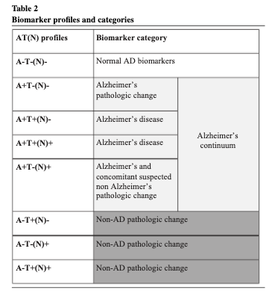

Slide 16
New Framework for Syndromal Staging of Cognitive Continuum
Aims to clarify the distinction between 3 cognitive states:
Cognitively unimpaired
2. Mild Cognitive Impairment
3. Dementia
Jack et al., 2018

Slide 17
New NIA-AA Criteria for Alzheimer’s disease dementia
Dementia present using All-Cause Dementia criteria
Insidious onset over months to years
Progressive cognitive impairment
Amnestic presentation
Non-amnestic presentation
Language: word finding
Visuospatial: getting lost, impaired face recognition
Executive dysfunction: reasoning, judgment, problem solving
Exclusionary criteria
Other dementia or disorder affecting cognition: vascular, dementia with Lewy bodies, frontal temporal dementia, other

Slide 18
The Current Stages of Alzheimer’s Disease
Preclinical AD:
Abnormal brain changes but no symptoms
Mild Cognitive Impairment (MCI) due to AD
Show decline in one or more cognitive domains (usually memory first)
Patients remain independent in their functional abilities ( do not meet criteria for dementia)
Insight of impairment is usually preserved
Biomarker evidence of the disease is available
AD Dementia: ( Very Mild, Mild, Moderate, Severe)
Cognitive impairment interferes with independence in functional abilities.
Biomarker evidence of the disease is available

Slide 19
Subjective Cognitive Decline (SCD) is in the new Framework
Self-Report of abnormal cognitive function- new growing public health issue
Previous studies have shown that individuals with subjective memory complaint are more likely to develop MCI or dementia, compared to individuals that do not have memory issues.
SCD has the potential to be a symptomatic marker of developing Alzheimer’s Disease, and it’s being considered one of the earliest clinical stages of AD that precedes MCI.

Slide 20
New research efforts on SCD
SCD seems useful in privileged white populations but is less so for Black and African-Americans ( Jackson et al., 2017)
Current research is focusing on establishing biomarkers to identify SCD as preclinical presentation of Alzheimer’s Disease Dementia. (Ebenau et al., 2020)
The rate of decline in individuals with subjective cognitive decline is approximately 7% per year. (Resinberg et al.,2019)
The risk of decline in individuals with subjective cognitive decline is lower in a community-based sample. (Slot et al., 2019)
More work is being done looking at the impact that anxiety and worry, often seen in SCD, have in the future development of MCI and dementia:
Both Anxiety and SCD are independent constructs that are useful to identify high risk populations for preventative interventions and trials (Liew, 2020)
β-amyloid Deposition correlates with the worry of having the cognitive impairment (Verfaille et al., 2019)

Slide 21
3. LATE (Limbic-predominant, Age-related, TDP-43 Encephalopathy)

Slide 22
Alzheimer’s disease-like disorder with negative amyloid and/or tau biomarkers?
Some patients appear to have Alzheimer’s disease clinically but do not have amyloid and/or tau biomarkers—the pathologic definition of Alzheimer’s.
How do we understand this?
Maybe these patients have another disorder…

Slide 27
4. New research efforts focus on Pre-Clinical AD

Slide 28
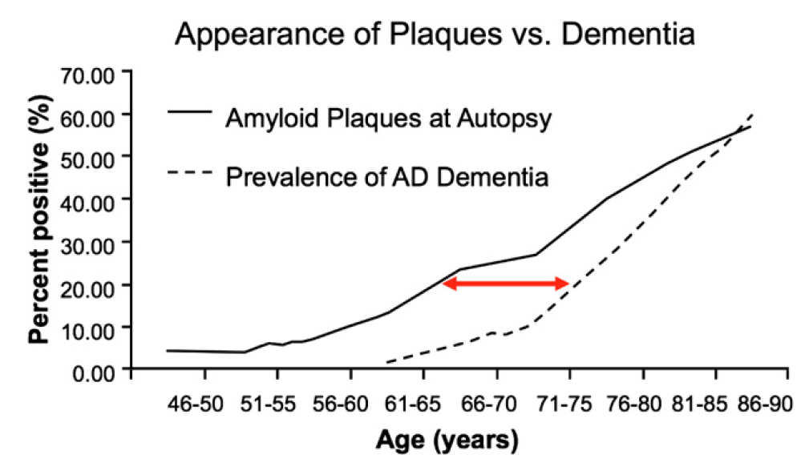
Pathophysiology starts decades prior to clinical disease
Budson & Solomon, Practical Neurology 2012;12:88–96; After Sperling et al., AlzDement 2011;7:280

Slide 29
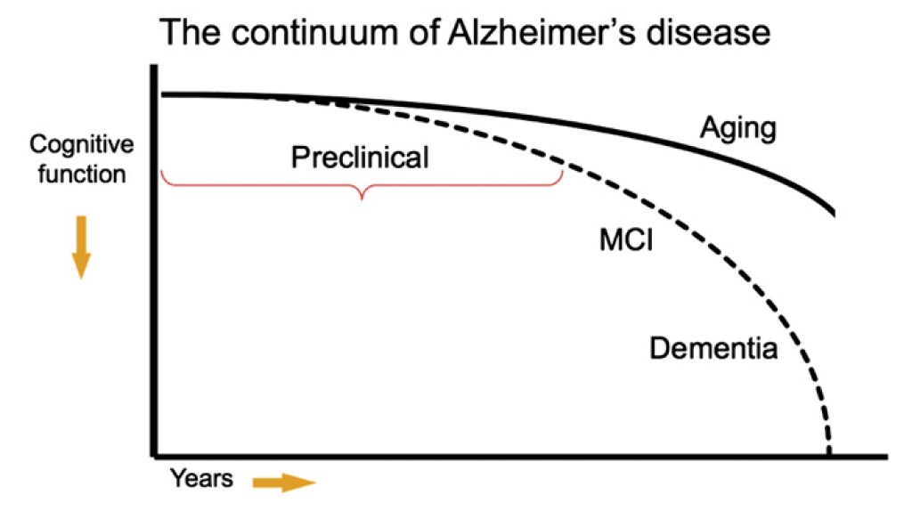
Budson & Solomon, 2016; After Sperling et al., AlzDement 2011;7:280
Notes:
Aggiungere ricerca su pre-clinical

Slide 30
Pre-Clinical AD
Characterized by Aβ pathology in individuals that are not cognitively impaired.
> Aβ accumulation is linked to greater risk of progression to MCI and dementia.
For now, only possible to treat symptoms after the disease has destroyed brain tissue.
New research efforts are trying to target the pathology before the symptoms arise .

Slide 31
New Research on Pre-Clinical AD
New efforts to determine the associations between AT(N) biomarker profiles and memory decline in individuals without dementia. (Clifford et al., 2019)
Faster memory decline in the A+T+(N)+, A+T+(N)-, and A+T-(N)+ groups that do not yet have symptoms.
Aβ accumulation is linked to significant cognitive dysfunction in cognitively unimpaired individuals (Insel et al., 2020)
Moving forward, this is really important in order to select unimpaired Aβ positive individuals that have not yet progressed into the downstream mechanism from Aβ pathology (tau aggregates, cell death).

Slide 32
Take Home Points
New and more effective biomarkers are going to help diagnose AD before the symptoms start.
The future hope is that treatments could target the disease at its earliest stages before irreversible brain damage or mental decline occurs.

Slide 33
New Treatments for AD and other Related Dementias

Slide 34
Current treatments available for AD (& LATE)
Why will they likely work for LATE? Because participants with LATE were included in all of the AD clinical trials!
Maybe they won’t work for LATE—or maybe they will work better! New studies are needed.
Current Medications to improve cognition:
Cholinesterase Inhibitors:
donepezil (Aricept, available oral dissolving tablet, now generic)
rivastigmine (Exelon, available QD patch)
galantamine (formerly Razadyne, now generic)
huperzine A (Cerebra). Nutritional product.
Memantine:
Namenda

Slide 35
Treatment Outcomes
Disease arrest
Slowed
progression
Function
Treatment
Symptomatic benefit
No effect
Time
From Budson & Solomon, 2016

Slide 36
Treatment for AD Dementia : What’s new?
New symptomatic medications being developed which modulate neurotransmitters to improve cognition and/or reduce agitation.
2. New disease modifying therapies being developed with the aim of slowing down the progression of the pathology:
Most use monoclonal antibodies directed against either β-amyloid plaques and tau tangles. (ex: anti-amyloid, anti-tau, anti-inflammation, neuroprotective)
Some induce a special frequency EEG waves in the brain.
Some try to eliminate infectious brain pathogens theorized to cause Alzheimer’s.

Slide 37
1. New Symptomatic Treatments
Aim to facilitate cognition and improve symptoms:
Ongoing trials look at drug effects on different neurotransmitters (ex: NMDA, Serotonin)
Trials also looking at the effect of anti-inflammatory, metabolic, and hormonal treatments.
Souvorexant: FDA approved for treatment of insomnia and is now being prescribed (Herring et al., 2019)
Pimavanserin: still in progress - It appears to be a safe and effective treatment of psychosis in AD, at least for a short period of time, while it seems to have no effect long term (Ballard et al., 2018: Cummings et al., 2018)

Slide 38
2. New Disease-Modifying Treatments
Major Focus on Research Today! – will be really important in the Pathway to successful AD management
New β-amyloid directed treatments
New tau directed treatments
Beyond Amyloid and Tau:
Regulate Brain inflammation
AD due to a bacterial infection
Brain Stimulation to Reduce Amyloid
Lifestyle Changes
Overall,
Disease-Modifying drugs aim to slow down (perhaps halt) the progression of the disease
New efforts to address the role of tau and other effects of amyloid in the progression of AD (Longo & Massa, 2020)

Slide 39
New β-amyloid directed treatments
Secretase-inhibitors: to block formation of β-amyloid
Anti-aggregants: prevent formation of multiple β-amyloid filaments aggregates
Monoclonal antibodies: to remove neuronal plaques

Slide 40
1. Secretase –Inhibitors
To date there have been no positive clinical trials
Semagacestat (Lilly, γ-secretase inhibitor): Clinical Trial failed to slow β-amyloid formation as well as worsened cognition.
BACE Secretase Inhibitors:
Verubecestat (Merk, 2017)- failed progression due to worsening of cognition
Same results for other pharma companies
New trials might start soon that will use lower doses and better monitoring for cognitive decline.

Slide 41
2. Anti-aggregants
Potential new drugs that block accumulation of β-amyloid.
They prevent formation of multiple β-amyloid filaments aggregates
As few as two aggregates can be neurotoxic ! (Long & Holtzman, 2019)
Alzhemeded (by Neurochem): Phase II successful to reduce β-amyloid, however no reduction in cognitive decline
However, it did slow cognitive decline in ApoE4 homozygotes patients! (Abushakra et al., 2017)
Alzelon licensed a prolonged version of Alzhemed- Starting Phase III now (Tolar et al., 2020).

Slide 42
3. Vaccines
Active Vaccines:
compound AN1792 seemed to have promising effects against β-amyloid and slowing down functional decline
however too many potential side effects from the treatment (since it requires the body to produce anti-bodies)
Monoclonal Antibodies: potentially safer since using laboratory or harvested from human blood antibodies
Bapineuzumab (Salloway et al., 2014) and Solanezumab (Doody et al., 2014) = good safety profiles but no significant effect seen.
Ongoing trials include patients in very early AD and MCI due to AD stages, while others just include individuals that are at risk to develop AD in the future.
Aducanumab (By Biogen ): All phases completed- On August 2020, granted priority review by the FDA to expedite the approval of the medication
Gantenerumab ( By Roche): Phase II in progress

Slide 43
“A4”(Anti-Amyloid vaccines for asymptomatic at risk individuals)
Sponsored by National Institute on Aging (Sperling et al., 2014 )
Looking at the effectiveness of solanezumab in individuals that do not have symptoms and that have abnormally high levels of beta-amyloid in the brain.
Study has been following patients since 2014
Positive PET Scan is required to be included in the trial
“AHEAD”
New trial started in 2020, aiming to treat who has no symptoms but is at risk for AD due to positive PET scan or a genetic predisposition (Aisen et al., 2019)

Slide 44
b. New Treatments targeting neurofibrillary tangles are needed
Anti-Tau treatment is now considered as important as anti-β-amyloid in AD progression.
Also, tau seems the primary cause of cell death in other related dementias as CTE, and Primary Age-Related Tauopathy (PART)- no β-amyloid involvement in these dementia types.
Anti-tau treatments have become a major focus in the current research to block tau aggregation and block tau spreading from cell to cell (Congdon & Sigurdsson, 2018)

Slide 45
Anti-Tau Treatments in progress:
TauRX compound LMTB: Phase III tested in mild to moderate AD with negative results. Currently looking at its effect in early Alzheimer’s Disease.
New Phase II trials (focus on MCI, and early AD using positive tau and β-amyloid PET scans) –initiated in 2019
Gosuranemab (by Biogen)
Zagotenemab (by Lilly)
Since these trials started, many other anti-tau studies initiated using both drugs and biologics (Cummings et al., 2019)

Slide 46
c. Beyond Amyloid and Tau
Other mechanisms and pathways need to be targeted in order to arrive at a successful disease modifying treatment
New approaches to: (Long & Holtzman, 2019)
Enhance neuroprotection
Reduce inflammation
Induce neuronal growth factors
Changes in life style
Possibility that these new therapies in combination with anti-amyloid and tau will lead to the best results achieved so far.

Slide 47
Regulating Inflammation- ‘Deep Biology approach’ (Long & Massa, 2020)
Evidence of inflammation seen in brains post-mortem
Joint effort by Alector and AbbVie pharmaceuticals to target brain inflammation
New antibody to improve brain cells that work against inflammation (microglia)
In mice, amyloid deposits were nearly cut in half
Phase I is completed, and Phase II is starting this year

Slide 48
Is AD a Bacterial Infection?
Germ that causes periodontal disease has been found in brain tissue from patients with Alzheimer’s disease.
Possible that this bacterium enters in the brain causing AD due to a weaker brain in aging – causing inflammation and neurodegeneration (Dominy et al., 2019)
Could an anti-bacterial be used?
CORE 388 (by Cortexyme)-
Anti-bacterial that in mice reduces inflammation and protects neurons
Phase I in humans – succeeded
Now initiated Phase II/III in 500 subjects with mild to moderate Alzheimer’s Disease

Slide 49
Can Brain Stimulation Reduce Amyloid?
MemoryEMTM: Type of technology that stimulates the brain with Electromagnetic waves.
Results of small clinical trial on mild to moderate AD patients showed that 7 out of the 8 subjects that participated had improved cognition, and no side effects reported (Arendash et al., 2019).
Next step is to replicate this in a randomized placebo controlled study, with the aim to see if the effects of the treatment persist long term.

Slide 50
Can Brain Stimulation Reduce Amyloid?
2. New external stimulation methods using sights and sounds to produce a particular pattern of naturally occurring brain activity in the brain.
Researchers from MIT have found positive effects from using light pulses in mice. The treatment boosted presence of a specific type of waves (Gamma waves) that are associated with memory, as well as improved learning and memory.
Other research has shown the same using sounds (Martorell et al., 2019)
Based on this, 2 clinical trials started by Cognito Therapeutics in MA:
Aim to see if the use of patterns of lights and sounds will result in the reduction of Aβ and enhanced cognitive functioning

Slide 51
Lifestyle changes might also slow down the disease
Number of ongoing clinical trials aiming to study how lifestyle changes can impact the disease.
FINGER trial (1250 participants at risk for cognitive decline)-multidomain intervention study
1 group completed a Lifestyle intervention that consisted on diet, exercise, cognitive training and vascular risk monitoring. Other group just received medical advice.
Results: It can improve or maintain cognitive function in elderly at risk for AD (Rosenberg et al., 2017)
Hard to replicate these results in a trial with Alzheimer’s Disease patients.
However multiple trials are currently investigating the contribution of physical activity, healthy diet, staying cognitively active (learning and socializing).

Slide 52
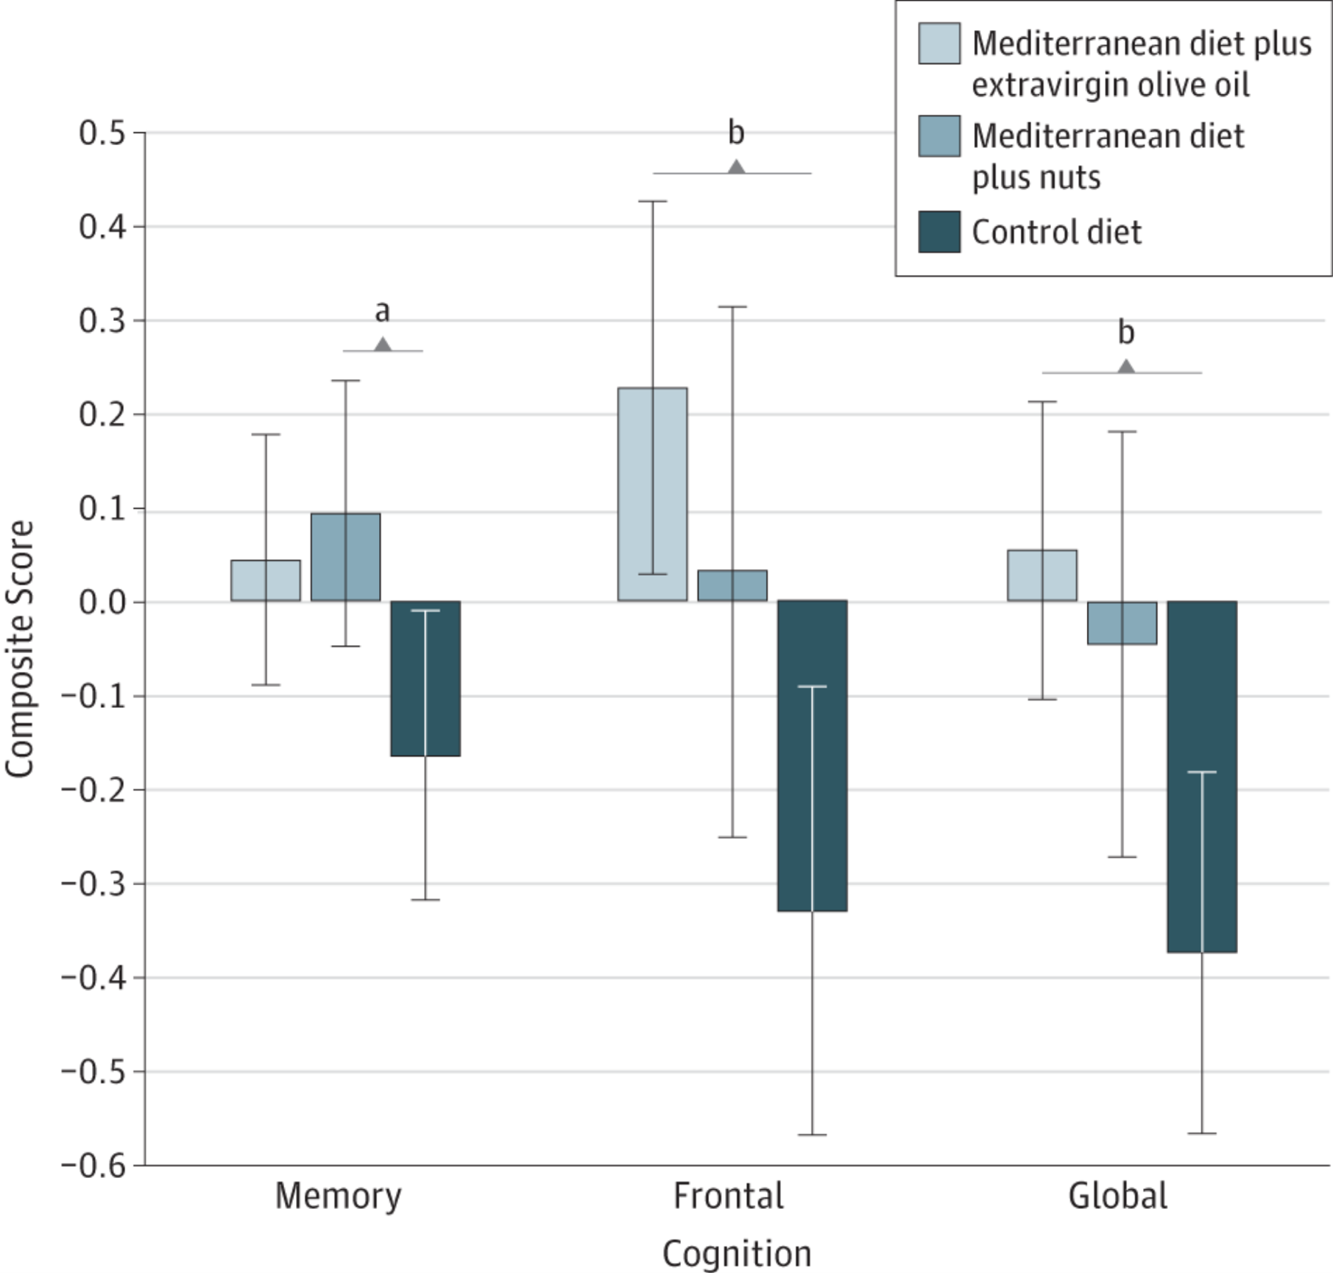
Mediterranean diet improves cognitive function vs. control diet
334 cognitively healthy adults
Mean age 67 years
Randomly assigned
Med diet + olive oil
Med diet + nuts
Control
Fish, olive oil, avocado, fruit, vegetables, beans, nuts, whole grains, red wine
From: Mediterranean Diet and Age-Related Cognitive Decline: A Randomized Clinical Trial
JAMA Intern Med. 2015;175(7):1094-1103. doi:10.1001/jamainternmed.2015.1668

Slide 53
Exercise increases hippocampal volume in older adults
120 older adults 55-80, mean 66 years
Randomized to 1 yr of exercise or stretching

Slide 54
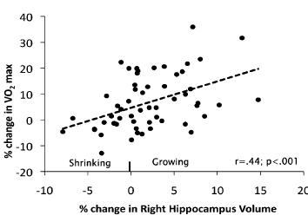
⍙VO₂ max correlates with ⍙ hippocampal volume

Slide 55
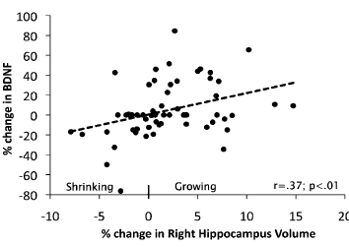
⍙ BDNF correlates with ⍙ hippocampal volume

Slide 56
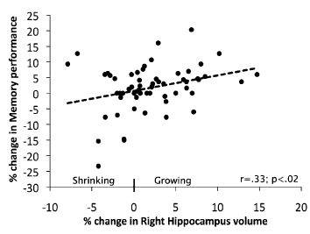
⍙memory performance correlates with⍙ hippocampal volume

Slide 57
COVID-19 and Dementia
Major cognitive effects can results from COVID
Cognitive tests performance of survivors of ICU show deficits in memory and attention that can be comparable to someone who has had a moderate brain injury.
These effects can have a major impact on daily life functioning.
But also subtle cognitive effects are seen:
In cases of mild COVID Infection, impairment in sustained attention was seen in individuals that had fully recovered from the infection. (Zhou et al., 2020)
Long-term cognitive effects:
Cognitive Impairment from COVID could be due to small strokes or lack of oxygen which are both risk factors for dementia.
COVID-19 frequently leads to brain damage particularly in those over 70, and this could eventually mean that it could place its survivors at higher risk for developing AD Dementia. (Heneka et al., 2020)
New Research efforts are now required to investigate the impact that COVID-19 can have on development of AD and AD related dementias.

Slide 58
Take Home Points
As of today, there are no effective medications that can halt the disease, however ongoing clinical trials are moving forward to improve ways to slow down and possibly stop the disease progress.
While pharmacological treatments are being tested, more and more research efforts are showing promising results on the importance of sleep, healthy Mediterranean diet, socialization, and cognitive engagement in order to improve or even just maintain cognitive function.
Due to the current pandemic, new research efforts are necessary to understand the impact that COVID-19 can have in increasing the risk of AD and related dementias.

