Slide 1
Advisory Council on Alzheimer’s Disease and All Other Dementias
Executive Office of Elder Affairs
Elizabeth Chen, Secretary
June 21, 2022
3:00-5:00 pm
Video Conference

Slide 2
Agenda
Welcome, Logistics, Introductions (10 min)
Care Planning Team: Updates and Discussion (30 min)
Update on Equitable Access & Care Workstream (10 min)
Why Diversity, Equity, and Inclusion (DEI) Matter (60 min)
Panel of Individuals with Lived Experience
Next Steps and Vote to Adjourn (10 min)

Slide 3
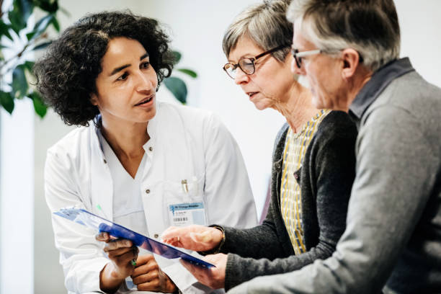
Person-Directed Care Planning
Care Planning Implementation Team
Status and Discussion
June 21, 2022
Workgroup Leads
Linda Pellegrini, MS, GNP-BC, Geriatric Nurse Practitioner,
UMass Memorial Medical Center
Susan Antkowiak, Vice President of Programs & Services,
Alzheimer’s Association, MA/NH Chapter

Slide 4
Person-Directed Care Planning
Our team’s charge as described by the Council in the State Plan:
Develop a person-directed care plan framework and template

Slide 5
Care Planning Implementation Team
Linda Pellegrini, MS, GNP-BC
Council Member & Workstream Co-lead
Care Planning Implementation Team Co-lead
Geriatric Nurse Practitioner
UMass Memorial Medical Center
Susan Antkowiak
Council Member
Care Planning Implementation Team Co-lead
Vice President of Programs & Services
Alzheimer’s Association
Mike Belleville
Council Member
Dementia Advocate
Deb Dowd-Foley
Caregiver Specialist
Elder Services of Worcester Area, Inc.
Laurie Herndon, MSN, GNP, BC (on sabbatical)
Project Director
Hinda and Arthur Marcus Institute for Aging Research, Hebrew SeniorLife
Judy Johanson
Dementia Advocate
Mass. Alzheimer’s Disease Research Center, MGH
Aaron Madow
Graduate Student (MPH candidate)
University of Massachusetts
Gad A. Marshall, MD
Medical Director of Clinical Trials at Center for Alzheimer Research and Treatment,
Brigham and Women’s Hospital (BWH); Associate Neurologist at BWH; Assistant in Neurology at Massachusetts General Hospital; Associate Professor of Neurology at Harvard Medical School

Slide 6
Care Planning Implementation Status
Updates and Accomplishments
Intern acquired - Aaron Madow, Public Health Graduate Student, University of Massachusetts.
Committee member, Laurie Herndon, on 6-month sabbatical
Convened two focus groups for people living with dementia.
Created focus group resources including fliers, emails for potential participants, phone screening protocol, scripts, and discussion questions.
Participants were recruited from Mass General Brigham and Alzheimer’s Association (Early Stage Support Group and Early Stage Advisory Council).

Slide 7
Care Planning Implementation Status
Updates and Accomplishments (Continued)
Phone or Zoom interviews were conducted with nine interested participants.
Some interested participants did not attend. One interested participant withdrew.
Three individuals participated in one session while two individuals participated in a second session.
Alzheimer’s Association staff facilitated focus group discussions. Meeting minutes were documented, and the sessions were recorded with the participants’ verbal consent. Participants were advised the recordings would be viewed by the workgroup members and not shared or used for any other purpose.

Slide 8
Care Planning Implementation Status
Updates and Accomplishments (Continued)
Discussion questions were shared in advance with participants, allowing them the opportunity to think about their experiences.
Questions included:
What was your experience of communicating with your doctor or healthcare provider about your concerns? Please share a positive experience or a negative experience. What types of things would you have expected from your doctor when discussing your diagnosis?
What are the most important things you want a doctor or healthcare provider to know about you?
Focus group facilitators were provided with discussion questions and suggested follow-up questions to support open discussion.

Slide 9
Care Planning Implementation Status
Next Steps
Recruit caregivers or care partners of someone living with Alzheimer’s or other dementia to participate in focus groups in early Fall
Review information from all focus group sessions with workgroup members to inform next steps
Make decision if using an existing tool or create a new template

Slide 10
Care Planning Challenges and Solutions
Challenges
Recruiting a diverse representation of participants
limited pool of individuals living with dementia from which to recruit
achieved diversity with gender and different forms of dementia but no apparent diversity with race or ethnicity
Engaging unsupported individuals
Funding a third-party convener of stakeholders to develop the template
Ensuring practitioners/providers value and utilize the input and experiences of the patient/person living with dementia

Slide 11
Care Planning Challenges and Solutions
Solutions
Engage Advisory Council members to broaden recruitment efforts, elevating opportunity to ensure greater diversity of participants
Collaborate with other workgroups to support reciprocal relationship between the person living with dementia and their practitioner/provider
Equitable Access & Care
ensure outcome meets the needs of diverse populations
Public Awareness
consider public awareness campaign highlighting the value of a reciprocal relationship between the person living with dementia and their practitioner/providers
Initial Diagnosis & Services Navigation
ensure the value of a reciprocal relationship between the person living with dementia and their practitioner/providers is part of provider education

Slide 12
CARE PLANNG DISCUSSION (15 min)
Discussion
How can the Advisory Council leverage relationships to help us recruit participants more accurately reflecting the diversity of our communities?
How do we promote the partnership between practitioners and their patient/person living with dementia to utilize the person-driven model of care planning?

Slide 13
Advisory Council on Alzheimer’s Disease and All Other Dementias, June 2022
Update on Equitable Access & Care Workstream
(10 min)

Slide 14
Why Diversity, Equity, and Inclusion Matter
Panel of Individuals with Lived Experience (60 min)
Everyone on today’s panel has been affected by dementia
Today, they will share their stories around cultural understanding (or lack of thereof) experienced anywhere; for example, among:
healthcare professionals, dementia care professionals, elder service agencies
senior centers, service providers, neighbors, friends, family, etc.
Clint Kershaw
Valderez Oliveira
Pastor Tirsa Ramirez

Slide 15
Next Steps & Vote to Adjourn
Next Meeting:
August 18, 2022
3:00 to 5:00 pm
Location: TBD
Vote to Adjourn

