Slide 1
A&F-IT Artificial Intelligence (AI) Journey Syed Z. Ali Director of Digital Analytics & AI June 5, 2025

Slide 2
Prioritization Criteria
AWS Sandbox sufficient for
Development
Validation
Specify the tools, if not available in AWS Sandbox
Can the project be validated against
Publicly available data or
Anonymized data or
Without real data
Can project be done without AI or ML?

Slide 3
AI Proposal Review Panel
Robin Healey
Ray Piccinni
Kavita Gangal
Hind Mouadden
Barry Lacroix
Syed Ali

Slide 4
Support Team
EOTSS
AWS Sandbox Management
Account and resource access / privileges
A&F IT
Development Support
Communication Support
AWS Engineers
Technical SMEs

Slide 5
Support Team
Christopher Clifford (EOTSS)
Kasi Thanikonda (A&F)
Chuck Meredith (A&F)
Asad Khalid (A&F)
Suresh Akana (A&F)
Rosalind Verone (A&F)
Syed Ali (A&F)
AWS SMEs
Tom Cobb
Ameer Sheriff
Henry Zhong
Sanjay Chakladar
Notes:
Break into teams with functions

Slide 6
AI Initiative #1- Pilot Projects
Document Analyzer
SummArIto
Amrit Maharjan
Tom Farl
Intelligent Dashboard
State Employee Diversity Dashboard
Andrew Netson
Chuck Meredith
Intelligent Dashboard
Kousalya Jagadisan
John Pan
Srinivas Kandru
Private AI
Private AI using Open-Source Solutions
Syed Ali
Dom Giacchetta
Dashboard for Cigarette/Cigar/e-Cigarette Tax Accounts
Predictive Model
NCP Payment Compliance Predictive Model
Chris Martino
Subbu Perumal
Yuhui Luo
Masilamani Dharmarajan
Smart Code Development
Better Terraform using Amazon Q Developer
Asad Khalid
Sathish Konda
Kasirao Thanikonda
Scott McDonald

Slide 7
AI Initiative #1- Pilot Projects
Document Analyzer
SummArIto
Amrit Maharjan
Tom Farl
Intelligent Dashboard
State Employee Diversity Dashboard
Andrew Netson
Chuck Meredith
Intelligent Dashboard
Kousalya Jagadisan
John Pan
Srinivas Kandru
Private AI
Private AI using Open-Source Solutions
Syed Ali
Dom Giacchetta
Dashboard for Cigarette/Cigar/e-Cigarette Tax Accounts
Predictive Model
NCP Payment Compliance Predictive Model
Chris Martino
Subbu Perumal
Yuhui Luo
Masilamani Dharmarajan
Smart Code Development
Better Terraform using Amazon Q Developer
Asad Khalid
Sathish Konda
Kasirao Thanikonda
Scott McDonald
Innovation Mastermind Award

Slide 8
AI Initiative #1- Pilot Projects
Document Analyzer
SummArIto
Amrit Maharjan
Tom Farl
Intelligent Dashboard
State Employee Diversity Dashboard
Andrew Netson
Chuck Meredith
Intelligent Dashboard
Kousalya Jagadisan
John Pan
Srinivas Kandru
Private AI
Private AI using Open-Source Solutions
Syed Ali
Dom Giacchetta
Dashboard for Cigarette/Cigar/e-Cigarette Tax Accounts
Predictive Model
NCP Payment Compliance Predictive Model
Chris Martino
Subbu Perumal
Yuhui Luo
Masilamani Dharmarajan
Smart Code Development
Better Terraform using Amazon Q Developer
Asad Khalid
Sathish Konda
Kasirao Thanikonda
Scott McDonald

Slide 9
AWS Q
Deployed for
Java 8 to Java 21 refactorization (non-production environment)
Terraform code (non-production environment)
FinOps support

Slide 10
AI Initiative #2- Pilot Projects
Smart Code Development
Chatbot
CometsHD Customer Web Assistant
Kasi Thanikonda
Claire Gongas
Document Translation
AI para la traduccion
Radha Iyer
Swathi Mall
Matt Serdukoff
Syed Ali
Chatbot
MassAchieve AI Assistant
Hans Domercant
Sathish Konda
Cheyenne Mowatt
Kratika Gupta
Joan Morgan
ODI 2 Glue
Niranjan Deshpande
Edward Santora
Syed Ali
Sentiment Analysis
SenseAI
Mani Dharmarajan
Chris Martino
George Jothimani

Slide 11
AI Initiative #2- Pilot Projects (cont.)
Entity Matching
Sentinel Match
Yuhui Luo
Chuck Meredith
Real-time voice translation
RAY Comm
Syed Ali
Amrit Maharjan
Office Copilot
Kasi Thanikonda
Syed Ali
CoMA Copilot
Syed Ali
Intelligent Assistant to Ops
AI Monitoring (AIM)
Bhavya Suryadevara
Peter Kourkoutas
Intelligent FinOps Assistant
DOR FinOps Companion
Asad Khalid
Joseph Decristoforo
Alex Sullivan

Slide 12
AI Initiative #2- Pilot Projects (cont.)
Entity Matching
Sentinel Match
Yuhui Luo
Chuck Meredith
Real-time voice translation
RAY Comm
Syed Ali
Amrit Maharjan
Office Copilot
Kasi Thanikonda
Syed Ali
CoMA Copilot
Syed Ali
Intelligent Assistant to Ops
AI Monitoring (AIM)
Bhavya Suryadevara
Peter Kourkoutas
Intelligent FinOps Assistant
DOR FinOps Companion
Asad Khalid
Joseph Decristoforo
Alex Sullivan

Slide 13
AI Initiative #2 - Deadline
Extended until June 30, 2025

Slide 14
AI Review Board (AIRB)
Encourage AI use
Responsible to review AI requests.
Facilitate ANF-IT and all agencies in responsible use of AI
Assist existing ARB for AI evaluation
Recommend best possible use
Recommend security configurations.
Highlight DOs and DON’Ts

Slide 15
AIRB Activities
Service | Requested By | Action Performed | Status
AWS Q | ANF-IT Infrastructure/DevOps Team CometsHD Java Development Team | Reviewed and recommended necessary security parameters. | Security Applied and it’s now available in Non-Prod environment.
Figma AI | Division of Local Services (DLS) | Reviewed and recommended necessary security parameters. | Pending with CISO and DOR to review
GitHub Copilot | Genisys .Net Team | Under review
Lexis+ AI | DOR Tax Team | Under review
AWS Entity Resolution | DOR Tax Data Analytics Team | Under review
DOR data policy in Cloud | DOR Legal Team | AIRB suggested policy around data in the cloud. | Under review with DOR
DOR VRM process in the Cloud | DOR Legal Team | AIRB suggested what type of cloud service should go through VRM and the process flow in general | Under review with DOR

Slide 16
AIRB Tech Team
Jason Franzman
Chuck Meredith
Rajiv Singh
Suresha Akana
Asad Khalid
Scott Mcdonald
Kasirao Thanikonda
Sathish Konda
Syed Ali

Slide 17
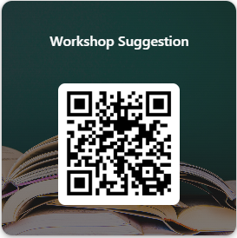
Workshops
AWS SMEs
AWS 101
AWS AI Labs (Bedrock)
AWS Lambda, Cloud9
ANF-IT
AWS Bedrock, Sagemaker, Glue
AWS Lambda
AWS Q
Upcoming
Prompt Engineering
Your choice (https://forms.office.com/g/haQDgFk7Pm)

Slide 18
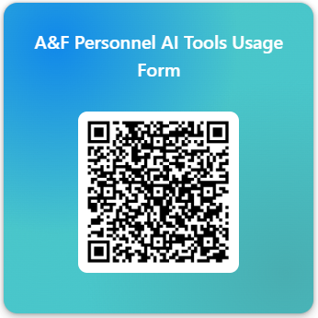
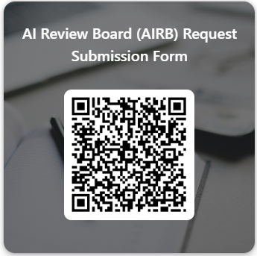
AIRB
Inventory of AI tools
Requests to access AI tools
For general inquiries about any AI tool, please send an email to ANFITAIRB@mass.gov

Slide 19
Inventory or Intention to use AI Tools

Slide 20
A&F-IT Artificial Intelligence (AI) Journey
Thank you!

