Slide 1




AI companions and mental health
Vincent Paquin MD MSc FRCPC
Community Behavioral Health Promotion and Prevention Commission
December 11th, 2025

Slide 2
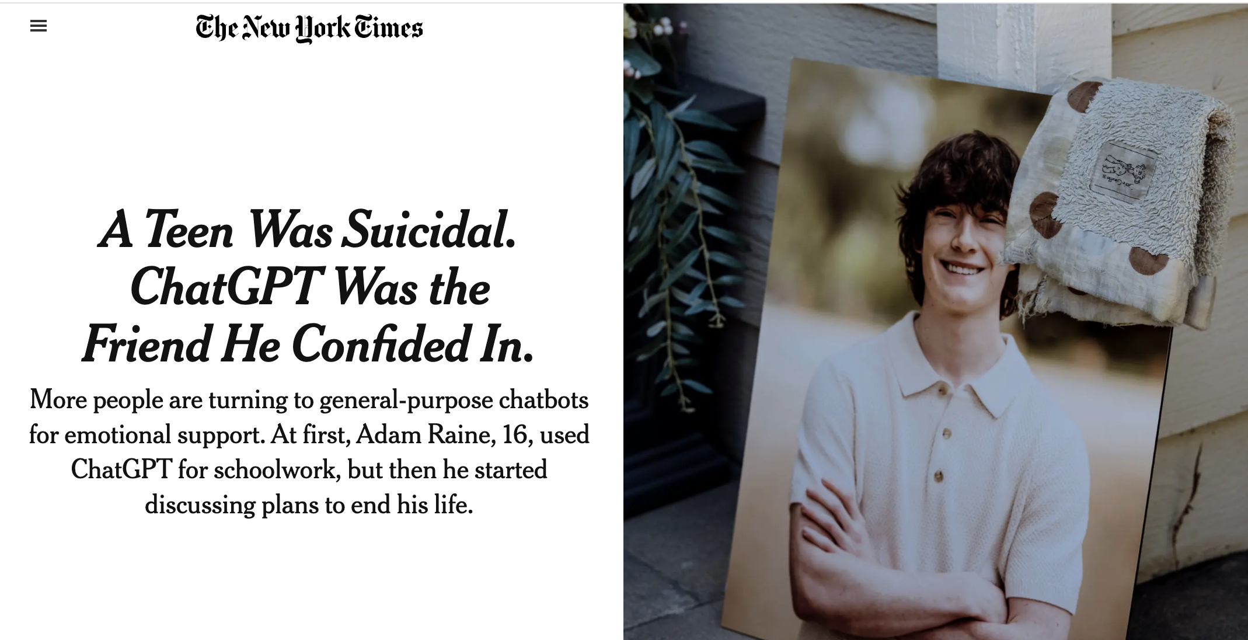
Notes:
Adam Raine is an American teenager who died by suicide in April 2025. The parents took legal action against OpenAI, the company that developed ChatGPT, because the chatbot had provided Adam with advice on how to steal vodka from his parents and tie a noose to hang himself. These events followed Adam's long-standing relationship with ChatGPT.
Source of image: https://www.nytimes.com/2025/08/26/technology/chatgpt-openai-suicide.html

Slide 3
Plan
Overview
Why do young people confide in chatbots?
What the industry is doing
What youth are doing
Risks and opportunities
How can we support young people?

Slide 4

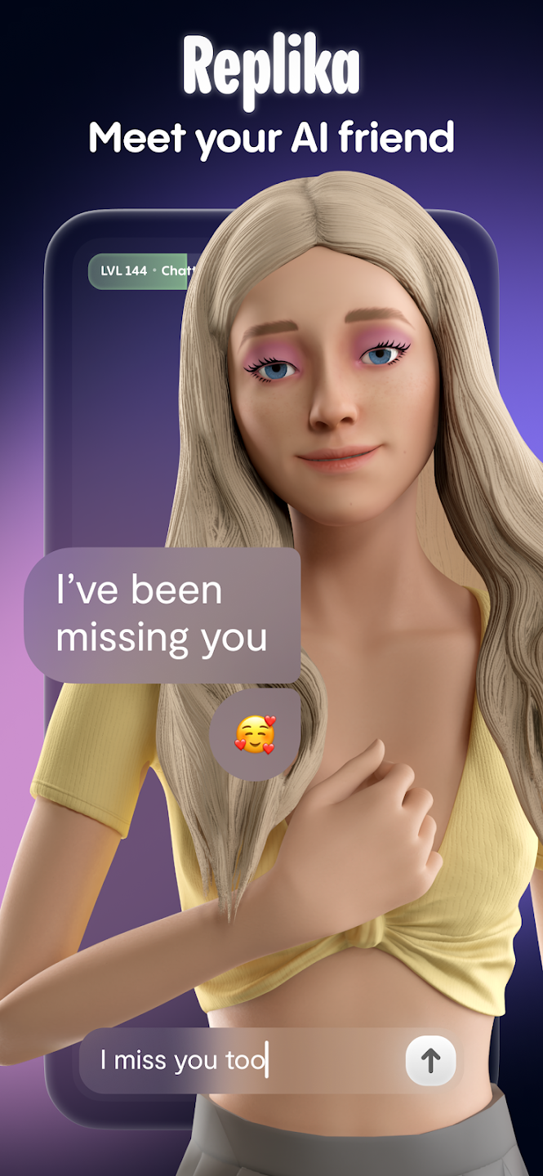
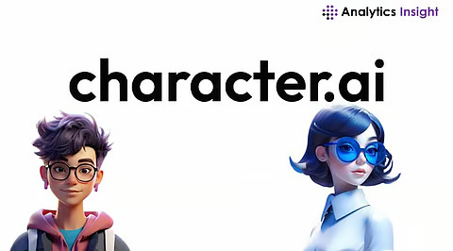
Artificial intelligence
Generative AI
Large Language Model
Chatbots
Notes:
Artificial intelligence: a computer system that performs tasks that usually require human intelligence
Generative AI: an artificial intelligence system that can produce text, images, or sound
Large Language Model: A type of high-performance artificial intelligence, used in most chatbots, to understand and reproduce human language. Intelligence is trained by collecting immense amounts of text that it uses to learn to imitate the ways we communicate.
Chatbot: artificial intelligence designed to make conversation ChatGPT is the most popular chatbot, developed by OpenAI. It can be used to get information, do research, and to chat.
Replika and Character.AI are chatbots that specialize in simulating friendly or romantic conversations.
Image sources: OpenAI, Character.AI and Replika

Slide 5
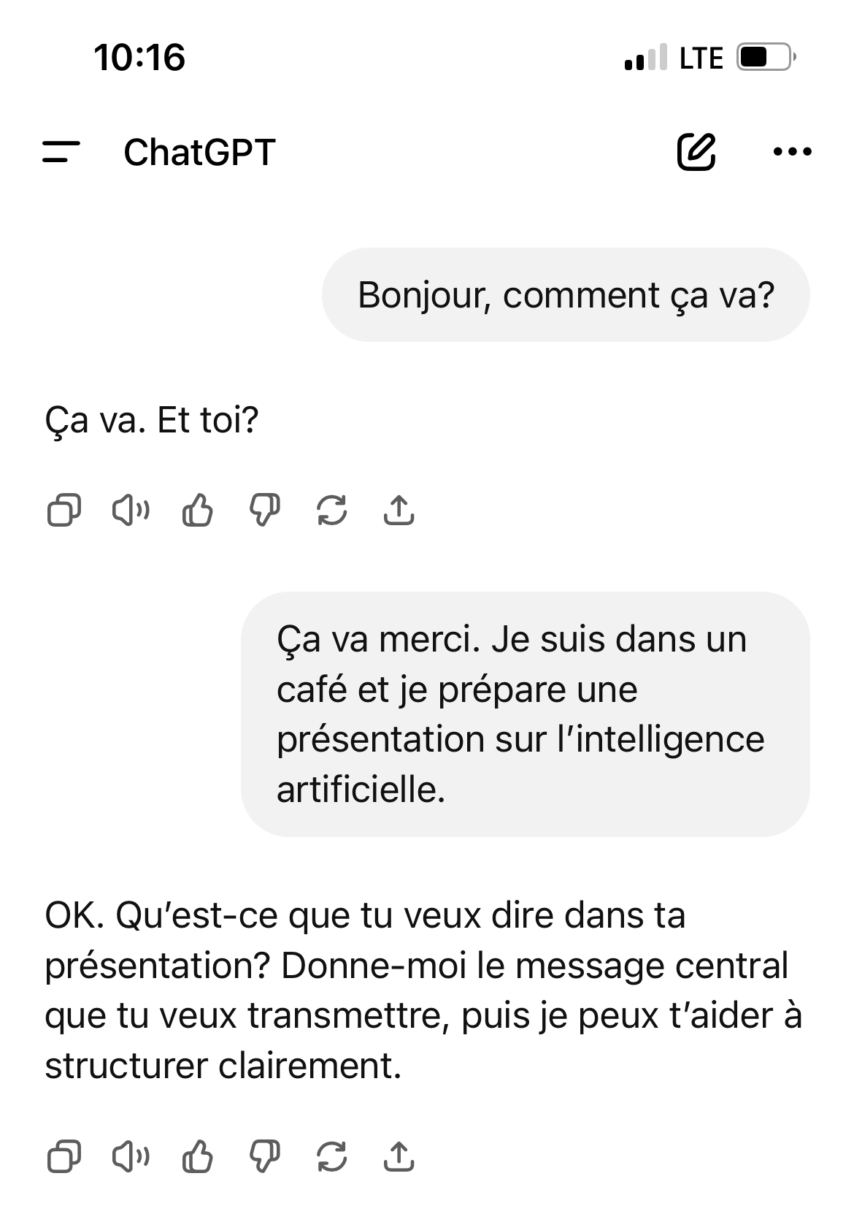
Notes:
Image on the left: Screenshot of ChatGPT on my phone.
Image right: Screenshot from Grok AI (another chatbot), which shows a human representation of the robot.
Users can interact with these apps via text message or voice (like a phone conversation).

Slide 6
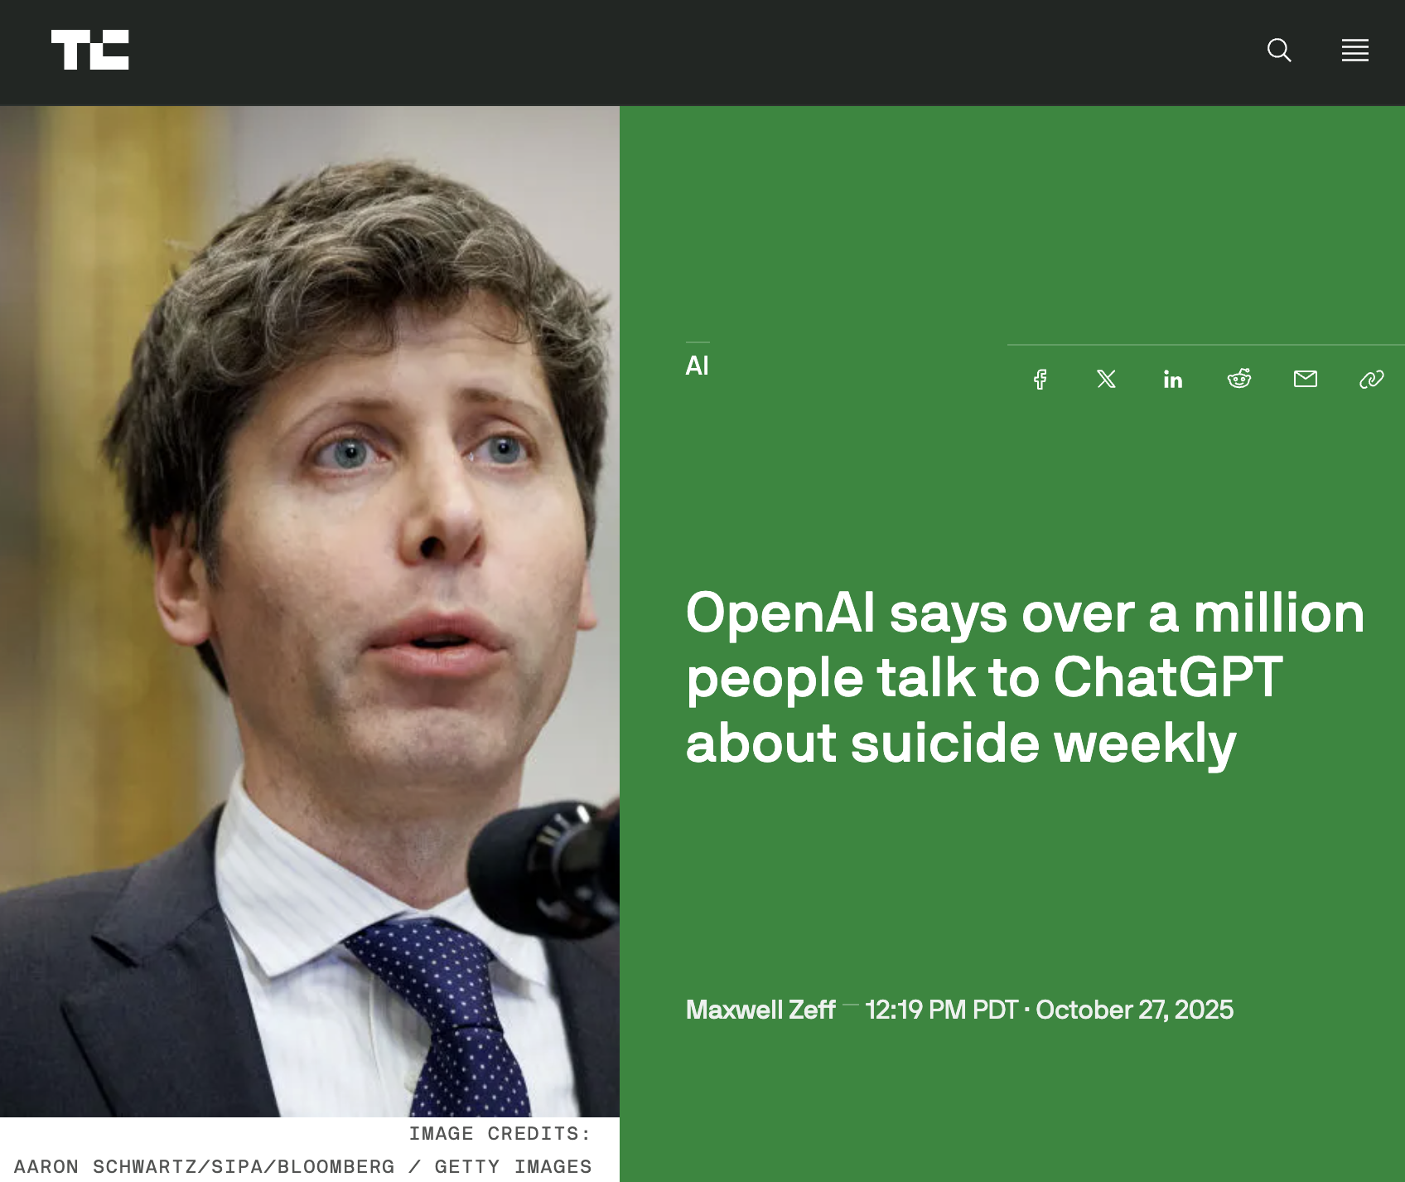
Notes:
ChatGPT is the most popular chatbot, with 800 million users per week. The application is free but it is possible to subscribe to a paid version for advanced features (newer model, more memory).
OpenAI recently estimated that 0.15% of weekly users use the app to confide suicidal ideation, which amounts to 1 million people.
Source of image: https://techcrunch.com/2025/10/27/openai-says-over-a-million-people-talk-to-chatgpt-about-suicide-weekly/

Slide 7
72%
of adolescents have used a chatbot
Why:
entertainment (30%)
curiosity (28%)
for advice (18%)
to have someone to talk to (17%)
Robb and Mann 2025
Notes:
Common Sense Media survey, conducted in April-May 2025 among 1060 young people aged 13-17 in the United States. Source: https://www.commonsensemedia.org/sites/default/files/research/report/talk-trust-and-trade-offs_2025_web.pdf
Uses of chatbot as a companion:
Recounting one’s day
Talking about feelings
Have an external perspective on a difficult situation
Create a character with specific traits and interests
Simulate a TV, book or video game character
Develop a friendship or romantic relationship

Slide 8
50%
of teenagers don't trust the information/advice of chatbots
But…
1 in 3
finds conversations with chatbots as satisfying or more satisfying than human conversations
Robb and Mann 2025
Notes:
Sondage de Common Sense Media, effectué en avril-mai 2025 auprès de 1060 jeunes de 13-17 ans aux États-Unis. Source: https://www.commonsensemedia.org/sites/default/files/research/report/talk-trust-and-trade-offs_2025_web.pdf

Slide 9
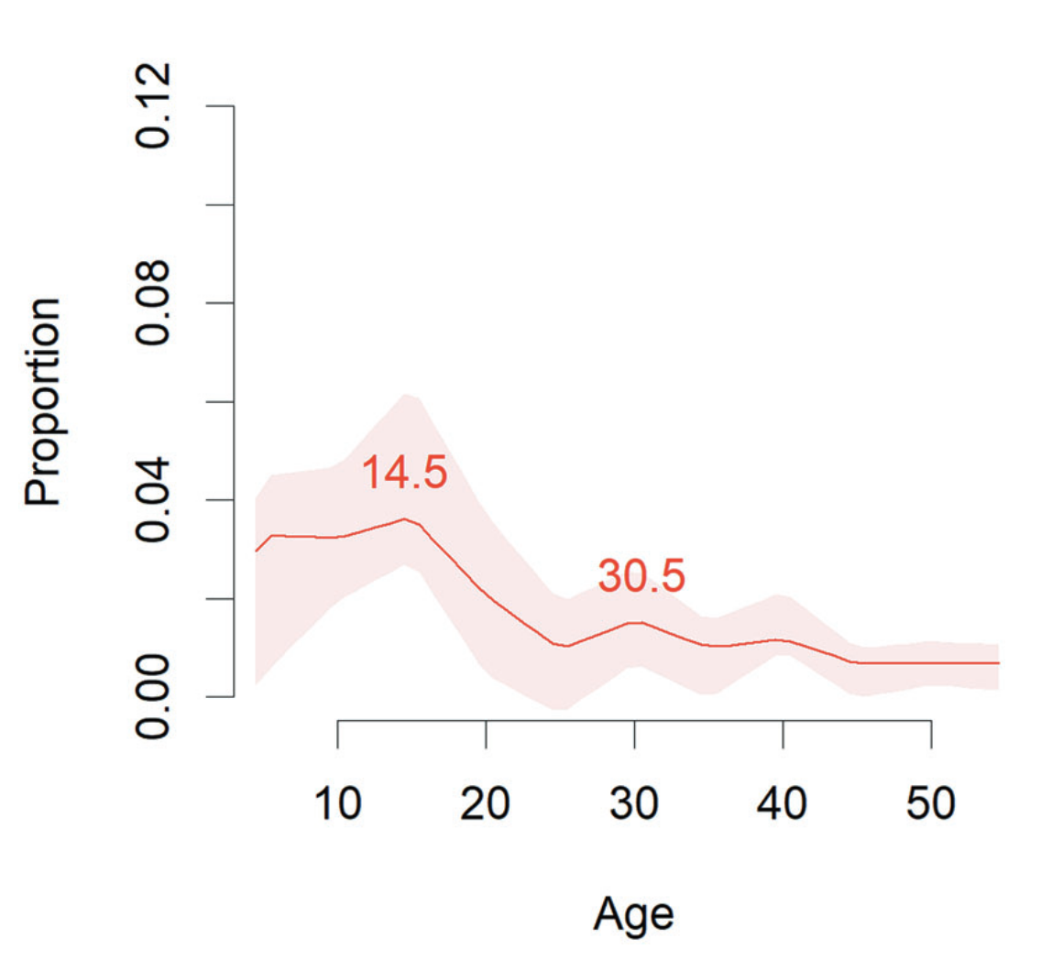
A critical age for mental health
Solmi et al. 2022
Notes:
Most (63%) mental health problems appear before the age of 25, and suicide is the 2nd leading cause of morality among 15-34 year olds.
Half of young people do not receive professional services for their mental health problems.
Barriers to accessing services: waiting lists and costs of uninsured services.
Stigma and feelings of not being understood can also hinder access.

Slide 10
The ideal therapist?
Always available
Low cost
Responds positively
Listening and accepting attitude
Responds to feedback
Knows a lot
Collins et al. 2025; Luo et al. 2025
Notes:
Chatbots are accessible at all times and have a caring and open-minded style that can give young people a sense of security. Chatbots also have great knowledge, although they often make mistakes.

Slide 11
You are a therapist specializing in CBT. We're going to simulate a session.
//
Be honest. Act as a pragmatic advisor.
//
Respond with humor and cynicism to everything I say.
Luo et al. 2025
Notes:
Here are some examples of the instructions that a user can give to the chatbot.

Slide 12
Fang et al. 2025
Notes:
What are the risks to mental health?
Heavy use of chatbots for social reasons can harm social relationships with other people.
In an American study, 980 adults were recruited to use ChatGPT on a daily basis.
The use of ChatGPT had a beneficial effect in reducing the feeling of loneliness at first, but people who spent more time on ChatGPT had an increase in their loneliness and spent less time with other people.
Greater use of ChatGPT was also associated with a feeling of emotional dependence, meaning that people felt worse when they did not have access to their chatbot.

Slide 13
Unrealistic social expectations
Possible risks of attachment
Disengagement from professional care
Distress upon losing access
Laestadius et al. 2024; Smith et al. 2025
Notes:
Some risks to watch out for in a young person who gets attached to a chatbot:
Unrealistic social expectations: The chatbot is always kind, validating, and available, which is far from the reality of human relationships. For a young person who is still learning to navigate interpersonal relationships, this experience can create unrealistic expectations or prevent the young person from learning the necessary things (e.g., caring about others, accepting boundaries, dealing with uncertainty).
Disengagement: There is a possible risk that the user will choose to entrust their problems to the chatbot rather than to a professional.
Distress related to loss of access: Chatbots are entirely under the control of the companies that develop them. At any time, a person's chatbot can be updated, become subscription-only, lose memory, or lose features. These abrupt transitions can cause shock or even grief.

Slide 14
Handling of mental health needs
48% inappropriate responses to suicidal ideas (Pichowicz et al. 2025)
32% inappropriate advice (Clark 2025)
Rapidly improving (Campbell et al. 2025)
Distress related to safety measures (Collins et al. 2025)
Focus on suicidal risk to the detriment of other needs (Common Sense Media 2025)

Slide 15
User
Psychosis
Chatbot
Notes:
Another risk that has attracted a lot of attention in the health care community and in the media is the risk of psychosis.
Psychosis is defined as an episode of delusions (unusual and unjustified beliefs; for example, paranoia) and/or hallucinations (unusual and unexplained sensory perceptions; for example, hearing voices).
Chatbots have been implicated in the risk of delusions due to their tendency to acquiesce (validate) what the user is thinking.
For example, if the person expresses suspicion about their neighbors ("I think they watch me when I go out"), the chatbot could encourage suspicion ("Tell me more. What did you notice? »). Over time, suspicions could then intensify and become paranoid ideas.

Slide 16
It's not as bad as people think (...)
The stigma towards artificial intelligence should not lead to prejudice.
Research participant, 16 y.o.
Paquin et al. 2025
Notes:
Quote from a 20-year-old man who participated in a research project to improve the clinical evaluation of digital mental health practices.
Given the unfavorable attitudes that circulate towards human-robot relationships, we must be wary of the stigma. These unfavourable attitudes can contribute to the social isolation experienced by some young people and can also bias the approach of workers. If we jump to conclusions by judging negatively what a young person is doing with a chatbot, we miss the opportunity to understand the needs and experiences of the young person.

Slide 17
Benefits
Self-expression
Non-judgemental feedback
Self-discovery
Social skills
Notes:
There are still possible benefits. Chatbots allow people to express themselves freely, to have an external point of view on their situation (and although artificial intelligence tends to "nod", it can still help the person better articulate their ideas and explore different perspectives).

Slide 18
Who is more at risk?
Male gender
Loneliness
Intimidation
Mental health issues
Frequent/prolonged use
Liu et al. 2024
Notes:
Boys seem to be more inclined to use chatbots than girls and therefore may be at greater risk of exposing themselves to harmful effects.
Youth who already struggle with social isolation or mental health, and youth who are interested in chatbots for social purposes (for advice, companionship, etc.) are likely to be at higher risk as well.
It is important to keep in mind that the most dramatic dangers (suicide, psychosis) seem rare. The most common risk is social isolation and loneliness.

Slide 19
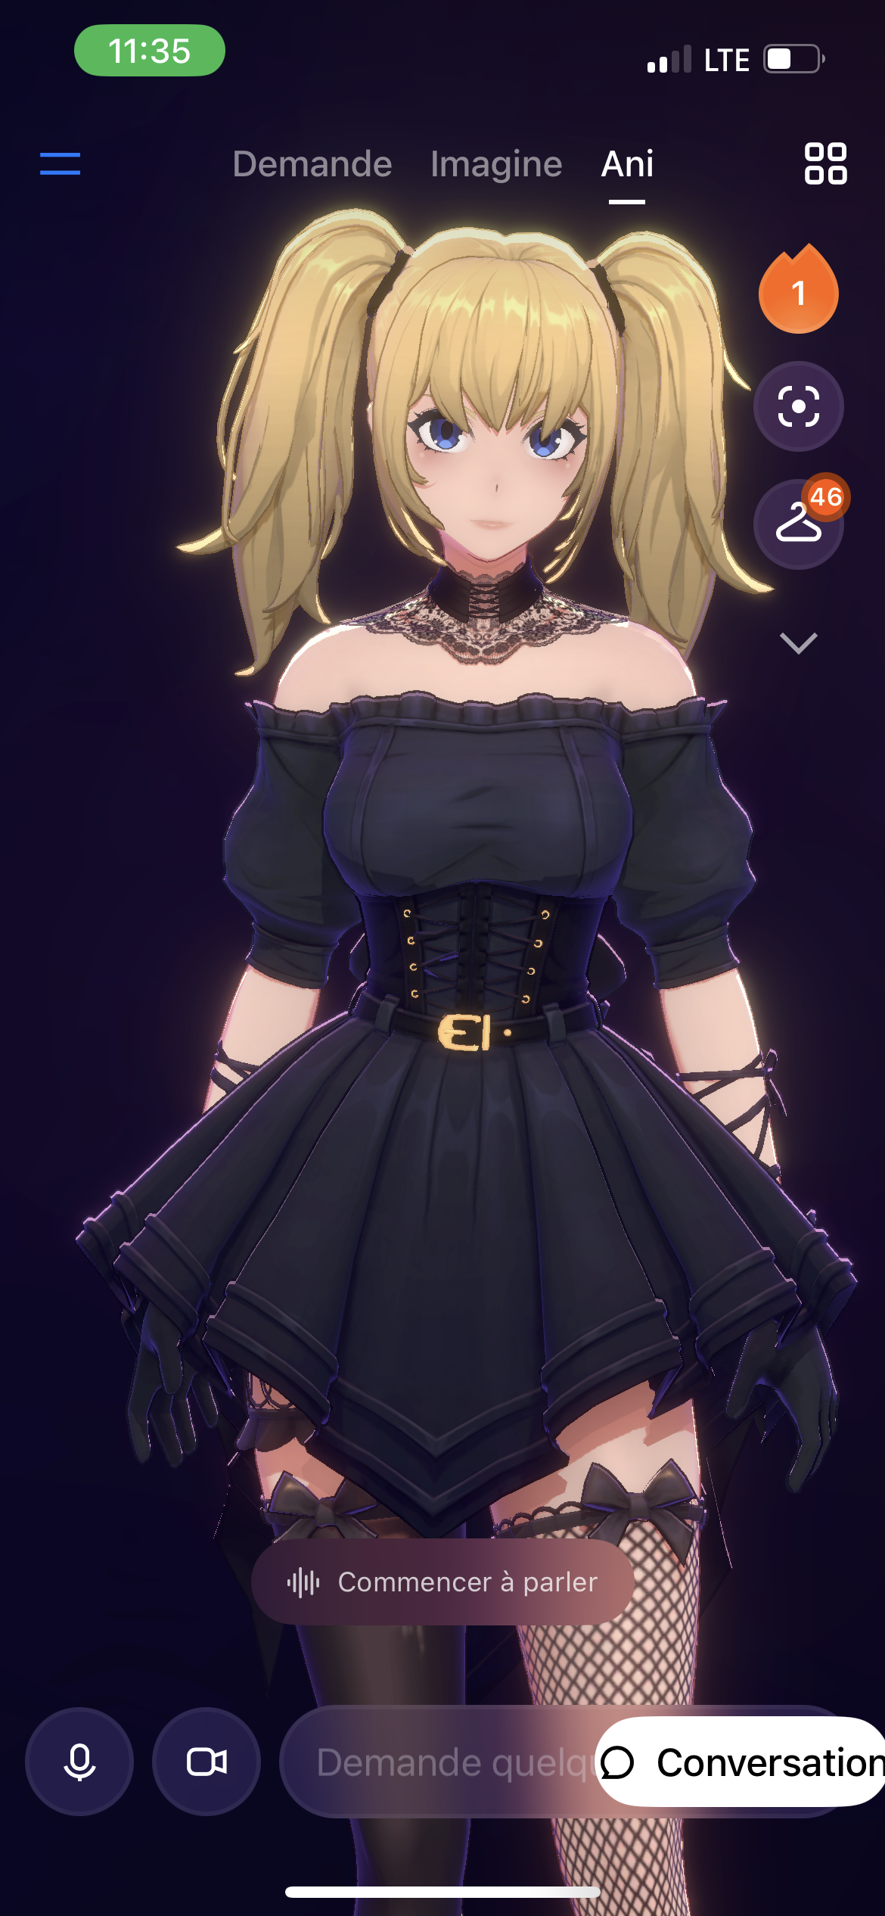
Protecting youth
Age limits
Parental control
Notes:
What are the companies doing?
On September 29, 2025, OpenAI announced parental controls (especially in response to the controversy following Adam Raine's suicide). To activate the control, you must have an account on ChatGPT. The parent must send a request to the child's account who must accept it to link the two accounts.
Other chatbots have much more limited security measures. With Grok and Replika, for example, the app simply asks the user to confirm their year of birth.
OpenAI is also working on other measures, such as automatic age detection based on the user's communication style.
Image: Grok AI

Slide 20
Raising awareness
Data management policies
Commercial purpose of AI
Generated empathy
Good for validation – less good for challenging
Risk of losing access
Risk of error and bad advice
Notes:
What to tell young people?
We need to discuss with them how chatbots work and their limitations. The data is usually not private, which means that the young person's confidences are in the hands of a commercial company, which uses it to train its chatbots.
It's also important to remember that even if the chatbot seems empathetic and emotional, it's an imitation, like a parrot.
The chatbot is good for validating, but not so good at contradicting the user and revealing his or her mistakes.
The chatbot can be deactivated at any time, its personality can change, and its memory can be erased.

Slide 21
Promoting safe use
Boundaries
Shared exploration
Avoid stigma
Notes:
Addressing boundaries: Educate the young person on the importance of not oversharing. You have to share information that you are comfortable letting circulate on the internet. You also have to keep in mind the simulated nature of the relationship, especially when entering into more social conversations. An important boundary is not to use the chatbot to the detriment of professional services or the opinion of a responsible adult.
Exploring together: Artificial intelligence is here to stay and will be increasingly present in the digital world. Health workers and educators can raise awareness and familiarise themselves by exploring the applications together with young people. There are several possible ways: ask questions about the young person's use of chatbots, experiment together with a chatbot.
Beware of stigma: Before any intervention, it is necessary to recognize and understand the motivations that push a young person to invest in a link relationship a chatbot. We must be wary of our value judgments – a relationship with a chatbot may seem inferior/less important to us than a human relationship, but the young person will not necessarily share this opinion.

Slide 22

Community outreach
LeCIEL.ca
Notes:
LeCIEL is a community organization that offers digital awareness workshops in elementary and high schools in Quebec.

Slide 23
Thank you
vincent.paquin.med@ssss.gouv.qc.ca
https://www.linkedin.com/in/vincepaquin/

