Slide 1
Addressing Methamphetamine and Other Stimulant Use
Alex S. Keuroghlian, MD MPH
Associate Professor of Psychiatry, Harvard Medical School
Director, National LGBTQIA+ Health Education Center at The Fenway Institute
Director, Massachusetts General Hospital Psychiatry Gender Identity Program

Slide 2
Continuing Medical Education Disclosure
Program Faculty: Alex S. Keuroghlian, MD, MPH;
Current Position: Director of the Division of Education and Training at the Fenway Institute; Associate Professor of Psychiatry, Harvard Medical School
Disclosure: I have the following relevant financial relationship to disclose— I edited a textbook with McGraw Hill and receive royalties. Any potential conflicts of interest have been mitigated through an attestation that I will not reference the textbook within this presentation.

Slide 3
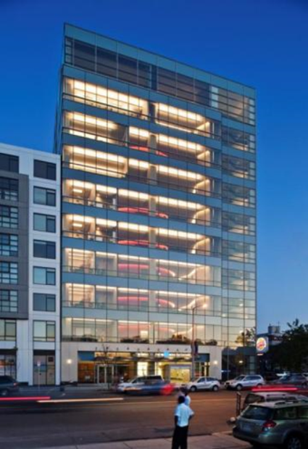
Our Roots
Fenway Health
Independent 501(c)(3) FQHC
Founded 1971
Mission: To enhance the wellbeing of the LGBTQIA+ community as well as people in our neighborhoods and beyond through access to the highest quality health care, education, research, and advocacy
Integrated primary care model, including HIV and transgender health services
The Fenway Institute
Research, Education, Policy

Slide 4
LGBTQIA+ Education and Training
The National LGBTQIA+ Health Education Center offers educational programs, resources, and consultation to health care organizations with the goal of providing affirmative, high quality, cost-effective health care for lesbian, gay, bisexual, transgender, queer, intersex, asexual, and all sexual and gender minority (LGBTQIA+) people.
Training and Technical Assistance
Grand Rounds
Online Learning
  Webinars, Learning Modules
  CE, and HEI Credit
ECHO Programs
Resources and Publications
www.lgbtqiahealtheducation.org

Slide 5
What is Crystal Meth?
Methamphetamine
Looks like rock candy
Snorting: “rush” effect lasts 3-5 minutes
Injecting: “rush” effect lasts 5-10 minutes
Swallowing: “rush” effect up to 30 minutes
Rectal: Variable duration of “rush”
Intoxication or “high” lasts 4-16 hours
Slide adapted from Dr. Kevin Kapila (Fenway Health)

Slide 6
The Rush
Caused by a massive release of norepinephrine, dopamine and serotonin
Increases release of dopamine in nucleus accumbens, which is part of the reward center in the brain
Increases heart rate, blood pressure, body temperature
Slide adapted from Dr. Kevin Kapila (Fenway Health)

Slide 7
Cost
Many people do not have to pay, often freely available at a party
Can also be exchanged for sex
Can be sold in smaller amounts, lowest about $20
The financial toll is related to impaired judgement and loss of job rather then cost of drug itself
Slide adapted from Dr. Kevin Kapila (Fenway Health)

Slide 8
Crystal Meth Use Among Men Who Have Sex with Men (MSM)
10x more use among MSM than general population; annual prevalence 12-30% among MSM
Increased pleasure from sex
At one circuit party, 43% reported meth use
Loss of inhibition
Weight loss
Alertness
Issues of aging in the community
Slide adapted from Dr. Kevin Kapila (Fenway Health)

Slide 9
Crystal Meth and Sexual Activity
Sex lasts longer, with delay in ejaculation
Can cause erectile dysfunction, increased sildenafil use
Disinhibition leads to rougher sex, more rectal trauma and trauma to penis
Multiple partners
More condomless intercourse
Slide adapted from Dr. Kevin Kapila (Fenway Health)

Slide 10
Why Crystal Meth at 60 Years Old?
“It’s the best sex I ever had.”
“I’m not old and invisible.”
“I love my partner, but we met when shoulder pads were in style.”
“Younger guys are interested in me, I know it’s the drugs but when you’re high it feels real.”
Slide adapted from Dr. Kevin Kapila (Fenway Health)

Slide 11
Crystal Meth’s Appeal for People Living with HIV
People with HIV report not having to worry about rejection based on status
Burnout on safer sex: crystal meth use coincides with condomless sex and sex without HIV pre-exposure prophylaxis (PrEP)
Slide adapted from Dr. Kevin Kapila (Fenway Health)

Slide 12
Recreation Vs. Addiction
Not all people who use crystal meth become physiologically dependent
While some people may not escalate use, will often have less safe sex while using
Many people will go for long periods without escalating use and stop
Some will use for a long period time and gradually increase use
Others may develop addiction rapidly
Slide adapted from Dr. Kevin Kapila (Fenway Health)

Slide 13
Patterns of Increase in Crystal Meth Use
Weekend use extends to weekday use
Extended periods of heavy use
Increased sexual risk with use
More intense sexual behaviors, increase in partners, rougher sex
People living with HIV start to miss taking antiretroviral medication, others start to miss PrEP
Missed work, constantly covering up use
Slide adapted from Dr. Kevin Kapila (Fenway Health)

Slide 14
Crystal Meth and Sexually Transmitted Infections (STIs)
At parties where crystal meth is used, multiple partners is the norm
Syphilis: painless lesion; primary lesion on tonsil or in rectum is often not seen
Evolution of gonorrhea resistant to ciprofloxacin
Lymphogranuloma venereum
Methicillin-resistant Staphylococcus aureus
HIV
Hepatitis
Slide adapted from Dr. Kevin Kapila (Fenway Health)

Slide 15
Crystal Meth and Hepatitis C
Increase risk of transmission with injecting (slamming), more traumatic sex, sharing bumpers and straws with snorting
Possibility of increase in cognitive deficits with combination of crystal meth, hepatitis C and HIV, separate from how advanced liver disease is
Crystal meth adversely impacts engagement in hepatitis C care
Slide adapted from Dr. Kevin Kapila (Fenway Health)

Slide 16
Negative Health Effects (Early)
Paranoid ideation/delusions, hallucinations
Depression after high is gone
Seratonin syndrome when mixed with other club drugs or synaptic serotonin reuptake inhibitors (SSRIs)
Vascular (stroke, myocardial infarction, colitis)
Seizure related to overheating
Slide adapted from Dr. Kevin Kapila (Fenway Health)

Slide 17
Negative Health Effects (Chronic Use)
Persistent psychiatric problems: psychosis and depression
Memory deficits
Dental decay related to decreased saliva, grinding teeth, increased sugar intake
Dermatological effects due to skin picking, “crystal bumps”
Erectile dysfunction
Muscle wasting
Damage to relationships, occupation, finances
Slide adapted from Dr. Kevin Kapila (Fenway Health)

Slide 18
Addressing Crystal Meth Use in Clinical Care
20-minute follow-up visits
  Cannot solve all problems
Avoid argument
Do not underestimate ambivalence
  Relapse is common, should not be thought of as good/bad, it just happens
  Provider’s agenda may not be the patient’s agenda
  Patients do hear what we say, when they are ready
Slide adapted from Dr. Kevin Kapila (Fenway Health)

Slide 19
Harm Reduction
Many people are not ready to stop, but will engage in care
Ask patients: what is their bottom line, what would lead them to think there is a problem?
Hydrate, eat
Fluoride rinse, sugar free hard candy/gum
Plans for taking medication during use, can someone be on meds while using; discuss PrEP
Frequent STI screening
Safer sex, serosorting
Slide adapted from Dr. Kevin Kapila (Fenway Health)

Slide 20
What Brings Crystal Meth Users Into Recovery?
Seroconversion
Work performance
Relationships/family
Shame
Fear around meth-induced psychosis
HIV not well-controlled
Primary treatment team
Slide adapted from Dr. Kevin Kapila (Fenway Health)

Slide 21
Sex and Shame
Important to deal with issues of shame and sex
Sexual experimentation: multiple partners, receptive sex, sex without condoms or PrEP
Internet videos
Sex in sobriety can feel boring, be triggering, can feel less intimate
Slide adapted from Dr. Kevin Kapila (Fenway Health)

Slide 22
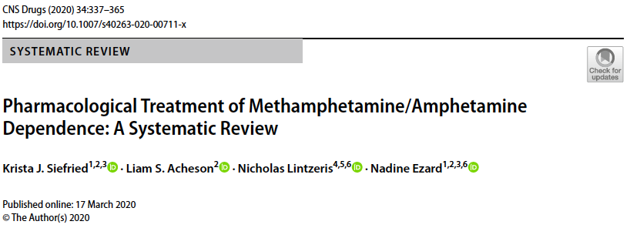
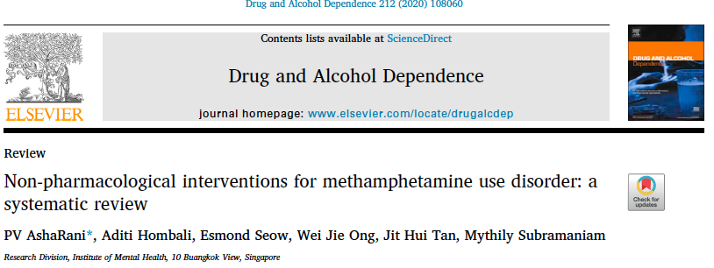
Pharmacological Treatment and Non-pharmacological Interventions

Slide 23
Positive Affect Intervention
Multi-component intervention developed by Adam Carrico and colleagues
Focused on improving mood states in order to boost and extend the effectiveness of community-based contingency management for stimulant abstinence among methamphetamine users, and in turn achieve more durable reductions in HIV viral load.
​
Notes:
No concerns from EC

Slide 24
Positive Affect Intervention
Many people of different skill levels could implement
Augments contingency management in a compelling way
Data indicating an impact on viral suppression that is very strong
Applicable more broadly than only with MSM, and more broadly in terms of other stimulants (e.g., cocaine instead of crystal meth)

Slide 25
Recovery
Extreme commitment vs. ambivalence
Dealing with roles of partners/family
Inpatient hospitalization often not an option
Individual and group therapy
Motivational enhancement therapy
Partial hospitalization programs
Crystal Meth Anonymous (CMA), Alcoholics Anonymous (AA), Narcotics Anonymous (NA)
Tweaker.org
Slide adapted from Dr. Kevin Kapila (Fenway Health)

Slide 26
Early Sobriety
Often turbulent
Seroconversion can be trigger to use
Initially partner/family supportive, however when crisis is over this may change
Need time in recovery, relapse can happen even after a year out
Slide adapted from Dr. Kevin Kapila (Fenway Health)

Slide 27
Contact Information:
  Alex S. Keuroghlian MD MPH (akeuroghlian@fenwayhealth.org)

Slide 28

The National LGBTQIA+ Health Education Center provides educational programs, resources, and consultation to health care organizations with the goal of optimizing quality, cost-effective health care for lesbian, gay, bisexual, transgender, queer, intersex, asexual, and all sexual and gender minority (LGBTQIA+) people.
The Education Center is part of The Fenway Institute, the research, training, and health policy division of Fenway Health, a Federally Qualified Health Center, and one of the world’s largest LGBTQIA+ focused health centers.
 617.927.6354
education@fenwayhealth.org
8 www.lgbtqiahealtheducation.org
www.acponline.org/fenway

