Slide 1
Agricultural Preservation Restriction Program Department of Agricultural Resources
Division of Agricultural Conservation and Technical Assistance
APR Local Match Policy

Slide 2
Local Match
What is the Local Match?
A requirement that a local funding source contributes a minimum % towards an APR acquisition. Sources can include a municipality, land trust, another NGO partner, and/ or a landowner donation.
Why is there a Local Match requirement?
Stretch limited state funding.
Create and demonstrate local support for farmland protection and farm economies.
Notes:
It should be noted that NRCS ALE Program funds is not considered part of the local match/ contribution

Slide 3
History
1988 Department Staff and ALPC's began encouraging Town contributions.
No application would be denied due to a Town’s refusal to contribute.
Applications with Town contributions will be given added consideration.
2004: Smart Growth Initiative
"Commonwealth Capital" program
Additional APR funding stream for Municipalities.
20% local match required.
Notes:
1) Local contribution had been sought prior to the 1988 Policy Discussion
2)Bringing Smart Growth to Massachusetts; Douglas Foy and the Office of Commonwealth Development. Harvard Kennedy School: Case Program

Slide 4
History
2005: All funding for APR via Commonwealth Capital
2008: Temporary relief from 20% local match
Due to economic downturn
5% discount for smart growth principles continue
Alternatively, Communities that can demonstrate average historic match could receive similar discounts
These policies has remained in place to the present day
2021: Review of Policy. Anecdotal evidence of:
Local match being passed on to landowners
Offers being declined
Difficult to assess how active Ag Comms and tracking systems are
Need to update the policy
Notes:
1) Local contribution had been sought prior to the 1988 Policy Discussion
2)Bringing Smart Growth to Massachusetts; Douglas Foy and the Office of Commonwealth Development. Harvard Kennedy School: Case Program

Slide 5
Proposal Goals
Maintaining and increase # of applications to APR
Maintain and increase # of offers accepted
How would that be accomplished?
Reduce the number and size of bargain sales that are a result of the local match policy
Notes:
1) Local contribution had been sought prior to the 1988 Policy Discussion
2)Bringing Smart Growth to Massachusetts; Douglas Foy and the Office of Commonwealth Development. Harvard Kennedy School: Case Program

Slide 6
Proposed Policy Adjustment
Proposal:
Project ≤ $17,000 Cap will require a minimum local match/ contribution of 10%
If a community has a Right to Farm bylaw, then required local match/ contributions is reduced to 5%
Projects > $17,000 Cap the minimum required local match/ contribution is 10%.

Slide 7
Anticipated Benefits to Policy Change
# & size of bargain sales decreases
APR becomes more attractive to farmers
# of APR applications increase
# of offers accepted & farms protected increases
Puts additional dollars in farmers pockets – enhancing opportunity for more viable APR’s
Streamline APR process

Slide 8
Analysis Part 1: % Match
Analysis of projects completed in the past 5 years:
89% of projects only required 10% match or less
Majority of projects (62%) included a bargain sale.
Bargain sales assist meeting the local match at least 28% of the time.
Takeaway: Significant # of landowners had to decide whether to accept a bargain sale due to the local match
Nearly half (48%) of all bargain sales were projects where the bargain sale was the entire local match.
Takeaway: The local match requirement was passed on entirely to a significant number of landowners (though some may opt for it).
Bargain Sales ranged up to $204,000
Median & Average of $82,000
It is reasonable to expect that at least some offers have and will be declined under such circumstances.
Notes:
1) Local contribution had been sought prior to the 1988 Policy Discussion
2)Bringing Smart Growth to Massachusetts; Douglas Foy and the Office of Commonwealth Development. Harvard Kennedy School: Case Program

Slide 9
Conclusion #1
Anecdotal + Emperic evidence
Local Match level above 10% no longer needed
Not in the best interest of the program
Notes:
1) Local contribution had been sought prior to the 1988 Policy Discussion
2)Bringing Smart Growth to Massachusetts; Douglas Foy and the Office of Commonwealth Development. Harvard Kennedy School: Case Program

Slide 10
Analysis Part 2: Reduction Incentives
It is a challenge to evaluate how active Agricultural Commissions and tracking systems are.
The Right to Farm by law is an incentive that can be adequately evaluated.
In addition, NRCS has ranking criteria for RTF bylaw as part of their project evaluations
Notes:
1) Local contribution had been sought prior to the 1988 Policy Discussion
2)Bringing Smart Growth to Massachusetts; Douglas Foy and the Office of Commonwealth Development. Harvard Kennedy School: Case Program

Slide 11
Conclusion #2
In light of Conclusion #1 (A Local Match more than 10% is not needed);
Considering these two incentives reduce the local Match from 20% to 10%;
And recognizing activity level of Ag Commission & Tracking Systems are difficult to measure;
Only one incentive appears advisable – the RTF bylaw
Notes:
1) Local contribution had been sought prior to the 1988 Policy Discussion
2)Bringing Smart Growth to Massachusetts; Douglas Foy and the Office of Commonwealth Development. Harvard Kennedy School: Case Program

Slide 12
Analysis Part 3: Additional Considerations
Is a Local Match necessary?
No
Staff and previous ALPC’s have seen value in leveraging local dollars.
The Match has been viewed to stretch limited APR funding,
Demonstrate local support for projects,
Provides a process to educate communities about the importance of APR land
Are APR funds leveraged in other ways?
Yes
As much as 50% of the APR purchase price
-ACEP-ALE
- Another source if ACEP-ALE is not used
Notes:
1) Local contribution had been sought prior to the 1988 Policy Discussion
2)Bringing Smart Growth to Massachusetts; Douglas Foy and the Office of Commonwealth Development. Harvard Kennedy School: Case Program

Slide 13
Analysis Part 3: Additional Considerations
Is Community support evaluated in other ways?
It can be
APR Regulation enables but does not require municipalities to provide comments or recommendations
Notes:
1) Local contribution had been sought prior to the 1988 Policy Discussion
2)Bringing Smart Growth to Massachusetts; Douglas Foy and the Office of Commonwealth Development. Harvard Kennedy School: Case Program

Slide 14
Analysis Part 3: Additional Considerations
Is there funding available to cover any additional increase in spending?
Yes. Based on the data, any increase in spending is expected to be in the range of $35,000 per year. The Department has more than adequate discretionary funds available to cover this increase.
Should there be a periodic review and update to this policy?
Yes, the APR program is required by regulation to review our policies at least every 3 years.
Notes:
1) Local contribution had been sought prior to the 1988 Policy Discussion
2)Bringing Smart Growth to Massachusetts; Douglas Foy and the Office of Commonwealth Development. Harvard Kennedy School: Case Program

Slide 15
Next Steps
Take questions & comments from ALPC today
The Commissioner will determine whether to adopt the policy as is or with modifications.
If adopted, the new policy will be applied to new APR acquisition offers that are scheduled to go out to landowners soon after ALPC meeting (this January).

Slide 16
Proposed Policy Adjustment
Proposal:
Project ≤ $17,000 Cap will have a local match/ contribution of 10%
If a community has a Right to Farm bylaw, then required local match/ contributions is reduced to 5%
Projects > $17,000 Cap the local minimum required local match/ contribution is 10%.

Slide 17
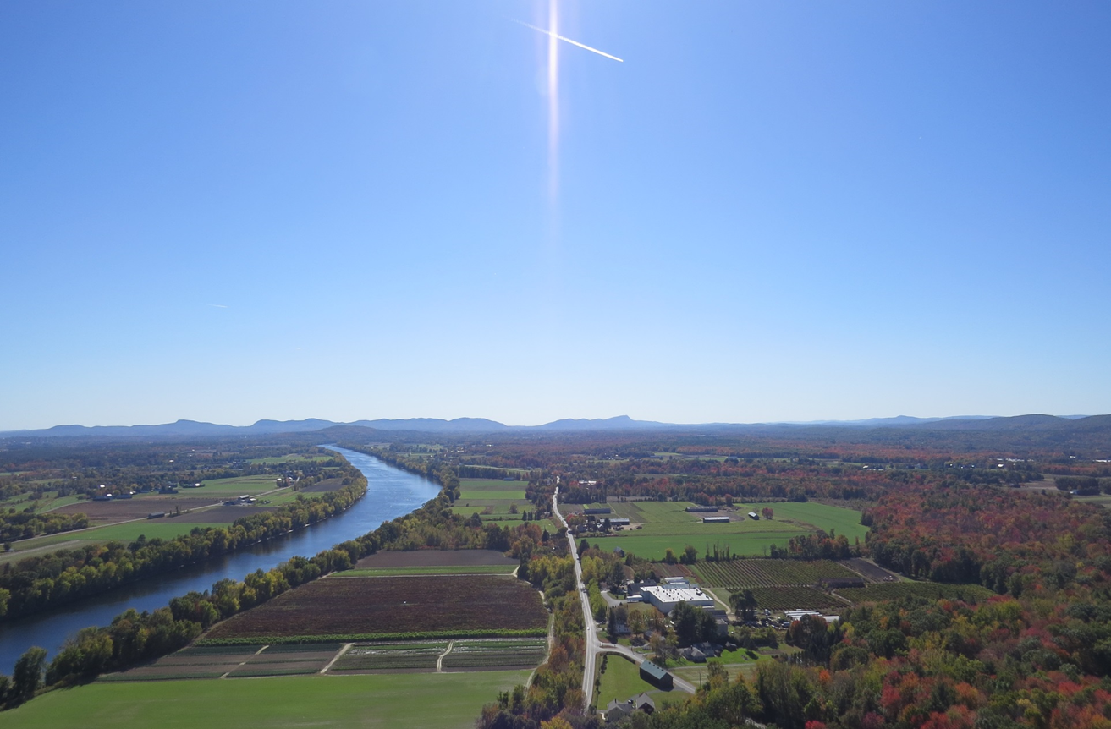
Agricultural Preservation Restriction Program
Division of Agricultural Conservation and Technical Assistance
Massachusetts Department of Agricultural Resources
251 Causeway Street, Boston, MA 02114 www.mass.gov/agr

