Slide 1
ALR Commission Meeting #11
Tuesday, November 17th | 11:00 AM

Slide 2
Agenda
Opening | Secretary Robin Lipson (10 min)
ALR Affordability Panel (45 min)
Public Hearing Reflection (30 min)
3. Wrap-Up | Secretary Robin Lipson (5 min)

Slide 3
Final Report Roadmap

Slide 4
Final Report Roadmap Calendar
November
December
Mon | Tue | Wed | Thu | Fri
3 | 4 | 5 ALR Commission Public Hearing | 6 | 7
10 | 11 Veterans Day | 12 | 13 | 14
17 | 18 ALR Mtg 11–12:30 Affordability Panel Public Hearing Reflections | 19 | 20 | 21
24 | 25 | 26 | 27 Thanksgiving | 28
Mon | Tue | Wed | Thu | Fri
1 | 2 | 3 ALR Mtg 1:30–3 State Fire Marshall Review Recommendations | 4 | 5
8 | 9 | 10 Finalize report & send to Commission members | 11 | 12
15 | 16 | 17 | 18 | 19
22 | 23 | 24 | 25 Christmas | 26
29 | 30 | 31 Report Due
Need to schedule Commission meeting to finalize report

Slide 5
Massachusetts Affordable Housing Options for Older Adults

Slide 6
Key Terms
Affordable Housing: Federal term reflecting the goal of spending no more than 30% of gross household income on housing — leaving enough to cover other expenses.
Spending >30% = Housing Cost Burdened
Spending >50% = Severely Housing Cost Burdened
Area Median Income (AMI): Middle income in your area based on federal data set updated annually providing figures by household size and geography
Low-Income Brackets:
Extremely Low Income (ELI): <30% AMI→ most MassHealth members fall here
  FFS, SCO and One Care ~ 28% AMI
  Waivers and PACE ~35% AMI
Very Low Income (VLI): 30-50% AMI
Low Income (LI): 50-80% AMI
Low Income Housing Tax Credit (LIHTC): Federal program awards tax credits to housing developers for reserving % of units as rent-restricted or low-income housing; LIHTC financed housing is targeted to people with incomes < 60% AMI.

Slide 7
Components of Affordable Housing
Most affordable housing contains one or more of the following 3 components
Capital – “bricks and mortar”
  One-time costs for acquiring land/buildings, renovations, construction
  Funding comes from government loans/grants, banks, and philanthropy
Operating
  Maintenance, utilities, systems (e.g., HVAC), and upkeep (e.g., snow removal)
  Ongoing costs
  Operating funding:
    Usually covered by rent payments from resident
    Deeply affordable housing targeted to people with lower incomes requires operating/project based subsidies since resident rent payments are insufficient
Supportive Services
  Some buildings employ a Resident Service Coordinator to assist all residents in connecting to resources
  Residents of affordable housing must pay and arrange for any support services they may want/need to address their individual needs
  Some residents of affordable housing may be over income for MassHealth and other state service programs

Slide 8
Types of Affordable Housing
Private Subsidized Housing
  Owned by for-profit or non-profit orgs
  Income-restricted; rent reduced via government capital funds
  Often serves households <60% AMI
  Can be age restricted
Public Housing
  Owned by local housing authorities
  Ongoing federal/state rent subsidies
  Serves households <80% AMI
  Some properties targeted to older adults/people with disabilities
Estimated 110,000 age restricted senior affordable housing units across the Commonwealth, split somewhat evenly between public housing and private assisted housing
There is a shortage of affordable housing across the state, and most properties have long waitlists.

Slide 9
Housing Options for Older Adults in Massachusetts
RESIDENTIAL
Subsidized/Affordable
RESIDENTIAL
Market Rate
INSTITUTIONAL
Licensed
Variable Acuity (but housing and services provided separately)
Variable Acuity (housing and services intertwined)
Affordable Senior Housing
  Federal HUD/USDA
  EOHLC/ MassHousing
  Income targeted
  Some properties are mixed finance and some are subsidized
Public Housing
  State or HUD Funded
  Subsidized
  Income targeted
Market-Rate Senior Housing
  Independent Living
Assisted Living Residence
  Traditional Care
  Memory Care
  (271 ALRs)
Rest Home
  Residential Care Facility
  (58 Rest Homes)
Nursing Facility
  SNF
  LTC
  (346 NFs)
AGE CERTIFIED
DPH LICENSED
DPH LICENSED
Continuing Care Retirement Community (CCRC) or “Life Plan” Housing Options

Slide 10
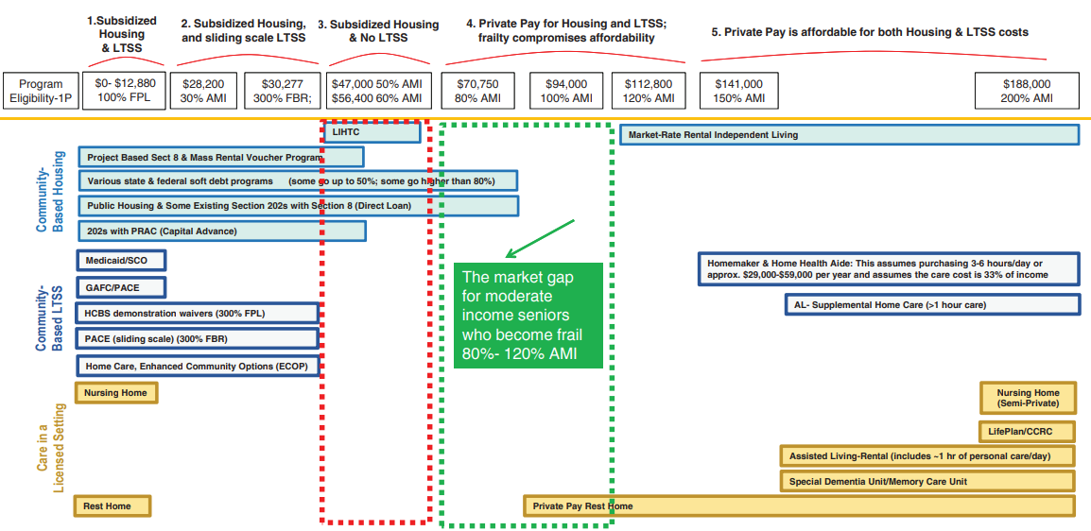
Eligibility for Senior Affordable Housing & Long-Term Services and Supports
Note: Graphic created by 2LifeCommunities and represents historic amounts (circa MA 2021)

Slide 11
Thank You

