Slide 1
Advisory Council on Alzheimer’s Disease and All Other Dementias
Executive Office of Aging & Independence
Whitney Moyer, Chair
May 6, 2025
3:30-5:00 pm
Video Conference

Slide 2
Agenda
Welcome, Logistics, Announcements, Introductions (15 min)
Annual Report: Present, Discuss, and Plan to Vote (40 min)
Going Forward: Prioritization Exercise (32 min)
Next Steps and Vote to Adjourn (3 min)

Slide 3
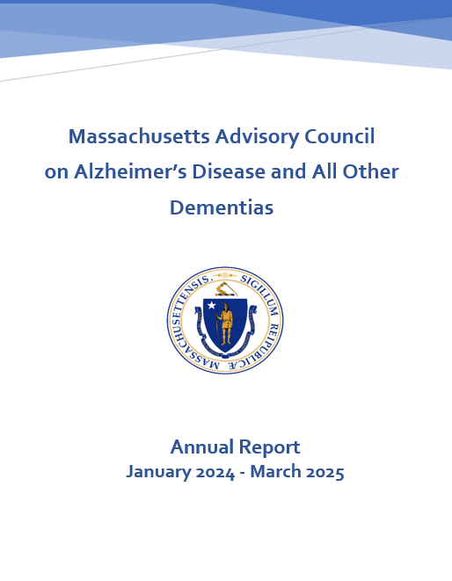
Annual Report Review
January 2024 – March 2025
Present Highlights (20 min)
Annual Report Review
DRAFT
Present Highlights

Slide 4
Activities and Achievements by Workstream
The report includes six sections, one for each of the following workstreams:
Caregiver Support and Public Awareness
Diagnosis and Services Navigation
Equitable Access and Care
Physical Infrastructure
Public Health Infrastructure
Quality of Care
For each recommendation in the state plan, the report includes activities and accomplishments (January 2024 through March 2025); and next steps.
Invaluable volunteers and teams worked on behalf of the Council.
See the report for a list of all team members by team and workstream.

Slide 5
1. Caregiver Support and Public Awareness
Workstream Goals
Identify short-term approaches to improve awareness of the pathways to available supports and services for dementia caregivers and persons living with dementia
Compare and evaluate the experiences of caregivers of people living with dementia as they navigate the Commonwealth’s system of supports and services
Workstream Leads
Barbara Meehan, Council Member - Dementia Advocate, Former Caregiver
Hector R. Montesino, Council Member - President and CEO, Embrace Home Care and Health Services, Dementia Advocate

Slide 6
1. Caregiver Support and Public Awareness
Public Service Announcements and Video Production
Produced videos and content for public service announcements for distribution in June.
Caregiver Experience with Aging Services Access Points (ASAPs)
Implemented Changes in Response to Market Research Findings
Rebranding. Changed name to “Executive Office of Aging & Independence” (AGE), recognizing how
adults value independence and self-determination.
Caregiver Portal. Added concise information to AGE’s caregiver portal (program descriptions, eligibility, costs).
Examined Caregiver Experience with ASAPs
Surveys & Tests. In 2024, conducted consumer surveys and consumer experience testing in all 24 ASAPs
Dementia Caregiver Scenario. Twenty completed calls were made by “imitation consumer” using a dementia caregiver scenario - Information & Referral specialists suggested the caller contact the MA Family Caregiver Support Program in only 3 of the calls; and the Alzheimer’s Association in none of the calls.
Addressing concerns. In January 2025, AGE reflected on findings from the surveys and experience testing to begin addressing concerns and updating ASAP designation tools, processes, and a compliance scoring approach.

Slide 7
2. Diagnosis and Services Navigation
Workstream Goal
Increase the number of people living with dementia who are diagnosed, informed of their diagnosis, and able to effectively attain helpful information, services, and care planning
Workstream Lead
James Wessler, Council Member - President and CEO, Alzheimer’s Association, MA/NH Chapter and New England Regional Leader

Slide 8
2. Diagnosis and Services Navigation
Diagnosis
Sharing Best Practices
As reported in last year’s annual report, this part of the workstream merged with the efforts of the
Medical and Scientific (MedSci) Advisory Committee of the Alzheimer’s Association, MA/NH Chapter
to examine solutions and share best practices across health care systems.
Dementia Screening in Home Care Program
In 2025, AGE will follow-up on its promise to reassess the feasibility of convening a team with
representatives from AGE and ASAPs to identify opportunities in the home care program to
to advocate for appropriate screening and diagnosis.
Services Navigation
Leveraged Synergies Across the Council’s Teams
To better leverage synergies, the state plan’s recommendations on “services navigation” addressed
by Council teams working within the “Quality of Care” workstream.

Slide 9
3. Equitable Access and Care
Workstream Goal
Close gaps in equitable access
to information, supports,
services, and care
Workstream Leads
Hugo Aparicio, MD, MPH, Workstream Lead and Council Member - Associate Professor of Neurology, Boston University School of Medicine; Stroke Specialist in the Department of Neurology, Boston Medical Center
Jatin Dave, MD, MBBS, MPH, Workstream Lead and Council Member (until mid-December 2024) - Chief Medical Officer, MassHealth; Director, Office of Clinical Affairs, Commonwealth Medicine, UMass Chan Medical School (until mid-December 2024)

Slide 10
3. Equitable Access and Care
Equity Priorities, DEI Tool, and Listening Session
Set priorities. Defined equity priorities related to dementia care.
Developed Tool. Developed a DEI tool designed to help the Council and its teams examine their work with a “diversity, equity, and inclusion (DEI) lens.”
Initiated Recurring Listening Sessions. Refined the DEI tool based on discussions with people with lived experience - key finding was lack of effective communication with health care providers.
Younger-Onset Dementia – Awareness & Access to Services
As promised last year, in 2025 AGE will determine the feasibility of implementing the
state plan’s recommendations on improving awareness of and access to services
available for people affected by younger-onset dementia.

Slide 11
4. Physical Infrastructure
Workstream Goal
Identify and incorporate dementia friendly physical infrastructure into
age friendly physical infrastructure work
Workstream Lead
Pam MacLeod, MBA, PMP - Senior Project Director for the Council; Massachusetts Executive Office of Aging & Independence; and UMass Chan Medical School

Slide 12
4. Physical Infrastructure
Designing Age and Dementia Friendly Spaces
Provided Guidance Currently Under Consideration by State Agencies
Senior Housing Requirements. Recommended changes to the state’s guidance on senior housing design to better meet cognitive and physical accessibility needs.
Guidance for Building Designers. Recommended guidance to add to the state’s designer manual used for public infrastructure projects.
Emergency Shelter Plans. Advised Emergency Management Agency on age and dementia friendly emergency shelter design practices.
Public Library Construction. Encouraged inclusion of dementia friendly design in public library construction grants.
Developed Assessment Tools
Partnered with Boston University students to create tools to help “citizen advocates” assess age and dementia friendliness of public spaces including senior centers, libraries, and outdoor parks.

Slide 13
5. Quality of Care
Workstream Goal
Identify gaps in quality of care for people living with dementia in Massachusetts, as well as strategies to close those gaps
Workstream Lead
Linda Pellegrini, MS, GNP-BC, Council Member - Geriatric Nurse Practitioner, UMass Memorial Medical Center

Slide 14
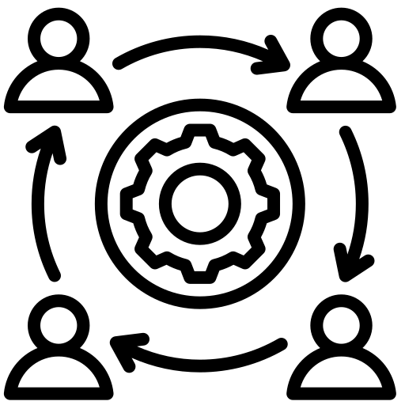
5. Quality of Care
Person-Centered Dementia Care Planning
Developed a Dementia Care Planning Toolkit for individuals living with dementia and their
care teams:
Includes guidance, sample plans, and a simple worksheet to support meaningful conversations.
Promoted the toolkit at two webinars, distributed it widely; will continue to promote it.
Interdisciplinary Dementia Care
Identified dementia care gaps with input from the Council, its teams, and people with lived
experience.
Analyzed care models; selected Care Ecosystem as best fit for interdisciplinary dementia care.
Found that effective dementia care requires a focus on dementia care planning, navigation of care and social service systems, and ongoing caregiver support.
Explored care barriers: e.g., overloaded primary care, system confusion, fragmented services.
Designing a plan for a pilot with clinical consultants and navigators to streamline, support, and integrate care.

Slide 15
6. Risk Reduction and Public Health Infrastructure
Workstream Goal
Reduce the risk of dementia among Massachusetts residents while enhancing the state’s public health infrastructure to address dementia
Workstream Lead(s)
TBD

Slide 16
6. Risk Reduction and Public Health Infrastructure
Springfield’s Healthy Brain Initiative
As reported last year, in 2023, the Springfield Dementia Friendly Coalition
partnered with a team working on behalf of the Council to secure a grant for a
“Healthy Brain Initiative.”
In 2024, the Coalition launched the initiative with an event to raise dementia awareness and promote brain health, early detection, screening, and diagnosis.
At the event, participants viewed a brief video, spoke with experts, and visited information tables on local supports and services.

Slide 17
Looking to the Future
Develop an Updated State Plan on ADRD
As indicated in the annual report:
Most of the recommendations in the state plan have been implemented;
now is the time to update it.
We’ll spend time in 2025 to identify key priorities to guide a new state plan for release in 2026.
The Council’s work on the plan will require:
examining key challenges facing people affected by dementia;
exploring potential solutions to those challenges; and
determining how the Council can potentially support each solution, e.g., by leading, advising, partnering, advocating, or deferring.

Slide 18
Annual Report Review
January 2024 – March 2025
Provide Comments and Vote (20 min)
Annual Report Review
DRAFT
Provide Comments and Discuss Voting Procedures

Slide 19
4. Going Forward: Prioritization Exercise (32 min)
1
Risk Reduction
2
Early Recognition, Detection, and Diagnosis
3
Communica-
tion and Support at Diagnosis
4
Caregiver Support & Education, and System Navigation
5
Integrated, Equitable, and High-Quality Dementia Care
6
Safe and Accessible Physical Environ-ments
Notes:
These are the six “challenge areas” provided in the survey sent to you prior to this meeting. In the survey, we asked you to rank each one from 1 to 6 with “1” being the most impactful. By “impactful,” we mean both the depth of impact, i.e., how much hardship, stress, or difficulty the challenge creates; and the breadth of impact, i.e., how many people are affected by it.

Slide 20
(a) High-Impact Areas: Survey Results
Challenge Area | # Votes for Rank of 1 or 2 | Comments from Council Members
Early Recognition, Detection, and Diagnosis | 7 | Skills and incentives for early, accurate diagnosis in primary care settings (Susan) Obstacles around screening and diagnosis in primary care (Jim)
2. Caregiver Support & Education, and System Navigation | 5 | Screening for caregiver stress, burden, depression, and anxiety so that appropriate referrals can be made (Brent) Awareness and education statewide for all residents via TV, media, buses, trains, radio, etc. (Hector) Financial impact on caregivers (Barb)
3. Integrated, Equitable, and High-Quality Care | 4 | Includes communication and support at diagnosis, and caregiver support, education, and system navigation (Linda)
4. Risk Reduction | 2 | Engagement of public health to focus on the traditional public health role, i.e., addressing lifestyle and modifiable risk factors (Jim)
5. Communication and Support at Diagnosis | 2 | Would be included in “integrated, equitable, and high-quality care” category (Linda)
“Other” Challenge Areas with a rank of 1 or 2
Gaps for low income and non-English speakers (Jim)
Recruiting and training the direct care workforce across the continuum (Susan)
Comments in survey related to federal funding cuts/ risks
Council should identify and articulate local impact of federal cuts to Medicaid and potential subsequent gaps in services (Susan)
Council may want to discuss including research funding as a high-impact challenge (Linda)
Notes:
“Early recognition, detection, and diagnosis” received the highest number of votes, i.e., 7 votes as a “top two” high-impact challenge area. “Caregiver support & education, and system navigation” came in second with 5 votes; and “integrated equitable and high-quality care” came in close at 4 votes.

Slide 21
(b) High-Impact Areas: Insights and Opportunities
For the top two high-impact challenge areas below:
What key factors lead you to rank it as high impact?
Which critical factors could be addressed next and how?
What do you think the Council’s role should be in addressing those factors?
Early Recognition, Detection, and Diagnosis
(7 votes for rank of 1 or 2) ^{(a)}
Critical Factors
Timely recognition and diagnosis within the healthcare system
Stigma and fear delaying symptom acknowledgment and diagnosis
Access to timely and equitable screening and diagnosis
Culturally sensitive and inclusive assessment approaches
Other? (e.g., from previous slide: addressing obstacles in primary care settings, e.g., skills and incentives)
Caregiver Support & Education, and System Navigation
(5 votes for rank of 1 or 2) ^{(b)}
Critical Factors
Early and ongoing support and education for caregivers
Awareness of available services among professionals and the public (Also, from previous slide: TV, radio, media, etc.)
Ongoing support for navigating care and services
Financial strain on individuals and families
Other? (e.g., from previous slide: addressing gaps for low income and non-English speakers)
(b) Votes from: Hector, Rep. Stanley, Jim, Randi, Barb
(a) Votes from: Hector, Rep. Stanley, Jim, Zee, Susan, Hugo, Linda

Slide 22
(c) Focusing Our Efforts: What Comes Next?
To Discuss at the Council’s Next Meeting (September 18, 2025)
For each high-impact challenge area and factors driving it, describe:
Current State – Who is currently working on this; and what are they doing?
Future State - What would meaningful progress look like in the next 2 to 3 years?
Solutions - What can be done to make meaningful progress; and what should the Council’s role be in getting there?
To present at the next meeting, AGE will examine the above from the state’s
perspective by exploring the extent that high-impact challenges are being
addressed within the Executive Office of Health and Human Services (EOHHS).

Slide 23
5. Next Steps & Vote to Adjourn (3 min)
Ad Hoc Meeting to Vote on Annual Report
Next Council Meeting
Thursday, September 18, 2025
3:30 pm to 5:00 pm
Council Meetings
(3:30 pm to 5:00 pm)
Thursday, September 18, 2025
Tuesday, December 16, 2025
Vote to Adjourn

