Slide 1
Advisory Council on Alzheimer’s Disease and All Other Dementias
Executive Office of Elder Affairs
Elizabeth Chen, Secretary
November 7, 2023
3:00-5:00 pm
Video Conference

Slide 2
Agenda
Welcome, Logistics, Introductions (10 min)
Challenges Around Dementia in Asian Communities (30 min)
Physical Infrastructure Team Update and Discussion (25 min)
Care Planning Team Update and Discussion (25 min)
Discussion of Council’s Role Around Early Dementia Detection and Diagnosis (25 min)
Next Steps and Vote to Adjourn (5 min)

Slide 3
2. Challenges Around Dementia in Asian Communities (30 min)
1. Panel Members/Speakers (15 minutes)
Dale Chin, caregiver
Jun Yang, caregiver
David Ho, caregiver
2. Discussion Between Council and Panel Members (15 minutes)

Slide 4
3. Age and Dementia Friendly
Physical Infrastructure
Implementation of Recommendations
Status and Discussion
November 7, 2023
Implementation Team Co-leads
Patty Sullivan, Program Director
Dementia Friendly MA
MA Councils on Aging (MCOA)
James Fuccione, Executive Director
MA Healthy Aging Collaborative (MHAC)

Slide 5
Implementation Team Members
Implementation Team Co-Leads
Patty Sullivan, MS
Program Director
Dementia Friendly MA
MA Councils on Aging
James Fuccione, MPA
Executive Director
MA Healthy Aging Collaborative
Team Members
Beth Giannini, AICP
Transportation Program Manager
Franklin Regional Council of Govts
Pam MacLeod, MBA, PMP
Senior Project Director
MA Executive Office of Elder Affairs
Sandra Martin, MEP, MPH
Senior Planner and Health Agent
Berkshire Public Health Alliance
Public Health Program at Berkshire Regional Planning Commission
Ruth Neeman, AIA
Principal, Director of Senior Environments Studio
LWDA
Ithzel Polanco-Cabadas
Real Estate Project Manager
2Life Communities
Philippe Saad, AIA, LEED AP
Principal
Dimella Shaffer

Slide 6
Age and Dementia Friendly
Physical Infrastructure
Our charge as described in the Alzheimer’s State Plan:
Goal
Identify and incorporate dementia-friendly physical
infrastructure into age-friendly physical infrastructure work
Recommendation #1 (Raise Awareness for Community Planning)
Raise awareness of the importance of age- and dementia-friendly design
Recommendation #2 (Incorporate Scoring into Public Projects)
Incorporate age and dementia friendly scoring into all
state-funded physical infrastructure projects

Slide 7
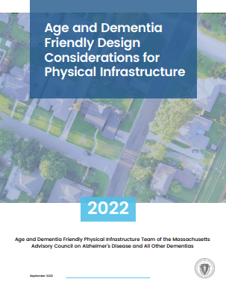
Updates and Accomplishments
Distributed our physical infrastructure guide to numerous organizations who in turn shared the link with their networks
Worked with the American Planning Association-MA who included an article about our guide in their spring 2023 newsletter
Delivered presentations about the guide to numerous organizations, for example:
MA Assisted Living Association, MA Councils on Aging, Leading Age MA, MA Library Association, Dementia Friendly Maine, MA Health and Hospital Association, and regional transportation providers
Continued to promote the guide’s usage among age and dementia friendly communities and local and regional planning agencies
Shared the guide while promoting the FY 2024 round of grant opportunities from the state’s Shared Streets and Spaces Program
American Trails, a national organization, included the guide in their resource library

Slide 8
Updates and Accomplishments (Continued)
Fostered collaborative relationships with design, planning, and public infrastructure procurement sectors to promote a shared vocabulary and comprehension of age and dementia friendly design principles
Conducted analysis of state, municipal, and other built environment funding sources to pinpoint opportunities for incorporating age and dementia friendly design standards
Identified areas of focus where the team believes it can have the greatest impact

Slide 9
Next Steps: Remaining Projects
Senior Housing - Discuss suggested edits with the MA Executive Office of Housing and Livable Communities to their design requirements for senior housing (known as “Appendix L”).
Design Guidelines - Discuss potential edits with the MA Division of Capital Asset Management and Maintenance (DCAMM) around their Designer Guidelines and Procedures for designers working on state and municipal funded physical infrastructure projects.
Emergency Shelters - Discuss potential enhancements with the MA Emergency Management Agency (MEMA) around their Mass Care and Shelter Coordination Plan.
Library Construction and Renovation - Discuss potential language around including age and dementia friendly requirements in calls for proposals from the MA Public Library Construction Program (MPLCP) of the MA Board of Library Commissioners.

Slide 10
Next Steps: Remaining Projects (Continued)
Senior Center Construction and Renovation - Explore options around legislative language to ensure that senior centers are age and dementia friendly (to discuss further with you later today).
Physical Space at Supportive and Social Day Programs - Proposed language for upcoming RFR
Layman’s Assessment Tool for Citizen Advocacy of AF/DF Physical Infrastructure - Boston University’s MetroBridge program

Slide 11
Challenges
Bringing our ambitious projects to a close and fully incorporated into the work of procurement officials, planners, architects, dementia experts, and everyone else who works with older adults
Reaching the long-term goal of having many of the state’s procurement processes reflect the needs of older adults and all people living with dementia

Slide 12
Solutions
Identified seven specific initiatives that we can realistically accomplish within the next twelve months (listed on Slides 6 and 7)
At Dementia Friendly Massachusetts (DFM) and the MA Healthy Aging Collaborative (MHAC), with the help of this team, we’ve successfully operationalized much of this team’s work:
As part of our day-to-day jobs at DFM and MHAC, we will continue to build partnerships with the design, planning, and procurement communities to share the PI guide and raise awareness of the importance of age and dementia friendly design

Slide 13
DISCUSSION (15 mins)
Our Questions
(1) We plan to continue to seize opportunities that align with a broad interpretation of our team’s charge. Part of our charge, as indicated in the state plan, is to:
“Incorporate age and dementia friendly scoring into all state-funded physical infrastructure projects”
We interpret “scoring” as:
Any approach that results in explicit preference for (or specific requirements around) the inclusion of age and dementia friendly characteristics in proposed infrastructure projects that receive funding from the state or a municipality.
Question: Do you agree that we continue our work with this broad interpretation of our charge?

Slide 14
DISCUSSION (Continued)
Our Questions (Continued)
(2) Current State Budget Earmarks: Recent annual state budgets have included earmarked funding for the construction and modernization of specific senior centers and other specific projects that serve older adults.
Question: If this practice continues, how likely would it be for the legislature to consider James and my recommendation that in future budgets, language be included that requires that this Council’s PI guide be considered in the implementation of these state-funded projects?

Slide 15
4. Person-Directed Care Planning
Care Planning Implementation Team
Status and Discussion
November 7, 2023
Implementation Team Co-leads
Susan Antkowiak, VP of Programs & Services
Alzheimer’s Association, MA/NH Chapter
Linda Pellegrini, Geriatric Nurse Practitioner
UMass Memorial Medical Center

Slide 16
Implementation Team Members
Implementation Team Co-leads
Susan Antkowiak, VP of Programs & Services
Alzheimer’s Association, MA/NH Chapter
Linda Pellegrini, Geriatric Nurse Practitioner
UMass Memorial Medical Center
Team Members
Rachel Broudy, MD
Faculty Lead on Elder Care Work at Ariadne Labs
Medical Director, Pioneer Valley Hospice and Palliative Care
Board Member, Life Path Aging Services Access Point (ASAP), Franklin County
Deb Dowd-Foley
Caregiver Specialist
Elder Services of Worcester Area, Inc.
Laurie Herndon, MSN, GNP, BC
Project Director, Hinda and Arthur Marcus Institute for Aging Research, Hebrew SeniorLife
Judy Johanson
Dementia Advocate
Massachusetts Alzheimer’s Disease Research Center, Massachusetts General Hospital (MGH)
Aaron Madow
Graduate Student (MPH Candidate)
University of Massachusetts
Gad A. Marshall, MD
Medical Director of Clinical Trials, Center for Alzheimer Research and Treatment, Brigham and Women’s Hospital (BWH)
Associate Neurologist, BWH
Assistant in Neurology, (MGH)
Associate Professor of Neurology, Harvard
Medical School
Pam Mirick, RN
Former Family Caregiver, Retired Nurse

Slide 17
Our Team’s Charge
Our team’s charge as described by the Council in the State Plan:
Develop a person-directed care plan framework and template

Slide 18
Updates and Accomplishments
Developed a coded analysis of focus group themes and responses Focus Groups Coded Analysis
Reviewed transcripts of focus group discussions to further develop themes
Welcomed new workgroup member: Rachel Broudy, MD, Ariadne Labs
In September 2023, explored collaboration with Ariadne Labs and reviewed person-driven care planning models
Re-assessed original vision of person-centered/person-directed care plan and discovered no readily accessible plan for people living with dementia that meets our workgroup’s recommendations (see next slide)
Notes:
Our workgroup’s updates and accomplishments since publishing the Council’s annual report in March 2023.

Slide 19
Original Vision of Essential Characteristics of Every Person-Directed Care Plan
Includes voice of person living with dementia and care partners
in its development and implementation
Established early upon diagnosis
Available in multiple
languages
Reflects wishes for future and how to live the best life possible
Updated frequently
Reflects best practices in care planning based on goals of care and what matters most to patient
Includes discussion of natural history and prognosis to help patients and families understand prognosis and progression of disease as they work with providers in setting goals
Reflects ongoing changes
Shared across care providers and settings
Integrates personally meaningful goals with clinical goals and ensures quality of life and a positive approach to care
Helps the person living with dementia and care partners navigate care through all stages
Includes goals around diet and exercise
Reflects discussion of values, beliefs, interests, abilities, concerns, likes and dislikes
Includes advance care plan and plan for when/if person living with dementia or their caregiver becomes ill or hospitalized
Reflects ongoing quality of care advocacy from care partners (including medication review)
Allows for choice/success, dignity and respect

Slide 20
Next Steps
Collect Models - Complete outreach to collect person-driven care planning models
(November 2023 to January 2024)
Recommend Model(s) - Review and recommend person-driven care planning models to add to resource list
(January 2024 to March 2024)
Recommend Distribution Approach - Identify an approach for distributing care planning resources to families and providers (March 2024 to June 2024)
Research existing approaches
Explore distribution opportunities
Decide on a recommended distribution approach
Promote Recommended Model(s) - Identify approaches for promoting use of recommended care planning model(s) among persons living with dementia, caregivers and providers

Slide 21
Challenges
Identify accessible and reliable resources for person-driven care planning models
Notes:
3

Slide 22
Care Planning Implementation Status
Rachel Broudy, MD
Faculty Lead on Elder Care Work, Ariadne Labs
Medical Director, Pioneer Valley Hospice and Palliative Care
Board Member, Life Path Aging Services Access Point (ASAP), Franklin County

Slide 23
We are a joint center for health systems innovation at Brigham & Women’s Hospital and the Harvard T.H. Chan School of Public Health

Slide 24
WHAT USERS FEEL
Maintain a sense of purpose - a reason to keep living
Accept that my brain is changing and that will bring limitations
Maintain my sense of identity
Feel we’re all in this together
Know what I will need
Know how to ask for what I need
Know what to expect
Still feel valued and worthy as a person
Feel comfortable talking about this as a family
Feel capable of getting the care we need
Feel I have enough help
My environment adapts to meet my needs
Grieve the losses
Take it all a step at a time
Feel confident in the decisions we made
Grieve the losses
Continue to do what I can for myself for as long as possible
Continue to engage in the world
Enjoy time with PLWD
Feel safer - know we’re going to be ok
Rested
Feel less alone
Feel seen and heard
We each contribute our strengths to care
Accept what is out of my control
Continue to do things that bring me joy
Person Living with Dementia
Care
Partner
Feel good about the care PLWD receives
Have somewhere to turn in crisis
Accept what is out of my control
Feel seen and heard
Feel good about how I handled what was in my control
Feel less scared
Can be present in my daily life
Feel better equipped to navigate the system
Feel respected and valued
Know my family will be ok
Feel a sense of peace
Can easily find and understand information I need
Maintain my own life

Slide 25
BEST BET TOOL: ASSESSMENT & PLANNING TOOL Our best bet is a holistic strengths-based assessment and care planning tool that supports families in living well with dementia
ASSESSMENT AREAS
FUNCTIONAL PRINCIPLES
Process offers roadmap for families
Goals and quality of life
Family strengths and challenges
Family centered goals drive care plan
ASSESSMENT & PLANNING TOOL
Community Supports
Focus on quality of life and living with dementia
Medical Care
Strengths- based

Slide 26
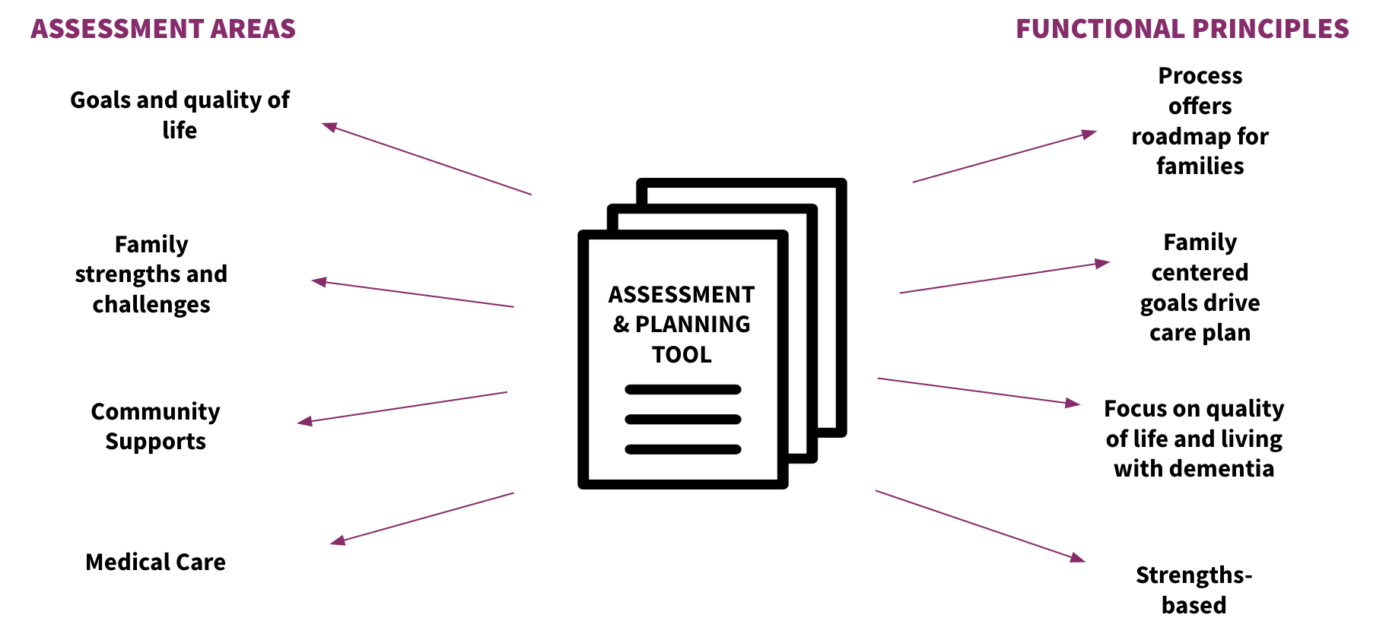
BEST BET TOOL: FULL SOLUTION Our best bet includes a planning tool + implementation strategies
HOW
IMPLEMENTATION STRATEGIES
WHO | Engage and prepare primary user
WHEN/WHERE | Embed into current practice
HOW | Workflows and training
WHY | Messaging to patients and staff
MEASURE | Measure process and impact
IMPROVE | Improve tool and implementation strategies based on measures
SUSTAIN | Develop a system for sustained use and reevaluation
WHAT

Slide 27
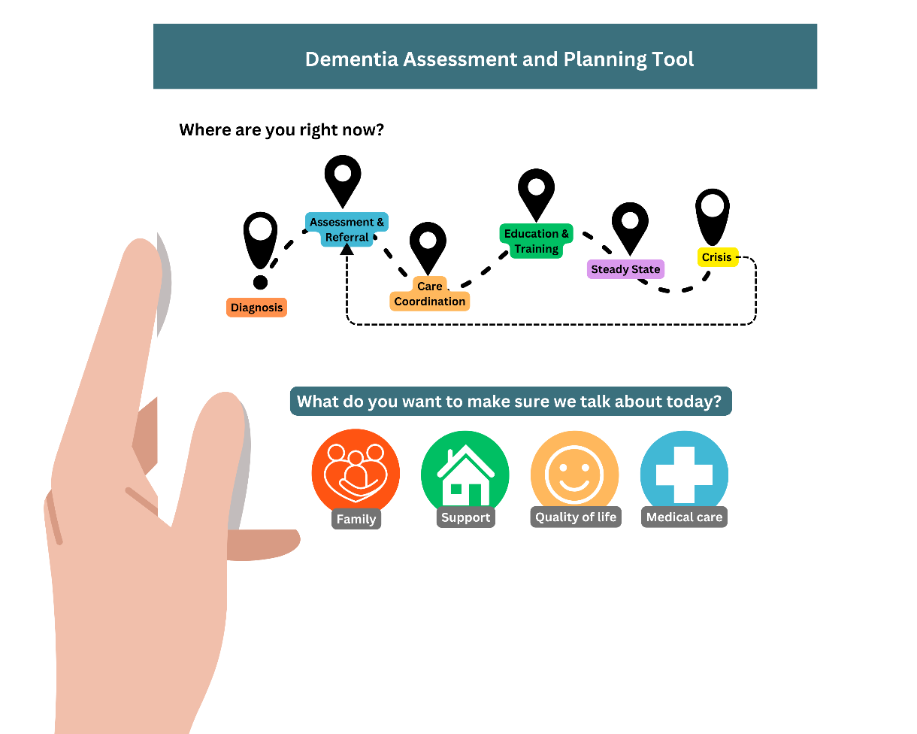
BEST BET TOOL: WHAT COULD THIS LOOK LIKE IN PRACTICE?

Slide 28
Interviews and Focus Groups
Learning from you:
What do you want and need in an assessment and care planning tool?
How would you use it?
Providers, people living with dementia and their friends, supporters and families, and community organizations
Please reach out to learn more
rbroudy@ariadnelabs.org

Slide 29
DISCUSSION (15 min)
Do you agree with or have comments and questions about our refined goal?
Original Goal - Develop a person-directed care plan framework and template
Refined Goal - Recommend, distribute, and promote person-centered and person-directed care planning resources; and collaborate with Ariadne Labs in their development of a person-centered assessment and care plan for people living with dementia and their caregivers.
Are there person-driven care planning models, or accessible and reliable resources for such models that you can recommend to us?
Notes:
We are creating a resource list by connecting with individuals who use person-centered assessment and care planning resources in their work.

Slide 30
5. Discussion of Council’s Role Around Early Detection and Diagnosis (25 min)
Which two do Council Members believe are the areas of greatest need?
Equitable access to screening, assessment, and diagnosis
Culturally sensitive provider/patient communication that respects culturally diverse beliefs, which may include stigmatizing perceptions of dementia
MCI and early dementia detection and screening by health care workers
Access to culturally sensitive cognitive assessments, including family observations, clinician interviews, and diagnostic testing (biomarkers)
Public awareness of early warning signs (individuals and health care providers)
Role of emerging technologies on access to screening and diagnosis
Effective communication of diagnosis
Other?
2. What strategy and practical activities can this Council (or a new Council workgroup) implement to significantly enhance detection and/or diagnosis?

Slide 31
6, Next Steps & Vote to Adjourn (5 min)
Next Steps
Draft the Council’s next annual report
Review and vote on the report at next Council meeting on February 6, 2023
Submit the annual report (due on March 1, 2024)
Council Meetings, 2024
(3:00 pm to 5:00 pm)
2/6/24
5/7/24
8/6/24
11/5/24
Vote to Adjourn

