Slide 1
Alzheimer’s Advisory Council
Executive Office of Elder Affairs
Elizabeth Chen, Secretary
October 27, 2020
3:00-5:00 pm
Video Conference

Slide 2
Agenda
Welcome, Meeting Logistics and Introductions (15 min)
Brief Updates from Workgroup Leads (10 min)
Status Update on Chapter 220 of the Acts of 2018 (10 min)
Presentation (5 min)
Discussion (5 min)
Physical Infrastructure Workgroup (20 min)
Presentation (10 min)
Discussion (10 min)
Caregiver Support and Public Awareness Workgroup (60 min)
Presentation (20 min)
Discussion (40 min)
Next Steps (5 min)

Slide 3
Brief Updates from Workgroup Leads
Two-Minute Updates
BOLD¹ Infrastructure (J. Lavery, E. Chen)
Quality of Care (L. Pellegrini, M. Brennan)
Diagnosis and Services Navigation (T. Farley-Bouvier, J. Wessler)
Research (A. Budson)
Equitable Access and Care (J. Jackson)
Note: The remaining two workgroups will deliver presentations today.
Building our Largest Dementia Infrastructure

Slide 4
Chapter 220 of the Acts of 2018 Status Update
Alzheimer's Association Update on the Status of Chapter 220 of the Acts of 2018
Susan Antkowiak, VP of Programs & Services
Daniel Zotos, Director of Public Policy & Advocacy
October 27th, 2020

Slide 5
Chapter 220 of the Acts of 2018 Status Update
Top Issues Facing the Commonwealth that Led to Legislative Action
Alzheimer’s and dementia prevalence and cost.
Diagnosis or lack thereof- less than 50% of people with dementia are diagnosed and of those diagnosed less than 50% are told of their diagnosis.
MA is ranked 6th highest in the nation for hospital readmission rates for Medicare beneficiaries with Alzheimer’s; adds to cost and contributes to poor quality of care.
Care standards have been established in long-term care (SNFs, ALFs) and home care; acute care setting is the last frontier.

Slide 6
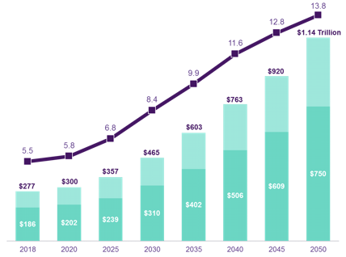
Chapter 220 of the Acts of 2018 Status Update

Slide 7
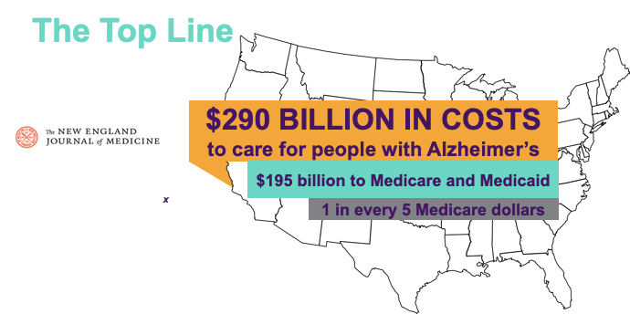
Chapter 220 of the Acts of 2018 Status Update

Slide 8
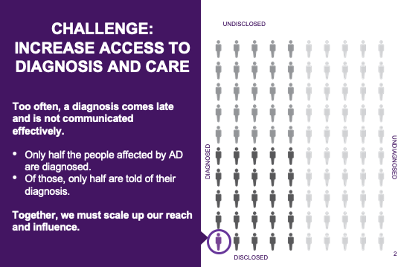
Chapter 220 of the Acts of 2018 Status Update

Slide 9
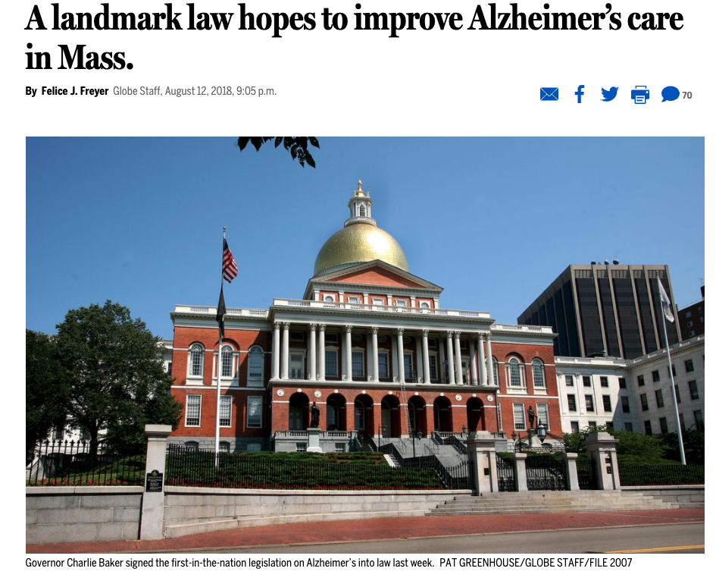
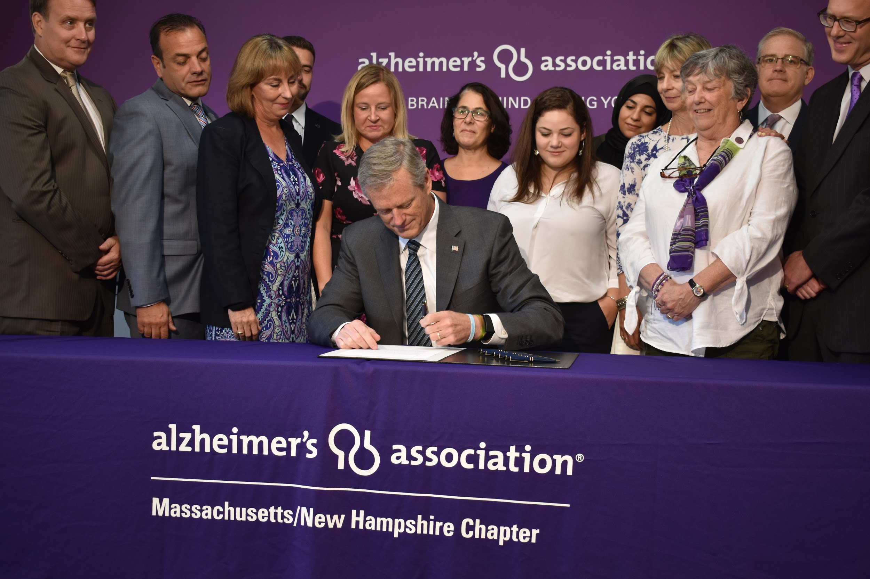
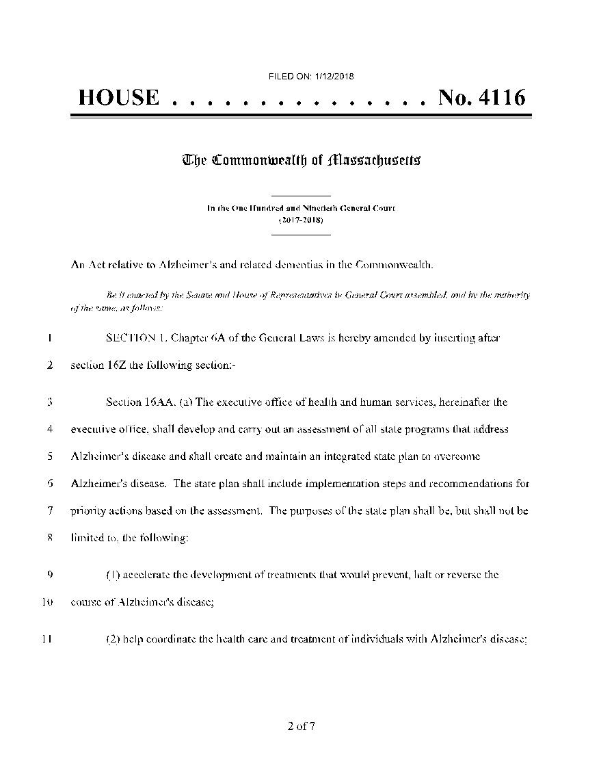
Chapter 220 of the Acts of 2018 Status Update
August 9, 2018 - H.4116 Signed into Law!

Slide 10
Chapter 220 of the Acts of 2018 Status Update

Slide 11
Chapter 220 of the Acts of 2018 Status Update
Summary
1. Creates permanent statewide advisory council and an integrated state plan to effectively address Alzheimer’s disease.
2. Requires content about Alzheimer’s and related dementias be incorporated into physicians, physician’s assistants, registered nurses and practical nurses continuing education programs that are required for the granting or renewal of licensure.
3. Requires doctors to share an Alzheimer’s diagnosis and treatment plan to a family member or legal personal representative within the existing framework of federal and state privacy laws.
4. Requires hospitals that serve an adult population to have an operational plan in place for recognizing and managing individuals with dementia within three years of the laws’ enactment.
5. Requires elder protective services caseworkers to be trained on Alzheimer’s disease.
https://malegislature.gov/Laws/SessionLaws/Acts/2018/Chapter220#:~:text=Section%2016AA.,the%20treatment%20of%20Alzheimer's%20disease.

Slide 12
Chapter 220 of the Acts of 2018 Status Update
1. Creates permanent statewide advisory council and an integrated state plan to effectively address Alzheimer’s disease
The Advisory Council is up and running and has held five meetings so far.
Workgroups have recently been formed on the following topics: equitable access & care, quality of care, public awareness, caregiver support, education & respite, initial diagnosis & services navigation, physical infrastructure and research.
The advisory council shall annually provide to the executive office and the legislature a report which shall include:
Information and recommendations on Alzheimer’s disease policy;
Evaluation of all state-funded efforts in Alzheimer's disease research, clinical care, institutional, home-based and community-based programs;
Outcomes of such efforts;
Any proposed updates to the state plan, which the advisory council shall annually review.
The first report required under section 16AA of chapter 6A of the General Laws shall be provided not later than March 1, 2021.
Tasked with updating State Alzheimer’s Disease Plan (2012).

Slide 13
Chapter 220 of the Acts of 2018 Status Update
2. Requires content about Alzheimer’s and related dementias be incorporated into physicians, physician’s assistants, registered nurses and practical nurses continuing medical education programs that are required for the granting or renewal of licensure.
All licensees will have until November 6, 2022 to complete this one-time requirement.
Must attest to DPH that you have completed training (similar to domestic violence, opioid)
Approximately 51,000 licensees have completed training requirement so far (August)
Current MA CME Offerings
Mass Medical Society http://www.massmed.org/ALZ/
Launched in February and developed in collaboration with the Alzheimer’s Association
417 participants so far
5 modules (3.5 CME total)
Mass Health & Hospital Association Online Course
Mass Nurses Association
Presented to BORIN prior to pandemic
Online CE (1.75)
Alzheimer’s Association, MA/NH Chapter
Presented by Dr. Brent Forester
300+ trained
No further funding for CME accreditation
Alzheimer’s Association National Online Course
Five 15-minute modules; up to 1.25 CME
CME accreditation underwritten by the MetLife Foundation
Notes:
186,000 clinicians in MA impacted/eligible for this training
All applicants and licensees who apply for a license from November 7, 2018 through June 30, 2019, shall hereby be granted an administrative waiver of the Alzheimer’s educational training requirement for this licensing cycle. As of June 27, 2019, the waiver has been extended to December 31, 2019. All licensees will have until November 6, 2022 to complete this one-time requirement.

Slide 14
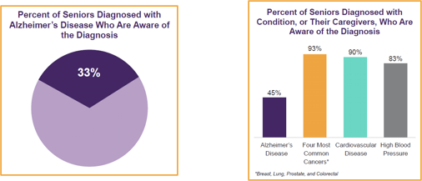
Chapter 220 of the Acts of 2018 Status Update
3. Requires doctors to share an Alzheimer’s diagnosis and treatment plan to a family member or legal personal representative within the existing framework of federal and state privacy laws.
There is no penalty for a physician who does not comply with this requirement, but the spirit of this component is to encourage the physician to use their clinical judgement so that if they determine the patient has dementia, they can alert the family to the necessity to get more involved with supporting and assisting the person.
There has been no notification of this requirement to physicians as of yet.
*Alzheimer’s Association Care Planning Toolkit
*Alzheimer’s Association information and videos on disclosing a diagnosis

Slide 15
Chapter 220 of the Acts of 2018 Status Update
4. Requires hospitals that serve an adult population to have an operational plan in place for recognizing and managing individuals with dementia within three years of the laws’ enactment
Develop an operational plan to identify dementia and/or delirium and create a specialized plan if detected
Ensure designated caregivers are involved in hospital processes including transfers and discharge planning
Develop QAPI measures including how clinical and relevant non-clinical staff receive routine training
Mass Health & Hospital Association (MHA) lead a workgroup to develop and action plan document including tools and resources. Report published in 2018.
Compliance is due October 1, 2021
Operational plans would be invaluable during pandemic protocol
Between January 1 and August 15, there were 178,563 COVID-19 hospitalizations among Medicare fee-for-service (FFS) beneficiaries. More than a third of them had a diagnosis of Alzheimer’s or another dementia.

Slide 16
Chapter 220 of the Acts of 2018 Status Update
5. Requires elder protective services caseworkers to be trained on Alzheimer’s disease.
Executive Office of Elder Affairs has developed and delivered comprehensive dementia training for all elder protective service workers.
240 of the 290 protective service workers in MA have completed training in dementia
Of the remaining 50 workers, 40 are currently taking the recently released online training (10 have not yet started it)
Turnover among protective service workers has averaged about 5%
New workers take the online training within their first month
Notes:
The training for protective services caseworkers must specifically focus on recognizing signs and symptoms of cognitive impairment including but not limited to Alzheimer’s disease and understanding how cognitive impairment may affect screening, investigation and service planning.

Slide 17
Alzheimer’s Advisory Council
Physical Infrastructure Workgroup
10/27/20

Slide 18
Physical Infrastructure Workgroup
Elizabeth Chen, PhD, MBA, MPH (Workgroup Lead) Secretary, Executive Office of Elder Affairs Chair, Alzheimer’s Advisory Council
Laura Brelsford
Assistant General Manager
Department of System-Wide Accessibility
MBTA
Elana Brochin
Program Director of Health Equity
MA Assoc. of Community Development Corporations (MACDC)
Angela Cleveland, AICP
President, American Planning Association
Massachusetts Chapter (APA-MA)
Director of Community and Economic Development, City of Amesbury
Jackie DeWolfe
Director of Sustainable Mobility
Office of the Secretary
Massachusetts Department of Transportation
Linda Dunlavy
Executive Director
Franklin Regional Council of Governments
James Fuccione, MPA
Senior Director
Massachusetts Healthy Aging Collaborative
Jeffrey R. Parenti, PE, PTOE, PTP, ENV SP
Deputy Chief Engineer
Division of Design and Engineering
MA Department of Conservation and Recreation (DCR)
Kathryn Quigley
Deputy Director of Strategic Planning
Department of System-Wide Accessibility
MBTA
Patty Sullivan
Program Manager, Dementia Friendly Massachusetts
Massachusetts Councils on Aging
Jeffrey Walker, AICP
Executive Director
Southeastern Regional Planning & Economic Dev. District (SRPEDD)
Amy Walsh, M.Sc., CDP
Dementia Friendly Boston
Age Strong Commission, City of Boston
Sharon M. Yager
Caregiver Specialist
Family Caregiver Support Program
Montachusett Home Care
Leominster, MA

Slide 19
What are Dementia Friendly Communities?
Communities that “foster the ability of people living with dementia to remain in the community and engage and thrive in day to day living”
(Dementia Friendly America)
Notes:
Pam (1 min)
Each movement is very similar – see red highlighting. Rooted in the theory of “active aging”
AF movement is about people of all ages placing a special focus on older adults
DF movement focuses solely on people living w/ dementia and their care partners.

Slide 20
What is Dementia Friendly Physical Infrastructure?
Dementia Friendly Physical Infrastructure is:
Familiar
Legible
Distinctive
Comfortable
Safe
Accessible

Slide 21
What is Dementia Friendly Physical Infrastructure?
Some examples:
x Familiar
x Legible
Distinctive
x Accessible
x Comfortable
x Safe
Familiar
Legible
Distinctive
Accessible (Depends on where placed)
Comfortable
Safe (Depends on where placed)

Slide 22
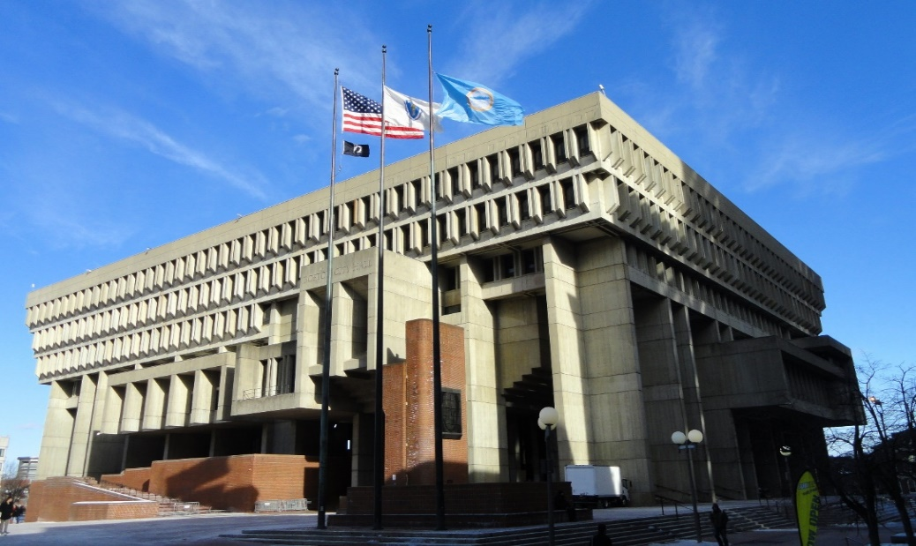
What is Dementia Friendly Physical Infrastructure?
x Familiar
x Legible
x Distinctive
x Accessible
Comfortable
Safe
x Familiar
x Legible
x Distinctive
x Accessible
Comfortable
Safe
Gray shaded items are not applicable

Slide 23
Why is Dementia Friendly Physical Infrastructure Important?
People living with dementia:
Continue to go out alone, providing sense of self-respect
Are less aware of dangers and possibility of losing way
Can’t always interpret cues that signal a purpose or entrance
Can get anxious or confused in complex, crowded or noisy places
Often use landmarks and visual cues rather than maps or directions
Source: Neighborhoods for Life – A Findings Leaflet by Elizabeth Burton, Lynne Mitchell and Shibu Raman

Slide 24
Challenges
Age friendly (AF) efforts can sometimes overlook the needs of people living with dementia
Efforts to make infrastructure accessible are likely to address physical disabilities, but don’t always address cognitive disabilities
Unless a dementia friendly (DF) community is conducting AF efforts as well, they are more likely to focus solely on the social needs of people living with dementia
MA has over 160 communities working to become DF – few are addressing the physical infrastructure needs of people living with dementia

Slide 25
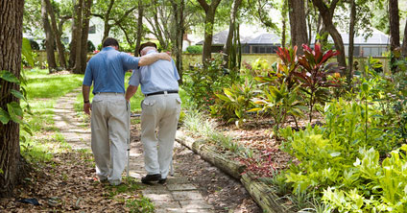
Opportunities
✓ With just a few tweaks and often no additional cost, AF efforts can become dementia friendly and benefit people of all ages and abilities
✓ MA has a growing number of communities working to become both AF and DF. MA has developed an AF/DF Integration Toolkit to help: https://tinyurl.com/AF-DFtoolkit
All MA communities that are aligning AF & DF efforts are addressing the physical infrastructure needs of people living with dementia.

Slide 26
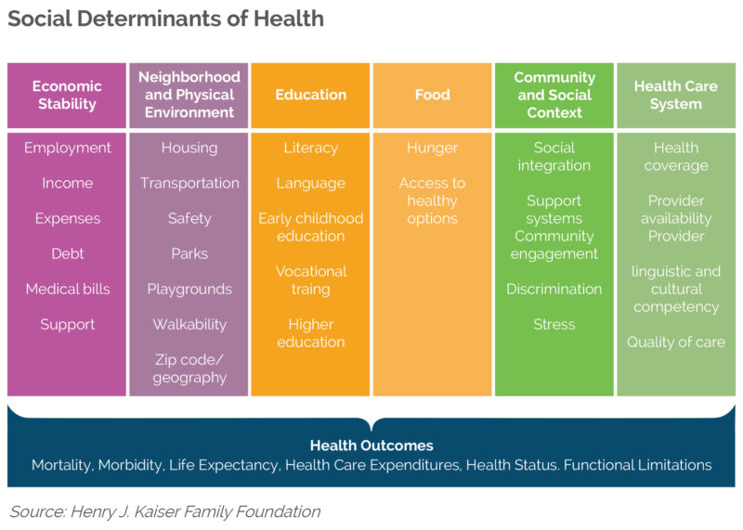
Opportunities
✓AF and DF physical infrastructure plays an essential role in improving social determinants of health, helping to reduce health and wellness disparities not only for people living with dementia, but everyone.

Slide 27
Physical Infrastructure Workgroup Goal
WORKGROUP GOAL
Identify and incorporate dementia friendly physical infrastructure into age friendly
physical infrastructure work

Slide 28
Physical Infrastructure Workgroup Recommendation
Recommendation
Raise awareness of the importance of age and dementia friendly design
Responsible Organization
Dementia Friendly Massachusetts (DFM) Leadership Team
Massachusetts Councils on Aging (leader of DFM team)
MA Executive Office of Elder Affairs (EOEA)
Jewish Family and Children’s Service
Massachusetts Healthy Aging Collaborative
Alzheimer’s Association, MA/NH Chapter
Latino Health Insurance Program, Inc.
No incremental cost
Proposed implementation strategies would be included as part of the age and dementia friendly portfolio of activities managed by EOEA and its DFM partners listed above
Costs/Resources

Slide 29
Physical Infrastructure Workgroup Recommendation
Raise awareness of the importance of age and dementia friendly design
Implementation Strategies
Strengthen relationships between the dementia friendly (DF) community movement and key stakeholders at the municipal, regional and state levels by taking these steps:
In 2021:
Identify regularly scheduled municipal, regional and statewide meetings and conferences for community planners.
Develop and deliver at least one presentation to key stakeholders that:
clarifies what DF physical structure looks like
uses community planning language while discussing DF concepts, e.g., “Smart Growth,” “Housing Choice,” “Transit Oriented Development”
allows for a two-way dialogue between the Dementia Friendly Massachusetts (DFM) leadership team and planners

Slide 30
Physical Infrastructure Workgroup Recommendation
Raise awareness of the importance of age and dementia friendly design
Implementation Strategies
In 2021 and every year thereafter, continuously improve the presentation, incorporating advice about approaches, tools, or additional knowledge that would increase likelihood of AF & DF planning and design for:
Parks, outdoor spaces, transportation, residential and commercial buildings
In 2022, determine feasibility of working with community planners to convene webinar. If deemed feasible, convene, record and distribute it to municipal, regional and statewide planners via their websites, newsletters and email blasts.
Beginning in November 2020, place “DF physical infrastructure” on monthly agenda of DFM leadership team, who, beginning in 2021, is responsible for:
ensuring effective and timely implementation
seeking advice from this workgroup as needed
reporting back to the Council on progress

Slide 31
Summary and Discussion with Council
Council’s comments, questions, approval to adopt?
Recommendation - Raise awareness
Summary of Proposed Implementation Strategies
In 2021, strengthen relationships between DF movement and stakeholders by identifying gatherings of community planners; and developing and delivering at least one presentation that allows for a two-way dialogue.
In 2021 and every year thereafter, continuously improve the presentation with input from stakeholders.
In 2022, determine feasibility of working with community planners to convene a webinar; if deemed feasible, convene, record, and distribute it.
Beginning in November 2020, place “DF physical infrastructure” on the monthly agenda of the DFM leadership team, who, beginning in 2021, is responsible for:
ensuring effective and timely implementation
seeking advice from the Physical Infrastructure Workgroup as needed
reporting back to the Council on progress

Slide 32
Alzheimer’s Advisory Council
Caregiver Support and Public Awareness Workgroup
10/27/20

Slide 33
Caregiver Support and Public Awareness Workgroup
Workgroup Members
Barb Meehan Council Member & Co-lead Alzheimer’s Advocate/Former Caregiver
Hector R. Montesino Council Member & Co-lead President Embrace Home Care Services
Katie Brandt, MM Director of Caregiver Support Services and Public Relations Massachusetts General Hospital Co-Chair, National Alzheimer’s Project Act (NAPA) Council
Jennifer Hoadley, CDP Regional Manager Southeastern MA Alzheimer's Association
Senator Patricia Jehlen Council Member Co-chair, Joint Committee on Elder Affairs
Rhiana Kohl Council Member Caregiver
Kathryn Perrella, LSW, CIRS A/D Options Program Manager Elder Services of the Merrimack Valley and North Shore
Susan Salisbury Community Services and Information Director Tri-Valley, Inc.
Patty Sullivan Program Director Dementia Friendly Massachusetts Massachusetts Councils on Aging (MCOA)

Slide 34
Council’s Initial Discussion and
Immediate Activities Conducted
Council expressed concern around increased stress among caregivers from:
Disruption in routine; social isolation; lack of meaningful engagement
Fewer supports (e.g., in-home support, adult day health, friends, family)
Restricted visits for PLWD in residential care
Council’s initial suggested solutions:
Provide 4-hour respite opportunities for dementia caregivers
Develop a telephonic companion visitation program for PLWD
Council’s charge:
Identify strategies to support caregivers of PLWD to implement in the short term
Activities conducted after Council meeting:
EOEA team examined current services and support landscape; identified challenges
Due to the challenge around lack of awareness of and subsequent access to services:
Role of Public Awareness Workgroup was expanded to include Caregiver Support
A “secret shopper” exercise was conducted

Slide 35
Challenges Identified by EOEA Team
Opportunities for respite and other supports exist, but not everyone knows the path to find them
Telephonic companion programs exist, but many don’t know how to find them. Also, a PLWD’s need for visual cues can be a barrier
Need to ensure that caregiver supports address their specific needs to effectively alleviate the stress associated with the pandemic
Each person/family has unique needs that when met may be more essential to alleviating stress during the pandemic and beyond, for example:
ongoing services in the home
opportunities to learn coping strategies or strategies to address specific challenges
opportunities for meaningful engagement for the PLWD

Slide 36
Service and Support Landscape for
PLWD and their Caregivers
 | Services and Supports | Services Targeted Towards… |  | Eligibility Requirements
 |  | Caregivers | Consumers
Support for Caregivers | Massachusetts Caregiver Coalition – Caregiving information for workplaces - webinars for working caregivers and resources | x |  | Employed
 | Savvy Caregiver and Powerful Tools for Caregivers (Evidenced Based Programs) – Healthy Living Center | x |  | None
 | Mass Family Caregiver Support Program | x |  | None
 | Support Groups at ASAPs and COAs- coping mechanisms, caregiver relief, grief/loss | x |  | None
 | Employer Resource Guide for supporting caregivers | x
 | Frontotemporal Degeneration (FTD) telephone and in-person support groups for families affected by FTD (the most common form of dementia for people under age 60) - This support is sponsored by the Association for FTD (AFTD) | x | x | None
 | Lewy Body Dementia (LBD) Caregiver Line - Telephone support for caregivers of persons living with LBD; links them with experienced LBD caregivers – this support is sponsored by the LBD Association (LBDA) | x |  | None
Services for Consumers | Adult Day Health (ADH) |  | x | MH clinical eligibility
 | Support Groups at COAs – support programs for early-stage, early onset, and individuals with Mild Cognitive Impairment (MCI) |  | x | None
 | Adult Foster Care Program through MassHealth – program for housing, ADL/IADL support & stipend for caregivers; Caregiver Homes through Seniorlink (MassHealth) - Structured Family Caregiving model is known as Enhanced Adult Foster Care | x | x | MH clinical eligibility
 | Personal Care Attendant program through MassHealth – program for ADL/IADL support certain caregivers can receive pay for care they are provided | x | x | MH clinical eligibility
 | Memory Cafes – Provides social engagement opportunities for PLWD and caregivers - PLWD must be accompanied by caregiver | x | x | None
 | Social Day and other community programs |  |  | None*
 | In-home ADL/IADL support |  | x | None*
 | Companion support through Home Care programs |  | x | None*
 | Alzheimer’s/Dementia Coaching (Habilitation Therapy) |  | x | EOEA waiver and non-waiver home care enrollees
 | Advanced Cellular Personal Emergency Response Service (mobile PERS) |  | x | EOEA non-waiver home care enrollees
 | ABI/MFP Waiver – in-home supports through MassHealth for acquired brain injury members, supports caregiver |  | x | MH clinical eligibility
Information & Referral | Options Counseling available to caregivers, families and older adults | x | x | None
 | Mass.gov webpage/caregiving – multiple resources listed – MFCGS, DDS, DYS, PCA, NF, etc. | x |  | None
 | Resource Connections (Phone & Website) – MassOptions, Alzheimer’s Association, ASAP Info & Referral, Brain Injury Association | x | x | None
Alzheimer's Association | Caregiver support groups | x |  | None
 | Support groups and Alz Meet-ups (social events) for people living with early-stage and early onset dementia |  | x | None
 | Community Resource Finder (by zip code) | x | x | None
 | Public events to raise awareness and specialized education programs for PLWD, caregivers and the public | x | x | None
 | Peer-to-Peer Companion Program – PLWD in the early stages provide telephone companionship for people recently diagnosed with dementia |  | x | None

Slide 37
Caregiver Support and Public Awareness Workgroup Goals
WORKGROUP GOALS
Goal 1
Identify, explore and recommend short-term strategies to support caregivers of individuals who are living with a diagnosis of dementia
Goal 2
Identify approaches to improve awareness of the pathways to available supports and services for dementia caregivers and their care partners.

Slide 38
Caregiver Support and Public Awareness Summary of Recommendations
GOAL 1 - Identify, explore and recommend short-term strategies to support caregivers and PLWD
1.1. Using rapid testing, establish opportunities for PLWD living at home and long-term care facilities to safely gather in-person and indoors with caregivers, families and friends
1.2 Establish a volunteer-driven program that provides respite for dementia caregivers focusing on in-person interactions PLWD
1.3. Provide assistive technology to all ASAPs for distribution to PLWD and their caregivers
1.4 Provide tips on how to prepare for post-diagnosis discussions with support service providers
GOAL 2 - Identify approaches to improve awareness of pathways to available supports and services
2.1. Make and distribute three videos in multiple languages of caregivers talking about the help they got and how they got it
2.2. Place on EOEA’s mass.gov website, an overview of statewide services, supports and pathways for PLWD and their caregivers
FROM SECRET SHOPPER EXERCIZE
2.3. Implement changes at ASAPs that ensure that stressed dementia caregivers who call an ASAP are consistently and effectively referred to existing service/support options that may be helpful
2.4. Make changes to ensure that referrals helpful to family caregivers flow between ASAP & Alzheimer’s Association and vice versa
2.5. Require that ASAP staff include in their referrals the Massachusetts Family Caregiver Support Program when such a referral would likely be helpful to a dementia caregiver
2.6. Make automated phone messages at ASAPs clear and easy for a dementia caregiver to connect to a person for help

Slide 39
Workgroup Recommendations and Implementation Strategies
GOAL 1
Identify, explore and recommend short-term strategies to support caregivers of individuals who are living with a diagnosis of dementia
Recommendations
1.1. Using rapid testing, establish opportunities for PLWD living at home and long-term care facilities to safely gather in-person and indoors with caregivers, families and friends.
Implementation Strategies
Examine the Commonwealth’s rapid testing capability and rollout strategy.
After examining rapid testing rollout plans and evaluating constraints and risks:
(a) Develop indoor and in-person opportunities in community settings:
Identify safe indoor spaces for PLWD to gather with others such as COA’s, town spaces, community centers, etc.
Develop rapid testing protocols for PLWD to safely gather with others
Identify staff needed to acquire and administer rapid tests at gathering places
Identify delivery model (i.e., memory cafes or other) and identify staff needed to develop, manage and oversee activities
(b) Develop indoor opportunities in long-term care settings:
Review the rapid testing protocols around visits currently being developed by EOHHS for long-term care facilities; ensure that they will meet the needs of PLWD and their caregivers.

Slide 40
Workgroup Recommendations and Implementation Strategies
GOAL 1
Identify, explore and recommend short-term strategies to support caregivers of individuals who are living with a diagnosis of dementia
Implementation Strategies
Conduct an inventory of such programs managed by ASAPs COA’s, colleges via a survey and learn from their experience, e.g., pitfalls to avoid and success factors.
Identify and develop implementation plan for a program deemed feasible to replicate, adjust, and implement in the short term. Estimate costs and seek and acquire funding.
For example, Coastline (ASAP) partnership with Bristol Community College’s Occupational Therapy Assistant program:
Last fall, students worked with clients by engaging them with recreational pursuits.
Students developed a plan for their clients to help them perform these activities.
Clients socialized with the students and allowed caregivers temporary respite.
Students received dementia training resulting in increased understanding of memory loss and its impact on PLWD and their caregivers.
This fall, the program will be relying heavily on video conferencing.
Recommendations
1.2. Establish a volunteer-driven program that provides respite for dementia caregivers focusing on in-person interactions PLWD

Slide 41
Workgroup Recommendations and Implementation Strategies
GOAL 1
Identify, explore and recommend short-term strategies to support caregivers of individuals who are living with a diagnosis of dementia
Implementation Strategies
Examine associated costs by viewing data from EOEA’s prior federal grant for assistive technology where funds were distributed to ASAPs for their clients:
Pre-pandemic, assistive technology was well received. For example, robotic pets helped reduce stress and agitation of PLWD caused by isolation and loneliness.
During the pandemic, there is an even greater need for the benefits derived from this type of technology.
Determine costs, seek and acquire funding, identify responsible parties, and develop an implementation plan for rapid execution.
Distribute funds to all ASAPS for purchasing assistive technology for distribution to their clients.
Recommendations
1.3. Provide assistive technology to all ASAPs for distribution to PLWD and their caregivers

Slide 42
Workgroup Recommendations and Implementation Strategies
GOAL 1
Identify, explore and recommend short-term strategies to support caregivers of individuals who are living with a diagnosis of dementia
Implementation Strategies
Conduct an inventory of guides and tip sheets that are already available on how to prepare for post-diagnosis discussions with support and service providers. Review these existing resources and identify one or more that would be valuable to share with stakeholders.
Refer to the Massachusetts Age- and Dementia Friendly Integration Toolkit, which has relevant examples. Review similar resources from the Alzheimer's Association.
Determine how to ensure that stakeholders are aware of these resources and encourage them to disseminate them to caregivers
Distribute to key stakeholders (e.g., neurologists, primary care physicians, hospitals, senior centers, ASAPs and other organizations in the state’s elder services network)
Recommendations
1.4 Ensure that caregivers have easy access to tips on how to prepare for post-diagnosis discussions with support service providers

Slide 43
Workgroup Recommendations and Implementation Strategies
GOAL 2
Identify approaches to improve awareness of the pathways to available supports and services for dementia caregivers and their care partners.
Recommendations
Implementation Strategies
Estimate costs and seek and acquire funding
Identify a person who speaks English as well as either Spanish or Portuguese; or one who speaks all 3 languages to provide an overview of dementia and interview the caregivers.
Identify 3 dementia caregivers (1 being a person of color, 1 Spanish speaking and 1 Portuguese speaking ) to be interviewed for 10 minutes on video. Caregivers would meet criteria such as:
Benefited from supports and services that are available statewide with no or limited eligibility requirements
An articulate speaker and willing to be on Cable TV
Caring for an older adult
Work with caregivers on their responses to interview questions
Provide phone numbers and website addresses for MassOptions and Alzheimer’s Association on screen at end of each video
2.1. Make and distribute three videos in multiple languages of caregivers talking about the help they got and how they got it.

Slide 44
Workgroup Recommendations and Implementation Strategies
GOAL 2
Identify approaches to improve awareness of the pathways to available supports and services for dementia caregivers and their care partners.
Recommendations
Implementation Strategies (Continued…)
Disseminate video to:
MassAccess to distribute to all local Cable TV stations
Senior centers to put in their websites and newsletters
Memory Sunday churches to place in their bulletins
EOEA’s Mass.gov website
2.1. Make and distribute three videos in multiple languages of caregivers talking about the help they got and how they got it. (Continued…)

Slide 45
Workgroup Recommendations and Implementation Strategies
GOAL 2
Identify approaches to improve awareness of the pathways to available supports and services for dementia caregivers and their care partners.
Recommendations
Implementation Strategies
Determine which of the currently available information would be most useful.
Organize that information into user-friendly format and ensure that eligibility criteria are clear.
Link to the town-by-town list of ASAPs and the Alzheimer's Association helpline.
Post on EOEA’s website landing page under Dementia Information and Resources, which currently exists, but does not include this information.
2.2. Place on EOEA’s mass.gov website, an overview of statewide services, supports and pathways for PLWD and their caregivers

Slide 46
Workgroup Recommendations and Implementation Strategies
GOAL 2
Identify approaches to improve awareness of the pathways to available supports and services for dementia caregivers and their care partners.
“SECRET SHOPPER” EXERCISE
To help identify potential gaps in current pathways, a “secret shopper” exercise was conducted.
Goal of Exercise
Evaluate and compare the experiences of 3 dementia caregivers (aka, “secret shoppers”) who were asked to contact the following organizations to seek help to alleviate stress caused by the isolation and loss of routine due to the pandemic”
MassOptions
Local ASAPs
Alzheimer’s Association

Slide 47
Workgroup Recommendations and Implementation Strategies
GOAL 2
Identify approaches to improve awareness of the pathways to available supports and services for dementia caregivers and their care partners.
“SECRET SHOPPER” EXERCISE (Continued…)
FINDINGS
All three caregivers came away without help.
Referrals that may be helpful to family caregivers do not always flow between the ASAP and the Alzheimer’s Association and vice versa.
ASAPs may not be referring caregivers to their local Massachusetts Family Caregiver Support Program (MFCSP) (available to all caregivers) when it may be helpful.
Some ASAPs have automated messages that may be so confusing that stressed caregivers hang up and give up.

Slide 48
Workgroup Recommendations and Implementation Strategies
Goal 2
Identify approaches to improve awareness of the pathways to available supports and services for dementia caregivers and their care partners.
“SECRET SHOPPER” EXERCISE (Continued…)
Recommendations
Implementation Strategies
Identify 3 more caregivers who are not already “in the system.”
Conduct another secret shopper exercise and:
Provide specific guidance prior to their calls
Talk to each caregiver after calls; ask each one the same questions
Ensure that the caregivers call all 3 organizations
Determine if dementia caregivers are effectively referred to existing helpful service/support options; identify areas for improvement; estimate costs; seek and acquire funding; and develop an implementation plan to make improvements.
Establish a means for MassOptions, ASAPs and Alzheimer’s Association to follow up on satisfaction of caregivers of PLWD after referring to other organizations. This may require establishment of a ticket system and volunteers. Estimate costs; seek and acquire funding.
2.3. Implement changes at ASAPs that ensure that stressed dementia caregivers who call an ASAP are consistently and effectively referred to existing service/support options that may be helpful.

Slide 49
Workgroup Recommendations and Implementation Strategies
GOAL 2
Identify approaches to improve awareness of the pathways to available supports and services for dementia caregivers and their care partners.
“SECRET SHOPPER” EXERCISE (Continued…)
Recommendations
Implementation Strategies
Make it a required standard practice that ASAPS include the Alzheimer’s Association’s 24/7 Helpline in their referrals to dementia caregivers at first contact by:
Informing ASAP Executive Directors of this required standard practice.
Identifying staff that caregivers first encounter at each ASAP and include this in their training.
Implementing this recommendation as well as monitoring and reporting progress (EOEA) to the Council using data from EOEA’s statewide referral database.
2.4. Make changes to ensure that referrals helpful to family caregivers flow between the ASAP and Alzheimer’s Association and vice versa.

Slide 50
Workgroup Recommendations and Implementation Strategies
GOAL 2
Identify approaches to improve awareness of the pathways to available supports and services for dementia caregivers and their care partners.
“SECRET SHOPPER” EXERCISE (Continued…)
Recommendations
Implementation Strategies
Make it a standard practice that the Alzheimer’s Association include the appropriate ASAP in their referrals to dementia caregivers at first contact by:
Identifying staff that caregivers first encounter at the Alzheimer’s Association and include this in their training. Staff would refer to: https://contactus.800ageinfo.com/FindAgency.aspx to identify the ASAP (aka “regional elder care agency”) .
Implementing this recommendation as well as monitoring and reporting progress (Alzheimer’s Association) to the Council.
2.4. Make changes to ensure that referrals helpful to family caregivers flow between the ASAP and Alzheimer’s Association and vice versa. (Continued…)

Slide 51
Workgroup Recommendations and Implementation Strategies
GOAL 2
Identify approaches to improve awareness of the pathways to available supports and services for dementia caregivers and their care partners.
“SECRET SHOPPER” EXERCISE (Continued…)
Recommendations
Implementation Strategies
Identify the situations where ASAP Information and Referral (I&R) staff refer dementia caregivers to the MFCSP.
Determine if referrals to the MFCSP are being made where needed and if not, identify areas for improvement and develop an implementation plan to make those improvements.
Ensure that this recommendation be implemented (EOEA) and monitor and report progress to the Council using data from EOEA’s statewide referral database.
2.5. Require that ASAP staff include in their referrals the Massachusetts Family Caregiver Support Program (MFCSP) when such a referral would likely be helpful to a dementia caregiver.

Slide 52
Workgroup Recommendations and Implementation Strategies
GOAL 2
Identify approaches to improve awareness of the pathways to available supports and services for dementia caregivers and their care partners.
“SECRET SHOPPER” EXERCISE (Continued…)
Recommendations
Implementation Strategies
Listen to and evaluate automated phone messages from the perspective of a stressed dementia caregiver.
Identify and make changes to ASAP automated messages where necessary and ensure that an option to talk to (or leave a message with) a person is always included.
2.6. Make automated phone messages at ASAPs clear and easy for a dementia caregiver to connect to a person for help.

Slide 53
Summary of Recommendations and Discussion with Council
GOAL 1 - Identify, explore and recommend short-term strategies to support caregivers and PLWD
1.1. Using rapid testing, establish opportunities for PLWD living at home and long-term care facilities to safely gather in-person and indoors with caregivers, families and friends
1.2 Establish a volunteer-driven program that provides respite for dementia caregivers focusing on in-person interactions PLWD
1.3. Provide assistive technology to all ASAPs for distribution to PLWD and their caregivers
1.4 Provide tips on how to prepare for post-diagnosis discussions with support service providers
GOAL 2 - Identify approaches to improve awareness of pathways to available supports and services
2.1. Make and distribute three videos in multiple languages of caregivers talking about the help they got and how they got it
2.2. Place on EOEA’s mass.gov website, an overview of statewide services, supports and pathways for PLWD and their caregivers
FROM SECRET SHOPPER EXERCIZE
2.3. Implement changes at ASAPs that ensure that stressed dementia caregivers who call an ASAP are consistently and effectively referred to existing service/support options that may be helpful
2.4. Make changes to ensure that referrals helpful to family caregivers flow between ASAP & Alzheimer’s Association and vice versa
2.5. Require that ASAP staff include in their referrals the Massachusetts Family Caregiver Support Program when such a referral would likely be helpful to a dementia caregiver
2.6. Make automated phone messages at ASAPs clear and easy for a dementia caregiver to connect to a person for help

Slide 54
Next Steps
Next Council Meetings (to be scheduled)
December 1, 2020
3:00 - 5:00 pm
February 9, 2021
3:00 - 5:00 pm
In the meantime, please direct any questions and materials to:
Pam MacLeod – pam.macleod@mass.gov

