Slide 1
Advisory Council on Alzheimer’s Disease and All Other Dementias
Executive Office of Elder Affairs
Elizabeth Chen, Secretary
November 1, 2022
3:00-5:00 pm
Video Conference

Slide 2
Agenda
Welcome, Logistics, Introductions (20 min)
Screening and Diagnosis: Presentation & Discussion (35 min)
Care Planning: Presentation & Discussion (20 min)
Younger-Onset Dementia and Equity Analysis Workgroup: Presentation, Discussion, Vote (20 min)
Physical Infrastructure: Presentation & Discussion (15 min)
Next Steps and Vote to Adjourn (10 min)

Slide 3
Alzheimer’s Advisory Council Meeting
November 1, 2022
Workstream: Diagnosis & Services Navigation
Diagnosis Implementation Team
Status and Discussion
Workstream Leads
Representative Tricia Farley-Bouvier
James Wessler
Diagnosis Implementation Team Lead
James Wessler

Slide 4
Implementation Team Members
James Wessler (Diagnosis Implementation Team Lead)
Council Member
Chief Executive Officer, Alzheimer's Association, MA/NH Chapter, and New England Regional Leader
Kathryn C. Burns, MHA
Chief Executive Officer
Greater Lynn Senior Services, Inc.
Hollis D. Day, MD, MS
Chief of Geriatric Medicine, Boston
Medical Center and Associate Professor of Medicine, Boston University School of Medicine
James Lavery
Council Member
Director, Bureau of Health Professions Licensure
Massachusetts Department of Public Health
Liz McCarthy
Health Systems Director
Alzheimer’s Association, New England Region
Rebecca Starr, MD, AGSF
Medical Director, Geriatrics
Cooley Dickinson HealthCare
Hagen Yang, MD
Neurologist
Atrius Health
Braintree - Harvard Vanguard

Slide 5
State Plan Recommendation
Recommendation around diagnosis as described in the Alzheimer’s State Plan:
Recommendation
Significantly increase the numbers of undiagnosed or cognitively impaired residents who are diagnosed with dementia and informed of their diagnosis

Slide 6
Council’s Annual Report, April 2022
Four Focus Areas Indicated as “Next Steps” in
the Council’s Annual Report, April 2021:
1. Develop and pilot a primary care screening workflow
2. Collaborate with MHA to develop a roadmap on how to create and implement a dementia operations plan
3. Develop a guide with BORIM to help physicians initiate diagnosis conversations
4. Examine how ASAPs identify home care clients with undiagnosed dementia; identify opportunities to ensure appropriate screening, care, and support
Notes:
Progress since publishing the Council’s annual report in April 2022.

Slide 7
Challenges, Solutions, Next Steps
1. Identify primary care practices to pilot a dementia screening workflow; assess effectiveness; develop implementation tool for practices to replicate
Challenges:
Unrealistic dependance on PCPs, many demands, time constraints
Patients have up to a one-year wait at our major hospitals’ dementia diagnostic centers for a full diagnostic evaluation (unless part of a clinical study)
Solution:
Implement innovative approaches to relieve PCP burden around diagnosis and screening workflow; i.e., alternate payment models
Next Steps: Assess approaches to expand capacity statewide.
Approaches:
Hub & Spoke model (Disseminate screening/diagnosis beyond larger medical centers)
Ex: Georgia Memory Net
Care Ecosystem & Utilizing Community Health Workers
Ex: Care Ecosystem at UCSF
Ex: Initiative at Cooley Dickinson
Better utilization of Annual Wellness Visits (Medicare Advantage)

Slide 8
Accomplishments & Next Steps
2. Collaborate with MHA to develop a brief user-friendly roadmap for development and implementation of a dementia operations plan
ACCOMPLISHMENTS
Roadmap successfully launched in October 2022
Over 300 attended webinar where roadmap was presented and discussed
NEXT STEPS
Alzheimer’s Association will work with MHA to develop a toolkit to potentially:
include detailed options for screening and training;
share sample plans to help hospitals learn from each other; and
educate families/consumers on how to advocate for a loved one.

Slide 9
Challenges, Solutions, Next Steps
3. Develop a guide with BORIM to help physicians initiate diagnosis conversations
CHALLENGES
Physicians may be unclear about what to say to patients (with borderline scores)
Lack of clarity regarding next steps, even with a clear screen. Confusion over emerging treatments
Time constraints at PCP practices may result in rushed conversations and confusion among patients and families
SOLUTION
Develop clear, concise, time-saving guidance that explains how to attain informed consent; takes the guesswork out of how to initiate diagnosis conversations; engages family care partners; and directs patients to resources and support
Develop Practice Guidelines as new treatments are approved (Alz Assn)
NEXT STEPS
Some of our workgroup members are working to draft this guidance for review by EOEA
BORIM and EOEA have agreed to work together to include guidance as an addendum to BORIM’s dementia diagnosis-related guidance released in November 2021

Slide 10
Challenges, Solutions, Next Steps
4. Examine ASAP processes used to identify home care consumers with undiagnosed dementia. Identify opportunities to enhance education and advocacy for appropriate healthcare, treatment, and care
CHALLENGES
Current ASAP processes may reveal untapped opportunities to identify home care consumers living with undiagnosed dementia
SOLUTION
Identify the untapped opportunities
NEXT STEPS
Together with EOEA , we will convene a team to identify, examine, and seize opportunities in the home care program to advocate for appropriate screening, diagnosis, care, support and treatment

Slide 11
Diagnosis Discussion (20 min)
Questions
Examples of approaches:
Implementing a “Hub & Spoke” model (organizing and funding?)
Can we work with insurers, particularly Medicare Advantage plans?
Can we use Community Health Workers for screening such as spreading the approach used at Cooley Dickinson Hospital to other regions of the state?
As new treatments are approved, how do we ensure equal access to all Massachusetts residents, who are appropriate for specific therapies?
How would you propose we assess approaches to expand the Commonwealth’s capacity to screen and diagnose for dementia?
Are there other potential approaches you would recommend we examine, pilot, or implement?

Slide 12
Person-Directed Care Planning
Care Planning Implementation Team
Status and Discussion
November 1, 2022
Workgroup Leads
Linda Pellegrini, MS, GNP-BC, Geriatric Nurse Practitioner,
UMass Memorial Medical Center
Susan Antkowiak, Vice President of Programs & Services,
Alzheimer’s Association, MA/NH Chapter

Slide 13
Person-Directed Care Planning
Our team’s charge as described by the Council in the State Plan:
Develop a person-directed care plan framework and template

Slide 14
Care Planning Implementation Team
Linda Pellegrini, MS, GNP-BC
Council Member & Workstream Co-lead
Care Planning Implementation Team Co-lead
Geriatric Nurse Practitioner
UMass Memorial Medical Center
Susan Antkowiak
Council Member
Care Planning Implementation Team Co-lead
Vice President of Programs & Services
Alzheimer’s Association
Mike Belleville
Council Member
Dementia Advocate
Deb Dowd-Foley
Caregiver Specialist
Elder Services of Worcester Area, Inc.
Laurie Herndon, MSN, GNP, BC (on sabbatical)
Project Director
Hinda and Arthur Marcus Institute for Aging Research, Hebrew SeniorLife
Judy Johanson
Dementia Advocate
Mass. Alzheimer’s Disease Research Center, MGH
Aaron Madow
Graduate Student (MPH candidate)
University of Massachusetts
Gad A. Marshall, MD
Medical Director of Clinical Trials at Center for Alzheimer Research and Treatment,
Brigham and Women’s Hospital (BWH); Associate Neurologist at BWH; Assistant in Neurology at Massachusetts General Hospital; Associate Professor of Neurology at Harvard Medical School

Slide 15
Care Planning Implementation Status
Updates and Accomplishments
Conducted two focus group sessions with family caregivers
Special thanks to:
Barb Meehan, Advisory Council Member
Deb Dowd Foley, Caregiver Specialist, Elder Services of Worcester Area, Inc.
Yung Phan, Multicultural & Senior Services Coordinator, Worcester Elder Affairs
Alzheimer’s Association
Sessions were held via Zoom, recorded with permission, minutes were taken, facilitated by Alzheimer’s Association staff
Questions provided in advance:
What was the experience of communicating with your doctor or healthcare provider about concerns regarding your loved one? Please share a positive experience or a negative experience. What types of things would you have expected from your doctor when discussing the diagnosis of your loved one?
What are the most important things you want a doctor or healthcare provider to know about your loved one?

Slide 16
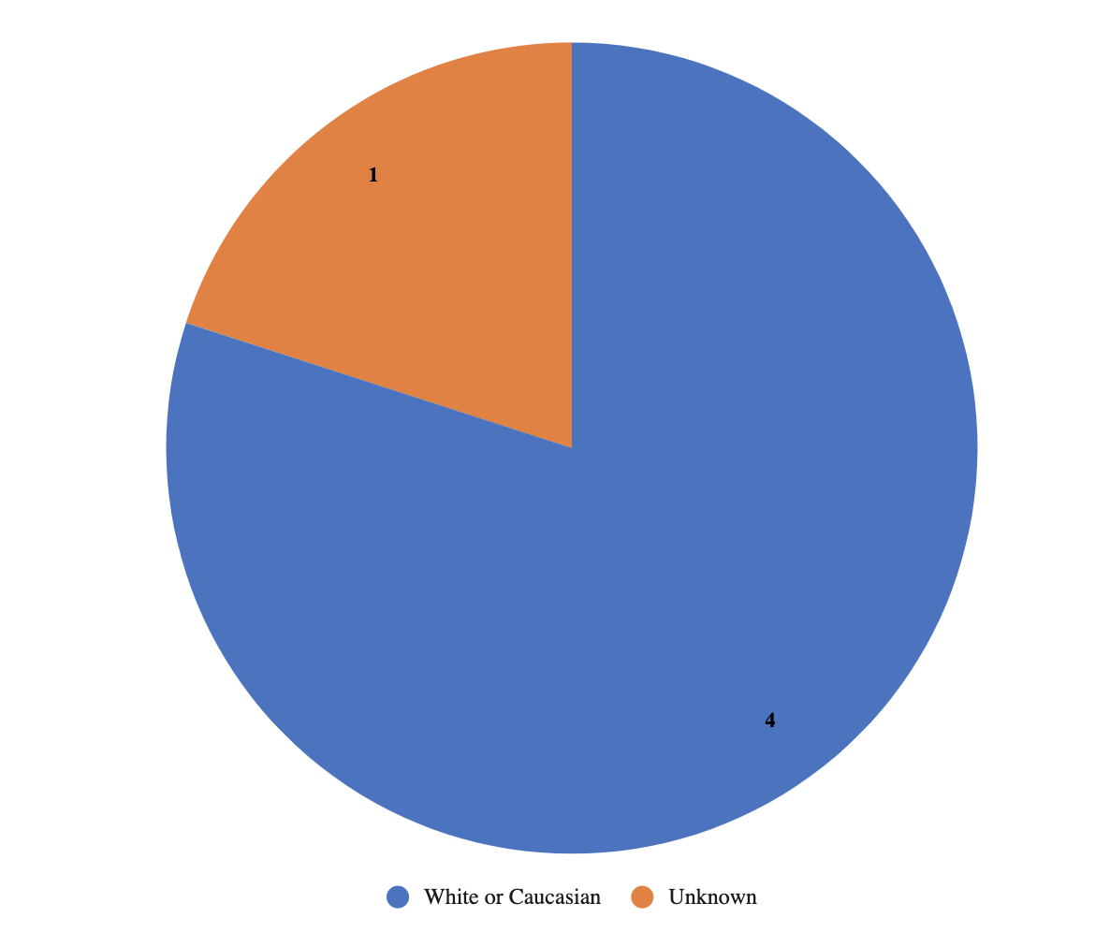
Care Planning Implementation Status
Updates and Accomplishments (Continued)
Participant demographics: race/ethnicity of people living with dementia

Slide 17
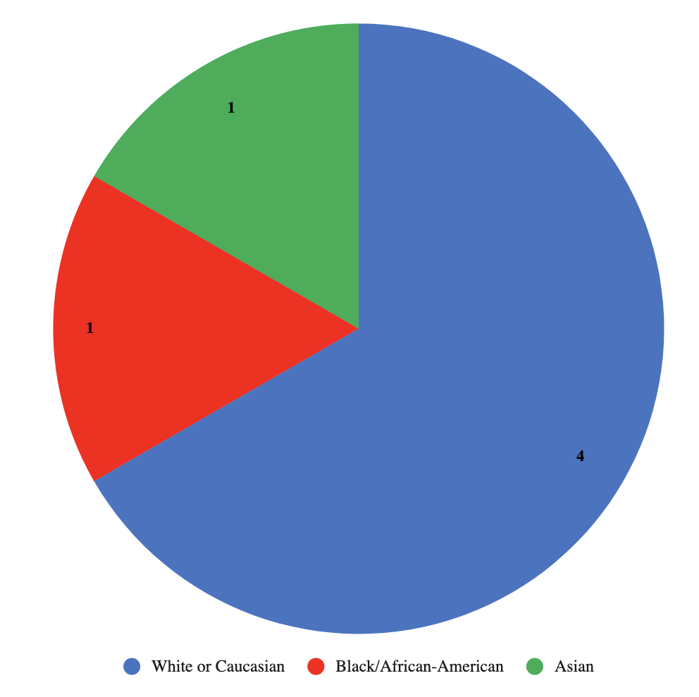
Care Planning Implementation Status
Updates and Accomplishments (Continued)
Participant demographics: race/ethnicity of caregivers

Slide 18
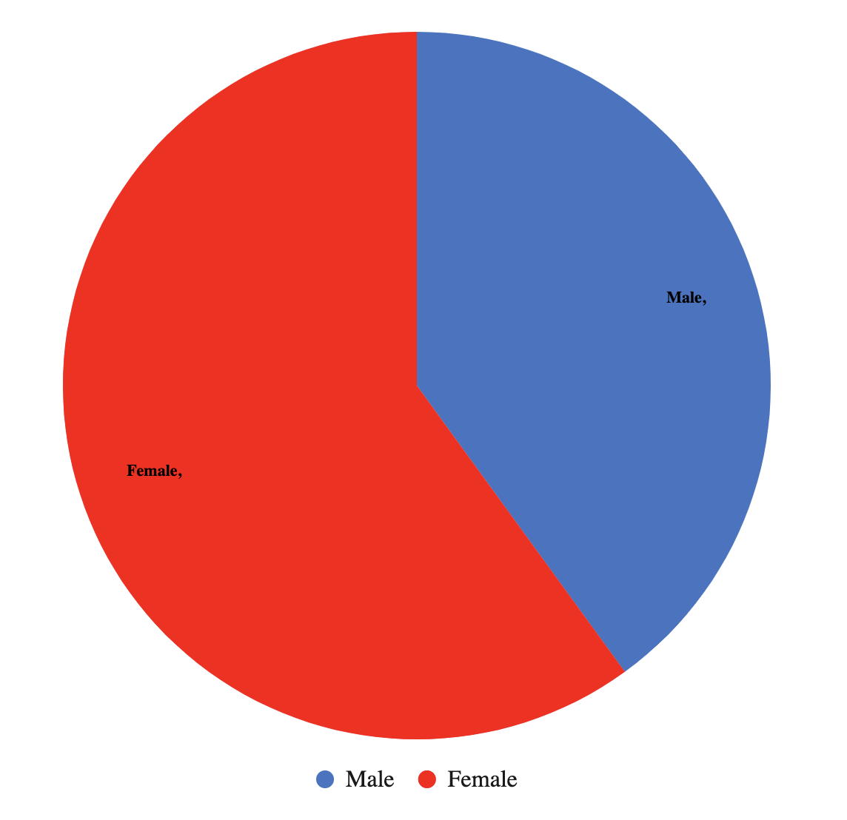
Care Planning Implementation Status
Updates and Accomplishments (Continued)
Participant demographics: gender of people living with dementia

Slide 19
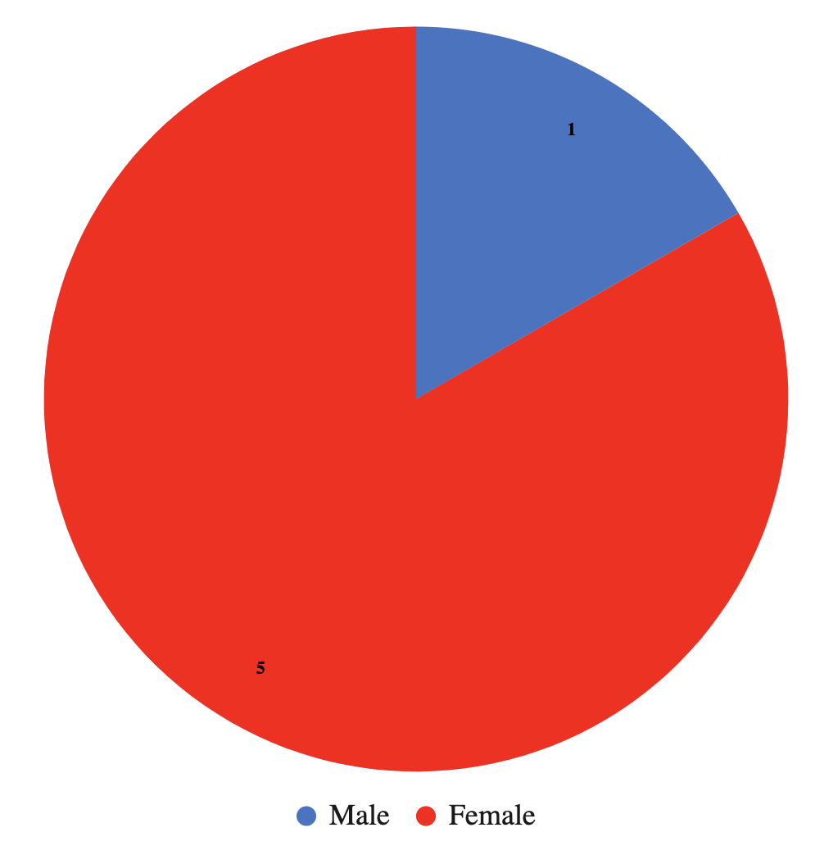
Care Planning Implementation Status
Updates and Accomplishments (Continued)
Participant demographics: gender of caregivers

Slide 20
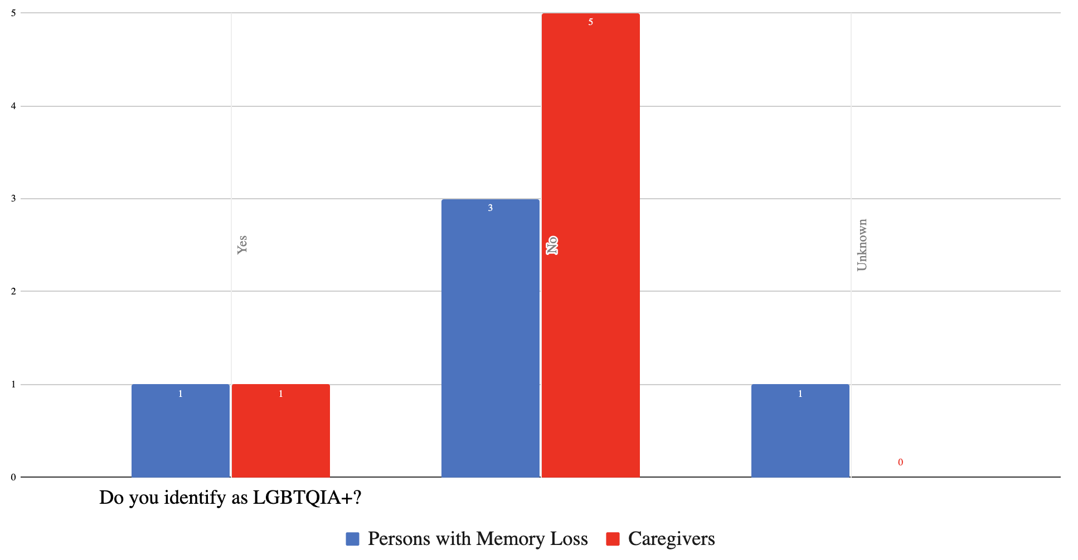
Care Planning Implementation Status
Updates and Accomplishments (Continued)
Participant demographics: LGBTQ+ individuals in both groups

Slide 21
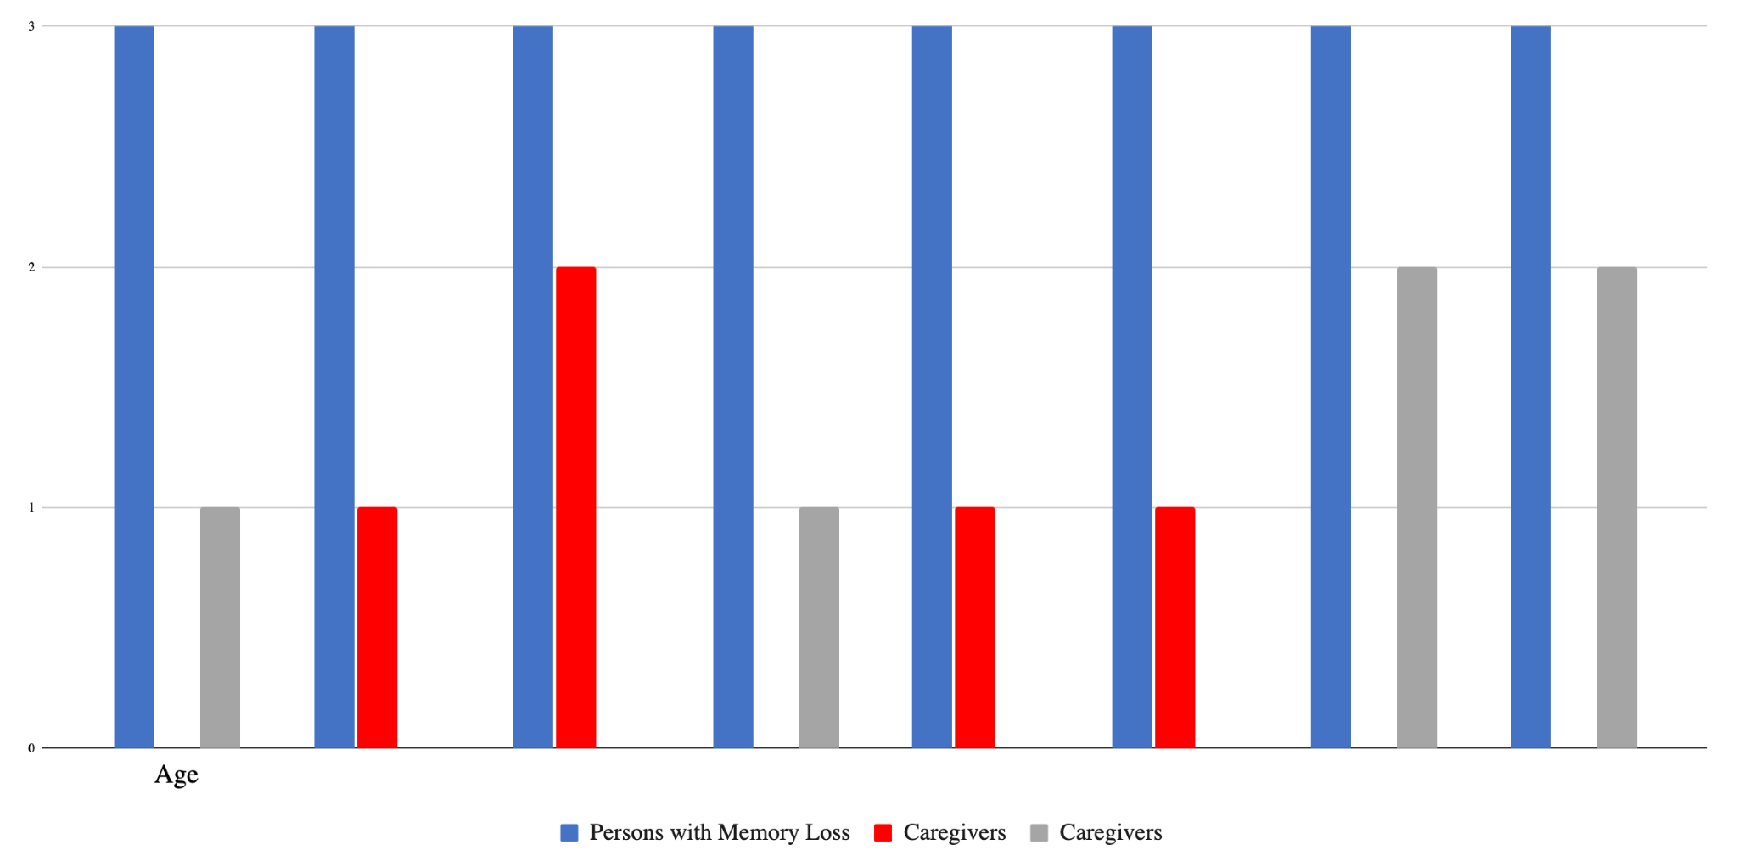
Care Planning Implementation Status
Updates and Accomplishments (Continued)
Participant demographics: age of both groups

Slide 22
Care Planning Implementation Status
Updates and Accomplishments (Continued)
Themes from focus group sessions with people living with dementia:
Question: What was the experience of communicating with your doctor or healthcare provider about concerns regarding your loved one?
Delay in getting the diagnosis and difficulty of the diagnostic process
complaints of memory problems not being taken seriously
difficulty getting an appointment with a neurologist
diagnostic process was brutal, traumatic, debilitating
focus was on physical exam and medications, NOT how the person was doing
care and support were not available during the process
some were told, “Go home and get your affairs in order”, “see you in 6 months”, no guidance was offered
not knowing what to expect
Positive experiences
when the person had a long-standing relationship with the PCP - felt like they know them as a person
Referral to Dementia Care Coordination program - “the call made a huge difference”
Health care provider offered support that was positive and affirming
offered positive suggestions
recommended exercise, intellectual stimulation, social stimulation

Slide 23
Care Planning Implementation Status
Updates and Accomplishments (Continued)
Themes from focus group sessions with people living with dementia (continued):
Question: What are the most important things you want a doctor or healthcare provider to know about your loved one?
need for care and support
“get to know me as a person, not as a person with Alzheimer’s disease
how to find acceptance and still live your best life
how to tell other people
what can you do to delay progression and maintain some control
“Told my doctor up front my strengths, things that were important to me like writing and meeting friends”
advocate for yourself
early diagnosis is important so you can state what you want and make decisions for yourself
need better overall care management and integration

Slide 24
Care Planning Implementation Status
Updates and Accomplishments (Continued)
Themes from focus group sessions with caregivers:
Question: What was the experience of communicating with your doctor or healthcare provider about concerns regarding your loved one?
Communication
believe the caregiver when they say there is a problem
lack of guidance, care coordination and navigation, especially between the PCP and specialists
“people are rushed”, “system is flawed”
“I feel like an orchestra conductor, but I do not know anything about music”
“I was not prepared for how much I would have to advocate”
importance of asking the caregiver how they are doing

Slide 25
Care Planning Implementation Status
Updates and Accomplishments (Continued)
Themes from focus group sessions with caregivers (continued):
Question: What are the most important things you want a doctor or healthcare provider to know about your loved one?
“who the person is”, “they are not their illness”, “help me to help her live the life she was living”
listen to the caregivers - acknowledge who they are in the process
trying to navigate the resources on your own can be daunting
referral to a memory center was a life saver
there should be cultural considerations

Slide 26
Care Planning Implementation Status
Updates and Accomplishments (Continued)
Themes from focus group session with Vietnamese caregiver with interpreter:
lack of care coordination with specialists
lack of explanations to family regarding medications, care
no instructions after hospitalization, guidance or communication - “had to figure it out ourselves”
daughter found ways to deal with mother’s outbursts by trial and error
had a Vietnamese speaking counselor for a year, insurance changed, and new counselor did not speak Vietnamese, could not access an interpreter
sister sent herbal medication from Vietnam that was helpful
wishes her mother had a program to go to where she could socialize with others who spoke Vietnamese

Slide 27
Care Planning Implementation Status
Next Steps
Meet with work group members
Discuss themes of sessions of people living with dementia and of those with caregivers
Consider value of creating new tool or using existing tools to help people living with dementia have improved communication, express their preferences and goals to health providers
Explore opportunities for directing tools to families and providers

Slide 28
Care Planning Challenges and Solutions
Challenges
Recruiting a diverse representation of participants
Ensuring practitioners/providers value and utilize the input and experiences of the patient/person living with dementia
Identifying best opportunities to provide tools to people living with dementia, caregivers and health providers

Slide 29
DISCUSSION (15 min)
Discussion
How can focus group data inform other work groups?
How do we promote the partnership between practitioners and their patient/person living with dementia to utilize the person-driven model of care planning?

Slide 30
Younger-Onset Dementia and Equity Analysis Workgroup
Recommendations & Implementation Plan
Workgroup Lead: Rhiana Kohl, PhD, Council Member
Presenter: Mike Belleville, Council Member and Dementia Advocate

Slide 31
Workgroup Members
Younger-Onset Dementia & Equity Analysis Workgroup of the
Council’s Equitable Access & Care Workstream:
Rhiana Kohl, PhD, Council Member (Workgroup Lead)
Mike Belleville, Council Member & Dementia Advocate Kathy Devine, Prescription Advantage Program Manager - EOEA Chelsea Gordon, Director of Public Policy & Advocacy, Alzheimer’s Association, MA/NH Chapter Judy Johanson, Dementia Advocate - Mass. Alzheimer’s Disease Research Center, MGH Tracy Lungelow, Caregiver
Joe Montminy, Dementia Advocate Paul Mathew, MD, Caregiver Barbara Meehan, Council Member & Dementia Advocate/Former Caregiver

Slide 32
Goal, Challenges, Recommendations
Goal
Address unmet needs and close gaps in equality, equity, and inclusion for people living with younger-onset dementia and the people who care for them
Challenges for Individuals Affected by Younger-Onset Dementia
Lack of awareness and access to the services, supports, and resources available to them
Unmet needs due to the differing nature of their challenges and their age compared with older adults
Recommendations
For people affected by younger-onset dementia and the medical community:
(1) Improve Awareness
Currently Available Services, Supports, and Resources
(2) Improve Access

Slide 33
Implementation Strategies, Years 1-3
Beginning in Year 1 (Calendar Year 2023)
Conduct comprehensive analysis, clarifying age-related eligibility of services and supports available to younger onset population
Examine resources available from aging services agencies, other government agencies, and the Alzheimer’s Association
Design and develop a younger-onset section within EOEA’s dementia website that clearly specifies available resources
Ensure that resources are identified and included in the new dementia webpages around:
Mental health support (therapy, support, and support groups)
Financial planning and management (help around making the right choices; protecting assets; and planning for the future)

Slide 34
Implementation Strategies, Years 1-3
Soon after today’s meeting…
Ask the following teams to review and address a list of considerations developed by our workgroup, which are associated with these issues:
Diagnosis and Services Navigation Workstream - PCPs may not consider or may dismiss a young person’s experiences with dementia symptoms.
Care Planning Workgroup - Although activities that promote wellbeing/living a good life/social engagement are beneficial, not everyone is aware of opportunities and how critical they are to maintaining a positive quality of life.
Research Workstream - People living with younger-onset dementia lack opportunities to participate in clinical trials.

Slide 35
Implementation Strategies, Years 1-3
Beginning in Year 2 (Calendar Year 2024)
Implement a communications plan that ensures that stakeholders¹ gain a better understanding of available resources
Implement a variety of communication approaches
For example:
Launch the new younger-onset dementia webpages by disseminating the link
Convene informational sessions and webinars
Determine if available mental health and financial planning and management resources meet identified needs; and if not, recommend solutions
1. Stakeholders include Aging Services Access Points, the medical community, and individuals affected by younger-onset dementia

Slide 36
Looking to the Future
Years 3 and Beyond
Work will continue beyond Years 1 and 2; and any new recommendations will be presented at future Council meetings
The Council will likely continue to examine other unmet needs and new recommendations and implementation strategies
Potential examples:
Specialized services tailored for people affected by younger-onset dementia
Services for children of a parent living with younger-onset dementia

Slide 37
Organizations and Resources
Responsible Organizations (no incremental costs)
MA Executive Office of Elder Affairs (EOEA)
Resources
Lists of state supported services for people affected by younger-onset dementia prepared by our workgroup
Resources available from the Alzheimer’s Association
Information from other organizations such as the federal government and dementia-related organizations

Slide 38
Moving to Implementation
Vote to Adopt or Amend
Recommendations & Implementation Plan

Slide 39
Age and Dementia Friendly
Physical Infrastructure
Implementation of Recommendations
Status and Discussion
November 1, 2021
Workstream Lead
Secretary Elizabeth Chen, EOEA
Implementation Team Co-leads
Patty Sullivan, Program Director
Dementia Friendly MA
MA Councils on Aging
James Fuccione, Senior Director
MA Healthy Aging Collaborative

Slide 40
Implementation Team Members
Implementation Team Co-Leads
Patty Sullivan, MS
Program Director
Dementia Friendly MA
MA Councils on Aging
James Fuccione, MPA
Senior Director
MA Healthy Aging Collaborative
Maureen Mullaney, BS, MA
Transportation and GIS Program Manager II
Franklin Regional Council of Governments
Ruth Neeman, AIA
Principal, Director of Senior Environments Studio
LWDA
Philippe Saad, AIA, LEED AP
Principal
Dimella Shaffer
Sanja Stegich, Intern
Pam MacLeod, MBA, PMP
Senior Project Director
MA Executive Office of Elder Affairs
Sandra Martin, MEP, MPH
Senior Planner and Health Agent
Berkshire Public Health Alliance
Public Health Program at Berkshire Regional Planning Commission
Molly McKenna, MSW LCSW
Programs Development Manager
2Life Communities

Slide 41
Age and Dementia Friendly Physical Infrastructure
Our charge as described in the Alzheimer’s State Plan:
Recommendation #1 (Raise Awareness for Community Planning)
Raise awareness of the importance of age- and dementia-friendly design
Develop Age and Dementia-Friendly Design Considerations
Recommendation #2 (Incorporate Scoring into Public Projects)
Incorporate age- and dementia-friendly scoring or explicit preference into all state-funded physical infrastructure projects

Slide 42
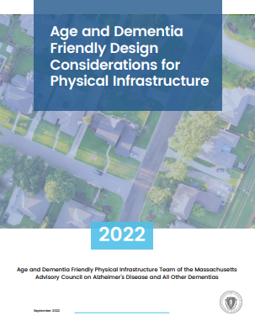
Updates and Accomplishments
Age and Dementia Friendly
Design Considerations
for Physical Infrastructure
☑ Developed a guide to rethinking how we plan, design, build, renovate, and maintain the Commonwealth’s built environment with a special focus on our residents’ needs as they age
☑ Developed an extensive Distribution Plan for the guide
☑ Delivered multiple presentations about the guide (Boston Society for Architecture, MCOA, Leading Age National, MHAC, Mass Trails) and many others are in the pipeline
Notes:
Progress since publishing the Council’s annual report in April 2022.

Slide 43
Next Steps
Continue to distribute the guide to architects, planners, and the aging services community more broadly
Distribute to communities/COAs that received earmarks in the State Budget for the construction and /or maintenance of facilities
Continue to work to incorporate dementia friendly elements in future versions of state procurement RFPs and/or add the following language:
“Preference in this competition will be given to proposals that reflect the needs of older adults including those living with dementia.”

Slide 44
Challenges and Solutions
Challenges
Design Criteria- Technical Specifications vs Design Considerations
Communicating the importance/benefits of including such criteria in the procurement process
Reaching the long-term goal of having many of the state’s procurement processes reflect the needs of older adults and all people living with dementia
Solutions
Continue to build partnerships with the design, planning, and procurement communities to establish a common language and meaning of age and dementia friendly design

Slide 45
DISCUSSION (7 min)
We are seeking your advice on:
Upcoming state-funded procurements
Hospitals or other public-facing settings where plans are underway for renovations or new construction
Notes:
We are looking for more opportunities to advocate for embedding age and dementia friendly characteristics into physical infrastructure design.

Slide 46
Next Steps & Vote to Adjourn
Next Steps
Draft the Council’s next annual report
Review and vote on the report at next Council meeting on February 7, 2023
Submit the annual report (due on March 1, 2023)
Vote to Adjourn

