Slide 1
Alzheimer’s Advisory Council
Executive Office of Elder Affairs
Elizabeth Chen, Secretary
February 15, 2022
3:00-5:00 pm
Video Conference

Slide 2
Agenda
Welcome, Logistics, Introductions (10 min)
Open Meeting Law & Conflict of Interest (5 min)
Follow-up from December’s Meeting (50 min)
Discuss Name of Council (15 min)
View Photos of Dementia Friendly Spaces (10 min)
Equity and Inclusion Update (5 min)
Presentation & Discussion: Screenings at Aging
Services Access Points (ASAPs) (20 min)
Annual Report Review and Vote (20 min)
Envisioning the Future: Roundtable Discussion (25 min)
Closing and Vote to Adjourn (10 min)

Slide 3
Brief Review of Open Meeting Law and Conflict of Interest
Open Meeting Law and Conflict of Interest Refresher

Slide 4
Open Meeting Law and Conflict of Interest Refresher
Open Meeting Law
The Council’s meetings are subject to the Open Meeting Law (OML) and must be held in public with notice of the meeting, including the agenda, provided to the public at least 48 hours in advance.
We are currently operating under an extension of the emergency act signed by Governor Baker that extended certain COVID-19 measures adopted during the State of Emergency until April 1, 2022. This emergency act suspended certain provisions of the OML and permits us to conduct our meetings remotely.
Under the OML, members cannot communicate with a quorum (simple majority) of the members regarding topics before this Council (in person or via email) outside of a public meeting.
For any questions about the OML, feel free to reach out to Council staff or contact the Attorney General's Division of Open Government directly at (617) 963-2540 or openmeeting@state.ma.us
Additional information can be found at: www.mass.gov/the-open-meeting-law

Slide 5
Open Meeting Law and Conflict of Interest Refresher
Conflict of Interest
By the very nature of their service on the Council, members are considered special state employees and are subject to the State’s Conflict of Interest Law.
In addition to familiarizing themselves with the details of the Conflict of Interest Law, members are required to undertake a required online Conflict of Interest training upon joining the Council and every other year thereafter. All certification forms should be sent directly to Council staff to maintain in our records.
Council members should view the State Ethics Commission as a resource and are encouraged to contact the State Ethics Commission with any questions or concerns related to potential conflicts of interest and any required disclosures.
The State Ethics Commission can be contacted at (617) 371-9500
Requests for advice can also be submitted through the State Ethics Commission’s website: www.mass.gov/orgs/state-ethics-commission
Advice is confidential and cannot be provided for past conduct or for matters pertaining to a third party.

Slide 6
Naming the Council: Discuss & Vote
Discuss Name
of Council
Current Name
Massachusetts Alzheimer’s Advisory Council
Proposed New Name
Massachusetts Advisory Council on
Alzheimer’s Disease and All Other Dementias

Slide 7
Dementia Friendly Physical Infrastructure
Photos of Dementia Friendly Spaces

Slide 8
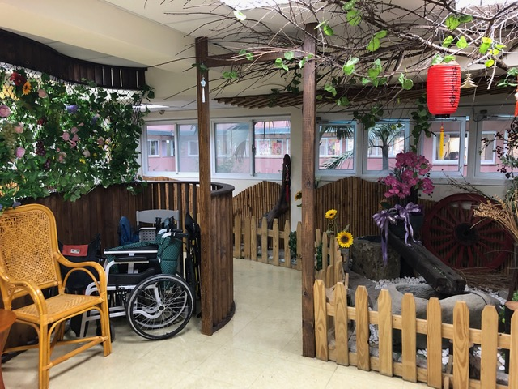
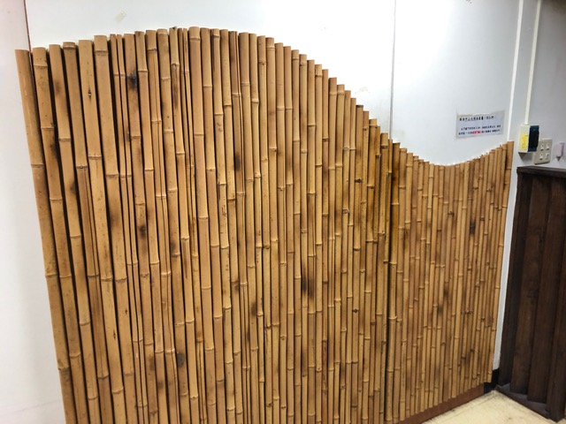
Dementia Friendly Assisted Living

Slide 9
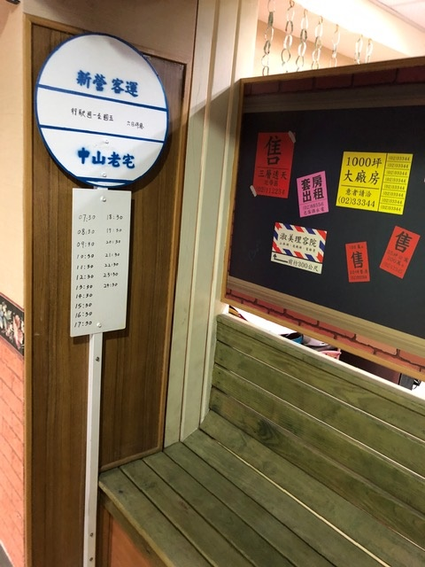
Dementia Friendly Assisted Living

Slide 10
VA New England Healthcare System
Notes:
If you look between the inner buildings, you will see that they are all connected through above-ground tunnels (built in the 1920s) that form walls between the buildings to allow patients to roam freely around the very large inner courtyard without eloping.

Slide 11
White Oak Cottages

Slide 12
White Oak Cottages

Slide 13
White Oak Cottages

Slide 14
Equity and Inclusion
Equity and Inclusion Update

Slide 15
Executive Office of Elder Affairs
RESPECT INDEPENDENCE INCLUSION
Memory Loss Screenings at Aging Services Access Points (ASAPs)

Slide 16
Massachusetts State Home Care Program Overview
State Home Care Program Eligibility
Program Goals
Main Functions
Support individual in a community setting
Successfully age in place
Offer Person Centered Approach to care
Assessments (scheduled & ad hoc based on status changes)
Develop Comprehensive Care Planning
Interdisciplinary case management
Education
60+ or under 60 with a ADRD diagnosis
1 Activity of Daily Living Need (ADL) or 6 Instrumental Activity of Daily Living Needs (IADL)
At Intake - service need for at least 1 ADL or Shopping, Meals or Medication Management, additional interventions/services available
Any income/ Lives in Massachusetts
Advocacy
Provide care management
Provide In-home supports and services
Education on public benefits
Referrals for services and community care
Notes:
SHC is a voluntary program

Slide 17
Assessment within the State Home Care Program Overview
Assessment
Point in time evaluation
Cadence
Minimum of 2 x a year for all consumers (CDS)
Scheduled 6 -month intervals
Increases 3-6+additional visits
Acuity
Services
Risk
Systems Focused
Comprehensive Data Set (CDS)
Structured Set Questions
Falls Indicators
Health/Welfare
Comprehensive, Objective
Memory Loss screen
Psychosocial
Support systems
Behavioral Health & Medical Treatment/Care
Home Environment
Conversation
Observation
Voluntary
Multi-select, free text, functional scales
ADL/IADLs
Self – reported Consumer or Caregiver/Family
Registered Nurse or Care Manager
Consumer Goals
Notes:
Functional procedural questions – how do you ….
Verbal overlay CDS is based on MDS
RN is an evaluator, not providing medical care

Slide 18
Assessing for symptoms related to dementia within the CDS
Memory recall ability for both short term and procedural/executive functioning
Cognitive decision – making ability and level of independence in making daily decisions
Behavioral changes – wandering, acting impulsively, experiencing delusions, hallucinations, repetition, expressing thoughts
Memory loss screen
Several areas within assessment evaluate:
memory loss concerns
behavioral health
cognition changes

Slide 19
3 Types of Assessments conducted in Home Care
Evaluating Memory Loss, Cognitive Changes, & Behavioral Changes
Assessed comprehensively a minimum of every 6 months (CDS) –
Multi-systems review inclusive of for short term memory recall, and procedural recall, executive functioning, behavioral changes, cognition changes, health and welfare, safety, falls indicators, medical care and consumer goals
Includes Memory Loss Screening –
reviewed with consumers without ADRD or who have not previously scored lower than 2, conducted at least annually or as needed
Home visits every 2-3 months in addition to CDS assessment visits–
based on acuity, risk, support system, includes questions related to short term memory recall, procedural memory, behavior and cognition and consumer goals
Situational impromptu status changes visits, as needed occurrence –
Consumer’s cognitive status
Change in memory, physical/cognitive functioning or behavioral functioning
Initiated through ASAP, direct service provider, community partners, family

Slide 20
Who is assessed with the Memory Loss Screening?
Memory Loss Screening Completed
6 months of the initial State Home Care enrollment
Consumers who exhibit signs of decreased cognitive functioning, rescreened (regardless of time since last screen)
Rescreened annually
Voluntary by the consumer
High score on initial screen
Memory Loss Screening Not Completed
Unless the reason is related to acute treated medical condition (ex: UTI)
If a consumer scores 2 or below on the initial screen, the screen is not repeated
Deferred (dementia not suspected)
Diagnosis of ADRD
Consumer request or refusal
Presents challenge to individuals (analog clocks, drawing/writing)
Notes:
Memory Loss Screen = Mini- Cog (copyrighted tool)
Lack experience with analog clocks
Very low academic achievements
Lack of ability

Slide 21
Memory Loss Screening Tool
Tool
May identify possible cognitive impairment
Is not a diagnostic tool
Contains 2 components
Word recollection (3 item recall test)
Executive/cognitive composite (simple Clock drawing test)
Scoring - Each component must be completed to achieve a total score
Total Score ranges from 0 – 5
Determined by number of words recalled correctly and accuracy of drawn clock face and required time
A score of 3 + is considered indicates lower likelihood of dementia
A score of 2 or below may identify a potential concern for further follow up with the medical professional
Follow up is voluntary
Consumers who test within the 0 – 2 range may be exempt from testing in the future
If a screening is not completed, the Assessor must identify why the screening was not utilized
Notes:
Voice over Mini-Cog – for Memory Loss Screen
Results of the testing process conducted are specific to that moment in time
A score below 2 will be reviewed at next Assessment to determine if there is a long term or short- term memory impairment (ex: Urinary Tract Infection impact)

Slide 22
CY2019 Consumers with ADRD
61,991 Consumers active & assessed in the Home Care program
CY2019 - 20.13% of consumer’s assessed in Home Care identified as having Alzheimer’s disease or a related dementia diagnosis.
Consumers do not receive a memory loss screen due to known ADRD diagnosis.

Slide 23
CY2019 Types of Dementia by %
Self-reported by Consumer or Caregiver and/or medical confirmation.

Slide 24
Memory Loss Screen Scoring:
Total based on accurate clock drawn (possible 2 points) and number of words recalled correctly (possible 3 points).
0 through 5 points possible on a 5-point scale:
Notes:
**If no score is recorded, Assessor must include reason - ON NEXT SLIDE

Slide 25
Notes:
Of those eligible for screening

Slide 26
Interventions after Assessment
Memory recall, short term, procedural executive functional changes,
Behavioral changes,
Cognition changes,
Memory Loss Screening occurs
Offer consumer follow-up with medical care team -share results of Memory Loss Screen if completed
Offer consumer follow-up with family and/or caregiver(s) -share results of Memory Loss Screen if completed
If consumer agrees, follow up with Medical care team, Physician, Neurologist
If a Consumer scores 2 or below on the Memory Loss Screening a Notice is sent to medical professional
Conference call with consumer to medical professional during course of home visit
Habilitation Therapy: Discussion of available supports and tools to help maintain a quality of life with a memory impairment
Family Caregiver support program: help caregivers who may be looking for support or guidance.
Educate & Offer additional services: Dementia Counseling, Technology Assistive Devices, Supportive Home Care Aides
Person Centered approach to maintain dignity, self direction and independence for the Consumer
Notes:
Responses to CDS questions trigger action

Slide 27
Alzheimer’s Advisory Council
Annual Report Review
Present Highlights
Provide Comments
Vote

Slide 28
Executive Summary
Briefly highlights the progress and next steps around implementing the Alzheimer’s State Plan published in April 2021
Summarizes anticipated updates to the state plan in 2022
Refers to the Council’s intention to regularly refresh the state plan with new recommendations and implementation strategies

Slide 29
Introduction
Introduces the document as the work of the Council, established under Chapter 220 of the Acts of 2018
Refers to lists of Council members (Appendix A) and implementation team and workgroup members (Appendix B)
Describes how the report is organized
Expresses gratitude for the volunteers that make the Council’s progress possible

Slide 30
Implementing Effective and
Sustainable Solutions
Presents progress, accomplishments, and next steps for each of the seven workstreams:
Caregiver Support and Public Awareness
Diagnosis and Services Navigation
Equitable Access and Care
Physical Infrastructure
Public Health Infrastructure
Quality of Care
Research

Slide 31
Progress (Some Highlights)
1. Caregiver Support and Public Awareness
Gained momentum on improving
awareness of available supports and services
Website
Videos
Referrals

Slide 32
Progress (Some Highlights)
2. Diagnosis and
Services Navigation
Implemented approaches to promote effective dementia screening and diagnosis; family engagement; and access to information, support, and care after a dementia diagnosis.
Resources
on
Screening
and
Diagnosis
Formal
Guidance
on Informing
Families of
Diagnosis

Slide 33
Progress (Some Highlights)
3. Equitable Access and Care
Implemented important first steps toward advancing the Council’s goal of equitable and
inclusive access to dementia
information, care planning, health care, support, and services.
Recruited
Over
20 individuals
to Advise
Council
Began
Identifying
Barriers Faced by
Young People
with Dementia

Slide 34
Progress (Some Highlights)
4. Physical Infrastructure
Made significant progress describing the characteristics
of dementia-friendly physical infrastructure with a focus
on safety, wayfinding, and community engagement.
Developed
Draft Guide
with Dementia
Friendly
Design
Considerations
Provided Guidance
to Applicants for
Grant Funding
from MassDOT’s
Shared Streets and
Spaces Program

Slide 35
Progress (Some Highlights)
5. Public Health Infrastructure
Established a methodology for assessing the state’s public health infrastructure around dementia with a focus on reducing the risk of dementia among Massachusetts residents.
Designed an
Assessment
Framework
and Began
Populating it
with Data
Will Form Team
to Assess and
Recommend
Strategies to
Reduce
Dementia Risk

Slide 36
Progress (Some Highlights)
6. Quality of Care
Made considerable progress toward addressing the lack of
person-directed dementia care planning; and began efforts
to promote interprofessional dementia care teams.
Developing
Care Planning
Guide
Promoting
Interprofessional
Dementia Care
Participating
in Statewide
Direct
Care Workforce
Initiatives
Launched
Online Training
for Direct
Care Workers

Slide 37
Progress (Some Highlights)
7. Research
Began identifying individuals to implement strategies to increase the diversity of dementia research and researchers
Began identifying
team to design
approaches to
achieve research
diversity objectives

Slide 38
Looking to the Future
Describes anticipated changes to the state plan in 2022, including:
Strategies to close gaps for people living with younger-onset dementia and their caregivers
Approaches to reduce the risk of dementia among MA residents
Refers to the state plan as a “living document”
Describes the Council's intention to continuously work with appropriate stakeholders to implement sustainable solutions

Slide 39
Appendices
Three appendices are included at the end of the document:
Appendix A: Council Members
Appendix B: Implementation Teams & Workgroups
Appendix C: Care Planning Resources

Slide 40
Alzheimer’s Advisory Council
Annual Report Review
Present Highlights
Provide Comments
Vote

Slide 41
Envisioning the Future
Although the Council’s workstreams are broadly focused, the state plan’s recommendations are specific
After each specific recommendation is implemented, the Council intends to develop and implement new recommendations
What are one or two things that we have not yet discussed (within any workstream) that when time allows, you would want the Alzheimer’s Advisory Council to address?
Roundtable Discussion
Workstreams
Caregiver Support and Public Awareness
Diagnosis and Services Navigation
Equitable Access and Care
Physical Infrastructure
Public Health Infrastructure
Quality of Care
Research

Slide 42
Next Meeting & Vote to Adjourn
Next Meeting:
May 17, 2022
3:00 to 5:00 pm
Vote to Adjourn

