Slide 1
Massachusetts Advisory Council on Alzheimer’s Disease and All Other Dementias
Executive Office of Elder Affairs
Elizabeth Chen, Secretary
February 7, 2023
3:00-5:00 pm
Video Conference

Slide 2
Agenda
Welcome, Logistics, Introductions (10 min)
Open Meeting Law & Conflict of Interest Refresher (5 min)
ADRD Treatment: Advances, Opportunities, Challenges (45 min)
Annual Report Review and Vote (30 min)
Next Steps and Closing Remarks (20 min)
Final Roll Call (10 min)

Slide 3
Open Meeting Law and Conflict of Interest Refresher
Open Meeting Law and Conflict of Interest Refresher

Slide 4
Open Meeting Law and Conflict of Interest Refresher
Open Meeting Law
The Council’s meetings are subject to the Open Meeting Law (OML) and must be held in public with notice of the meeting, including the agenda, provided to the public at least 48 hours in advance.
We are currently operating under an extension of the emergency act signed by Governor Baker that extended certain COVID-19 measures adopted during the State of Emergency until March 31, 2023. This emergency act suspended certain provisions of the OML and permits us to conduct our meetings remotely.
Under the OML, members cannot communicate with a quorum (simple majority) of the members regarding topics before this Council (in person or via email) outside of a public meeting.
For any questions about the OML, feel free to reach out to Council staff or contact the Attorney General's Division of Open Government directly at (617) 963-2540 or openmeeting@mass.gov
Additional information can be found at: www.mass.gov/the-open-meeting-law

Slide 5
Open Meeting Law and Conflict of Interest Refresher
Conflict of Interest
By the very nature of your service on the Council, members are considered special state employees and are subject to the State’s Conflict of Interest Law.
In addition to familiarizing yourselves with the details of the Conflict of Interest Law, members are required to undertake a required online Conflict of Interest training within 30 days of appointment to the Council and every other year thereafter. After completing the training, certification forms should be sent directly to Council staff to maintain in our records.
Council members should view the State Ethics Commission as a resource and are encouraged to contact the State Ethics Commission with any questions or concerns related to potential conflicts of interest and any required disclosures.
The State Ethics Commission can be contacted at (617) 371-9500
Requests for advice can also be submitted through the State Ethics Commission’s website: www.mass.gov/orgs/state-ethics-commission
Advice is confidential and cannot be provided for past conduct or for matters pertaining to a third party.

Slide 6
ADRD Treatment Advances Review and Discuss
What might these treatment advances mean in terms of opportunities and challenges for:
Massachusetts residents; clinicians; researchers; government; and
the Council’s priorities going forward?

Slide 7
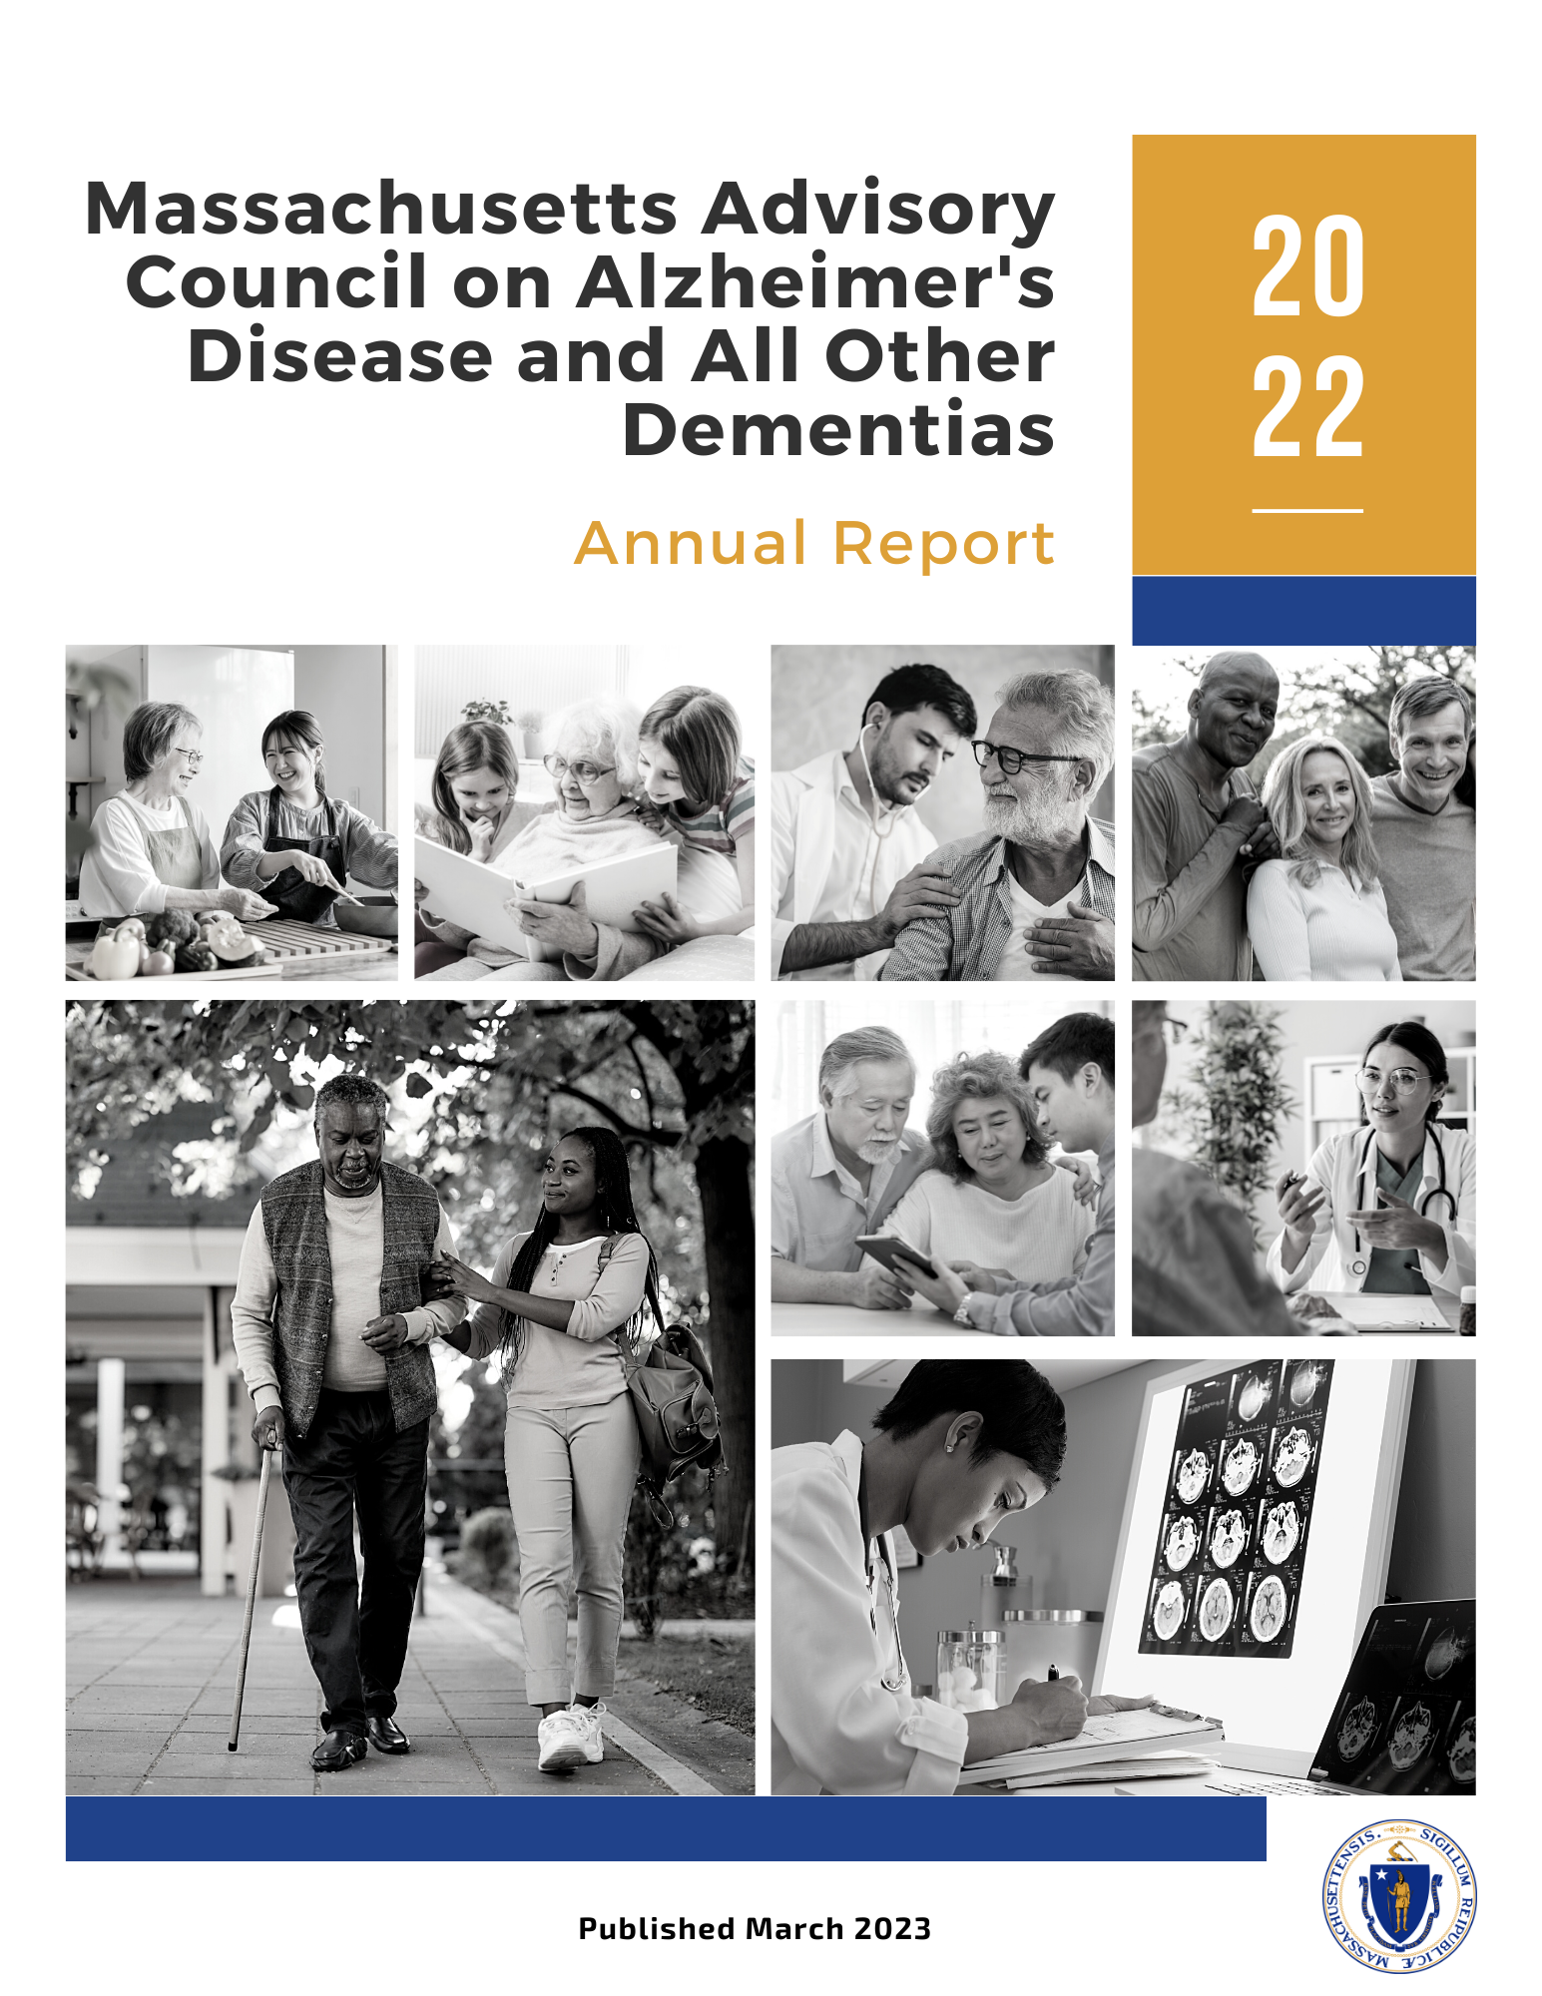
Annual Report, 2022
DRAFT
Annual Report Review
Present Highlights
Provide Comments
Vote

Slide 8
Executive Summary
Briefly highlights progress during 2022 and next steps around implementing the Alzheimer’s State Plan published in April 2021
Refers to the Council’s intention to regularly refresh the state plan with new recommendations and implementation strategies
Recognizes calendar year 2022 as the first year the Council has voted to adopt an amendment to the state plan

Slide 9
Introduction
Introduces the report as the work of the Council, established under Chapter 220 of the Acts of 2018
Refers to lists of Council members (Appendix A) and implementation team and workgroup members (Appendix B)
States that this is the Council’s third annual report and its second since it published the Alzheimer’s State Plan in April 2021
Describes how the report is organized
Expresses gratitude for the volunteers that make the Council’s progress possible

Slide 10
Implementing Effective and
Sustainable Solutions
Presents progress and next steps during 2022 for each of the seven workstreams:
Caregiver Support and Public Awareness
Diagnosis and Services Navigation
Equitable Access and Care
Physical Infrastructure
Public Health Infrastructure
Quality of Care
Research
Indicates that many of the next steps involve building the organizational and team infrastructure necessary for effective implementation
Caregiver Support and Pub Awareness
Diagnosis and Services Navigation
Equitable Access and Care
Physical Infrastructure
Public Health Infrastructure
Quality of Care
Research

Slide 11
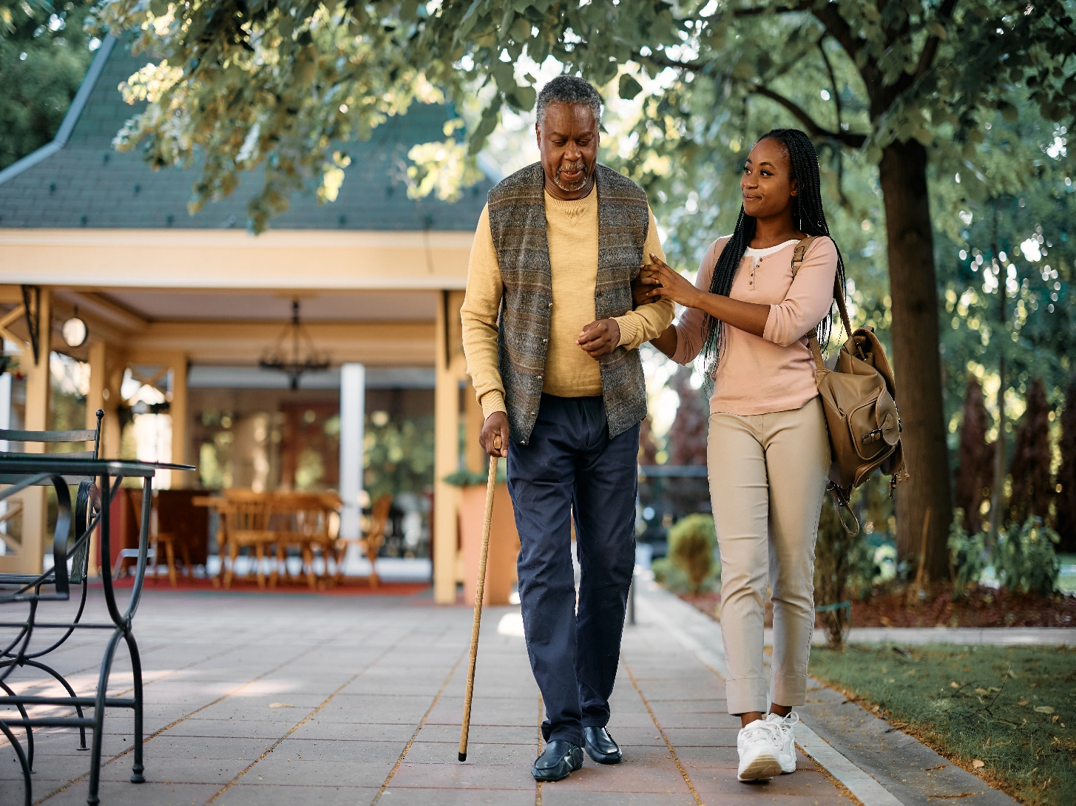
1. Caregiver Support and Public Awareness
Workstream Leads
Barbara Meehan, Council Member - Dementia Advocate, Former Caregiver
Hector R. Montesino, Council Member - President and CEO, Embrace Home Care and Health Services, Dementia Advocate

Slide 12
1. Caregiver Support and Public Awareness
Progress and Next Steps (Some Highlights)
Videos
Distributed caregiver video; new videos are in the pipeline
Website
Improved dementia website after consulting with people
affected by dementia
Caregiver Experience
Launched initiatives to:
improve awareness and access (aging services network); and
enhance outcomes & consumer experience for ASAP consumers ¹
¹ ASAP: Aging Services Access Point

Slide 13
2. Diagnosis and Services Navigation
Workstream Leads
Representative Tricia Farley-Bouvier, Council Member - Massachusetts House of Representatives
James Wessler, Council Member - President and CEO, Alzheimer’s Association, MA/NH Chapter and New England Regional Leader

Slide 14
2. Diagnosis and Services Navigation
Progress and Next Steps (Some Highlights)
Acute Care Dementia Operations Plan Roadmap
Developed dementia operations plan roadmap; planning to
develop toolkit
Screening & Diagnosis Workflow
Will examine innovative approaches to relieve PCP burden around
screening and diagnosis workflow
Expansion of Dementia Care Coordination (DCC)
Secured funding to expand DCC
Development of Physician Guide
Planning to provide guidance on initiating diagnosis conversation
Screening in Home Care
Will identify opportunities in home care to advocate for
appropriate screening, diagnosis, care, support, and treatment

Slide 15
3. Equitable Access and Care
Workstream Leads
Jatin Dave, MD, Council Member - Chief Medical Officer, MassHealth; Director, Office of Clinical Affairs, Commonwealth Medicine, UMass Chan Medical School
Hugo Aparicio, MD, MPH, Council Member (co-leader beginning in 2023) - Assistant Professor of Neurology, Boston University School of Medicine; Faculty Lead of the Research and Policy Team Program at the BU Center for Antiracist Research; Stroke Specialist in the Department of Neurology, Boston Medical Center

Slide 16
3. Equitable Access and Care
Progress and Next Steps (Some Highlights)
Attained Knowledge around Diversity, Equity, and Inclusion (DEI)
Participated in DEI training
Developed draft DEI vision statement and pledge
Listened to residents share their experiences, challenges,
and cultural barriers
Examined Barriers to Dementia Care, Services, Risk Reduction
Reviewed examples of how some populations experience
greater societal barriers than others
Will Form and Deploy Equity and Inclusion (EI) Team
Will build a diverse team to provide workgroups with
collaborative advice on refining policies, plans, activities,
programs, or deliverables

Slide 17
4. Physical Infrastructure
Workstream Lead
Secretary Elizabeth C. Chen, PhD, MBA, MPH, Council Chair - Secretary, Massachusetts Executive Office of Elder Affairs

Slide 18
4. Physical Infrastructure
Progress and Next Steps (Some Highlights)
Published Guide to Promote Age- and Dementia-Friendly (AF/DF) Design
Distributed a guide to state and municipal government officials,
architects, planners, and many other stakeholders
Improved Stakeholder Awareness and Understanding
Delivered presentations and led discussions with numerous
stakeholder organizations
Promoted AF/DF Design for Municipal Construction Projects
Distributed the guide to Council on Aging Directors that are planning
public facility construction and renovation projects
Began Efforts to Include AF/DF Characteristics in State Procurements
Began discussions with state officials to incorporate AF/DF
elements in future state procurements

Slide 19
5. Public Health Infrastructure
Workstream Lead(s)
To be determined

Slide 20
5. Public Health Infrastructure
Progress and Next Steps (Some Highlights)
Began Assessing Interest in Grant Opportunity
Began to assess interest and identify ideas around a grant
opportunity from the Centers for Disease Control and Prevention
(subsequently announced in January 2023)
Will Continue to Seek Resources
Will continue to seek resources and funding to implement activities
designed to improve the state’s public health infrastructure around
dementia

Slide 21
6. Quality of Care
Workstream Lead
Linda Pellegrini, MS, GNP-BC, Council Member - Geriatric Nurse Practitioner, UMass Memorial Medical Center

Slide 22
6. Quality of Care
Progress and Next Steps (Some Highlights)
Attained Information to Inform Person-Directed Care Plan Framework
Convened focus groups with patients and caregivers, gaining
insight on their experiences communicating with physicians ¹
Planning to Promote Interprofessional Dementia Care
Began efforts to form team to develop a plan to ensure that
providers have what they need to effectively build and retain
interprofessional dementia care teams
¹ To view the focus group findings, see Appendix C of this annual report

Slide 23
7. Research
Workstream Lead
Andrew Budson, MD, Council Member - Chief of Cognitive & Behavioral Neurology, Associate Chief of Staff for Education and Director of the Center for Translational Cognitive Neuroscience at Veterans Affairs (VA) Boston Healthcare System; Associate Director for Research at Boston University Alzheimer's Disease Center; Lecturer in Neurology at Harvard Medical School; Medical Director of the Boston Center for Memory

Slide 24
7. Research
Progress and Next Steps (Some Highlights)
Difficulty Identifying Individuals to Lead & Form Implementation Team
Ambitious recommendations and strategies coupled with a lack of
bandwidth resulted in the Council placing these efforts “on hold”
in 2022
Will Reevaluate this Workstream’s Strategies
Planning to engage Council in discussion(s) to reevaluate the state
plan’s goal, recommendations, and strategies associated with
dementia research

Slide 25
Looking to the Future
Reminds readers that the Council will regularly amend the state plan, bring appropriate stakeholders to the table, and implement solutions
Refers to an amendment to the state plan adopted in 2022, which was included as the final section of the annual report

Slide 26
Amendment to the Massachusetts State Plan on
Alzheimer’s Disease and Related Dementias, 2022
Presents an amendment to the state plan’s section entitled, Equitable Access and Care by including:
challenges faced by individuals affected by younger-onset dementia; and
a recommendation and implementation plan approved by the Council in November 2022

Slide 27
Appendices
Three appendices are included at the end of the annual report:
Appendix A: Council Members
Appendix B: Implementation Teams & Workgroups
Appendix C: Themes from Focus Group Sessions with People Affected by Dementia

Slide 28
Alzheimer’s Advisory Council
DRAFT
Annual Report Review
Present Highlights
Provide Comments
Vote

Slide 29
Next Steps and Vote to Adjourn
Review Next Steps
Next Meeting
May 9, 2023
3:00 to 5:00 pm
Vote to Adjourn

