Slide 1
Advisory Council on Alzheimer’s Disease and All Other Dementias
Executive Office of Elder Affairs
Elizabeth Chen, Secretary
August 8, 2023
3:00-5:00 pm
Video Conference

Slide 2
Agenda
Welcome, Logistics, Introductions (20 min)
Challenges Around Dementia in the Black Community (35 min)
Equity and Inclusion Team Update (25 min)
Innovative Dementia Care Models (35 min)
Next Steps and Vote to Adjourn (5 min)

Slide 3
2. Challenges Around Dementia in the Black Community (35 min)
1. Panel Members/Speakers (15 minutes)
Dr. Carl V. Hill, Ph.D., MPH, Chief Diversity, Equity and Inclusion Officer, National Office of the Alzheimer’s Association
Kevin Reynolds, Diversity, Equity and Inclusion Chair, Alzheimer’s Association, MA/NH Chapter
Mr. Leo Foster, Dementia caregiver, Springfield
2. Discussion between Council and Panel Members (20 minutes)

Slide 4
Advisory Council on Alzheimer’s Disease and All Other Dementias
3. Equity and Inclusion Team:
Update (10 min) and Discussion (15 min)
August 8, 2023
Team Leads
Jatin Dave, MBBS, MPH, Council Member - Chief Medical Officer, MassHealth; Director, Office of Clinical Affairs, ForHealth Consulting, UMass Chan Medical School
Hugo Aparicio, MD, MPH, Council Member - Assistant Professor of Neurology, Boston University School of Medicine; Faculty Lead of the Research and Policy Team Program at the BU Center for Antiracist Research; Stroke Specialist in the Department of Neurology, Boston Medical Center
S-1m

Slide 5
Our Team
Doris Harris, PhD - Doris serves on the Springfield Dementia Friendly Coalition and hosts the radio show, Health Matters in Springfield (90.7 FM WTTC). She has an expertise in qualitative and quantitative public health research and is a consultant, health editor, and facilitator. Additionally, she writes a health editorial for Af-Am Point of View, a free newsmagazine by and for the African American community in Springfield.
Liana Mendes-Santos - Liana is a Doctor of Psychology. She works as a researcher at the Multicultural Alzheimer’s Prevention Program (MAPP) at Massachusetts General Hospital and as a visiting researcher at Boston University’s Vision & Cognition Laboratory, which focuses on perception and cognition in aging and neurological conditions.
Kathy Service - Kathy is a nurse practitioner residing in Northampton and a sought-after speaker at the national level on aging issues and dementia, often with a special focus on people with intellectual and developmental disabilities. She has served on advisory boards nationally and internationally, and has written articles, book chapters and educational modules on aging and dementia
Beth Soltzberg - Beth directs the Alzheimer’s/Related Dementias Family Support Program at Jewish Family & Children's Service (JF&CS) in Waltham, MA. She manages the state’s Dementia Friends movement; serves on the Dementia Friendly Massachusetts Leadership Team; leads the JF&CS Memory Café Percolator; and hosts a biennial symposium entitled, Let's Talk About Dementia and Culture.
Judith Thermidor - Judith, an internationally trained physician, is Resident Wellness Director for CSI Support & Development Services. She deploys collaborative efforts to promote clinical trials among underrepresented aging populations and works with Collaboration for Research Equity, Sustainability, and Trust (CREST) at Tufts Medical Center; Alzheimer's Association; Dementia Friends Massachusetts; and the Community Advisory Board at Massachusetts Alzheimer’s Disease Research Center (MADRC). H-30s
Notes:
Also, Kevin Reynolds from our panel today will be joining our team’s upcoming meetings

Slide 6
The Team’s Charge
Deploy members of the Equity & Inclusion team to:
Review the Council’s work (policies, plans, and deliverables) through a DEI lens
Identify barriers around DEI that may prevent certain groups from benefiting from the Council’s work
Recommend approaches to eliminate, weaken, or mitigate the impact of those barriers
H-30s

Slide 7
Progress to Date
Formed Team - Convened two meetings over last four months
Revised DEI Vision & Pledge - Fine-tuned this document: view link here
Discussed Approach - Discussed how to effectively view the Council’s efforts through a “DEI lens.” We asked:
How will we know if what we are reviewing is equitable and inclusive?
What specific things should we be checking for?
How do we prioritize our efforts?
Examined Data - Looked for state-specific data, and asked researchers:
What groups in MA, for which we have evidence, are the most disproportionately affected by barriers to dementia information, care, services, and support? -- (Will show this data in a minute)
Discussed Barriers to Accessing Treatments - Began discussing expected barriers to equitable access to anti-amyloid treatments
H-2m

Slide 8
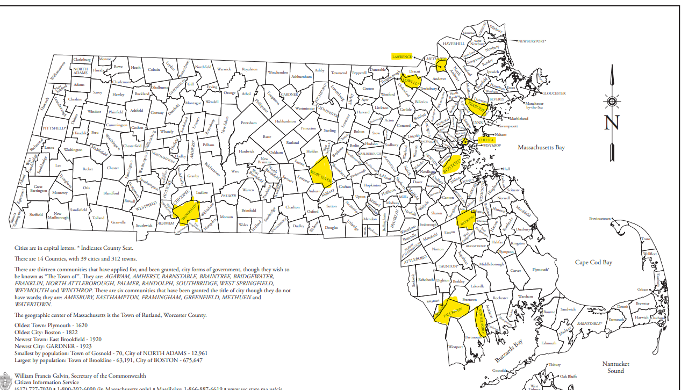
Data Overview Communities with Older Adults at Significant Risk of Poor Health Outcomes
We received this response from researchers at UMass Boston’s Gerontology Institute:
“We focus on communities rather than groups, recognizing the influence of where we live, work, play, and pray on health outcomes.”
They recommended the Council focus on 10 specific “priority communities”
Communities where older adults face significant risk of poor health outcomes (The analysis was based on multiple health indicators for serious, complex disease (including ADRD), and physical and mental disability)
Lawrence
LEGEND
AF =
Age Friendly infrastructure in place
DF = Dementia Friendly infrastructure in place
Lowell
AF & DF
Peabody
AF Only
Chelsea
No AF or DF
Worcester
Roxbury
Springfield
Brockton
Source: Healthy Aging Data Report, 2018
(Data is from 2015).
Fall River
New Bedford
J-1m
Notes:
1. UMass Boston’s Gerontology Institute also suggested: “If [you] must prioritize only one community, focus on Springfield.”
2. Based on the same data source, communities with the highest % of 65+ population with ADRD diagnosis in order are:
Gardner (19.31%), Webster (19.18%); East Longmeadow (19.03%), Chelsea (18.77%), Wrentham (18.64%), Holyoke (18.56%), and Ayer (18.11%)

Slide 9
Data Overview Communities with the Highest % of Black/African American and Hispanic/ Latino Older Adults
Black/African Americans in Massachusetts - At least 2 times more likely to have dementia in U.S.
Highest percentage age 60+ in order (over 20%) - Randolph, Brockton, Boston, Springfield
Highest number age 60+ in order (over 2,000) - Boston, Springfield, Brockton, Worcester, Randolph, Cambridge
Hispanic/Latinos in Massachusetts - About 1.5 times more likely to have dementia in U.S.
Highest percentage age 60+ in order (over 20%) Lawrence, Chelsea, Holyoke, Springfield, Lynn
Highest number age 60+ in order (over 2,000) - Boston, Lawrence, Springfield, Worcester, Lynn, Holyoke, Lowell, Chelsea
Source: U.S. Census, 2020
Link to data (ranked by percentage)
Link to data (ranked by number)
Note: Blue highlighting indicates intersection with prior slide
J-2m

Slide 10
Recommendations
Address Geographic Disparities - We recommend that the Council and its workgroups consider geographic disparities while developing and implementing its recommendations by:
Establishing Local Partnerships - Form partnerships with local leaders
Implementing Inclusive Decision-Making - Listen to and incorporate feedback from community members
Practicing Humility - Approach all discussions and efforts with humility and a learning mindset
Adopt These Guiding Principles Around Anti-Amyloid Treatment
Promote Equitable Access Across the Spectrum - Ensure equitable access to screening, imaging, diagnosis, infusions, and monitoring
Eliminate Barriers by Addressing the Factors that Drive Them - Ensure anti-amyloid treatments are free of barriers driven by factors including but not limited to culture, language, poverty, insufficient knowledge, lack of health literacy, insufficient insurance coverage, and lack of transportation; as well as racism, ableism, and other forms of discrimination
H-3m

Slide 11
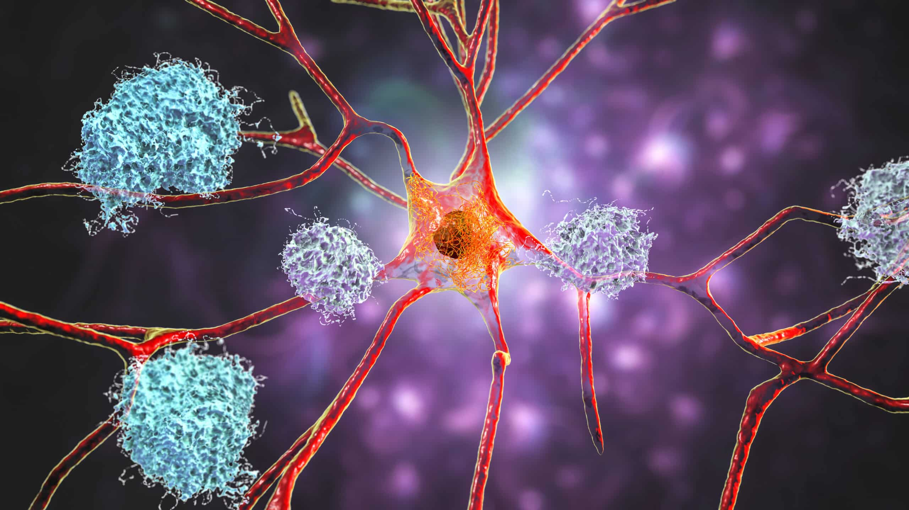
Discussion (15 minutes)
What are your thoughts on:
Considering geographic disparities while developing and implementing Council recommendations?
2. The Equity & Inclusion Team’s initial focus on equitable access to anti-amyloid treatments?
1) J-5m
2) H-5m

Slide 12
4. Innovative Dementia Care Models: New Team on
Interprofessional Dementia Care (5 min)
Team Co-Leads
Alina Sibley, CNP
Team Lead for Geri-Pal Home Care
Baystate Health, Springfield, MA
Christopher Wight, LICSW
Clinical Social Worker, Dementia Care Collaborative Division of Palliative Care & Geriatric Medicine, Massachusetts General Hospital (MGH), Boston, MA
Stephen Bonasera, MD, PhD
Chief, Division of Geriatrics & Palliative Care
Medical Director, Baystate Memory Assessment and Care Clinic
Department of Medicine
Baystate Medical Center, Springfield MA
Joe Costello
Dementia advocate
Retired executive
Brent P. Forester, MD, MSc.
(Council Member)
Dr. Francis S. Arkin Chair of Psychiatry, Tufts University School of Medicine
Chief and Chair, Department of Psychiatry, Tufts Medical Center
Director of Behavioral Health, Tufts Medicine
Lenore Jackson-Pope, RN, BSN, MSM, CCRP
Co-Director of Primary Care Outreach
Center for Alzheimer Research and Treatment (CART) and
Massachusetts Alzheimer’s Disease Research Center (MADRC)
Mass General Brigham
Boston, MA
Jayne Kelleher
Home Care Director, Bethany at Home, Framingham, MA
Board Member of Massachusetts Home Care Aide Council
Liz McCarthy
Health Systems Director
New England Region, Alzheimer’s Association
Pam Mirick, RN
Former Family Caregiver, Retired Nurse
Christine Ritchie, MD, MSPH
(Council Member)
Kenneth L. Minaker Endowed Chair in Geriatric Medicine
Research Director, MGH Division of Palliative Care and Geriatric Medicine
Director, Mongan Institute Center for Aging and Serious Illness
Director, MGH Dementia Care Collaborative
Professor of Medicine, Harvard Medical School
Boston, MA
Wayne S. Saltsman, MD, PhD, CMD, AGSF
Chief Medical Officer, All Care VNA,
Hospice & Private Home Care Services
Lynn, MA
Amy Walsh
Project Manager
Institute for Health Care Improvement (IHI)
Boston, MA

Slide 13
4. Innovative Dementia Care Models (30 min)
Innovative Dementia Care Models: Presentation (15 min) & Discussion (15 min)
Stephen Bonasera, MD, PhD
Chief, Division of Geriatrics & Palliative Care
Medical Director, Baystate Memory Assessment and Care Clinic
Department of Medicine
Baystate Medical Center, Springfield MA

Slide 14
Caregiving…
Providing care for elders is well documented for H. sapiens and H. neanderthalis; cetaceans and elephants have also been observed to provide care for elder members of their pod/family
First recorded mentions in the Epic of Gilgamesh, 2100 BC
15.7 million adult family caregivers care for someone who has Alzheimer's disease or other dementia
The economic value of the care provided by unpaid caregivers of those with Alzheimer's disease or other dementias was $217.7 billion in 2014
Alzheimer's Association. 2015 Alzheimer's Disease Facts and Figures

Slide 15
Caregiver Characteristics…
65% of care recipients are female, with an average age of 69.4.
75% of all caregivers are female, and may spend as much as 50% more time providing care than males
Higher-hour caregivers (21 hours or more weekly) are nearly 4 times more likely to be caring for a spouse/partner.
Female caregivers tend to handle the most difficult caregiving tasks (i.e., bathing, toileting, and dressing) compared to male counterparts, who are more likely to help with finances and arrangement of care
National Alliance for Caregiving and AARP. Caregiving in the U.S. 2015
Institute on Aging. Read How IOA Views Aging in America. 2016

Slide 16
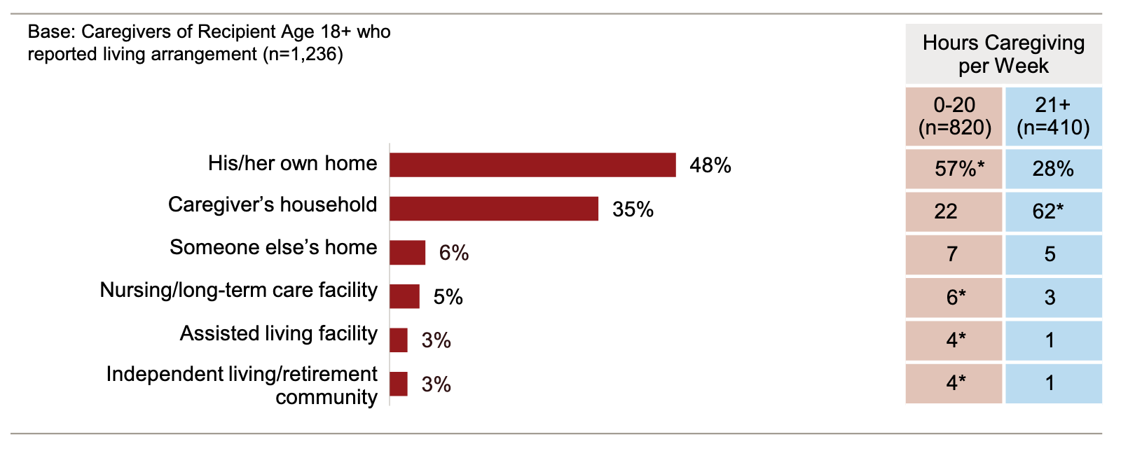
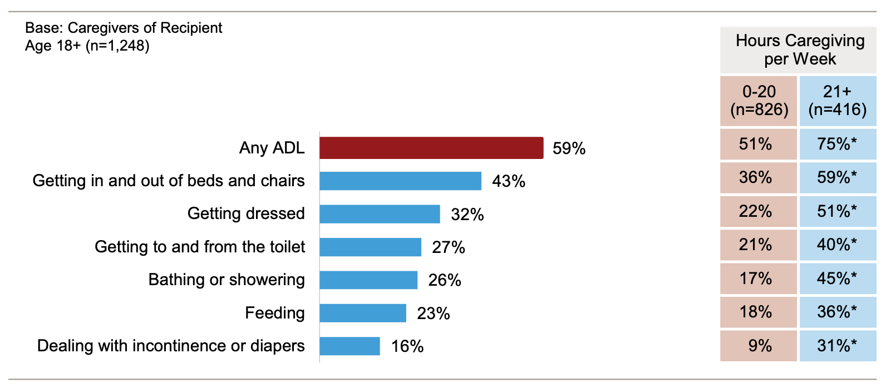
More Caregiver Characteristics…
Persons requiring less care a week tend to reside in their own home, while persons requiring more care a week tend to reside in the caregiver’s home
Persons requiring more care tend to need more help with ADLs, particularly dressing, bathing, toileting, feeding, and continence
National Alliance for Caregiving and AARP. Caregiving in the U.S. 2015
Institute on Aging. Read How IOA Views Aging in America. 2016

Slide 17
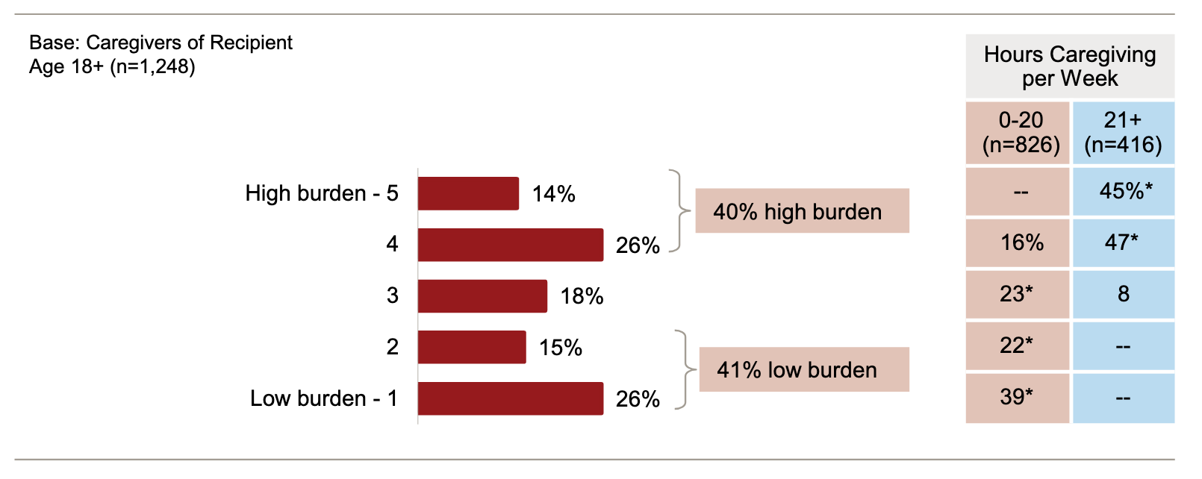
More Caregiver Characteristics…
Most caregivers who report high levels of burden are providing >20 hrs per week of effort
Most caregivers working >20 hrs per week feel as if they had no choice regarding their role as caregiver
29% of caregivers working >20 hrs per week state that caregiving has had an adverse impact on their health.
National Alliance for Caregiving and AARP. Caregiving in the U.S. 2015
Institute on Aging. Read How IOA Views Aging in America. 2016

Slide 18
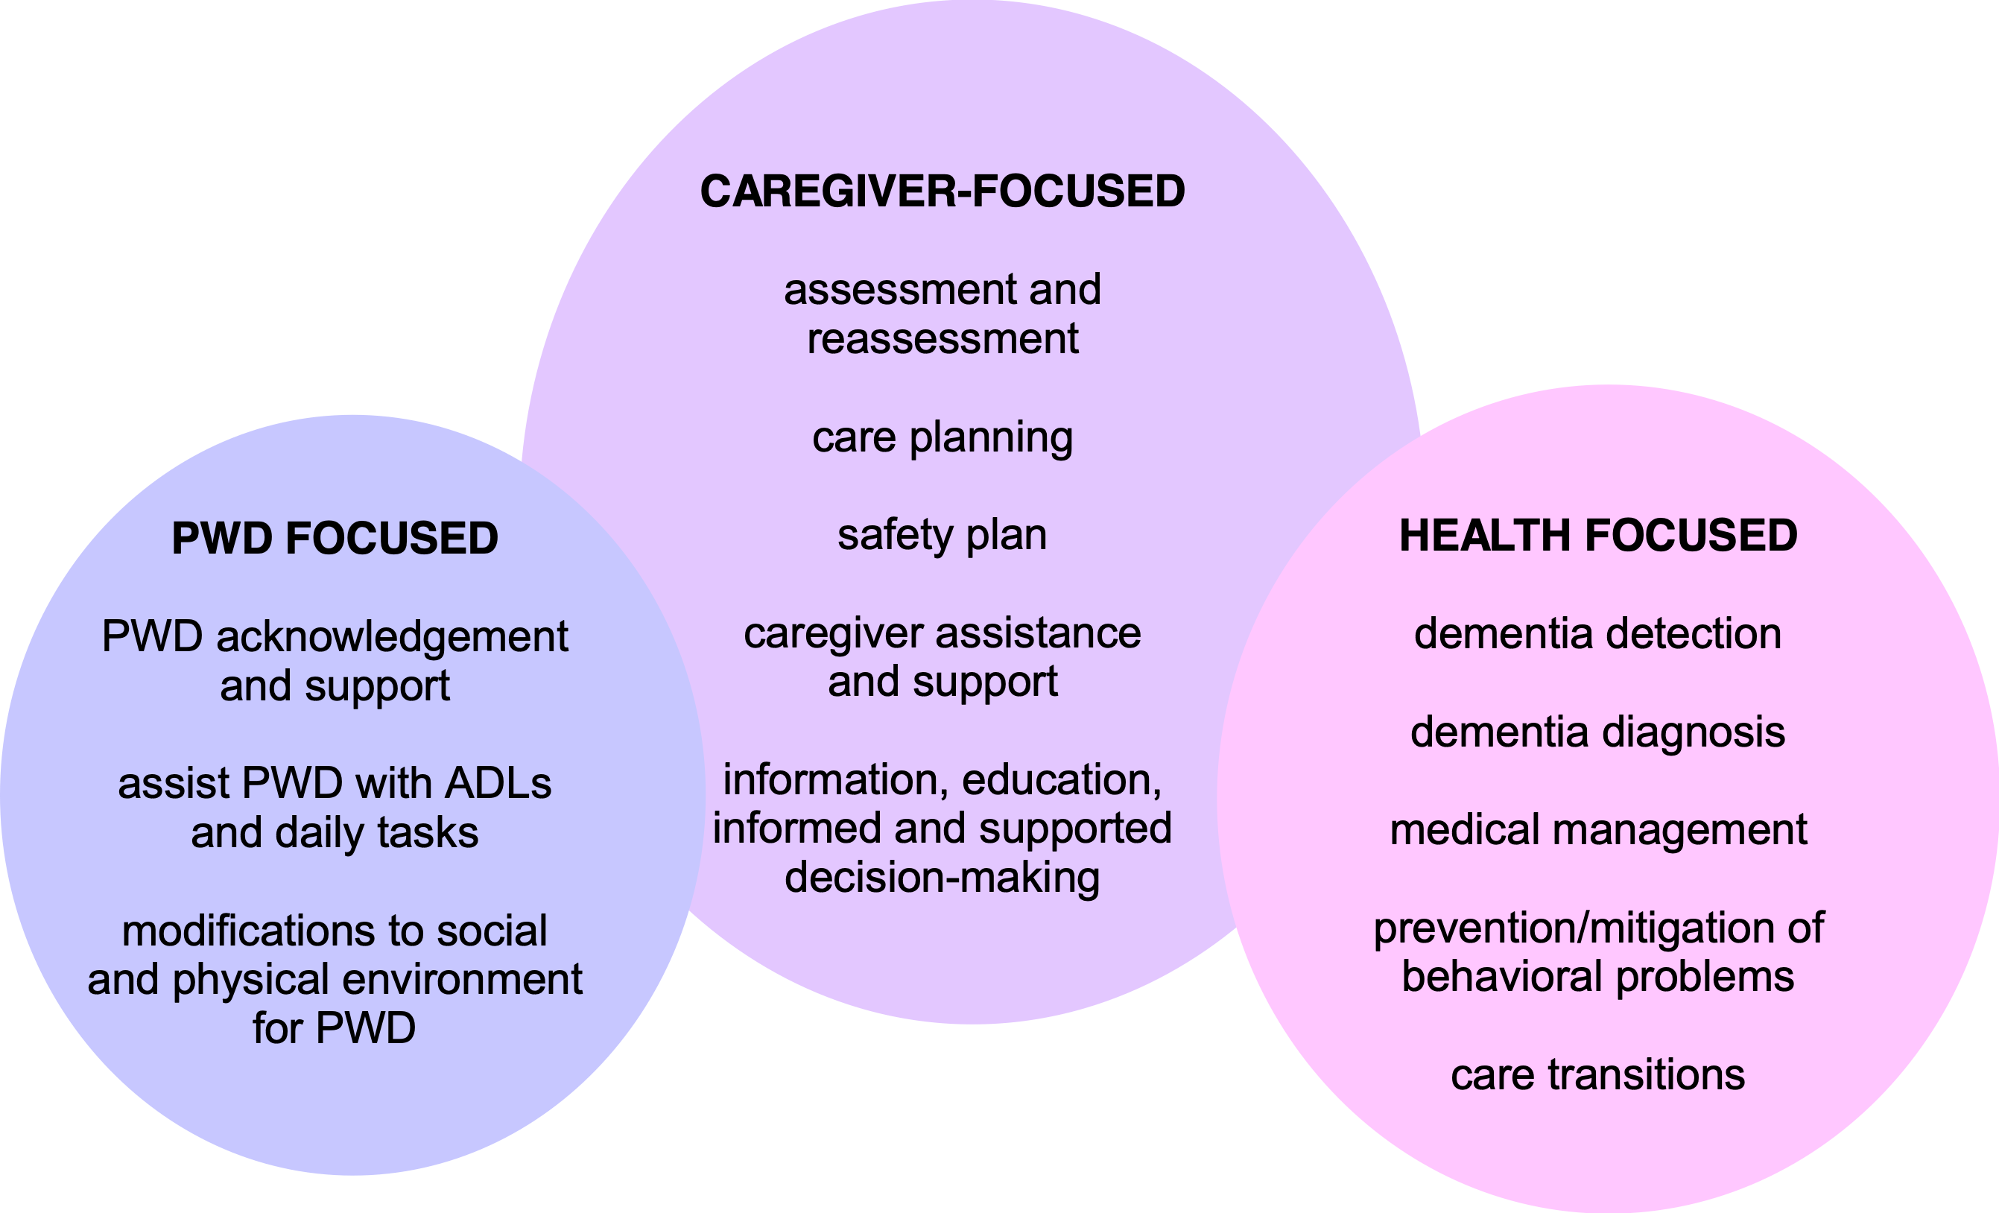
What Should Plans that Support
Caregivers for PLWD Look Like …
Gitlin LN, Maslow K, Khillan R.
Report to the National Advisory
Council on Alzheimer’s Research,
Care, and Services. 2018 Apr 27.

Slide 19
Outcome Measures…
Involve parties need to identify research priorities and relevant outcomes
Develop research measures that are important for studying dementia care, services, and supports
Develop standards for the evidence needed to determine which programs and services are ready for widespread implementation and dissemination
Gitlin LN, Maslow K, Khillan R. Report to the National Advisory Council
on Alzheimer’s Research, Care, and Services. 2018 Apr 27.

Slide 20
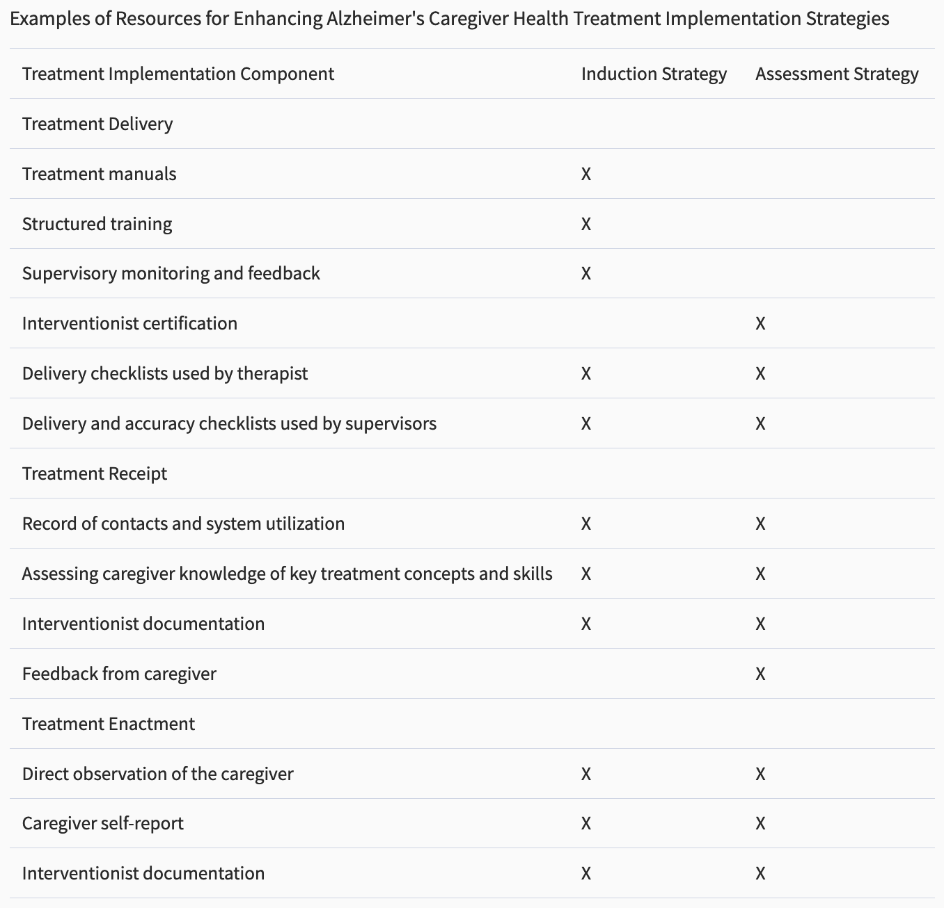
REACH I and II
REACH I and II
Burgio L et al. The Gerontologist. 41(4):481-489, 2001.

Slide 21
Rosalynn Carter Institute
for Caregiving
Has undergone clinical trial testing
“Dealing with Dementia” has proven to be a model educational material of its type
Structure and organization highly amenable to localization and customization
Demonstrated cost savings in VA patients, and relatively inexpensive to implement (mostly costs for coach training and FTE)
Limited nature of services, higher barriers to access community care options
Does not distribute different tasks to team members with different skill sets
Ambitious trials tested multiple different interventions, as well as different approaches to implement/assess each intervention
Individual trials were underpowered, and underestimated efficacy of tested interventions

Slide 22
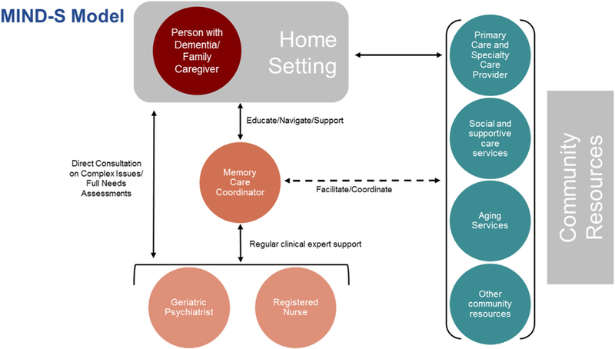
Mind at Home
Memory Care Coordination
Seamus QM et al., Contemporary Clinical Trials. 71:103-112, 2018.

Slide 23
Mind at Home
Memory Care Coordination
Only trial at this time to demonstrate successful delay of xitions from home to ALF/SNF
Prominent trend toward decreasing CG burden and decreasing CG time with PWD
Currently undergoing 2 year RCT examining Mind@Home intervention in >300 subjects randomized 1:1; major outcomes are to replicate delay in xition from home, and to quantify cost of intervention. Secondary outcomes include CG burden, PWD QoL, PWD NPS, and dyad unmet needs.
Geropsychiatry has a prominent role in this particular care model, is it part of the ‘special sauce?’
Assessments completed at home, with all the complexities that entails (“getting in the door and establishing rapport,” bed bugs, presence of firearms, having no place to sit, the presence of pets, allergies, and suspicions of the motives of researchers”)
Telephone/email f/u assessments

Slide 24
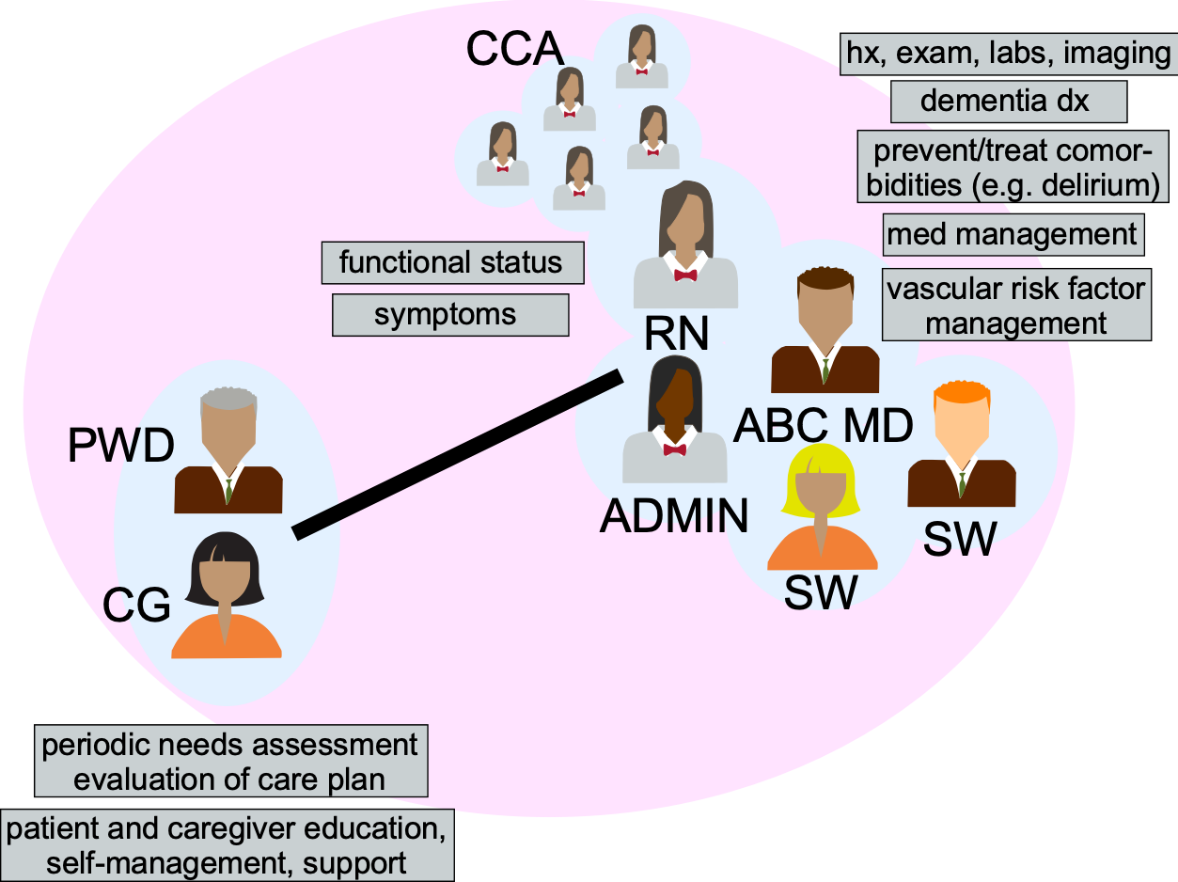
ABC Organization
ABC organization
Adapted from:
French et al., Health Affairs. 33(4):613-618, 2014
LaMantia et al., JAGS. 63:1209–1213, 2015.

Slide 25
Aging Brain Care
A large QI project, but not a clinical trial.
Has been implemented across large patient cohort in private-public health care partnership (Eskinazi Health/University of Indiana)
In its initial implementation, a minority of patients receiving the intervention had dementia; most patients who received intervention had depression
Assessments at home or in clinic
Reduced PHQ-9 scores of persons with depression relative to baseline
Reduced care burden scores of persons with dementia relative to baseline.
Validated HABC Monitor tool for measuring cognitive, functional, and psychiatric sx of dementia as well as caregiver burden
Demonstrated cost savings, mostly thru lower ER and hospital spending
More expensive model to implement given greater FTEs for MD and highly skilled RN team members

Slide 26
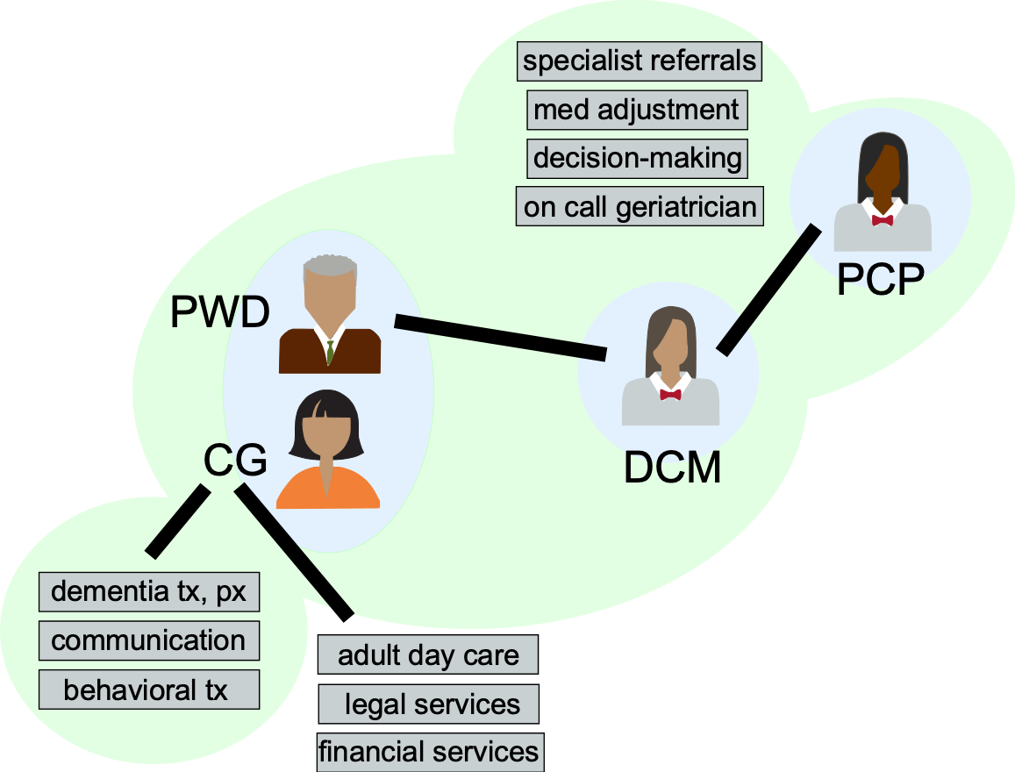
UCLA Alzheimer’s & Dementia Care (ADC)
Pathophysiology
Approved treatments
cholinesterase inhibitors noncompetitive antagonists
anti-amyloid immunotherapy
Approaches in clinical trial
secretase inhibitors
RAGE antagonists
PPARγ inhibitors
Caregiving optimization REACH Mind at Home Aging Brain Care (ABC)
UCLA ADC Care Ecosystem
Final thoughts …
UCLA Alzheimer’s & Dementia Care (ADC)
Reuben et al., JAGS. 61(12):2214-2218, 2013.
Tan et al., Health Affairs. 33(4):619-625, 2014.

Slide 27
UCLA Alzheimer’s & Dementia Care
(ADC)
A large-scale quality improvement project, but NOT a clinical trial
Successfully implemented most of their QI goals (had most difficulty with issues surrounding medications)
Assessments in clinic only
Program received positive marks from both healthcare providers and caregivers
Demonstrated cost savings in Medicare patients
Almost 100% of participants had goals of care conversation, ~70% WRITTEN notes regarding goals of care, low ER and ICU utilization before death, high hospice utilization before death
Strong emphasis on medical management issues, with availability of 24-hour RTC MD consultation (thru fellowship program), DCM who made medication changes.
Less emphasis on referrals to community services and organizations

Slide 28
Care Ecosystem
Care Ecosystem organization
Possin et al., PLoS Medicine 2018

Slide 29
Care Ecosystem
Assessments and interventions by telephone, limited patient portal accessible by internet (Possin et al., PLoS Medicine 14(3):e1002260, 2017).
Intervention provided successfully by care navigators, a new kind of position in the health care system (Bernstein et al., J Alzheimer Dis, 71(1):45-55, 2019).
Created educational infrastructure for robust CTN training (Dulaney S, et al., Alz Dement. 16:e041596, 2020).
Decreased person-with-dementia ER visits (Possin et al, JAMA Intern Med. 179(12):1658-1667, 2019).
Decreased caregiver depression and caregiver burden at both 6- and 12-month time points (Possin et al, JAMA Intern Med. 179(12):1658-1667, 2019).
Increased person-with-dementia QoL (Possin et al, JAMA Intern Med. 179(12):1658-1667, 2019).
Increased caregiver sense of self-efficacy at 6 mo (Merrilees et al., Dementia. 19(6):1955-1973, 2020).
Decreased caregiver depression and ER usage (Guterman et al., JAMA Neurol. 76(10):1166-73, 2019).
Decreased sense of caregiver burden (Bernstein et al., Alz Dement: Trans Res & Clin Int. 6(1):e12010, 2020).

Slide 30
Care Ecosystem
Decreased benzodiazepine, anticholinergic, and atypical antipsychotic use at both 6 and 12 month time points (Liu et al., Alzheimers Dementia. 19(5):1865-1875, 2023).
Increased likelihood that decedents would die in accordance with prior stated preferences (Ma et al., J Alz Dis. 83(4):1767-73, 2021).
Worked with CG and PLWD to successfully address financial abuse and mismanagement (Manivannan et al., J Alzheimer's Dis, 86(1):219-229, 2022)
Monthly cost to deliver service estimated at $90-110 per person (Rosa et al., JAGS. 67(12):2628-33, 2019).
Estimated PMPM savings of between $500 and $650
Demonstrated feasibility of using this care model as a clinical service (Rosenbloom et al., Alz Dement. 17:e057587, 2021; Possin et al., Alz Dement. 18:e063938, 2022.).
Underlines current thinking that caregivers (properly supported) have positive experiences and develop meaningful connections with the people they are caring for (Bernstein-Sideman et al., in press).
Demonstrated feasibility of real-time functional monitoring of activity and lifespace in older adults with dementia (Zylstra et al. J Neurosci Meth. 300:59-67, 2018; Manley et al., Alz Dement Trans Res Clin Int. 6(1):e12017, 2020).

Slide 31
Discussion (15 minutes)

Slide 32
Next Steps and Vote to Adjourn (5 min)
Next Steps
Next Meeting
November 7, 2023
3:00 to 5:00 pm
Vote to Adjourn

