Slide 1
Advisory Council on Alzheimer’s Disease and All Other Dementias
Executive Office of Elder Affairs
Elizabeth Chen, Secretary
August 16, 2022
3:00-5:00 pm
Video Conference

Slide 2
Agenda
Welcome, Logistics, Introductions (15 min)
Developing Approach for Building Diversity, Equity, and Inclusion (DEI) into the Council’s Work: Presentation & Discussion (35 min)
Younger-Onset Dementia and Equity Analysis Workgroup: Presentation & Discussion (30 min)
Council Member Roundtable Discussion (30 min)
Next Steps and Vote to Adjourn (10 min)

Slide 3
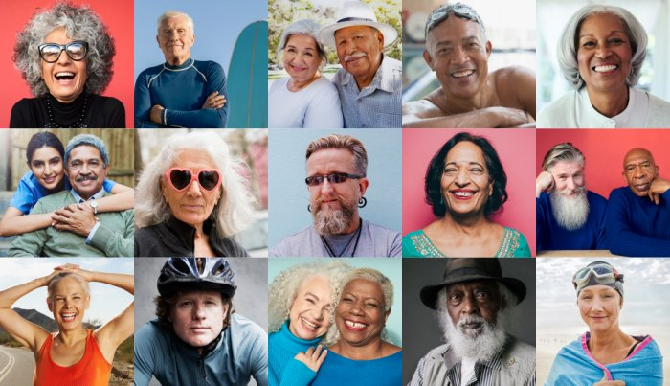
Building Diversity, Equity, and Inclusion into the Council’s Work
Workstream: Equitable Access and Care
Workstream Lead: Jatin Dave, MD

Slide 4
Definitions
Diversity - Any dimension that can be used to differentiate groups and people from one another.^{i}
Equality vs. Equity - Equality has to do with giving everyone the exact same resources, whereas equity involves distributing resources based on the needs of the recipients.^{ii}
Equality - Equality aims to ensure that everyone gets the same things in order to enjoy full, healthy lives.^{iii}
Equity - Equity is defined as “the state, quality or ideal of being just, impartial and fair.” The concept of equity is synonymous with fairness and justice. To be achieved and sustained, equity needs to be thought of as a structural and systemic concept ^{iv}
Heterogeneous - Consisting of dissimilar or diverse ingredients or constituents ^{v}
Inclusion - The action or state of including or of being included within a group or structure. More than simply diversity and numerical representation, inclusion involves authentic and empowered participation and a true sense of belonging.^{vi}
i. US Department of Housing and Urban Development
ii. Ellen Gutoskse, What’s the Difference Between Equity and Equality?
iii and iv. Annie E. Casey Foundation. Race Equity and Inclusion Action Guide.
v. https://www.merriam-webster.com/dictionary/heterogeneous
vi. Annie E. Casey Foundation. Race Equity and Inclusion Action Guide.

Slide 5
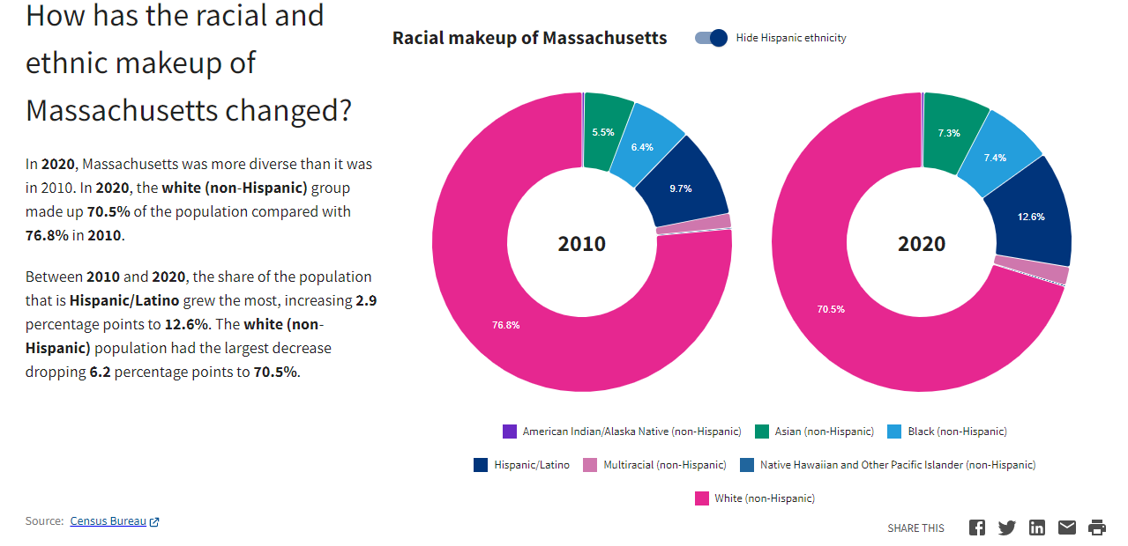
Massachusetts Racial and Ethnic Makeup

Slide 6
Non-English Speakers in Massachusetts
Source: https://datausa.io/profile/geo/massachusetts#demographics

Slide 7
Examples of Underrepresented Groups
Black/African American (not Latinx)
Latinx, including Brazilian/Portuguese speaking
Cape Verdean
Immigrants and refugees
Asian immigrants (in order of number of people in MA: Chinese, Vietnamese, Khmer/Cambodian, Korean, Burmese)
Individuals living in rural areas
Individuals who are incarcerated
Individuals with housing insecurity
LGBTQ+ communities
Native Americans
People living alone with dementia
Individuals with intellectual and developmental disabilities (I/DD)
Blind or vision impaired
People with hearing loss/late deafened
Veterans

Slide 8
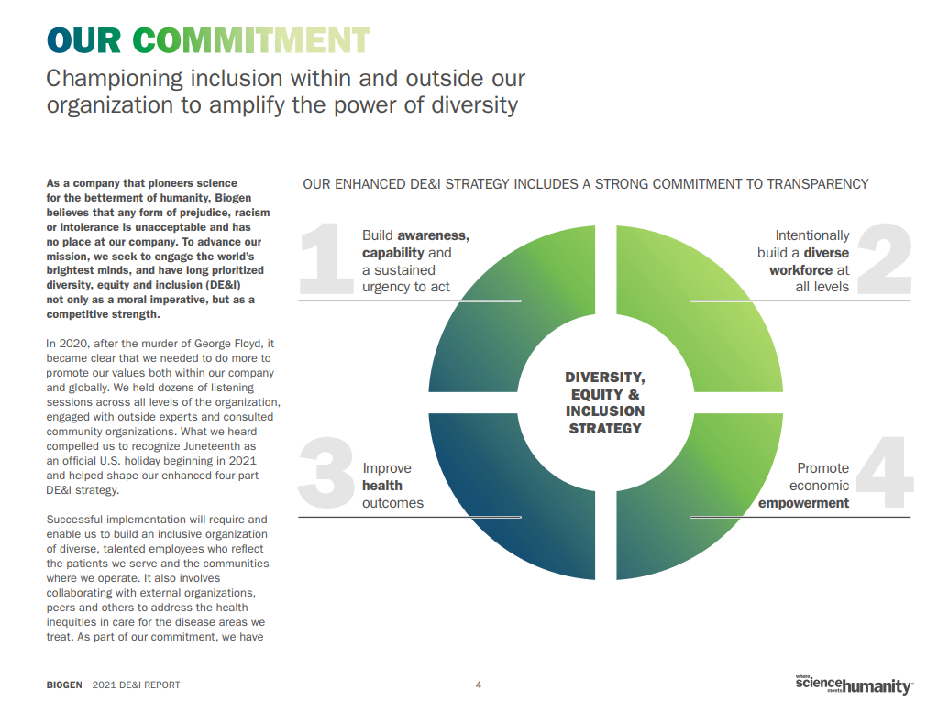
Many Organizations Have DEI Strategies (Example)
6 Source: 2021 Diversity, Equity & Inclusion Report, Biogen

Slide 9
Equity & Inclusion (EI) Team to Help Council Develop a DEI Vision & Pledge
As you know, we are in the process of building an “Equity & Inclusion (EI) team” and working on making it more heterogeneous.
An EI Team kick-off meeting will be convened as soon as possible.
The EI team will be asked to review and edit a draft of the Council’s “vision” and “pledge” to promote DEI in our work.

Slide 10
Vision and Pledge to Promote DEI
DRAFT
VISION
The Massachusetts Advisory Council on Alzheimer's Disease and All Other Dementias envisions a Commonwealth that reflects the communities we serve and values and benefits all people affected by dementia equally — one that addresses cultural, economic, environmental, and other societal barriers. We recognize and value the lived experience of all Massachusetts residents affected by dementia and strive for equitable outcomes for all.
PLEDGE
As we work to achieve our goals, we pledge to:
Build and cultivate a culture of diversity, equity, and inclusion among all individuals working to advance the Council’s goals including the Council, its workgroups, focus groups, and other partners.
Listen to, learn from, respect, and value diverse life experiences and perspectives including the experiences of those disproportionally affected by societal barriers to dementia research, care, services, support, and decision-making.
Highlight and address inequities as we develop policy recommendations, programs, and resources for individuals and families affected by dementia and hold ourselves accountable for successes and failures.
Commit to residents affected by dementia that they will receive the support, services, and care needed to live healthy and meaningful lives.
Notes:
Please review this and send your comments and any suggested changes to Pam MacLeod.
You will see this again with edits from this council as well as from the EI team.

Slide 11
Diversity, Equity and Inclusion
Why Diversity, Equity, and Inclusion (DEI) Matter
Some populations experience greater societal barriers than others to quality dementia care, support, and risk reduction
Some barriers are specific to dementia; some apply to all healthcare
Barriers exist for individuals before a diagnosis, after a diagnosis, and at every stage of the disease
People who are disproportionately affected by these barriers struggle at the beginning of their dementia journey and at each additional stage
As a potential reference for workgroups, we listed some examples of barriers and groups disproportionately affected by them (Appendix A)
Notes:
Examples of barriers: “Lack access to screening and diagnosis;” and “no informal/family caregiver options”
Appendix A of this PPT is for Council member reference. You all have a copy.

Slide 12
Goal and Objectives
Goal - Build a solid foundation of DEI into our work
Objectives
Engage diverse Equity & Inclusion (EI) Team to:
Identify barriers that may prevent certain groups from benefiting from the Council’s work
Determine reasons for the barriers; identify approaches to eliminate them, weaken them, or mitigate their impact
Refine recommended policies, implementation plans, activities, programs, or deliverables to achieve our DEI goal
Notes:
As stated in our state plan.

Slide 13
Support for Workgroups
Deploy members of the EI Team to work collaboratively with the workgroups to achieve our DEI goal
Prior to deploying the team’s members to advise workgroups, convene them to learn from each other by responding to the following:
What challenges have you encountered associated with dementia that are specifically due a lack of cultural understanding?
What benefits have you experienced when interacting with people who had a solid understanding of your cultural community?
Notes:
Responses can be around cultural understanding (or lack of understanding) experienced anywhere, e.g., among healthcare professionals, dementia care professionals, elder service agencies, senior centers, service providers, neighbors, friends, and family - just to name a few.

Slide 14
Proposed Approach
1. Review & Provide Feedback
Volunteers (“advisors”) from EI Team review the workgroup’s relevant materials or activities.
Provide feedback to the workgroup at one of its meetings.
Allow for Shared Leadership and Accountability
The workgroup leader/ Council member informs the Council of the status and next steps around addressing the advice provided.
If the workgroup and advisors did not reach consensus at the workgroup’s meeting, the recommendation(s) and issues are discussed and voted upon by the Council.

Slide 15
Questions for Council
How can we ensure that the Council’s membership reflects the diversity of the people we serve?
If you are a member of (or work with people within) an underrepresented group, is there anything you would like to share from your personal experiences before we convene the EI Team?
What challenges have you encountered or expect as we build DEI into our work?
If you lead a workgroup, can you explain how this approach would be implemented within your workgroup in terms of your specific activities or work products?
Other ideas or concerns about how to incorporate DEI into our work?
Notes:
Council members may pick and choose which question(s) they would like to respond to.

Slide 16
Advisory Council on Alzheimer’s Disease and All Other Dementias
APPENDIX A
Societal Barriers to
Quality Dementia Care, Services,
Support, and Risk Reduction

Slide 17
Some Examples of Societal Barriers and Groups Disproportionately Affected
Examples of Barriers | Examples of Groups Disproportionately Affected
Lack access to screening and diagnosis | People lacking financial resources (Black/African Americans, Hispanic Individuals, Native Americans) Rural dwellers People ages 30-64 living with undiagnosed younger onset Alzheimer’s Disease (AD) People ages 45-64 living with undiagnosed non-AD dementia (Frontotemporal dementia and Lewy Body dementia)
Sensitive to stigma and fear of talking with doctor about cognitive impairment | There may be specific groups disproportionately affected by this barrier
Lack understanding of difference between dementia and normal aging | There may be specific groups disproportionately affected by this barrier
No informal/family caregiver options | Individuals living alone; LGBTQ+ individuals; People estranged from family
Lack financial resources | Black/African Americans; Hispanic Individuals; Native Americans
Unable to navigate the bureaucracies | People lacking financial resources (see above)
Lower educational attainment | People lacking financial resources (see above)
Lack reliable transportation | People lacking financial resources (Black/African Americans, Hispanic Individuals, Native Americans); Rural dwellers; People unable to drive and without access to public transportation
Under age 65 and experiencing dementia symptoms | People ages 30-64 living with undiagnosed younger onset Alzheimer’s Disease (AD); People ages 45-64 living with undiagnosed non-AD dementia (Frontotemporal dementia, Lewy Body dementia)
Lack access to healthcare | Black/African Americans and other minority populations
Work in low-paying jobs without health insurance benefits | Black/African Americans and other minority populations
Unemployed | Black/African Americans and other minority populations
Disclaimer - This list is for illustrative purposes and is not the result of a thorough or robust review of studies or data and should not be interpreted as such.

Slide 18
Societal Barriers to Quality Dementia Care, Services, and Support
Some Examples of Societal Barriers and Groups Disproportionately Affected
Examples of Barriers to Risk Reduction (12 Modifiable risk factors) | Examples of Groups Disproportionately Affected
Less education | People lacking financial resources (Black/African Americans, Hispanic Individuals, Native Americans)
Social isolation | Individuals living alone; People isolated from family; People estranged from family; Individuals with mental health or behavioral health conditions
Untreated hearing loss | Non-Hispanic white adults ages 60 and over
Depression | Racial/ethnic, gender, and sexual minorities (due to lack of access to high-quality mental health care, stigma surrounding mental health care; and lack of awareness about mental health)
Obesity | Black/African Americans, Hispanic Individuals, Native Americans
Excessive alcohol consumption | Minority populations (e.g., racial/ethnic, gender, sexual identity); Military veterans
Physical inactivity | Hispanic, Black/African Americans, Native Americans; Adults ages 25 and older with less than a high school education; Adults ages 25 and older living in poverty
Smoking | Adults that live in rural areas; Military veterans; Lesbian/gay/bisexual adults (LGB); Adults that did not graduate high school; Americans living in poverty; Uninsured Americans; Indigenous peoples; Americans with mental or behavioral health conditions; Adults in public housing
High blood pressure | Black/African Americans; Asian Americans; Hispanic Americans
Diabetes | Native Americans; Hispanic Americans; Black/African Americans
Traumatic brain injury (TBI) (including concussion) | TBI: people between the ages of 15 - 24 years; persons under the age of 5 or over the age of 75 also at a significantly higher risk Concussions: older adults and children ages 4 and under (due to fall risk); Adolescents (due to bike accidents and sports-related head injuries); Military personnel (due to exposure to explosive devices)
Air pollution | Black/African Americans, Asian and Hispanic Americans; Low-income populations; People with occupational exposure to air pollution
Disclaimer - This list of examples is for illustrative purposes and is not the result of a thorough or robust review of studies or data and should not be interpreted as such.

Slide 19
Advisory Council on Alzheimer’s Disease and All Other Dementias
APPENDIX B
Links to Helpful Resources

Slide 20
Links to Helpful Resources
Diversity, Equity, and Inclusion in Alzheimer’s and Dementia - PowerPoint Presentation, Alzheimer’s Association
Special report on Race, Ethnicity and Alzheimer’s in America, 2021 Alzheimer’s Disease Facts and Figures (Section 7), Alzheimer’s Association
Diversity, Equity & Inclusion, Alzheimer’s San Diego
Diversity, Equity, Inclusion & Access, Minnesota Board on Aging
Better Brain Health through Equity: Addressing Health and Economic Disparities in Dementia for African Americans and Latinos, Milken Institute
LGBT and Dementia, Sage and Alzheimer’s Association
Connecting with Asian and Pacific Islanders (AAPIs) About Dementia, National Asian Pacific Center on Aging
Dementia and IDD, Eunice Kennedy Shriver Center, UMass Chan Medical School
The Most Costly Chronic Medical Condition in America: Experts Talk About the Rural Aspects of Alzheimer’s Disease and Related Dementias, Kay Miller Temple, MD
Supporting Native American elders living with dementia, Jennifer Tinkelberg
Attacking cultural trauma and dementia among Vietnamese immigrants, UC Davis Health
Serving Hispanic Families, Home and Community Based Services for People with Dementia and their Caregivers: A Toolkit for the Aging Network, Alzheimer’s Association
Perspectives in Brief: Planning for the Next Phase in Alzheimer’s Disease: Partnering with Communities of Color, Biogen

Slide 21
Caregiver Factsheets from the Diverse Elders Coalition
Caregiver Factsheets from the Diverse Elders Coalition - DiverseElders.org
What Providers Should Know About African American Family Caregivers
What Providers Should Know About American Indian Family Caregivers
What Providers Should Know About AAPI Family Caregivers
What Providers Should Know About Hispanic Family Caregivers
What Providers Should Know About LGBT Family Caregiver
What Providers Should Know About Southeast Asian American Family Caregivers

Slide 22
Younger-Onset & Equity Analysis Update & Next Steps
Workstream: Equitable Access and Care
Workgroup: Younger-Onset & Equity Analysis Workgroup Lead: Rhiana Kohl, PhD
Presenter: Joe Montminy, Dementia Advocate and Workgroup member

Slide 23
Younger-Onset & Equity Analysis Workgroup Members
Younger-Onset & Equity Analysis Workgroup of the
Council’s Equitable Access & Care Workstream:
Rhiana Kohl, PhD, Council Member (Workgroup Lead)
Mike Belleville, Council Member & Dementia Advocate Kathy Devine, Prescription Advantage Program Manager - EOEA Liz Gross, Caregiver
Chelsea Gordon, Director of Public Policy & Advocacy, Alzheimer’s Association, MA/NH Chapter Judy Johanson, Dementia Advocate - Mass. Alzheimer’s Disease Research Center, MGH Tracy Lungelow, Caregiver
Joe Montminy, Dementia Advocate Paul Mathew, MD, Caregiver Barbara Meehan, Council Member & Dementia Advocate/Former Caregiver

Slide 24
Younger-Onset & Equity Analysis Workgroup’s Charge
Workgroup’s Charge
Conduct an analysis of the needs of people affected by younger-onset dementia and provide guidance for other teams on how to apply an equity and inclusion lens
by using this population as a case study
Source: The Council’s Annual Reports, April 2020 and April 2021

Slide 25
Younger-Onset and Equity Analysis Workgroup’s Goal
Our Goal
Address unmet needs and close gaps in equality, equity, and inclusion for people living with
younger-onset dementia and
the people who care for them

Slide 26
Accomplishments & Updates
Identified challenges or unmet needs associated with younger-onset dementia
Examined each need through an equality and equity lens by identifying why they remain unmet:
Barriers to Equality | Barriers to Equity
Individuals living with dementia under age 60 do not qualify for some state-supported essential services and supports available to older adults living with dementia and their caregivers. | Individuals living with younger-onset dementia and their caregivers have unmet needs due to the differing nature of their needs compared with older adults living with dementia.

Slide 27
Accomplishments & Updates
(Continued)
Developed a list of state supported services & supports available for older adults living with dementia
Examined eligibility and age restrictions around each service and support
Identified those unavailable or not easily accessible to younger adults

Slide 28
Accomplishments & Updates
(Continued)
Determined if the unmet needs resulted from barriers to equality or equity and categorized them within six themes:
Public Awareness, Education, and Stigma
Diagnosis
Services & Supports
Caregivers
Finances
Clinical Trials

Slide 29
Next Steps
Prioritize unmet needs and develop recommendations to address them
While preparing our recommendations, we will likely focus on developing approaches to address:
Building awareness of and expanding access to services and supports for those living with younger-onset dementia and the people who care for them
Provide Council with recommendations around unmet needs falling within the purview of the Council's other workstreams

Slide 30
Next Steps (Continued)
At a future Council meeting, we will provide:
Our recommendation(s) and justification in terms of challenges, unmet needs, and feasibility
Proposed implementation plan(s)

Slide 31
Younger-Onset & Equity Analysis Workgroup
Questions or Comments?

Slide 32
Council Member Roundtable Discussion

Slide 33
Next Steps & Vote to Adjourn
Next Meeting:
November 1
3:00 to 5:00 pm
Location: Video Conference
Vote to Adjourn

