Slide 1
Alzheimer’s Advisory Council
Executive Office of Elder Affairs
Elizabeth Chen, Secretary
September 1, 2021
3:00-5:00 pm
Video Conference

Slide 2
Agenda
Welcome, Meeting Logistics, Introductions (10 min)
Diagnosis & Services Navigation Workstream (50 min)
Diagnosis Implementation Team (25 min)
Services Navigation Implementation Team (25 min)
Council Member Roundtable: Updates & Discussion (35 min)
Closing Remarks and Final Roll Call (10 min)

Slide 3
Alzheimer’s Advisory Council
Moving from Planning to Action, 2021
Workstream: Diagnosis & Services Navigation
Implementation of Recommendations - Status and Discussion
September 1, 2021
Workstream Leads
Representative Tricia Farley-Bouvier
James Wessler

Slide 4
Implementation Team Members
LEGEND: Blue - Diagnosis Implementation Team | Purple - Services Navigation Implementation Team
Representative Tricia Farley-Bouvier
(Workstream Co-lead)
Council Member
James Wessler
(Workstream Co-lead)
Council Member
Chief Executive Officer, Alzheimer's Association,
MA/NH Chapter
and New England Regional Leader
Kathryn C. Burns, MHA
Chief Executive Officer
Greater Lynn Senior Services, Inc.
Hollis D. Day, MD, MS
Chief of Geriatric Medicine, Boston
Medical Center and Associate Professor of Medicine, Boston University School of Medicine
James Lavery
Council Member
Director, Bureau of Health Professions Licensure
Massachusetts Department of Public Health
Liz McCarthy
Health Systems Director
Alzheimer’s Association, New England Region
Ellen M McDonough
Former Director of Clinical Services
Elder Services of Cape Cod & the Islands
Nicole McGurin, MS, CDP
Family Services Director
Alzheimer's Association, MA/NH Chapter
Molly Purdue, PhD
Executive Director
Cape Cod Alzheimer's Family Support Center
Caitlin Roy
Options Counselor
Aging Services of North Central Massachusetts
Rebecca Starr, MD, AGSF
Medical Director, Geriatrics
Cooley Dickinson HealthCare
Karyn B. Wylie, MS, LSW
MA Aging & Disability Resource Consortia (ADRC) Coordinator
MA Executive Office of Elder Affairs
Hagen Yang, MD
Neurologist
Atrius Health
Braintree - Harvard Vanguard

Slide 5
Diagnosis and Services Navigation
As described by the Council in the Alzheimer’s State Plan:
Recommendation #1 (Diagnosis)
Significantly increase the numbers of undiagnosed or cognitively impaired residents who are diagnosed with dementia and informed of their diagnosis
Recommendation #2 (Services Navigation)
Ensure that after a dementia diagnosis, individuals and their families have access to comprehensive information and care planning services

Slide 6
1. Diagnosis
Recommendation #1 (Diagnosis)
Team Lead: James Wessler
Significantly increase the numbers of undiagnosed or cognitively impaired residents who are diagnosed with dementia and informed of their diagnosis
Clinician Toolkit
Disclosure to Caregiver(s)
Practice Change in Primary Care
Available online
Full complement of resources
Increase awareness of mandate
Pilot implementation
Measurement and evaluation

Slide 7
Diagnosis Implementation Status
Updates & Accomplishments
Clinician Toolkit: reviewed existing resources, including assessment tools for low-literacy/IDD populations
Identified pilot in primary care as best method to evaluate practice change
Collaborated with DPH to inform Health Systems of ACOP deadline extension to 10/1/2022
Next Steps
Identify & recruit PCP practice(s) to implement change in diagnostic process
Develop Clinician Toolkit, possibly collaborating with MHA for distribution
Work with BORIM to drive adoption of diagnosis/treatment plan disclosure requirement

Slide 8
Diagnosis Challenges and Solutions
Engaging BORIM
Engaging MHA
Pilot site recruitment
Challenges
Initial meeting held with MHA
Identified existing template for pilot recruitment
Continue to seek engagement with BORIM
Solutions

Slide 9
Diagnosis Discussion (15 min)
Questions
Are there examples of successful practice changes? How were those successes achieved?
How can we measure adherence with diagnosis/treatment plan disclosure?
Advice
With which organizations/stakeholders should we collaborate to distribute Clinical Toolkit?
What resonates with Primary Care to change practice?

Slide 10
2. Services Navigation
Recommendation #2 (Services Navigation)
Team Lead: Representative Tricia Farley-Bouvier
Ensure that after a dementia diagnosis, individuals and their families have access to comprehensive information and care planning services
I. Road Map
II. Dementia Care Coordination Program Expansion
III. PCP Interactions with Unsupported Individuals

Slide 11
Services Navigation Implementation Status
I. Road Map
Updates and Accomplishments
Identified two-page document entitled, “Next Steps After an Alzheimer’s Diagnosis” from the National Institute on Aging (NIA) of the National Institutes of Health (NIH)
Next Steps
Interview PCPs to determine the most helpful information in a road map
Determine how to best make the “Next Steps” document available to PCPs
Determine how to integrate local resources
Explore placing dementia information and links on electronic medical records (EMRs)

Slide 12
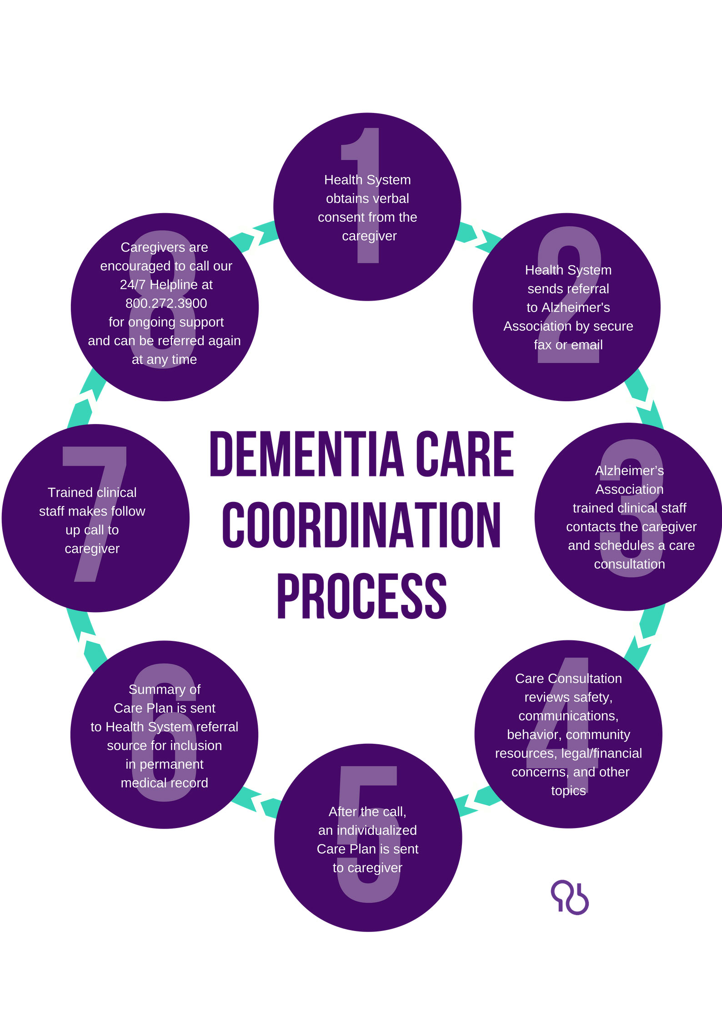
Services Navigation Implementation Status
II. Dementia Care Coordination
Program Expansion

Slide 13
Services Navigation Implementation Status
II. Dementia Care Coordination Program Expansion
Updates and Accomplishments
23 referring partners
1,739 referrals in FY 2021; more than 12,000 referrals since the start of the program in 2014
Final year of 4-year program evaluation providing outcomes for providers and caregivers and recommendations for program improvement
Next Steps
Expand funding to increase capacity of the program
Add new referring partners with focus on underserved populations
Implement program improvements from the evaluation

Slide 14
Services Navigation Challenges and Solutions
Challenges
Being able to engage with PCPs because of their tight schedules
Balancing the need for information about local resources with information from statewide and national organizations
Having printed information for PCPs that will be changing
Time constraints delayed work on our third recommendation - to identify best practices in addressing the needs of unaccompanied or unsupported individuals diagnosed with dementia
Solutions/Potential Strategies
Team members will have individual conversations with PCPs
Direct people to Alzheimer’s Association and MassOptions
Create a digital version of “next steps after diagnosis” document with links to local resources

Slide 15
Services Navigation Discussion (15 min)
Questions
How can we best reach PCPs?
Do you know of any best practices or guidance for providers around addressing the needs of unaccompanied and/or unsupported individuals diagnosed with dementia?

Slide 16
Council Member Roundtable (35 min)
Updates & Discussion
Quality of Care (M. Brennan & L. Pellegrini)
Caregiver Support & Public Awareness (B. Meehan & H. Montesino)
Physical Infrastructure (E. Chen)
Research (E. Chen for A. Budson in absentia)
Public Health Infrastructure (J. Dave and J. Lavery)
Equitable Access & Care Workstream: Equity & Inclusion Consultancy (E. Chen for J. Jackson in absentia)

Slide 17
Next Steps
Next Council Meeting – December 7, 2021, 3:00 to 5:00 pm
1. Presentation and Discussion on the Physical Infrastructure Workstream
2. Council Member Roundtable: Updates & Discussion

