Slide 1

MA Advisory Council on Alzheimer’s Disease and All Other Dementias
Executive Office of Elder Affairs
Robin Lipson, Acting Secretary
September 10, 2024
3:00-5:00 pm
Video Conference

Slide 2
Agenda
Welcome, Updates, and Meeting Logistics (15 min)
Public and Private Insurers: Opportunities and Challenges (50 min)
Challenges Around Dementia in LGBTQIA+ Communities (40 min)
Next Steps and Final Roll Call (15 min)

Slide 3
2. Public and Private Insurers: Opportunities and Challenges (50 min)
Panel Participants
1. Blue Cross Blue Shield of Massachusetts
Michelle Powderly, RN, BS
Senior Clinical Director, Government Programs
2. Point32Health
Jonathan Harding, MD, FAAPL
Chief Medical Officer, Medicare Plans
3. MassHealth
Charles (Chuck) T. Pu. MD, FACP, CMD
Senior Medical Director, Office of Long Term Services and Supports
MA Executive Office of Health and Human Services
4. Centers for Medicare and Medicaid Services (CMS)
Tanya Pagan Raggio-Ashley, MD, MPH, FAAP
Acting Regional Chief Medical Officer
CMS NY Region 2 and CMS Boston Region 1

Slide 4

MA Advisory Council on Alzheimer’s Disease and all other Dementias: September 10, 2024 BCBSMA Presenter: Michelle Powderly, RN, BS Senior Clinical Director, Government Programs
BLUE CROSS BLUE SHIELD OF MASSACHUSETTS
Blue Cross Blue Shield of Massachusetts is an Independent Licensee of the Blue Cross and Blue Shield Association.
4

Slide 5

BLUE CROSS BLUE SHIELD OF MASSACHUSETTS Dementia Care
Stages of Dementia | Early stage-Mild | Middle Stage-Moderate | Late Stage-Severe
 | Coverage spanning all stages of the dementia journey Diagnosis: High Tech radiology (MRI, Amyloid PET scans), neurological evaluation Treatment for Alzheimer’s patients in mild stage: Lecanemab (Leqembi®) and Donanemab (KisunlaTM) Care Navigation and Planning Patient/caregiver education about: medical and mental health treatment clinical trials support services available in community
BLUE CROSS BLUE SHIELD OF MASSACHUSETTS
Blue Cross Blue Shield of Massachusetts is an Independent Licensee of the Blue Cross and Blue Shield Association.
5

Slide 6
BCBSMA CARE Navigation Resources
Stages of Dementia | Early Stage Mild | Middle Stage Moderate | Late Stage Severe
Who is the Care Team? | Dedicated interdisciplinary clinical team (nurses, social workers, behavioral health providers) to support members in their dementia journey
Ways members can be identified to offer Care Team services | After emergency department visits Discharged to home from an inpatient stay Discharged to home from a skilled nursing facility Referrals from external clinical partners who complete home visit Referrals from members/caregivers and providers
What the Care Team does | Caregiver support Resource navigation including health plan benefits and community resources
BLUE CROSS BLUE SHIELD OF MASSACHUSETTS
Blue Cross Blue Shield of Massachusetts is an Independent Licensee of the Blue Cross and Blue Shield Association.
6

Slide 7
KEY Community Partners
Stages of Dementia | Early Stage-Mild | Middle Stage-Moderate | Late Stage-Severe
Alzheimer’s Association | Alz.org provides health related and scientific content to educate health care professionals and people with the disease on available therapies and resources Dementia Care Coordination Program of the Alzheimer’s Association (since 2017): BCBS refers caregivers to dedicated Dementia Care Coordinator who performs telephonic consultation with member’s caregiver and provides an extensive overview of all the resources and support programs available for members with dementia and their caregivers
ASAPS ( Aging Service Access Points) | 24 Statewide ASAPs ( Aging Service Access Point) that provide programs and services designed to support adults aged 60 and older, and their caregivers. BCBS Medicare Advantage has created a Transition in Care Program with Elder Services of Worcester to coordinate work with multiple ASAPs, for Seniors who have had an ED visit and who live in Central Mass
BLUE CROSS BLUE SHIELD OF MASSACHUSETTS
Blue Cross Blue Shield of Massachusetts is an Independent Licensee of the Blue Cross and Blue Shield Association.
7

Slide 8
Thank you
8

Slide 9

Dementia Care Consultation Program In Collaboration with the Alzheimer’s Association Presentation to the MA Alzheimer Disease and Related Dementias Advisory Council September 10, 2024
Jonathan Harding, MD, FAAPL
Chief Medical Officer, Medicare Plans
Point32Health
With
Megan Stolze MSW LICSW
Senior Behavioral Health Care Manager/Dementia Care Consultant
9

Slide 10
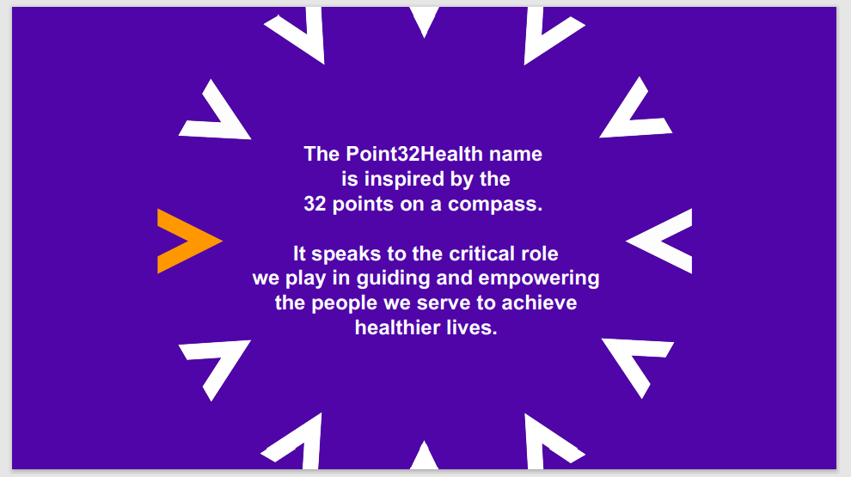
Point32Health: We Guide and Empower Healthier Lives For Everyone, By Working Differently
10

Slide 11

Our Family of Companies
11

Slide 12

Total Membership: 2 Million Members
Product Core Area | # Members
Commercial | 1,001,251
Medicare Advantage | 124,241
Medicare Supp Individual | 53,703
Medicaid | 134,473
Direct | 199,412
Duals (SCO>=65 and OneCare <65) | 20,347
Diversified (HPI) | 458,023
New Hampshire:
140,563 members
Maine:
99,888 members
Massachusetts:
1,506,971 members
Connecticut:
17,156 members
Rhode Island:
33,998 members
12

Slide 13
SCO Utilization Ratio: Dementia vs. No Dementia
Dementia Patients Have Significantly Higher Rates of Inpatient Admissions, SNF usage and Emergency Department Visits
 | Acute Inpatient Admissions | SNF Admits | ED Visits
 | Per 1000 per month | Per 1000 per month | Per 1000 per month
 | 3.4 | 5.4 | 1.7
MA – SCO
 | 3.4 | 5.4 | 1.7
The diagnosis of dementia carries with it a multiple of Inpatient and SNF admissions
13
Notes:
Hospital and SNF use is even more magnified in dementia population. SNF use is 5X as much as in the non dementia population.

Slide 14
Dementia Care Consultant: Role
To Improve Patient Care,
We Launched a Dementia Care Consultation Program in 2012 with Alzheimer’s Association MA/NH Chapter
Work as Specialists who provide education, support and care planning guidance.
Support member/caregiver alongside RNCM management.
Provides consult and follow-up as indicated by case need; average length of engagement is 4-6 months.
Consult with RNCM where formal referral is not indicated or is declined by caregiver.
Interactions are primarily telephonic or virtual (as requested).
In-person consults at Newton or Worcester Alzheimer’s Association Office
Family consults offered
DCCs Currently Unable to Provide:
In-person home safety assessments
Cognitive assessment
Ongoing clinical therapy
LTC placement
Therefore, they complement nurse care management, do not replace it.
14
Notes:
Work as Specialists who provide education, support and care planning guidance.
Support member/caregiver alongside RNCM management.
average length of engagement is 4-6 months.
Interactions are primarily telephonic or virtual (as requested).
In-person consults at Newton or Worcester Alzheimer’s Association Office

Slide 15
Other Information
15

Slide 16
Dementia Prevalence by Market
Dementia prevalence varies by state and type of product
Prevalence ranges from 2 – 12% of our Medicare populations
Prevalence in Duals products is significantly higher
Dementia continues to be underdiagnosed and under reported in physician claims
We define a patient with dementia as
Having a claims history in the last 5 years
Any diagnosis of dementia or any utilization of dementia related drugs
Medical Treatment
Fewer than half our members with dementia are taking a drug to ameliorate symptoms
Of 7 patients taking these drugs, one will exhibit benefit and one will experience side effects
16
Notes:
Prevalence of dementia varies by Health Plan from 2.4% in CT, our newest plan with youngest average age of membership, to over 12% in SCO with high levels of disability.
Prevalence varies a lot by data definitions: what data source is included, how many claims are required to confirm the diagnosis, from what time period are the claims pulled. By one data definition our SCO dementia prevalence is over 30%

Slide 17

Dementia Care Consultation: Background
Goal: Improve quality of life for members and caregivers with memory related concerns
Began as a pilot program from 2012-2013 with Alzheimer’s Association MA/NH Chapter
Service available to all Point32Health members across all product lines
Over 4,150 members/caregivers served
Current State:
2 Dementia Consultants
Collaboration with Harvard Pilgrim’s Institute on the National Institute of Aging’s Co-CARE-AD grant
FAST- Functional Assessment Screening Tool - Internal Pathway
Future State:
Satisfaction Survey distribution
Impact of DCC on ED visits and readmissions
Direct involvement during dementia related psych inpatient stays
17
Notes:
We developed a program to help support our members with dementia by helping their family caregivers cope with the condition.
We’ve provided these consultations to thousands of members
We are continually evolving the program.

Slide 18
Dementia Care Consultation: Goals
Dementia Care Consultation is an in-depth, personalized service for individuals and families who are facing many decisions and challenges associated with Alzheimer’s disease and other dementias.
The goal is for each family/caregiver to:
Develop an understanding of a dementia diagnosis
Make a plan to maximize the independence of the person with memory loss
Secure needed resources
Develop strategies for the best possible symptom management and communication
18
Notes:
Make a plan to maximize the independence of the person with memory loss
Secure needed resources
Develop strategies for the best possible symptom management and communication

Slide 19

Dementia Consultant Interventions
Disease Education
Safety Recommendations
Wandering- Risk Reduction Strategies
Support Group connection
Interdisciplinary Team Meetings to meet holistic needs
Grief Counseling
Goals of care conversations with member and caregivers
Caregiver stress reduction techniques
19
Notes:
This slide shows some of the interventions the Dementia Care Consultants can use to help family caregivers provide better support to the care recipient.
The goal for the health plan is to reduce utilization of expensive facility based services
The goal for society is to reduce or delay institutionalization in long term care, aka custodial care, facilities.
The goal for the member is to be able to be cared for as long as possible by their own family members
The goal for the caregivers is reduced burnout and more satisfaction in providing care to the care recipient.

Slide 20
Dementia Consultant Program Metrics
Dementia Care Consultation Program | 2022 | 2023 | Q1 2024
Engagement Rate | 64.0% | 70.0% | 94.6%
20
Notes:
This has been a referral based program.
Referrals can come from PCPs, from nurse care managers, or from families who learn about these services from our member materials.
Engagement rate is fairly high.
During our CO CARE AD study, we used claims based algorithms to generate referrals so we could identify a control group for the study.

Slide 21
Payor Panel (Continued)
MassHealth
Charles (Chuck) T. Pu. MD, FACP, CMD
Senior Medical Director, Office of Long Term Services and Supports
MA Executive Office of Health and Human Services

Slide 22

Massachusetts Advisory Council on Alzheimer’s Disease and All Other Dementias
Public Health and Private Insurers: Opportunities and Challenges Around Dementia Care
Tanya Pagán Raggio-Ashley, MD, MPH, FAAP Acting Chief Medical Officer Regions I and II Center for Clinical Standards and Quality
September 10 , 2024
22

Slide 23
This presentation was prepared as a tool to assist providers and is not intended to grant rights or impose obligations. Although every reasonable effort has been made to assure the accuracy of the information within these pages, the ultimate responsibility for the correct submission of claims and response to any remittance advice lies with the provider of services.
This presentation is a general summary that explains certain aspects of the Medicare Program, but is not a legal document. The official Medicare Program provisions are contained in the relevant laws, regulations, and rulings. Medicare policy changes frequently, and links to the source documents have been provided within the document for your reference
The Centers for Medicare & Medicaid Services (CMS) employees, agents, and staff make no representation, warranty, or guarantee that this compilation of Medicare information is error-free and will bear no responsibility or liability for the results or consequences of the use of this guide.
No financial conflicts to disclose
23

Slide 24
Guiding an Improved Dementia Experience (GUIDE) Model
Dementia affects more than 6.7 million Americans in 2023, with 14 million projected cases by 2060.
People with dementia often have multiple chronic conditions and receive fragmented care, leading to high rates of hospitalization and emergency department visits.
They also may have behavioral health symptoms and often need 24/7 care
The challenges of managing health care, providing constant support, and dealing with the behavioral and psychological symptoms of dementia can present a significant mental, physical, emotional, and financial burden for caregivers and disproportionately impact Black, Hispanic, and Asian Americans, Native Hawaiian, and Pacific Islander populations.
24
Notes:
CMS is the largest insurer in the US

Slide 25
CMS - Scope
As the largest single purchaser of health care dollars, Medicare plays a key role in transitioning our health care system away from fee-for-service and towards value-based care.
CMS is the largest purchaser of health care in the world
CMS programs provide health care coverage to over 170M people, or 1 of every 3 Americans (Medicare, Medicaid, CHIP, Basic)
In 2022, more than 66M people are enrolled in Medicare, with more than 88M enrolled in Medicaid and CHIP
More than 12 million people are enrolled in both programs, and these individuals have very high rates of chronic illness; most with multiple chronic conditions
Most Medicare beneficiaries - over 80% - are over age 65
Some people come into Medicare first, typically through age, and others become beneficiaries because of disability or other health status (e.g. renal disease)
Beneficiaries with Medicaid or no supplemental coverage were more likely to be Black, covered by Medicare based on disability, and have functional limitations
Medicare Beneficiary Enrollment Trends and Demographic Characteristics
25

Slide 26
Percentage of Medicare FFS Beneficiaries with 21 Selected Chronic Conditions: 2021
26

Slide 27
The GUIDE Model is testing an alternative payment methodology for participants that deliver comprehensive, coordinated dementia care.
Participants will assign people with dementia and their caregivers to a Care Navigator who will help them access GUIDE services and supports, and non-GUIDE services and supports including clinical services and non-clinical services such as meals and transportation through community-based organizations
Unpaid caregivers will be connected to evidence-based education and support, such as training programs on best practices for caring for a loved one with dementia… also help caregivers access respite services
https://www.cms.gov/priorities/innovation/innovation-models/guide
27
Notes:
The GUIDE Model will set a standard approach to care, including 24/7 access to a support line, as well as caregiver training, education, and support services
This standard approach will allow people with dementia to remain safely in their homes for longer by preventing or delaying nursing home placement and improve quality of life for both people with dementia and their unpaid caregivers

Slide 28
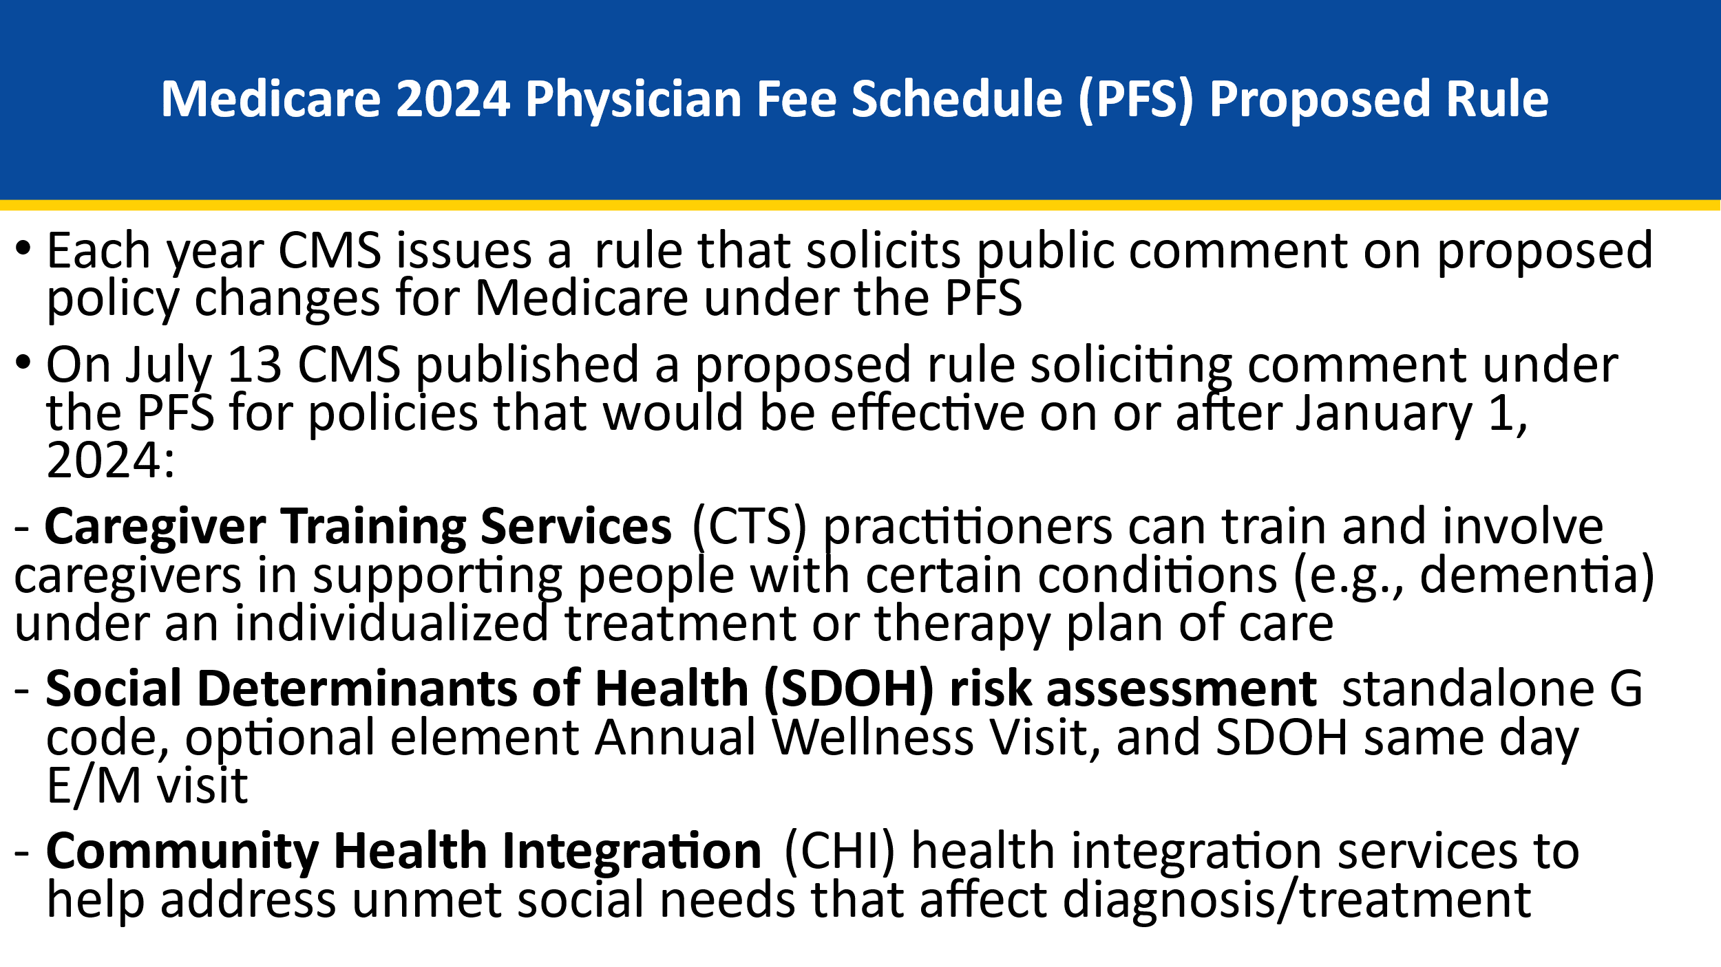
28

Slide 29
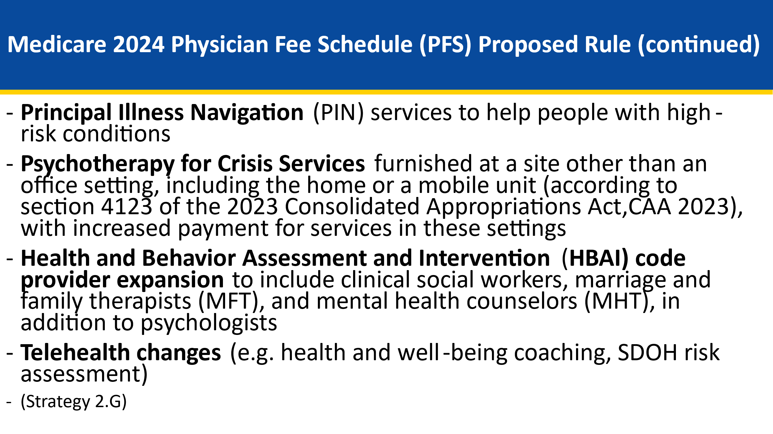
29

Slide 30
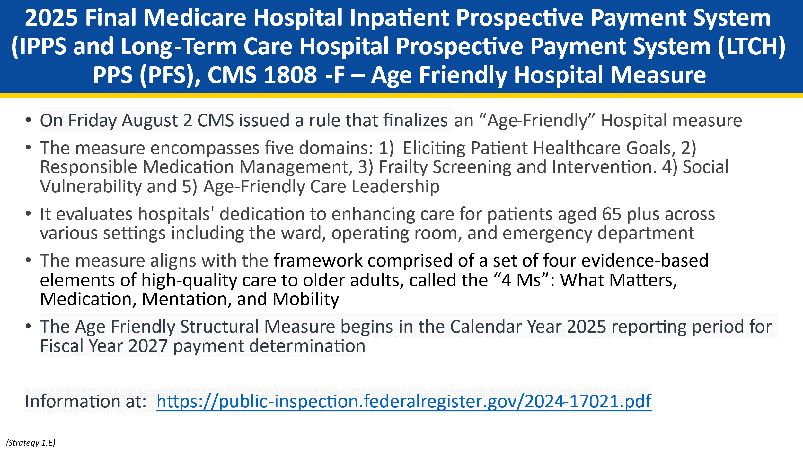
30

Slide 31
Thank You!
Contact Tanya Pagan Raggio-Ashley, MD, MPH, FAAP
tanya.raggio@cms.hhs.gov
Acknowledgements
Dr. Shari Ling, CMS CCSQ Deputy Chief Medical Officer
Ms. Ellen Blackwell CMS CCSQ
31

Slide 32
More on Medicare Coverage of Monoclonal Antibodies Directed Against Amyloid for the Treatment of Alzheimer’s Disease
On July 6, 2023, FDA approved Leqembi™ (lecanemab) for treatment of Alzheimer’s disease based on a clinical endpoint. On the same day, CMS launched the Anti-Aβ mAb CED Study, which uses the CMS National Patient Registry
For monoclonal antibodies approved by FDA for the treatment of AD based upon evidence of efficacy from a direct measure of clinical benefit, Medicare coverage may be provided in CMS-approved prospective comparative studies; study data may be collected in a registry
Information at: Broader Medicare Coverage of Leqembi (Lecanemab) Available Following FDA Traditional Approval
32

Slide 33
Four Approved Studies
Alzheimer's National Registry for Treatment and Diagnostics Sponsor: Alzheimer's Disease and Related Disorders Association, Inc Clinicaltrials.gov number: NCT06170268 CMS Approval Date: 1/29/2024
Georgia Memory Net Anti-Amyloid Monoclonal Antibody Registry Sponsor: Emory University Clinicaltrials.gov number: NCT05999084 CMS Approval Date: 11/14/2023
A Prospective Comparative Study Of Monoclonal Antibodies For The Treatment Of Alzheimer's Disease Sponsor: Beth Israel Deaconess Medical Center Clinicaltrials.gov number: NCT05925621 CMS Approval Date: 07/11/23
Prospective Study on Anti-Amyloid-β Monoclonal Antibodies Directed Against Amyloid for the Treatment of Alzheimer’s Disease Coverage of Evidence Development (The Anti-Aβ mAb CED Study)
Clinicaltrials.gov number: NCT06058234
33

Slide 34
3. Challenges Around Dementia in LGBTQIA+ Communities (40 min)
Panel Participants
Jacqueline Buckley
Dementia Caregiver
Westminster, MA
2. Deb Allen
Dementia Caregiver
Brookline, MA
3. Mark McKay
Dementia Caregiver
Lynn, MA
4. Dan Stewart
Deputy Director, Aging Equality Project Human Rights Campaign Foundation

Slide 35





4. Next Steps & Final Roll Call (15 min)
Upcoming Meetings
January’s Agenda
Upcoming Council Meeting, 3 pm to 5 pm
Tuesday, January 14, 2025
Note: Council meeting on 11/5/24 is canceled
Presentations & Discussions
Interdisciplinary Dementia Care
Dementia Care Planning
Equity & Inclusion
What is one thing you’ve heard today
that may change the way you think
about the work of this Council?
Vote to Adjourn

