Slide 1
Massachusetts Advisory Council on
Alzheimer’s Disease and All Other Dementias
Executive Office of Elder Affairs
Robin Lipson, Secretary
January 9, 2025
3:30-5:00 pm
Video Conference

Slide 2
Agenda
Welcome, Logistics, Introductions (10 minutes)
Team Accomplishments, Deliverables, and Proposals
Dementia Care Planning Team (25 minutes)
Team on Interdisciplinary Dementia Care (30 minutes)
Equity and Inclusion Team (20 minutes)
III. Next Steps and Vote to Adjourn (5 minutes)

Slide 3
Massachusetts Council on Alzheimer’s
Disease and All Other Dementias
Dementia Care Planning Team
Updates, Accomplishments, and Discussion
January 9, 2025
Team Co-Leads
Susan Antkowiak, VP of Programs & Services
Alzheimer’s Association, MA/NH Chapter
Linda Pellegrini, Geriatric Nurse Practitioner
UMass Memorial Medical Center

Slide 4
The Council’s Team on Dementia Care Planning
Team Co-Leads
Susan Antkowiak, VP of Programs & Services
Alzheimer’s Association, MA/NH Chapter
Linda Pellegrini, Geriatric Nurse Practitioner
UMass Memorial Medical Center
Rachel Broudy, MD
Faculty Lead on Elder Care Work at Ariadne Labs;
Medical Director, Pioneer Valley Hospice and Palliative Care;
Board Member, Life Path Aging Services Access Point (ASAP), Franklin County
Deb Dowd-Foley
Caregiver Specialist
Elder Services of Worcester Area, Inc.
Laurie Herndon, MSN, GNP, BC
Project Director, Hinda and Arthur Marcus Institute for Aging Research, Hebrew SeniorLife
Judy Johanson
Dementia Advocate
Massachusetts Alzheimer’s Disease Research Center, Massachusetts General Hospital (MGH)
Pam MacLeod, PMP, MBA
Senior Project Director
Massachusetts Executive Office of Elder Affairs
Gad A. Marshall, MD
Medical Director of Clinical Trials, Center for Alzheimer Research and Treatment, Brigham and Women’s Hospital (BWH), Associate Neurologist, BWH, Assistant in Neurology, (MGH), Associate Professor of Neurology, Harvard Medical School
Pam Mirick, RN
Former Family Caregiver, Retired Nurse

Slide 5
Our Team’s Goal
Goal
Recommend, distribute, and promote
person-centered and person-directed care planning resources; and advise Ariadne Labs in their development of a tool for person-centered assessment and care planning for people
living with dementia and their caregivers.
Source: Massachusetts State Plan on Alzheimer’s Disease and Related Dementias
Notes:
This is our team’s goal as it appears in our state’s Alzheimer’s state plan.

Slide 6
Updates and Accomplishments
✓ Continued to collect and review person-centered care planning resources and tools
✓ Researched, discussed, and agreed upon the benefits of person-centered dementia care planning, its unique characteristics, and key elements
✓ Reviewed and provided advice to Ariadne Labs on prototypes of its care planning tool
✓Designed a dementia care planning toolkit (nearly complete)
Preliminary Title: “Care Planning For Living Well With Dementia”
Purpose: Facilitate the creation of person-centered care plans that support living well with dementia
Intended Audiences:
People living with dementia
Dementia care partners and families
Community-based service providers
Residential care providers
Healthcare providers
✓ Developed a detailed communication plan
6
Notes:
Updates and accomplishments since we last presented to the Council

Slide 7
Findings
1. Insights
Effective Dementia Care Planning is Inconsistent - While exceptions exist, anecdotal evidence suggests that dementia care plans may lack availability, omit key elements like patient values and care partner roles, and may fail to adapt to disease progression
Collaboration is Essential - Effective dementia care planning involves discussions among the person with dementia, healthcare providers, community service providers, residential care providers, care partners, and family members
Dementia Care Planning Fosters Stability - Dementia care plans can provide clarity, avoid emergencies, and alleviate stress for care partners
Dementia Care Plans are Flexible and Evolving - Dementia care plans can take any form, start simple, and grow over time, supporting communication through all stages of the disease
7

Slide 8
Findings
2. Benefits of a Person-Centered Dementia Care Plan
Personalized Approach - Looks beyond diagnosis, respecting life experiences, preferences, goals, and values while addressing medical, emotional, social, spiritual, and physical needs
Empowerment - Empowers individuals, families, and care partners to address the complexities of dementia
Care Alignment - Aligns care with how the person responds to dementia, improving health and wellbeing
Navigation Assistance - Helps care recipients and care teams manage care and navigate support
Crisis Prevention - Reduces uncertainty, minimizes crises, reduces care partner stress
Meaningful Living - Fosters meaningful and joyful lives for people affected by dementia
Better Outcomes - Leads to better care, health outcomes, and improved quality of life for care recipient and care partner; and fewer hospitalizations, ER visits, and long-term care placements
8

Slide 9
Findings
3. Unique Aspects of Dementia Care Planning
Cognition and Communication Support - Supports cognition, communication, and behavior
Quality of Life Focus - Prioritizes maintaining quality of life, not just treating the disease
Personhood Preservation - Acknowledges the need to maintain a sense of personhood and self-determination
Flexible Approach - Adapts as needs change with each stage of the disease; and acknowledges care partner’s essential and evolving role as the dementia progresses
Safety Considerations - Addresses contributing factors for agitation, aggression, or safety risks
9
Notes:
Here are some unique aspects of dementia care planning as compared with care planning for people affected by other diseases

Slide 10
Steps to Developing a Person-Centered Dementia Care Plan
(1)
Discuss and gather relevant person-centered information, and agree
on plan of action
(2)
Document and update goals, strategies, and other pertinent information
10
Notes:
Our

Slide 11
Summary of Key Elements of Person-Centered Dementia Care Planning
Discuss
Involve all key stakeholders
Collect information on concerns, values, interests, abilities, preferences
Identify care gaps and assess risks/benefits of potential interventions
Agree on care and support to be provided and approaches for delivering it
Maintain ongoing discussions to monitor and adjust plan as needs evolve
Document
Goals of care centered on the person’s priorities and what matters most to them
Assessment of cognitive, functional, and safety status
A plan and referrals for addressing medical, emotional, social, and spiritual needs
Strategies to address risks to health, safety, and quality of life
Support for care partners and identification of circle of support
Approaches for medication management
Proactive strategies to handle crises, health changes, and end-of-life care
Regular updates to the care plan
11
Notes:
Our team’s toolkit, which we will briefly describe in a minute, includes additional details about the key elements of dementia care planning.

Slide 12
Toolkit Overview
Reflecting on our findings, our team developed a toolkit on dementia care planning
Outlines the benefits of dementia care planning
Describes what person centeredness means for people with dementia
Includes key elements of dementia care plans and provides samples
Provides a reference sheet to community-based services and supports
Includes a discussion worksheet for individuals and their care teams
Provides online links to helpful dementia care planning resources
Includes guidance on equitable and inclusive care planning
12

Slide 13
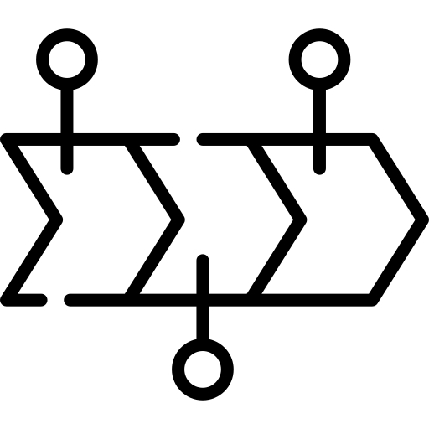
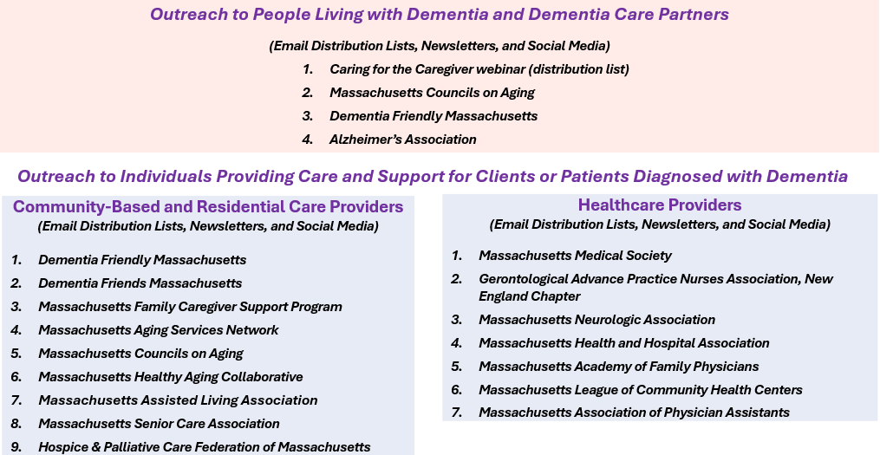
Next Steps
January 2025
Finalize the toolkit and develop webinar slides to accompany its release
Coordinate with key contacts to plan and implement outreach activities
February 2025
Develop and distribute flyers with link to the toolkit and webinar registration
March 2025
Convene both webinars, record them, and distribute the recording (final milestone)
Recognize this team’s achievements and bring its work to a close.
13
Notes:
First webinar is for People Living with Dementia and Dementia Care Partners
The second webinar is for Individuals Providing Care and Support for Clients or Patients Diagnosed with Dementia
Note: We will also distribute the toolkit to this Council when finalized

Slide 14
Discussion (10 minutes)
In general, what are your thoughts about our team’s deliverables?
Do you have any advice for our team?
Could you recommend a communications contact to assist with our outreach at:
Massachusetts Medical Society
Massachusetts Neurologic Association
Massachusetts Health and Hospital Association
Massachusetts Academy of Family Physicians
Massachusetts League of Community Health Centers
Massachusetts Association of Physician Assistants
14

Slide 15
Massachusetts Council on Alzheimer’s
Disease and All Other Dementias
The Council’s Team on
Interdisciplinary Dementia Care (IDC)
Status, Proposal, and Discussion
January 9, 2025
Christopher Wight, MSW, LICSW Clinical Social Worker
Department of Neurology, Memory Disorders Unit
Massachusetts General Hospital, Boston, MA

Slide 16
The Council’s Team on Interdisciplinary Dementia Care
Team Co-Leads
Alina Sibley, CNP (through August 2024)
Team Lead for Geri-Pal Home Care, Baystate Health, Springfield, MA
Christopher Wight, LICSW Clinical Social Worker, Memory Disorders Unit
Department of Neurology, Massachusetts General Hospital, Boston, MA
Stephen Bonasera, MD, PhD
Chief, Division of Geriatrics & Palliative Care
Medical Director, Baystate Memory Assessment and Care Clinic
Department of Medicine
Baystate Medical Center,
Springfield, MA
Kathryn M. Corelli, MD
Internal Medicine Physician, Chestnut Hill, MA
Joe Costello
Organizational Consultant and Dementia Advocate
Brent P. Forester, MD, MSc.
(Council Member)
Dr. Francis S. Arkin Chair of Psychiatry,
Tufts University School of Medicine
Chief and Chair, Department of Psychiatry, Tufts Medical Center
Director of Behavioral Health,
Tufts Medicine
Lenore Jackson-Pope, RN, BSN, MSM, CCRP
Co-Director of Primary Care Outreach
Center for Alzheimer Research and Treatment (CART) and
Massachusetts Alzheimer’s Disease Research Center (MADRC)
Mass General Brigham
Boston, MA
Pam MacLeod, MBA, PMP
Senior Project Director
MA Executive Office of Elder Affairs
Liz McCarthy
Health Systems Director
New England Region, Alzheimer’s Association
Pam Mirick, RN
Former Family Caregiver, Retired Nurse
Christine Ritchie, MD, MSPH (Council Member)
Kenneth L. Minaker Endowed Chair in Geriatric Medicine
Research Director, MGH Division of Palliative Care and Geriatric Medicine
Director, Mongan Institute Center for Aging and Serious Illness
Director, MGH Dementia Care Collaborative
Professor of Medicine, Harvard Medical School, Boston, MA
Amy Walsh
Project Manager
Institute for Health Care Improvement (IHI)
Boston, MA
Notes:
Before we begin, I’d like to thank our team. I’m grateful to have the opportunity to present their work today.

Slide 17
Our Team’s Original Goal
Original Goal
Develop a plan that ensures that staff in primary care across the state receive the training and support needed to build and retain interprofessional dementia care teams
Source: Massachusetts State Plan on Alzheimer’s Disease and Related Dementias
Notes:
This is our team’s goal as it appears in our state’s Alzheimer’s State Plan.

Slide 18
Updates and Accomplishments
✓ Reviewed Gaps Within Current Dementia Care System
Gaps in Dementia Care
Caregiver support and education
Clinical and nonclinical care navigation/care planning
Coordination with care for other chronic conditions
Home safety and behavior management
Medical and community care integration
General understanding of dementia risk factors
Availability of interdisciplinary dementia care workforce
Primary care workforce availability and education
Polypharmacy risk management
Equitable access to high quality care
Awareness of available services among healthcare professionals and the public
Timely communication of diagnosis
18
Notes:
Gaps: Rather than read every gap, I’ll let you scan them yourselves. We compiled this list after hearing from our workgroup’s members, Council members, Council meeting panels of people living with dementia and caregivers, and focus groups convened by the Council's other workgroups.

Slide 19
Updates and Accomplishments
Conducted Analysis of Effective Dementia Care Within Primary Care
✓ Identified 40 key service elements, benefits, requirements, and responsible professionals
✓ Studied evidence-based interdisciplinary dementia care models
✓ Evaluated five models with Care Ecosystem chosen as a fit for Massachusetts
✓ Aligned the services with Care Ecosystem’s capabilities, GUIDE, and Age-Friendly Health Systems
✓ Studied comparable initiatives here and in other states
19

Slide 20
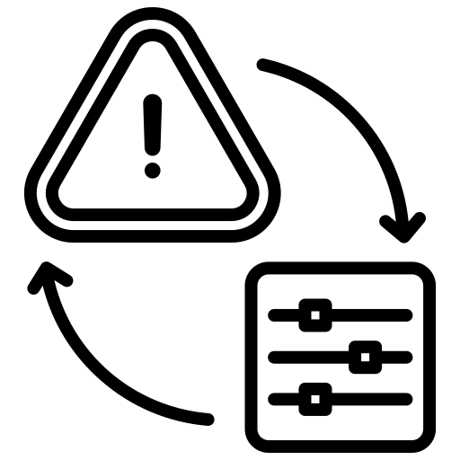
Perspective Informed by Analysis
Current Perspective Informed by the Team’s Analysis
Although effective dementia care relies on interdisciplinary collaboration, achieving this requires augmentation of existing, geographically-based infrastructure that:
Exhibits a strong focus on dementia care navigation and caregiver support with clinical expertise;
supports existing provider capabilities;
strengthens collaboration; and
interconnects services for seamless coordination.
20
Notes:
Our current perspective - informed by our analysis - is indicated here.

Slide 21
Recommended Revised Team Goal
Team Vision, Mission, and Revised Goal (For Council Review)
Vision
A sustainable, centralized model of integrated dementia care in Massachusetts
Mission
Address gaps in dementia care
Revised Goal (Proposed State Plan Amendment)
Develop a plan that ensures that individuals with dementia and their care partners have access to an evidence-based dementia care navigation program
21
Notes:
If the Council agrees with this revised goal, we will take a formal vote to include it as an amendment to the Alzheimer’s State Plan at the next Council meeting.
Background information only:
The pilot’s goals would include desired outcomes for patients and caregivers as well as financial outcomes such as health system cost savings.

Slide 22
Preliminary Proposal for Further Development Pilot a Care Ecosystem Program in Massachusetts
22

Slide 23
Why Pilot a Care Ecosystem Program in Massachusetts?
Challenges
Solution: Care Ecosystem
Overburdened primary care practices
Provides primary care practices with clinical consultation
Care Ecosystem utilizes a proven, evidence-based approach to dementia care
Confused patients and consumers
★ Provides ongoing person-centered care planning and care navigation
Fragmented or suboptimal care, caregiver stress, high costs
★ Streamlines care management; improves patient outcomes; reduces caregiver stress; lowers health care costs
Notes:
Background information only:
Overburdened primary care practices. PCPs lack time to form relationships needed to meet ongoing needs of dementia patients and their caregivers.
Confused patients and consumers. We are rich with clinical and community-based services; however, people affected by dementia can become confused about the right choice.
Suboptimal care, caregiver stress, high costs. Each service may address just one need or overlap with other services, which can generate suboptimal care, a lack of health- and social- care integration, caregiver stress, and greater costs to community-based and health care systems.

Slide 24
Care Ecosystem Team:
Clinical Consultants and Care Team Navigators
Care Ecosystem Team
Physician
Clinical Consultants
Pharmacist
Nurse Coordinator (NP)
Social Worker
Care Team
Navigators
Care Team Navigators
We envision a centralized, grant-funded, state-contracted Team

Slide 25
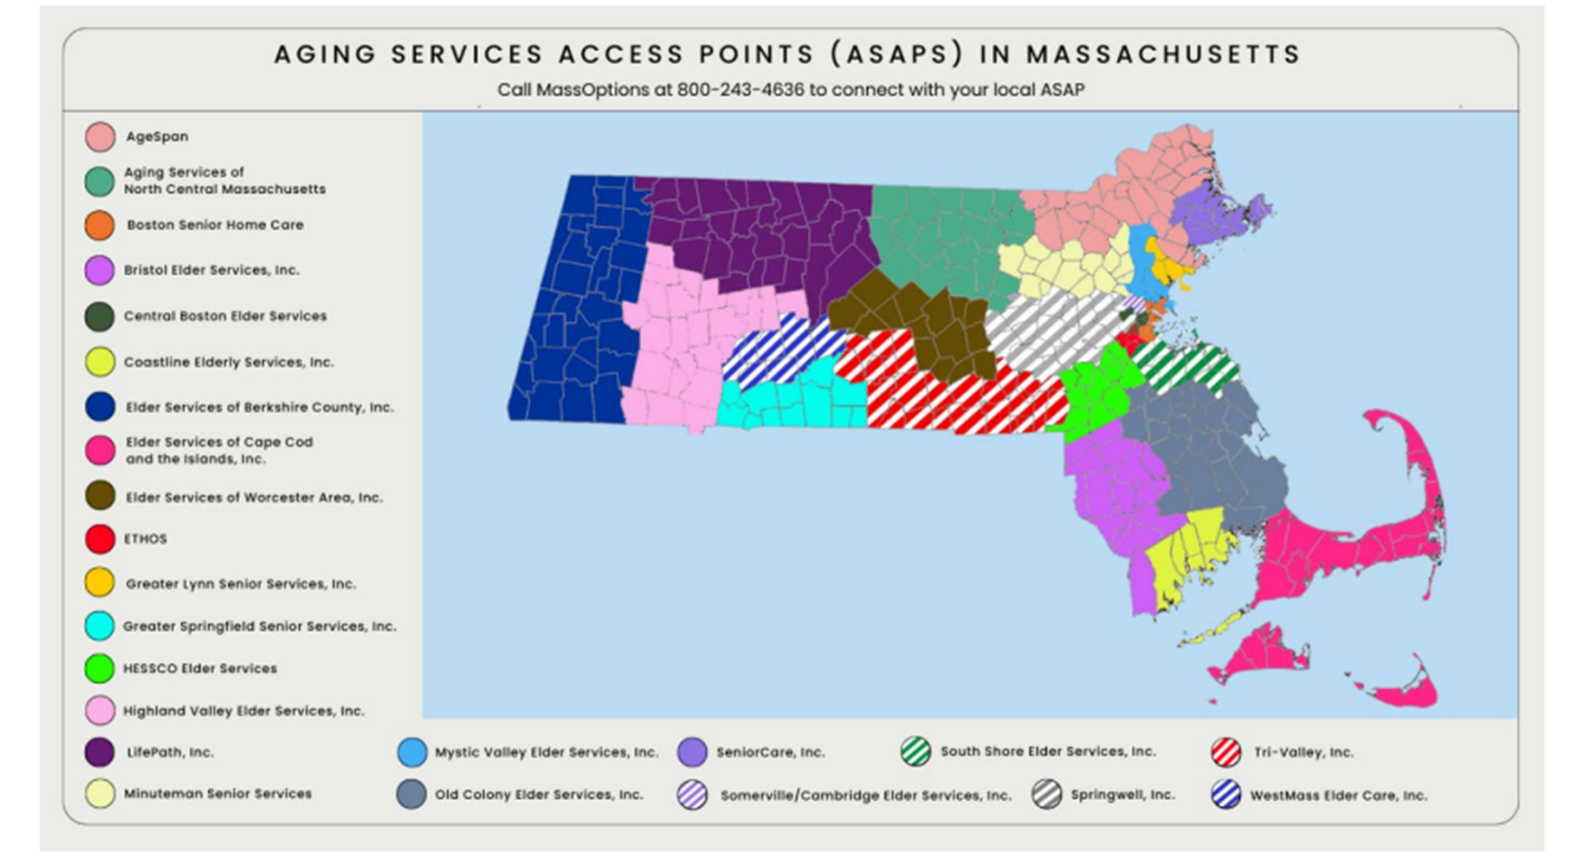
Care Ecosystem Team:
ASAP Infrastructure – Dementia Care Equity

Slide 26
Transforming Dementia Care with Support from Care Ecosystem Team
Key Participants in the Care Ecosystem Program
Dementia Patient/Caregiver Dyads
Maintain trusted ongoing relationship with the program’s Care Team Navigators
Primary Care Practices
Refer patients to program’s care team navigators
Receive consultation from the program’s clinical consultants
Continue to make all medical decisions and provide all medical care
Clinical Consultants
(Physician, Pharmacist, Nurse Coordinator, Social Worker
Provide PCP with clinical consultation
on medical components of care
-
Care Team Navigators
Receive referrals to program; conduct intake interviews
Maintain ongoing trusting relationships with dyads
Identify available services; develop and maintain person-centered care plans
Ensure delivery of planned care and support
Collaborate with clinical consultants on medical issues
ASAP & Other Community Service Providers
Receive support from Care Team Navigators
Program Manager
Oversees all activities
Care Ecosystem Team = Care Team Navigators and Clinical Consultants

Slide 27
Key Considerations and Issues to Resolve
Assess stakeholder interest
Identify how this program may align with existing MassHealth
programs and initiatives
Continue gathering information about similar programs
Explore options around program coordination and leadership (e.g. state vs. health system/practice level)
Evaluate options for operationalizing the program
Identify sources of grant funding and determine costs
Explore sustainable revenue streams beyond grant funding (e.g., billing/service codes)
Determine financial benefits and return on investment
Develop sustainability and scalability plan
27
Notes:
Although our team has come a long way in thinking about how to implement interdisciplinary dementia care here in Massachusetts, several considerations remain for us to discuss and resolve. This slide lists some of them.

Slide 28
Discussion (20 minutes)
In general, what are your thoughts about piloting a centralized model of comprehensive dementia care in Massachusetts with a strong focus on dementia care navigation and ongoing caregiver support?
What do you like the most about this concept and what are your biggest concerns?
What advice do you have for our team?
28
Notes:
Presenter will show these questions and encourage Council members to respond to any or all questions appearing here, which will be copied/pasted into the chat box. We will stop sharing the slides during the discussion.

Slide 29
Massachusetts Advisory Council on
Alzheimer’s Disease and All Other Dementias
Equity & Inclusion Team
Updates, Accomplishments, and Discussion
January 9, 2025
Hugo Aparicio, MD, MPH (Council Member) - Associate Professor of Neurology, Boston University School of Medicine; Stroke Specialist in the Department of Neurology, Boston Medical Center

Slide 30
The Council’s Team on Equity & Inclusion
Team Co-Leads
Hugo Aparicio, MD, MPH
(Council Member)
Associate Professor of Neurology, Boston University School of Medicine; Stroke Specialist in the Department of Neurology,
Boston Medical Center
Jatin Dave, MD, MBBS, MPH
(Council Member until mid-December 2024)
Chief Medical Officer, MassHealth; Director, Office of Clinical Affairs, ForHealth Consulting, UMass Chan Medical School
(Until mid-December 2024)
Doris Harris, PhD, Consultant, Springfield Dementia Friendly Coalition member, host of Health Matters radio show in Springfield (90.7 FM WTTC)
Pam MacLeod, MBA, PMP, Senior Project Director, Massachusetts Executive Office of Elder Affairs
Kevin Reynolds, Diversity, Equity and Inclusion Chair, Alzheimer’s Association, Massachusetts/New Hampshire Chapter
Kathy Service, NP, Consultant on aging issues and dementia, often with a special focus on people living with intellectual and developmental disabilities
Beth Soltzberg, LICSW, MBA, Director, Alzheimer’s/Related Dementias Family Support Program, Jewish Family & Children's Service, Waltham
Judith Thermidor, Resident Wellness Director, CSI Support & Development Services, Community Health Educator in Haitian Creole and Spanish

Slide 31
Our Team’s Goal
Our Team’s Goal
(Calendar Year 2024)
Recommend approaches to eliminate, weaken, or mitigate the impact of barriers that may prevent certain groups from benefiting from the Council’s work.
Source: Massachusetts Advisory Council on Alzheimer's Disease and All Other Dementias Annual Report (Calendar Year 2023)
Notes:
This was our team’s goal for 2024, as it appears in the Council’s annual report for calendar year 2023.

Slide 32
Updates and Accomplishments
✓ Defined Equity Priorities – Identified Equity and Inclusion Areas of Focus Specific to Dementia Care
✓ Developed Diversity, Equity, and Inclusion (DEI) Tool - Identified key considerations within each area of focus to guide the Council and its teams in reviewing their work through a “DEI lens”
Shared it with the Council’s Dementia Care Planning team to include in their toolkit
Piloted the use of the DEI tool with Harvard School of Public Health’s Ariadne Lab to refine its care planning tool currently undergoing testing
Will share the DEI tool with the Council’s team on Interdisciplinary Dementia Care
Stigma and Cultural Sensitivity
Cultural Humility
Communication and Language
Health Literacy
Beliefs about Medication
Family Involvement
Traditional Healers and Religious Spiritual, and Cultural Practices
Referrals to Community Services and Supports
Assessing Cognitive Function
Dietary Considerations
Assessing Behavioral Health
Cultural Competence in Advanced Care Planning and Palliative Care
Community Engagement
32
Notes:
Updates and accomplishments since we last presented to the Council

Slide 33
Updates and Accomplishments
✓ Discussed Approach for Refining DEI Tool - Identified benefits and logistics around hosting an annual listening session with people living with dementia within communities exhibiting significant health disparities and high dementia risk
✓ Organized and Hosted Listening Session with Secured Funding and Venue
Secured funding from Point32Health Foundation for one listening session in 2024
Identified a health center and attained its agreement to host a session with its patients
Developed questions for participants using our DEI tool as a guide
Convened session in September 2024 in a health center within a predominantly African American/Black community in Springfield
✓ Refined the DEI Tool - Updated our DEI tool based on feedback from this listening session with the potential opportunity for further enhancements through ongoing community engagement initiatives
33
Notes:
Updates and accomplishments since we last presented to the Council

Slide 34
Updates and Accomplishments
✓ Explored the Following Topics with Listening Session Participants
Understanding dementia and its impact on families
Cultural and family beliefs about health and traditions
Communication with healthcare providers
Influence of family and others on decisions affecting health or wellbeing
Accessing and benefiting from community services
Engaging the community
Discussing and addressing stressful behaviors
34
Notes:
Questions asked:
What does the word “dementia” mean to you? How has it affected you and your family?
What cultural or family beliefs, preferences, or traditions do you have about food, medication, spiritual practices, future planning, or ways to stay healthy; and how comfortable are you discussing them with your healthcare providers? In what ways would you like healthcare providers to respect your beliefs, preferences, or traditions?
At the places you get healthcare, do the staff provide you with clear and understandable information? How could they improve their communications with you?
Do your family and others in your life influence decisions that affect your health or well-being? If so, how have their opinions or decisions been helpful or stressful for you?
What community services are most helpful to you as a person living with dementia or a family member, and how can healthcare providers help you access those services?
How can healthcare providers engage your community to understand your needs around dementia care?
How comfortable is it for you to discuss stressful behaviors that you may be experiencing and concerned about? What would you like to see healthcare providers do to help with those concerns?
Is there anything else that you think we really need to know?

Slide 35
Key Findings from Listening Session
1. Lack of Effective Communication with Healthcare Providers
“I asked what the medication is for, and he told me not to worry about that”
“He seldom looked at me.”
“The PCP or care providers are sometimes not listening. I want the best care; we are very important”
Much of what we heard is reflected in these summary phrases:
Recognize me as a person and as an important person
Look at me, not the computer; look me in the eye while speaking
Be attentive and present; don’t rush; listen to me and my questions
Respect my desire and need to understand my health and medication
Get to know me as a human being; know my needs and preferences
Do not make assumptions based on my culture, race, or ethnicity
35
Notes:
Our most important finding was the general lack of effective communication with healthcare providers, as reflected in the summary phrases listed here.

Slide 36
Key Findings from Listening Session
2. Lack of Knowledge of Available Services
Most participants were somewhat silent when asked about available community services, except for one who referred to the Alzheimer’s Association, Greater Springfield Senior Services, and hospice care
One participant said: “I’m afraid of some services because I heard they can take away all my money”
Another participant recommended that a phone number for help be posted at senior centers, grocery stores, and church bulletins
36

Slide 37
Importance:.
Key Findings from Listening Session
3. Insights
Importance - Although it takes significant effort, sessions like this are essential
Engagement - Participants valued the opportunity to be heard, felt respected, and said they would be happy to do it again
Facilitation - A key success factor was the skilled facilitator, Dr. Doris Harris who is well-known, respected, and trusted in the community and health center
37

Slide 38
Next Steps
Wrapping Up Our Team’s Work in January 2025
Include a link to our DEI tool in the Dementia Care Planning team’s toolkit
Provide the team on Interdisciplinary Dementia Care with the DEI tool for reference while designing its deliverables
Having achieved our goal, convene a final team meeting on Friday, January 10, 2025, to:
identify approaches for operationalizing annual listening sessions within existing statewide programs such as Dementia Friendly Massachusetts; and
develop a process for ensuring ongoing refinements to the Council’s DEI tool.
38

Slide 39
Discussion (10 minutes)
Your comments or questions?
(For example, how do we continue to develop and implement the use of the DEI tool?)
39

Slide 40
Next Steps & Vote to Adjourn
Next Council Meeting, April 29, 2025
Present and vote on annual report
Discuss the Council’s priorities going forward
Remaining Council Meetings in 2025 (3:30 to 5:00 pm)
Tuesday, April 29, 2025
Thursday, September 18, 2025
Tuesday, December 16, 2025
Vote to Adjourn
40

