Slide 1
Advisory Council on Alzheimer’s Disease and All Other Dementias
Executive Office of Elder Affairs
Elizabeth Chen, Secretary
May 7, 2024
3:00-5:00 pm
Video Conference

Slide 2
Agenda
Welcoming Remarks and Meeting Logistics (10 min)
Understanding the Financial Impact of Dementia on Individuals and Families (40 min)
Financial Barriers to Dementia Care and Support in Primary Care Settings (45 min)
Access to Dementia Treatment: Challenges & Solutions (20 min)
Next Steps and Final Roll Call (5 min)

Slide 3
2. Understanding the Financial Impact of Dementia on Individuals and Families (40 min)
Caregiver Panel
Irene Heller (Lexington)
Sonja Dahlberg (Cape Cod)
Kate Albrecht (Shelburne Falls)
Jan Peterson (Hadley)

Slide 4
3. Financial Barriers to Dementia Care and Support in Primary Care Settings (45 min)
Primary Care Panel
Jennifer Maynard, BS, RN, MPA
Executive Director
MassPACE Association
Jerry H. Gurwitz, MD The Dr. John Meyers Professor of Primary Care Medicine Professor of Medicine, Family Medicine and Community Health, and Population & Quantitative Health Sciences
UMass Chan Medical School and UMass Memorial Medical Center

Slide 5
Overview of PACE
MA Advisory Council on Alzheimer’s Disease & All Other Dementias
May 7th, 2024

Slide 6
Defining PACE
PACE stands for “Program of All-inclusive Care for the Elderly”: is a provider-based, fully integrated healthcare plan for individuals who are aged 55 and over and have significant healthcare needs.
PACE is the alternative to the nursing home; you get all the care you need all while staying put in your community where you feel comfortable.
PACE
All you need in one place.
masspace.net

Slide 7
What Is PACE??
A Medicare program and Medicaid state option that gives community-based care and services to people 55 or older who otherwise would need a nursing home level of care.
An integrated system of care for the frail elderly that is:
Community-based
Comprehensive
Capitated
Coordinated
Program of All-Inclusive Care for the Elderly
PACE
PACE
All you need in one place.
masspace.net
All you need in one place.
masspace.net

Slide 8
PACE Model Philosophy
The PACE Model of Care is centered on the belief that it is better for the well-being of frail elders with chronic care needs and their families to be served in the community whenever possible.
Honoring the wants and needs of frail elders and their families:
To be cared for in familiar surroundings
To maintain the autonomy of their care
To maintain a maximum level of physical, social and cognitive function
PACE
PACE
All you need in one place.
masspace.net
All you need in one place.
masspace.net

Slide 9
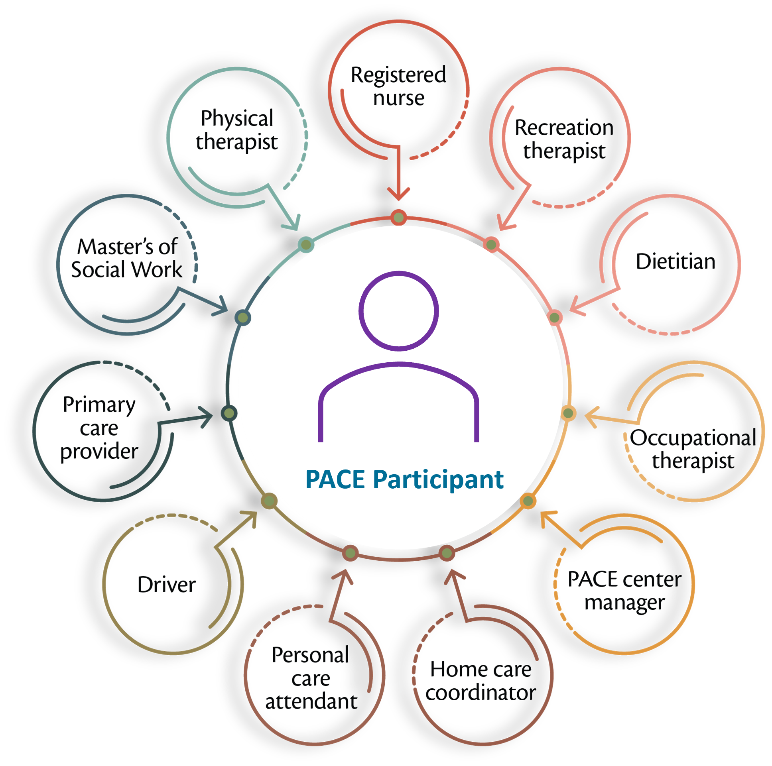
PACE Model of Care
PACE participants are served by an 11-member interdisciplinary team (IDT).
PACE participants receive services at the PACE center and at their homes.
PACE is a Part D provider and provides full prescription drug coverage, including all Medicare, Medicaid and medically necessary services, with no benefit limitations, copays or deductibles
PACE programs receive capitated payments per participant and are at full risk for the services provided; payments do not change based on the utilization patterns of participants.
PACE
PACE
All you need in one place.
masspace.net
All you need in one place.
masspace.net
Notes:
The PACE IDT takes care of:
Scheduling transportation to medical appointments
Day programs at the PACE Center or elsewhere
Deliveries of medications and meals to the homes
Social services that make sure the home environment is safe and appropriate

Slide 10
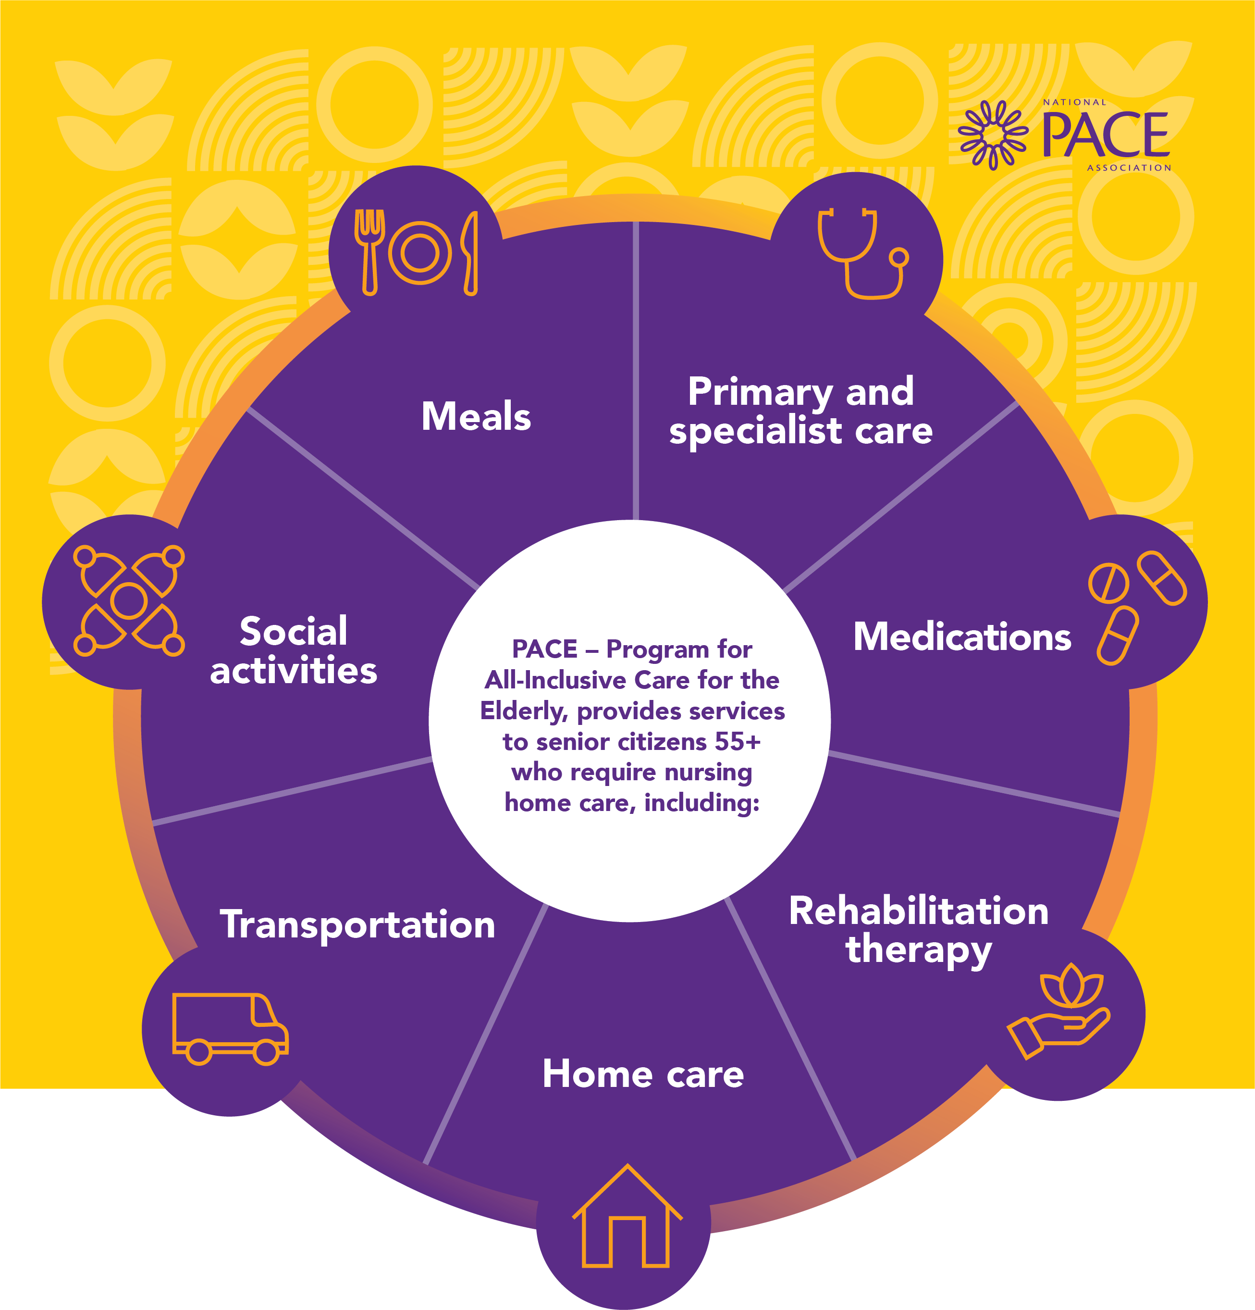
Other Services Provided
Behavioral Health
Nursing
Nutritional Counseling
Social Work
Medical Care
Personal Care
Social Services
Audiology
Dentistry
Optometry
Podiatry
Respite Care
Care Management
And More, with No COPAYS
Hospital and nursing home care are provided when necessary.
Any other care, services or supports deemed medically necessary to maintain or improve the health status of participants.
PACE
PACE
All you need in one place.
masspace.net
All you need in one place.
masspace.net

Slide 11
The PACE IDT huddles daily, sometimes twice, to discuss any episodes relating to any participant enrolled in that PACE program so that interventions can be implemented quickly before the health episode escalates unnecessarily.
This Photo by Unknown Author is licensed under CC BY-SA-NC
PACE
PACE
All you need in one place.
masspace.net
All you need in one place.
masspace.net
Notes:
Cover service requests

Slide 12
Why Does PACE Work?
PACE is both a health provider and a health plan
Full financial risk
Comprehensive services
Directly employed interdisciplinary team that manages each participant’s care
The Four C’s:
Community-based
Comprehensive
Capitated
Coordinated
Full Financial Risk
Directly Employed Interdisciplinary Team
Comprehensive Services
PACE
PACE
All you need in one place.
masspace.net
All you need in one place.
masspace.net

Slide 13
PACE
PACE
All you need in one place.
masspace.net
All you need in one place.
masspace.net

Slide 14
TODAY
PACE programs are authorized by each state’s Medicaid agency
PACE is currently in 32 states, the District of Columbia and growing.
Over 70K participants served nationally
In MA programs are awarded coverage by zip code.
Currently there are 8 PACE organizations who together operate 23 PACE Centers serving 270 Cities and Town's out of 351.
Source: NPA PACE by the Numbers 2024
PACE
PACE
All you need in one place.
masspace.net
All you need in one place.
masspace.net

Slide 15
PACE Organizations in MA
PACE
PACE
All you need in one place.
masspace.net
All you need in one place.
masspace.net

Slide 16
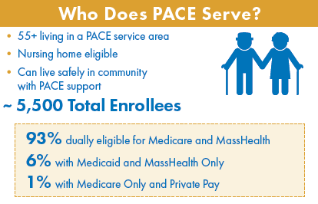
Who we Serve in MA
PACE
PACE
All you need in one place.
masspace.net
All you need in one place.
masspace.net
Notes:
Cover how PACE is paid for

Slide 17
Our Participants
Let’s say your Mother, Doris has always told you since you were little: “The last place I want to live is in a nursing home.”
She must:
be 55-years or older
have an in-home safety assessment and a full medical and behavioral health assessment to determine if she qualifies clinically for nursing home care and can live safely in her community*
lives in a PACE Service Area
*Arranged and completed by the PACE team in the potential enrollee's home
PACE
PACE
All you need in one place.
masspace.net
All you need in one place.
masspace.net

Slide 18
For example, if your Mom, Doris requires an air conditioner to prevent over-heating or help with respiratory illness, PACE will have one installed for the participant.
PACE
PACE
All you need in one place.
masspace.net
All you need in one place.
masspace.net

Slide 19
If Doris wants to attend the day center only Mondays and Wednesday, Mondays to see Barbara for book club and Weds to play bingo, transportation can be organized.
This Photo by Unknown Author is licensed under CC BY
PACE
PACE
All you need in one place.
masspace.net
All you need in one place.
masspace.net

Slide 20
PACE takes care of the whole person. You might say we were the pioneers 30 years ago in understanding the social determinants of health. The IDT embraces each participant uniquely and does whatever is necessary for that individual to thrive.
PACE
PACE
This Photo by Unknown Author is licensed under CC BY
All you need in one place.
masspace.net
All you need in one place.
masspace.net

Slide 21
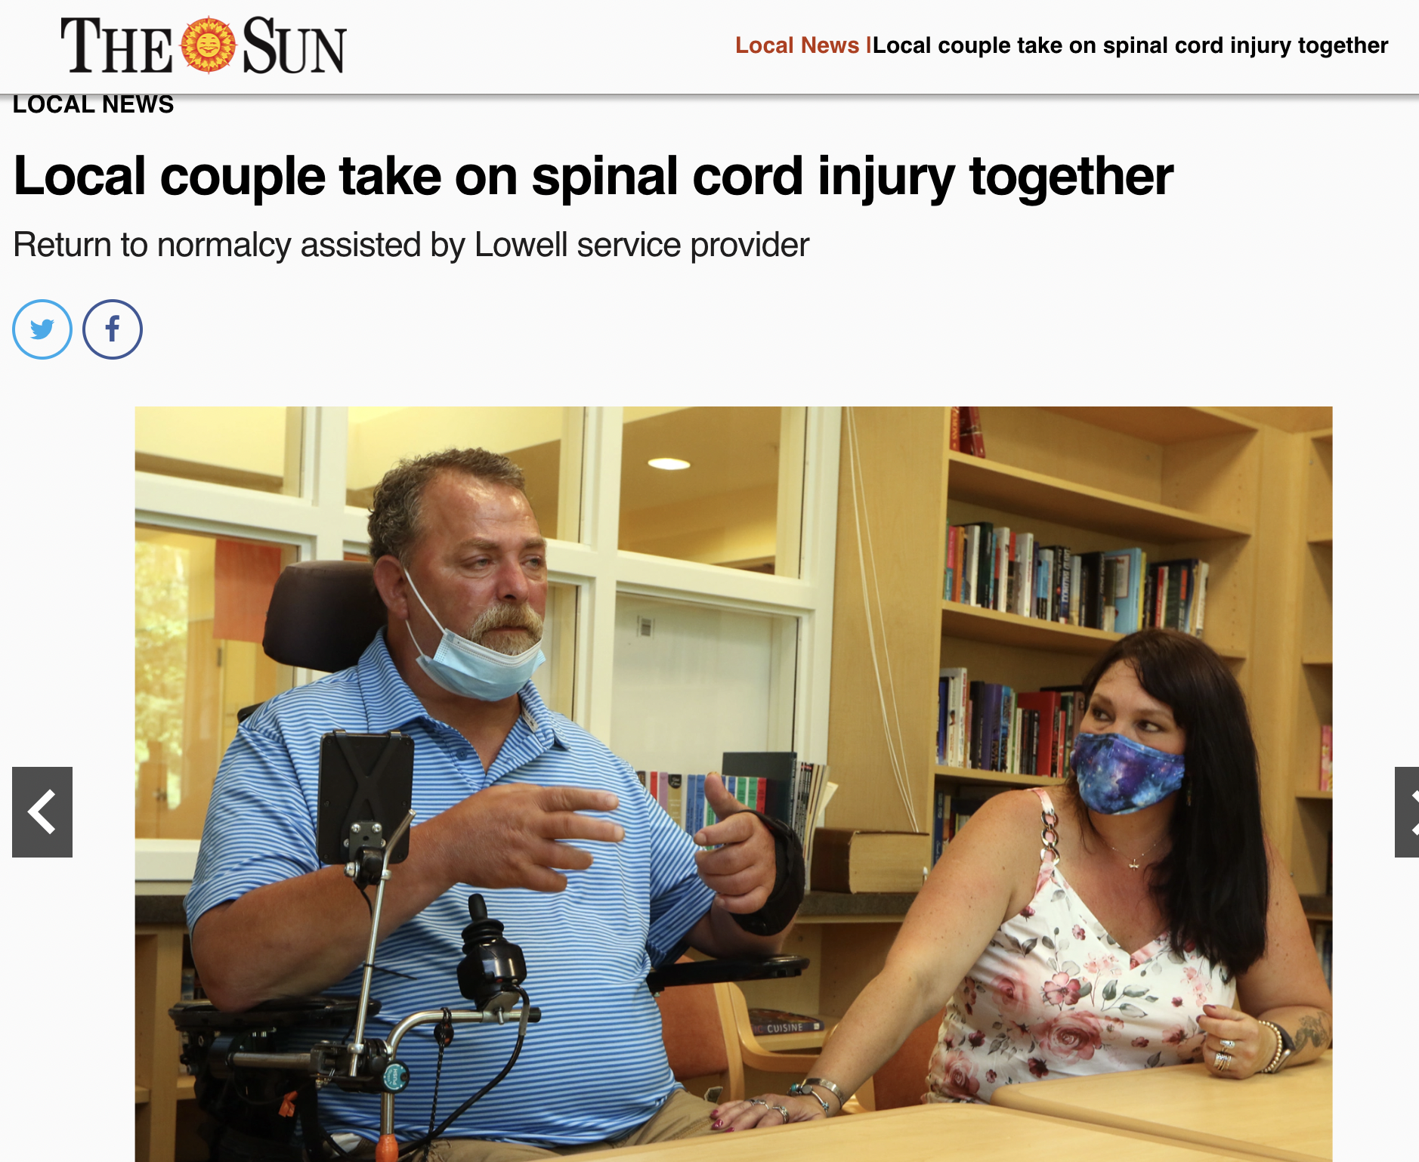
"PACE was the Holy Grail of treatment the couple was searching for. PACE made it possible to both: support Tracy as a caregiver and give Jimmy the freedom and independence he needed."
https://www.lowellsun.com/2022/09/04/local-couple-take-on-husbands-spinal-cord-injury/
PACE
PACE
All you need in one place.
masspace.net
All you need in one place.
masspace.net

Slide 22
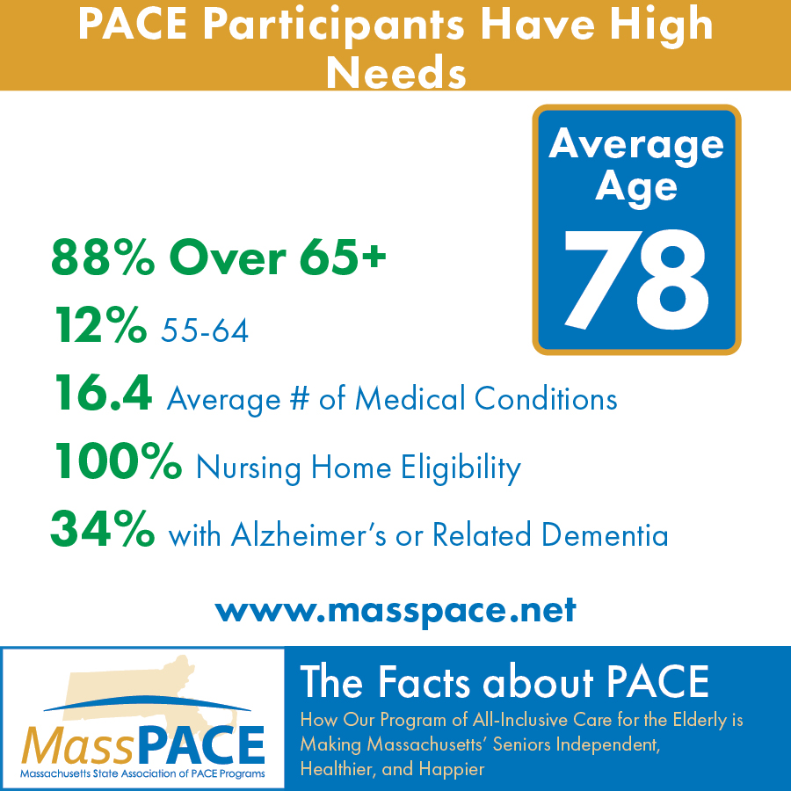
66% with a behavioral health condition
PACE
PACE
All you need in one place.
masspace.net
All you need in one place.
masspace.net

Slide 23
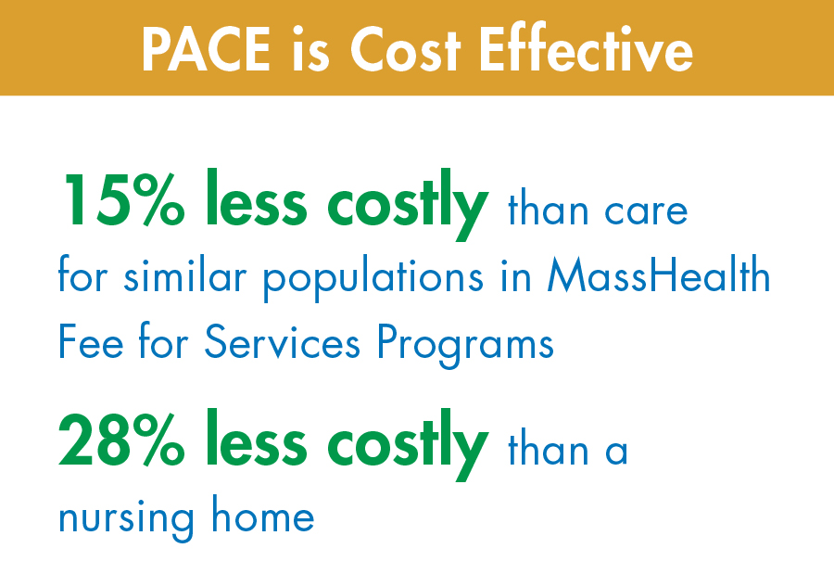
PACE Value
PACE
PACE
All you need in one place.
masspace.net
All you need in one place.
masspace.net

Slide 24
PACE
PACE
All you need in one place.
masspace.net
All you need in one place.
masspace.net

Slide 25
ASPE Finds PACE to Be a Consistently ‘High Performer’
Study conducted by the U.S. Department of Health and Human Services, Office of the Assistant Secretary for Planning: Comparing Outcomes for Dual-Eligible Beneficiaries in Integrated Care
PACE
PACE
All you need in one place.
masspace.net
All you need in one place.
masspace.net

Slide 26
Want to Learn More about PACE and Housing? Download PACE and Housing Report Today!
PACE
PACE
All you need in one place.
masspace.net
All you need in one place.
masspace.net

Slide 27
Contact:
Jennifer Maynard, Executive Director jmaynard@masspace.net Taylor Nelson, Program and Communications Associate tnelson@masspace.net
Connect:
LinkedIn
Facebook
Twitter/X
Vimeo
Thank you!
PACE
PACE
All you need in one place.
masspace.net
All you need in one place.
masspace.net

Slide 28
3. Financial Barriers to Dementia Care and Support in Primary Care Settings (45 min)
Jerry H. Gurwitz, MD The Dr. John Meyers Professor of Primary Care Medicine Professor of Medicine, Family Medicine and Community Health, and Population & Quantitative Health Sciences
UMass Chan Medical School and UMass Memorial Medical Center

Slide 29
Dementia Care for Patients & Caregivers The Perspective of the PCP
(It is the worst of times, it is the best of times.)
Jerry H. Gurwitz, MD
Massachusetts Advisory Council on Alzheimer’s Disease and All Other Dementias
May 7, 2024

Slide 30
U.S. Health Care in 2024
So who’s really in charge?
It’s not the Primary Care Provider.
Nearly three quarters of all U.S. physicians are employed by hospitals or corporations.
10% (and growing) are employed by a single Fortune 500 company.
Limited time: 15-20 minute visits
Emphasis on coding and billing
Ongoing distractions and demands of the electronic health record throughout the workday and beyond the workday…
Salary/bonus relates to productivity measured in RVUs, even if in capitated arrangements.
Employed providers rarely think about the patient’s type of insurance coverage unless the electronic health record forces them to.
Training in dementia care is very limited – PCPs, staff, care coordinators…
Reimbursement for dementia care – Code 99483 – not sure how often it is used. Use not specially encouraged (versus other things).
Crises outside of workday – to ER

Slide 31
What Patients & Caregivers Often Need (but may not want to or be able to pay for…)
Driving evaluation (approach to being able to take away keys)
Transportation (including to appointments)
Caregiver attendance at appointments
Homemaker services (nonskilled services)
Caregiver support/respite
Food/nutrition – beyond Meals on Wheels
Housing situation(s) – home safety
Assisted living options
PACE options
Legal guidance/assistance relating to finances/assets
Assistance with challenging family dynamics

Slide 32
D-CARE: Health System – Based Dementia Care
What the PCP does…
What the Dementia Care Specialist does…
Assessment by NP or PA Dementia Care Specialist of patients and caregivers.
Individualized dementia care plan prepared for PCP.
Dementia Care Specialist implements plan.
Ongoing dementia care management by Dementia Care Specialist including referral to community-based services – meals, driving evaluation, day care, financial and legal counseling, transportation.
24/7/365: telephone access for assistance and advice.
Approve recommendations of Dementia Care Specialist or modifies – communication via Electronic Health Record
Address medical recommendations as needed. Dementia care specialist will address social, behavioral, and other issues/concerns. This takes it off the plate of PCP.
Reuben DB et al. JAGS 2020; 68:2492-2499.

Slide 33
CMS GUIDE: Guiding an Improved Dementia Experience

Slide 34
Nuts and Bolts of GUIDE - Standardized Package of Services
Limited to community-dwelling Medicare FFS beneficiaries who have dementia.
Not Medicare Advantage and not PACE.
Interdisciplinary Care Team - Lynchpin is the trained Care Navigator (RN, SW, or community health worker)
Takes a lot off the shoulders of PCP.
9 Domains
Comprehensive assessment
Care planning
Ongoing monitoring and support
Medication reconciliation and management
24/7 access to care team member or helpline
Care coordination and transitional care management
Referrals and coordination of services
Caregiver education
Respite services

Slide 35
Caveats about GUIDE (Health Care Leaders)
Health care leaders are skittish about necessary infrastructure investment (costs of interdisciplinary team and its organization) and actual revenue from program?
Will it lose money? If there is any possibility of that happening it becomes a non-starter.

Slide 36
4. Access to Dementia Treatment: Challenges & Solutions (20 min)
Daniel Z. Press, MD
Chief, Cognitive Neurology Unit, Beth Israel Deaconess Medical Center Associate Professor of Neurology, Harvard Medical School

Slide 37
Access to Dementia Treatment: Challenges & Solutions
Daniel Press, MD, Chief, Cognitive Neurology Unit and
Associate Professor of Neurology, Harvard Medical School

Slide 38
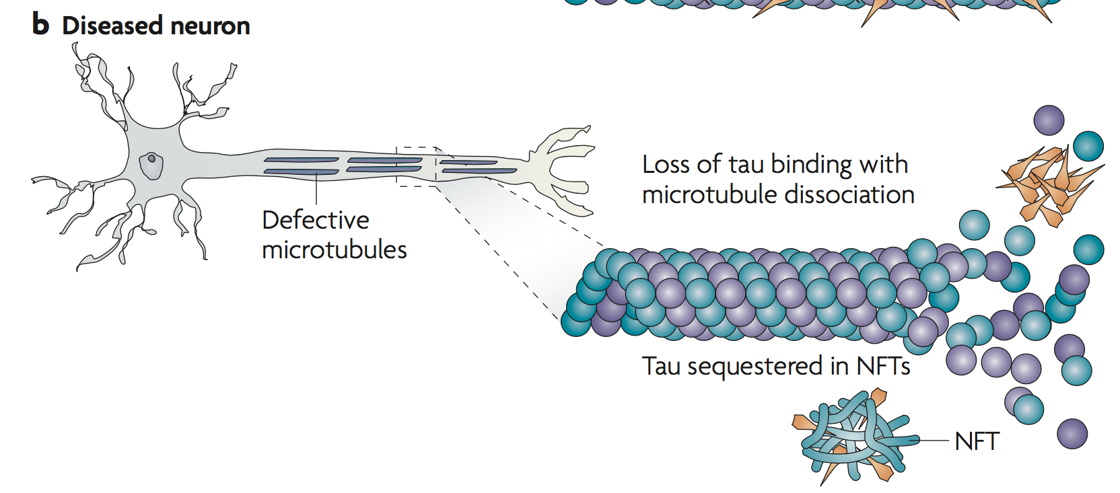
AD Neuropathology
62 y.o. woman who presented with poor memory and severe spatial impairment, with Balint syndrome and myoclonus later in the course of 8 year-illness.
Amyloid Cascade
Tau Cascade
Ballatore, Lee, and Trojanowski Nature Reviews Neuroscience, 2007

Slide 39
Lecanemab Phase III clinical trial: Primary endpoint (Clinical Dementia Rating – Sum of Boxes)
27.1% Slowing of Decline
1.21
1.66
p<0.001
Notes:
Fig. 2 Randomization allocations by treatment group per protocol-defined interim analyses. The response adaptive randomization correctly
allocated subjects into the dose groups likely to be ED90 doses (10 mg/kg monthly and biweekly) as early as the first interim analysis at 197
subjects, with both emerging by the 300th subject randomized, and these doses remained the most likely doses to demonstrate efficacy
throughout the remainder of the study. However, before the interim analysis of 350 subjects, Health Authorities restricted randomization around
ApoE4 carrier status, whereby ApoE4 carriers (hetero- or homozygous) were not to be randomized to the 10 mg/kg biweekly dose going forward.
As a consequence, the response adaptive randomization algorithm was revised. After each subsequent interim analysis (starting with 350 subjects
randomized), the randomization probability vector was split between ApoE4 carrier and non-carrier strata to ensure no ApoE4 carriers were
enrolled on the 10 mg/kg biweekly dose (more details in Appendix C). At the same time, the revised response adaptive randomization preserved
the overall randomization probabilities

Slide 40
Amyloid PET
At 18 months, the mean amyloid level was 23 centilloids (amyloid negative is less than 30)
3.64
-55.48
p<0.001
Notes:
Fig. 2 Randomization allocations by treatment group per protocol-defined interim analyses. The response adaptive randomization correctly
allocated subjects into the dose groups likely to be ED90 doses (10 mg/kg monthly and biweekly) as early as the first interim analysis at 197
subjects, with both emerging by the 300th subject randomized, and these doses remained the most likely doses to demonstrate efficacy
throughout the remainder of the study. However, before the interim analysis of 350 subjects, Health Authorities restricted randomization around
ApoE4 carrier status, whereby ApoE4 carriers (hetero- or homozygous) were not to be randomized to the 10 mg/kg biweekly dose going forward.
As a consequence, the response adaptive randomization algorithm was revised. After each subsequent interim analysis (starting with 350 subjects
randomized), the randomization probability vector was split between ApoE4 carrier and non-carrier strata to ensure no ApoE4 carriers were
enrolled on the 10 mg/kg biweekly dose (more details in Appendix C). At the same time, the revised response adaptive randomization preserved
the overall randomization probabilities

Slide 41
ADVERSE EVENTS
EVENT | LECANEMAB (N=898) | PLACEBO (N=897)
Serious Adverse Event | 14% (n=126) | 11% (n=101)
AE leading to discontinuation of trial agent | 7% (n=62) | 3% (n=26)
Infusion Reaction | 26% (n=237) | 7% (n=66)
ARIA-E or ARIA-H | 22% (n=193) | 10% (n=85)

Slide 42
DISEASE MODIFYING IMMUNOTHERAPY FOR ALZHEIMER’S DISEASE (DiAD) CLINIC BIDMC ALZHEIMER’S DISEASE CLINICAL REGISTRY

Slide 43
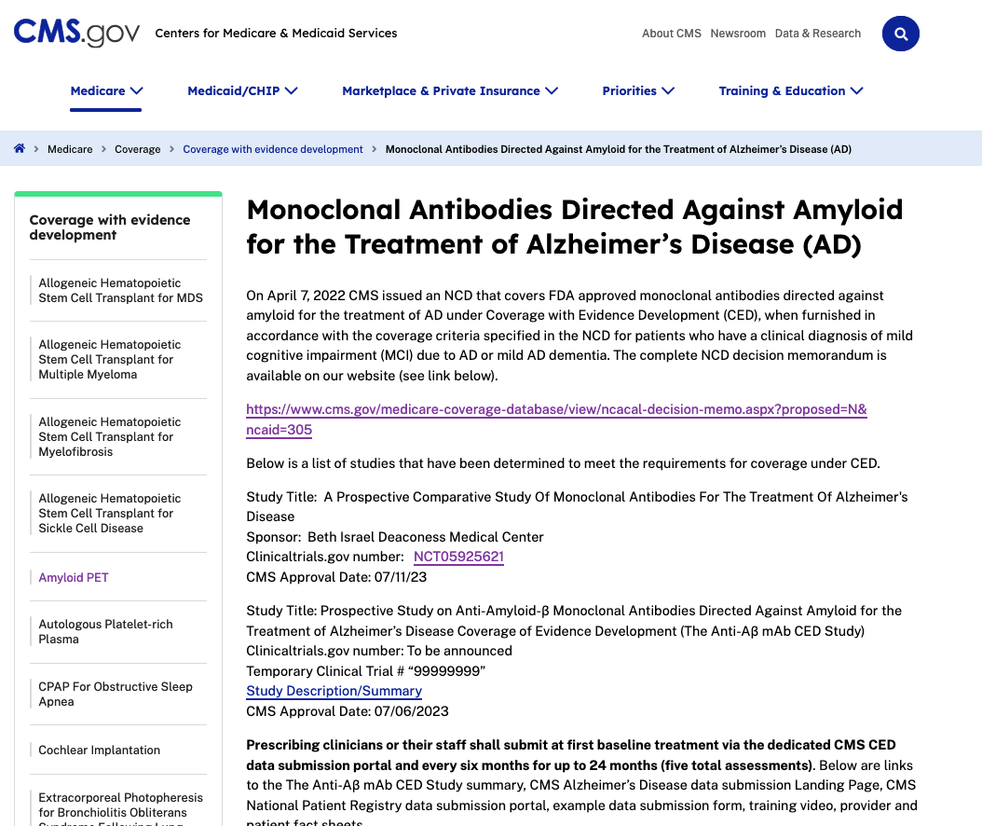

Slide 44
On waitlist for eval
n = 64
DiAD Evaluation
n = 107
as of 4/1/2024
Excluded from Lecanemab n = 45
Apo E status exclusion (n = 7)
CDR > 1 (more than mild AD, n = 16)
MRI criteria (n = 2)
Other diagnosis (n = 4)
Patient wishes (n = 12)
Medical Contraindication (n = 1; started anticoagulation)
Amyloid Status (n=3)
On Hold = 3 (various stages)
In workup n = 13
Met AUC n = 46
Begun infusions
n = 27
Scheduled for infusion n = 0
Awaiting infusion
n = 19
Active on therapy n = 26
D/C therapy n =1
GZ5 n = 17
CRC n = 6
Outside (ViVO) n = 2
Needham n = 1

Slide 45
Anticipated 2023/24 FDA Reviews
Donanemab
Amyloid beta-directed monoclonal antibody
Once monthly IV infusion
Phase 3 trial, early AD with amyloid & tau pathology: slowed cognitive decline by 35% over 18 months
Awaiting FDA approval
Subcutaneous lecanemab
Once weekly, could be done at home
Self/caregiver vs. healthcare provider administration TBD
Submission for FDA review, awaiting results, likely late summer/early fall 2024
Potential BILH Specialty Pharmacy access
BILH System P&T Committee Meeting
IPD Analytics Pharmacy & Therapeutics Watch List October 30, 2023
Sims et al. TRAILBLAZER-ALZ2. JAMA. 2023.

Slide 46
Conclusions
We have entered the age of disease-modifying therapies for MCI and Mild AD
These therapies only slow progression partially and have a host of challenges to their administration
Equitable use of these therapies across the state and across groups, particularly underserved communities, is going to be a challenge

Slide 47
6. Next Steps & Final Roll Call (5 min)
Next Council Meeting
Tuesday, September 10, 2024
(3:00 to 5:00 pm)
Financial barriers and solutions from the perspective of public & private insurers
Challenges from the perspective of individuals from LGBTQIA+ communities
Brief updates from our workgroups
Vote to Adjourn

