Slide 1
COMMONWEALTH OF MASSACHUSETTS
Charles Baker, Governor
Matthew Beaton, Secretary
Judith Judson, Commissioner
Opportunities for Municipalities in MassSave’s 3-Year Plans
Green Communities Division Webinar
April 11, 2019

Slide 2
Today’s Presenters
Maggie McCarey, DOER Energy Efficiency Division Director,
  Overview of 3-Year Plans
Margaret Song, C&I Program Manager, Cape Light Compact
Bill Bullock, Energy Efficiency C&I Implementation, Eversource
Tom Palma, Manager, Distributed Energy Resources, Unitil

Slide 3
The energy hub for all Massachusetts cities and towns, not just designated “Green Communities.”
Green Communities Division
Energy Efficiency
Municipal Buildings
Street Lights
Schools
Renewable
Technical Assistance
Notes:
this is group is more up to speed than many others in terms of the Commonwealth’s clean energy initiatives, so I won’t spend a lot of time on the background of the Green Communities Division.
Important to note a few things though – including that, although the Division is most often associated with the designation of official Green Communities (such as the one we are meeting in tonight), we actually serve as a central clearinghouse for all things energy for all 351 cities and towns.

Slide 4
Green Communities Division - Programs & Resources for Municipalities
  Green Communities Designation and Grant Program
  MassEnergyInsight energy tracking and analysis tool
  Municipal Energy Technical Assistance
  Energy Management Services Procurement Oversight
  Website filled with tools & resources:
  www.mass.gov/orgs/green-communities-division-massdoer
  Email updates via e-blasts – Sign up by sending an email to:
  join-ene-greencommunities@listserv.state.ma.us

Slide 5
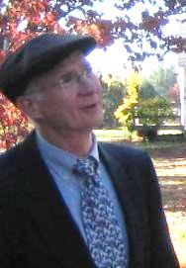

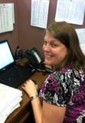
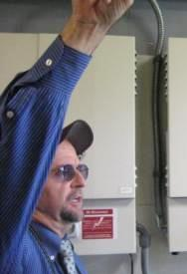
Outreach - Regional Coordinators
Regional Coordinators act as direct liaisons with cities and towns on energy efficiency and renewable energy activities
Located at each of the DEP Regional Offices:
WERO – SPRINGFIELD: Jim Barry
Jim.Barry@state.ma.us
NERO – WILMINGTON: Neal Duffy Neal.Duffy@state.ma.us
CERO – WORCESTER: Kelly Brown
Kelly.Brown@state.ma.us
SERO – LAKEVILLE: Seth Pickering
Seth.Pickering@state.ma.us
Notes:
And the Division’s four regional ambassadors in this effort are pictured here…..(INTRODUCE KELLY, NEAL, SETH AND JIM)
These people are key to the function of the Green Communities program at the local level – Hopefully, you have already connected at some point with your Green Communities regional coordinator. For those who haven’t, please introduce yourself today and make a note of their contact info.

Slide 6
Recording & Presentation
    The webinar is being recorded and will be available on our website in approximately 48 hours at:
    www.mass.gov/orgs/green-communities-division-massdoer
    Click on the camera icon top right of your screen to save any slides for future reference
    Use the Q & A icon on your screen to type in questions
Notes:
There will be time for Q&A at end, final answers will also be posted on the website with the webinar.

Slide 7

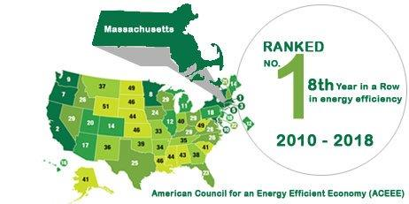
National Leader in Energy Efficiency
#1 eight years in a row for energy efficiency programs and policies
Three Year Energy Efficiency Plans consistently have the most aggressive goals in U.S.
Major source of GHG savings in the 2020 Clean Energy and Climate Plan
65,000 jobs and growing

Slide 8

Massachusetts Energy Efficiency Overview
Green Communities Act (2008) requires all cost-effective energy efficiency and demand reduction
An Act to Advance Clean Energy (2018):
  Expands allowable energy efficiency investments to include active demand management (including storage), strategic electrification, and fuel switching to clean energy sources.
  Broadens electric efficiency plans to “energy” efficiency plans.
  Changes Department of Public Utilities cost-effectiveness review to sector-level.

Slide 9
2019-2021 Three Year Planning Process
6 EEAC workshops to establish Council priorities for Plan | Fall 2017/Winter 2018
EEAC votes on its 2019-2021 priorities | February 2018
8 Public listening sessions | Winter/Spring 2018
April 30, 2018
DRAFT Plan
May – July 2018
Review and Comment on Draft Plan
July 31, 2018
Council Vote on Draft Plan Resolution
Throughout Summer 2018
Analysis, goal setting, and program design discussions continue
September 14, 2018
PAs Submit 2nd Draft of Plan
October 23, 2018
PAs submit updates to Plan and data tables to the EEAC
October 30th, 2018
Council unanimously approved Updated Plan
October 31, 2018
PAs submitted Final Plan to DPU
January 2019
Approval by the DPU

Slide 10
2019-2021 EE Plan Sets Aggressive Goals
Statewide Goals | 2019-2021
Net Lifetime MMBtu Savings | 261 million
CO2e Reductions (tons) | 2.6 million
Total Budget | $2.7 billion
Total Benefits | $9.3 billion
Electric Savings as % of Sales | 2.7 %
Gas Savings as % of Sales | 1.25%
  Gas Plans: Highest gas savings goals to date
  Electric Plans: Electric savings goals reflect expansion in programs like fuel switching and peak demand:
MMBtu Reduction (electric, oil, propane, etc.)
Peak Demand Reduction (Summer, Winter), including active demand
MWH Reduction
MW Demand Reduction

Slide 11
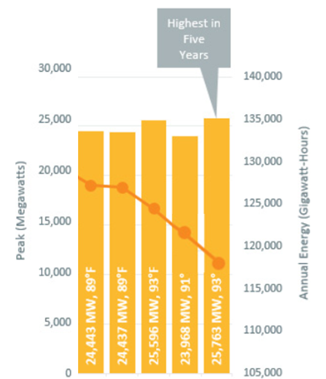
2019-2021 Themes: Peak Reduction
Continue to focus on energy efficiency, while pivoting to focus on reducing energy usage during times when demand is highest on the system and costs are highest for customers.
Active Demand Management Programs include residential direct load control, energy storage, C&I load curtailment
Goal | 2019-2021
Summer MW Total | 665
Winter MW Total | 500
Active Summer MW | 200
Active Winter MW | 50
Source: ISO New England

Slide 12
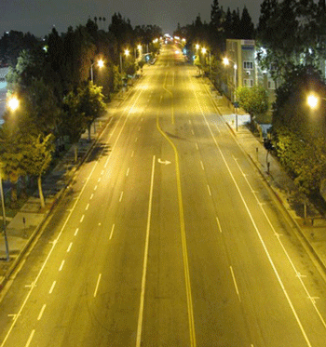
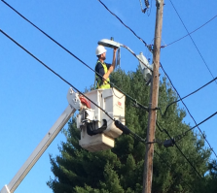
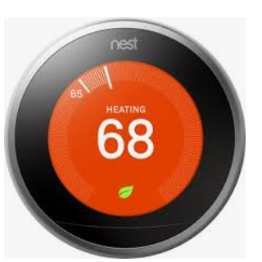
2019-2021 Themes: Winter Reliability
Focus on natural gas savings (therm savings goals increased over 12% from previous plan)
Continued focus on insulation/weatherization
Utilizing active demand technologies in winter, including storage
LED streetlight conversions

Slide 13

2019-2021 Themes:
Residential Enhancements
Enable broad participation and energy justice
  Moderate income, non-English speakers, and renter focus
  Pre-weatherization barrier financing
Municipal partnerships
Home Energy Scorecards
as part of in-home
assessment

Slide 14
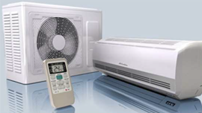
2019-2021:
Energy Optimization and Fuel Switching
  New energy efficiency goals for electric programs: MMBtu of total energy reduction
Consumer education through fuel-neutral heating and hot water recommendations during in-home assessments
Significant increases in incentives for cold climate heat pumps (air and ground source)
Opportunities for C&I optimization – HVAC especially

Slide 15

3 Year Energy Efficiency Plan: 2019 – 2021
New Initiatives
Fuel Switching: customers will be provided information on cleaner fuel options for heating with new incentives for customers to fuel switch to air source heat pumps and other renewable heating options.
Active Demand Reduction: Programs that help offset the most expensive hours of the year through load reduction and active dispatch from things like energy storage.
Passive House Incentives – training and rebates achieve greater energy efficiency in new construction
Home Energy Scorecards: through in-home energy audits, providing information to customers on the benefits of energy efficiency upgrades
Improved Outreach: Enhanced strategies and community outreach efforts targeting increased participation and savings for renters, moderate income customers and non‑English speaking customers

Slide 16
2019-2021 3YP- Overall Highlights
Support employment of over 78,000 workers
Targeting $9 billion in benefits
Aggressive energy reduction goals with significant corresponding Green House Gas reduction
Investment of over $2.7 billion over 3 years
New C&I strategies and programs for
  Active Demand Reduction
  Energy Optimization
Notes:
Smart art?

Slide 17
Program Structure

Slide 18
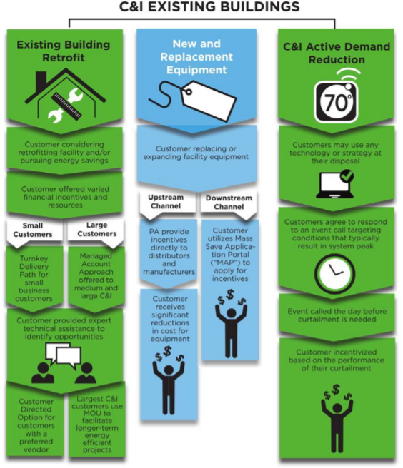


Slide 19
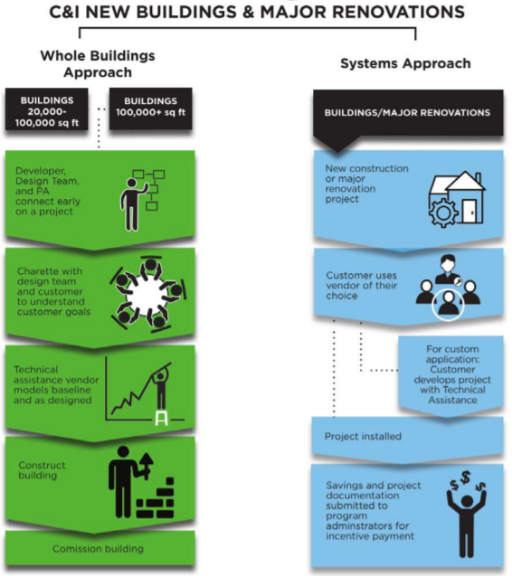
New for 2019
Focus on Passive House – trainings, pay for performance
Testing for Energy Use Intensity baselines for buildings early in the process
With MSBA decision, new schools can benefit from efficiency incentives!

Slide 20
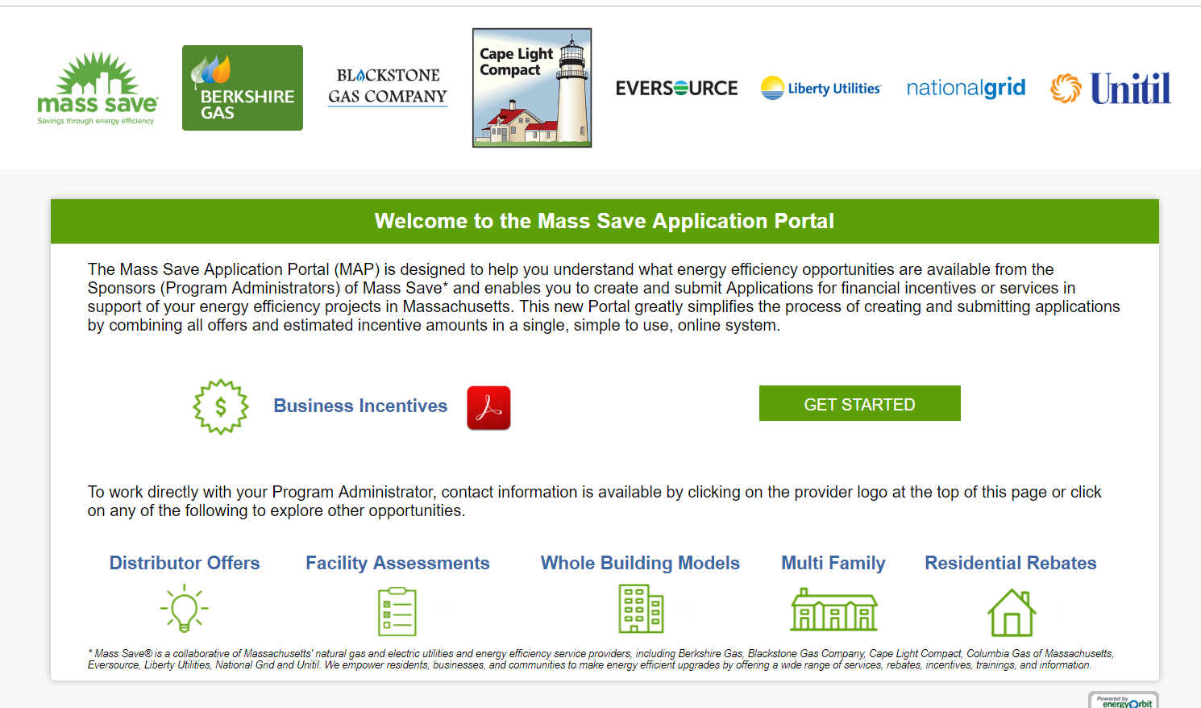
Massachusetts Application Portal

Slide 21
Community Partnership Strategy
A statewide municipal and community partnership strategy to secure additional savings for communities we serve
Partnering with municipalities and communities is a critical pathway, particularly to gain insights on reaching renters/landlords and multilingual populations.
Program Administrators are focused on targeting communities identified as having lower program participation.
The Partnership Strategy will include a stronger connection to municipal governments, whose local knowledge and trusted relationships can be a valuable connection point for increasing awareness and participation in Program Administrator efficiency offers.
The Partnership Strategy will support municipally led outreach for cities and towns of all sizes to enroll local participants.
Program Administrators will establish a two-way communication channel for municipalities by offering regular check-in calls, periodic trainings and a suite of marketing materials.

Slide 22
New Initiatives:
Energy Optimization

Slide 23

ENERGY OPTIMIZATION
Optimize energy use without focus fuel type
Strategic Electrification with focus on oil and propane heat to heat pumps
  First approach – Custom analysis
  Coming soon – prescriptive rebates and other pathways
New for 2019
Ability to review opportunities for oil and propane-heated buildings!
Notes:
This is express permission to address deliverable fuels and strategic electrification

Slide 24
New Initiatives:
Equipment and Systems Performance Optimization Program (ESPO)

Slide 25
Summary of Key Differences
P4P
Single Track
ESPO
4 Tracks
No investigation funding
Investigation funding
Minimal support, generally reactive
Early-stage support, intentionally proactive

Slide 26
ESPO Program Overview
Equipment & Systems Performance Optimization Program
Retrofit opportunities for RCx, O+M & Low Cost Tuning Measures for…
Tuning Measures:
Pick from list of select measures
Targeted Systems Tuning:
Prioritize individual, high potential systems
Whole Building & Process Tuning:
Holistically review entire building or process
Monitoring Based Commissioning: Continuously monitor equipment or systems for abnormalities & take corrective action

Slide 27
Track Relationships
Incentive & Resources Increase
Low Cost Tuning Measures
Targeted Systems Tuning
Whole Building & Process Tuning
Cond. Water Reset
Chilled Water Reset
Chiller Plants
Cycle Evap. Fans
Clean Cond. Coils
Refrigeration
Comprehensive Review of All Building & Process Systems
Reduce Defrost
Anti-Sweat Controls
RTUs/AHUs
Economizer Tuning
Leak Repair
Compressed Air
Pressure Reduction
MBx– Equipment, System or Whole Building Level

Slide 28
Incentives & Offerings
Program | Equipment & Systems Performance Optimization
Track | Low Cost Tuning Measures | Targeted Systems Tuning | Whole Building & Process Tuning
Type | Standard | Custom
Provided Resources | Support provided as needed | Fully Funded Tuning Investigation*
Base Incentive Amount | Per measure prescribed incentive | $0.17/kWh $1.20/therm
Performance Bonus | N/A | Where savings relative to total consumption: >2.75% Electric - $0.03/kWh adder >1.5% Gas - $0.20/therm adder
Note: Monitoring Based Commissioning remains available through P4P
* For pre-approved projects, at the PAs discretion, with level of Customer commitment

Slide 29
Customer Eligibility
Must be a C&I customer within Mass Save Sponsors’ Service Territory
Existing building & controls
  Not at end of life or part of phase out plan
  Annual runtime >2,000 hours
Low Cost Measures & Targeted Systems
  Open to all
Whole Building & Process Tuning Track requires
  Existing functional control system required
  Annual electric consumption of over 5,000,000 kWh

Slide 30
Program Highlights:
Workforce Development

Slide 31


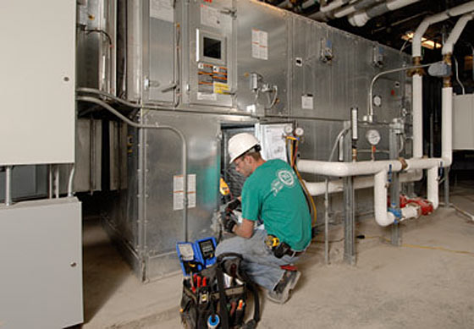
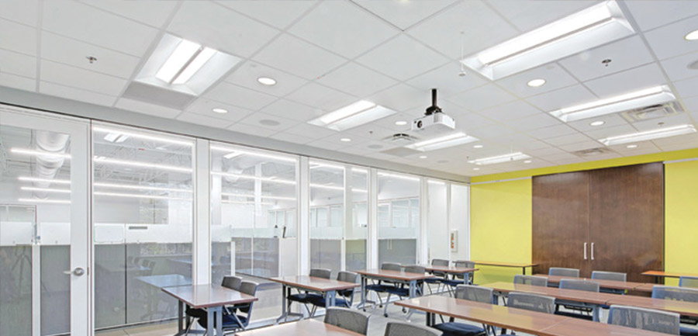
Workforce Development
Advanced Lighting Controls
Designers: Tues, May 7 8am-5pm
Installers: Wed, May 8 8am-5pm
IBEW
Saturday May 18 8am-2pm
Retro-commissioning and Monitoring‐Based Commissioning
Wed, April 24 8am-5pm
Norwood, MA – Four Points
www.maeep.org

Slide 32




Workforce Development
Building Operator Certification
Yarmouth, MA
Level I BOC
Apr 22 & 23, 2019 | BOC 1001 Energy Efficient Operation of Building HVAC Systems
May 7, 2019 | BOC 1002 Measuring and Benchmarking Energy Performance
May 21, 2019 | BOC 1003 Efficient Lighting Fundamentals
June 4, 2019 | BOC 1004 HVAC Controls Fundamentals
June 18, 2019 | BOC 1005 Indoor Environmental Quality
July 9, 2019 | BOC 1006 Common Opportunities for Low-Cost Operational Improvement
July 23, 2019 | BOC 1008 Operation & Maintenance Practices for Sustainable Buildings
TBA | BOC Certification Examination

Slide 33
Workforce Development
To learn more about Training and Workforce Development opportunities please email:
info@masssave.com
INCLUDE in the Subject: C&I Training and Workforce Development
New for 2019
Passive House trainings

Slide 34
New Initiatives:
Active Demand Reduction

Slide 35
Active Demand Management
Active Demand
Control & Dispatch
Pay for Performance
  Single Year
  V. Coincident Baseline
Year-to-Year incentives for capacity
PI for dispatching correctly
  Unknown until end of season
Notes:
Spell out PI

Slide 36
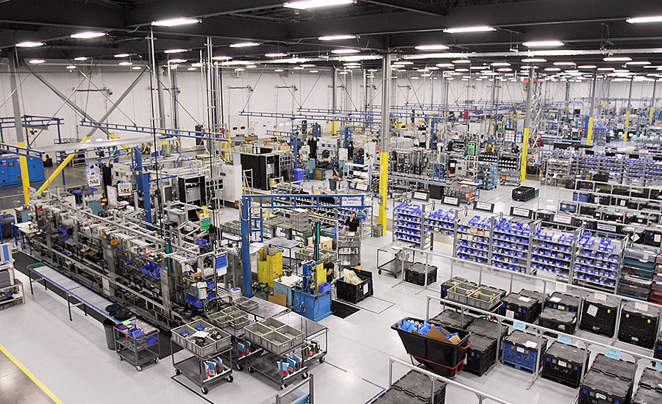
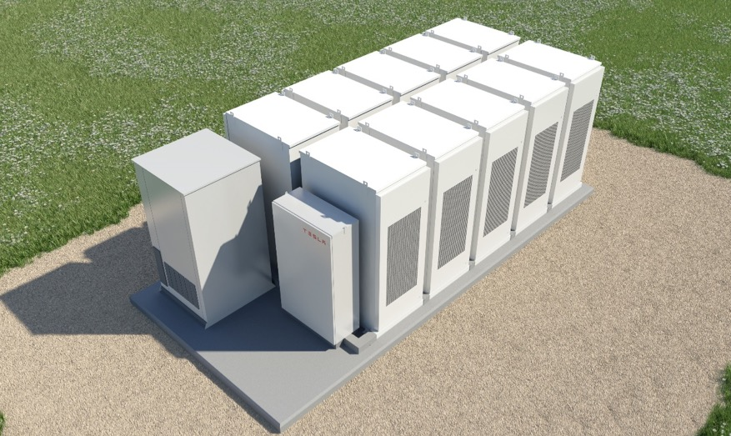
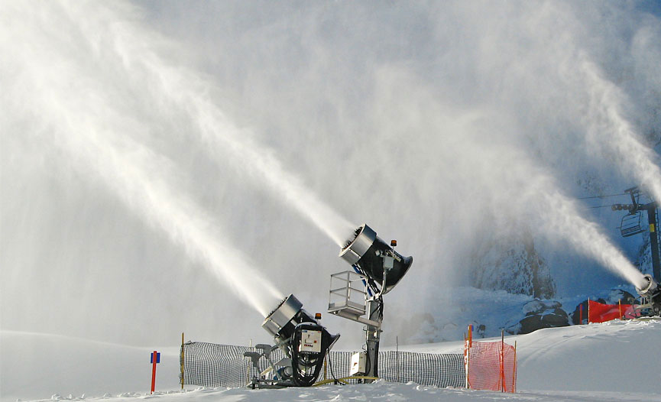
Three Options to Curtail
Targeted Summer
June – September
8 Events Maximum
24 Total Hours Max
3 Hour Event Duration
Weekday / Non-Holiday
Day Ahead Notifications
$35/kW-avg. for season
Daily Summer
June - September
3 Hour Event Duration
Dispatch window 2–7p
Weekday / Non-Holiday
Day Ahead Notifications
$200/kW-avg. for season
Targeted Winter
December – March
5 Events Maximum
15 Total Hours Max
3 Hour Event Duration
Weekday / Non-Holiday
Day Ahead Notifications
$25/kW-avg. for season
*Options may vary by service territory

Slide 37
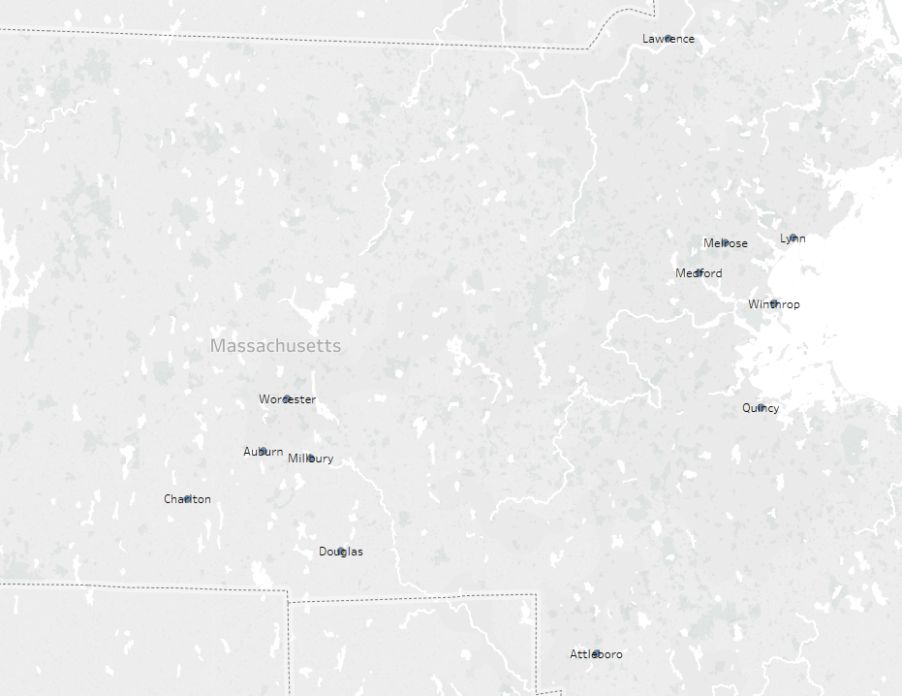
Example: Schools through National Grid
38 Schools in the Program in 2019 in 12 Cities (~3.2 schools per city)
Average Performance per school was 67kW (~$2,000 per year)
Top performing school curtailed 262kW (~$7,000 per year)

Slide 38
Program Highlights:
Streetlights

Slide 39


LED Street Light Conversions
Two types of projects that can receive an incentive and technical support from your Program Administrator:
Municipality owns the lights
Utility owns the lights – tariff
Advantages to LED Street Light Conversions:
Wattage reduced by 2/3rds – reduces winter peak, reducing carbon emissions.
Lowers kWh usage year round for approximately 4,000 hours, reducing carbon emissions.
Cuts down on glare compared to standard fixtures.
Have a long life up to 100,000 hours, reducing maintenance costs.
Could reduce operating costs.

Slide 40
Take Action
Contact your Program Administrator for further details on the topics discussed today and more!
Municipal Contacts
 | NC Contact Name | NC Contact Email | Retrofit Contact Name | Retrofit Contact Email | Streetlight Contact Name | Streetlight Contact Email
Berkshire Gas | Audrey Penna | apenna@berkshiregas.com | Audrey Penna | apenna@berkshiregas.com | n/a
Cape Light Compact | Margaret Song | msong@capelightcompact.org | Margaret Song | msong@capelightcompact.org | Margaret Song | msong@capelightcompact.org
Columbia Gas | Sam Alpert | salpert@nisource.com | Sam Alpert | salpert@nisource.com | n/a
Eversource East | Kim Cullinane | kim.cullinane@eversource.com | Steve Grattan | steven.grattan@eversource.com | Steve Grattan | steven.grattan@eversource.com
Eversource West | Charles Stellberger | charles.stellberger@eversource.com | Kim Kiernan | kim.kiernan@eversource.com | Kim Kiernan | kim.kiernan@eversource.com
Liberty | Stephanie Terach | stephanie.terach@libertyutilities.com | Stephanie Terach | stephanie.terach@libertyutilities.com | n/a
National Grid | Please see territory list for National Grid.
Unitil | John DiNapoli | dinapoli@unitil.com | John DiNapoli | dinapoli@unitil.com | John DiNapoli | dinapoli@unitil.com

Slide 41
?
?
?
Questions?

